Slide 1
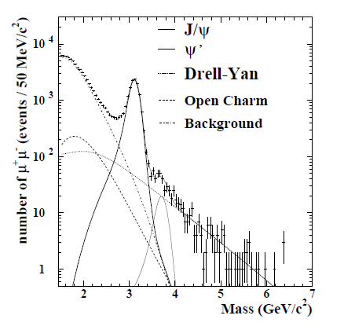
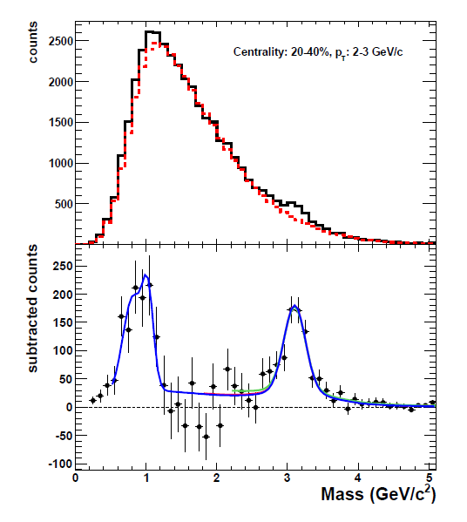
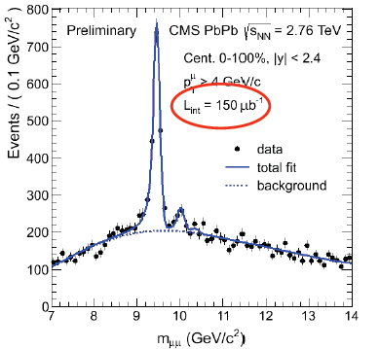

Heavy quarkonia and Quark-Gluon Plasma: a saga with (at least) three-episodes
E. Scomparin (INFN Torino)
EMMI/GSI, April 17, 2013
SPS: the discovery of the
anomalous suppression
RHIC: puzzling observations
from America
LHC: towards a new era ?
“A new hope”
“The Empire strikes back”
“Return of the Jedi”

Slide 2
Outline
Introduction, some concepts, a bit of history
pA/dA collisions: facts, analyses, problems
Au-Au/Pb-Pb collisions
  SPS and the “anomalous suppression”
  RHIC, between suppression and regeneration
  LHC
    Charmonia, a decisive test of regeneration scenarii
    Bottomonia, a decisive test of suppression scenarii
Conclusions

Slide 3
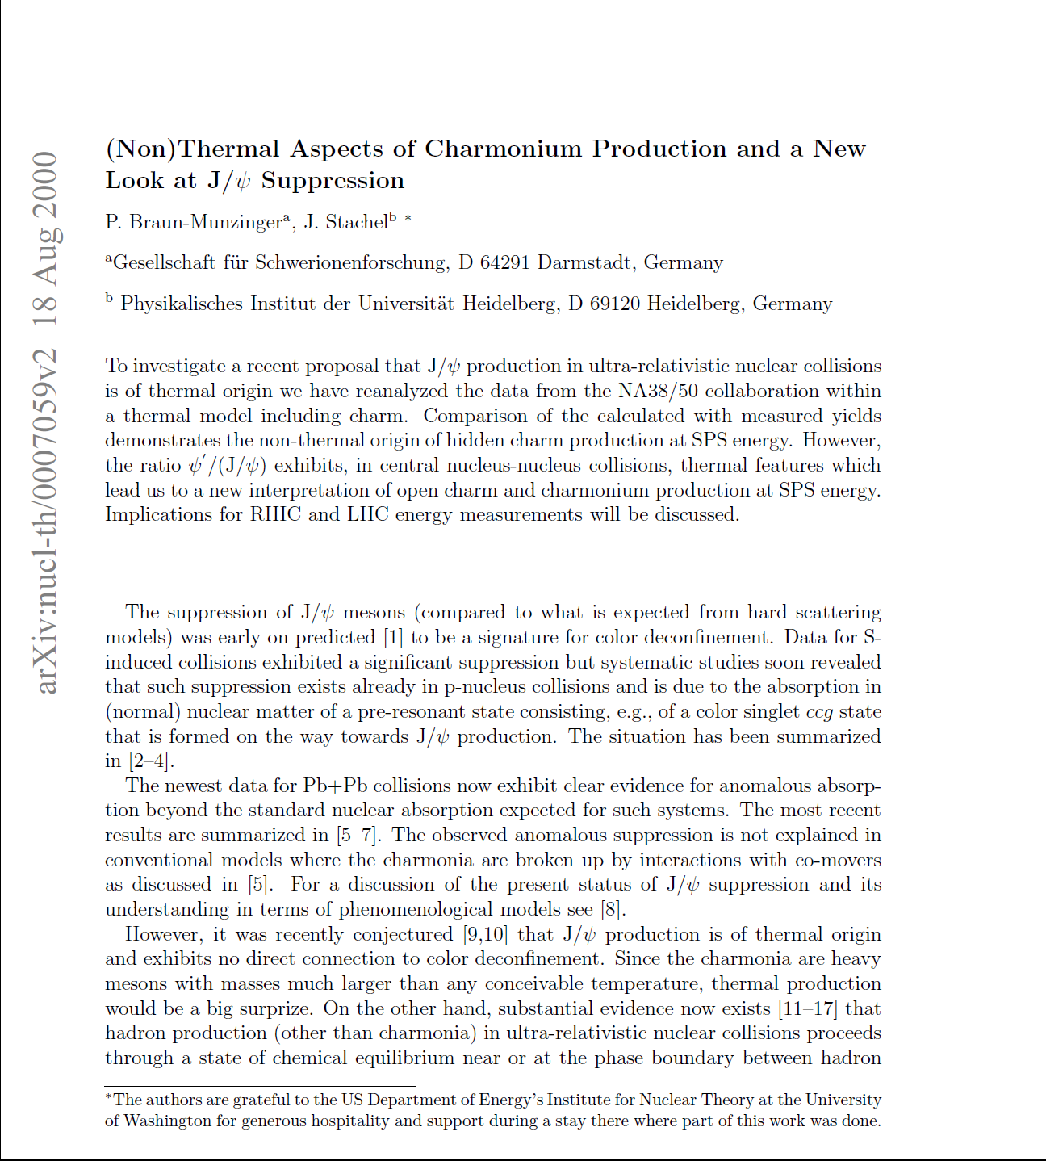
It’s a long story….
…27 years after the prediction of J/ψ
suppression by color screening
… 13 years after the prediction
of charmonium regeneration

Slide 4
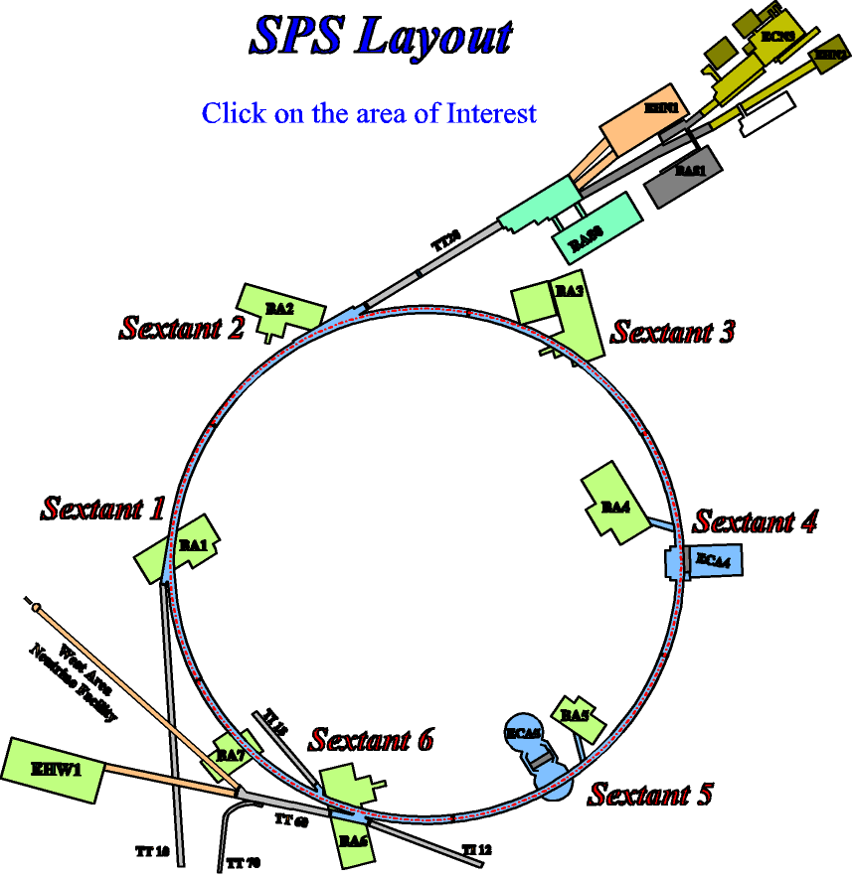
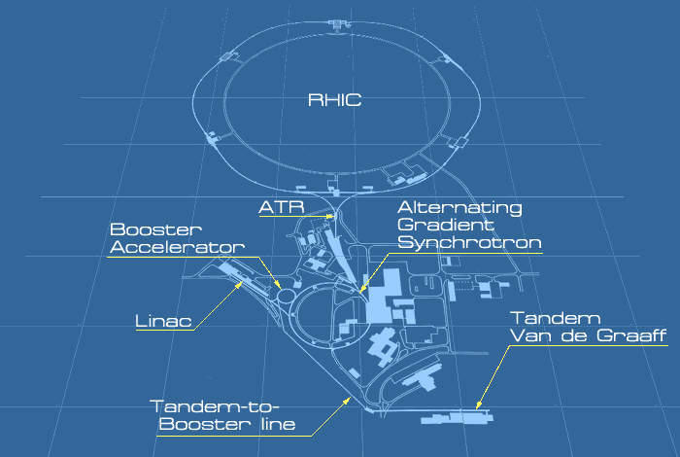

It’s a long story….
…27 years after O beams
were first accelerated in the SPS
…13 years after Au beams
were first accelerated at RHIC
… and barely 2.5 years (!!!) after Pb beams
first circulated inside the LHC

Slide 5
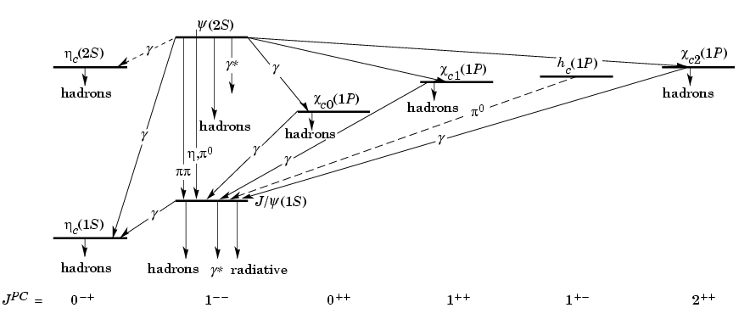
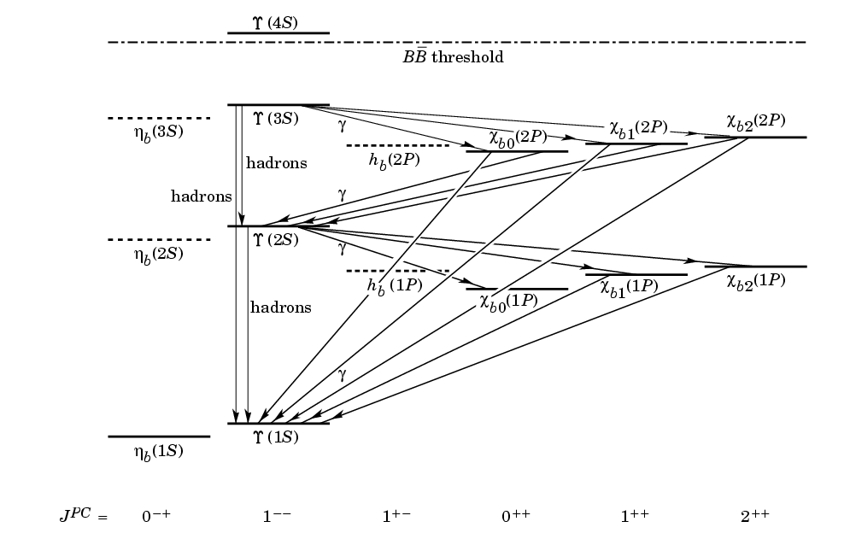
Heavy quarkonia states
Almost 40
years of
physics!
Spectroscopy
Decay
Production
In media
See 182 pages review
On arXiv:1010.5827

Slide 6
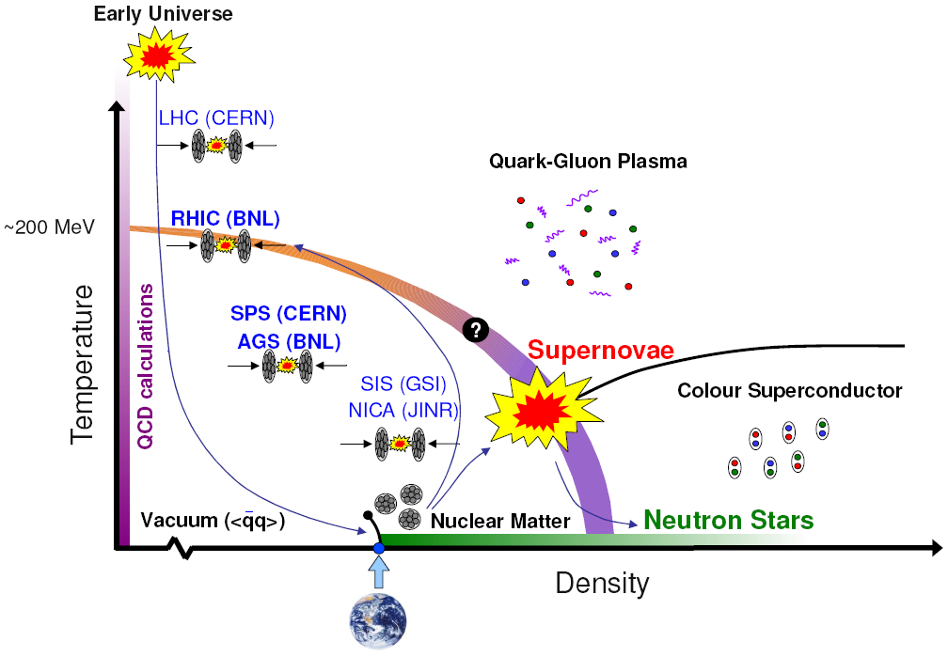
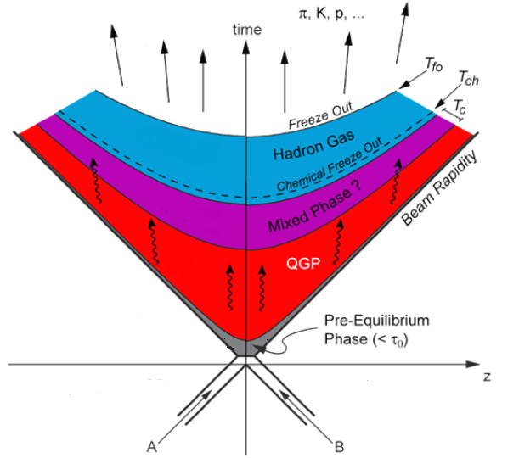
Which medium ?
We want to study the phase diagram of strongly interacting matter
Is it possible to deconfine quarks/gluons
and create a Quark-Gluon Plasma (QGP) ?
Only way to do that in the lab → ultrarelativistic HI collisions
Problems !
Quark-Gluon Plasma is short-lived !
Only final state hadrons are observed in our detectors
(indirect observation)

Slide 7
Probing the QGP
One of the best way to study QGP is via probes, created early in
the history of the collision, which are sensitive to the
short-lived QGP phase
Ideal properties of a QGP probe
  Production in elementary NN collisions
under control
VACUUM
  Interaction with cold nuclear matter
under control
HADRONIC
MATTER
  Not (or slightly) sensitive to the final-state
hadronic phase
  High sensitivity to the properties of the
QGP phase
QGP
None of the probes proposed up to now
(including heavy quarkonia!) actually satisfies
all of the aforementioned criteria
So what makes heavy quarkonia so attractive ?
Notes:
Other ways (not covered here): global event properties → flow, chemical composition and spectra of light hadrons

Slide 8
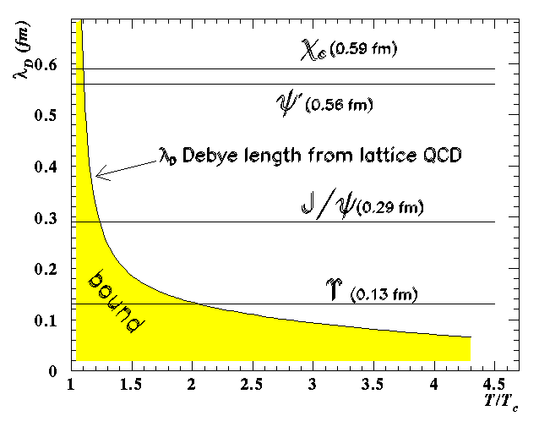
The original idea….
Screening of
strong interactions
in a QGP
Screening stronger at high T
λ_{D} → maximum size of a bound
state, decreases when T increases
Different states, different sizes
Resonance melting
QGP thermometer

Slide 9
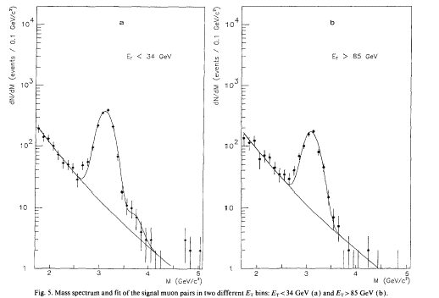
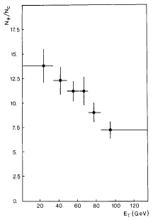
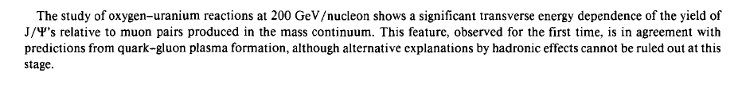
…and how first measurements looked like
NA38: first measurement of J/ψ suppression at the SPS,
O-U collisions at 200 GeV/nucleon(1986), J/ψ→μμ
periferiche
centrali
N_{J/ψ}
Peripheral
events
Central
events
cont. (2.7-3.5)
J/ψ is suppressed (factor 2!) moving from peripheral
towards central events
Do we see a QGP effect in O-U collisions at SPS?
Is this the end of the story ?

Slide 10
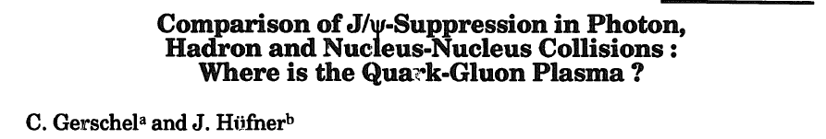
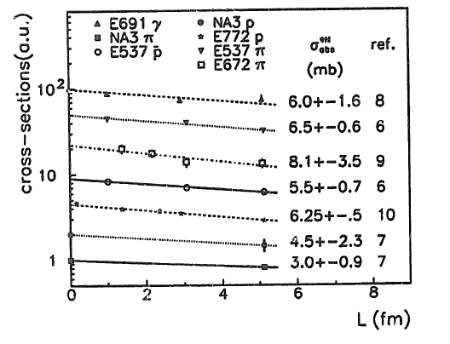
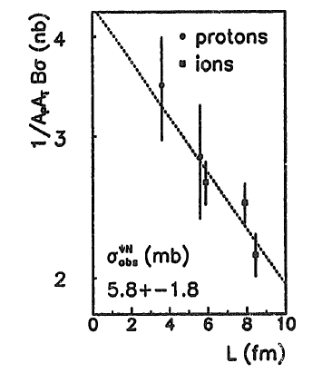
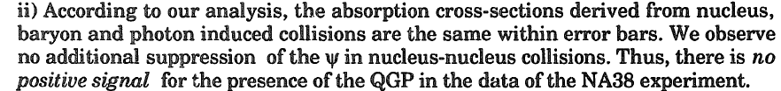
Early concerns…

Slide 11
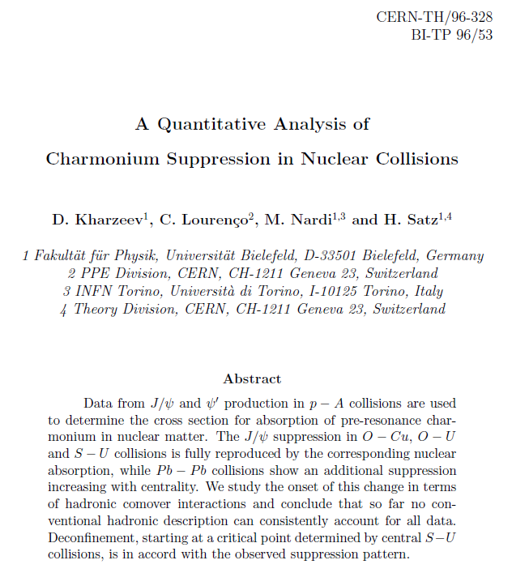
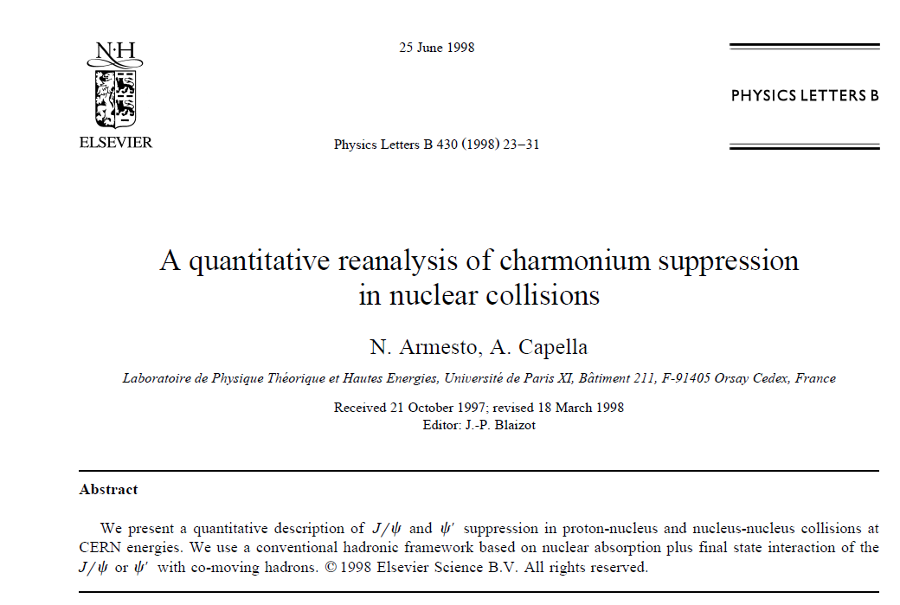

…and different opinions…
… give us today the “flavour” of hot discussions held at that time

Slide 12
...showed that the story was not simple
Some basic topics/problems:
What do we learn by looking at different quarkonium states?
Is it possible to define a “reference” (i.e. unsuppressed)
process in order to properly define quarkonium suppression ?
Can the melting temperature(s) be determined ?
Are there any other effects, not related to colour screening,
that may influence the yield of quarkonium states ?
None of these questions (unfortunately!)
has a trivial answer....

Slide 13

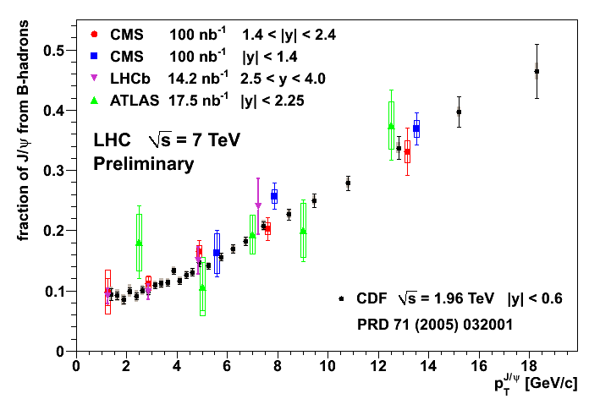
Sources of heavy quarkonia
Quarkonium production can proceed:
directly in the interaction of the initial partons
via the decay of heavier hadrons (feed-down)
Low p_{T}
For J/ψ (at CDF/LHC energies) the contributing mechanisms are:
Feed Down
30%
Direct
60%
Direct production
Prompt
Feed-down from higher charmonium states:
~ 8% from ψ(2S), ~25% from χ_{c}
B decay
10%
Non-prompt
B decay
contribution is p_{T} dependent
~10% at p_{T}~1.5GeV/c
B-decay component “easier” to separate →displaced production

Slide 14
Sequential suppression
The quarkonium states can be characterized by
the binding energy
radius
state | J/ψ | χ_{c} | ψ(2S)
Mass(GeV) | 3.10 | 3.53 | 3.69
ΔE (GeV) | 0.64 | 0.20 | 0.05
r_{o}(fm) | 0.25 | 0.36 | 0.45
More bound states → smaller size
Debye screening condition r₀ > λ_{D} will occur at different T
state | Υ(1S) | Υ(2S) | Υ(3S)
Mass(GeV) | 9.46 | 10.0 | 10.36
ΔE (GeV) | 1.10 | 0.54 | 0.20
r_{o}(fm) | 0.28 | 0.56 | 0.78
T_{c}
T_{c}
T_{c}
T_{c}
ψ(2S)
ψ(2S)
ψ(2S)
ψ(2S)
χ_{c}
χ_{c}
J/ψ
χ_{c}
J/ψ
χ_{c}
J/ψ
J/ψ
T~T_{c}
T~1.1T_{c}
T<T_{c}
T>>T_{c}
Sequential suppression of the resonances
thermometer for the temperature reached in the HI collisions

Slide 15
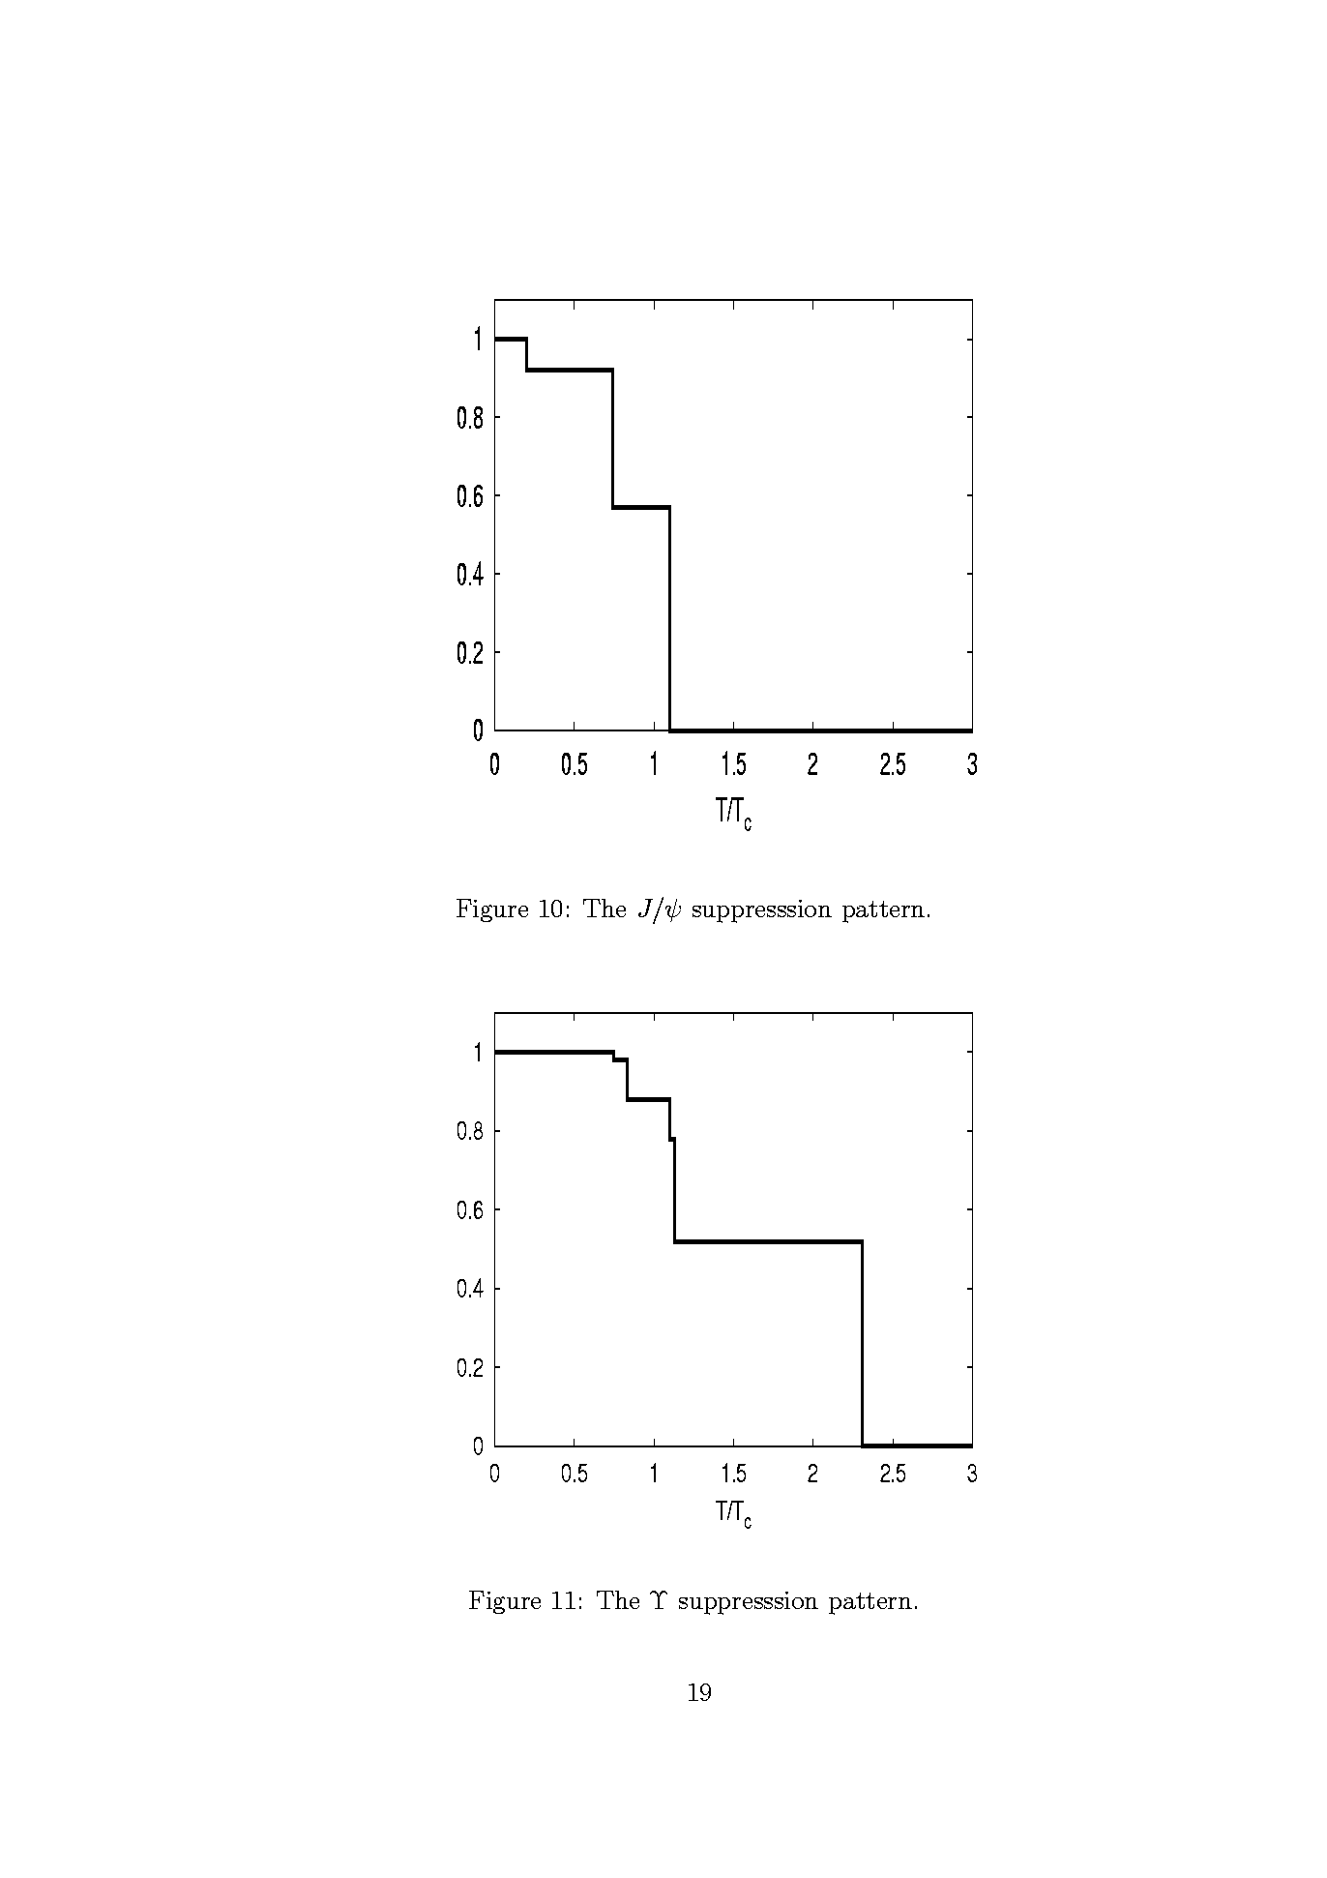
Feed-down and suppression pattern
Since each resonance should have a typical dissociation
temperature, one should observe «steps» in the suppression
pattern of the measured J/ψ when increasing T
ϒ(3S)
Digal et al.,
Phys.Rev. D64(2001)
094015
ψ(2S)
χ_{b}(2P)
χ_{c}(1P)
ϒ(2S)
χ_{b}(1P)
J/ψ
ϒ(1S)
J/ψ
ϒ
Ideally, one could vary T
  by studying the same system (e.g. Pb-Pb) at various √s
  by studying the same system for various centrality classes

Slide 16
Quantifying the suppression (1)
High temperature should indeed induce a suppression of the
charmonia and bottomonia states
How can we quantify the suppression ?
Low energy (SPS)
  Normalize the charmonia yield to the Drell-Yan dileptons
μ+
Advantages
  Same final state, DY is
  insensitive to QGP
  Cancellation of syst.
  uncertainties
g
c
J/ψ
g
c
μ-
q
μ+
γ*
Drawbacks
  Different initial state
  (quark vs gluons)
q
μ-

Slide 17
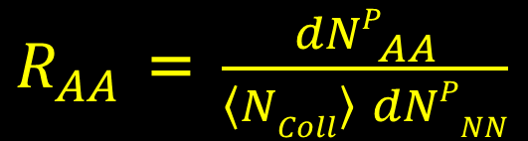
Quantifying the suppression (2)
At RHIC, LHC Drell-Yan is no more “visible” in the dilepton
mass spectrum → overwhelmed by semi-leptonic decays of
charm/beauty pairs
Solution: directly normalize to elementary collisions (pp), via
nuclear modification factor R_{AA}
$R_{AA}$ = $\frac{{dNP}_{AA}^{}}{\left\langle NColl\right\rangle dNPNN}$
R_{AA}<1 suppression
R_{AA}>1 enhancement
Advantages
same process in nuclear environment and in vacuum
Drawbacks
Systematics more difficult to handle (no cancellations)
An ideal normalization would be the open heavy quark yield
However, this is not straightfoward (see later)

Slide 18
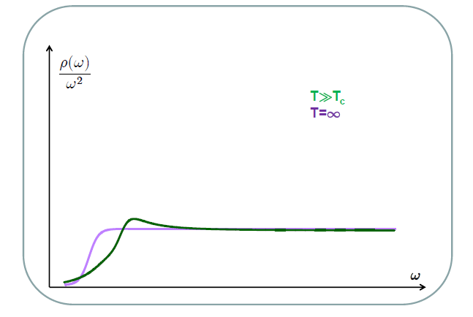
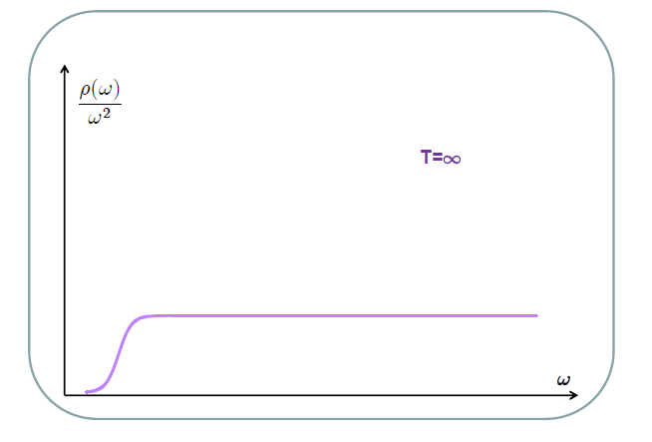
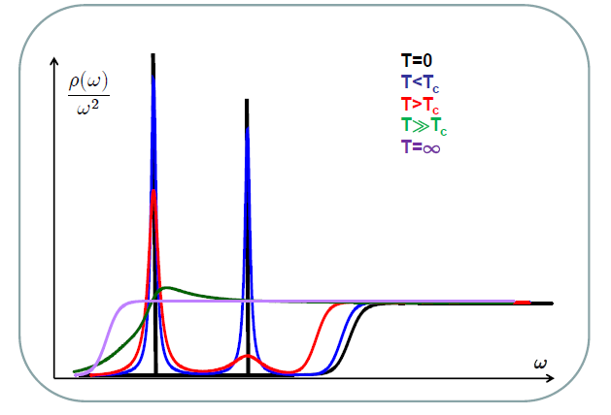
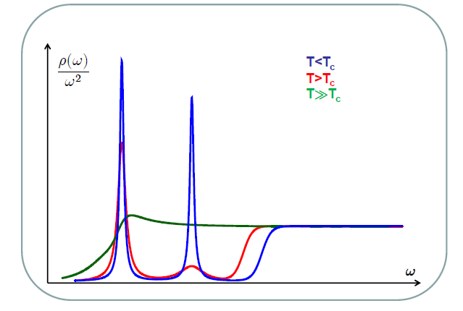
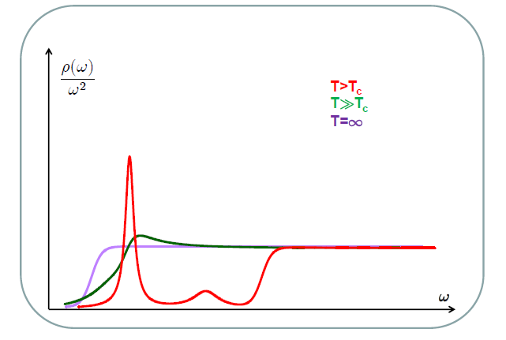
Can we get T_{diss} ?
Lattice QCD calculations are our main source of information
on the dissociation temperatures
Early studies showed that the complete disappearance of the J/ψ
peak occurred at very high temperatures (~2T_{c})
However spectral functions expected to change rather smoothly
From
O. Kaczmarek
How to pin down T_{diss} ?
Notes:
Lattice → temporal meson correlators, potential → static quark-antiquark correlators as input to Schrodinger equations

Slide 19
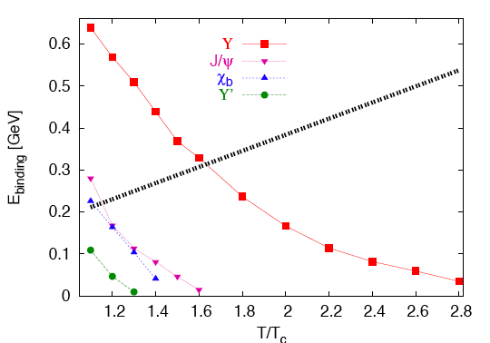
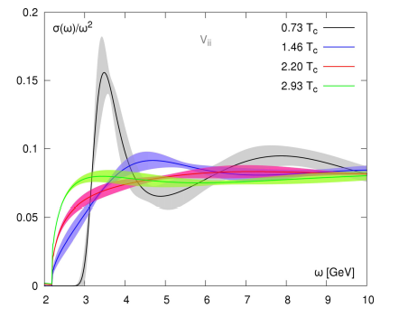
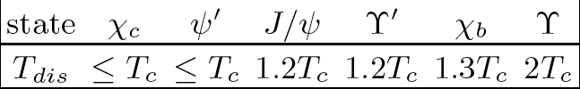
Recent results on T_{diss}
Binding energies for the
various states can be obtained
from potential models too
Assume a state “melts” when
E_{bind} < T → T_{diss} ~1.2 T_{c}
strong binding
weak binding
Recent results from lattice:
No clear sign of bound state
beyond T=1.46 T_{c}
Region close to T_{c} now under study
O.Kaczmarek@HP12
Notes:
Effective field theory and velocity dependence of the suppression (Vairo, Escobedo)

Slide 20
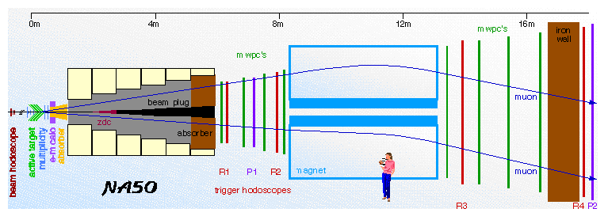
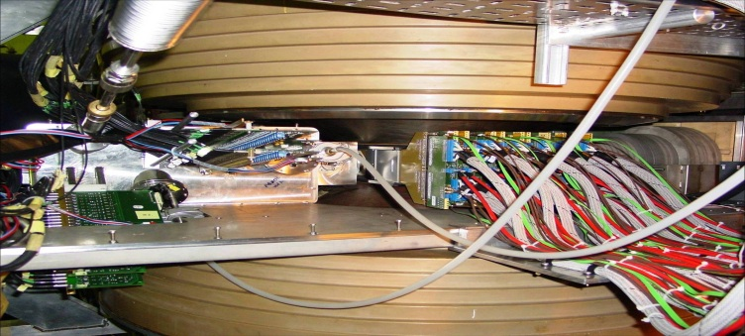
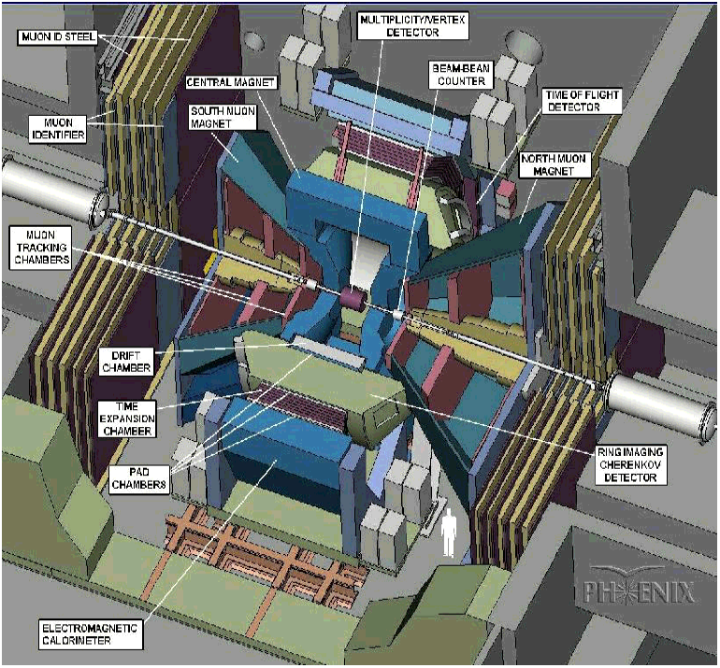
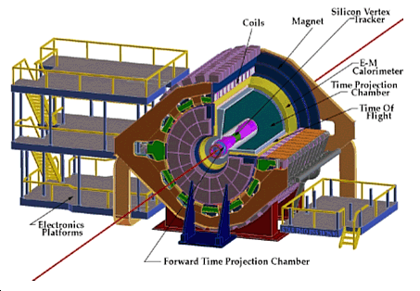
Experiments
From fixed target
at the SPS
(muons only)…
NA60
to RHIC collider
(muons+electrons)…
PHENIX
STAR

Slide 21
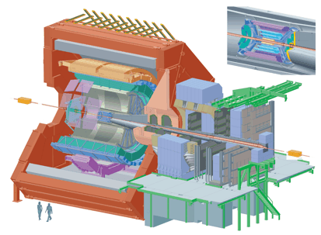
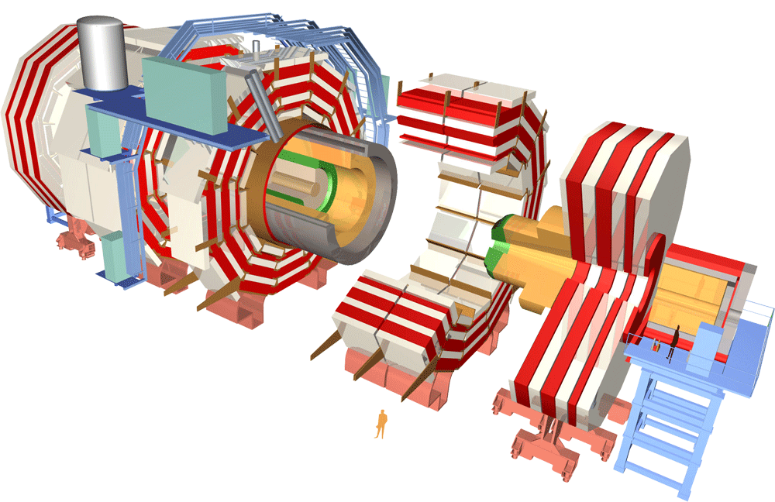
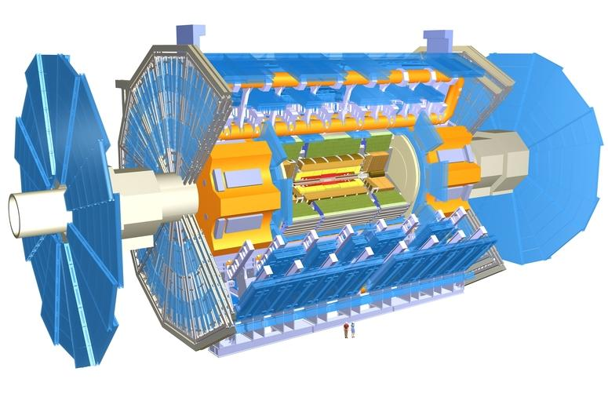
Experiments
…to the LHC
(electrons+muons)
ALICE (low p_{T})
ALICE → dedicated HI experiment
CMS+ATLAS → mainly pp, but very
good capability for charmonia and
bottomonia in HI
ATLAS (high p_{T})
CMS (high p_{T})

Slide 22
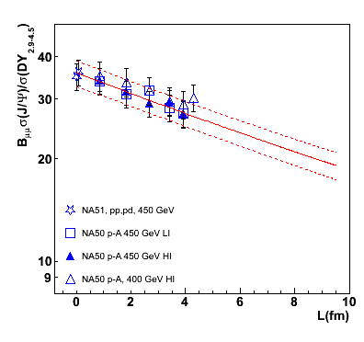
Looking into results: pA/dA
The “early” observation of a strong effect of cold nuclear matter
on quarkonium has led to a considerable effort of theory/experiment
Early studies concentrated on “nuclear absorption” as main
effect, estimating effective quantities
NA50, pA 450 GeV
N.B.: σ_{J/ψ}^{pA}/(A σ_{J/ψ}^{pp} )
is equivalent to R_{pA}
A significant reduction of the yield per NN collision is observed, usually parametrized by effective quantities (α, σ_{abs})

Slide 23
J/ψ vs ψ(2S): confirm break-up scenario
Less bound quarkonium states
should be easier to break….
and indeed this is the case
At SPS energies
Still, the dependence is weaker
than the expected r² one
Charmonium production process
happens on a rather long timescale
The nucleus “sees” the cc in
a (mainly) color octet state
Hadronization can take place
outside the nucleus
c
c
J/ψ, χ_{c}, ...
J/ψ, χ_{c}, ...
p
c
c
g
g

Slide 24
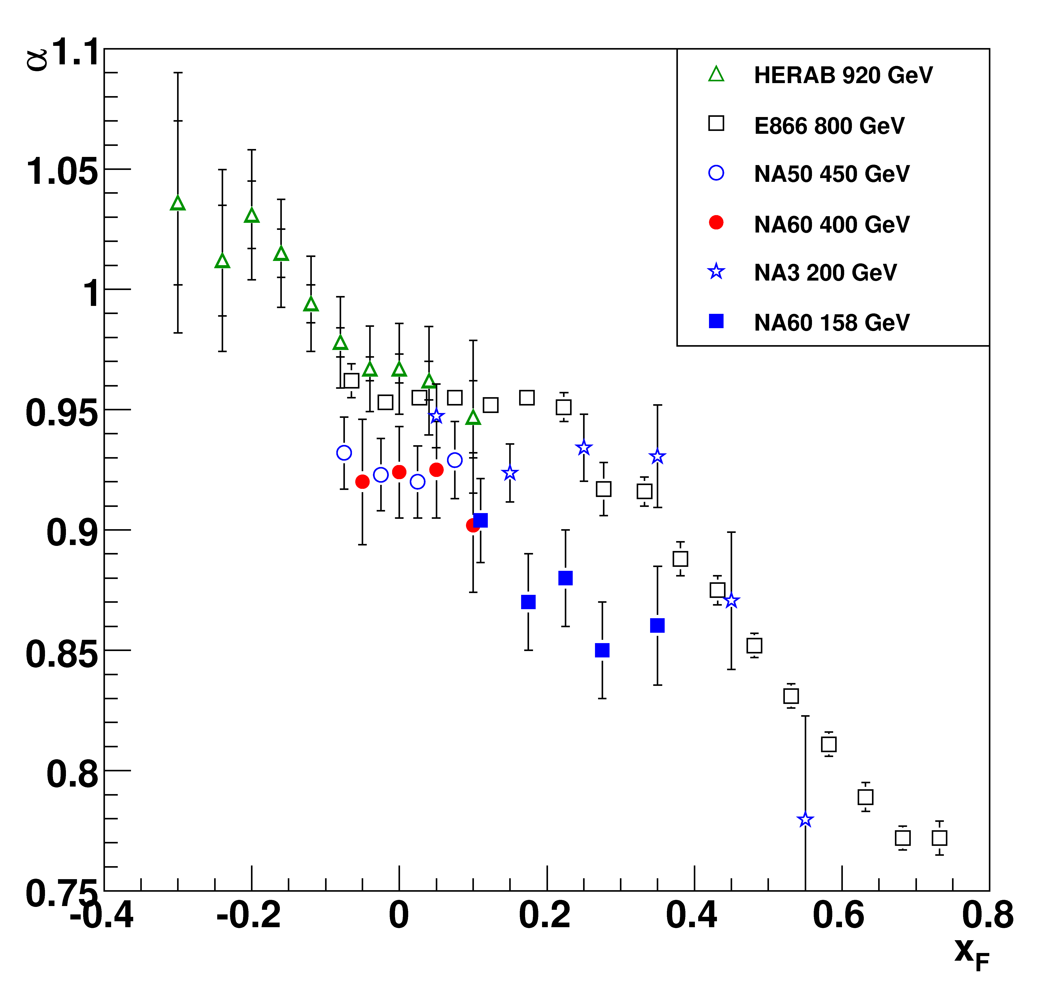
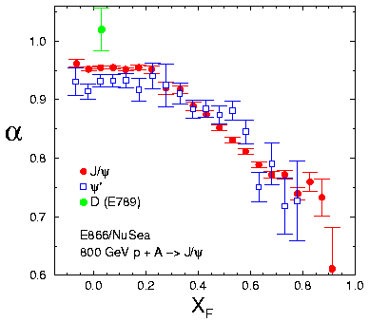
Is nuclear absorption the whole story ?
Collection of results from many fixed target pA experiments
Nuclear effects show a strong variation vs the kinematic variables
J/ψ
Very likely we observe a
combination of several
nuclear effects
higher √s
J/ψ vs ψ(2S)
lower √s
Fast ψ(2S) as absorbed as J/ψ!

Slide 25
A cocktail with many ingredients
The break-up of the cc pair because of the interactions with CNM
is an important effect, but other effects may also play a role
Nuclear shadowing
Initial state energy loss
Final state energy loss
Intrinsic charm in the proton
(first systematic study, R.Vogt, Phys. Rev. C61(2000)035203)
Lots of interesting physics
  Can we disentangle the various effects ?
  Can we calculate them in a reliable way ?
If we try to put together all the available fixed-target results,
do we reach a satisfactory understanding of what’s going on ?

Slide 26
Nuclear shadowing
Various parameterizations developed in the last ~10 years
Significant spread in the results, in particular for gluon PDFs
More recent analysis (EPS09), include uncertainty estimate
K.Eskola et al., JHEP04(2009)065
Assuming a certain production
approach (i.e. fixing the kinematics),
the shadowing contribution to
quarkonium production can be
separated from other nuclear effects
(from C. Salgado)

Slide 27
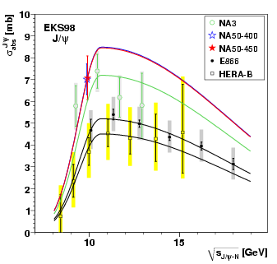
Is shadowing + absorption enough?
C. Lourenco, R. Vogt and H.K.Woehri, JHEP 02(2009) 014
Assume that the dominant effects are shadowing and cc breakup
cc break-up cross section should depend only on √s_{J/ψ-N}
Correct the results for shadowing (2→1 kinematics), using EKS98
Even after correction, there is still a significant spread of the
results at constant √s_{J/ψ-N}
Effects different from shadowing and cc breakup are important

Slide 28
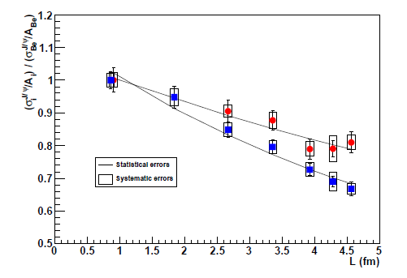
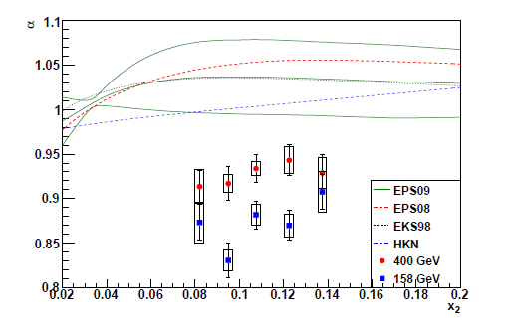
NA60 pA, 2 energies, same y_{lab}
Data taken with the same set-up, only changing E_{beam}
Same y_{lab} → same √s_{ψN}
Shadowing scales with x₂ → check on data
No scaling, evidence for other effects

Slide 29
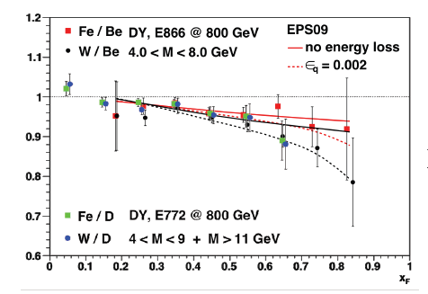
Initial-state energy loss
H.K.Woehri, “3 days of Quarkonium production...”, Palaiseau 2010
Energy loss of incident partons → shifts x₁
√s of the parton-parton interaction changes (but not shadowing)
ε_{q(g)}: fractional energy loss
ε_{q} =0.002 (small!) seems enough to reproduce Drell-Yan results
But a much larger (~factor 10) energy loss is required to
reproduce large-x_{F} J/ψ depletion from E866!
New theoretical approaches (Peigne’, Arleo): coherent energy loss,
may explain small effect in DY and large for charmonia

Slide 30
Moving to higher energies: dAu at RHIC
Is the situation becoming simpler at collider energies ?
Much larger √s at colliders, but:
  Integrated luminosity smaller than at fixed target
  Difficult to accelerate several different nuclei
  Use one nucleus and select on impact parameter, but:
RHIC
b
r_{T}
r_{T}’s
b
pA: r_{T} ~ b
dAu: due to the size of the deuteron <r>~2.5fm the distribution of
transverse positions are not very well represented by impact parameter

Slide 31
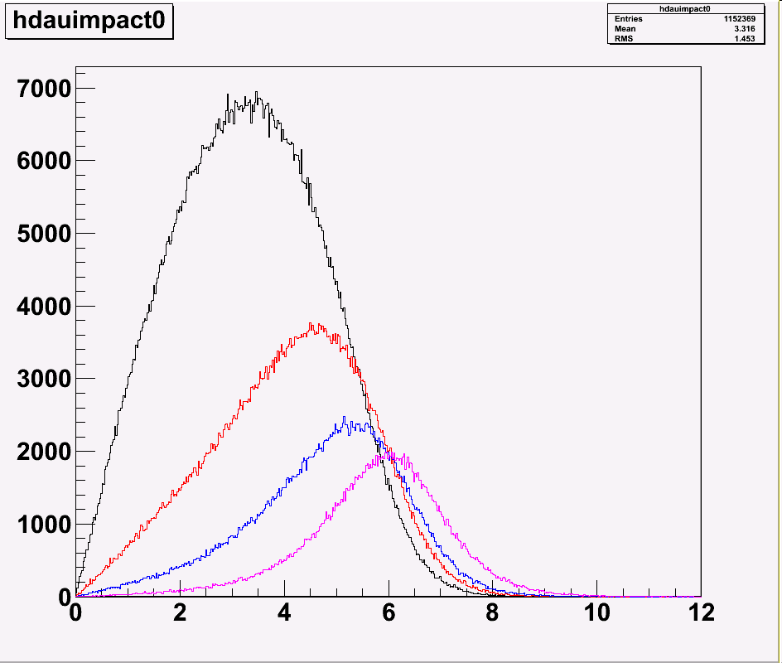
Consequences
Centrality classes do not probe
completely unique regions
and have a large amount of
overlap
L.A.LindenLevy,
“3 days of Quarkonium production...”,
Palaiseau 2010
r_{T}
Also shadowing estimates are less precise
(need b-dependence, proportionality of effect with L usually assumed)
(see S.R.Klein and R.Vogt, Phys. Rev. Lett. 91 (2003) 142301)

Slide 32

J/ψ suppression in d-Au
Regions corresponding to very different strength of shadowing
effects have been studied (-2.2<y<-1.2, |y|<0.35, 1.2<y<2.2)
→ good test of our understanding of the physics!
Fermi
Motion
forward y x~0.005
mid y x~0.03
backward y x~0.1
anti-shadowing
EMC
effect
shadowing
x
In spite of RHIC starting its data taking in 2000, first high
statistics dAu took place in 2008

Slide 33
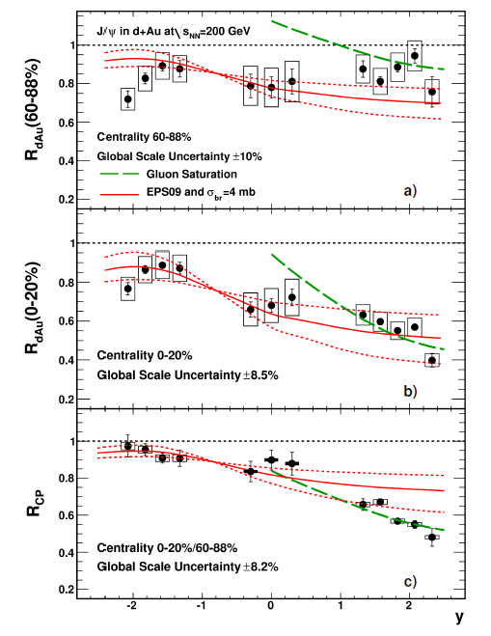
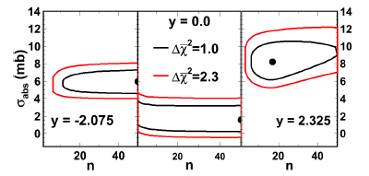
A “selection” of PHENIX R_{AA} results
Also at RHIC energies a
superposition of
shadowing+absorption is not
satisfactory, compared to data
In particular the relative
suppression between peripheral
and central events (R_{CP}) is not
reproduced
Best fit obtained with
“abnormally” steep centrality
dependence of the absorption
Issue related to the centrality selection ? Genuine physical effect ?

Slide 34
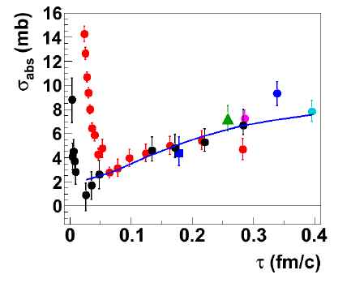


Recent approaches to fixed-target + collider results
McGlinchey, Frawley, Vogt,
arXiv:1208.2667
cc-N cross section (after correcting
for shadowing) should depend on
the size of the pair as it expands to
a fully formed meson
Calculate the proper time spent
by the cc pair in the nucleus
τ=β_{Z}L/γ
with
Data can be fitted with σ₁=7.2 mb, r₀=0.16 fm and v_{cc}=0
“Large” τ data are in agreement with this simple hypothesis
Other effects (energy loss?) not scaling with τ play a role in the
small τ region

Slide 35
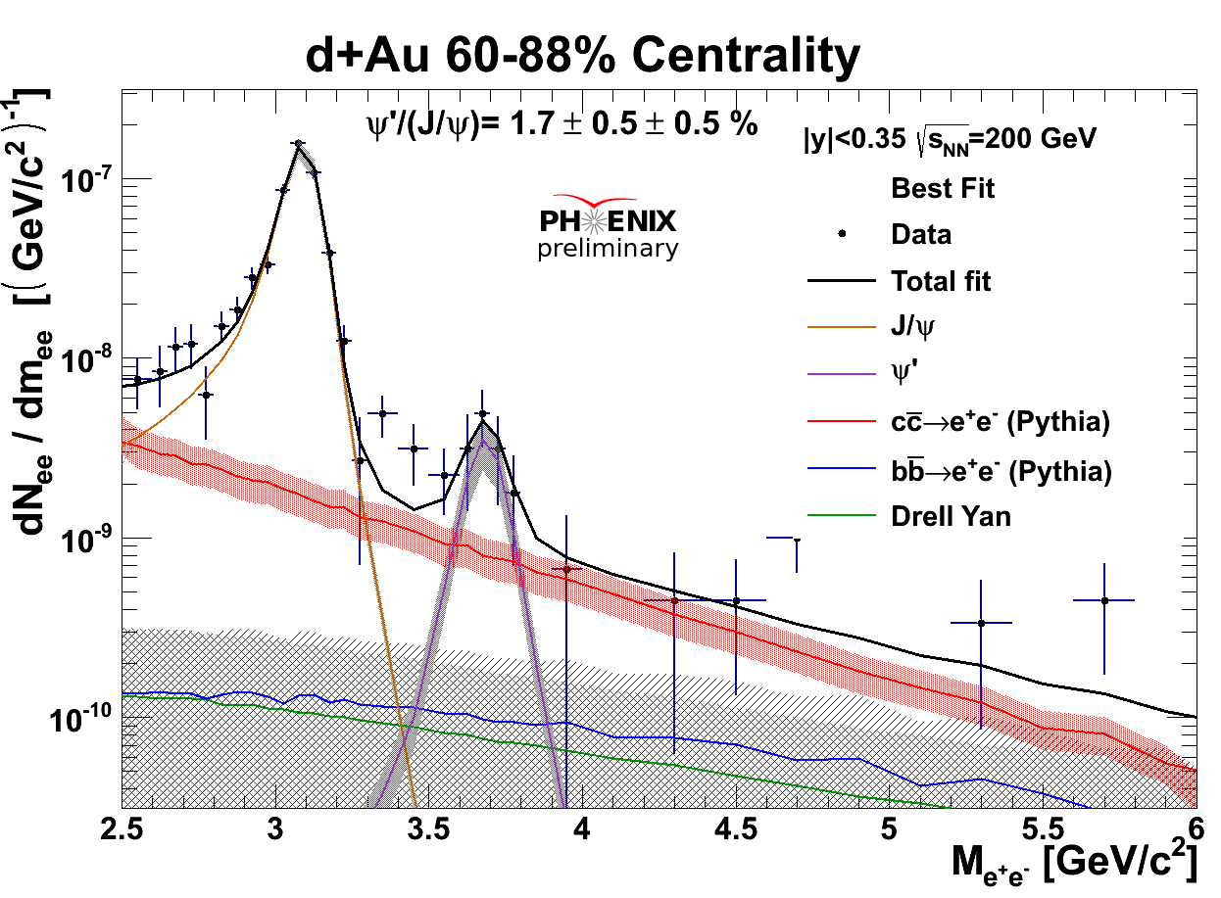


ψ(2S) suppression in d-Au
Shadowing effects for J/ψ and ψ(2S) should be very similar
At RHIC energy the final meson state should form outside the
nucleus → absorption effects expected to be similar
In contrast to these expectations,
much stronger ψ(2S) suppression!
Are we observing “hadronic comovers”?

Slide 36
Charmonia in cold nuclear matter: what did we learn?
Cold nuclear matter effects (both initial and final state) strongly
modify charmonium spectra
Physics interesting in its own but also for the understanding
of what is observed in AA collisions
Main features are understood, thanks to the large amount
of measurements covering large phase space regions
Quantitative description still lacking
  Large uncertanties on shadowing
  Energy loss effects
  Modelling of cc formation vs time still rather simplistic
Consequence: extrapolation of CNM to AA collisions in many
cases is still not completely satisfactory
Still, charmonium/bottomonium AA data contain very rich physics
and represent a unique set of observables for QGP studies!

Slide 37


PbPb results at √s_{NN} =17.2 GeV (SPS)
NA50 and the discovery of the anomalous J/ψ suppression
N.B.: cold nuclear matter effects were calibrated here from
pA results obtained at higher √s (27.4 GeV)

Slide 38

SPS “summary” plot
Compare NA50 (Pb-Pb) and NA60 (In-In) results, after
correcting for CNM effects evaluated at the correct √s
In-In 158 GeV (NA60)
Pb-Pb 158 GeV (NA50)
Anomalous suppression for central PbPb collisions
(up to ~30%, compatible
with ψ(2S) and χ_{c} melting)
Agreement between PbPb and InIn in the common Npart region
After correction for EKS98 shadowing
PbPb data not precise enough to clarify the details of the pattern!
B. Alessandro et al., EPJC39 (2005) 335
R. Arnaldi et al., Nucl. Phys. A (2009) 345

Slide 39

Is ψ(2S) suppressed too ?
Yes, but already for
light-nuclei projectiles
(S-U collisions)
Makes sense, the less bound
ψ(2S) state may need lower
temperatures to melt
Up to now, the most
accurate set of results
on ψ(2S) production in
nuclear collisions
Does this result confirm the sequential suppression scenario ?
Not clear, ψ(2S) expected to be completely suppressed….
…which is not the case

Slide 40

Moving to RHIC: expectations
Two main lines of thought
We gain one order of magnitude in √s. In the “color screening”
scenario we have then two possibilities
We reach T>T_{diss}^{J/ψ} → suppression becomes stronger than at SPS
We do not reach T>T_{diss}^{J/ψ} → suppression remains the same
2) Moving to higher energy, the cc pair multiplicity increases
A (re)combination of cc pairs
to produce quarkonia may take
place at the hadronization
→ J/ψ enhancement ?!

Slide 41

J/ψ R_{AA}: SPS vs RHIC
Let’s simply compare R_{AA}
(i.e. no cold nuclear effects taken into account)
Qualitatively, very similar
behaviour at SPS and
RHIC !
Do we see (as at SPS)
suppression of ψ(2S) and
χ_{c} ?
Or does (re)generation
counterbalance a larger
suppression at RHIC ?
PHENIX experiment
measured R_{AA} at both
central and forward
rapidity: what can we
learn ?

Slide 42

RHIC: forward vs central y
Comparison of results obtained at different rapidities
Mid-rapidity
Forward-rapidity
Stronger suppression at forward rapidities
Not expected if suppression
increases with energy density
(which should be larger at
central rapidity)
Are we seeing a hint of
(re)generation, since there are
more pairs at y=0?

Slide 43


Suppression vs recombination
Do we have other hints telling us that recombination can play a role at RHIC ?
J/ψ elliptic flow
→ J/ψ should inherit the heavy quark flow
Recombination could be measured in an indirect way
J/ψ y distribution
→ should be narrower wrt pp
J/ψ p_{T} distribution
→ should be softer (<p_{T}²>↓) wrt pp
Open
charm
Closed
Difficult to conclude

Slide 44


<p_{T}²> vs system size
No clear decrease of
<p_{T}²> wrt pp at RHIC,
as expected in case of
recombination
…still, at the SPS, there was a
very clear increase from elementary
to nucleus-nucleus collisions
→ Difficult to conclude

Slide 45

Comparisons with models
In the end, models can
catch the main features
of J/ψ suppression at
RHIC, but no quantitative
understanding
In particular, no clear
conclusion on
ψ(2S) and χ_{c} only
suppression
vs
All charmonia suppressed
+ (re)generation

Slide 46

An interesting comparison
What happens if we try taking into account cold nuclear matter
effects and compare with the same quantity at the SPS ?
In spite of the remaining “difficulties” in understanding CNM
effects and extrapolating them to AA
Nice “universal” behavior
Note that
charged multiplicity is
proportional to the energy
density in the collision
Maximum suppression
~40-50% (still compatible
with only ψ(2S) and χ_{c}
melting)
Is this picture confirmed
by LHC data?

Slide 47


Great expectations for LHC
…along two main lines
1) Evidence for charmonia
(re)combination: now or never!
2) A detailed study of
bottomonium suppression
ϒ(3S)
χ_{b}(2P)
ϒ(2S)
χ_{b}(1P)
Finally a clean probe, as J/ψ at SPS
ϒ(1S)
Mass
r₀
ϒ
Yes, we can!

Slide 48


ALICE, focus on low-p_{T} J/ψ
|y|<0.9
Electron analysis: background
subtracted with event mixing
→ Signal extraction by event
counting
Muon analysis: fit to the invariant
mass spectra → signal extraction by
integrating the Crystal Ball line shape

Slide 49


J/ψ, ALICE vs PHENIX
Even at the LHC, NO rise of J/ψ yield for central events, but….
Compare with PHENIX
  Stronger centrality dependence at lower energy
  Systematically larger R_{AA} values for central events in ALICE
Is this the expected signature for (re)combination ?

Slide 50


R_{AA} vs ⟨N_{part}⟩ in p_{T} bins
J/ψ production via (re)combination should be more
important at low transverse momentum
Compare R_{AA} vs ⟨N_{part} ⟩ for
low-p_{T} (0<p_{T}<2 GeV/c)
and high-p_{T} (5<p_{T}<8 GeV/c)
J/ψ
Different suppression pattern for low- and high-p_{T} J/ψ
Smaller R_{AA} for high p_{T} J/ψ
recombination
In the models, ~50% of low-p_{T} J/ψ are produced via (re)combination, while at high p_{T} the contribution is negligible → fair agreement from N_{part}~100 onwards
recombination

Slide 51


R_{AA} vs p_{T}
Expect smaller suppression for
low-p_{T} J/ψ → observed!
The trend is different wrt the one observed at lower energies, where an increase of the <p_{T}> with centrality was obtained
Fair agreement with transport models and statistical model

Slide 52


CMS, focus on high p_{T}
Muons need to overcome the magnetic field
and energy loss in the absorber
Minimum total momentum p~3-5 GeV/c to
reach the muon stations
Limits J/ψ acceptance
  Midrapidity: p_{T}>6.5 GeV/c
  Forward rapidity: p_{T}>3 GeV/c
..but not the ϒ one (p_{T} > 0 everywhere)

Slide 53



CMS explores the high p_{T} region
Centrality dep.
in
p_{T}
y
bins
(Maybe) we still see a hint of p_{T} dependence
of the suppression even in the p_{T} range
explored by CMS
Good agreement with ALICE in spite of the
different rapidity range (which anyway
seems not to play a major role at high p_{T})

Slide 54

CMS vs STAR high-p_{T} suppression
(Re)combination effects
should be negligible
CMS: prompt J/ψ
p_{T} > 6.5 GeV/c , |y|<2.4
0-5%
→ factor 5 suppression
60-100%
→ factor 1.4 suppression
STAR: inclusive J/ψ
p_{T}>5 GeV/c , |y|<1
High p_{T}: less suppression at RHIC than at LHC

Slide 55

Rapidity dependence
Rather pronounced in ALICE, and evident in the forward region
(~40% decrease in R_{AA} in 2.5<y<4)
More difficult to conclude between mid- and forward-rapidity
Not so pronounced at high p_{T} (see CMS, previous slides)
PHENIX-like ??
Shadowing
estimate
(EPS09, nDSg)
Compatible with central,
NOT with forward y
More general
CNM issue

Slide 56


Does the J/ψ finally flow ?
The contribution of J/ψ from (re)combination should lead
to a significant elliptic flow signal at LHC energy
First hint for J/ψ flow in heavy-ion collisions (ALICE, forward y) !
Significance up to 3.5 σ for chosen kinematic/centrality selections
Qualitative agreement with transport models including regeneration

Slide 57


J/ψ at the LHC: a “summary” plot
Main “qualitative” features
now explored
Precise theory calculations
are now needed!
Effect of “inclusive” (ALICE)
vs “prompt” (CMS)
expected to be small
“Onset” of regeneration at small y, p_{T} ?

Slide 58

J/ψ and open charm, more questions
Is the apparent similarity of D and J/ψ R_{AA} telling us something ?
In principle suppression mechanisms are different
(en. loss vs suppression) but….

Slide 59


ψ(2S): CMS vs ALICE
ψ(2S) much less bound than J/ψ
Results from the SPS showed a larger suppression than for J/ψ
(saturating towards central events ? One of the landmarks of stat. model)
No results from RHIC in Au-Au
Seen by both CMS (much better resolution!) and ALICE, different kinem.
Expectations for LHC ?

Slide 60


Enhancement/suppression ?
CMS: transition from strong (relative)
enhancement to suppression
in a relatively narrow p_{T} range
ALICE excludes a large
enhancement
At SPS, the suppression increased with centrality (the opposite for CMS)
Overall interpretation is challenging
ALICE vs CMS: should we worry? Probably not, seen the size of the errors
Large uncertainties: signal extraction, pp reference
Work needed to reduce systematics

Slide 61


Finally, the ϒ
LHC is really the machine for studying bottomonium in AA collisions
(and CMS the best suited experiment to do that!)

Slide 62




Strong suppression of ϒ(2S), wrt to ϒ(1S)
Separated ϒ(2S) and ϒ(3S)
Measured ϒ(2S)/ϒ(1S)double ratio vs. centrality
  centrality integrated
  no strong centrality dependence
Upper limit on ϒ(3S)
  centrality integrated
One of the long-awaited
signatures ?

Slide 63


First accurate determination of ϒ suppression
Suppression increases with
centrality
First determination of ϒ(2S)
R_{AA}: already suppressed in
peripheral collisions
ϒ(1S) compatible with only
feed-down suppression ?
→ Probably yes, also taking into
account the normalization
uncertainty
Compatible with STAR (but large uncorrelated errors): expected ?
Is ϒ(1S) dissoc. threshold still beyond LHC reach ? → Full energy

Slide 64


What did we learn ?
26 years after first suppression prediction, this is observed also in
the bottomonium sector with a very good accuracy
R_{AA} vs binding energy qualitatively interesting: can different p_{T}
coverage be seen as a way to “kill” recombination ?

Slide 65
Conclusions
Heavy quarkonia and QGP: after >25 years still a very lively
field of investigation, with surprises still possible
Very strong sensitivity of quarkonium states to the medium
created in heavy-ion collisions: interpretation not always easy
In particular, CNM effects still defy a quantitative understanding
Two main mechanisms at play in AA collisions
  Suppression by color screening/partonic dissociation
  Re-generation (for charmonium only!) at high √s
can qualitatively explain the main features of the results
Future of quarkonia
  multi-differential suppression studies
  cold nuclear matter at LHC
  full LHC energy
  complete characterization of excited states in the QGP

Slide 66




Size: 16 x 26 meters
Weight: 10,000 tons
Detectors: 18

Slide 67

Focus on Pb-Pb
PRL106 (2011) 032301
Centrality estimate:
standard approach
Glauber model fits
Define classes corresponding
to fractions of the inelastic
Pb-Pb cross section

Slide 68


Charged multiplicity – Energy density
PRL106 (2011) 032301
PRL105 (2010) 252301
dN_{ch}/dη = 1584 ± 76
(dN_{ch}/dη)/(N_{part}/2) = 8.3 ± 0.4
    ≈ 2.1 x central AuAu at √s_{NN}=0.2 TeV
    ≈ 1.9 x pp (NSD) at √s=2.36 TeV
Stronger rise with √s in AA w.r.t. pp
Stronger rise with √s in AA w.r.t. log extrapolation from lower energies
Very similar centrality dependence at LHC & RHIC, after scaling RHIC results (x 2.1) to the multiplicity of central collisions at the LHC

Slide 69


System size
Spatial extent of the particle emitting source extracted from interferometry of identical bosons
  Two-particle momentum correlations in 3 orthogonal directions -> HBT radii (R_{long}, R_{side}, R_{out})
  Size: twice w.r.t. RHIC
  Lifetime: 40% higher w.r.t. RHIC
ALICE: PLB696 (2011) 328
ALICE: PLB696 (2011) 328

Slide 70


Slide 71


Measurement via μμ decays
Approach adopted by NA50, PHENIX and ALICE
muon trigger
and tracking
magnetic field
Iron wall
target
beam
hadron absorber
Muon
Other
Place a huge hadron absorber to reject hadronic background
Implement a trigger system, based on fast detectors, to select μ
Reconstruct tracks in a spectrometer
Correct for multiple scattering and energy loss
Extrapolate muon tracks back to the target
  → Vertex reconstruction is usually rather poor (σ_{z}~10 cm)

Slide 72

Measurement via μμ decays
Approach adopted by NA60, CMS and foreseen in PHENIX and ALICE upgrades
Dipole magnet
vertex tracker
muon trigger
and tracking
target
magnetic field
Iron wall
hadron absorber
Muon
Other
Use a silicon tracker in the vertex region to track muons before they suffer multiple scattering and energy loss in the hadron absorber.
Improve mass resolution
Determine origin of the muons
or
!

Slide 73


Very first result
A couple of weeks after the end of the 2010 data taking,
ATLAS published the first LHC result on J/ψ suppression!
Interesting, but a bit deceiving! ~ same suppression
as at RHIC,SPS
However this comparison is not sound. Different p_{T} explored!

Slide 74
First results at the LHC
Great expectation (as for many other observables) from the
first LHC heavy-ion runs (Pb-Pb @ 2.76 TeV)
Complementary acceptance
  ALICE → low p_{T} J/ψ
  CMS/ATLAS → high p_{T} J/ψ, excellent resolution
Solve/clarify issue with J/ψ suppression/(re)generation
Advent of upsilon family (seen also at RHIC with small statistics)
  (Re)generation negligible
  Observe suppression of less bound ϒ(2S), ϒ(3S) wrt ϒ(1S)
Mass
r₀

