Slide 1
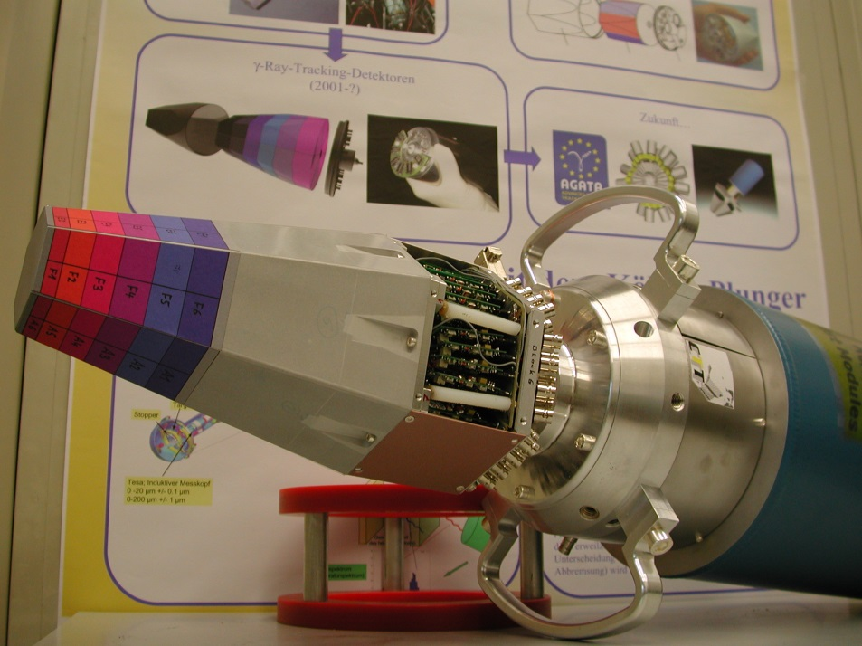
Applying γ-imaging techniques to nuclear physics experiments
Hans-Jürgen Wollersheim
Why position sensitive γ-ray detectors for radioactive ion beams?
3D position sensitive HPGe detectors
Characterization of position sensitive HPGe detectors

Slide 2
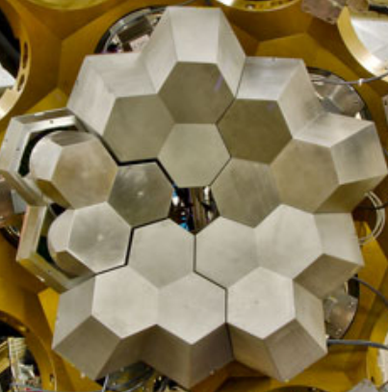
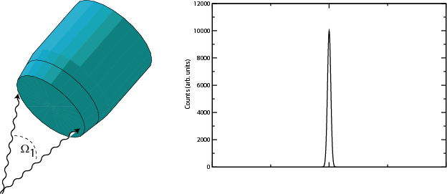
Challenges of γ-ray spectroscopy
efficiency vs resolution
Emission at rest
ΔE=2keV
Counts(arb. units)
γ ray
Channel No.
Composite HPGe detectors
in ADD BACK mode

Slide 3
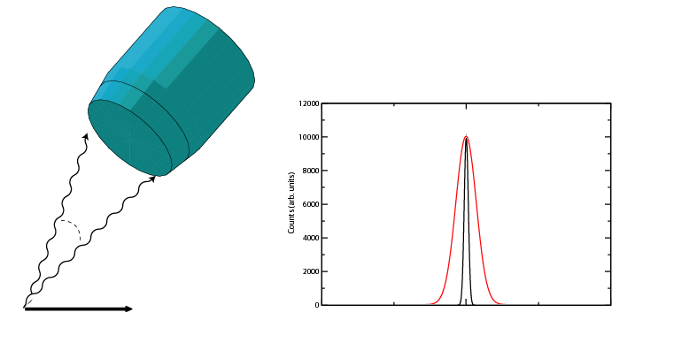
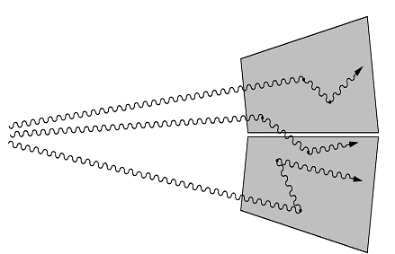
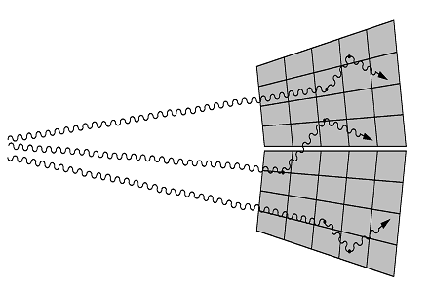
Challenges of γ-ray spectroscopy
efficiency vs resolution
Doppler broadening
High M_{γ}
Emission in flight
Δө
Counts(arb. units)
ө
v
Channel No.
Solution
- Segmentation
- Gamma-ray tracking
- Pulse shape analysis
- Doppler correction

Slide 4
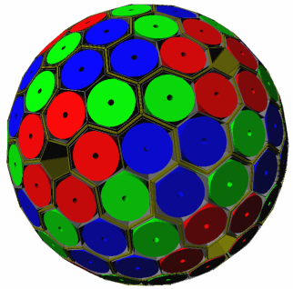
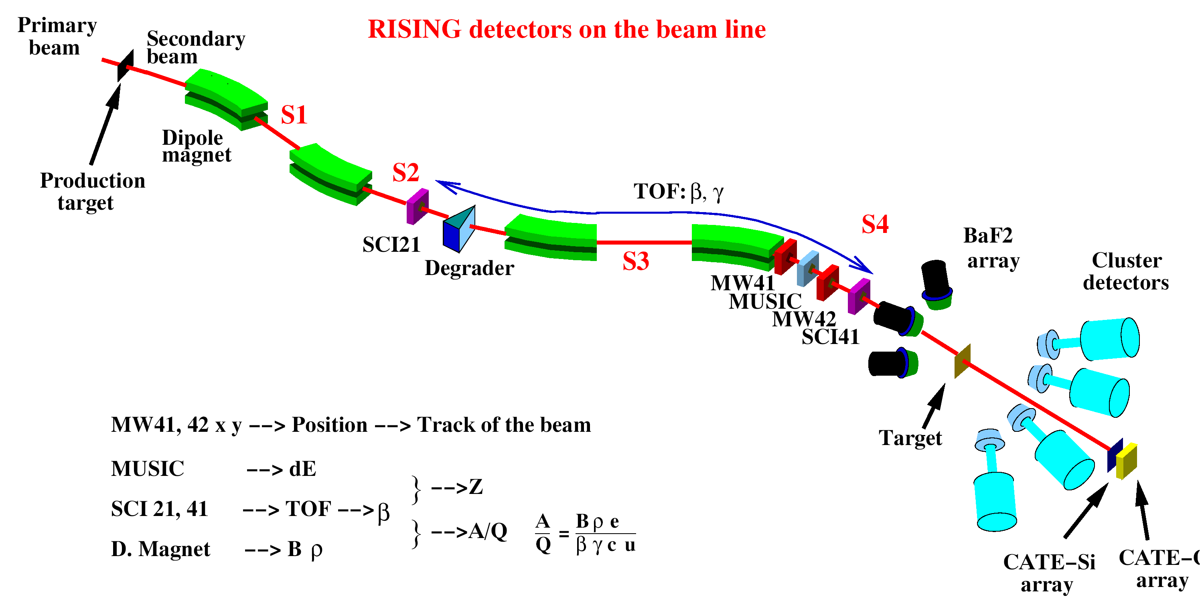
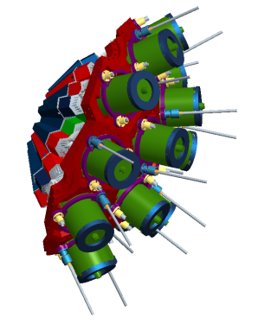
γ-ray spectroscopy with 3D position sensitive HPGe detectors
In flight γ-ray spectroscopy
HISPEC
Advanced GAmma Tracking Array
Efficiency: 43% (M_{γ} =1) 28% (M_{γ} =30)
P/T: 58% (M_{γ}=1) 49% (M_{γ}=30)
Angular resolution: ~1º
FWHM (1 MeV, v/c=50%) ~ 6 keV
Decay γ−ray spectroscopy after implantation
DESPEC

Slide 5
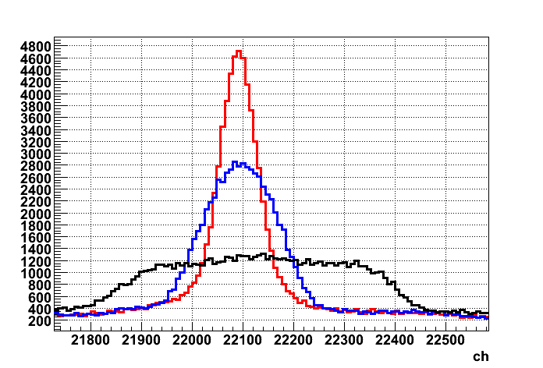
γ-ray spectroscopy with 3D position sensitive HPGe detectors
In flight γ-ray spectroscopy
Δθ
β = 0.5
Via tracking it becomes possible to determine the incident angle and preserve the good energy resolution.
θ
Decay γ−ray spectroscopy after implantation
E_{γ} = 1.3 MeV
Counts
PSA = 5 keV
Segment = 12 keV
Detector = 35 keV
Energy

Slide 6
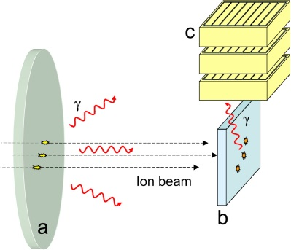
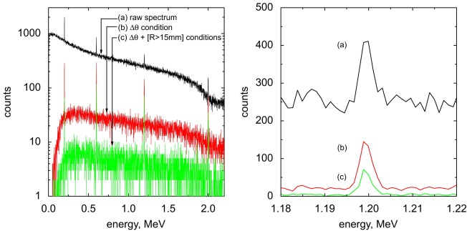
γ-ray spectroscopy with 3D position sensitive HPGe detectors
In flight γ-ray spectroscopy
θ
Background suppression and P/T can be improved by applying imaging techniques.
Decay γ−ray spectroscopy after implantation
S. Tashenov, et al. NIMA 586 (2008) 224-228

Slide 7

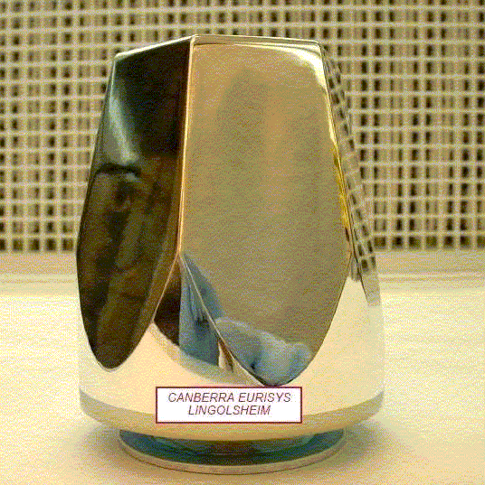
HPGe detector
7 cm
9 cm

Slide 8
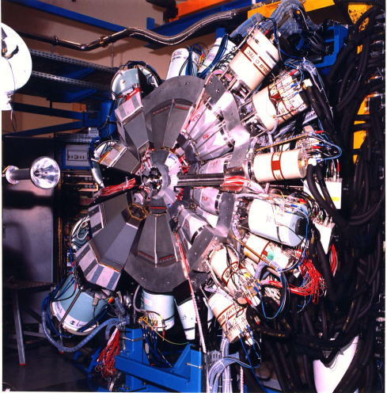
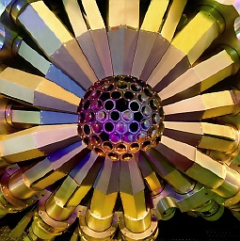
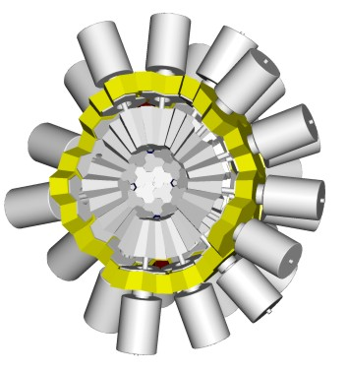
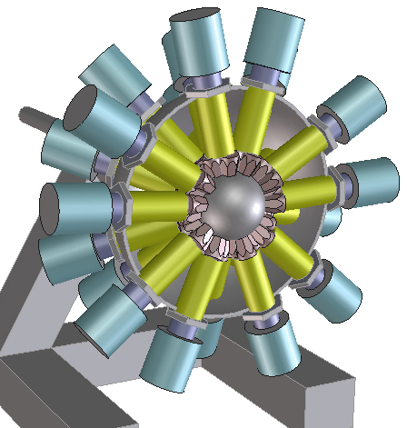
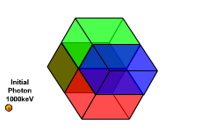
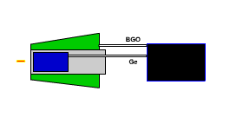
Gamma Arrays based on Compton
Suppressed Spectrometers
Tracking Arrays based on
Position Sensitive Ge Detectors
EUROBALL
GAMMASPHERE
AGATA
GRETA
ε ~ 10 - 7 %
( M_{γ} = 1 – M_{γ} = 30)
ε ~ 50 - 25 %
( M_{γ} = 1 - M_{γ} = 30)

Slide 9
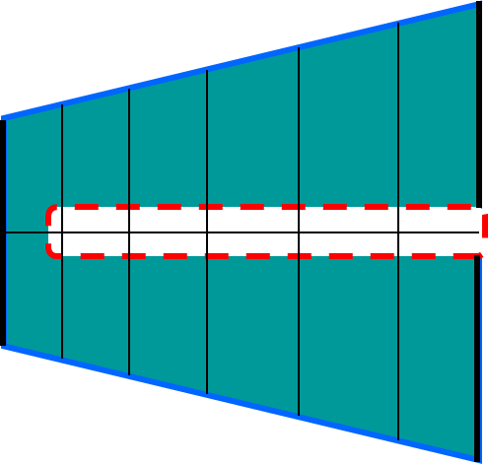
HPGe detector: working principle

Slide 10
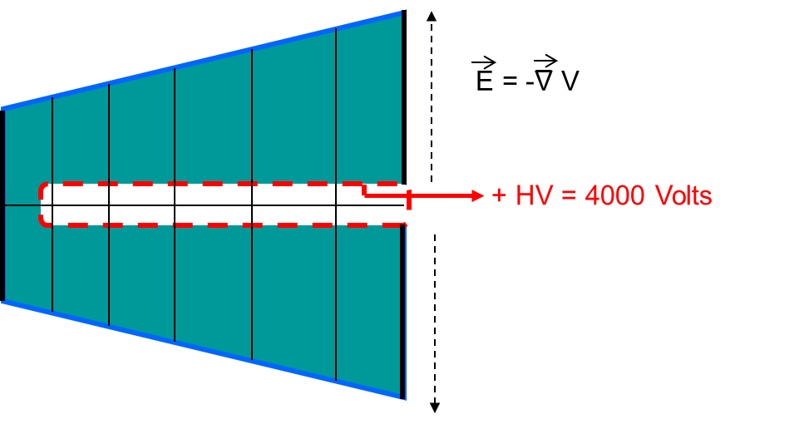
HPGe detector: working principle

Slide 11
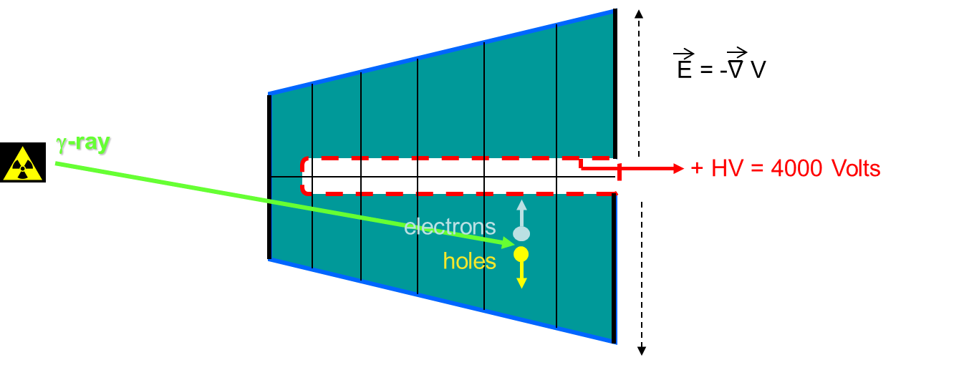
HPGe detector: working principle

Slide 12
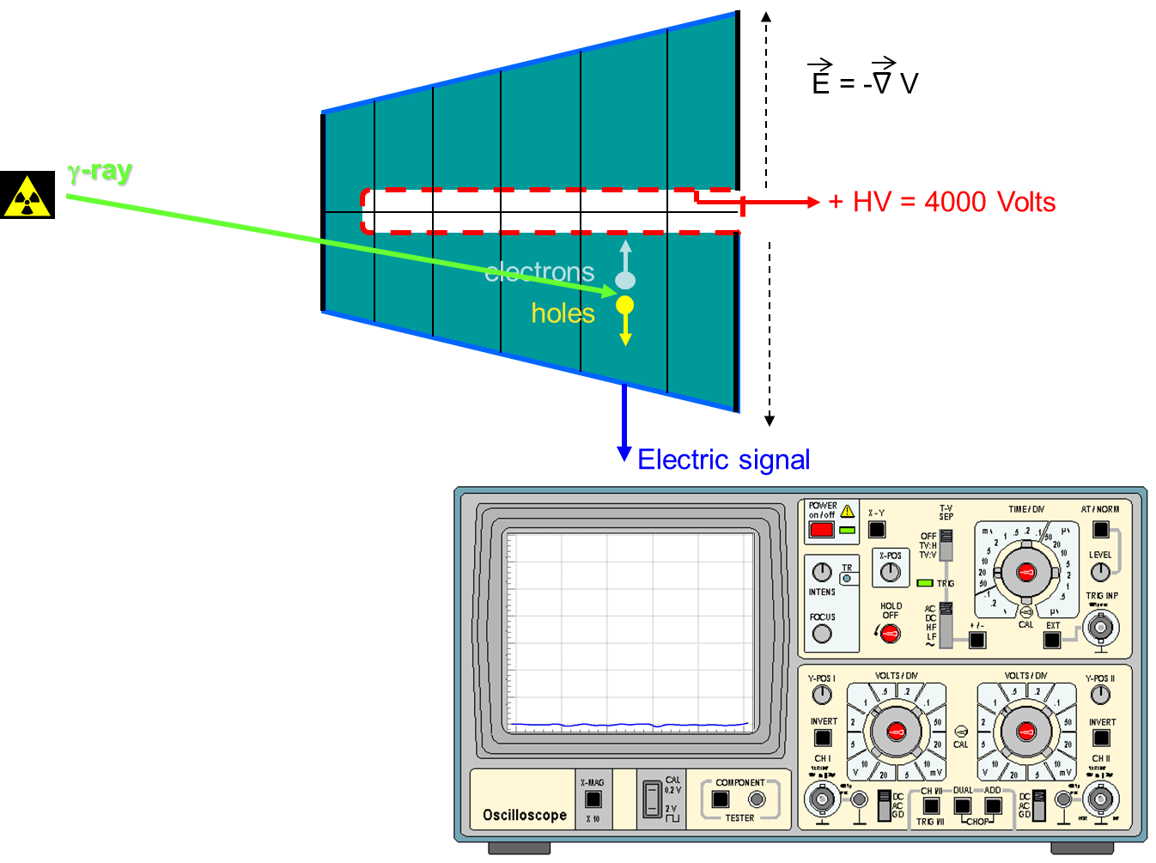
HPGe detector: working principle

Slide 13
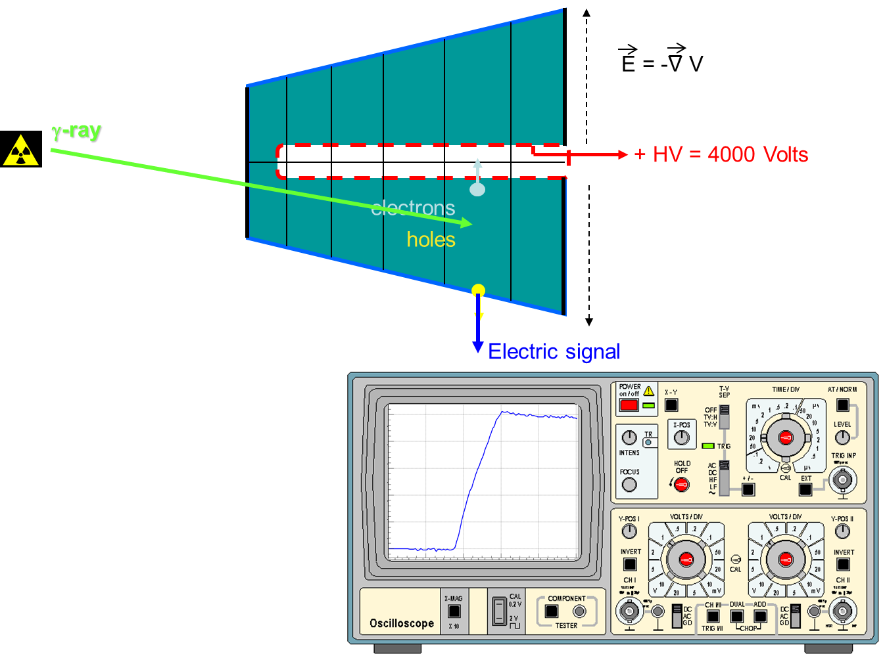
HPGe detector: working principle

Slide 14
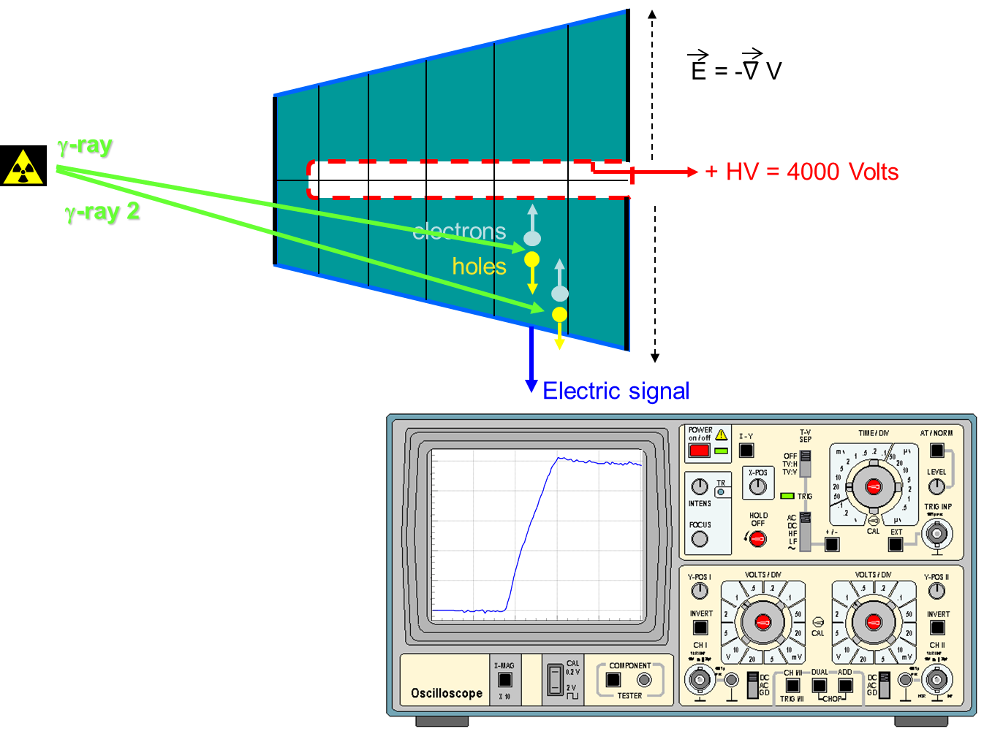
HPGe detector: position sensitivity

Slide 15
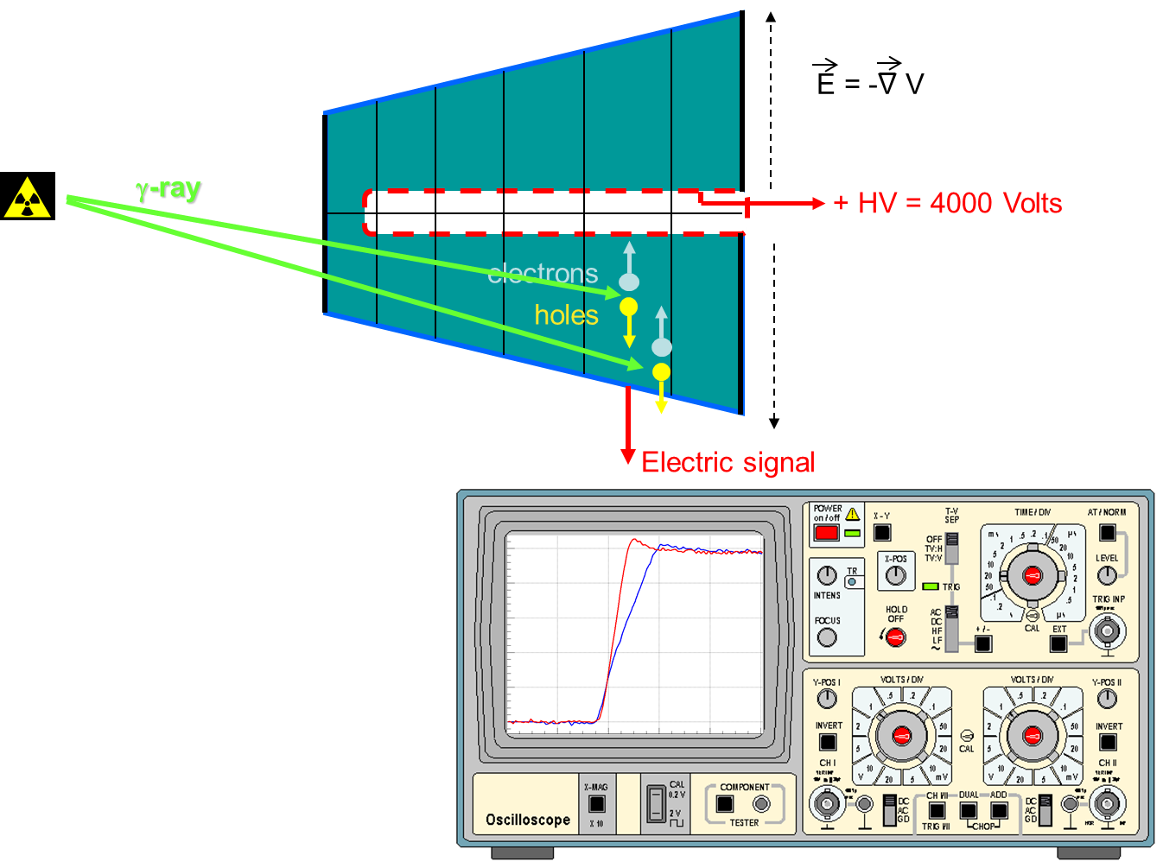
HPGe detector: position sensitivity

Slide 16
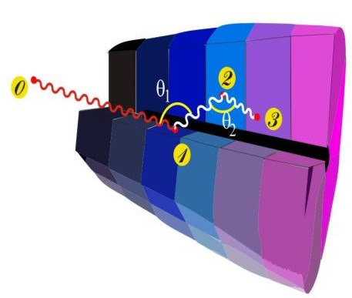
Ingredients of γ-ray tracking
Highly segmented
HPGe detectors
AGATA:
Advanced Gamma Tracking Array
Pulse Shape Analysis to identify the interaction position coordinates
Digital electronics
to record and
process segment signals
(x,y,z,E)_{i}
Reconstruction of tracks
e.g. by evaluation of permutations
of interaction points
reconstructed γ-rays

Slide 17
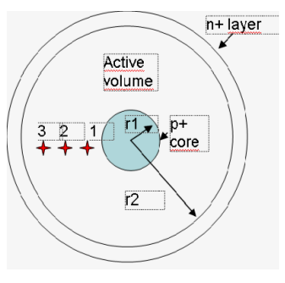
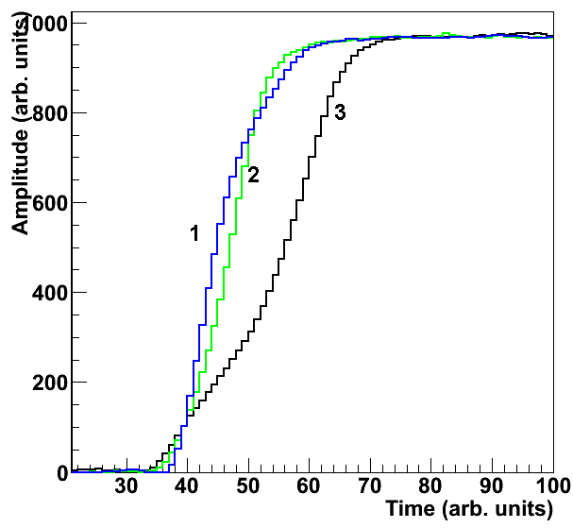
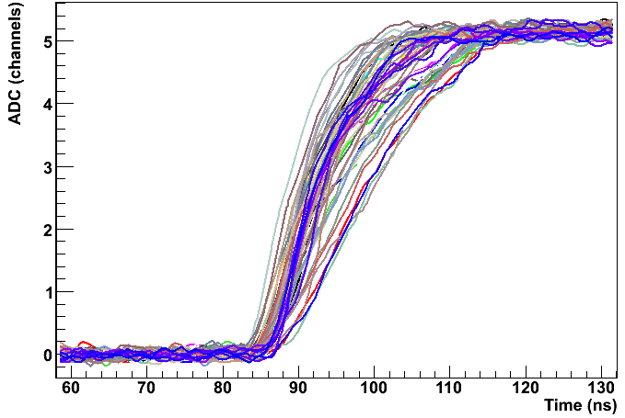
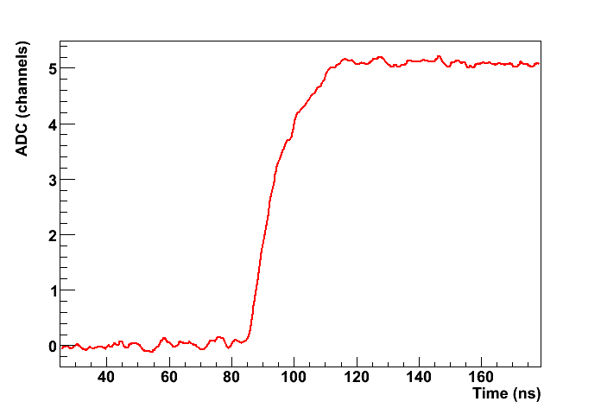
Ingredients of γ-ray tracking
Pulse Shape Analysis to identify the interaction position coordinates
Traces from a data base for known positions (x,y,z)
(x,y,z,E)_{i}
Comparison provides the position

Slide 18
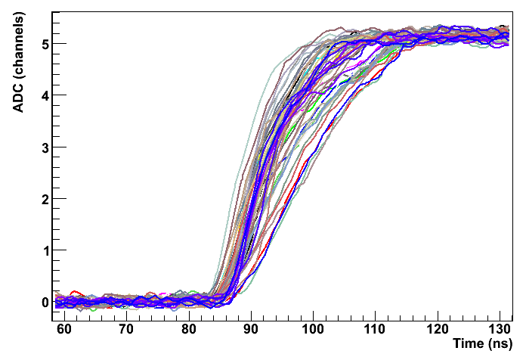
Method to characterize the pulse shape of HPGe detectors
Determine a data-base of pulse shapes S(x,y,z) which allows one to correlate an arbitrarily measured pulse, with an interaction position inside the detector.
?
How to do this?
Using PET principle in combination with γ-ray imaging techniques !

Slide 19
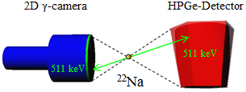
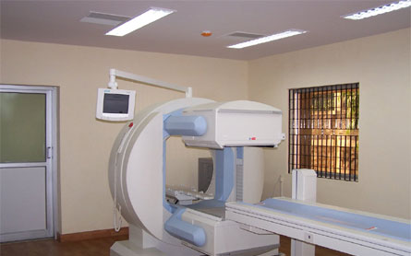
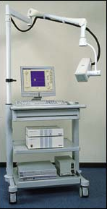
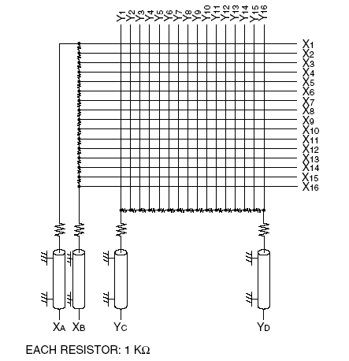
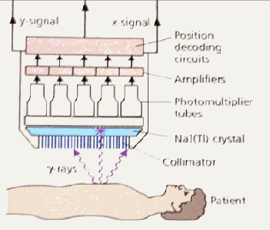
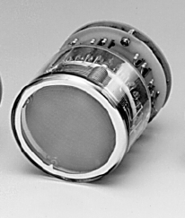
Which γ-camera to use?
Requirements:
Excellent resolution Δx = 2 mm
Large field of view FoV = 8x9 cm²
Large FoV of about 20 cm diam.
Low Spatial Resolution 5mm-1cm
Small FoV of about 3-4 cm diam.
Higher Spatial Resolution 2-3mm
www.siemens.de
Gem-imaging.com

Slide 20
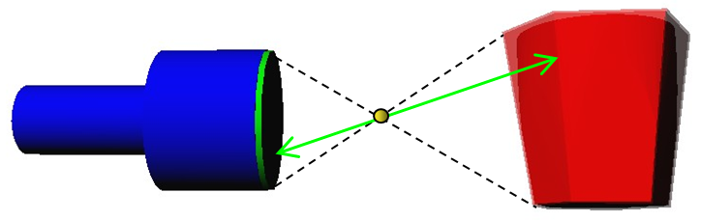
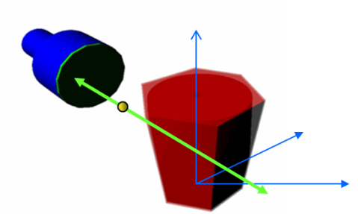
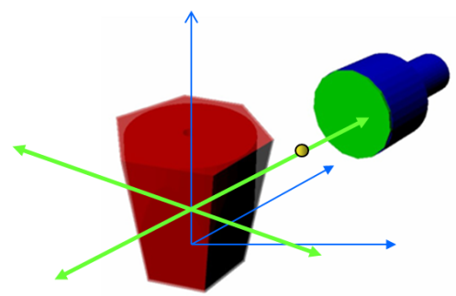
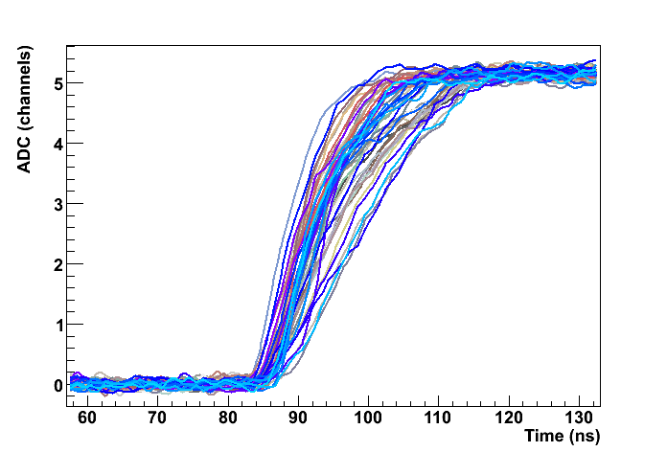

Method to characterize the pulse shape of HPGe detectors
PET approach using a high performance γ-camera
Features:
Estimated time 20^{h}
Precision: 1-2 mm
Imaging
Requirements:
Excellent resolution Δx/x
Large field of view FoV
2D γ-camera
HPGe-Detector
511 keV
511 keV
²²Na
Data group “A)” Data group “B)”
χ²(A_{i},B_{i})

Slide 21
Method to characterize the pulse shape of HPGe detectors
PET approach using a high performance γ-camera
Features:
Estimated time 20^{h}
Precision: 1-2 mm
Imaging
Requirements:
Excellent resolution Δx/x
Large field of view FoV
2D γ-camara
HPGe-Detector
511 keV
511 keV
²²Na
Data group “A)” Data group “B)”
χ²(A_{i},B_{i})

Slide 22
Which γ-camera to use?
Requirements:
Excellent resolution Δx = 2 mm
Large field of view FoV = 8x9 cm²
Large FoV of about 20 cm diam.
Low Spatial Resolution 5mm-1cm
Small FoV of about 3-4 cm diam.
Higher Spatial Resolution 2-3mm
www.siemens.de
Gem-imaging.com

Slide 23
Which γ-camera to use?
Requirements:
Excellent resolution Δx = 2 mm
Large field of view FOV = 8x9 cm²
Small FOV of about 3-4 cm diam.
Higher Spatial Resolution 2-3mm
Scintillator
Position Sensitive
PMT
Gem-imaging.com

Slide 24

Which γ-camera to use?
Requirements:
Excellent resolution Δx = 2 mm
Large field of view FOV = 8x9 cm²
Small FOV of about 3-4 cm diam.
Higher Spatial Resolution 2-3mm
γ-ray
Scintillator
Position Sensitive
PMT
Gem-imaging.com

Slide 25
Which γ-camera to use?
Requirements:
Excellent resolution Δx = 2 mm
Large field of view FOV = 8x9 cm²
Small FOV of about 3-4 cm diam.
Higher Spatial Resolution 2-3mm
γ-ray
Scintillator
Position Sensitive
PMT
Gem-imaging.com

Slide 26
Which γ-camera to use?
Requirements:
Excellent resolution Δx = 2 mm
Large field of view FOV = 8x9 cm²
Small FOV of about 3-4 cm diam.
Higher Spatial Resolution 2-3mm
γ-ray
Scintillator
Position Sensitive
PMT
Gem-imaging.com

Slide 27
Which γ-camera to use?
Requirements:
Excellent resolution Δx = 2 mm
Large field of view FOV = 8x9 cm²
Small FOV of about 3-4 cm diam.
Higher Spatial Resolution 2-3mm
γ-ray 2
γ-ray
Scintillator
Position Sensitive
PMT
Gem-imaging.com

Slide 28
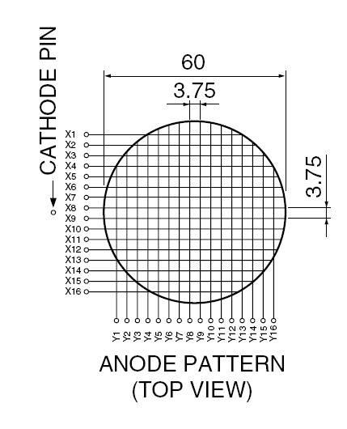
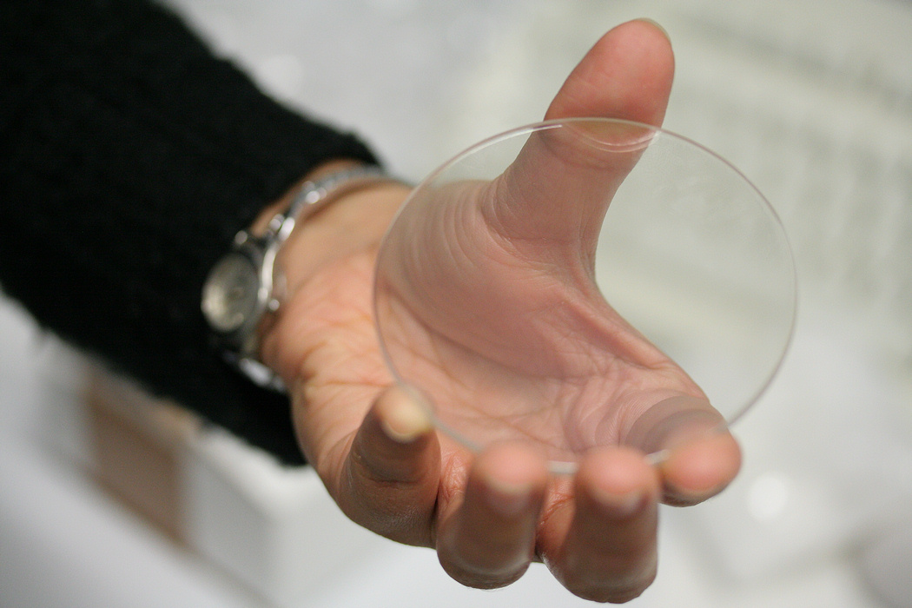
Gamma camera: Individual multi-anode readout
16 wires in X axis and 16 wires in Y axis
LYSO scintillator
Cerium-doped Lutetium Yttrium Orthosilicate
d = 76 mm
t = 3 mm
ρ = 7.4 g/cm³
Hamamatsu R2486 PSPMT
Photocathode = 56.25 mm
C.Domingo Pardo, N. Goel, et.al., IEEE, Vol.28, Dec. 2009

Slide 29
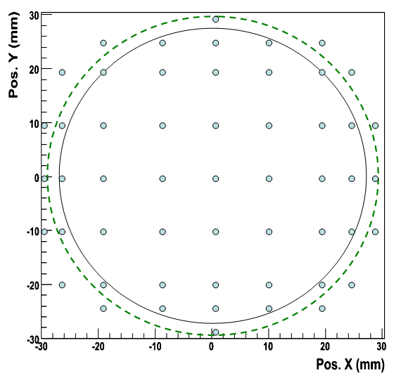
Position reconstruction
Collimated Na-22 source placed at different positions

Slide 30
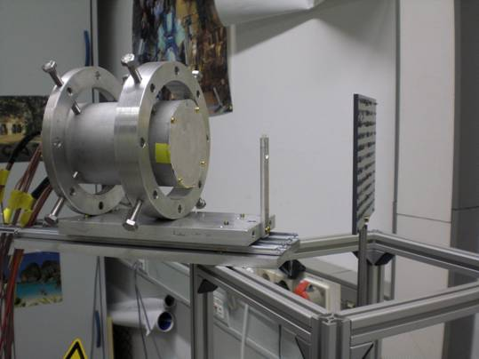
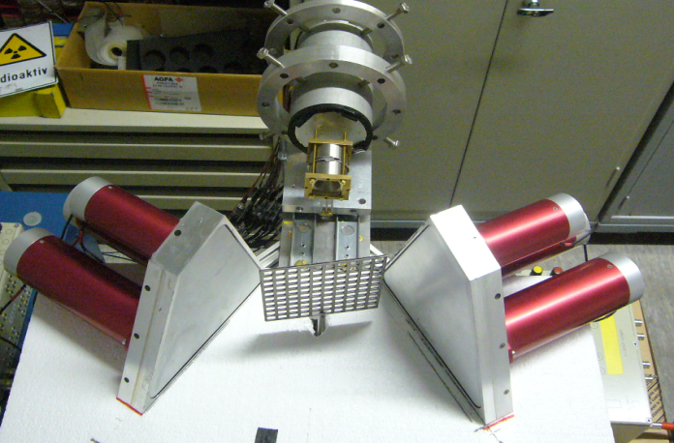
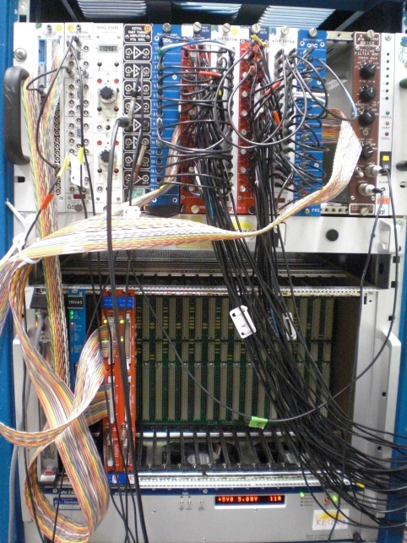
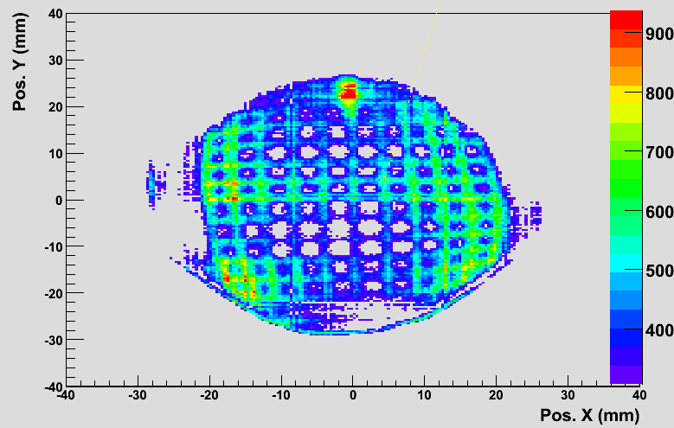
Position calibration
Determine: X_{r}(x_{m},y_{m}), Y_{r}(x_{m},y_{m})
Gamma-ray scattering technique
0⁰ position
Grid raw image when it is parallel to PSD surface (0 deg)

Slide 31
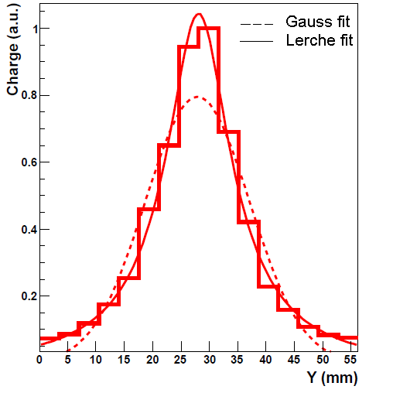

Position reconstruction
Central Interaction
Peripheral Interaction
Photocathode=56.26 mm
LYSO =76 mm
Reference peak fitting
average charge profile at the center
Charge (a.u.)
Y (mm)
Charge (a.u.)
Y (mm)
C. Domingo Pardo, N.Goel, et.al., IEEE, Dec. 2009 Volume: 28 Issue 12
C.W.Lerche, et.al., NIM A, Vol 537, pp. 326-330, Jan. 2005

Slide 32


Position reconstruction
Gaussian fitting
Reference peak fitting
Pos. X (mm)
Pos. X (mm)
Gaussian fitting works relatively well in the central region
Linear for 50 mm
Field of view = 28 cm²
Average spatial resolution in X and Y ~ 1mm

Slide 33

Method to characterize the pulse shape of HPGe detectors
Requirements:
Excellent resolution Δx = 2 mm
Large field of view FOV = 8x9 cm²

Slide 34

Method to characterize the pulse shape of HPGe detectors
Requirements:
Excellent resolution Δx = 2 mm
Large field of view FOV = 8x9 cm²

Slide 35

Method to characterize the pulse shape of HPGe detectors
Requirements:
Excellent resolution Δx = 2 mm
Large field of view FOV = 8x9 cm²

Slide 36

Method to characterize the pulse shape of HPGe detectors
Requirements:
Excellent resolution Δx = 2 mm
Large field of view FOV = 8x9 cm²

Slide 37

Scanner at GSI
²²Na
Position sensitive detector
Characteristics:
Faster
Precision: 1-2 mm
Imaging capability
Rotating table
Requirements:
1. Position sensitive detector
- Excellent Δx/x
- Large field of view
2. Method to compare the pulses

Slide 38

Superiority over conventional scanner
coincidence between the Germanium and BGO detectors for 90 degree Compton scattered events for depth determination
BGO
BGO
¹³⁷Cs
Advantage over conventional scanner: Full detector can be scanned in one measurement 10 times faster than a conventional scanner Accuracy of simulations can be checked for complex regions of electric field

Slide 39

Scanner based on pulse shape comparison scan
a)
a)
F.C.L. Crespi, et al. NIM A 593 (2008), 440

Slide 40
Scanner based on pulse shape comparison scan
b)
a)
a)
Collimated source
Geometric crossing point: x,y,z
Common pulse out of data sets (a) & (b)
b)
F.C.L. Crespi, et al. NIM A 593 (2008), 440

Slide 41
Pulse shape comparison scan method based on
a position sensitive detector
Position sensitive
detector
511 keV
²²Na
Recording pulse shapes for positions (a) and (b)
Identical signals at the crossing point.
a)
²²Na
Rotated by 90⁰
b)

Slide 42


χ² minimization method
0° measurement
90° measurement
amplitude, Φ
amplitude, Φ
t(ns)
t(ns)
distribution
Average pulse
amplitude, Φ
threshold
t(ns)

Slide 43


Characterisation of a planar HPGe detector
Front view
Side view
Planar Ge
d = 4 cm
t = 2 cm
²²Na
Position sensitive detector

Slide 44




Detector scan (test measurements)
Front view (0 deg):
Side view (90 deg):

Slide 45


Detector scan (test measurements)
Front view (0 deg):
Side view (90 deg):

Slide 46

Detector scan (data analysis)

Slide 47

Experimental validation of the method

Slide 48


AGATA: Advanced Gamma Tracking Array
4π array of germanium crystals
180 segmented crystals arranged around the reaction target
3D sensitivity
Symmetric AGATA prototype crystal

Slide 49

Signal shapes from all 36 segments
Photopeak event
Most significant transient charge signals are from the direct neighbouring segments

Slide 50


Azimuthal position
top F5
A4
F4
left
right
E4
bottom F3

Slide 51

Azimuthal position
top F5
A4
F4
left
right
E4
bottom F3

Slide 52

Azimuthal position
top F5
A4
F4
left
right
E4
bottom F3

Slide 53

Azimuthal position
top F5
A4
F4
left
right
E4
bottom F3

Slide 54

Azimuthal position
top F5
A4
F4
left
right
E4
bottom F3

Slide 55




Combined trace for pulse shape comparison
Direct neighbours of segment F3
We have the method, the device and the detector ready, lets do the scan of AGATA!

Slide 57






Intensity distribution
2D projected images for 511 keV coincident photopeak events in position sensitive detector and AGATA

Slide 58




Risetime distribution plots
Multi Geometry Simulation
V/cm
-
+
Electric field
t(ns)
t(ns)
Experimental
Simulated

Slide 59



Effective segmentation
Geometric
segmentation
MGS Segmentation
radius (mm)
Intensity distribution for segments in row F
Segment F3
Segment F2
Segment F1

Slide 60


From 2D to 3D: first deep insight into the detector
t(ns)
t(ns)
Experimental
Simulated
Discrepancy in the T90 values near the core in ring 1 ~ 50 ns
Extremely important to have an experimental pulse shape basis for PSA to be applied to the complicated geometries.

Slide 61
Summary & outlook
We have developed a γ-camera with spatial resolution, linearity and field of view substantially improved with respect to similar existing devices (3 times larger FOV, 2 times better resolution).
These improvements in the detection system allow us to characterize the pulse shape of HPGe detectors with an spatial matrix resolution of about 2 mm and in a short period of time (about 2 days per crystal of 9x7 cm² size compared to 3 months needed by other approaches).
The good performance of this new detection system makes it very suitable for many γ-ray imaging applications, not only in RIB experiments but also e.g. for medical physics
Our system uses conventional NIM and VME electronics, which makes it not easily portable, not easily scalable and rather expensive if one wants to build many of these devices. However, this drawback could be overcome thanks to the increasing technology of electronics, e.g. a new acquisition system based on ASIC, FPGA, etc technologies. This would also make the system more suitable for medical applications.
Applications with thicker scintillation crystals (1 cm) may become possible, without compromising its good performance, thanks to the more accurate measurement of the DOI. (Tests are in progress).

Slide 62

Summary & outlook
Our system uses conventional NIM and VME electronics, which makes it not easily portable, not easily scalable and rather expensive if one wants to build many of these devices. However, this drawback could be overcome thanks to the increasing technology of electronics, e.g. a new acquisition system based on ASIC, FPGA, etc technologies. This would also make the system more suitable for medical applications.
Applications with thicker scintillation crystals (1 cm) may become possible, without compromising its good performance, thanks to the more accurate measurement of the DOI. (Tests are in progress).

Slide 63

Conclusion and summary
1.Next generation of segmented HPGe based gamma arrays
for inflight spectroscopy
2.Pulse shape analysis and gamma ray tracking
3.A novel scanner based on pulse shape comparison scan

Slide 64
Conclusion and summary
1.Next generation of segmented HPGe based gamma arrays
for inflight spectroscopy
2.Pulse shape analysis and gamma ray tracking
3.A novel scanner based on pulse shape comparison scan
4.Development of a gamma camera to achieve superior
position resolution of 1 mm

Slide 65

Conclusion and summary
1.Next generation of segmented HPGe based gamma arrays
for inflight spectroscopy
2.Pulse shape analysis and gamma ray tracking
3.A novel scanner based on pulse shape comparison scan
4.Development of a gamma camera to achieve superior
position resolution
5.Succesful test with a planar HPGe crystal

Slide 66

Conclusion and summary
1.Next generation of segmented HPGe based gamma arrays
for inflight spectroscopy
2.Pulse shape analysis and gamma ray tracking
3.A novel scanner based on pulse shape comparison scan
4.Development of a gamma camera to achieve superior
position resolution
5.Succesful test with a planar HPGe crystal
6.Spatial characterisation of an AGATA detector

Slide 67
Conclusion and summary
1.Next generation of segmented HPGe based gamma arrays
for inflight spectroscopy
2.Pulse shape analysis and gamma ray tracking
3.A novel scanner based on pulse shape comparison scan
4.Development of a gamma camera to achieve superior
position resolution
5.Succesful test with a planar HPGe crystal
6.Spatial characterisation of an AGATA detector
7.Comparison with simulation

Slide 68
Conclusion and summary
1.Next generation of segmented HPGe based gamma arrays
for inflight spectroscopy
2.Pulse shape analysis and gamma ray tracking
3.A novel scanner based on pulse shape comparison scan
4.Development of a gamma camera to achieve superior
position resolution
5.Succesful test with a planar HPGe crystal
6.Spatial characterisation of an AGATA detector
7.Comparison with simulation
8.Implement signal basis for PSA

Slide 69






Multi Geometry Simulation
Potential map
Electric field

Slide 70

Necessity to scan detectors experimentally
Impurity concentration from capacitance-voltage measurements
Planar Geometry
Coaxial Geometry
It is not sufficient to find the impurity charge concentration applying
only the assumption of cylindrical or planar geometry.
Extremely important to have an experimental pulse shape basis for PSA to be applied to the complicated geometries.

Slide 71

AGATA S001 Detector Scan
511 keV coincident events

Slide 72




Position information from the polarity and amplitude of the image charges
Radius
12 mm
30 mm
Angle
90°
30°

