Slide 1

Outline: Large Hadron Collider
Lecturer: Hans-Jürgen Wollersheim
e-mail: h.j.wollersheim@gsi.de
web-page: https://web-docs.gsi.de/~wolle/ and click on
electrons versus protons
large electron positron collider
fixed-target or collider
large hadron collider
accelerator complex CERN

Slide 2
Large Hadron Collider (LHC) 2008 -
Built at CERN (Conseil européen pour la recherché nucléaire), straddling the French/Swiss border
27 km in circumference
Currently colliding beams of 6.5 TeV/beam
  Design energy of 7 TeV

Slide 3
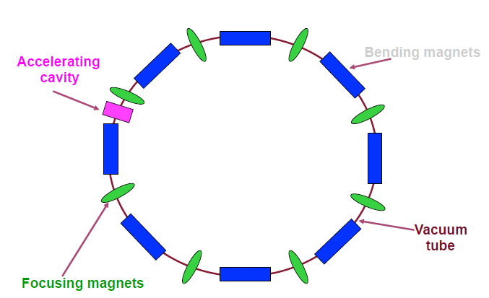
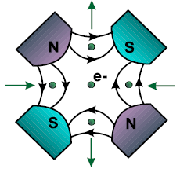
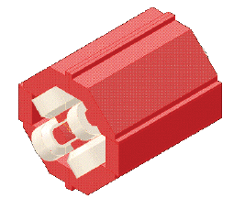
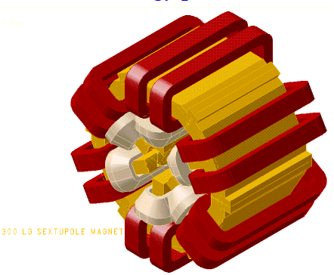
Synchrotron Ring Schematic
Bending magnets
B ~ X
B ~ X²
quadrupole magnet
sextupole magnet

Slide 4
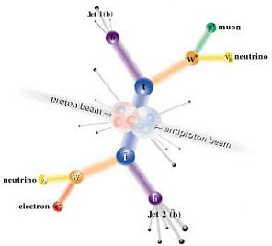
Electrons vs. Protons
Electrons are point-like
  Well-defined initial state
  Full energy available to interaction
Protons are made of quarks and gluons
  Interaction take place between these constituents.
  Only a small fraction of energy available, not well-defined.
  Rest of particle fragments → big mess!
So why not stick to electrons?

Slide 5
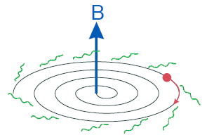
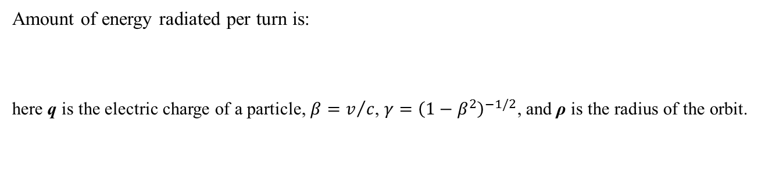
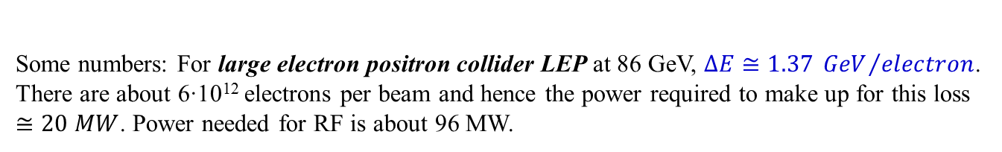
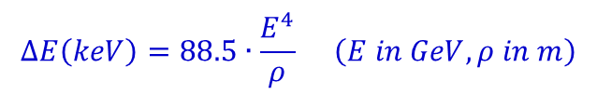
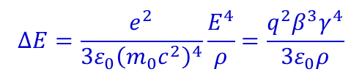

Synchrotron
Synchrotrons are the most widely used accelerators
  Beam of particles is constrained in a circular path by bending dipole magnets
  Accelerating cavities are placed along the ring
  Charged particles which travel in a circular orbit with relativistic speeds emit synchrotron radiation
Amount of energy radiated per turn is:
here q is the electric charge of a particle, $β=v/c$, $γ={\left(1−β^{2}\right)}^{−1/2}$, and ρ is the radius of the orbit.
$$∆E=\frac{e^{2}}{3ε_{0}{\left(m_{0}c^{2}\right)}^{4}}\frac{E^{4}}{ρ}=\frac{q^{2}β^{3}γ^{4}}{3ε_{0}ρ}$$
electron
$${\left(\frac{m_{p}}{m_{e}}\right)}^{4}={\left(\frac{938 MeV}{0.511 MeV}\right)}^{4}=1.1∙{10}^{13}$$
For $β≅1$, the energy $∆E$ lost per turn has a numerical value given by:
$$∆E\left(keV\right)=88.5∙\frac{E^{4}}{ρ} \left(E in GeV, ρ in m\right)$$
Some numbers: For large electron positron collider LEP at 86 GeV, $∆E≅1.37 {GeV}/{electron}$. There are about 6∙10¹² electrons per beam and hence the power required to make up for this loss $≅20 MW$. Power needed for RF is about 96 MW.

Slide 6
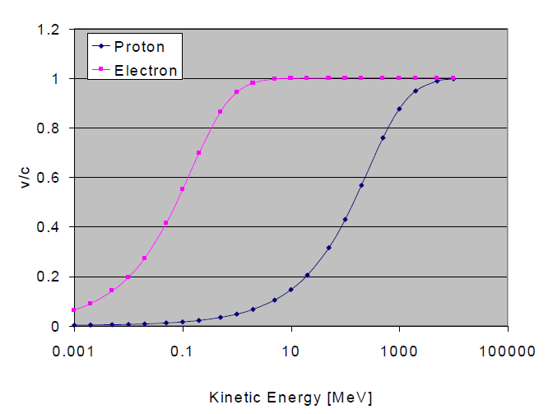
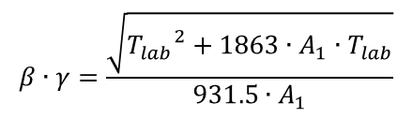


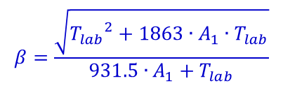
Proton and electron velocity vs. kinetic energy
heavy particle (p) become relativistic at higher energies
$$β=\frac{\sqrt{{T_{lab}}^{2}+1863∙A_{1}∙T_{lab}}}{931.5∙A_{1}+T_{lab}}$$
beam velocity:
Lorentz contraction factor:
$$γ=\frac{931.5∙A_{1}+T_{lab}}{931.5∙A_{1}}$$
$$β∙γ=\frac{\sqrt{{T_{lab}}^{2}+1863∙A_{1}∙T_{lab}}}{931.5∙A_{1}}$$
total energy:
$$E=T_{lab}+m_{0}∙c^{2}$$
The relevant formulae are calculated if A₁, Z₁ and A₂, Z₂ are the mass number (u) and charge number of the projectile and target nucleus, respectively, and T_{lab} is the laboratory energy (MeV).

Slide 7
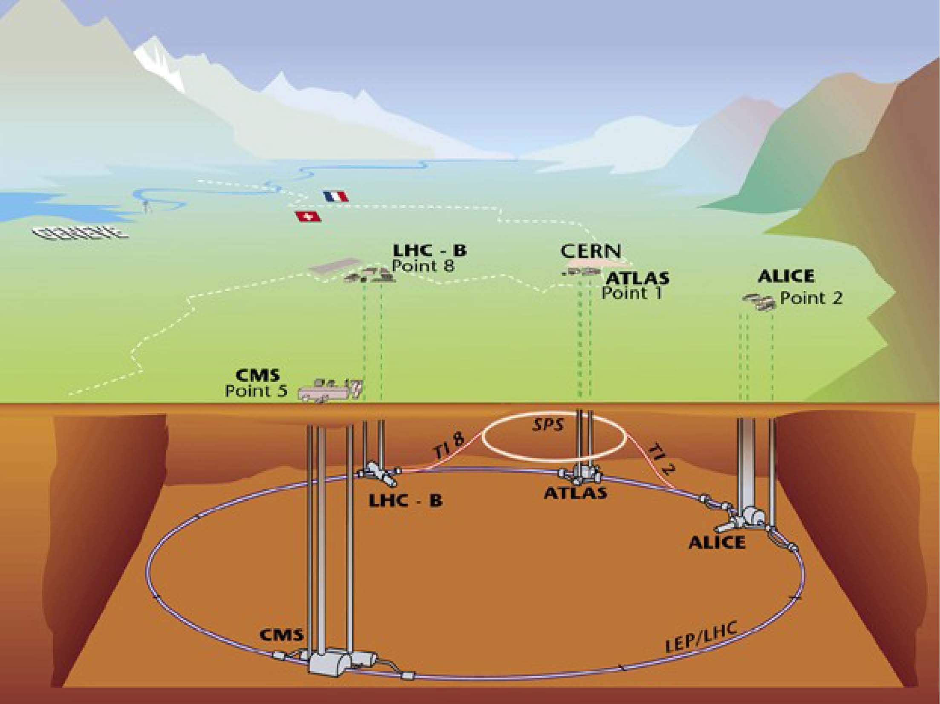
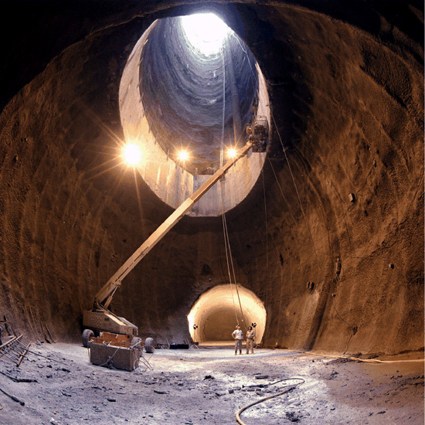
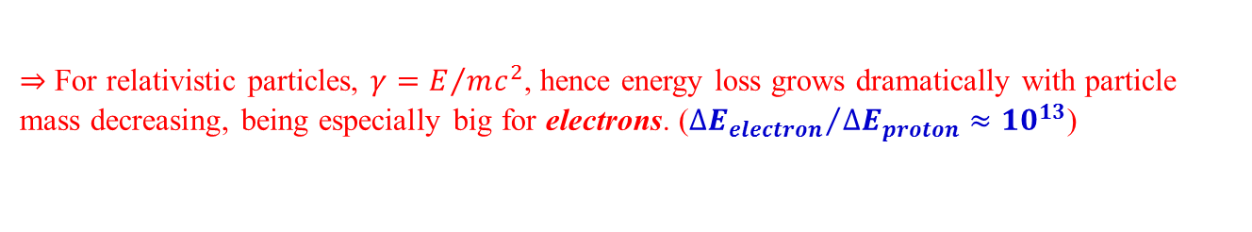
Large Electron Positron Collider (LEP) 1989-2000
$⇒$ For relativistic particles, $γ=E/{mc^{2}}$, hence energy loss grows dramatically with particle mass decreasing, being especially big for electrons. (${∆E_{electron}}/{∆E_{proton}}≈{10}^{13}$)
Limits on the amount of the radio-frequency power means that electron synchrotrons (large electron positron collider LEP, used from 1989 until 2000 at CERN) can not produce beams with energies more than 100 GeV.

Slide 8
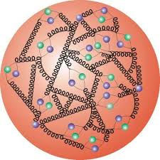
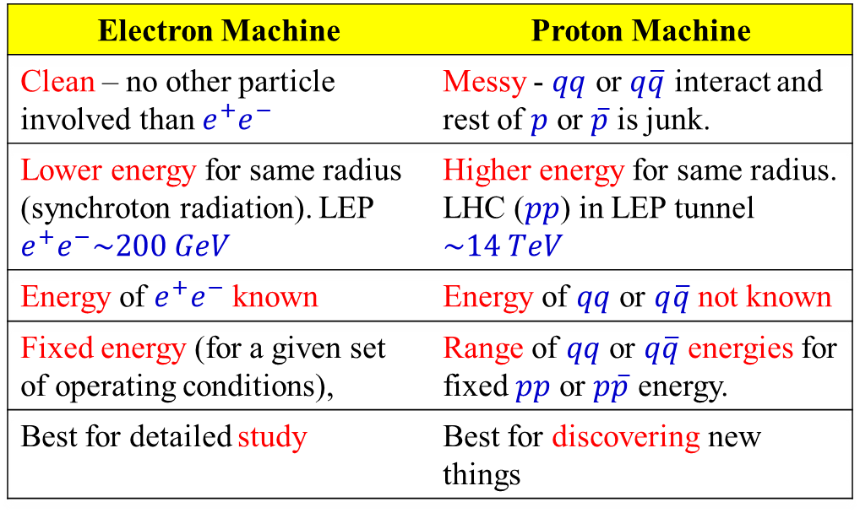
Electron versus proton machines
Electron Machine | Proton Machine
Clean – no other particle involved than $e^{+}e^{−}$ | Messy - $qq$ or $q\overline{q}$ interact and rest of $p$ or $\overline{p}$ is junk.
Lower energy for same radius (synchroton radiation). LEP $e^{+}e^{−}\sim 200 GeV$ | Higher energy for same radius. LHC ($pp$) in LEP tunnel $\sim 14 TeV$
Energy of $e^{+}e^{−}$ known | Energy of $qq$ or $q\overline{q}$ not known
Fixed energy (for a given set of operating conditions), | Range of $qq$ or $q\overline{q}$ energies for fixed $pp$ or $p\overline{p}$ energy.
Best for detailed study | Best for discovering new things
Hadron Collider (note, proton is a complex mixture of quarks and gluons):
Crazy background due to splashed quarks and gluons connected by complex color-charge strings.

Slide 9
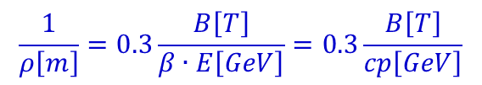
Synchrotron
The bending field changes with particle beam energy to maintain a constant radius:
$$\frac{1}{ρ\left[m\right]}=0.3\frac{B\left[T\right]}{β∙E\left[GeV\right]}=0.3\frac{B\left[T\right]}{cp\left[GeV\right]}$$
Example: for the large hadron collider LHC (ρ = 2805 [m]) and a magnetic field of the superconducting dipoles is B = 8.33 [T] (B_{iron} = 1.5 [T]) one obtains an energy of E_{max} = 7 [TeV]
B ramps in proportion to the momentum. The revolution frequency also changes with momentum
$⇒$ Maximal momentum is therefore limited by both the maximal available magnetic field B and the size of the ring ρ.
To keep particles well contained inside the beam pipe and to achieve the stable orbit, particles are accelerated in bunches, synchronized with the radio-frequency field.
Analogously to Linacs, all particles in a bunch has to move with the circulation frequency in phase with the radio-frequency field.
Requirement of precise synchronization, however, is not very tight: particles behind the radio-frequency phase will receive lower momentum increase, and other way around.
Notes:
$$\frac{m_{0}∙γ∙v^{2}}{ρ}=q∙v∙B→ρ=\frac{m_{0}∙γ∙v}{q∙B}=\frac{p}{q∙B} c∙p=β∙E→\frac{1}{ρ}=\frac{c∙q∙B}{β∙E}$$

Slide 10
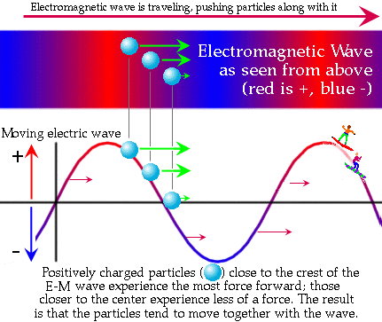
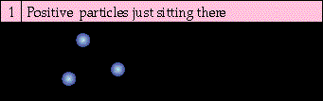
Synchrotron
Requirement of precise synchronization, however, is not very tight: particles behind the radio-frequency phase will receive lower momentum increase, and other way around.
$⇒$ Therefore all particles in a bunch stay basically on the same orbit, slightly oscillating
To keep particle beams focused, quadrupole and sextuple magnets are also placed along the ring and act like optical lenses

Slide 11
Synchrotron
Depending on whether beam is deposited onto a fixed target or is collided with another beam, both linear and cyclic accelerators are subdivided into two types:
“fixed-target” machines
“colliders” (“storage rings” in case of cyclic machines)
Much higher energies for protons comparing to electrons are achieved due to smaller losses caused by synchrotron radiation
To get the 14 TeV center-of-mass (CM) design energy of the LHC with a single beam on a fixed target would require that beam to have an energy of 100,000 TeV!
Would require a ring 10 times the diameter of the Earth!!

Slide 12



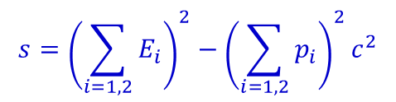
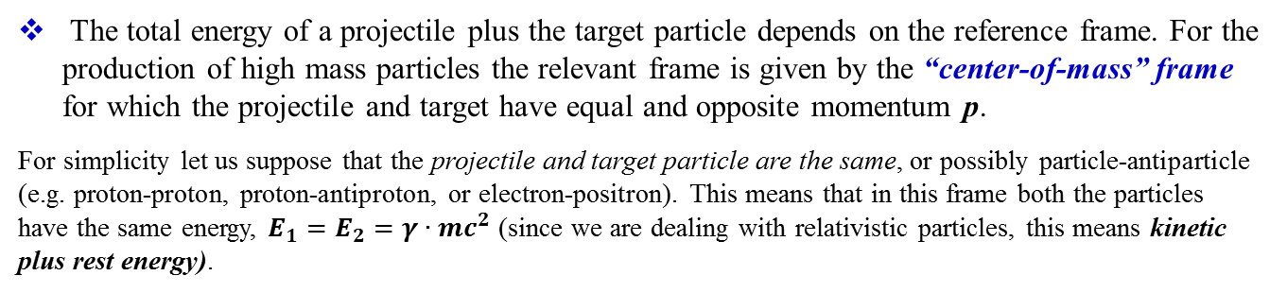
Colliding-beam experiment
In a colliding-beam experiment two beams of high-energy particles are made to cross each other.
The total energy of a projectile plus the target particle depends on the reference frame. For the production of high mass particles the relevant frame is given by the “center-of-mass” frame for which the projectile and target have equal and opposite momentum p.
For simplicity let us suppose that the projectile and target particle are the same, or possibly particle-antiparticle (e.g. proton-proton, proton-antiproton, or electron-positron). This means that in this frame both the particles have the same energy, $E_{1}=E_{2}=γ∙mc^{2}$ (since we are dealing with relativistic particles, this means kinetic plus rest energy).
$$s={\left(\sum_{i=1,2}{E_{i}}\right)}^{2}−{\left(\sum_{i=1,2}{p_{i}}\right)}^{2}c^{2}$$
In the center-of-mass frame, where the momenta are equal and opposite p₁ = -p₂, the second term vanishes and we have
$$s=4∙E_{1}^{2}=4γ^{2}m^{2}c^{4}$$
i.e. s is the square of the total incoming energy in the center-of-mass frame – this is a quantity that is often used in particle physics.
$$\sqrt{s}=2∙E_{1}=2γmc^{2}$$
1 TeV + 1 TeV = 2 TeV available cm energy

Slide 13

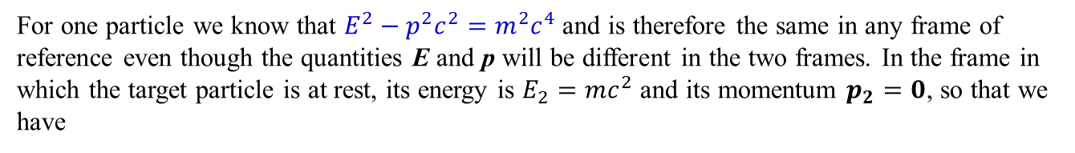
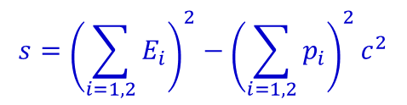
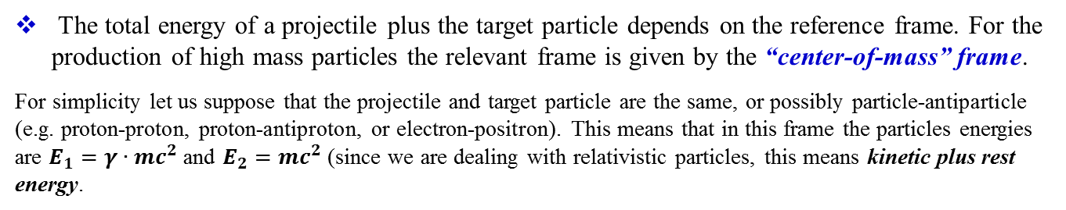
Fixed-target experiment
In a fixed-target experiment, a charged particle such as an electron or a proton is accelerated by an electric field and collides with a target, which can be a solid, liquid, or gas.
The total energy of a projectile plus the target particle depends on the reference frame. For the production of high mass particles the relevant frame is given by the “center-of-mass” frame.
For simplicity let us suppose that the projectile and target particle are the same, or possibly particle-antiparticle (e.g. proton-proton, proton-antiproton, or electron-positron). This means that in this frame the particles energies are $E_{1}=γ∙mc^{2}$ and $E_{2}=mc^{2}$ (since we are dealing with relativistic particles, this means kinetic plus rest energy.
$$s={\left(\sum_{i=1,2}{E_{i}}\right)}^{2}−{\left(\sum_{i=1,2}{p_{i}}\right)}^{2}c^{2}$$
For one particle we know that $E^{2}−p^{2}c^{2}=m^{2}c^{4}$ and is therefore the same in any frame of reference even though the quantities E and p will be different in the two frames. In the frame in which the target particle is at rest, its energy is $E_{2}=mc^{2}$ and its momentum $p_{2}=0$, so that we have
$$s={\left(E_{1}+mc^{2}\right)}^{2}−p_{1}^{2}c^{2}=E_{1}^{2}+m^{2}c^{4}+2mc^{2}E_{1}−p_{1}^{2}c^{2}=2m^{2}c^{4}+2mc^{2}E_{1}$$
$$\sqrt{s}=\sqrt{2m^{2}c^{4}+2mc^{2}E_{1}}=\sqrt{2\left(γ+1\right)m^{2}c^{4}}$$
1 TeV p + fixed target p = 43 GeV available cm energy

Slide 14
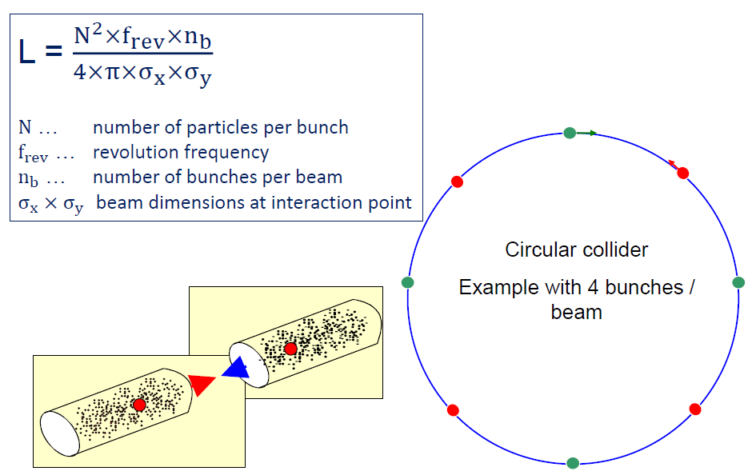

Luminosity parameters
10³⁴ cm⁻²s⁻¹
~ 10¹¹
11 kHz
2808
$$σ=16 μm$$
10 cm
16 μm

Slide 15
Luminosity for fixed-target experiment
The relationship of the beam to the rate of observed physics processes is given by the “Luminosity”
rate
cross-section (“physics”)
“Luminosity”
Standard unit for Luminosity is cm⁻²s⁻¹
Standard unit of cross section is “barn”=10⁻²⁴ cm²
Integrated luminosity is usually in barn⁻¹,where
nb⁻¹ = 10⁹ b⁻¹, fb⁻¹=10¹⁵ b⁻¹, etc
For (thin) fixed target:
target thickness
Example: MiniBooNe (neutrino oscillations) primary target:
incident rate
target number density

Slide 16
When should one operate in collider or fixed target mode?
It is really hard to set rules to this extent. Nevertheless, some examples can help.
1. Suppose you want to explore a new scale of energy to search for new physics
– In this case, you would prefer the highest energy in the CoM and thus you would opt for a collider
– The hadron colliders, in particular, will be your choice since they are still giving you the highest attainable
energy despite the non-elementary nature of their collision
– You would then design a multi purpose experiment capable to detect any signal of new physics in a wide
range of possibilities
2. Suppose, instead, you want to look for new physics in the high order corrections to an already known process,
e.g. CP violation in the B-decay
– In this case you would rather choose for the machine which can provide you with the optimal initial state to
investigate your process in the cleanest environment, i.e. best signal to background ratio
– Therefore you would opt for an asymmetric e+ e-collider to be run at the b b-bar resonance, Y(4s), a la
BaBar or Belle.
– In addition, you would ask for a new luminosity frontier at 10³⁶
3. Alternatively, and probably with a much richer physics program, you would choose for the extreme forward
region of a hadron collider where the B-production is peaked and you can profit of the huge boost given to the
b-hadrons
4. Even more, if you could rely on a very rich sponsor, you could ask for an extracted beam from LHC and form a
high energy photon beam to diffractively produce b b-bar hadrons on a light target
• The first scenario we contemplated here is that of ATLAS and CMS experiments, the second one that INFN is
now considering for a Super B-factory in Frascati, the third one that of the LHCB experiment and the fourth one
just a dream
– To be fair we should have listed B TeV as well, a program evidently to smart to be approved by our community

Slide 17
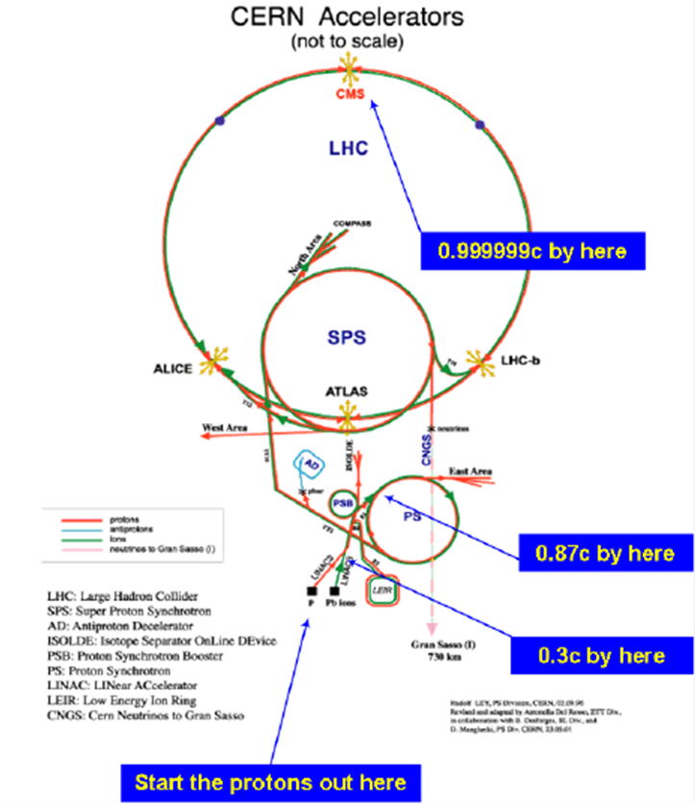
Accelerator Complex CERN
Most modern high energy accelerators are a series of linear accelerators and rings.
Each piece is designed to accept and accelerate particles for up to a particular energy.
Transferring a beam of particles between one piece and the next is one of the biggest challenges.

Slide 18
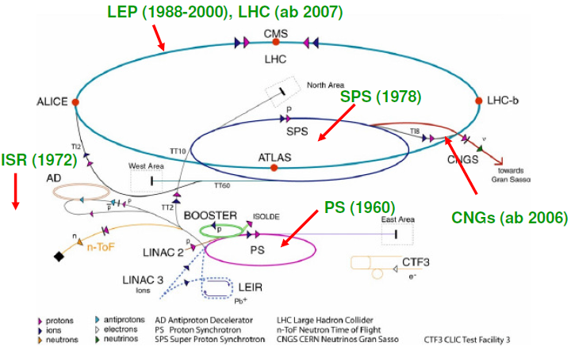
Accelerator Chains

Slide 19
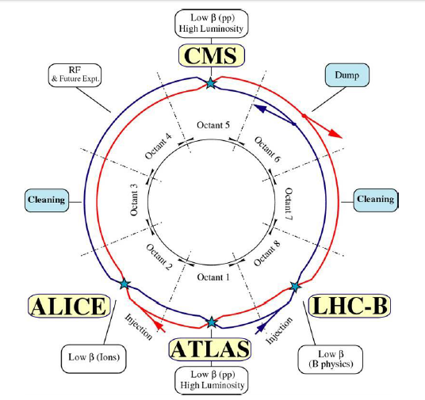
The LHC Layout

Slide 20
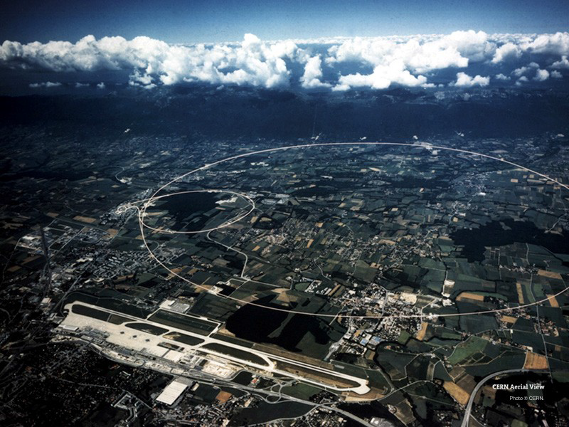
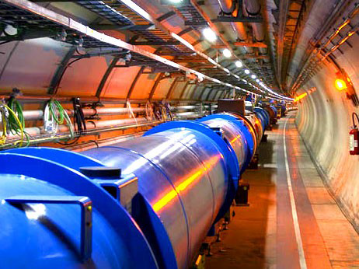
Large Hadron Collider (LHC)
LHC (p → ← p) 7(14) TeV
26.7 km circumference
40000 tons of cold mass spread over 27 km
10000 tons of Liquid Nitrogen (at T = 80 K)
60 tons of Liquid Helium (cools ring to final 1.9 K)

Slide 21
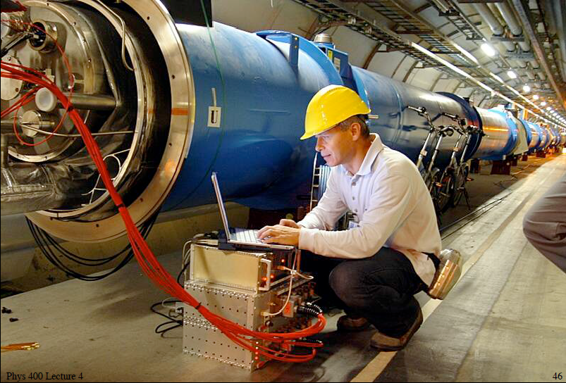
Inside Large Hadron Collider (LHC) tunnel
1232 superconducting magnets (14.3 m long, B = 0.5-8.33 T, 11700 Ampere)

Slide 22
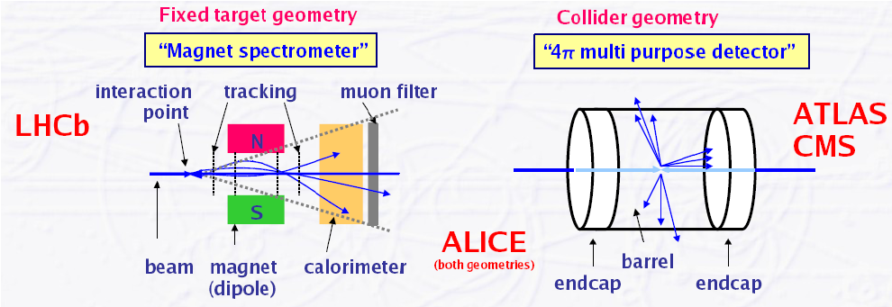
High Energy Physics (HEP) - Detectors
A perfect detector should reconstruct any interaction of any type with 100% efficiency and unlimited resolution (get “4-momenta” of basic physics interaction)
Efficiency: not all particles are detected, some leave the detector without any trace (neutrinos), some escape through not sensitive detector areas (holes, cracks for e.g. water cooling and gas pipes, electronics, mechanics)

Slide 23
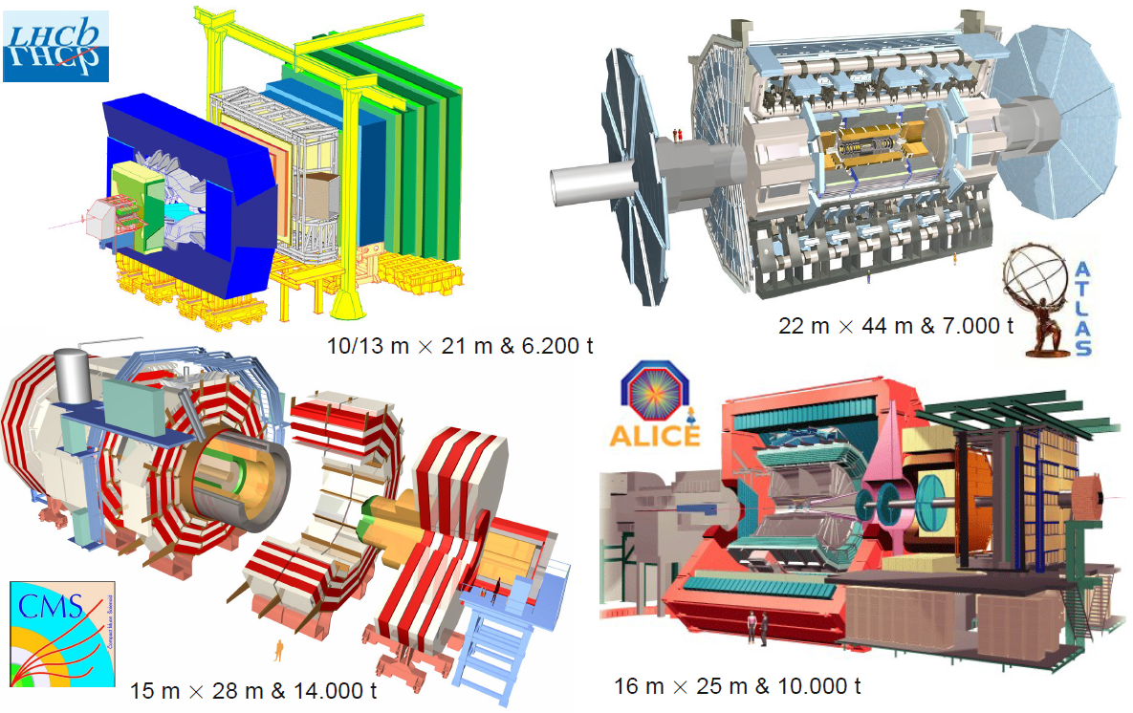
Experiments at LHC

Slide 24
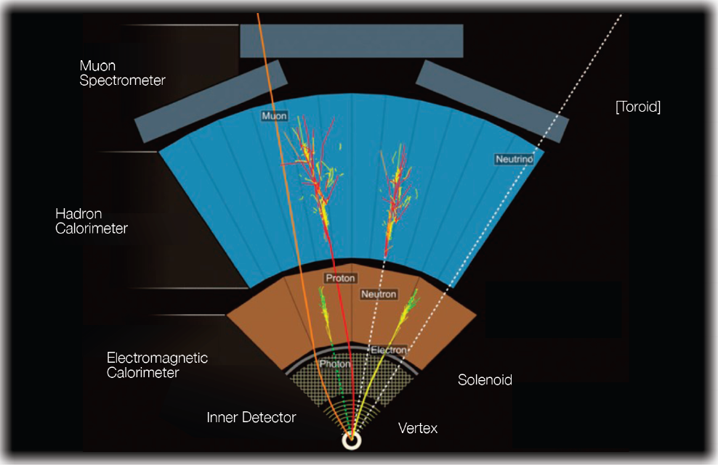
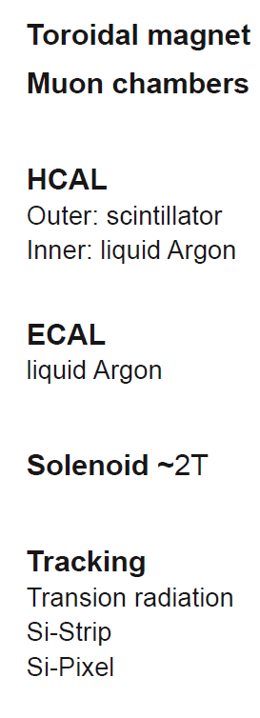
Particle Identification at ATLAS: Detector System @ Colliders
Notes:
A Toroidal LHC ApparatuS

Slide 25
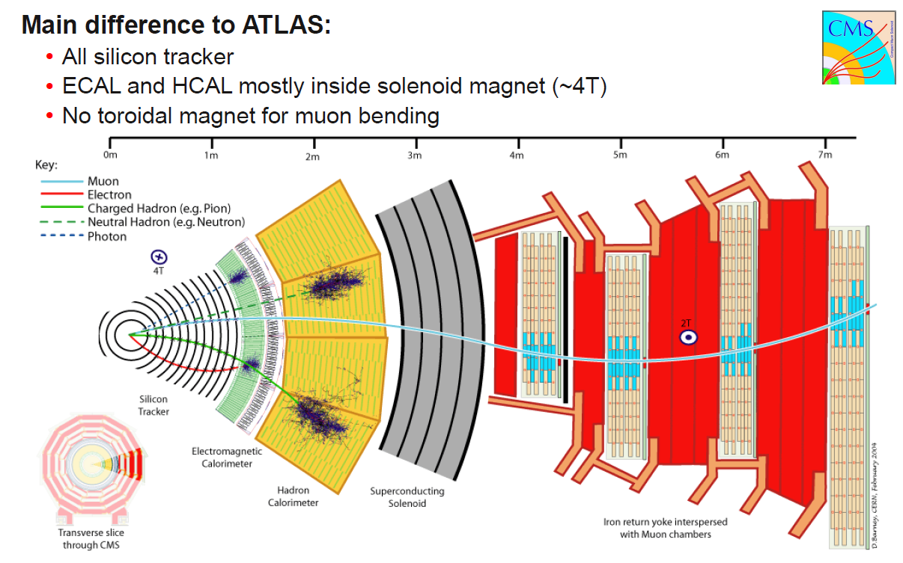
Particle Identification at CMS: Detector System @ Colliders
Notes:
Compact Muon Solenoid

Slide 26
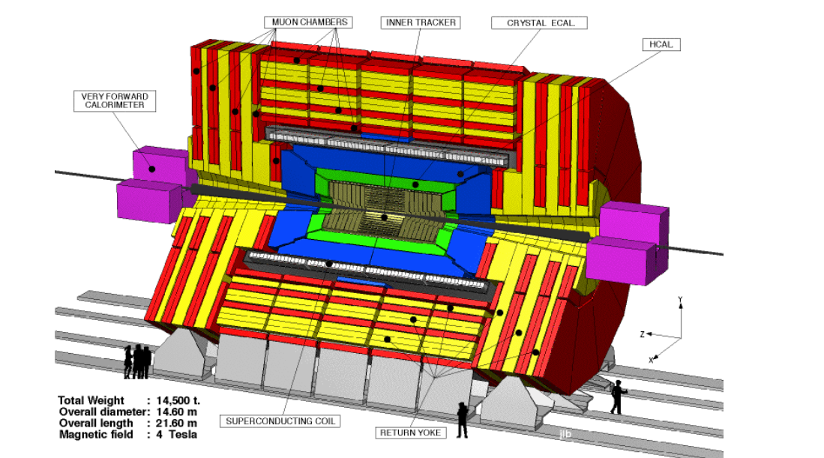
Multi-Purpose Detectors (LHC 2009 - …)

Slide 27
