Slide 1
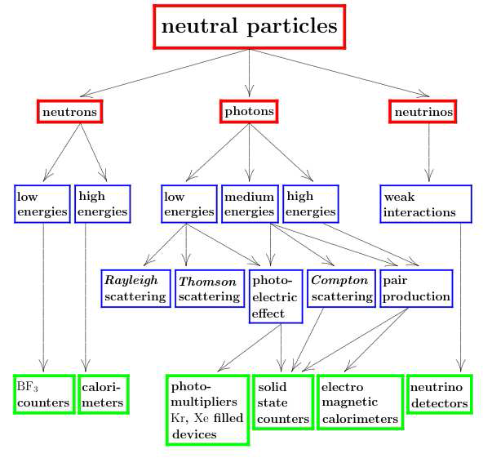
Neutral Particles

Slide 2
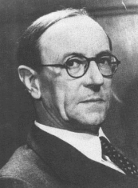
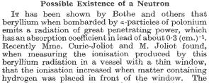
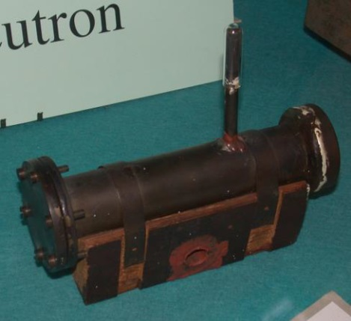
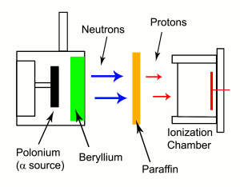
Neutron detectors
Neutron detectors do not detect neutrons but products of neutron interaction!
James Chadwick, Nature 132 (1932) 3252

Slide 3

Neutrons in Science …
Laboratory for fundamental physics: ElectricDipoleMoment
$$ℏω_{L}\sim μ∙B+d∙E$$
Ideal tool for probing matter:
  No Coulomb force: deep penetration
  Strong Interaction: isotope-specific detection
  Magnetic moment: magnetic structures
  Low energies: crystal structures
ultra cold neutron detection:
³He(n,p)³H

Slide 4

… Technology
Neutrons can be used to produce energy
Fusion
Fission
Biggest disadvantage: the (free) neutron is unstable:
Intense neutron sources require considerable efforts
  Reactors
  High-power low-energy accelerators
  Spallation sources
$$τ≈880 s$$

Slide 5
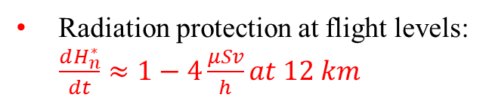
… and the world around
Cosmic Neutrons:
  Production in the atmosphere by galactic radiation
  Production on the sun
Neutron monitors:
Diagnostic for solar processes
Radiation protection at flight levels:
$\frac{dH_{n}^{∗}}{dt}≈1−4\frac{μSv}{h}at 12 km$
anticoin. shield
1 m² scintillator
prop. counters

Slide 6
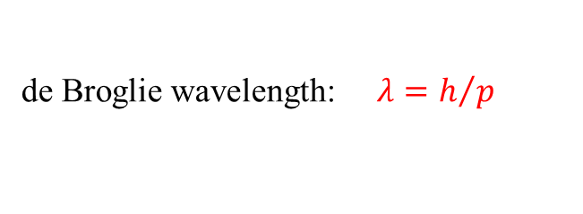
Classification of Neutrons
de Broglie wavelength: $λ=h/p$

Slide 7
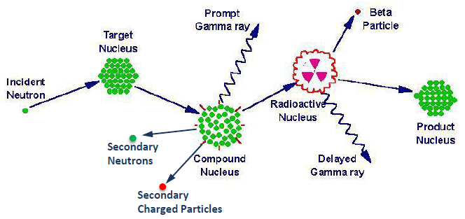
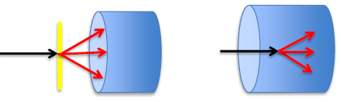
General detection principle
Neutron detectors do not detect neutrons but products of neutron interaction!
Detection of a neutron is a sequential process
1. Interaction of the incident neutron: neutron transport
2. Transport of secondary particles to or within sensing elements
hadron, ion, photon transport
3. Primary ionization by secondary particles
4. Conversion to optical photons, gas amplification:
Transport of electrons and optical photons
5. Conversion to electrical signal
external converter (radiator) converter = detector

Slide 8
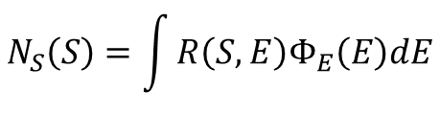
The neutron detection process
Detection of a neutron is a sequential process:
  Interaction of the incident neutron: Neutron transport
  Transport of secondary particles to or within sensing elements: Hadron, ion, photon transport
  Primary ionization by secondary particles
  Conversion of optical photons, gas amplification:
  Transport of electrons and optical photons
  5. conversion to electronical signal S
These steps are described by transfer functions T_{i}(s_{i-1},s_{i})
Convolution of the T_{i}’s: Response function R(S,E)
$$N_{S}\left(S\right)=\int{R\left(S,E\right)Φ_{E}\left(E\right)dE}$$
… How to solve this integral equation?

Slide 9
General detection principles
Basic requirements for neutron detection:
Slow neutrons: high Q-values, no resonances!
Fast and high-energy neutrons: large smooth cross sections!
Basic types of neutron detectors:
Neutron counters
  Signal does not depend on neutron energy
  Typical for detection of thermal neutrons
Neutron spectrometers
  Signal somehow related to neutron energy
  Inversion procedures are used to infer the neutron energy distribution

Slide 10
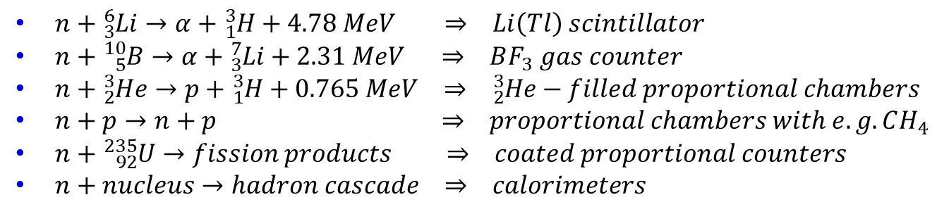

Interaction of Neutrons
Indirect detection technique: induce neutrons to interact and produce charged particles.
$n+{}_{3}^{6}{Li}→α+{}_{1}^{3}{H+4.78 MeV} ⇒ Li\left(Tl\right) scintillator$
$n+{}_{5}^{10}B→α+{}_{3}^{7}{Li}+2.31 MeV ⇒ BF_{3} gas counter$
$n+{}_{2}^{3}{He}→p+{}_{1}^{3}{H+0.765 MeV} ⇒ {}_{2}^{3}{He}−filled proportional chambers$
$n+p→n+p ⇒ proportional chambers with e.g. CH_{4}$
$n+{}_{92}^{235}U→fission products ⇒ coated proportional counters$
$n+nucleus→hadron cascade ⇒ calorimeters$
Neutron detection and identification is important in the field of radiation protection because the relative biological effectiveness (quality factor) is high and depends on the neutron energy.
$$H \left[Sievert\right]=q∙D\left[Gray\right]$$

Slide 11
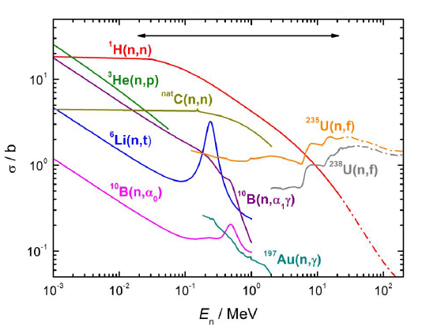
Interaction of neutrons with matter
Neutron detectors can only be detected after conversion to charged particles or photons:
Elastic scattering: ^{A}X(n,n)^{A}X → recoil nucleus ^{A}X^{Z+}
Inelastic scattering: ^{A}X(n,n´γ)^{A}X → recoil nucleus ^{A}X^{Z+} , e⁻
Radiative capture: ^{A}X(n,γ)^{A+1}Y → e⁻
Neutron emission: ^{A}X(n,2n)^{A-1}Y → radioactive daughter
Charged-particle emission: ^{A}X(n,lcp)^{A´}Y → (lcp = p, d, t, α), recoil nucleus ^{A´}Y^{Z+}
Fission: n + ^{A}X → ^{A1}X₁ + ^{A2}X₂ + νn → fission fragments
cross section relevant
for neutron detection

Slide 12
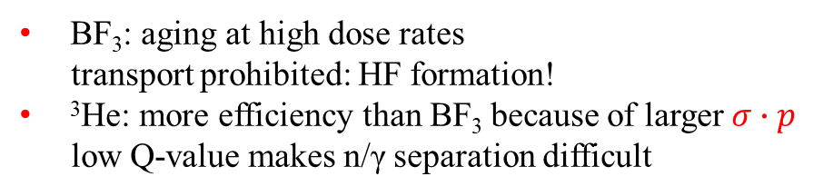
BF₃ and ³He proportional counters
Cylindrical and spherical shapes
Large variety of sizes: I < 1 m
and pressures: p < 1 bar (BF₃), 10 bar (³He)
Counters must be calibrated:
  ³He and BF₃ pressure ?
  ¹⁰B enrichment ?
  Electrical field ?
  Wall effects ?
n/γ discrimination using a pulse-height threshold
BF₃: aging at high dose rates
transport prohibited: HF formation!
³He: more efficiency than BF₃ because of larger $σ∙p$
low Q-value makes n/γ separation difficult

Slide 13
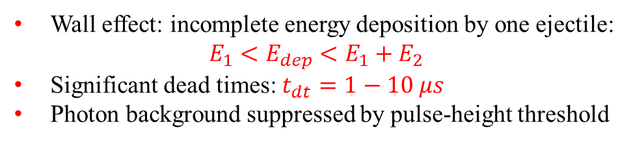
BF₃ and ³He pulse-height spectra
Wall effect: incomplete energy deposition by one ejectile:
$$E_{1}<E_{dep}<E_{1}+E_{2}$$
Significant dead times: $t_{dt}=1−10 μs$
Photon background suppressed by pulse-height threshold

Slide 14
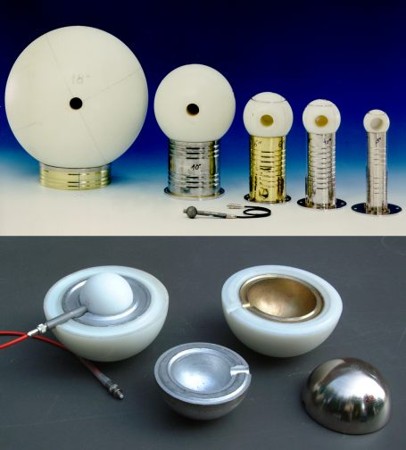

Neutron Detection
$n+{}_{2}^{3}{He}→{\left({}_{2}^{4}{He}\right)}^{∗}→p+{}_{1}^{3}H$, Q=0.765 MeV
Moderate neutrons in spheres of different sizes and then detect the charged particles in a proportional counter in the center.
Bonner sphere

Slide 15
Physics of organic scintillators
Unitary scintillators:
Benzene ring: delocalized π orbitals
Singlett (¹X, ¹X*, ¹X**) and triplet (³X*, ³X**) states
Principal physical processes:
Excitation by electron impact, ion-ion
recombination, …
Non-rad. efficient internal degradation
^{1,3}X**→^{1,3}X*+ phonon
drain via competing channels:
quenching states
Rad. decay ¹X* → ¹X:
prompt fluorescence: τ = 1-80 ns, λ_{fluor}>λ_{abs}
Rad. transition ³X** → ¹X* forbidden
Coll. deexc. ³X* + ³X* → ¹X* + ¹X* + phonon:
delayed non-exp. fluorescence: τ > 300 ns

Slide 16
Ionization quenching and pulse-shape discrimination
Increased ionization density:
  More ion-ion recombination
  Ratio of ¹X** and ³X** excitations increases
  Temporal concentration of transient
  quenching states (τ ≤ 100 ps)
Delayed fluorescence less dependent
on dE/dx than prompt fluorescence
Light yield dL(E)/dx is a non-linear function
Scint. decay depends on dE/dx
Pulse-shape discrimination
of particle species (Z,A)

Slide 17
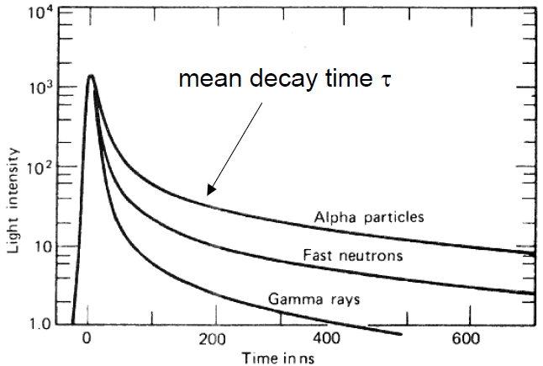
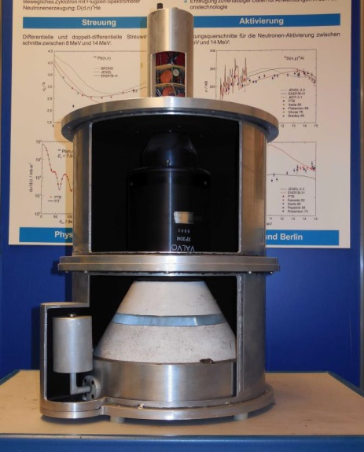
Pulse shape discrimination
Pulse shape discrimination (PSD) in organic scintillators are used in particularly liquid scintillators
(NE213 / BC501A)
PSD is due to long-lived decay of scintillator light caused by high dE/dx particle – neutron scatter interaction events causing proton recoil

Slide 18
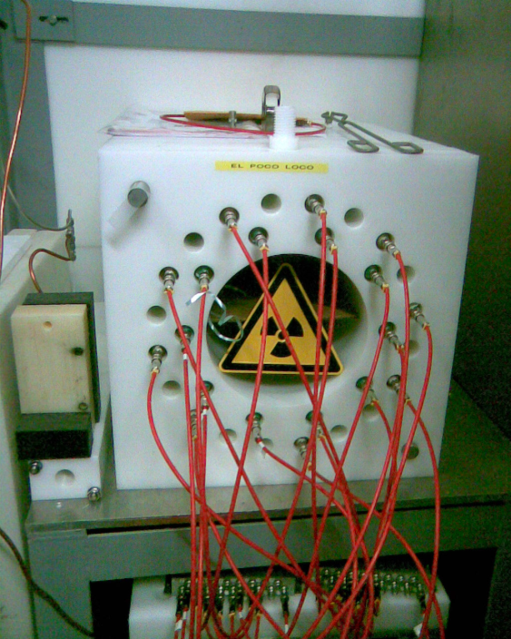
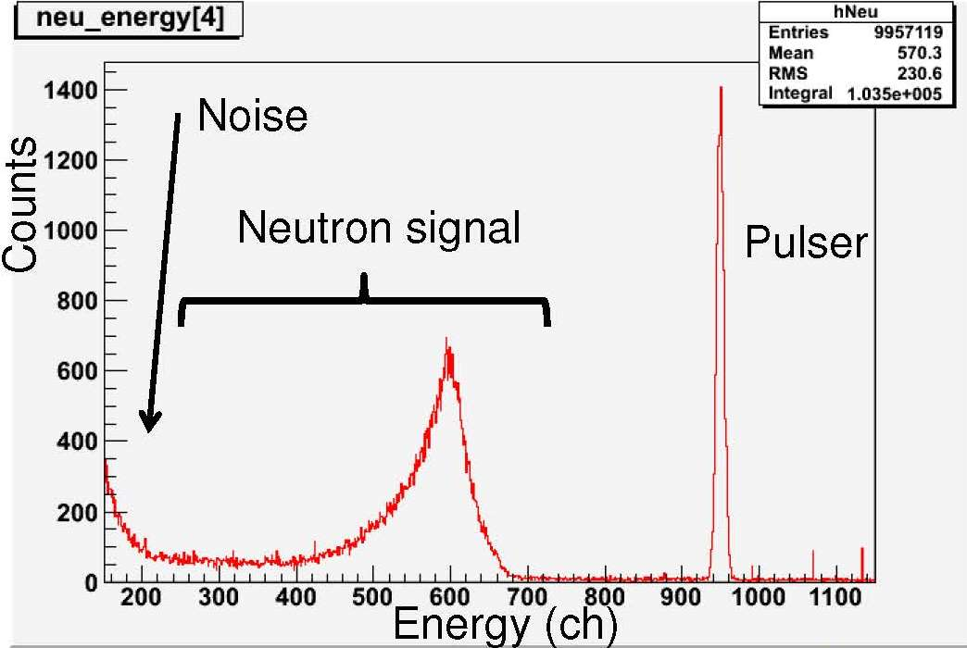
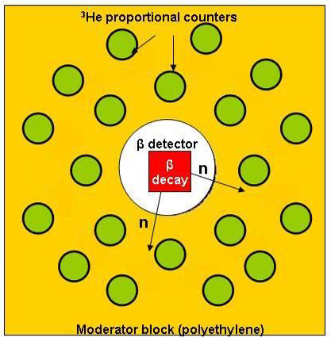
BEta deLayEd Neutron detector
$$n+{}_{2}^{3}{He}→p+{}_{1}^{3}H+765 keV σ_{th}=5400 b$$
BELEN-30 (90x90x80 cm³ PE)
20 ³He counters (20 atm) outer ring
10 ³He counters (10 atm) inner ring
efficiency (1 keV – 1MeV) ~ 40%

Slide 19
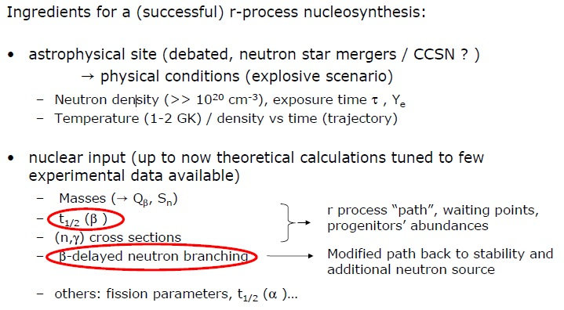
Understanding the r-process

Slide 20
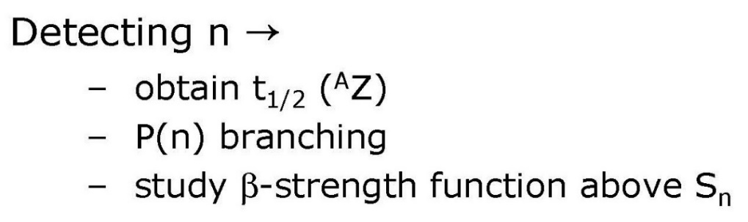
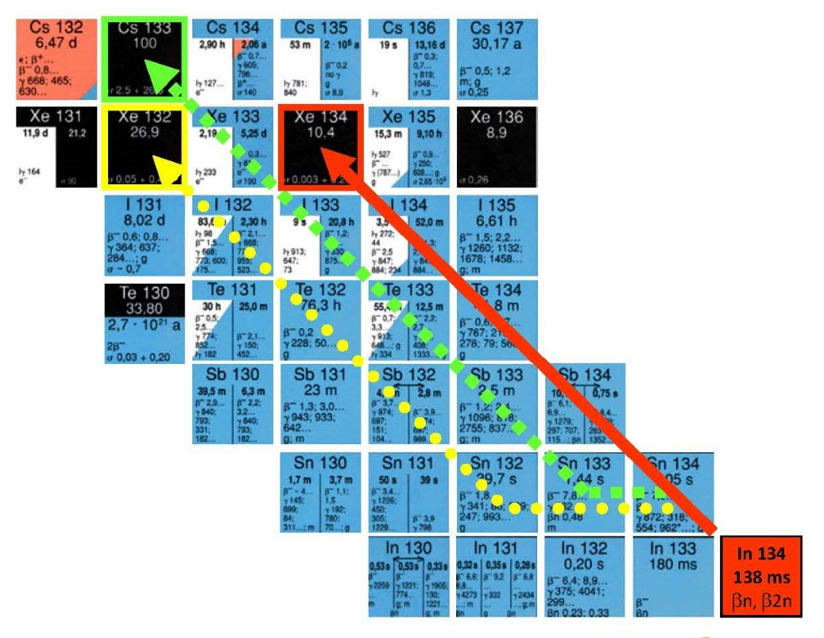
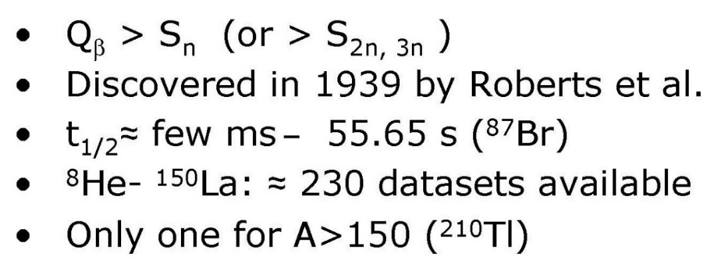
β-delayed neutron emission

Slide 21
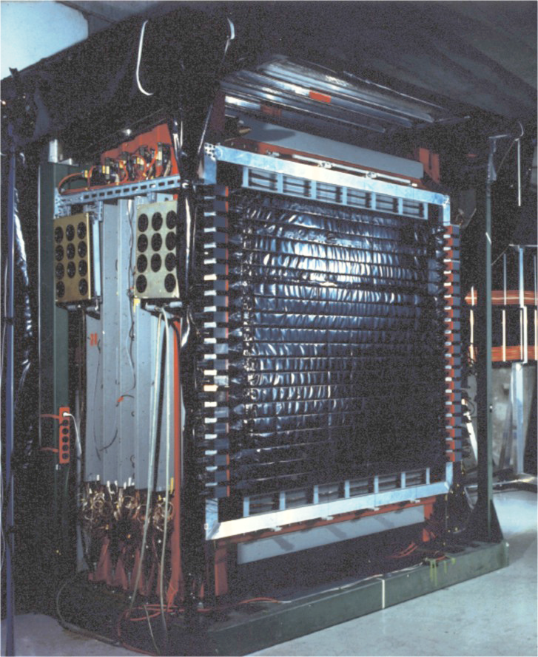
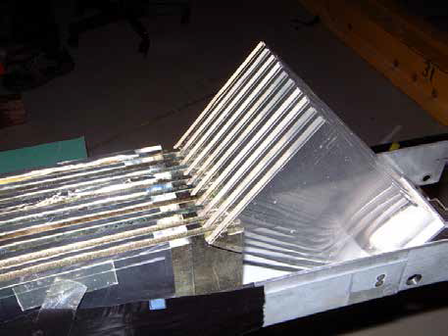
Large Area Neutron Detector
Large Area Neutron Detector (2m x 2m x 1m)
neutron energy T_{n} ≤ 1 GeV
ΔT_{n}/T_{n} = 5.3%
efficiency ~1
passive Fe-converter

Slide 22
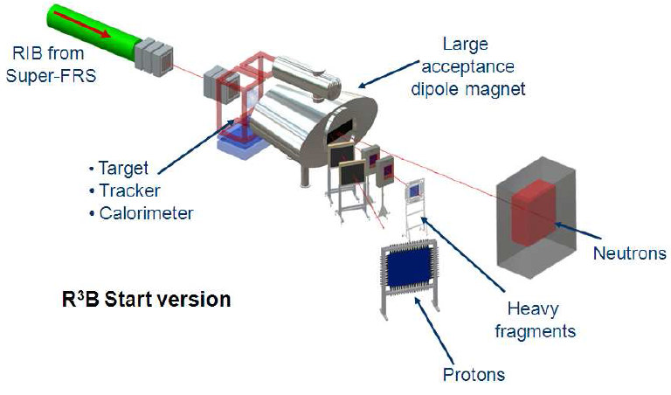
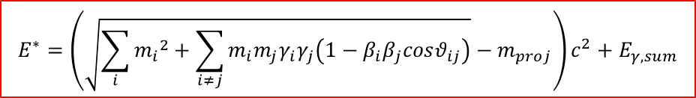
Reaction with Relativistic Radioactive Beams – R³B
Excitation energy E* from kinematically complete measurement of all outgoing particles
$$E^{∗}=\left(\sqrt{\sum_{i}{{m_{i}}^{2}}+\sum_{i≠j}{m_{i}m_{j}γ_{i}γ_{j}\left(1−β_{i}β_{j}cosθ_{ij}\right)}}−m_{proj}\right)c^{2}+E_{γ,sum}$$

Slide 23
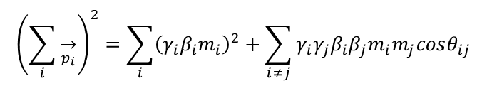
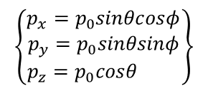
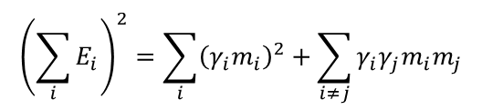

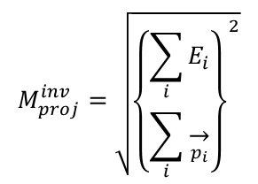


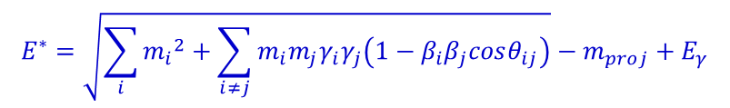

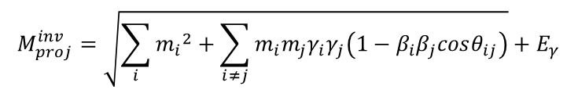
Invariant mass analysis
$$M_{proj}^{inv}=m_{proj}+E^{∗}$$
$$M_{proj}^{inv}=\sqrt{{\left\{\begin{matrix}\sum_{i}{E_{i}} \\ \sum_{i}{\overset{→}{p_{i}}}\end{matrix}\right\}}^{2}}$$
$${\left(\sum_{i}{E_{i}}\right)}^{2}=\sum_{i}{{\left(γ_{i}m_{i}\right)}^{2}}+\sum_{i≠j}{γ_{i}γ_{j}m_{i}m_{j}}$$
$${\left(\sum_{i}{\overset{→}{p_{i}}}\right)}^{2}=\sum_{i}{{\left(γ_{i}β_{i}m_{i}\right)}^{2}}+\sum_{i≠j}{γ_{i}γ_{j}β_{i}β_{j}m_{i}m_{j}cosθ_{ij}}$$
$$M_{proj}^{inv}=\sqrt{\sum_{i}{{m_{i}}^{2}}+\sum_{i≠j}{m_{i}m_{j}γ_{i}γ_{j}\left(1−β_{i}β_{j}cosθ_{ij}\right)}}+E_{γ}$$
Momentum reconstruction: (ħ=c=1)
four-momenta:
$$\hat{P}=\left(E,\vec{p}\right)$$
$$E^{∗}=\sqrt{\sum_{i}{{m_{i}}^{2}}+\sum_{i≠j}{m_{i}m_{j}γ_{i}γ_{j}\left(1−β_{i}β_{j}cosθ_{ij}\right)}}−m_{proj}+E_{γ}$$
$$\left\{\begin{matrix}p_{x}=p_{0}sinθcosφ \\ p_{y}=p_{0}sinθsinφ \\ p_{z}=p_{0}cosθ \end{matrix}\right\}$$
$$p_{0}=m_{0}βγ$$
$$γ^{2}\left(1−β^{2}\right)=1$$

Slide 24
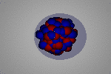
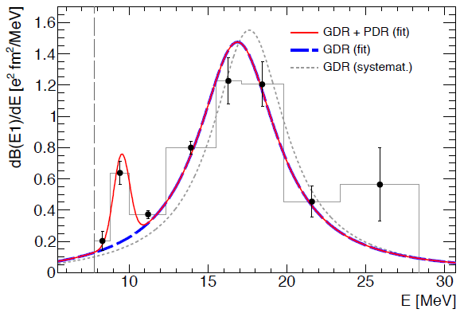
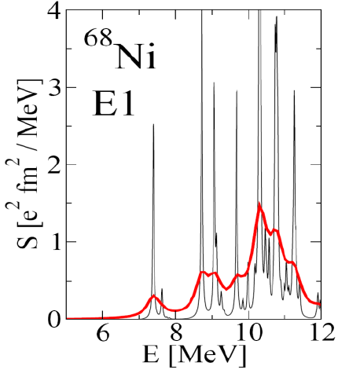
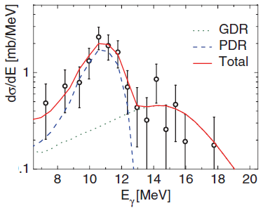
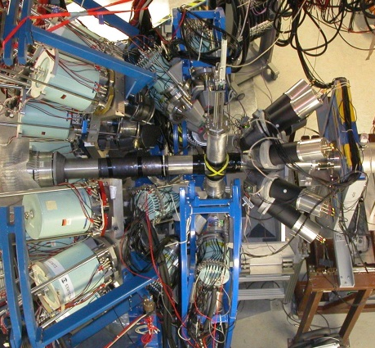
Dipole strength distribution of ⁶⁸Ni
mean field calculation
Pygmy resonance
neutron decay data
direct γ-decay
branching ratio:
Γ₀/Γ = 7(2)%
E.Litvinova et al.; PRC 79, (2009) 054312
γ-ray decay data
O. Wieland et al.; Phys. Rev. Lett 102, 092502 (2009)
D. Rossi et al.; Phys. Rev. Lett 111, 242503 (2013)

Slide 25
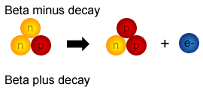
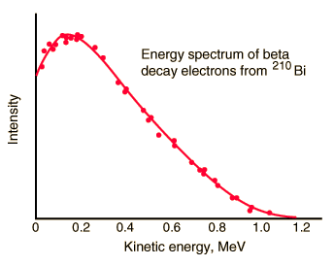
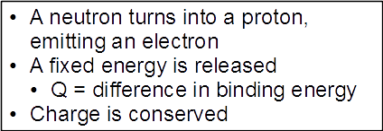
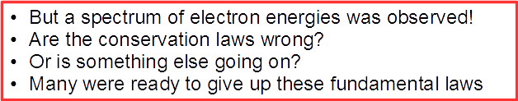
Neutrinos

Slide 26
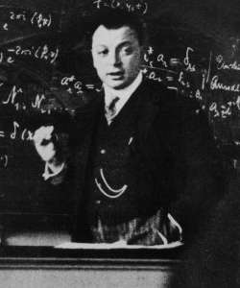
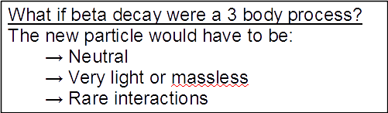
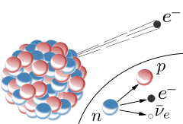
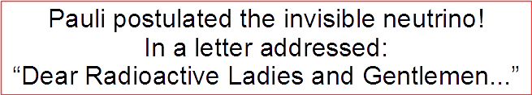
Neutrinos
Wolfgang Pauli

Slide 27
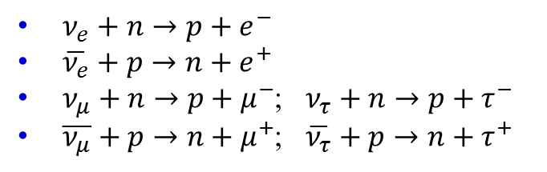
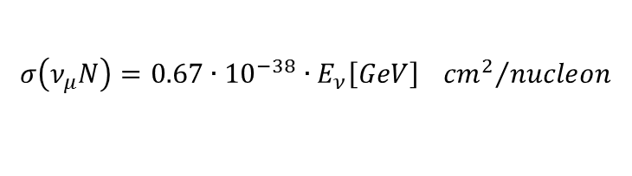
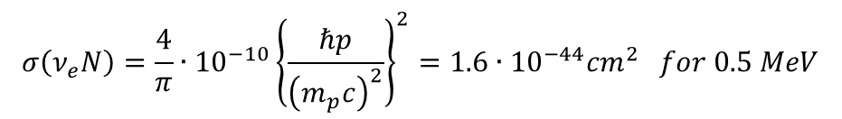
Interaction of Neutrinos
$ν_{e}+n→p+e^{−}$
$\overline{ν_{e}}+p→n+e^{+}$
$ν_{μ}+n→p+μ^{−}$; $ν_{τ}+n→p+τ^{−}$
$\overline{ν_{μ}}+p→n+μ^{+}$; $\overline{ν_{τ}}+p→n+τ^{+}$
(discovery of the neutrino)
Small cross section for MeV neutrinos:
$$σ\left(ν_{e}N\right)=\frac{4}{π}∙{10}^{−10}{\left\{\frac{ℏp}{{\left(m_{p}c\right)}^{2}}\right\}}^{2}=1.6∙{10}^{−44}{cm}^{2} for 0.5 MeV$$
Rate of solar neutrinos interacting in the Earth:
$$N∙σ∙d∙ρ∙flux=6.022∙{10}^{23}∙1.6∙{10}^{−44}{cm}^{2}∙1.2∙{10}^{9}cm∙5.5\frac{g}{{cm}^{3}}∙6.7∙{10}^{10}{cm}^{−2}s^{−1}=4{cm}^{−2}s^{−1}$$
For high energies (GeV-range):
$$σ\left(ν_{μ}N\right)=0.67∙{10}^{−38}∙E_{ν}\left[GeV\right] {{cm}^{2}}/{nucleon}$$

Slide 28



Detecting the Neutrinos
Inverse beta decay:
$$\overline{ν_{e}}+p→e^{+}+n$$

Slide 29





Discovery, Reines & Cowan 1956

Slide 30




Solar Neutrinos

Slide 31




First measurement of the solar neutrinos
Inverse beta-decay
(„neutrino-capture”)
40 days neutrino irradiation …
Expected: 60 atoms ³⁷Ar
600 tons
Carbon tetrachloride
Homestake Sun neutrino-
Observatory (1967−2002)

Slide 32




Super Kamiokande – Detection Concept

Slide 33




Super Kamiokande – the Detector

Slide 34

Super Kamiokande – the Detector

