Slide 1

Outline: Hexadecapole collectivity
Lecturer: Hans-Jürgen Wollersheim
e-mail: h.j.wollersheim@gsi.de
web-page: https://web-docs.gsi.de/~wolle/ and click on
Coulomb excitation
α-particle spectroscopy
E2 and E4 excitation of the 4⁺ state
hydrodynamical model

Slide 2
Shape parameterization
Axially symmetric hexadecapole
Axially symmetric hexadecapole
λ = 4
α₄₀ > 0, α_{4±1,2,3,4} = 0
α₂₀≠0, α_{2±1,2}= 0
λ = 4
α₄₀ < 0, α_{4±1,2,3,4} = 0
α₂₀≠0, α_{2±1,2} = 0

Slide 3
Some common nuclear shapes with axial symmetry
ND prolate
prolate + hexadecapole
prolate - hexadecapole
NOT SO COMMON SHAPES
ND oblate
Non-axial quadrupole Y₂₂

Slide 4

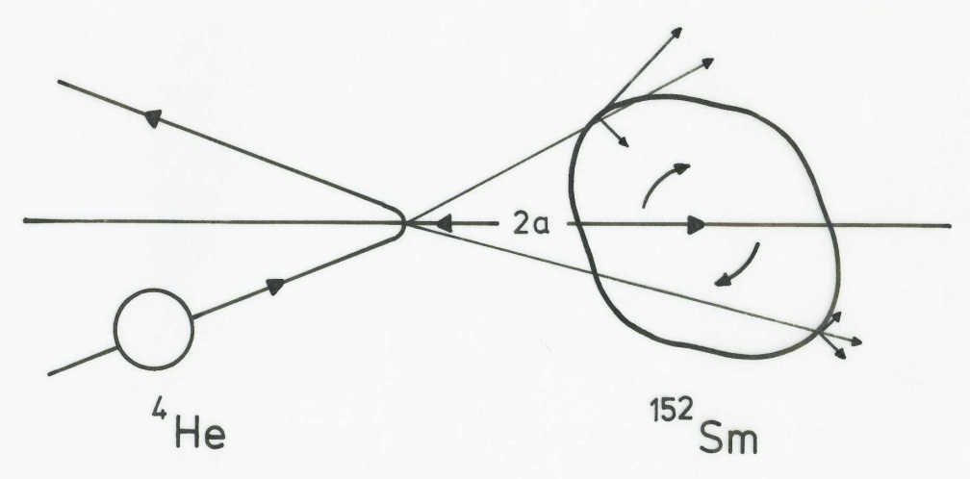
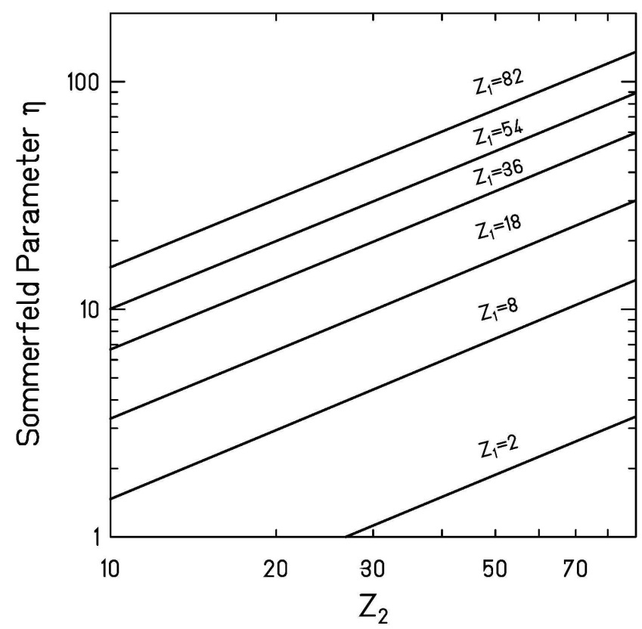

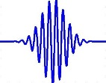

Coulomb excitation
particle
Sommerfeld parameter:
>> 1 requirement for a (semi-) classical treatment
of equations of motion (hyperbolic trajectories )
$$η=a∙k_{∞}=\frac{Z_{p}∙Z_{t}∙e^{2}}{ℏ∙v_{∞}}≫1$$
wave
⁴He (Z₁=2) projectiles behave like waves
quantummechanical analysis is needed

Slide 5
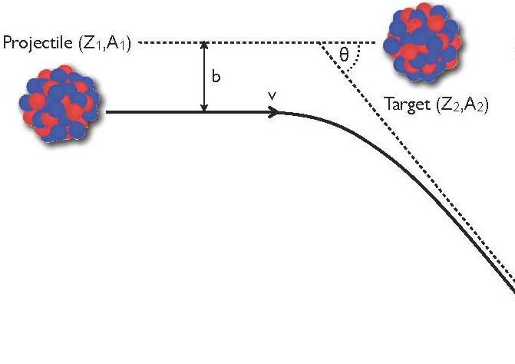

Classical Coulomb trajectory
impact parameter
scattering angle
Hyperbolic trajectory:
ε = sin⁻¹(θ_{cm}/2) eccentricity of orbit
distance of closest approach:
impact parameter:
angular momentum :
$$ℓ$$

Slide 6
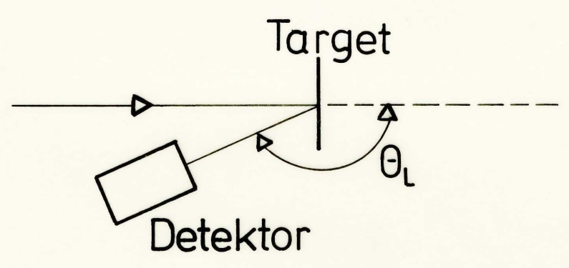
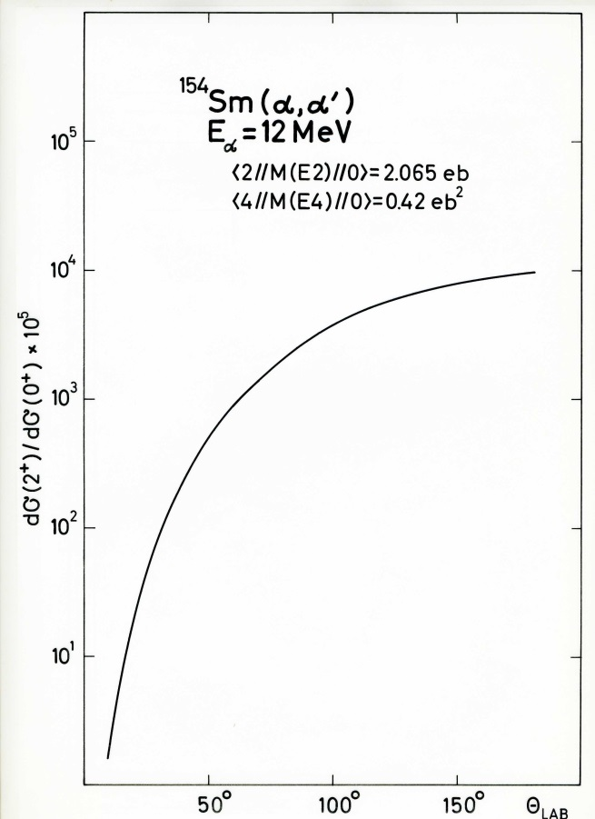
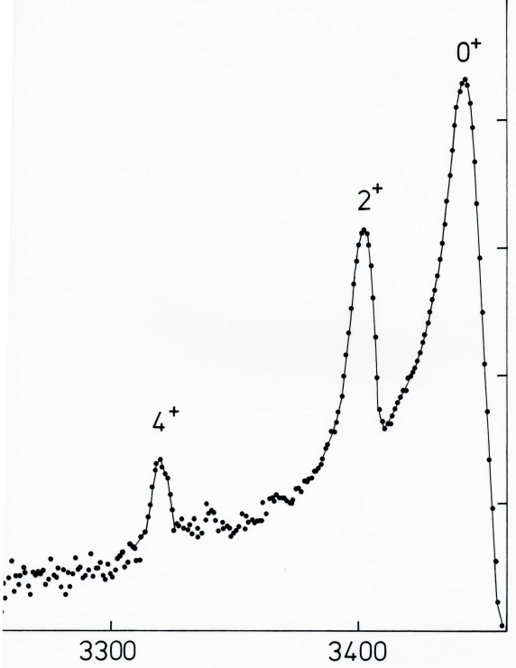
Coulomb excitation
excitation probability P_{i→f}
α-particle spectroscopy
¹⁵²Sm (α, α‘)
E_{α}=12 MeV
θ_{L}=160⁰
0⁺
10⁵
2⁺
10⁴
counts/channel
10³
4⁺
10²
α-detector at backward angle
inelastic
scattering
elastic
scattering
channel number

Slide 7
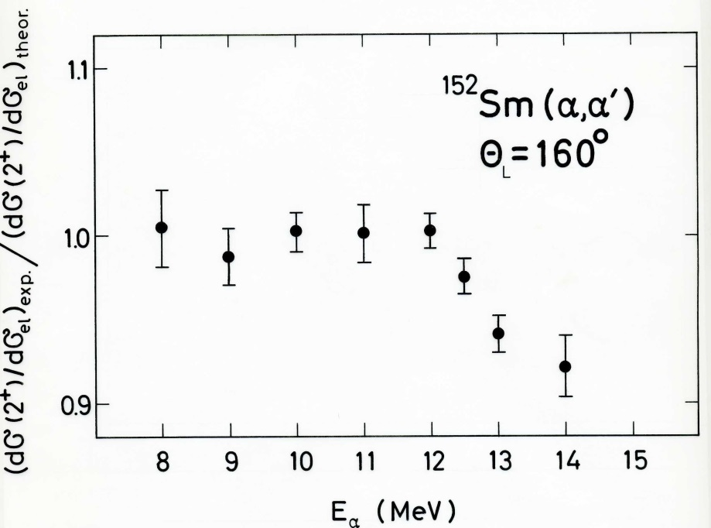
Coulomb excitation
r = C_{p} +C_{t} + 5 fm
α-particle spectroscopy
safe bombarding energy
¹⁵²Sm (α, α‘)
E_{α}=12 MeV
θ_{L}=160⁰
0⁺
10⁵
2⁺
10⁴
counts/channel
10³
4⁺
10²
inelastic
scattering
elastic
scattering
channel number

Slide 8
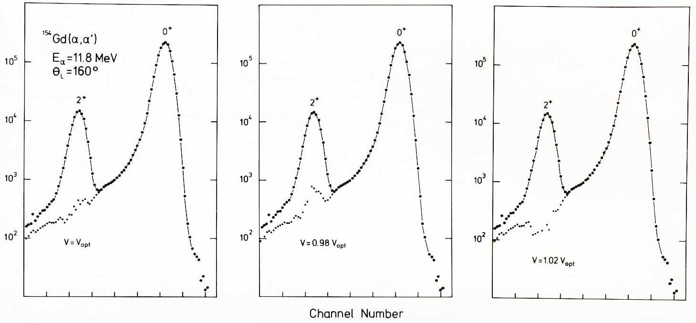
Experimental excitation energy
v = v_{opt}
v = 0.98·v_{opt}
v = 1.02·v_{opt}
r(x) ≡ measured spectrum
f(x) ≡ lineshape of elastic scattering

Slide 9
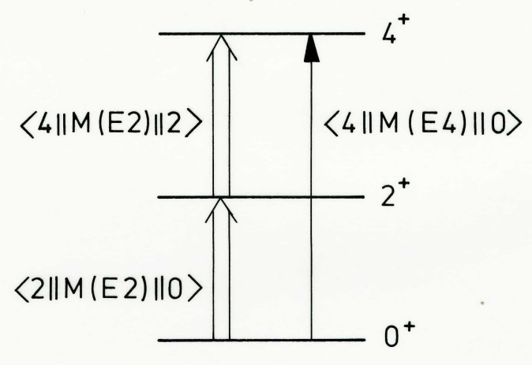
Double-step E2 vs E4 excitation of 4⁺ state
impact parameter
scattering angle
reduced transition matrix elements:
multipole moments Q_{λ} (liquid drop):

Slide 10
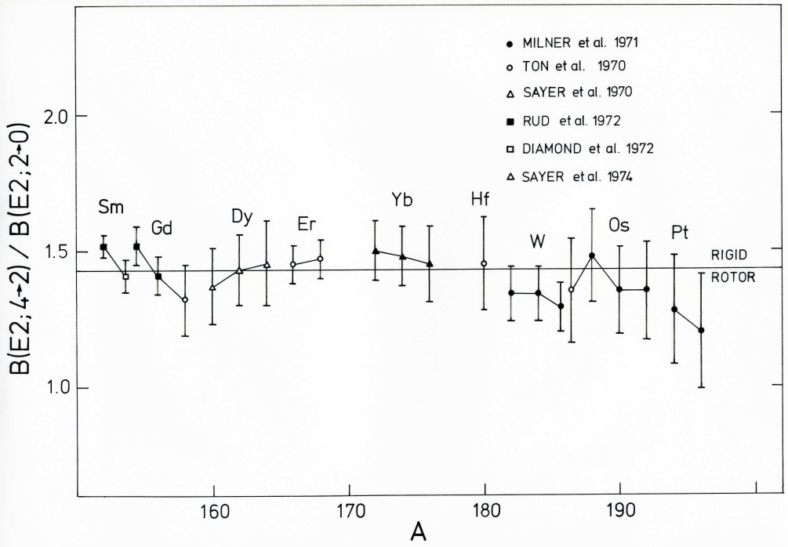
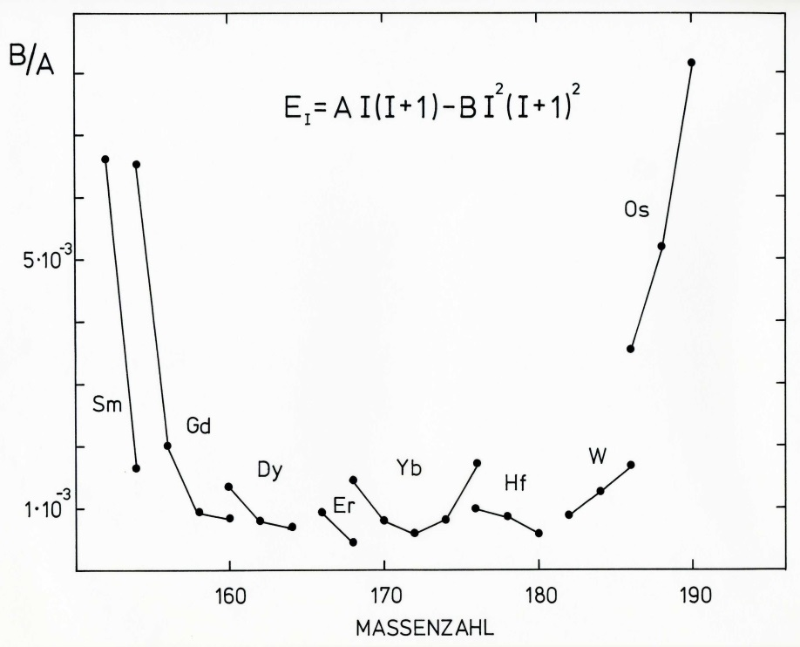
Double-step E2 excitation and rigid rotor model
rigid
rotor
rigid rotor model:
mass number

Slide 11
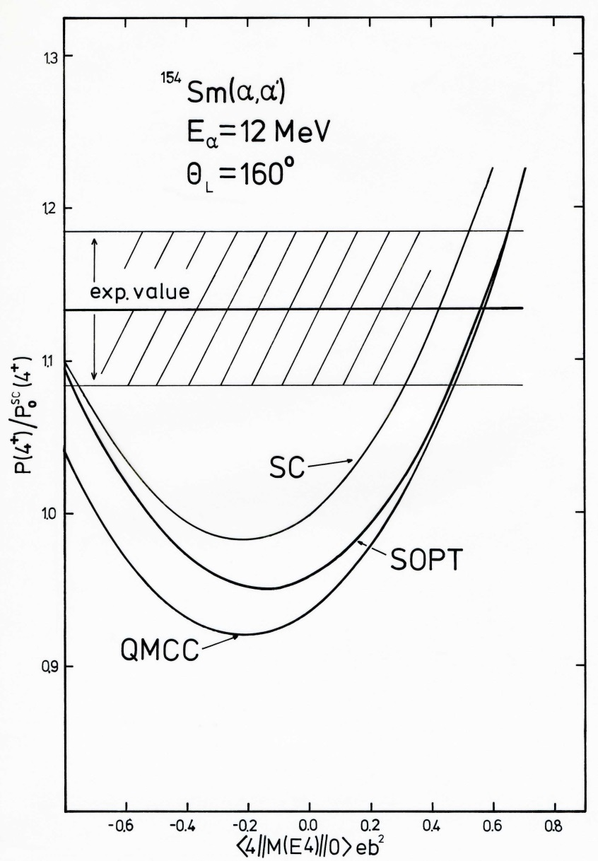
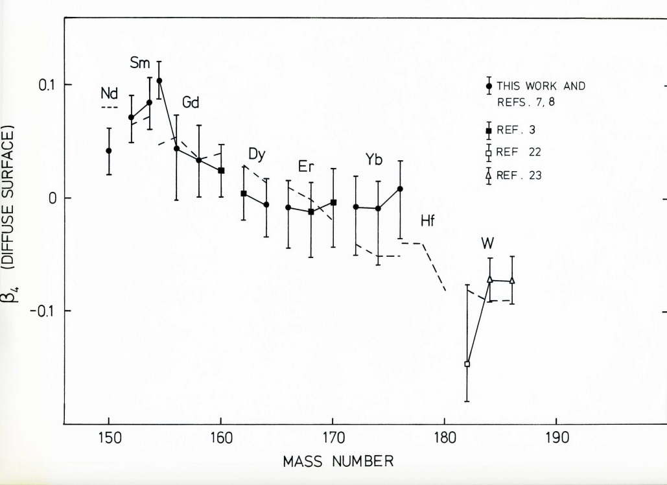

Coulomb excitation analysis
β₄ (diffuse surface)
mass number
SC ≡ semiclassical SOPT ≡ second order perturbation theory QMCC ≡ quantum mechanical coupled channel

Slide 12

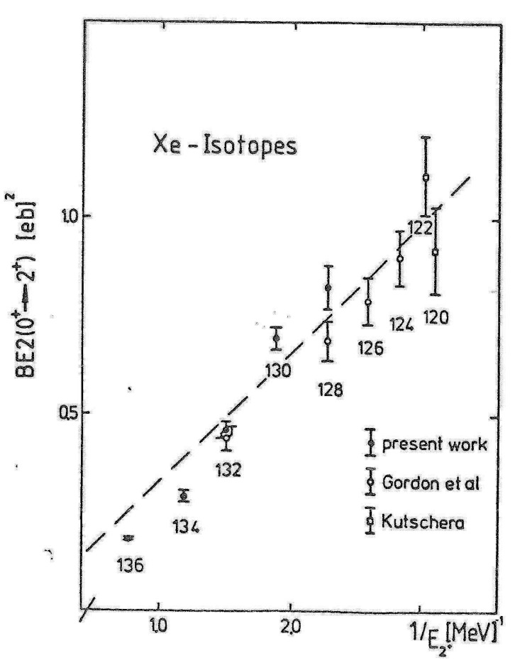

Hydrodynamical model
Reduced transition probability:
Excitation energy:
$$ℏ^{2}$$
Moment of inertia:

Slide 13
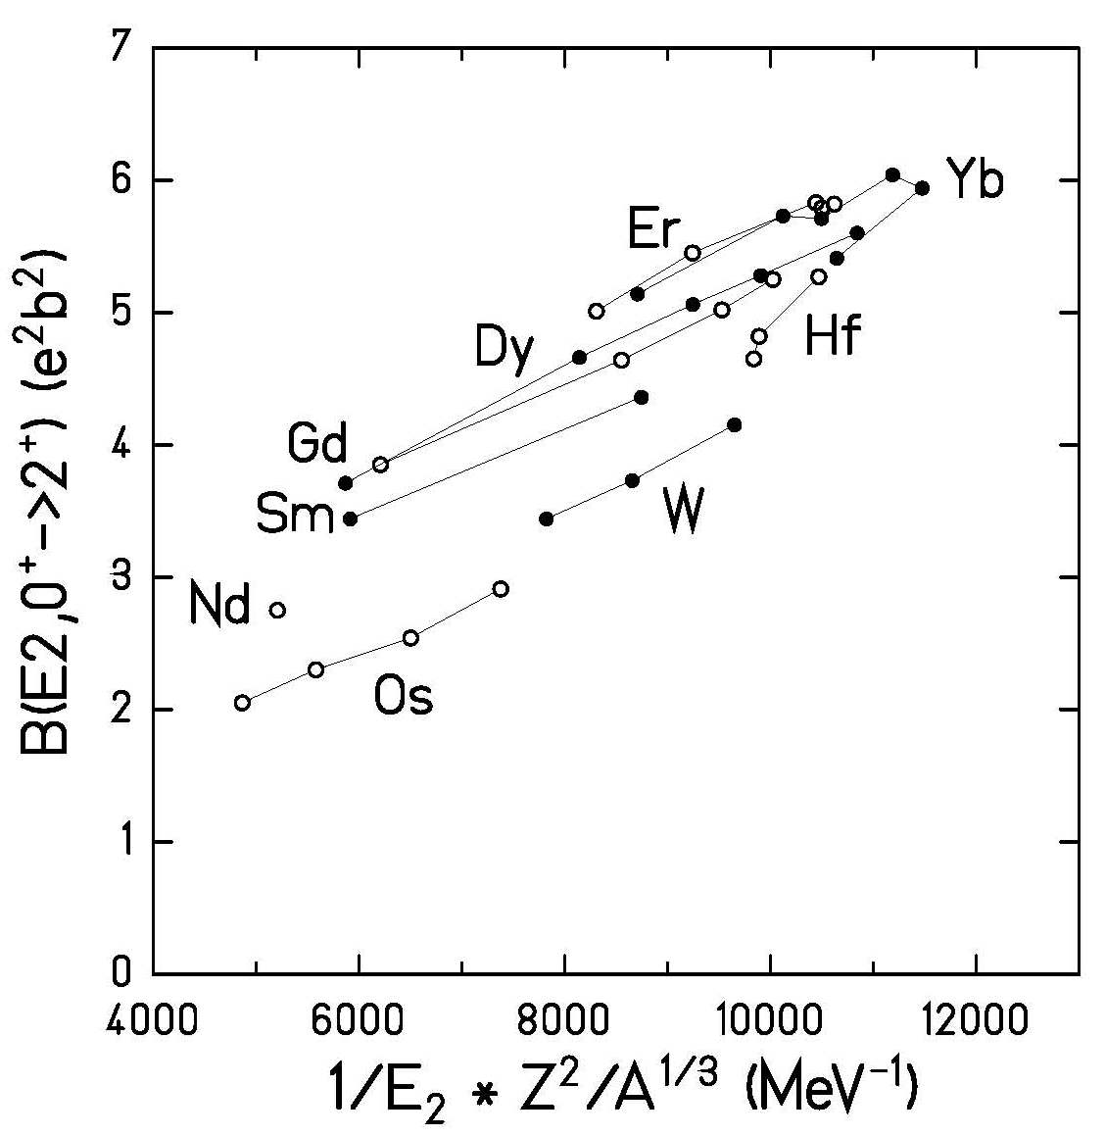
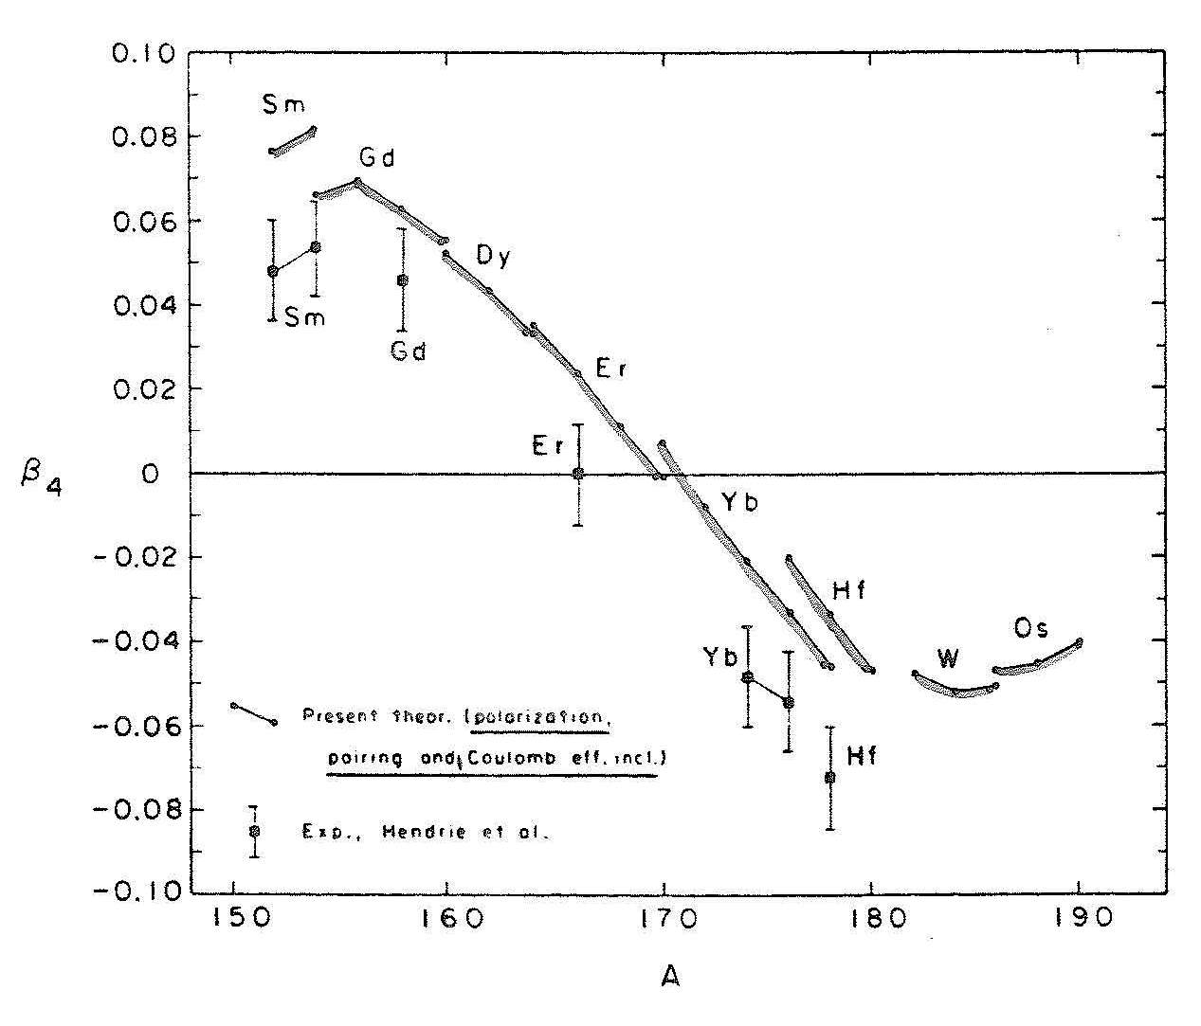

Hydrodynamical model
Reduced transition probability:
Excitation energy:
$$ℏ^{2}$$
first indication of a hexadecapole deformation

Slide 14
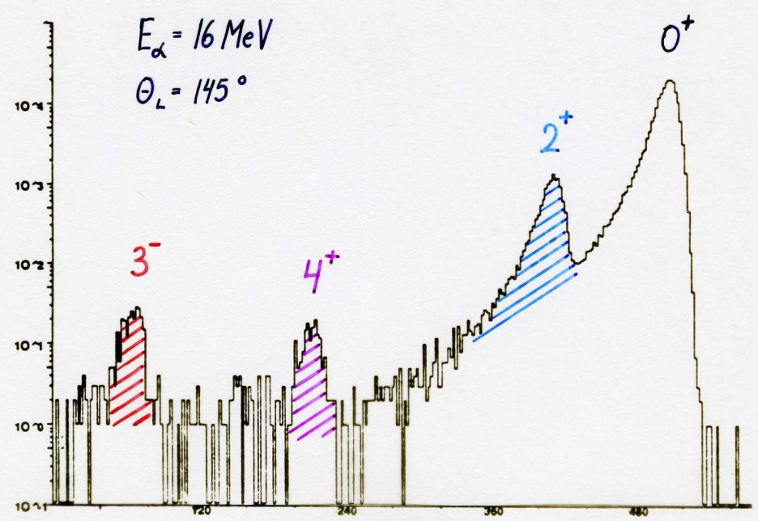
²²⁶Ra: quadrupole, octupole and hexadecapole deformation
0⁺
⁴He → ²²⁶Ra
E_{α} = 16 MeV
θ_{lab} = 145⁰
2⁺
counts
3⁻
4⁺
²²⁶Ra-target
beam direction
Si-detector
θ
channel number
λ |  | β_{λ} (exp) | β_{λ} (theo)
2 | 2.27 (3) | 0.165 (2) | 0.164
3 | 1.05 (5) | 0.104 (5) | 0.112
4 | 1.04 (7) | 0.123 (8) | 0.096

