Slide 1
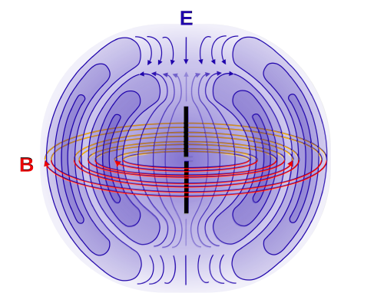
Electric/magnetic dipoles
Electric and magnetic dipole fields have opposite parity:
Magnetic dipoles have even parity and electric dipole fields have odd parity.
$$⇒ π\left(Mℓ\right)={\left(−1\right)}^{ℓ+1} and π\left(Eℓ\right)={\left(−1\right)}^{ℓ}$$

Slide 2
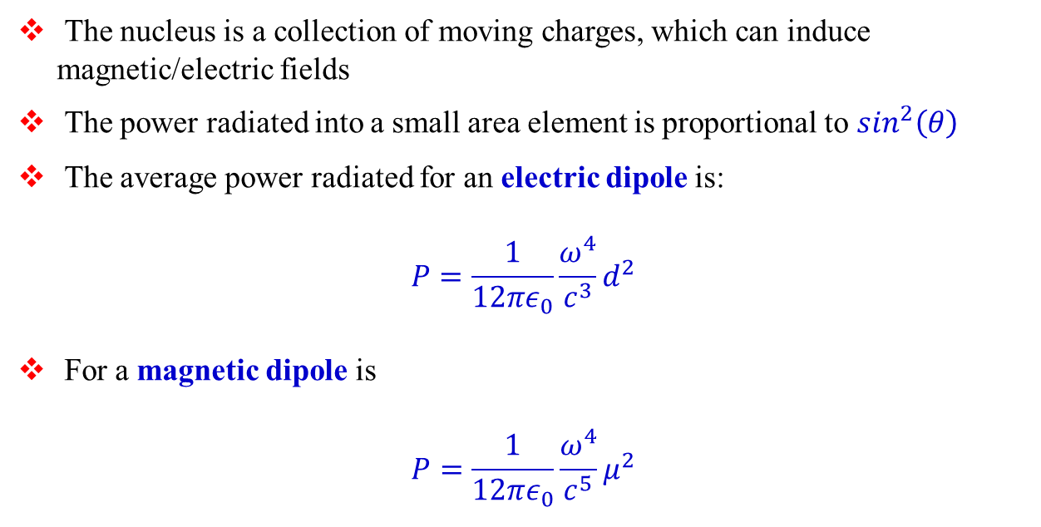
Classical electrodynamics
The nucleus is a collection of moving charges, which can induce magnetic/electric fields
The power radiated into a small area element is proportional to $\sin^{2}\left(θ\right)$
The average power radiated for an electric dipole is:
$$P=\frac{1}{12πε_{0}}\frac{ω^{4}}{c^{3}}d^{2}$$
For a magnetic dipole is
$$P=\frac{1}{12πε_{0}}\frac{ω^{4}}{c^{5}}μ^{2}$$

Slide 3
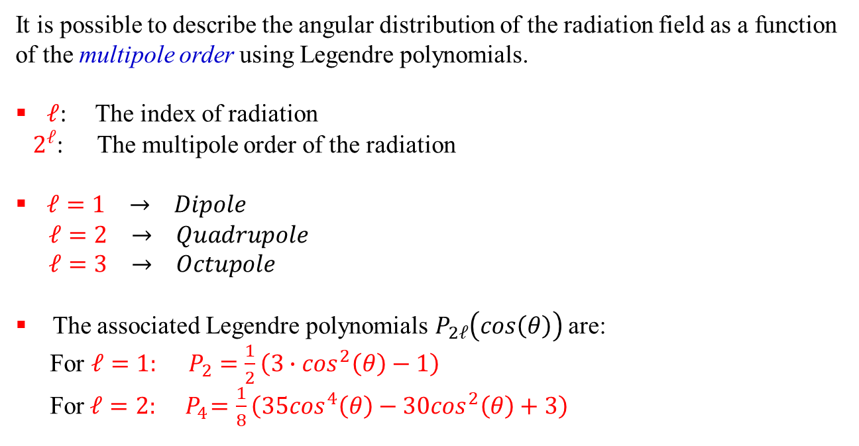
Higher order multipoles
It is possible to describe the angular distribution of the radiation field as a function of the multipole order using Legendre polynomials.
$ℓ$: The index of radiation
$2^{ℓ}$: The multipole order of the radiation
$ℓ=1 → Dipole$
$ℓ=2 → Quadrupole$
$ℓ=3 → Octupole$
The associated Legendre polynomials $P_{2ℓ}\left(cos\left(θ\right)\right)$ are:
For $ℓ=1: P_{2}=\frac{1}{2}\left(3∙\cos^{2}\left(θ\right)−1\right)$
For $ℓ=2: { P}_{4}=\frac{1}{8}\left(35\cos^{4}\left(θ\right)−30\cos^{2}\left(θ\right)+3\right)$

Slide 4
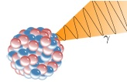
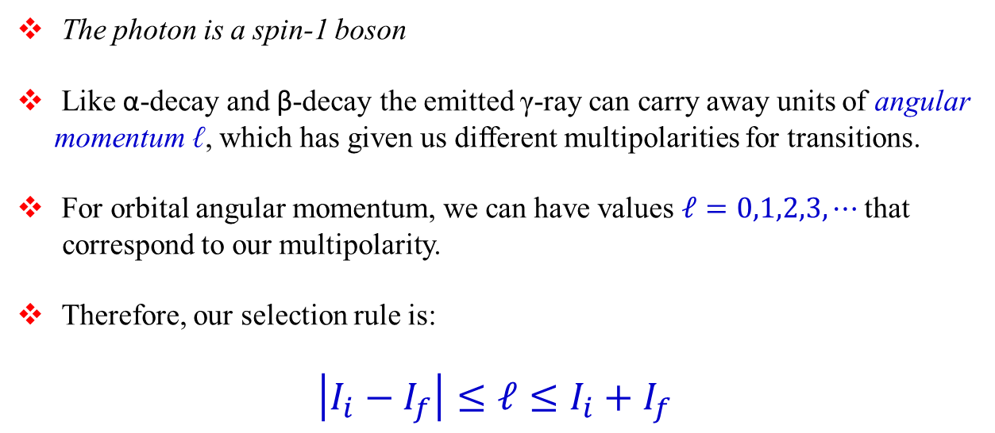
Nuclear excited state decay angular momentum in γ-decay
The photon is a spin-1 boson
Like α-decay and β-decay the emitted γ-ray can carry away units of angular momentum ℓ, which has given us different multipolarities for transitions.
For orbital angular momentum, we can have values $ℓ=0,1,2,3,⋯$ that
correspond to our multipolarity.
Therefore, our selection rule is:
$$\left|I_{i}−I_{f}\right|≤ℓ≤I_{i}+I_{f}$$

Slide 5
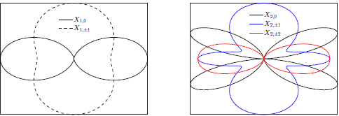
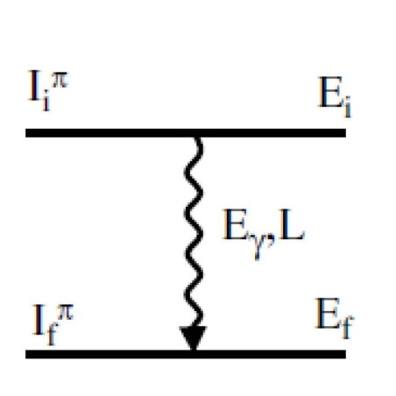




Characteristics of multipolarity selection rules
L | multipolarity | π(Eℓ) / π(Mℓ) | angular distribution
1 | dipole | -1 / +1
2 | quadrupole | +1 / -1
3 | octupole | -1 / +1
4 | hexadecapole | +1 / -1
⁞
ℓ = 1
ℓ =2
$$E_{γ}=E_{i}−E_{f}$$
$$\left|I_{i}−I_{f}\right|≤ℓ≤I_{i}+I_{f}$$
$$∆π\left(Eℓ\right)={\left(−1\right)}^{ℓ}$$
$$∆π\left(Mℓ\right)={\left(−1\right)}^{ℓ+1}$$

Slide 6

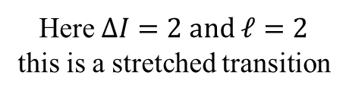
The basics of the situation
2
ℓ
0
$$\left|2−0\right|≤ℓ≤2+0$$
Here $ΔI=2 and ℓ=2$
this is a stretched transition

Slide 7

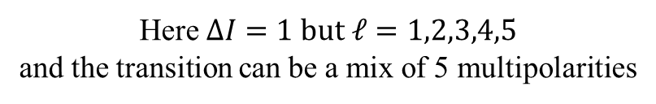
The basics of the situation
3
ℓ
2
$$\left|3−2\right|≤ℓ≤3+2$$
Here $ΔI=1 but ℓ=1,2,3,4,5$
and the transition can be a mix of 5 multipolarities

Slide 8

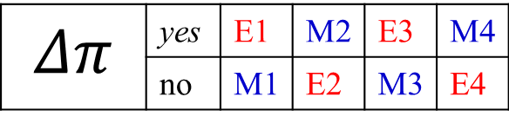


The basics of the situation
$E_{γ}, ℓ, Δπ$
Electromagnetic transitions:
$$Δπ \left(electric\right)= {\left(−1\right)}^{ℓ}$$
$$Δπ \left(magnetic\right)= {\left(−1\right)}^{ℓ+1}$$
$$Δπ$$ | yes | E1 | M2 | E3 | M4
 | no | M1 | E2 | M3 | E4

Slide 9
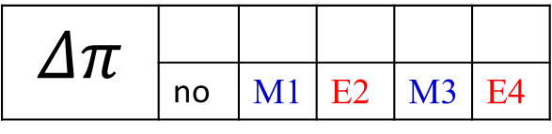

The basics of the situation
2⁺
ℓ
0⁺
$$\left|2−0\right|≤ℓ≤2+0$$
$$ℓ=2 and no change in parity$$
$$Δπ$$ | yes | E1 | M2 | E3 | M4
 | no | M1 | E2 | M3 | E4

Slide 10
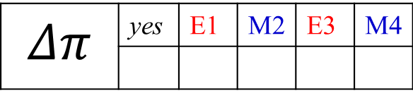

The basics of the situation
3⁺
ℓ
2⁻
$$\left|3−2\right|≤ℓ≤3+2$$
Here $ΔI=1 but ℓ=1,2,3,4,5$
$$Δπ$$ | yes | E1 | M2 | E3 | M4
 | no | M1 | E2 | M3 | E4
mixed E1,M2,E3,M4,E5

Slide 11
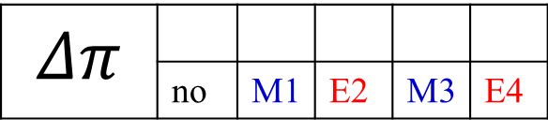

The basics of the situation
3⁺
ℓ
2⁺
$$\left|3−2\right|≤ℓ≤3+2$$
Here $ΔJ=1 but ℓ=1,2,3,4,5$
$$Δπ$$ | yes | E1 | M2 | E3 | M4
 | no | M1 | E2 | M3 | E4
mixed M1,E2,M3,E4,M5

Slide 12



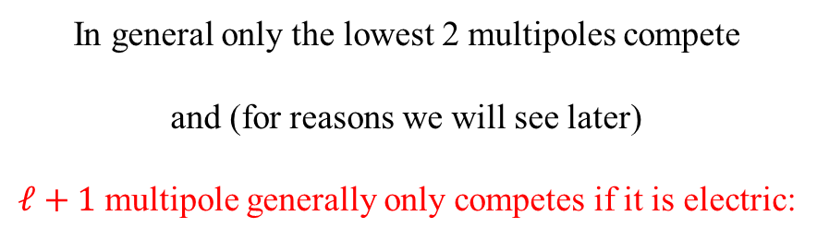
The basics of the situation
$3^{+}→2^{+}:$ mixed M1,E2,M3,E4,M5
$3^{+}→2^{−}:$ mixed E1,M2,E3,M4,E5
In general only the lowest 2 multipoles compete
and (for reasons we will see later)
$ℓ+1$ multipole generally only competes if it is electric:
$3^{+}→2^{+}:$ mixed M1/E2
$3^{+}→2^{−}:$ almost pure E1 (very little M2 admixture)

Slide 13
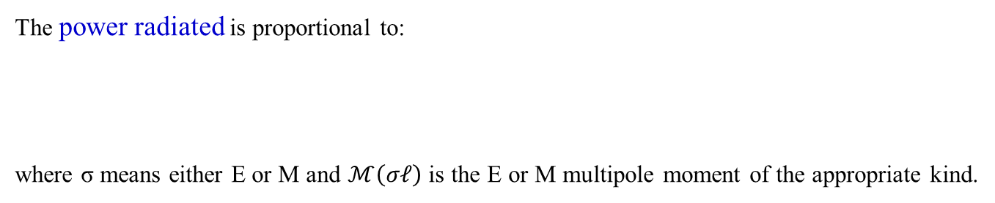
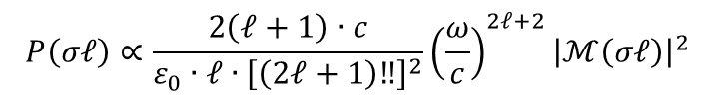
Characteristics of multipolarity
L | multipolarity | π(Eℓ) / π(Mℓ) | angular distribution
1 | dipole | -1 / +1
2 | quadrupole | +1 / -1
3 | octupole | -1 / +1
4 | hexadecapole | +1 / -1
⁞
ℓ = 1
ℓ =2
parity: electric multipoles π(Eℓ) = (-1)^{ℓ}, magnetic multipoles π(Mℓ) = (-1)^{ℓ+1}
The power radiated is proportional to:
where σ means either E or M and $ℳ\left(σℓ\right)$ is the E or M multipole moment of the appropriate kind.
$$P\left(σℓ\right)∝\frac{2\left(ℓ+1\right)∙c}{ε_{0}∙ℓ{∙\left[\left(2ℓ+1\right)‼\right]}^{2}}{\left(\frac{ω}{c}\right)}^{2ℓ+2}{\left|ℳ\left(σℓ\right)\right|}^{2}$$

Slide 14
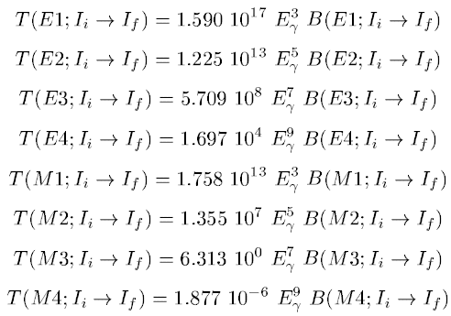
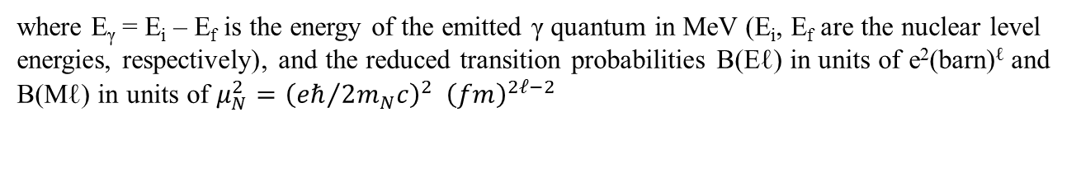
Emission of electromagnetic radiation
where E_{γ} = E_{i} – E_{f} is the energy of the emitted γ quantum in MeV (E_{i}, E_{f} are the nuclear level energies, respectively), and the reduced transition probabilities B(Eℓ) in units of e²(barn)^{ℓ} and B(Mℓ) in units of $μ_{N}^{2}={\left({eℏ}/{2m_{N}c}\right)}^{2} {\left(fm\right)}^{2ℓ−2}$

Slide 15
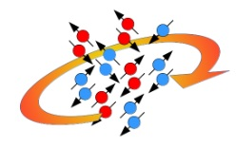
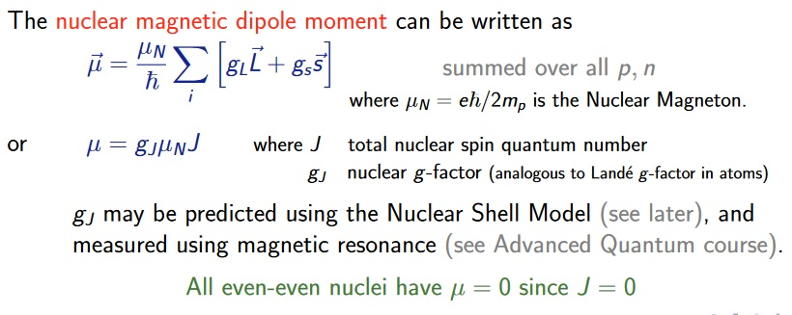
Nuclear shape magnetic moments
Nuclear magnetic dipole moments arise from
intrinsic spin magnetic dipole moments of
the protons and neutrons
circulating currents (motion of the protons)

Slide 16











Magnetic moment classical description
$$\vec{L}$$
e⁻-movement ⇒ magnetic moment $\vec{μ_{e}}$
$$\vec{n}$$
$$\vec{μ_{e}}=\frac{I}{c}∙A∙\vec{n}$$
A
I
$$I=−e∙ν=−e∙\frac{v}{2πr}$$
$$⇒ \vec{μ_{e}}=−\frac{1}{2}∙\frac{e∙v∙r∙\vec{n}}{c}$$
$$\vec{r}$$
$$A=π∙r^{2}$$
e⁻
angular momentum:
$$\vec{L}=\vec{r}×\vec{p}=r∙m_{e}∙v∙\vec{n} ⇒ \vec{μ_{e}}=−\frac{e}{2∙m_{e}∙c}\vec{L}$$
Quantum mechanical description: angular momentum will be quantized, in units of ħ.
$$μ_{B}=\frac{e∙ℏ}{2∙m_{e}∙c}=5.788∙{10}^{−11} \frac{MeV}{Tesla}$$
$$μ_{K}=\frac{e∙ℏ}{2∙m_{P}∙c}=3.152∙{10}^{−14} \frac{MeV}{Tesla}$$

Slide 17
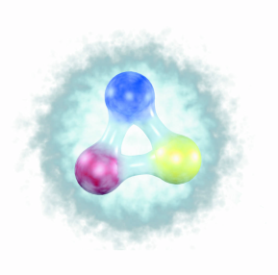


Quark model
 | Charge | Mass m_{q} | Spin | mag. Moment
u-quark | + 2/3 | ~ 1/3 M_{p} | 1/2
d-quark | - 1/3 | ~ 1/3 M_{p} | 1/2
$$2∙\left(\frac{2}{3}\right)∙\frac{e∙ℏ}{2{∙m}_{q}∙c}∙s=4∙μ_{K}∙s$$
$$2∙\left(−\frac{1}{3}\right)∙\frac{e∙ℏ}{2∙m_{q}∙c}∙s=−2∙μ_{K}∙s$$
general coupling rule:
Proton (uud) :
Neutron (ddu) :
g_{Dirac} = 2 prediction of the Dirac-theory for the gyromagnetic factor for spin ½-particles
g_{s}^{proton} = +5.58 ⇒ big deviation from g = 2 ⇔ no fundamental particle
g_{s}^{neutron} = -3.82

Slide 18
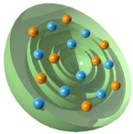


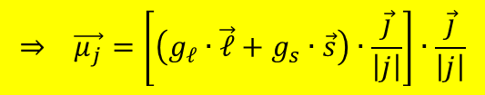



Success of the extreme single-particle shell model
Magnetic moments:
The g-factor g_{j} is given by:
with
Simple relation for the g-factor
of single-particle states
$$⇒ \vec{μ_{j}}=\left[\left(g_{ℓ}∙\vec{ℓ}+g_{s}∙\vec{s}\right)∙\frac{\vec{j}}{\left|j\right|}\right]∙\frac{\vec{j}}{\left|j\right|}$$
$$\vec{μ_{j}}=g_{ℓ}∙\vec{ℓ}+g_{s}∙\vec{s}=g_{j}∙\vec{j}$$
$${\vec{ℓ}}^{2}={\left(\vec{j}−\vec{s}\right)}^{2}={\vec{j}}^{2}−2∙\vec{j}∙\vec{s}+{\vec{s}}^{2}$$
$${\vec{s}}^{2}={\left(\vec{j}−\vec{ℓ}\right)}^{2}={\vec{j}}^{2}−2∙\vec{j}∙\vec{ℓ}+{\vec{ℓ}}^{2}$$
$${\vec{μ}}_{j}=\frac{g_{ℓ}∙\left\{j\left(j+1\right)+ℓ\left(ℓ+1\right)−3/4\right\}+g_{s}∙\left\{j\left(j+1\right)−ℓ\left(ℓ+1\right)+3/4\right\}}{2∙j\left(j+1\right)}∙\vec{j}$$
$$g_{j}=\frac{1}{2}∙\left(g_{ℓ}+g_{s}\right)+\frac{1}{2}∙\frac{ℓ\left(ℓ+1\right)−s\left(s+1\right)}{2j\left(j+1\right)}∙\left(g_{ℓ}−g_{s}\right)$$
μ/μ_{N}
nucleus state J^{π} model experiment
$$\frac{μ}{μ_{N}}=g_{nucleus}=g_{ℓ}±\frac{\left(g_{s}−g_{ℓ}\right)}{2ℓ+1} for j=ℓ±1$$

Slide 19
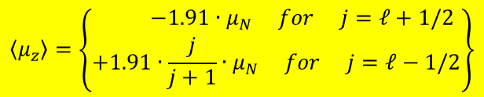
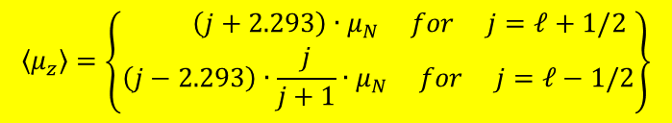
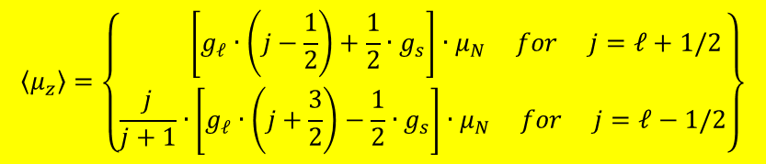
Success of the extreme single-particle shell model
$$\left\langle μ_{z}\right\rangle =\left\{\begin{matrix} \left[g_{ℓ}∙\left(j−\frac{1}{2}\right)+\frac{1}{2}∙g_{s}\right]∙μ_{N} for j=ℓ+1/2 \\ \frac{j}{j+1}∙\left[g_{ℓ}∙\left(j+\frac{3}{2}\right)−\frac{1}{2}∙g_{s}\right]∙μ_{N} for j=ℓ−1/2\end{matrix}\right\}$$
magnetic moments:
g-factor of nucleons:
proton: g_{ℓ} = 1; g_{s} = +5.585
neutron: g_{ℓ} = 0; g_{s} = -3.82
proton:
neutron:
$$\left\langle μ_{z}\right\rangle =\left\{\begin{matrix} \left(j+2.293\right)∙μ_{N} for j=ℓ+1/2 \\ \left(j−2.293\right)∙\frac{j}{j+1}∙μ_{N} for j=ℓ−1/2\end{matrix}\right\}$$
$$\left\langle μ_{z}\right\rangle =\left\{\begin{matrix} −1.91∙μ_{N} for j=ℓ+1/2 \\ +1.91∙\frac{j}{j+1}∙μ_{N} for j=ℓ−1/2\end{matrix}\right\}$$

Slide 20
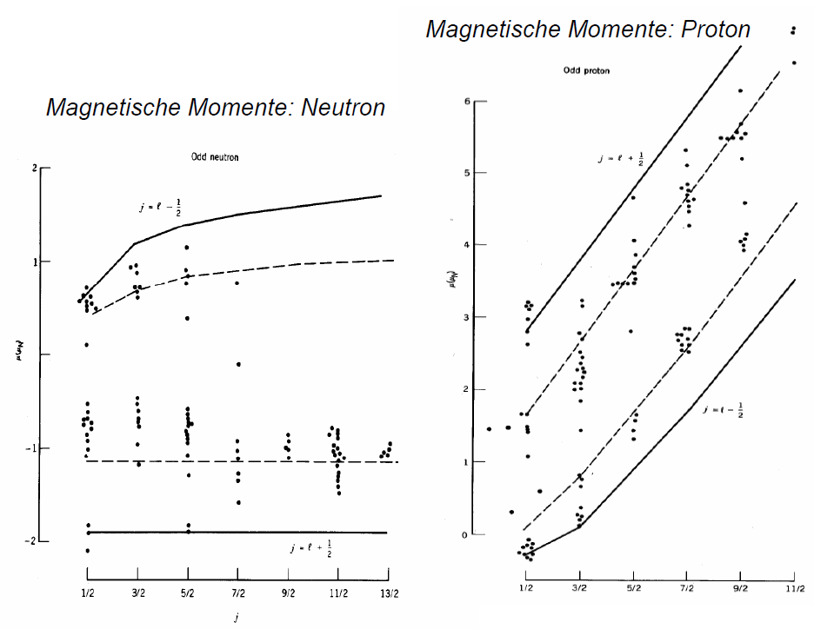
Magnetic moments: Schmidt lines
magnetic moments: proton
magnetic moments: neutron

Slide 21
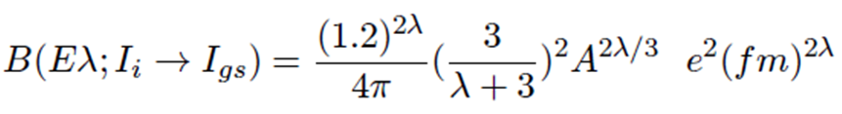
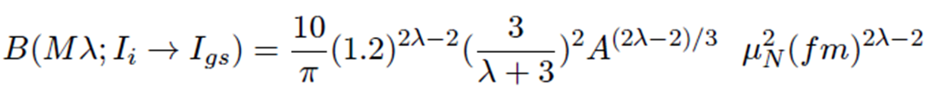
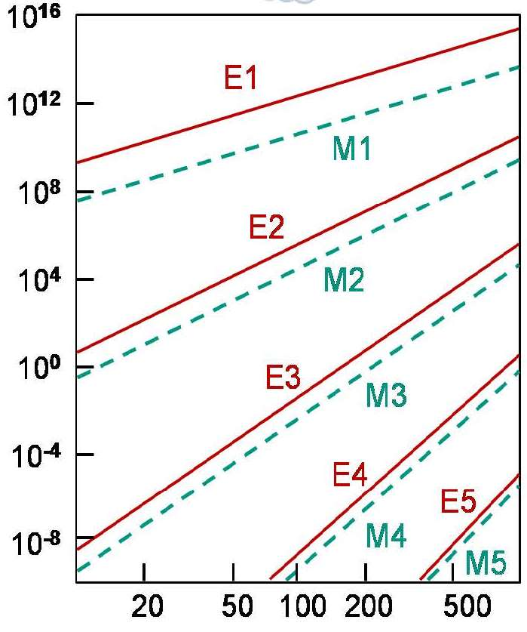
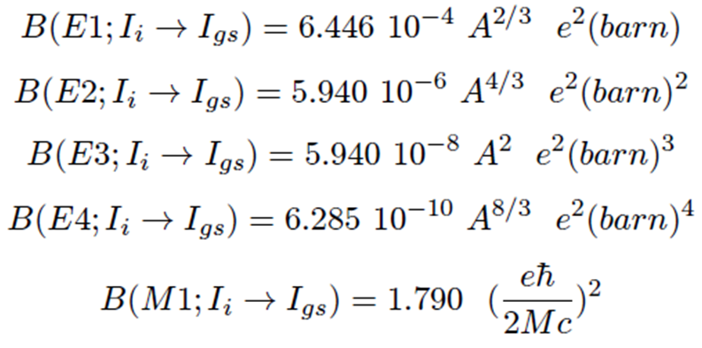
Single particle transition (Weisskopf estimate)
For the first few values of λ, the Weisskopf estimates are
transition probability λ [s⁻¹]
gamma energy E_{γ} [keV]

Slide 22
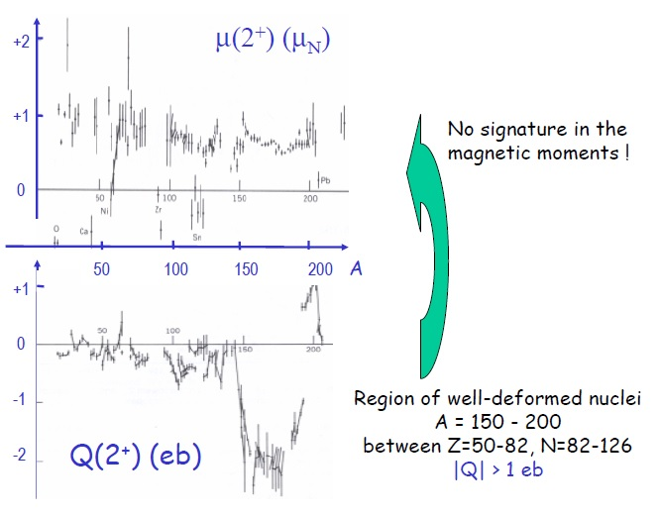
Magnetic moments are not sensitive to deformation or collectivity

Slide 23
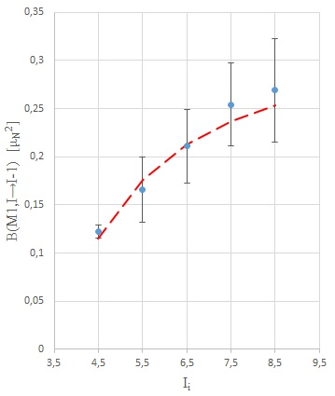
Odd-even nucleus: ¹⁸¹Ta
$$\left\langle I−1,K\left\|M\left(M1\right)\right\|I,K\right\rangle =−\sqrt{\frac{3}{4π}}\sqrt{\frac{\left(I+K\right)\left(I−K\right)}{I}}∙K∙\left(g_{K}−g_{R}\right)\left[1+δ_{K,1/2}{\left(−1\right)}^{I+1/2}b_{0}\right]μ_{N}$$
The quantity b₀ depends on the magnetic decoupling parameter
$$μ\left({7/2}^{+}\right)=2.3705±0.0007$$
$$μ=\frac{K}{I+1}∙\left(g_{K}−g_{R}\right)∙K+g_{R}∙I$$
g_{R} = 0.313(5)
g_{K} = 0.782(2)
$$μ\left({9/2}^{−}\right)=5.28±0.09$$
g_{K} –g_{R} = 0.469(6)
$${}_{}^{{9/2}^{−}}{\left(g_{K}−g_{R}\right)}=\frac{22}{81}\left({}_{}^{{9/2}^{−}}μ−{}_{}^{{7/2}^{+}}μ\frac{9}{7}+{}_{}^{{7/2}^{+}}{\left(g_{K}−g_{R}\right)}\frac{7}{2}\right)$$
$${}_{}^{{9/2}^{−}}{\left(g_{K}−g_{R}\right)}≈{}_{}^{{7/2}^{+}}{\left(g_{K}−g_{R}\right)}\frac{77}{81}+0.606=1.052$$
M. Loewe; dissertation

Slide 24
Matrix elements
$$\left\langle I−1,K\left\|M\left(M1\right)\right\|I,K\right\rangle =−\sqrt{\frac{3}{4π}}\sqrt{\frac{\left(I+K\right)\left(I−K\right)}{I}}∙K∙\left(g_{K}−g_{R}\right)\left[1+δ_{K,1/2}{\left(−1\right)}^{I+1/2}b_{0}\right]μ_{N}$$
The quantity b₀ depends on the magnetic decoupling parameter
energy | I^{π} | B(M1) Wu | B(M1) | $$\left\langle I^{π}−1\left\|M\left(M1\right)\right\|I^{π}\right\rangle$$
136.3 | 9/2⁺ | 0.068(4) | 0.122(7) | 1.105(31)
165.4 | 11/2⁺ | 0.093(19) | 0.166(34) | 1.411(138)
193.7 | 13/2⁺ | 0.118(21) | 0.211(38) | 1.719(148)
221.5 | 15/2⁺ | 0.142(24) | 0.254(43) | 2.016(164)
248.4 | 17/2⁺ | 0.15(3) | 0.27(5) | 2.205(195)

Slide 25
Odd-even nucleus: ¹⁸¹Ta
$$τ={\left\{\sum_{K}{\sum_{ℓ}{\left[ε_{N→K}^{2}\left(λ\right)+δ_{N→K}^{2}\left(λ\right)\right]}}\right\}}^{−1}$$
$${{13}/2}^{+}$$
0.495
$$τ=9.1±1.2 ps$$
$${{11}/2}^{+}$$
0.302
$$τ=23.1±4.3 ps$$
$$τ={T_{1/2}}/{ln2}$$
E2 + M1
E2
$${9/2}^{+}$$
0.136
$$τ=57.0±2.3 ps$$
E2 + M1
$${7/2}^{+}$$
0.0
¹⁸¹Ta
$$δ_{N→M}\left(λ\right)={\left\{\frac{8π\left(λ+1\right)}{λ{\left[\left(2λ+1\right)‼\right]}^{2}}\frac{1}{ℏ}{\left(\frac{ℏω}{ℏc}\right)}^{2λ+1}\right\}}^{1/2}∙{\left(2I_{N}+1\right)}^{−1/2}∙\left\langle I_{M}\left\|ℳ\left(λ\right)\right\|I_{N}\right\rangle$$
$$δ_{N→M}\left(E2\right)={\left\{1.225∙{10}^{13}∙E_{γ}^{5}{\left(MeV\right)}^{5}\right\}}^{1/2}∙{\left(2I_{n}+1\right)}^{−1/2}∙\left\langle I_{M}\left\|ℳ\left(E2\right)\right\|I_{N}\right\rangle$$
$$δ_{N→M}\left(M1\right)={\left\{1.758∙{10}^{13}∙E_{γ}^{3}{\left(MeV\right)}^{3}\right\}}^{1/2}∙{\left(2I_{n}+1\right)}^{−1/2}∙\left\langle I_{M}\left\|ℳ\left(M1\right)\right\|I_{N}\right\rangle$$
T. Inamura et al., Nucl. Phys. A270 (1976) 255
$$ε_{N→M}^{2}\left(ℓ\right)=δ_{N→M}^{2}\left(ℓ\right)∙α_{N→M}\left(ℓ\right)$$
conversion coefficient.: bricc.anu.edu.au

Slide 26
Odd-even nucleus: ¹⁸¹Ta
$$τ={\left\{\sum_{K}{\sum_{ℓ}{\left[ε_{N→K}^{2}\left(λ\right)+δ_{N→K}^{2}\left(λ\right)\right]}}\right\}}^{−1}$$
$${{13}/2}^{+}$$
0.495
$$τ=9.1±1.2 ps$$
$${{11}/2}^{+}$$
0.302
$$τ=23.1±4.3 ps$$
$$τ={T_{1/2}}/{ln2}$$
E2 + M1
E2
$${9/2}^{+}$$
0.136
$$τ=57.0±2.3 ps$$
E2 + M1
$${7/2}^{+}$$
0.0
¹⁸¹Ta
Spin I | E_{γ} (MeV) | (2I+1)^{-1/2} | <I-1//M()//I> | delta | α_{T} | ε² | τ (ps)
9/2 | 0.1365 | 0.3162 | -3.899 (E2) | -29594. | 1.1 | 9.98·10⁸ | 533
 |  |  | 1.103 (M1) | 73591 | 1.8 | 9.75·10⁹ | 58.7
11/2 | 0.1654 | 0.2887 | -4.291 (E2) | -48238 | 0.6 | 1.33·10⁹ | 274
 |  |  | 1.413 (M1) | 115044 | 1.0 | 1.38·10¹⁰ | 32.6
11/2 | 0.3017 | 0.2887 | 1.977 (E2) | 99868 | 0.1 | 8.08·10⁸ | 24.1
T. Inamura et al., Nucl. Phys. A270 (1976) 255

Slide 27
Oddproton-evenneutron nuclei
 |  | μ | (g_{K}-g_{R}) | B(M1)W.u. | (g_{K}-g_{R})
¹⁵³Eu | 5/2⁺ | +1.5324(3) | 0.551 | 0.00608(28) | 0.185
¹⁵⁹Tb | 3/2⁺ | +2.014(4) | 1.556 | 0.173(8) | 1.471
¹⁶⁵Ho | 7/2⁻ | +4.177(5) | 1.012 | 0.275(14) | 0.973
¹⁶⁹Tm | 1/2⁺ | -0.2316(15) |  | 0.0342(8)
¹⁷⁵Lu | 7/2⁺ | +2.2327(11) | 0.298 | 0.0354(14) | 0.349
¹⁸¹Ta | 7/2⁺ | +2.3705(7) | 0.352 | 0.068(4) | 0.484
¹⁸⁵Re | 5/2⁺ | +3.1871(3) | 1.217 | 0.28(5) | 1.252
¹⁸⁷Re | 5/2⁺ | +3.2197(3) | 1.242 | 0.260(18) | 1.206

Slide 28
Oddneutron-evenproton nuclei
 |  | μ | (g_{K}-g_{R}) | B(M1)W.u. | (g_{K}-g_{R})
¹⁵³Eu | 5/2⁺ | +1.5324(3)
¹⁵⁵Gd | 3/2⁻ | -0.2574(4) | -0.974 | 0.0493(39) | 0.783
¹⁵⁷Gd | 3/2⁻ | -0.3398(7) | -1.057 | 0.077(6) | 0.981
¹⁶¹Dy | 5/2⁺ | -0.4803(25) | -0.843 | 0.028(4) | 0.395
¹⁶³Dy | 5/2⁻ | +0.6726(35) | -0.190 | 0.00081(8) | 0.066
¹⁶⁷Er | 7/2⁺ | -0.56385(12) | -0.731 | 0.048(4) | 0.406
¹⁷⁷Hf | 7/2⁻ | +0.7935(6) | -0.232 | 0.00037(3) | 0.036
¹⁷⁹Hf | 9/2⁺ | -0.6409(13) | -0.666 | 0.094(8) | 0.479

