Slide 1

Outline: Nuclear shell model with residual interaction
Lecturer: Hans-Jürgen Wollersheim
e-mail: h.j.wollersheim@gsi.de
web-page: https://web-docs.gsi.de/~wolle/ and click on
experimental single-particle energies
coupling of two angular momenta
δ-interaction - pairing
generalized seniority scheme
signatures near closed shells

Slide 2
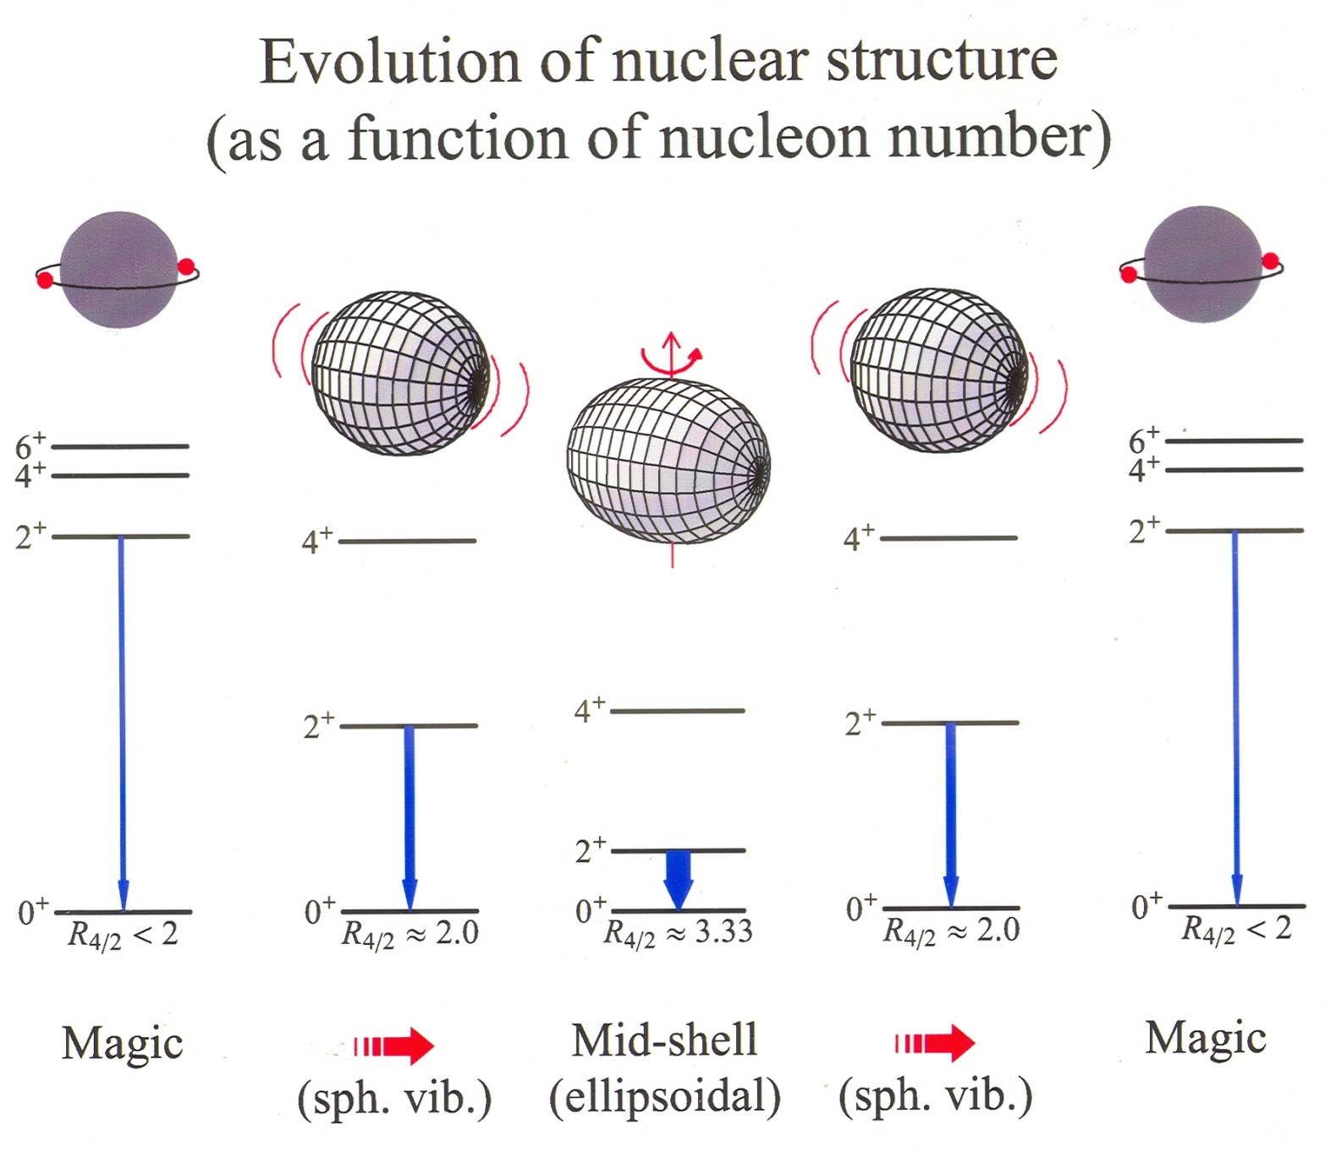

Slide 3
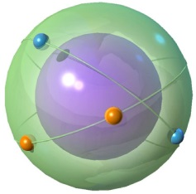


Shell model with residual interaction
$$H=H_{0}+H_{residual}$$
Start with 2-particle system, that is a nucleus „doubly magic nucleus + 2 nucleons“
Consider two identical valence nucleons with j₁ and j₂
Two questions:
What total angular momenta j₁ + j₂ = J can be formed?
What are the energies of states with these J values?
$$H_{residual}=H_{12}\left(r_{12}\right)$$

Slide 4
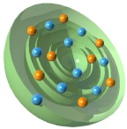
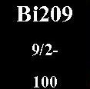
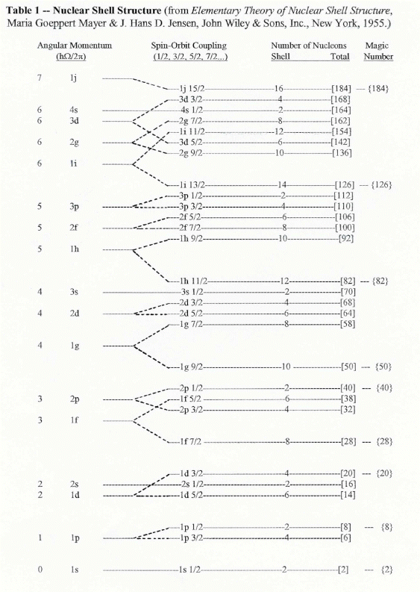
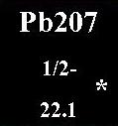
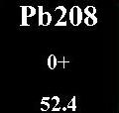
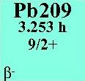
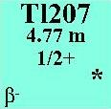
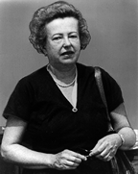
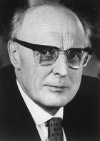
Nuclear shell structure
Maria Goeppert-Mayer J. Hans D. Jensen

Slide 5
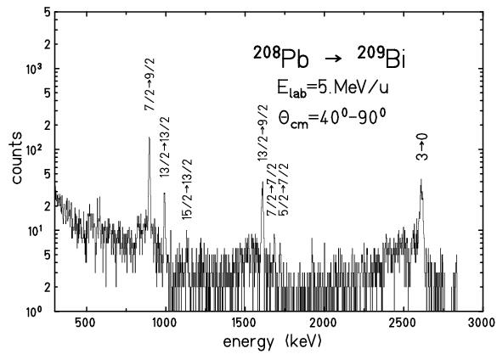
Experimental single-particle energies
γ-spectrum
single-particle energies
1 i_{13/2}
1609 keV
²⁰⁸Pb → ²⁰⁹Bi
E_{lab} = 5 MeV/u
2 f_{7/2}
896 keV
1 h_{9/2}
0 keV

Slide 6
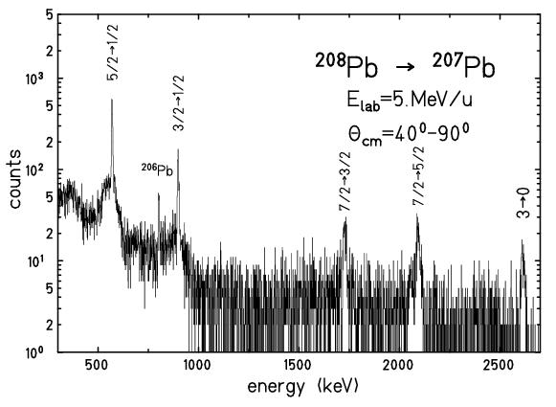
Experimental single-particle energies
γ-spectrum
²⁰⁸Pb → ²⁰⁷Pb
E_{lab} = 5 MeV/u
single-hole energies
3 p_{3/2}
898 keV
2 f_{5/2}
570 keV
3 p_{1/2}
0 keV

Slide 7
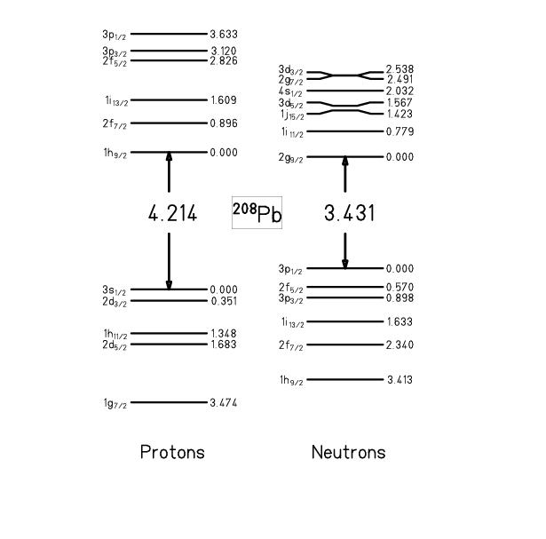
Experimental single-particle energies
particle states
²⁰⁹Bi
1 i_{13/2}
1609 keV
²⁰⁹Pb
2 f_{7/2}
896 keV
1 h_{9/2}
0 keV
energy of shell closure:
²⁰⁷Tl
²⁰⁷Pb
hole states
protons
neutrons

Slide 8
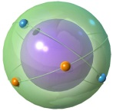
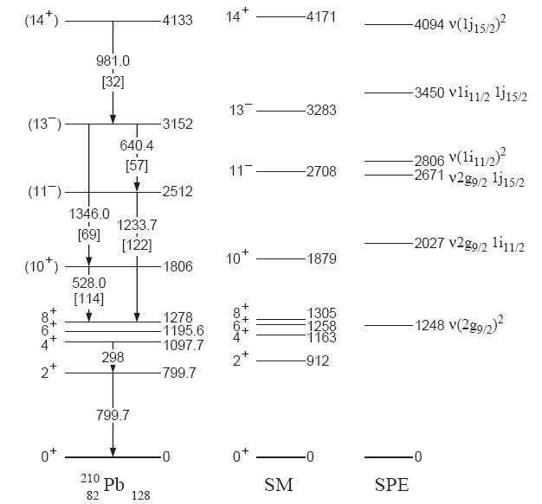
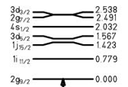
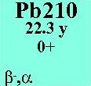
Level scheme of ²¹⁰Pb
2846 keV
2202 keV
1558 keV
exp. single particle energies
1423 keV
779 keV
0.0 keV
-1304 keV (pairing energy)
residual interaction !
M. Rejmund Z.Phys. A359 (1997), 243

Slide 9
Coupling of two angular momenta
j₁+ j₂ all values from: j₁ – j₂ to j₁+ j₂ (j₁ = j₂)
Example: j₁ = 3, j₂ = 5: J = 2, 3, 4, 5, 6, 7, 8
BUT: For j₁ = j₂: J = 0, 2, 4, 6, … ( 2j – 1) (Why these?)

Slide 10
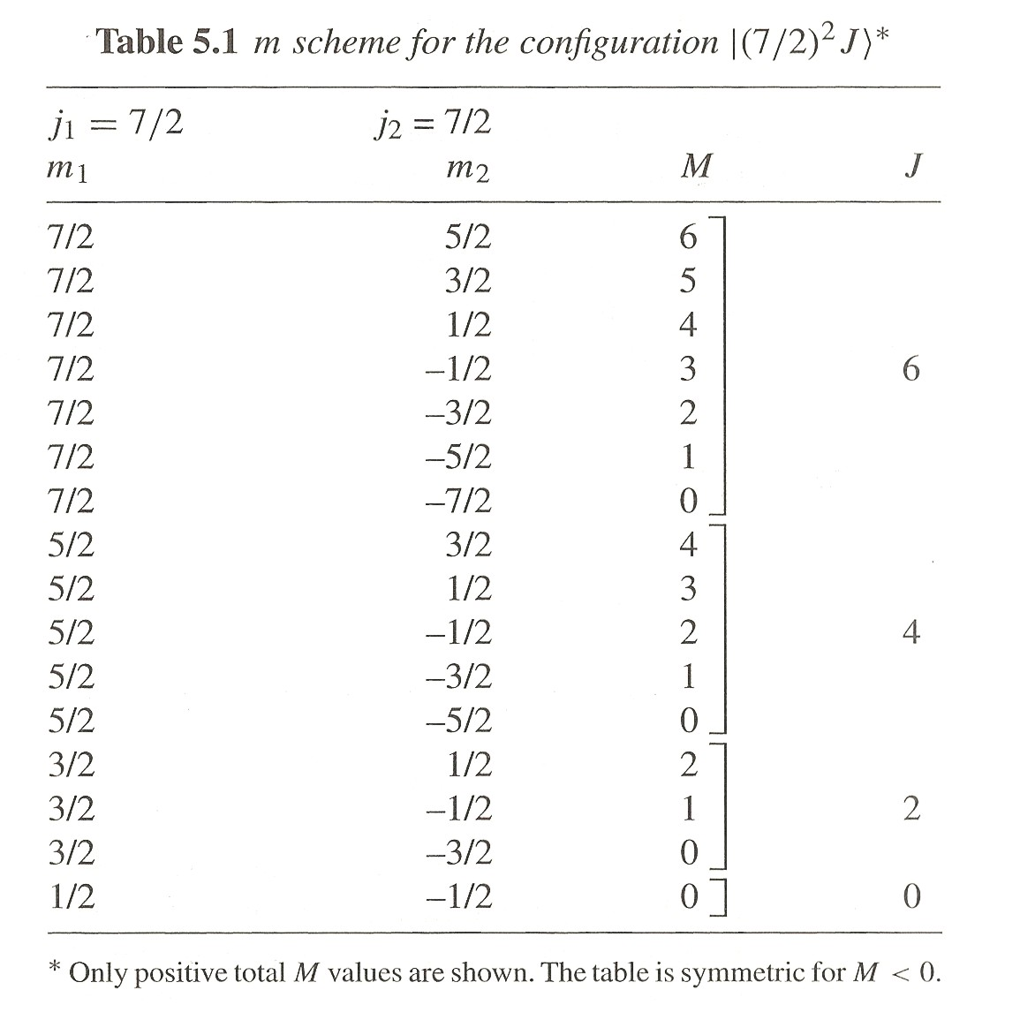
Coupling of two angular momenta
How can we know which total angular momenta J are observed for the coupling of two identical nucleons in the same orbit with angular momentum j?
Several methods: easiest is the “m-scheme”.

Slide 11
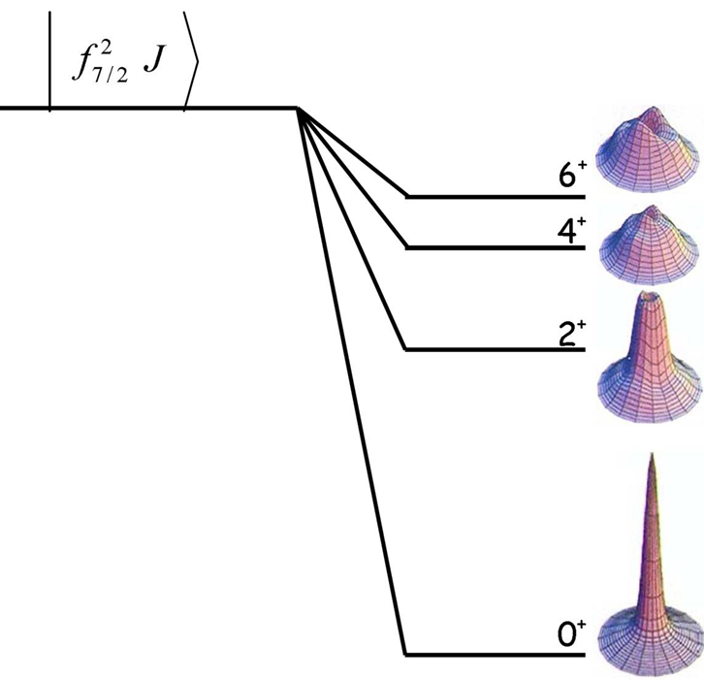
Coupling of two angular momenta

Slide 12
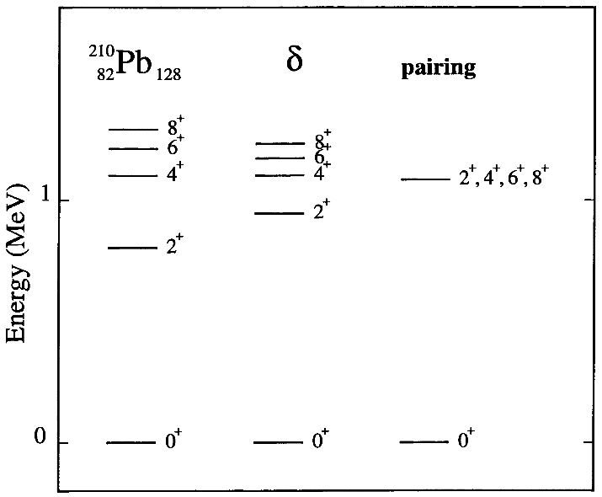
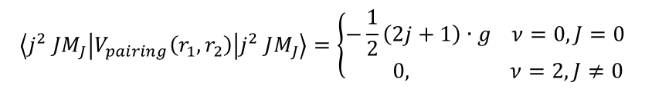
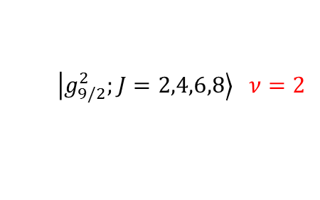
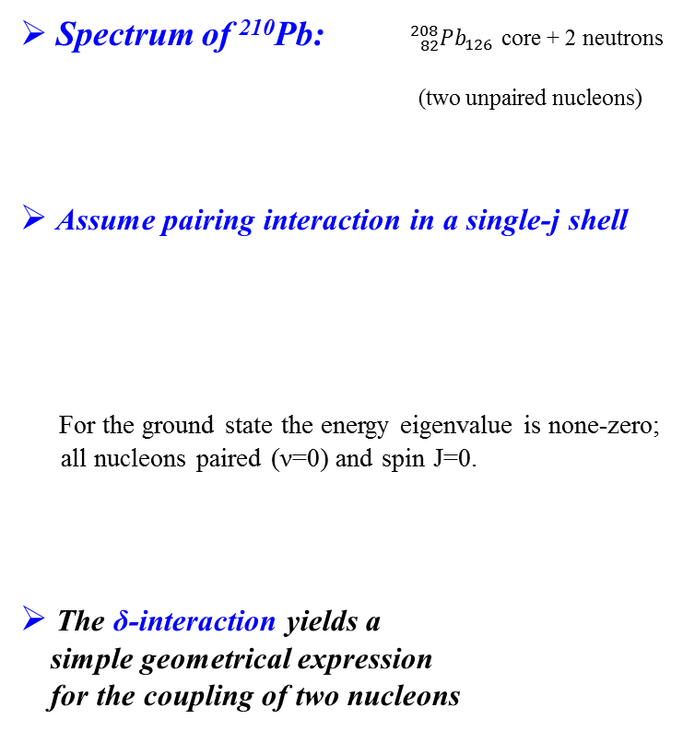
Residual interaction - pairing
Spectrum of ²¹⁰Pb: ${ {}_{82}^{208}{Pb}}_{126}$ core + 2 neutrons
(two unpaired nucleons)
Assume pairing interaction in a single-j shell
For the ground state the energy eigenvalue is none-zero;
all nucleons paired (ν=0) and spin J=0.
The δ-interaction yields a
simple geometrical expression
for the coupling of two nucleons
$$\left|\left.g_{9/2}^{2};J=2,4,6,8\right\rangle ν=2\right.$$
$$\left\langle j^{2} JM_{J} | V_{pairing}\left(r_{1},r_{2}\right) | j^{2} JM_{J}\right\rangle =\left\{\begin{matrix}−\frac{1}{2}\left(2j+1\right)∙g ν=0, J=0 \\ 0, ν=2, J≠0\end{matrix}\right.$$
8
6
4
2
0

Slide 13
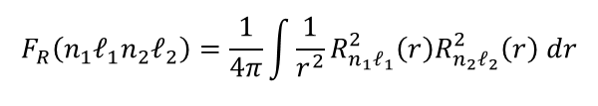


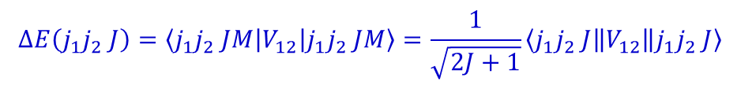

Pairing – δ-interaction
$$∆E\left(j_{1}j_{2} J\right)=\left\langle j_{1}j_{2} JM | V_{12} | j_{1}j_{2} JM\right\rangle =\frac{1}{\sqrt{2J+1}}\left\langle j_{1}j_{2} J\left\|V_{12}\right\|j_{1}j_{2} J\right\rangle$$
wave function:
$$φ\left(nℓm\right)=\frac{1}{r}R_{nℓ}\left(r\right)∙Y_{ℓm}\left(θ,φ\right)$$
interaction:
$$V_{12}\left(δ\right)=\frac{−V_{0}}{r_{1}r_{2}}δ\left(r_{1}−r_{2}\right) δ\left(cosθ_{1}−cosθ_{2}\right) δ\left(φ_{1}−φ_{2}\right)$$
$$ΔE\left(j_{1}j_{2} J\right)=−V_{0}∙F_{R}\left(n_{1}ℓ_{1}n_{2}ℓ_{2}\right)∙A\left(j_{1}j_{2} J\right)$$
$$F_{R}\left(n_{1}ℓ_{1}n_{2}ℓ_{2}\right)=\frac{1}{4π}\int{\frac{1}{r^{2}}R_{n_{1}ℓ_{1}}^{2}\left(r\right)R_{n_{2}ℓ_{2}}^{2}\left(r\right) dr}$$
with
and
$$A\left(j_{1}j_{2} J\right)=\left(2j_{1}+1\right)∙\left(2j_{2}+1\right)∙{\left(\begin{matrix}j_{1} & j_{2} & J \\ 1/2 & −1/2 & 0\end{matrix}\right)}^{2}$$
A. de-Shalit & I. Talmi: Nuclear Shell Theory, p.200

Slide 14

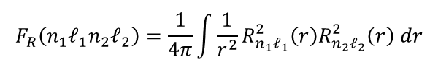
Pairing – δ-interaction
$$∆E\left(j_{1}j_{2} J\right)=\left\langle j_{1}j_{2} JM | V_{12} | j_{1}j_{2} JM\right\rangle =\frac{1}{\sqrt{2J+1}}\left\langle j_{1}j_{2} J\left\|V_{12}\right\|j_{1}j_{2} J\right\rangle$$
wave function:
$$φ\left(nℓm\right)=\frac{1}{r}R_{nℓ}\left(r\right)∙Y_{ℓm}\left(θ,φ\right)$$
interaction:
$$V_{12}\left(δ\right)=\frac{−V_{0}}{r_{1}r_{2}}δ\left(r_{1}−r_{2}\right) δ\left(cosθ_{1}−cosθ_{2}\right) δ\left(φ_{1}−φ_{2}\right)$$
$$∆E\left(j_{1}j_{2} J\right)=\frac{1}{2}∙\left(2j_{1}+1\right)∙\left(2j_{2}+1\right)∙\left\{\begin{matrix}ℓ_{1} & ℓ_{2} & J \\ j_{2} & j_{1} & 1/2\end{matrix}\right\}∙2∙\left(2ℓ_{1}+1\right)∙\left(2ℓ_{2}+1\right)∙{\left(\begin{matrix}ℓ_{1} & J & ℓ_{2} \\ 0 & 0 & 0\end{matrix}\right)}^{2}∙F_{R}\left(n_{1}ℓ_{1}n_{2}ℓ_{2}\right)$$
$${\left\{\begin{matrix}ℓ_{1} & ℓ_{2} & J \\ j_{2} & j_{1} & 1/2\end{matrix}\right\}}^{2}∙{\left(\begin{matrix}ℓ_{1} & J & ℓ_{2} \\ 0 & 0 & 0\end{matrix}\right)}^{2}→\frac{1}{\left(2ℓ_{1}+1\right)∙\left(2ℓ_{2}+1\right)}∙{\left(\begin{matrix}j_{1} & j_{2} & J \\ 1/2 & −1/2 & 0\end{matrix}\right)}^{2} for {\left(−1\right)}^{ℓ_{1}+ℓ_{2}−J}=1$$
$$ΔE\left(j_{1}j_{2} J\right)=−V_{0}∙F_{R}\left(n_{1}ℓ_{1}n_{2}ℓ_{2}\right)∙A\left(j_{1}j_{2} J\right)$$
$$F_{R}\left(n_{1}ℓ_{1}n_{2}ℓ_{2}\right)=\frac{1}{4π}\int{\frac{1}{r^{2}}R_{n_{1}ℓ_{1}}^{2}\left(r\right)R_{n_{2}ℓ_{2}}^{2}\left(r\right) dr}$$
with
and
$$A\left(j_{1}j_{2} J\right)=\left(2j_{1}+1\right)∙\left(2j_{2}+1\right)∙{\left(\begin{matrix}j_{1} & j_{2} & J \\ 1/2 & −1/2 & 0\end{matrix}\right)}^{2}$$
A. de-Shalit & I. Talmi: Nuclear Shell Theory, p.200

Slide 15
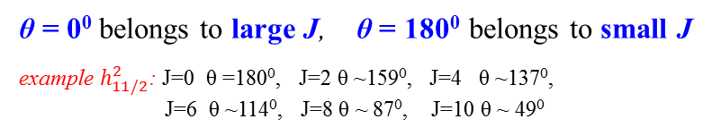
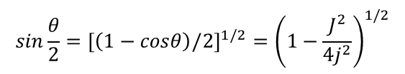

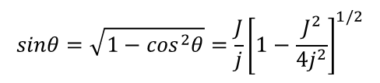



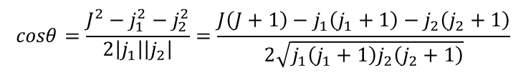
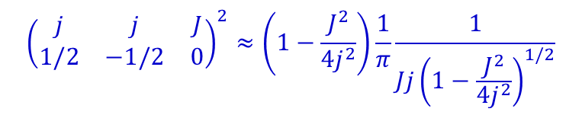


δ-interaction (semiclassical concept)
$$J^{2}=j_{1}^{2}+j_{2}^{2}+2\left|j_{1}\right|\left|j_{2}\right|cosθ$$
$$cosθ=\frac{J^{2}−j_{1}^{2}−j_{2}^{2}}{2\left|j_{1}\right|\left|j_{2}\right|}=\frac{J\left(J+1\right)−j_{1}\left(j_{1}+1\right)−j_{2}\left(j_{2}+1\right)}{2\sqrt{j_{1}\left(j_{1}+1\right)j_{2}\left(j_{2}+1\right)}}$$
θ
$$\vec{j_{2}}$$
$$cosθ≅\frac{J^{2}−2j^{2}}{2j^{2}} for j_{1}=j_{2}=j and j,J≫1$$
$$\vec{j_{1}}$$
$$\vec{J}$$
θ = 0⁰ belongs to large J, θ = 180⁰ belongs to small J
example $h_{11/2}^{2}$: J=0 θ =180⁰, J=2 θ ~159⁰, J=4 θ ~137⁰,
J=6 θ ~114⁰, J=8 θ ~ 87⁰, J=10 θ ~ 49⁰
$$sinθ=\sqrt{1−\cos^{2}θ}=\frac{J}{j}{\left[1−\frac{J^{2}}{4j^{2}}\right]}^{1/2}$$
$$sin\frac{θ}{2}={\left[\left(1−cosθ\right)/2\right]}^{1/2}={\left(1−\frac{J^{2}}{4j^{2}}\right)}^{1/2}$$
$${\left(\begin{matrix}j & j & J \\ 1/2 & −1/2 & 0\end{matrix}\right)}^{2}≈\left(1−\frac{J^{2}}{4j^{2}}\right)\frac{1}{π}\frac{1}{{Jj\left(1−\frac{J^{2}}{4j^{2}}\right)}^{1/2}}$$
$$=\frac{\sin^{2}\left(θ/2\right)}{π∙j^{2}∙sinθ}=\frac{tan\left(θ/2\right)}{π∙j^{2}}$$

Slide 16
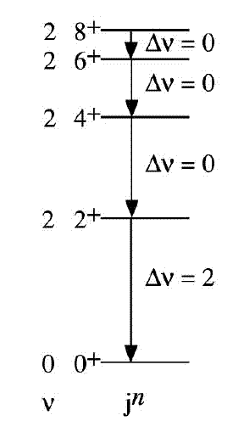
Pairing δ-interaction
8
6
4
2
0
δ-interaction yields a simple geometrical explanation for Seniority-Isomers:
ΔE ~ -V_{o}·F_{R}· tan (^{θ}/₂)
for T=1, even J
energy intervals between states 0⁺, 2⁺, 4⁺, ...(2j-1)⁺ decrease with increasing spin.

Slide 17


The ¹⁰⁰Sn / ¹³²Sn region, a brief background
Single particle energies
h_{11/2}
N=82
MeV
2.6
d_{3/2}
2.2
s_{1/2}
1.6
Z = 50
g_{7/2}
d_{5/2}
0.5
g_{7/2}
0
N=50
The ¹⁰⁰Sn / ¹³²Sn region
d_{5/2}
s_{1/2}
d_{3/2}
h_{11/2}
Naïve single particle filling

Slide 18
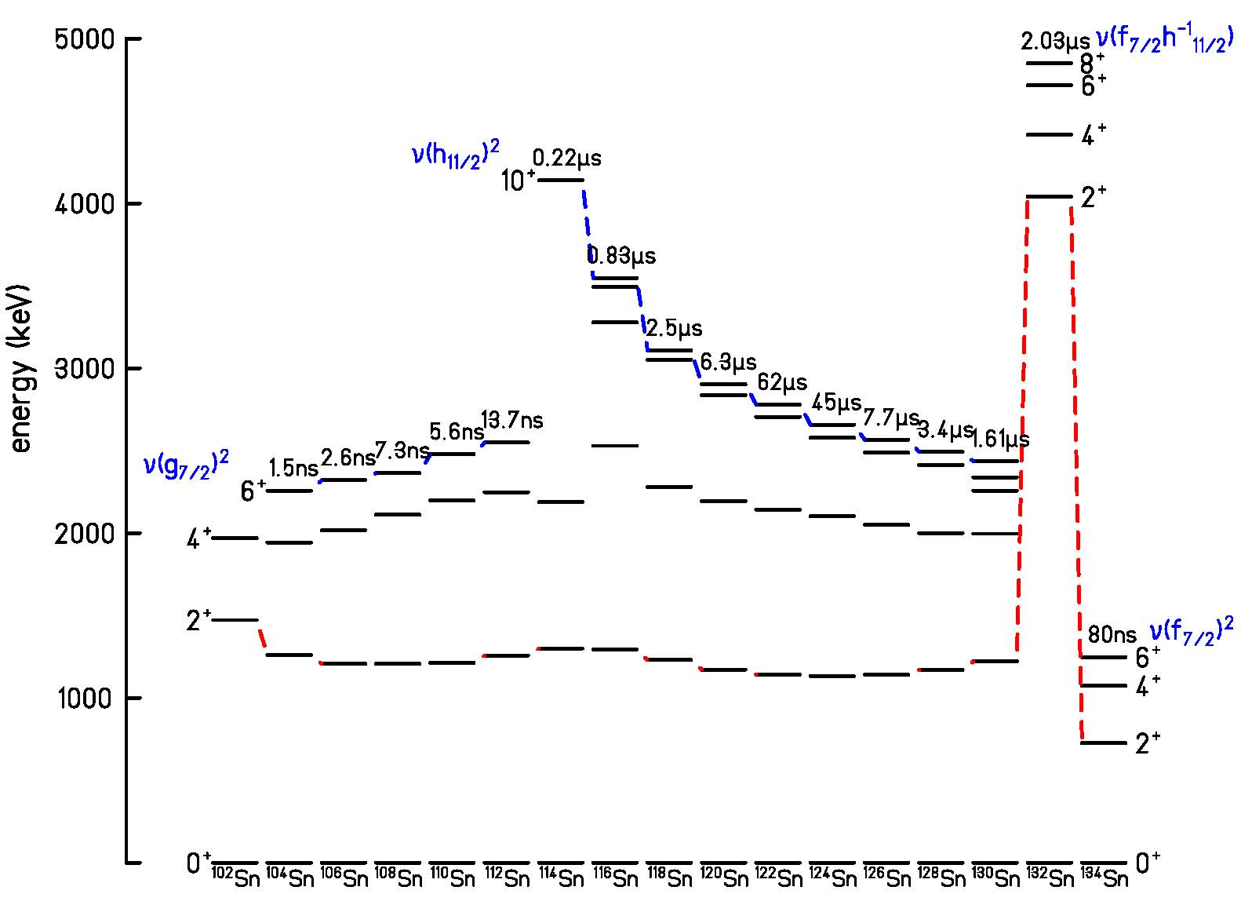
The ¹⁰⁰Sn / ¹³²Sn region, isomeric states
Single particle energies
h_{11/2}
N=82
MeV
2.6
d_{3/2}
2.2
s_{1/2}
1.6
d_{5/2}
0.5
g_{7/2}
0
N=50

Slide 19
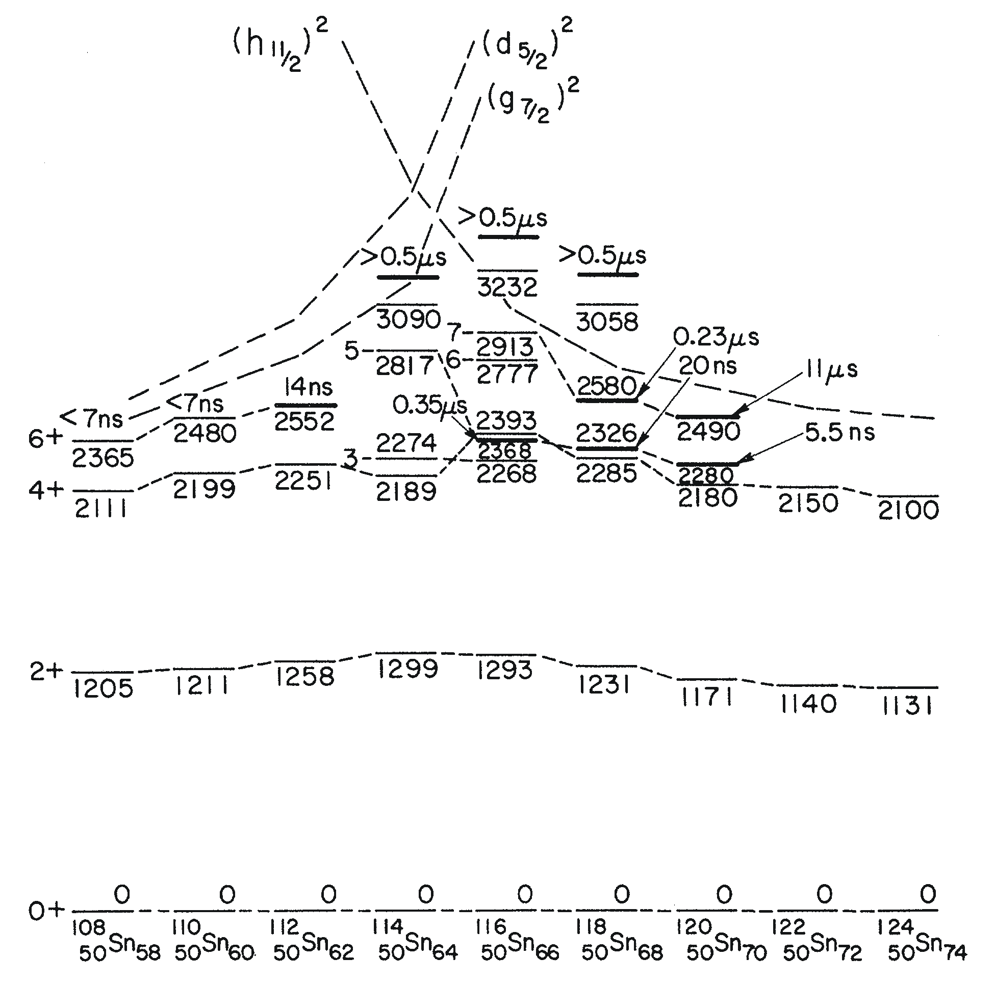
Generalized seniority scheme
Single particle energies
h_{11/2}
N=82
MeV
2.6
d_{3/2}
2.2
s_{1/2}
1.6
d_{5/2}
0.5
g_{7/2}
0
N=50
The ¹⁰⁰Sn / ¹³²Sn region

Slide 20
Isomeric states in ¹⁰⁶Sn – ¹¹²Sn
T_{1/2} = 2.8(5) ns
T_{1/2} = 7.4(4) ns
T_{1/2} = 5.6(4) ns
T_{1/2} =13.8(4) ns
6⁺
2323.6
6⁺
2365.1
6⁺
2477.0
6⁺
2548.9
304.1
253.6
280.8
301.7
4⁺
2019.1
4⁺
2111.5
4⁺
2196.2
4⁺
2247.2
812.1
905.1
984.6
990.6
T_{1/2}= 0.35 ps
2⁺
1207
2⁺
1206.4
2⁺
1211.6
2⁺
1256.6
1207
1206.4
1211.6
1256.6
0⁺
0
0⁺
0
0⁺
0
0⁺
0
¹⁰⁶Sn
¹⁰⁸Sn
¹¹⁰Sn
¹¹²Sn
T_{1/2} = 115 s
T_{1/2} = 10.2 m
T_{1/2} = 4 h
B_{exp}(E2,6⁺->4⁺) = 0.49(+-0.02) W.u
B_{exp}(E2,2⁺->0⁺) = 16.0 W.u

Slide 21
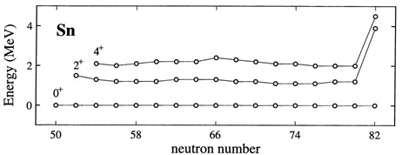
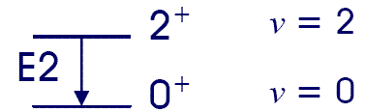


Generalized seniority scheme
Seniority quantum number ν is equal to the number of unpaired particles in the j^{n} configuration, where n is the number of valence nucleons.
energy spacing between ν=2 and ground state (ν=0, J=0):
$$E\left(j^{n},ν=2,J\right)−E\left(j^{n},ν=0,J=0\right)=\left\langle j^{2} J | V | j^{2} J\right\rangle +\frac{n−2}{2}∙V_{0}−\frac{n}{2}∙V_{0}$$
$$=\left\langle j^{2} J | V | j^{2} J\right\rangle −V_{0}$$
independent of n
energy spacing within ν=2 states:
$$E\left(j^{n},ν=2,J\right)−E\left(j^{n},ν=2,J´\right)=\left[\left\langle j^{2} J | V | j^{2} J\right\rangle +\frac{n−2}{2}∙V_{0}\right]−\left[\left\langle j^{2} J´ | V | j^{2} J´\right\rangle +\frac{n−2}{2}∙V_{0}\right]$$
$$=\left\langle j^{2} J | V | j^{2} J\right\rangle −\left\langle j^{2} J´ | V | j^{2} J´\right\rangle$$
independent of n
G. Racah et al., Phys. Rev. 61 (1942), 186 and Phys. Rev. 63 (1943), 367

Slide 22
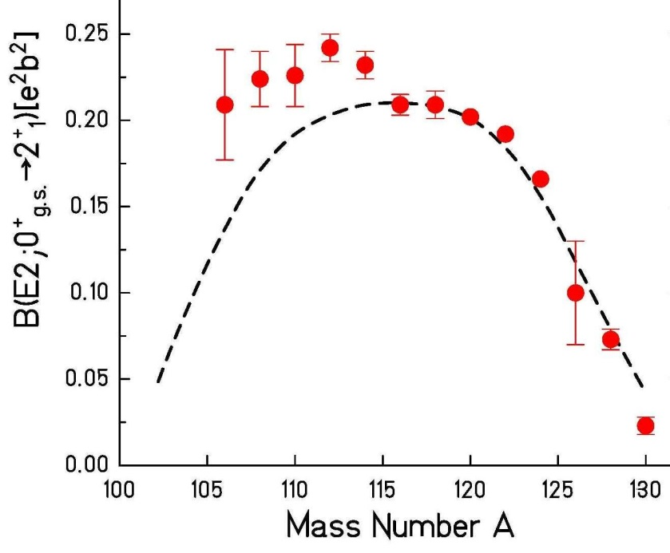



Generalized seniority scheme
Seniority quantum number ν is equal to the number of unpaired particles in the j^{n} configuration, where n is the number of valence nucleons.
E2 transition rates:
$$B\left(E2;J_{i}→J_{f}\right)=\frac{1}{2∙J_{i}+1}∙{\left\langle J_{f}\left\|Q\right\|J_{i}\right\rangle }^{2}$$
$${\left\langle j^{n} J=2\left\|Q\right\|j^{n} J=0\right\rangle }^{2}=\left[\frac{n∙\left(2j+1−n\right)}{2∙\left(2j−1\right)}\right]∙{\left\langle j^{2} J=2\left\|Q\right\|j^{2} J=0\right\rangle }^{2}$$
$$=\left[\frac{{\left(2j+1\right)}^{2}}{2∙\left(2j−1\right)}\right]∙f∙\left(1−f\right)∙{\left\langle j^{2} J=2\left\|Q\right\|j^{2} J=0\right\rangle }^{2} f=\frac{n}{2j+1}→1 for large n$$
$$B\left(E2;2_{1}^{+}→0_{1}^{+}\right)≈f∙\left(1−f\right)$$
≈ N_{particles}*N_{holes}
Sn isotopes

Slide 23
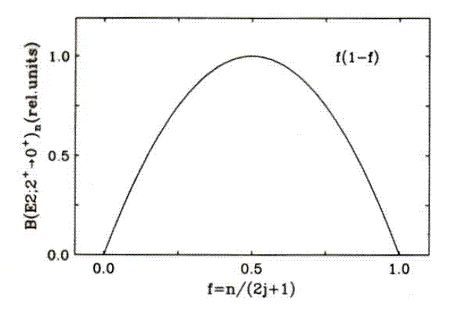
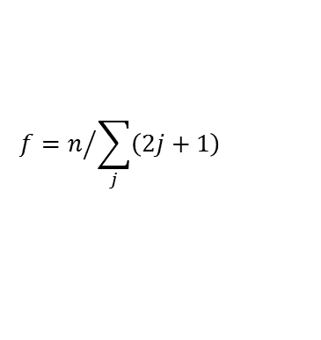
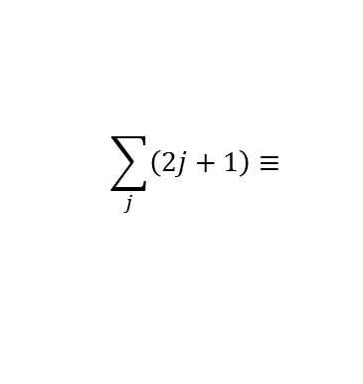

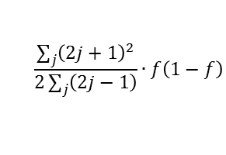
Generalized seniority scheme
Seniority quantum number ν is equal to the number of unpaired particles in the j^{n} configuration, where n is the number of valence nucleons.
$$\frac{\sum_{j}{{\left(2j+1\right)}^{2}}}{2\sum_{j}{\left(2j−1\right)}}∙f\left(1−f\right)$$
$$B\left(E2;2_{1}^{+}→0_{1}^{+}\right)≈f∙\left(1−f\right)$$
≈ N_{particles}*N_{holes}
$$f=n/{\sum_{j}{\left(2j+1\right)}}$$
$$\sum_{j}{\left(2j+1\right)}≡$$
number of nucleons between shell closures

Slide 24
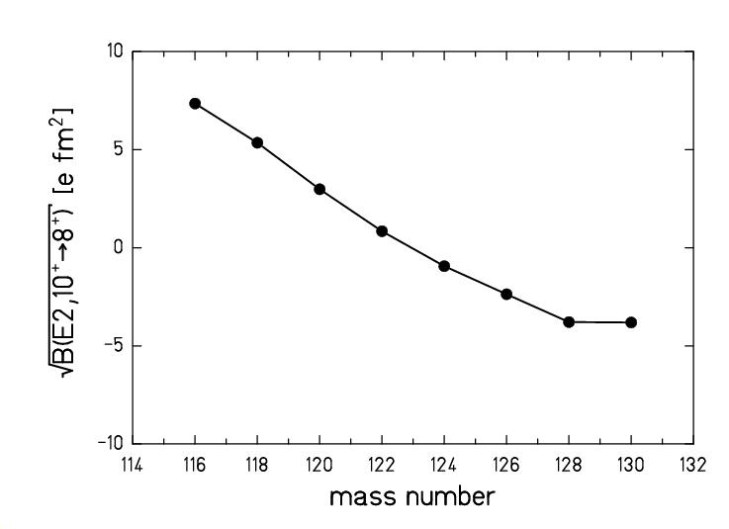


Generalized seniority scheme
Seniority quantum number ν is equal to the number of unpaired particles in the j^{n} configuration, where n is the number of valence nucleons.
E2 transition rates that do not change seniority (ν=2):
$$\left\langle j^{n} J\left\|Q\right\|j^{n} J´\right\rangle =\left[\frac{2j+1−2n}{2j−3}\right]∙\left\langle j^{2} J\left\|Q\right\|j^{2} J´\right\rangle$$
$$=\frac{2j+1}{2j−3}∙\left[1−2f\right]∙\left\langle j^{2} J\left\|Q\right\|j^{2} J´\right\rangle$$
Sn isotopes

Slide 25
8⁺(g_{9/2})⁻² seniority isomers in ⁹⁸Cd and ¹³⁰Cd
h_{11/2}
N=82
MeV
(8⁺)
2428
2.6
(6⁺)
d_{3/2}
2.2
(4⁺)
2281
s_{1/2}
1.6
(8⁺)
2128
N=50
Z=48
2083
d_{5/2}
0.5
(6⁺)
N=82
Z=48
(4⁺)
2002
g_{7/2}
0
1864
N=50
(2⁺)
participating neutron-orbitals
(2⁺)
1395
1325
two proton holes in the g_{9/2} orbit
No dramatic shell quenching!
0⁺
0⁺
A. Blazhev et al., Phys. Rev. C69 (2004) 064304 A. Jungclaus et al., Phys. Rev. Lett. 99 (2007), 132501

Slide 26
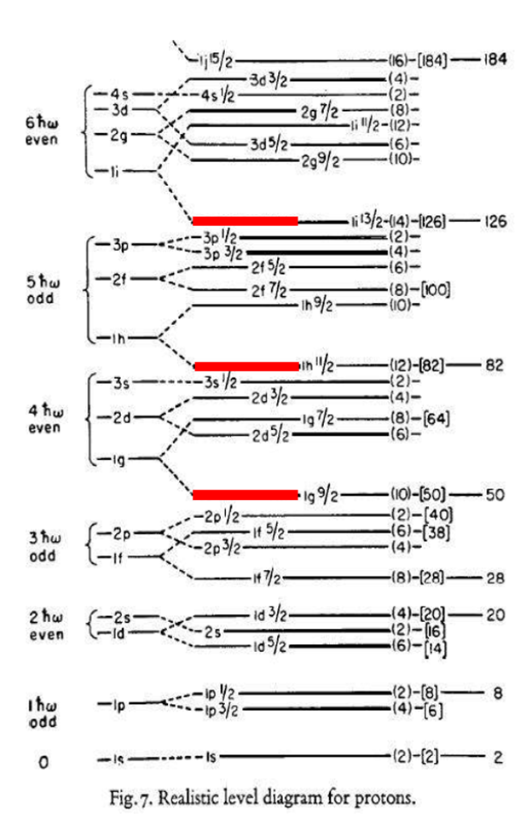
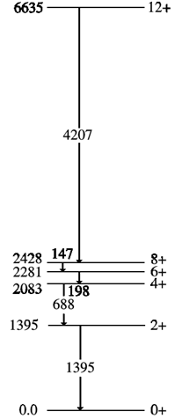

Spin isomer in ⁹⁸Cd
~230 ns
E4
$${}_{48}^{98}{{Cd}_{50}}$$
~170 ns
A. Blazhev et al., Phys.Rev.C69 (2004) 064304

Slide 27
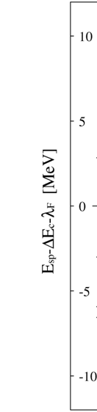
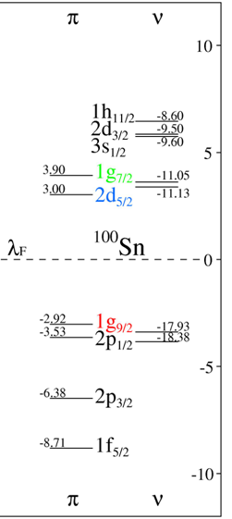
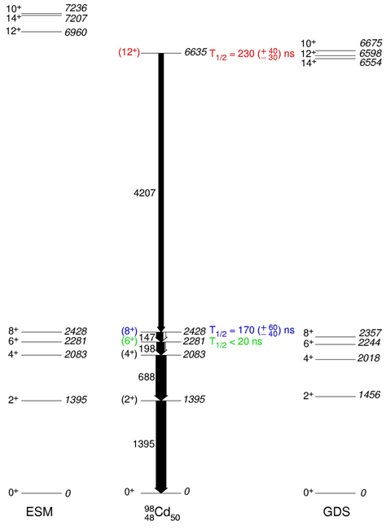
Core excited states in ⁹⁸Cd
e_{π} = 1.3(2)
e_{π} = 1.1
ESM: H. Grawe et al., NS98 AIP CP 481 (1999) 177
GDS: F.Nowacki, Nuc. Phys. A 704 (2002) 223c
A. Blazhev et al., Phys.Rev.C69 (2004) 064304

Slide 28
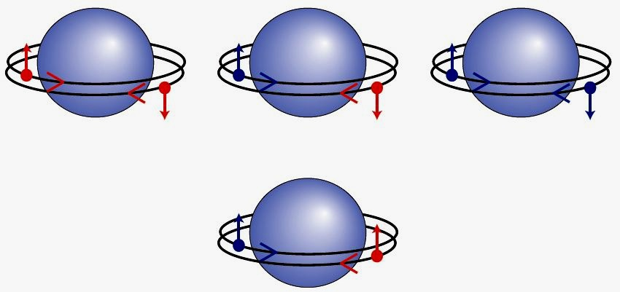
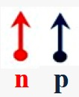
Nature of nucleon pair correlations
T=1 S=0
isovector pairing
T=0 S=1
isoscalar pairing
Deuteron-like pair condensate
Does T=0 pairing exist?
The strong nuclear force is observed to be roughly equally strong between a proton-proton(pp) pair and a neutron-neutron(nn) pair (charge symmetry) and
on average equally strong between a proton-neutron(pn) pair as between pp and nn pairs (charge independence).

Slide 29
What is the ground state structure of N=Z nuclei below ¹⁰⁰Sn
For ⁹²Pd and ⁹⁶Cd neutrons and protons
mainly occupy the g _{9/2} subshell
⁹²Pd
⁹⁶Cd
νg_{9/2}⁻¹
νg_{9/2}⁻¹
πg_{9/2}⁻¹
¹⁰⁰Sn
νg_{9/2}⁻¹
¹⁰⁰Sn
νg_{9/2}⁻¹
πg_{9/2}⁻¹
νg_{9/2}⁻¹
πg_{9/2}⁻¹
πg_{9/2}⁻¹
πg_{9/2}⁻¹
πg_{9/2}⁻¹
νg_{9/2}⁻¹
The conventional picture :
Ψ=({νg _{9/2}⁻²}₀₊)^{n} x ({πg _{9/2}⁻²}₀₊)^{n}
This would lead to a normal seniority type spectrum of
low-lying excited states

Slide 30
Shell Model calculations predict strong np-interactions
Model space: g_{9/2} (and f_{5/2 ,} p_{3/2} ,p_{½} )
⁹²Pd
⁹⁶Cd
νg_{9/2}⁻¹
πg_{9/2}⁻¹
νg_{9/2}⁻¹
πg_{9/2}⁻¹
πg_{9/2}⁻¹
νg_{9/2}⁻¹
¹⁰⁰Sn
¹⁰⁰Sn
νg_{9/2}⁻¹
πg_{9/2}⁻¹
νg_{9/2}⁻¹
πg_{9/2}⁻¹
νg_{9/2}⁻¹
πg_{9/2}⁻¹
Aligned np coupling:
Ψ=[({νg _{9/2}⁻¹ x πg _{9/2}⁻¹}₉₊)²]₀₊
x [({νg _{9/2}⁻¹ x πg _{9/2}⁻¹}₇₊)²]₀₊
Ψ=[({νg _{9/2}⁻¹ x πg _{9/2}⁻¹}₉₊)²]₀₊
J. Blomqvist et al.

Slide 31


Shell model calculations with T=0 np-pairing for ⁹²Pd
For ⁹²Pd, neutrons and protons mainly occupy the g_{9/2} subshell
This would lead to a seniority type spectrum of low-lying excited states
larger energy of 2⁺, smaller 4⁺, …
aligned np-coupling

Slide 32

Pd level systematics near N=Z
⁹²Pd, theory
⁹²Pd, exp
⁹⁴Pd, theory
⁹⁴Pd, exp
⁹⁶Pd, theory
⁹⁶Pd, exp
Shell model calculations by J. Blomqvist, R. Liotta, C. Qi

Slide 33


Experimental results and shell model calculations for ⁹²Pd
experimental results
shell model calculations
by Stockholm group
B. Cederwall et al., Nature 469 (2011) 68
evidence that T=0 mode of the np-interactions play a role in ⁹²Pd?

Slide 34

Experimental results and shell model calculations

Slide 35


T_{z} = +1 nucleus ⁹⁴Pd
14⁺ isomer
T_{z,π} = -1/2 for protons T_{z,ν} = +1/2 for neutrons

Slide 36
New manifestation of T=0 np “pairing”?
⁹²Pd
⁹⁶Cd
l=8
l=8
l=8
¹⁰⁰Sn
¹⁰⁰Sn
l=6
l=6
l=8
”Nuclear belly dancers”
Special deuteron-hole cluster like ground states imply significant deformation

Slide 37

B(E2;0⁺→2⁺) – sensitive probe of neutron-proton interactions
Shell model calculations by J. Blomqvist, R. Liotta, C. Qi

Slide 38

Evidence for enhanced collective strength in Te and Xe nuclei approaching N=Z
Te experimental E(2⁺) and B(E2; 2⁺→ 0⁺)
Quadrupole collectivity
The traditional view of the mechanism behind deformation and collectivity: long range np QQ interactions
Enhancement of collectivity due to np (short-range) pairing correlations predicted in new calculations by D.S Delion, R. Liotta et al.
Evidence for onset of collectivity, possibly induced by np pairing in neutron deficient Te and Xe nuclei
T_{z}=1 nucleus ¹⁰⁶Te : B. Hadinia, B. Cederwall et al., Phys. Rev. C 72, 041303 (2005)

Slide 39

Evidence for enhanced collective strength in Te and Xe nuclei approaching N=Z
Xe experimental E(2⁺) and B(E2; 2⁺→ 0⁺)
Quadrupole collectivity
The traditional view of the mechanism behind deformation and collectivity: long range np QQ interactions
Enhancement of collectivity due to np (short-range) pairing correlations predicted in new calculations by D.S Delion, R. Liotta et al.
Evidence for onset of collectivity, possibly induced by np pairing in neutron deficient Te and Xe nuclei
T_{Z}=1 nucleus ¹¹⁰Xe; M. Sandzelius, B. Hadinia,, B. Cederwall et al., Phys. Rev. Lett. 99, 022501 (2007)

Slide 40





Appendix
$$B\left(E2;J_{i}→J_{f}\right)=\frac{1}{2∙J_{i}+1}∙{\left\langle J_{f}\left\|Q\right\|J_{i}\right\rangle }^{2}$$
Seniority changing: Δν = 2
$${\left\langle j^{n} J=2\left\|Q\right\|j^{n} J=0\right\rangle }^{2}=\left[\frac{n∙\left(2j+1−n\right)}{2∙\left(2j−1\right)}\right]∙{\left\langle j^{2} J=2\left\|Q\right\|j^{2} J=0\right\rangle }^{2}$$
$$=\left[\frac{{\left(2j+1\right)}^{2}}{2∙\left(2j−1\right)}\right]∙f∙\left(1−f\right)∙{\left\langle j^{2} J=2\left\|Q\right\|j^{2} J=0\right\rangle }^{2} f=\frac{n}{2j+1}→1 for large n$$
Seniority conserving: ν → ν
$$\left\langle j^{n} J\left\|Q\right\|j^{n} J´\right\rangle =\left[\frac{2j+1−2n}{2j+1−2ν}\right]∙\left\langle j^{2} J\left\|Q\right\|j^{2} J´\right\rangle$$
$$=\frac{2j+1}{2j+1−2ν}∙\left[1−2f\right]∙\left\langle j^{2} J\left\|Q\right\|j^{2} J´\right\rangle$$
$$f=\frac{n}{2j+1}→1 for large n$$
Example: quadrupole moments this is why nuclei are prolate at the beginning of a shell and oblate at the end.

Slide 41



Signatures near closed shells
Excitation energy
Sn isotopes
N=82 isotones
N=50 isotones

