Slide 1
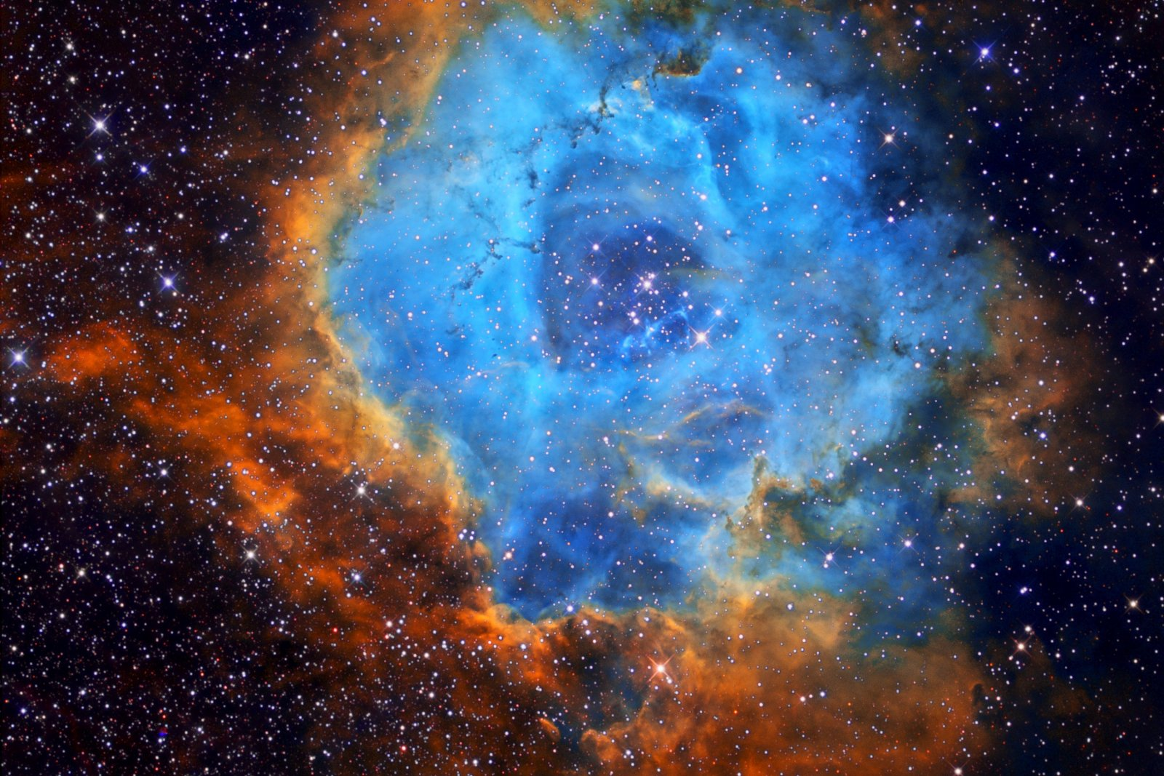

Outline: Evidence for Big Bang theory
GSI/FAIR
The Universe in the Laboratory

Slide 2
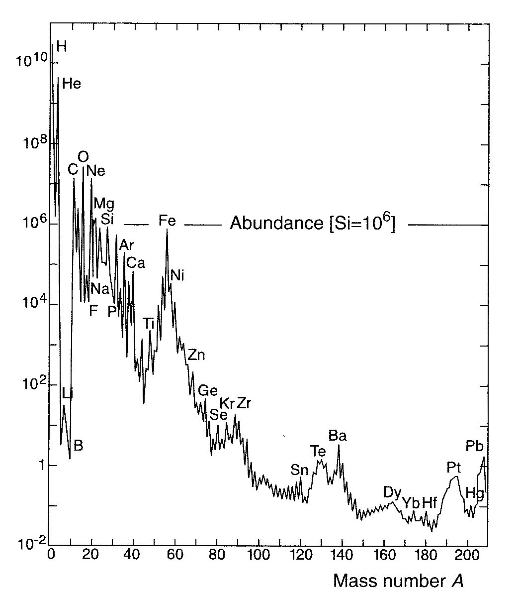
Nuclear Astrophysics: the origin of the elements
periodic table
Data sources:
Earth, Moon, meteorites, cosmic rays, solar & stellar spectra…
Features:
distribution everywhere similar
12 orders-of-magnitude span
H ~ 75%, He ~ 23%
C → U ~ 2% (“metals”)
D, Li, Be B under-abundant
exponential decrease up to Fe
almost flat distribution beyond Fe
How, where and when have the elements been made?

Slide 3
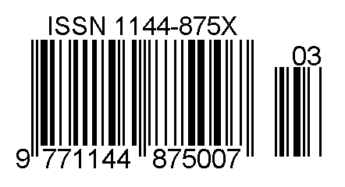
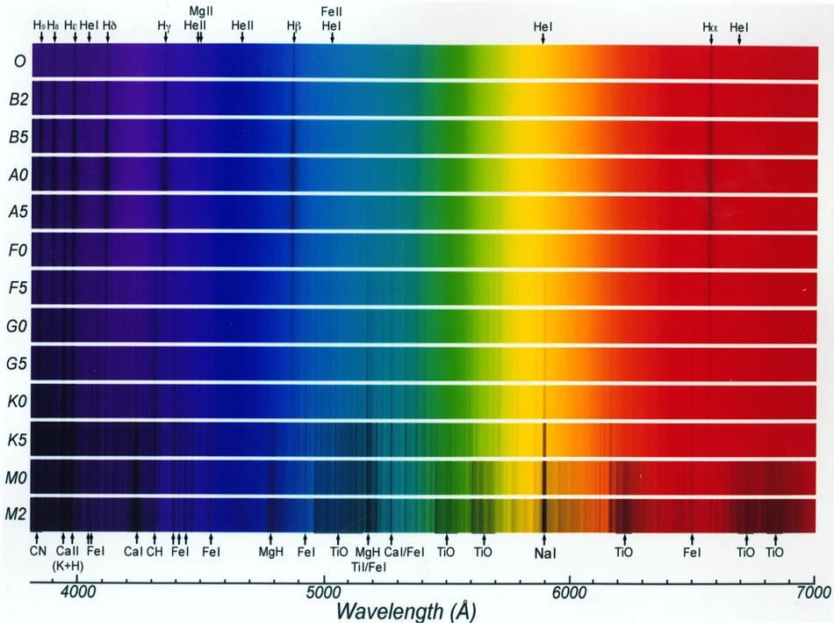
Stellar spectra classification
information about stars  electromagnetic radiation received on Earth
surface temperature & density
chemical composition
excitation/ionization degree
…
stellar spectra like barcodes
Oh
Be
A
Fine
Girl (Guy)
Kiss
Me
(Right
Now
Smack!)
temperature
Cecilia Payne (PhD Thesis, 1925)

Slide 4

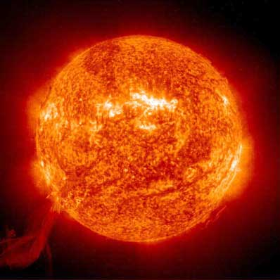
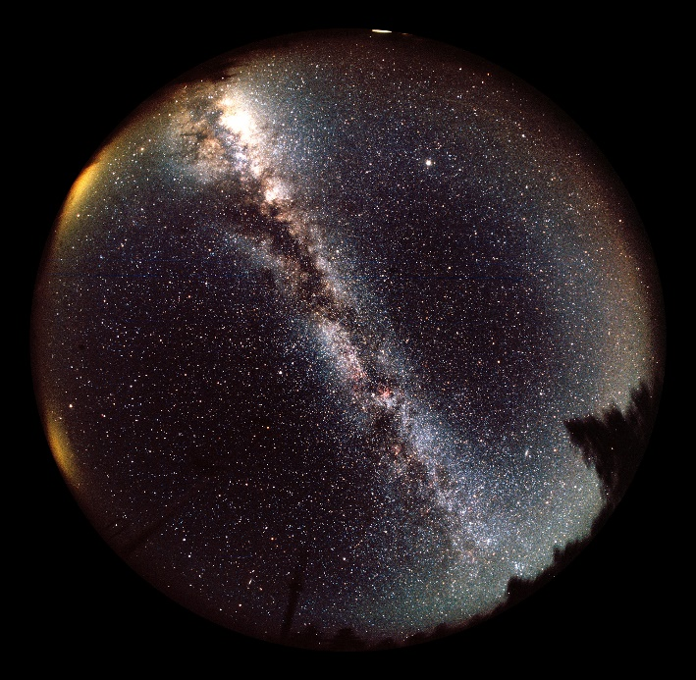
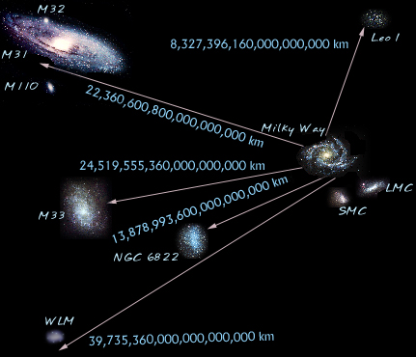
Our place in the Universe
the Earth D ~ 6.4·10³ km
the Sun R ~ 6.9·10⁵ km
T ~ 15·10⁶ K (our Sun) ⇒ kT ~ 1 keV
T ~ 10¹⁰ K (Big Bang) ⇒ kT ~ 2 MeV
average kinetic energy:
kT ~ 8.6·10⁻⁸ T[K] keV
our Galaxy D ~ 9·10¹⁷ km, 10¹¹ stars
the local group D ~ 4·10¹⁹ km 10-100 galaxies
typical star
M_{o} = 2x10³⁰ kg
Zoo of different stars:
Planetary nebulae
Red giants, Novae
Supernovae, Pulsars…
Milky Way
Zoo of different galaxies:
spherical, elliptical,
spiral, radio, quasars
How do stars form, live and die?
What are they made of and what makes them shine?

Slide 5
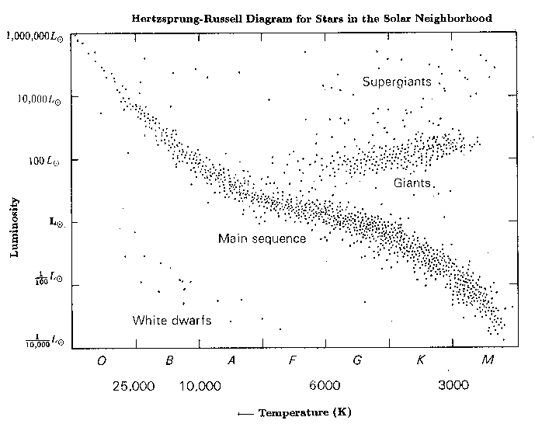

Hertzsprung-Russell (HR) diagram
SUPERGIANTS
GIANTS
Luminosity
sun
WHITE
DWARFS
No chaos, but order!
MAIN
SEQUENCE
← Temperature [K]
~ 95% of all stars in diagonal band called MAIN SEQUENCE
highest probability of observing them in this stage
longest stage in a star’s lifetime
Question: how long do stars live?

Slide 6
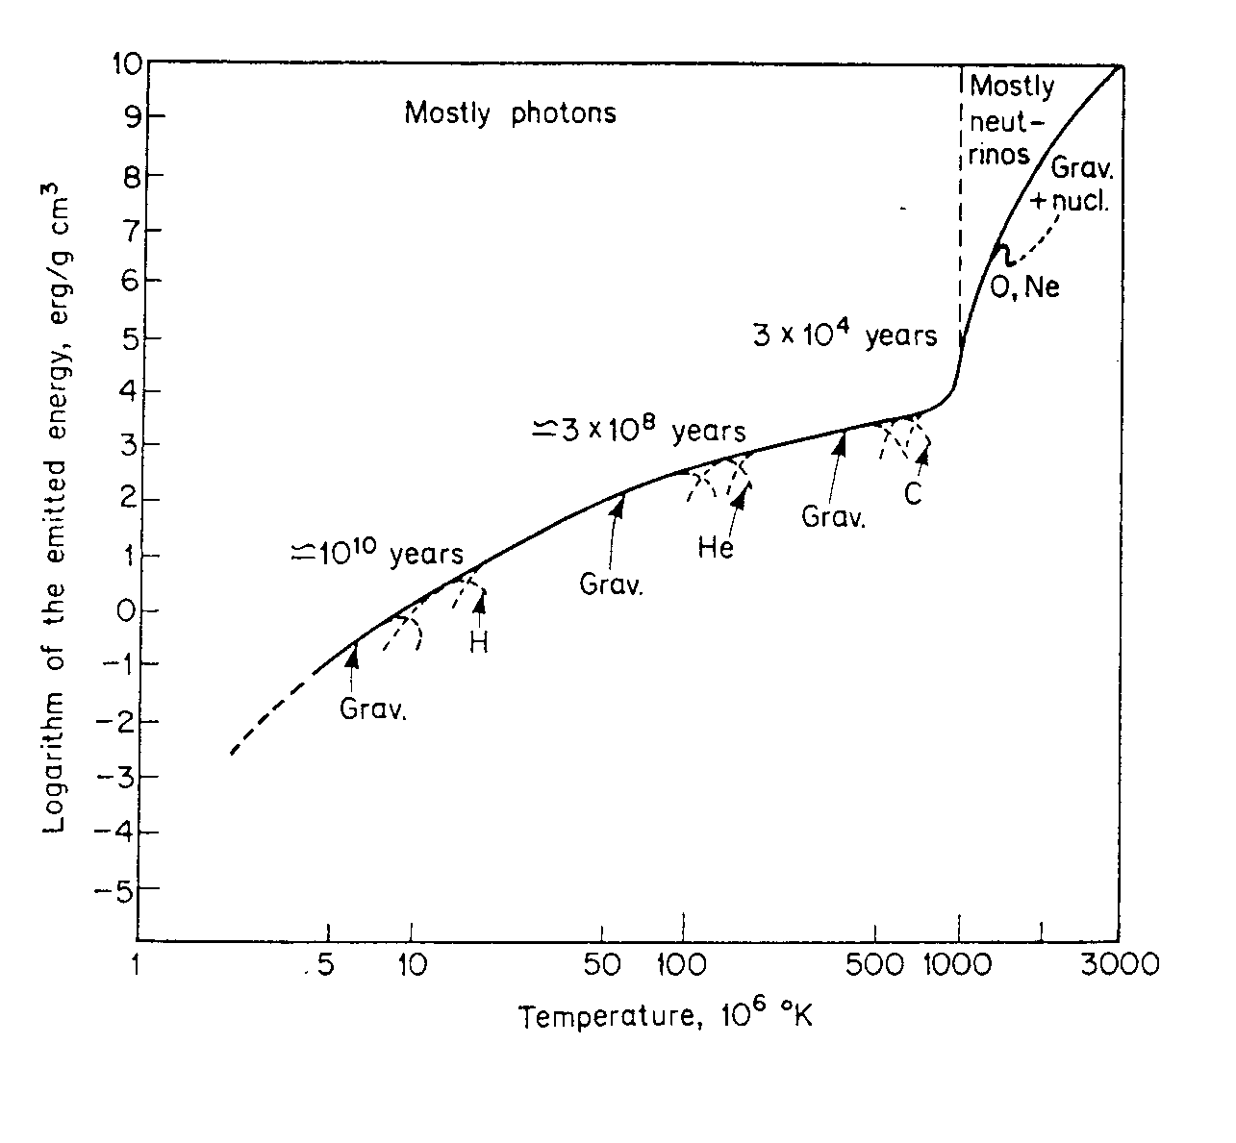
Stellar evolution…
Main parameters governing evolution: initial mass & initial chemical composition
Example: evolution stages of a 25 M star
Quiescent burning
Energy generation rate
ε ~ T^{n}
n ~ 4 (H-burning)
n ~ 30 (C-burning)
Pre-Supernova
~ days - seconds
Super Giant
~ 3x10⁴ y
Red Giant
~ 3x10⁸ y
O, Ne…
innermost regions only
contribute to nuclear burning
Main
Sequence
~ 10¹⁰ y
C
He
e.g. 1/10 M for H-burning
less for subsequent stages
H
Gravitational
Contraction
H-burning ≡ MAIN SEQUENCE
longest stage of star’s lifetime

Slide 7
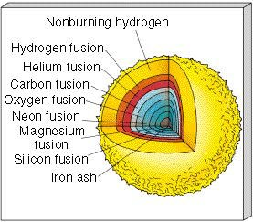
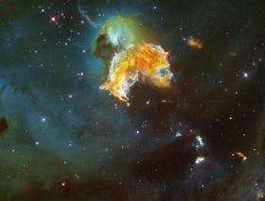
… and nucleosynthesis
nucleosynthesis
energy
HYDROGEN BURNING (1st equilibrium)
4p → ⁴He + 2β⁺ + 2ν + 26 MeV
HELIUM BURNING (2nd equilibrium)
3α → ¹²C
¹²C(α,γ)¹⁶O
+ 8 MeV
¹²C/¹⁶O BURNING
… ¹²C ashes = Ne, Na, Mg
… ¹⁶O ashes = Al, … Si
T, ρ
²⁸Si MELTING
major ash = ⁵⁶Fe
… A = 40-65
further reactions endothermic gravitational collapse
SUPERNOVA EXPLOSION
neutron star
black hole

Slide 8
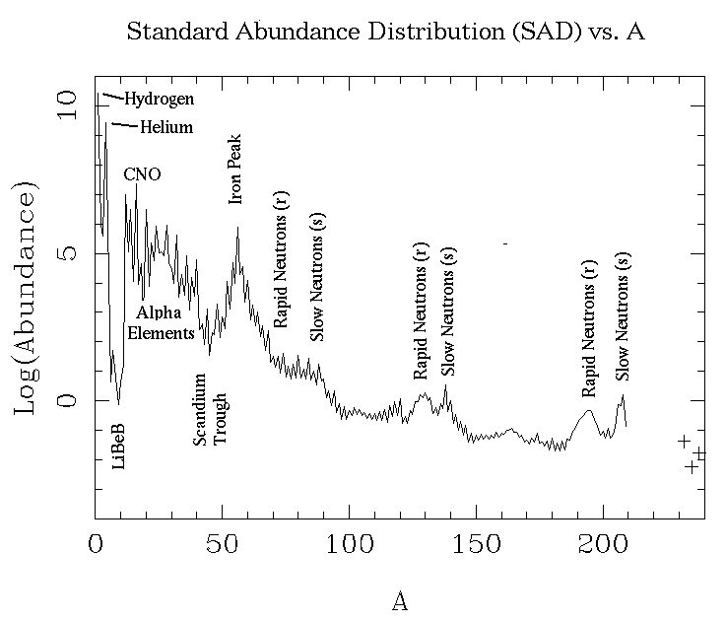
Synthesis of the trans-iron elements
charged-particle
induced reaction
mainly neutron
capture reaction
during quiescent stages
of stellar evolution
mainly during explosive
stages of stellar evolution
involve mainly STABLE NUCLEI
involve mainly UNSTABLE NUCLEI

Slide 9
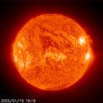
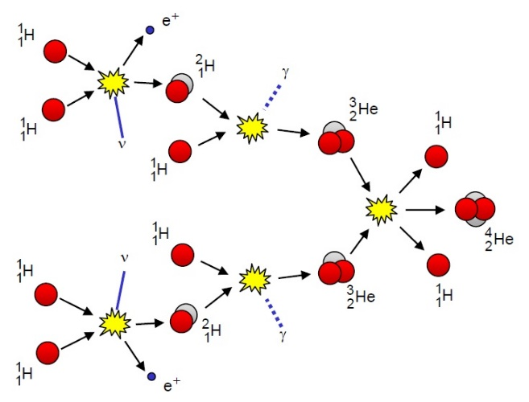


The ²H(p,γ)³He reaction solar fusion
$$σ\left(E\right)=S\left(E\right)∙{e^{−2πη\left(E\right)}}/E$$
$$η=\frac{Z_{1}∙Z_{2}∙e^{2}}{ℏ∙v_{∞}}$$
Sommerfeld parameter
LUNA demonstrate, for the first time, that it is possible to direct study solar fusion in the Gamow window from underground laboratories.
only three reactions studied directly at Gamow peak

Slide 10

Electron screening effect
E_{c}
σ(E) = S(E) exp(-2πη)
$$\frac{1}{E}$$
bare
penetration through
Coulomb barrier
between BARE nuclei
Coulomb potential
screened
E + U_{e}
E
0
R_{n}
R_{D}
R_{t}
in stellar plasmas:
ions in sea of free electrons
Debye-Hückel radius R_{D} ~ (kT/ρ)^{½}
enhanced cross-section by a factor:
S(E)
σ_{s}(E)
S_{s}(E)
E
screened S(E)
f(E) =
=
=
exp(πηU_{e}/E)
fit to measured
low-energy data
σ_{b}(E)
S_{b}(E)
E + U_{e}
∝ U_{e}
extrapolation from
fit to high-energy data
bare S(E)
0
E
PROBLEM: experimental Ue >> theoretical Ue

Slide 11
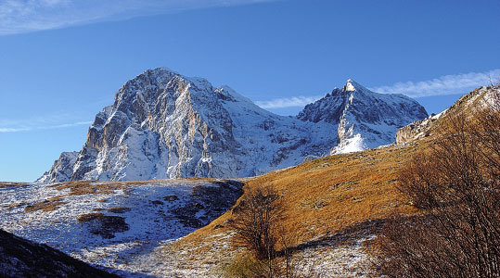
LUNA @ Laboratori Nazionali Gran Sasso
Rock as passive shielding
cosmic ray background reduction ~ 10⁻⁴
4-50 keV accelerator
p-, α-beams ≤ 1 mA
study of pp-chains
e.g. ³He + ³He

Slide 12
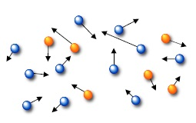
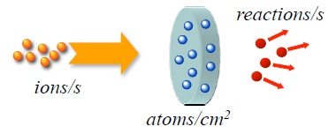
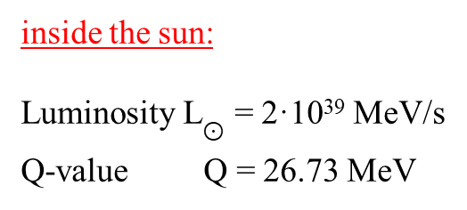
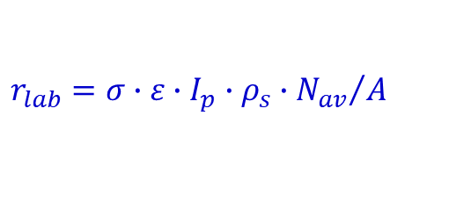

Reaction rates
inside the sun:
Luminosity L$⊙$ = 2·10³⁹ MeV/s
Q-value Q = 26.73 MeV
$$r_{⨀}=\frac{L_{⨀}}{Q}={10}^{38} s^{−1}$$
luminosity is the total amount of energy produced in a star and radiated into space in form of E-M radiation per time
in the lab:
ε ~ 10%
I_{p} ~ mA
ρ_{s} ~ mg/cm²
pb < s < nb
$$r_{lab}=σ∙ε∙I_{p}∙ρ_{s}∙{N_{av}}/A$$
even / month < r_{lab} < event / day
signal rate ≥ background rate
cosmic ray flux at the sea level ~ 2·10⁻² cm⁻² s⁻¹
on a 10 cm² detector ~ 2000 events / day !!!

Slide 13
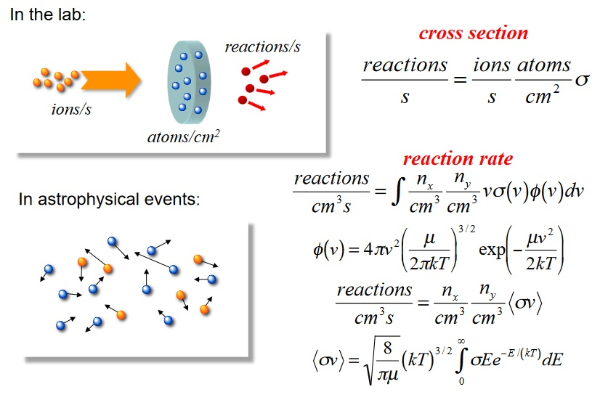
Nuclear reactions in the laboratory & in space

Slide 14
LUNA II upgrade
50 – 400 keV
accelerator laboratory
p-, α-beams ≤ 1 mA
Study of p-capture on CNO nuclei (CNO-cycles)
and α-capture on light nuclei
Inline-Cockcroft-Walton power supply

Slide 15
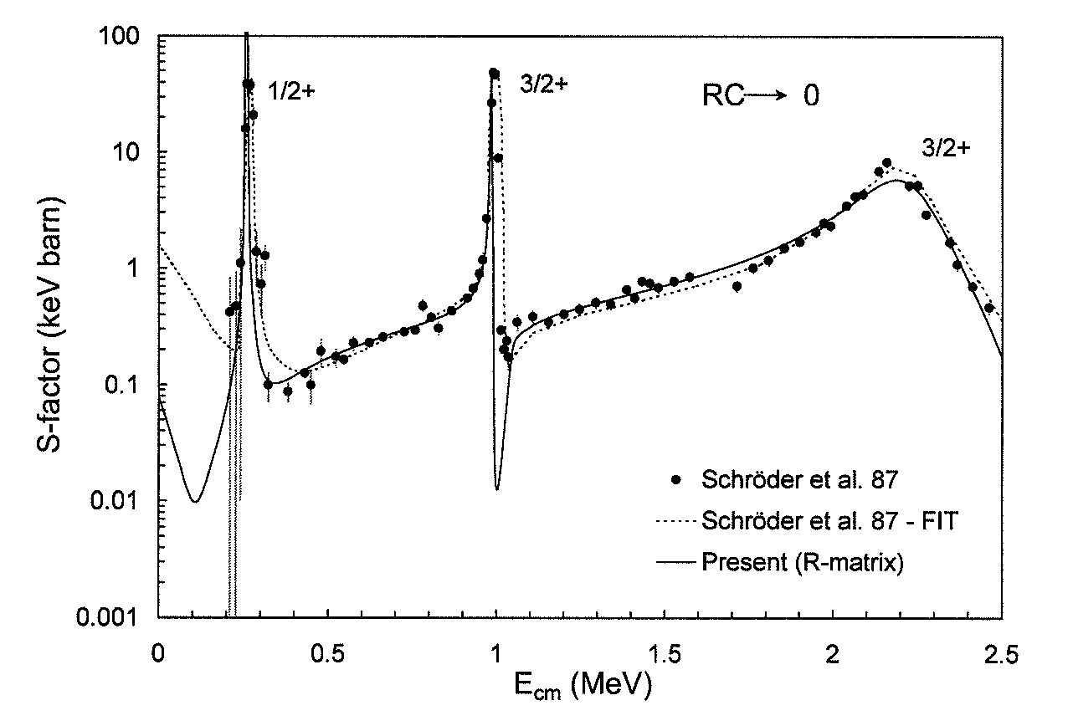
LUNA II 400 keV
¹⁴N(p,γ)¹⁵O
CNO cycle
O
15
energy generation rate
in massive main sequence stars
N
13
14
15
(slowest reaction in CNO cycle)
C
12
13
Astrophysical region:
20-80 keV
6
7
8
Angulo et al. 01

Slide 16
LUNA II 400 keV
¹⁴N(p,γ)¹⁵O
CNO cycle
O
15
energy generation rate
in massive main sequence stars
N
13
14
15
(slowest reaction in CNO cycle)
C
12
13
6
7
8
astrophysical S-factor
lowest measured σ = 0.24x10⁻¹² barn

Slide 17
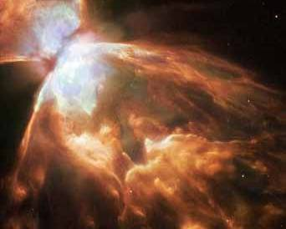
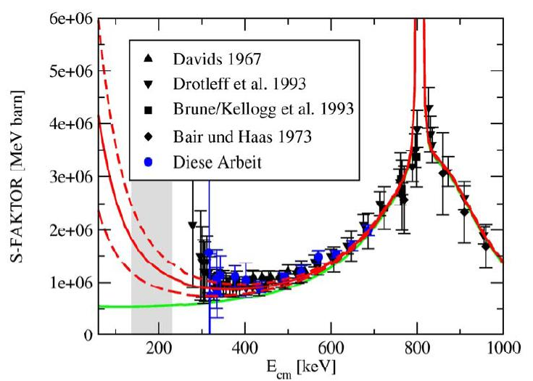
LUNA II 400 keV
¹³C(α,n)¹⁶O
importance: s-process in AGB stars
Gamow region: 130 - 250 keV
min. measured E: 270 keV
M. Heil, PhD Thesis - Karlsruhe, 2002
Courtesy: F. Strieder
contributions from sub-threshold states?
mainly hampered by cosmic background → good case for underground investigation

Slide 18
Synthesis of the trans-iron elements
charged-particle
induced reaction
mainly neutron
capture reaction
during quiescent stages
of stellar evolution
mainly during explosive
stages of stellar evolution
involve mainly STABLE NUCLEI
involve mainly UNSTABLE NUCLEI

Slide 19
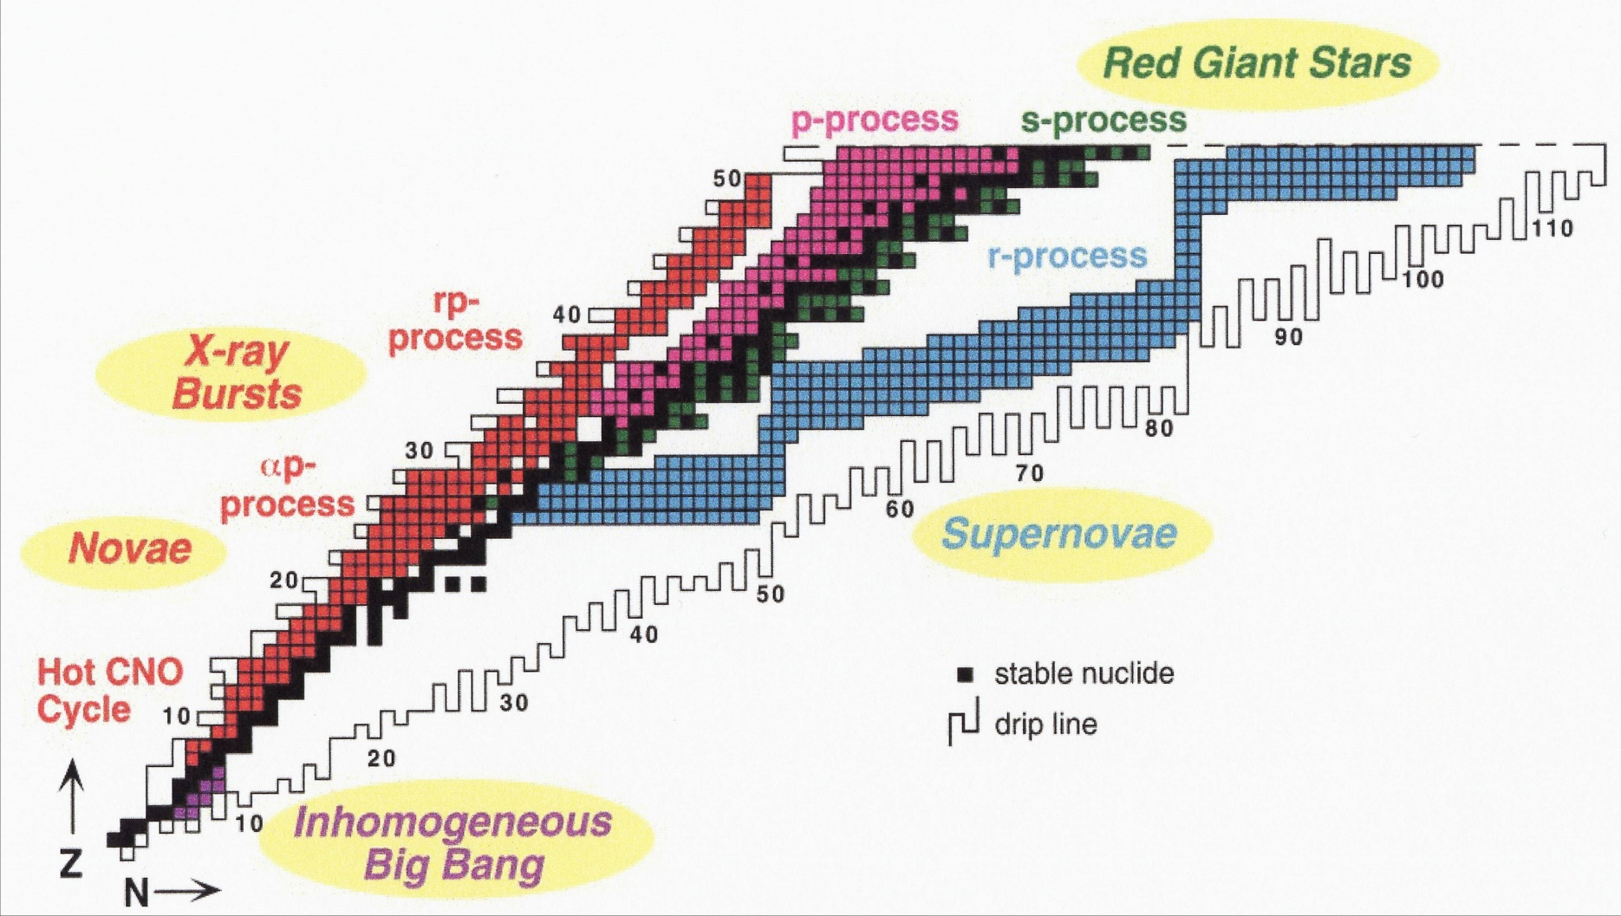
Main nuclear processes and astrophysical sites
M.S. Smith and K.E. Rehm,
Ann. Rev. Nucl. Part. Sci, 51 (2001) 91-130
nuclear reaction paths involve UNSTABLE species ⇒ Radioactive Ion Beams
key reactions identified by sensitivity of astrophysical models to nuclear inputs

Slide 20
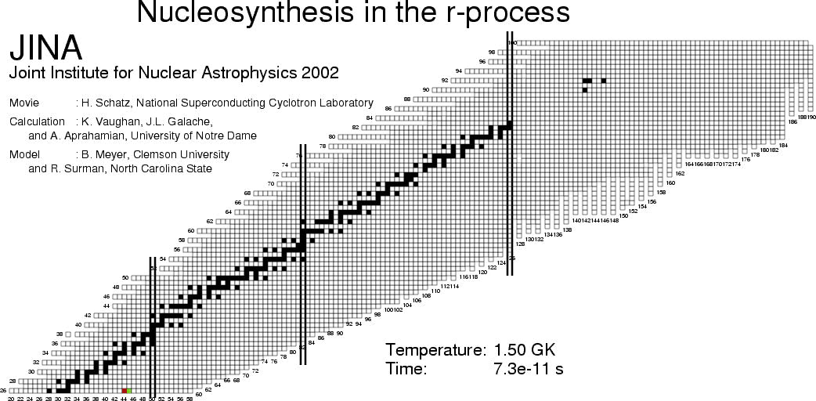
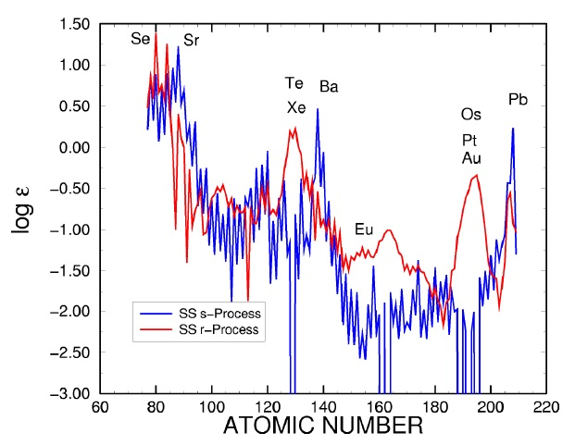
Timescale of the r-process
summing up time spent at waiting points: t ~ 0.5 – 10 s

Slide 21
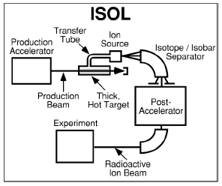
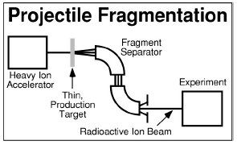
Radioactive Ion Beams production method
Isotope Separation on Line (ISOL) (CERN, LLN, ORNL, TRIUMF, ANURIB project)
Projectile Fragmentation (PF) (GANIL, GSI, MSU, RIKEN)
in-flight production (ANL, Notre Dame, TAMU)
batch mode production (suitable for long-lived species)
…
☺ excellent quality
high purity
high intensities
☺ independent from chemical properties
no limitations on t_{½} (fast separation)
☹ limited number of species
different production for different species
limited to nuclei with t_{½} ≥ 1s (allow for diffusion)
☹ typical beam energies too high for NA
poorer beam quality (energy, size)
possible beam contaminations
ANURIB: Advanced National facility for Unstable and Rare Isotope Beams
M.S. Smith and K.E. Rehm, Ann. Rev. Nucl. Part. Sci, 51 (2001) 91-130

Slide 22
Radioactive Ion Beams production method
Isotope Separation on Line (ISOL) (CERN, LLN, ORNL, TRIUMF)
Projectile Fragmentation (PF) (GANIL, GSI, MSU, RIKEN)
in-flight production (ANL, Notre Dame, TAMU)
batch mode production (suitable for long-lived species)
…
☺ excellent quality
high purity
high intensities
☺ independent from chemical properties
no limitations on t_{½} (fast separation)
☹ limited number of species
different production for different species
limited to nuclei with t_{½} ≥ 1s (allow for diffusion)
☹ typical beam energies too high for NA
poorer beam quality (energy, size)
possible beam contaminations
M.S. Smith and K.E. Rehm, Ann. Rev. Nucl. Part. Sci, 51 (2001) 91-130

Slide 23
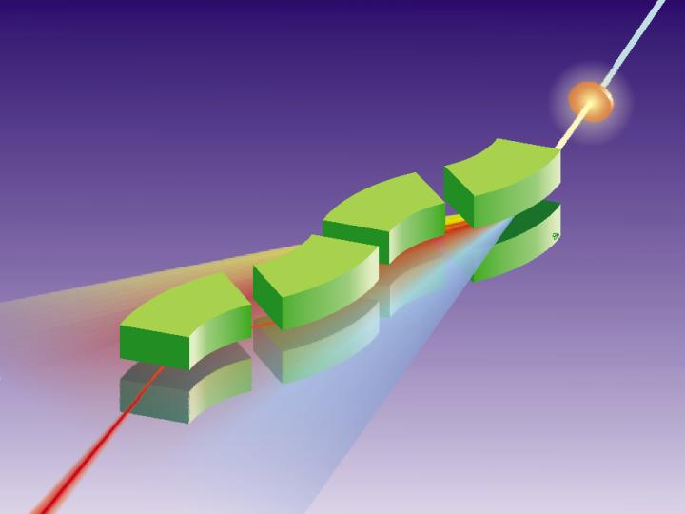
Radioactive Ion Beams next generation facility
Next generation
RIBs facilities
1.0-1.5 GeV/u
all elements up to uranium

Slide 24
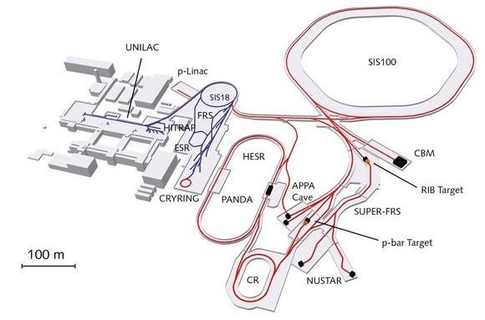
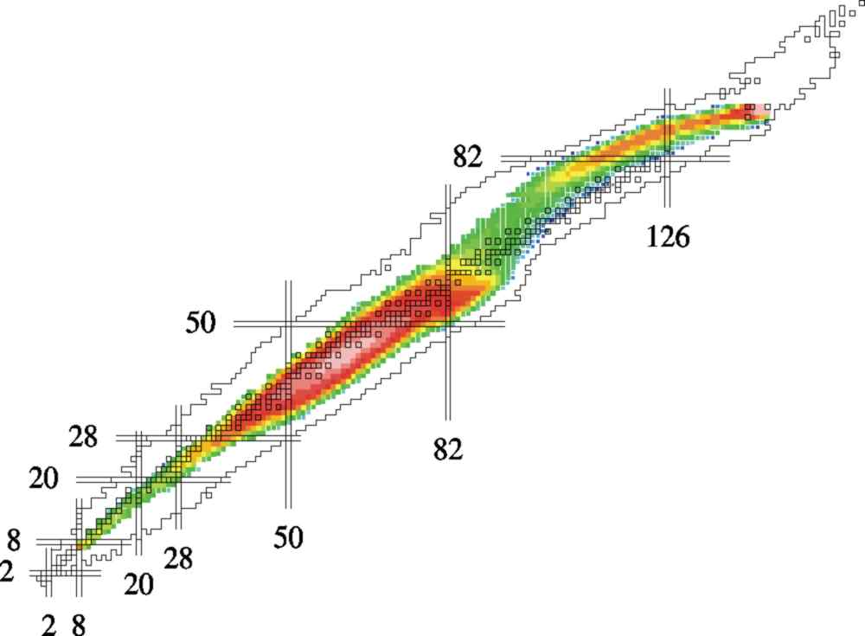
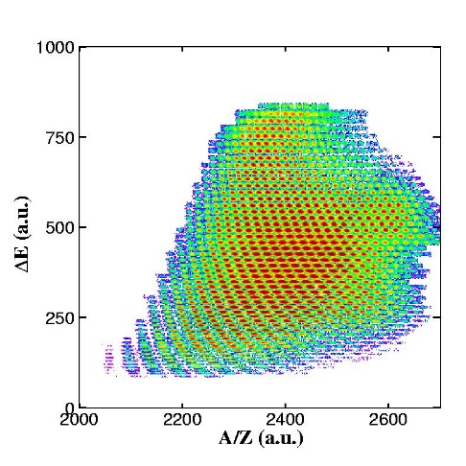
Radioactive Ion Beams next generation facility
The Future International Facility at GSI
FAIR – Facility for Antiproton and Ion Research
Next generation
RIBs facilities
existing
future
1.0-1.5 GeV/u
all elements up to uranium

Slide 25
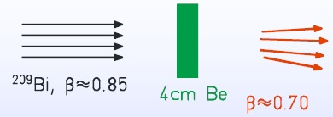
Radioactive Ion Beams production methods
Target fragmentation
Projectile fragmentation
fragmentation invented at LBNL in the 1980´s
target
beam
fragments

Slide 26
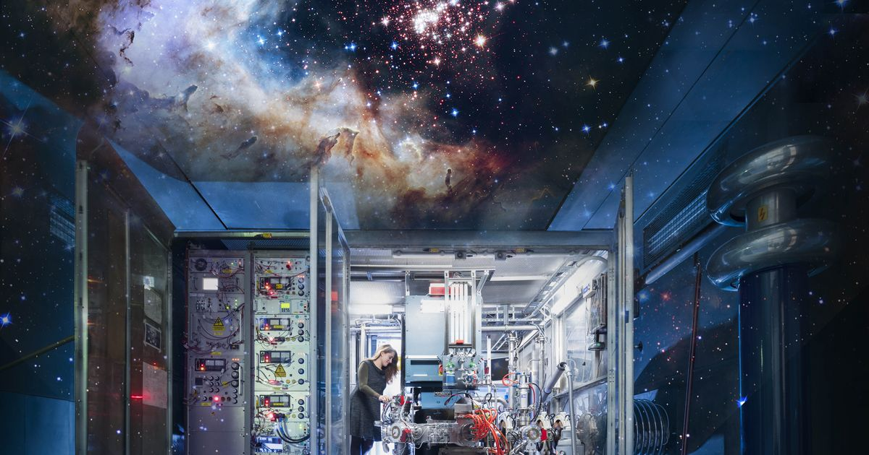
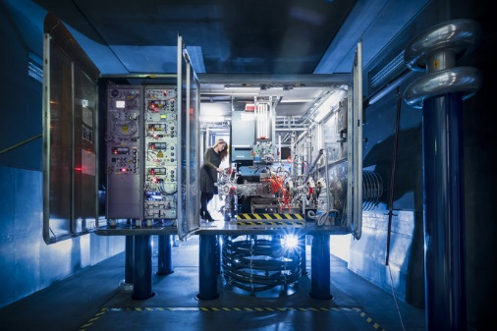
The Universe in the Laboratory

Slide 27
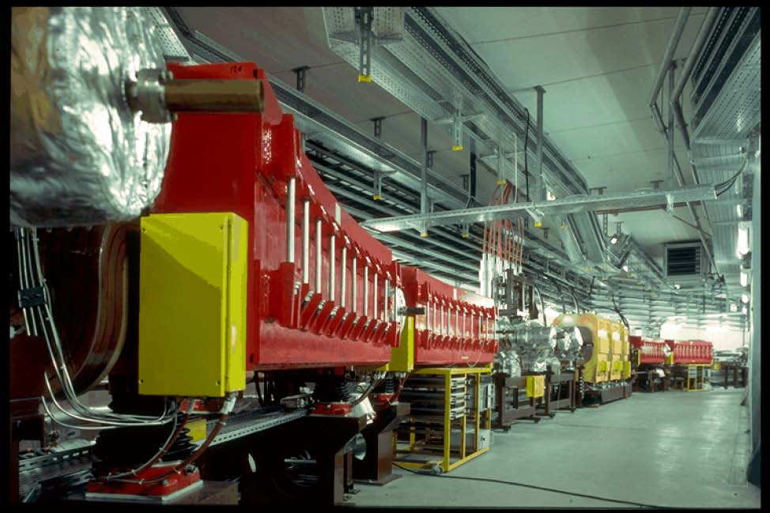

Fast radioactive beams – where?
GSI since SIS (early 90’s)
Intermediate-energy RIBs (tens of MeV/u) since many years
at GANIL, MSU, RIKEN
Future (and current) facilities
  RIBF@RIKEN
  FRIB@MSU
  FAIR-NuSTAR

Slide 28
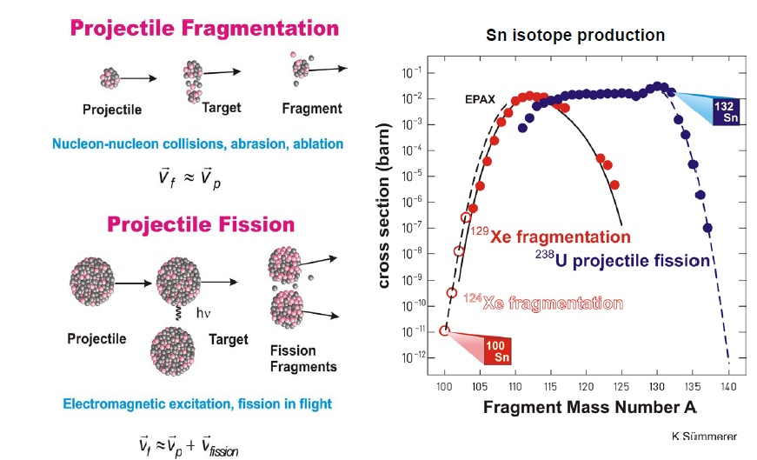
Production of exotic nuclei at relativistic energies

Slide 29
Rare Isotope Selection at FRS: Bρ-ΔE-Bρ Selection
Transmission :
20-70 % for fragmentation
< 2 % for fission
primary beam
⁸⁶Kr ~700 AMeV
20m
secondary beam
⁷⁸Ni ~ 100 AMeV
production target
⁹Be
magnetic dipoles
degrader
magnetic dipoles
Βρ ∝ βγ Α/Ζ
ΔΕ ∝ Ζ²f(β)
Βρ ∝ βγ Α/Ζ

Slide 30
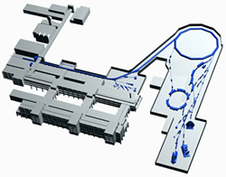
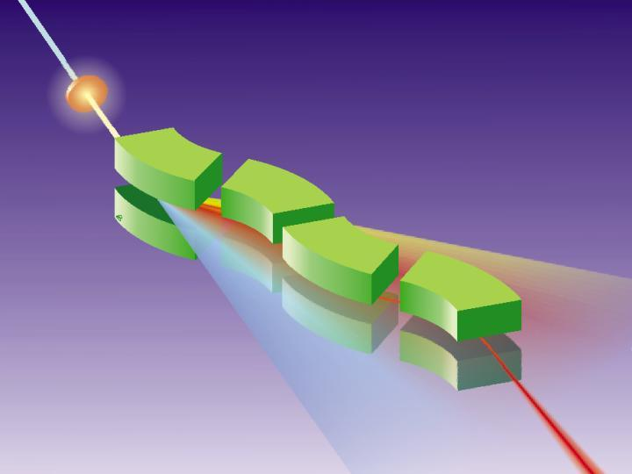
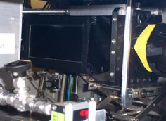
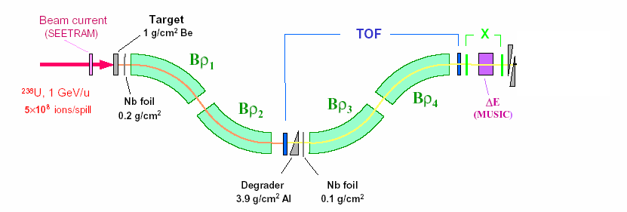
Production, Separation, Identification
UNILAC
SIS
fragment
FRS
abrasion
ablation
FRagment Separator
⁵⁶Cr, 100MeV/u
⁸⁶Kr, 480MeV/u
Standard FRS detectors
TPC-x,y position @ S2,S4
Plastic scintillator (TOF)
@ S4
MUSIC (ΔE)
@ S4

Slide 31
Fragment separator and storage ring
Production of highly charged, unstable ions at FRS
In-flight separation at FRS
→ Cocktail or mono-isotopic beams
Stochastic and/or electron cooling
→ same velocity for all ions
Schottky analysis
→ Mother and daughter in the same spectrum
SIS
FRS
ESR

Slide 32
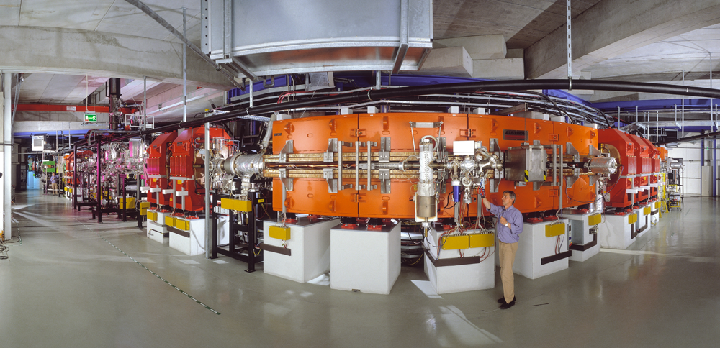
The Experimental Storage Ring ESR at GSI

Slide 33
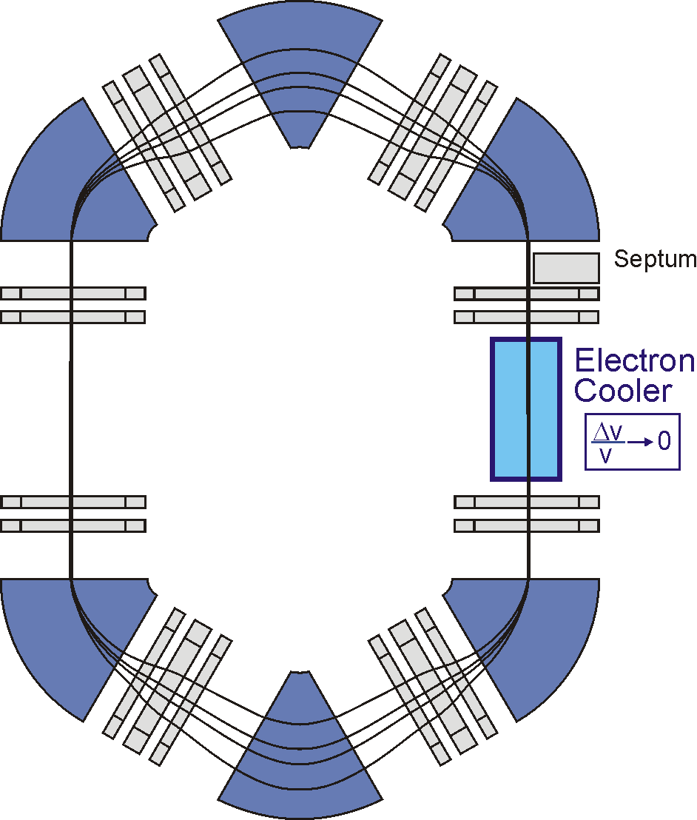






Schottky-mass-spectroscopy
4 particles with different m/q
time

Slide 34


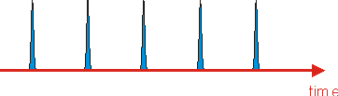
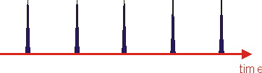
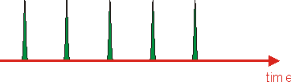


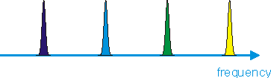

Schottky-mass-spectroscopy
Sin(ω₁)
Sin(ω₂)
fast Fourier transform
ω₄
ω₃
ω₂
ω₁
Sin(ω₃)
time
Sin(ω₄)

Slide 35
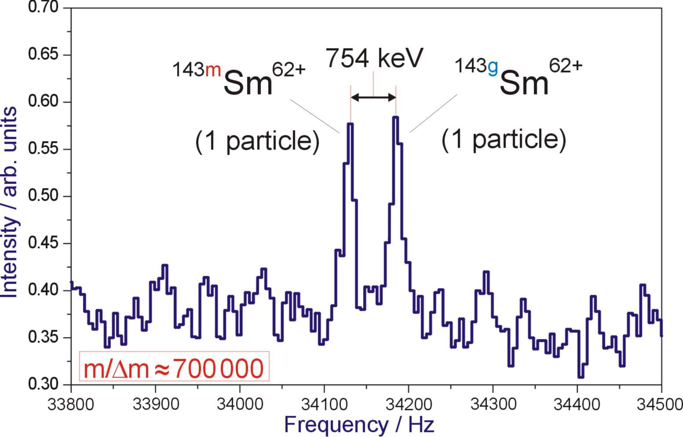
Small-band Schottky frequency spectra

Slide 36
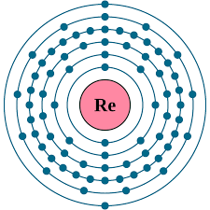
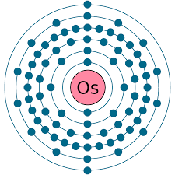
A) Nuclear Cosmic Clock – radioactive dating
How old is the Universe?
The 7 nuclear clocks for the age of the Earth, the solar system, the Galaxy and the Universe
nuclei | T_{1/2} [10⁹ y] | Q_{β} [keV]
⁴⁰K/⁴⁰Ar (β) | 1.3
²³⁸U…Th…²⁰⁶Pb (α,β) | 4.5
²³²Th…Ra…²⁰⁸Pb (α,β) | 14
¹⁷⁶Lu/¹⁷⁶Hf (β) | 30 | 1186 (7⁻→0⁺)
¹⁸⁷Re/¹⁸⁷Os (β) | 42 | 2.6 (5/2⁺→1/2⁻)
⁸⁷Rb/⁸⁷Sr (β) | 50 | 273 (3/2⁻→9/2⁺)
¹⁴⁷Sm/¹⁴³Nd (α) | 100

Slide 37

Fragment separator and storage ring
Production of highly charged ions at FRS
Stochastic and/or electron cooling
→ same velocity for all ions
Schottky analysis
→ Mother and daughter in the same spectrum
F. Bosch et al., Phys. Rev. Lett. 77 (1996),5190

Slide 38

Re/Os cosmos-chronometer
Red Giants
Supernovae

Slide 39


How to determine a long (33 y) beta half-life?
1. store and cool bare ¹⁸⁷Re for various
times (hours)
2. the β_{b} daughters, H-like ¹⁸⁷Os, are
not resolved in Schottky spectrum.
Q value only 62 keV at the same
atomic charge state q = 75⁺
3. after the (long) storage time
strip the one electron of ¹⁸⁷Os
in an intense gas jet, acting for
a few minutes only
4. the bare ¹⁸⁷Os ions are well-
resolved now, at q = 76⁺
5. the number of nuclear reaction
products (Hf, W,..) does not
depend on storage time
F. Bosch et al., PRL 77 (1996) 5190

Slide 40

Nuclear cosmic clocks
1. select a long-lived radioactive mother/daughter (β) couple
2. determine N(m), N(d) at time t
3. N(m) (t) = N(m) (t₀) exp[-λ(t-t₀)]
N(d) (t) = N(m) (t₀) [1 – exp[-λ(t-t₀)]
→ [N(d)/N(m)] (t) = exp[ λ(t-t₀)] – 1
one has to measure 'only'
the relative amount at time t and the decay probability λ of the mother
→ nuclear eon clocks
independent on stellar/galactic
evolution models !??
$$N_{m}\left(t\right)=N_{m}\left(t_{0}\right)∙exp\left[−λ∙\left(t−t_{0}\right)\right]$$
$$N_{d}\left(t\right)=N_{m}\left(t_{0}\right)∙\left\{1−exp\left[−λ∙\left(t−t_{0}\right)\right]\right\}$$
$$\frac{N_{d}\left(t\right)}{N_{m}\left(t\right)}=exp\left[λ∙\left(t−t_{0}\right)\right]−1$$
F. Bosch et al., Phys. Rev. Lett. 77 (1996),5190

Slide 41
The ´best-suited´ eon clock: ¹⁸⁷Re/¹⁸⁷Os
T_{N} > τ(¹⁸⁷Re) x R (¹⁸⁷Os/¹⁸⁷Re)_{d}
61.3 Ga x 0.137
= 8.4 Ga
but...
bare and H-like ¹⁸⁷Re undergoes
β_{b} decay to the first excited state
of ¹⁸⁷Os
nuclear matrix element not known
measurement of lifetime τ of
bare ¹⁸⁷Re at the ESR gives
→ τ (bare ¹⁸⁷Re) = (48 ± 3) a
instead of (61 ± 2) Ga
21.9 keV
85.8 keV
T_{½} = 33±2 a
453.9 keV
469.2 keV
T_{½} = 44±1 Ga
The Re/Os cosmic clock is strongly affected by the atomic charge state:
nuclear cosmic clocks are not independent on stellar evolution models
→T_{G} ~ 11 Ga

Slide 42

B) The stellar nucleosynthesis
Neutron beams
s-process (Red Giants)
radioactive beam facilities
r-process (Supernovae)
s-process (slow process):
  Capture times long relative to decay time
  Involves mostly stable isotopes
  N_{n} = 10⁶⁻¹² n/cm³ , kT = 8 – 90 keV
r-process (rapid process):
  Capture times short relative to decay times
  Produces unstable isotopes (neutron-rich)
  N_{n} = 10²⁰⁻³⁰ n/cm³

Slide 43



Neutron-capture processes
heavy elements are made by
slow $\left({τ_{β}}/{τ_{n}}<1\right)$
and
fast $\left({τ_{β}}/{τ_{n}}>1\right)$
neutron capture events
$$τ_{n}=lifetime against neutron capture$$
$τ_{β}=lifetime against β^{−}−decay$
Sequences of (n,γ) reactions and β⁻ decays
$$A\left(Z,N\right)+n↔A+1\left(Z,N+1\right)+γ$$
$$A\left(Z,N\right)→A\left(Z+1,N−1\right)+e^{−}+{\overline{ν}}_{e}$$
Closed neutron-shells give rise to the peaks at
Te, Xe / Ba and at Os, Pt, Au / Pb

Slide 44
Classical approach of the r-process (n,γ) and (γ,n) equilibrium
waiting point approximation
assume
(n,γ) ↔ (γ,n) equilibrium within isotopic chain, and
β-flow equilibrium
β-decay of nuclei from each Z-chain to (Z+1) is equal to the flow from (Z+1) to (Z+2)
rapid neutron
capture
β-decay
seed
Z
equilibrium favors
“waiting point”
N
(γ,n) photo-
disintegration
the nucleus with maximum abundance in each isotopic chain must wait for the longer
β-decay time scales
good approximation for parameter studies, BUT steady-flow approximation is not always valid

Slide 45
The „waiting-point“ concept in astrophysics
Nuclear Saha equation:
simplified $\frac{N\left(A+1,Z\right)}{N\left(A,Z\right)}∝n_{n}∙exp\left({S_{n}}/{kT}\right)$
high $n_{n}$ “waiting-point” shifted to higher masses
low $S_{n}$ “waiting-point” shifted to lower masses
low T “waiting-point” shifted to higher masses
Equilibrium-flow along r-process path:
$$\dot{N}\left(Z\right)=\sum_{A}{\left\{\frac{N\left(Z−1,A\right)}{τ_{β}\left(Z−1,A\right)}−\frac{N\left(Z,A\right)}{τ_{β}\left(Z,A\right)}\right\}}=0$$
- governed by β–decays from isotopic chain Z to (Z+1)
β-decay flow equilibrium implies (n,γ) – (γ,n) equilibrium
$$τ_{β}>τ_{n,γ},τ_{γ,n}$$
T_{1/2} (“waiting-point“) ↔N_{r-process}

Slide 46


¹³⁰Cd – the key isotope at N=82
R - abundances
Details of nuclear properties
¹³⁰Cd
⁴⁸ ⁸²
“..the calculated r-abundance ‘hole‘ in the A ≅ 120 region reflects ... the weakening of the shell strength ... below ¹³²Sn “ K-L Kratz
bottleneck at N=82 waiting point near stability?

Slide 47

Waiting Point lifetimes with Fragmentation Facilities
Beams GSI, FAIR N = 82,126
Why fragmentation?
  Lifetime measurements can be done with beams from low energy facilities
  But, fragmentation facilities have advantages:
    Use beams of mixed nuclides--Identification on event by event basis
    Greater reach toward dripline-see figure
    GSI and FAIR will cover a large part of r-process path

Slide 48



¹³⁰Cd – the key isotope at the A=130 peak
$$T_{1/2}\left(130Cd\right)⇔N_{r⨀}\left(130Te\right)$$
$$N_{r⨀}\left(130Te\right)≡solar system abundances 130Te$$
$$T_{1/2}\left(130Cd\right)=\left(162±7\right) ms$$
climb up the N=82 ladder A~130 “bottle neck”
K.-L. Kratz, Rev. Mod. Astr. 1 1988

Slide 49

Effects of N=82 “shell quenching”
“Shell quenching”
reduction of the spin-orbit coupling strength; caused by strong interaction between bound and continuum states;
due to diffuseness of “neutron-skin” and its influence on the central potential

Slide 50



Effects of N=82 “shell quenching”

Slide 51



¹³⁰Cd decay spectroscopy
Large Q_{β} value best reproduced by mass models with N=82 shell quenching
$$πg_{9/2}⨂νg_{7/2}$$

Slide 52
The N=82 shell gap
NONE of the mass models predicts the trend correctly!

Slide 53


ionization
chambers
(MUSIC41,42)
scintillator
(SC41)
beam
multiwire
chambers
(MW41,MW42)
degrader

Slide 54


Decay spectroscopy probes shell closures
¹³⁰Cd: DGF-timing
0
1.5
1.0
0.5
0.0
Energy ( MeV )
DGF time ( arbt. units )
Prompt γ-flash
Decay time range: 20 ns ... 20 μs
A. Jungclaus et al., Phys. Rev. Lett 99, 132501 (2007)

Slide 55
8⁺(g_{9/2})⁻² seniority isomers in ⁹⁸Cd and ¹³⁰Cd
h_{11/2}
N=82
MeV
(8⁺)
2428
2.6
(6⁺)
d_{3/2}
2.2
(4⁺)
2281
s_{1/2}
1.6
(8⁺)
2128
N=50
Z=48
2083
d_{5/2}
0.5
(6⁺)
N=82
Z=48
(4⁺)
2002
g_{7/2}
0
1864
N=50
(2⁺)
participating neutron-orbitals
(2⁺)
1395
1325
two proton holes in the g_{9/2} orbit
No dramatic shell quenching!
0⁺
0⁺
A. Blazhev et al., Phys. Rev. C69 (2004) 064304 A. Jungclaus et al., Phys. Rev. Lett. 99 (2007), 132501

Slide 56

Surprising β–decay properties of ¹³¹Cd

Slide 57

What about radioactive nuclei?
Use Inverse kinematics
¹H(⁶⁰Co, n)⁶⁰Ni
E_{x}
¹H
⁵⁶Ni
⁵⁶Cu
n
E_{lab}(MeV)
Unusual kinematics
  Light particle has low E, few MeV, angle near 90^{o.}
  Lab angle => E_{c.m.}
  Lab E => Θ_{c.m.}

Slide 58



Coulomb break up in inverse kinematics at GSI/LAND
^{92,93,94,100}Mo(γ,n) most abundant p-isotopes
TOF, ΔE
TOF, x,y
~18m
Projectile tracking
Tracking through ALADIN
Excitation energy E* from a kinematical complete measurement of all outgoing particles.

Slide 59
Testing Ab-Initio Calculations
¹²O
unbound
Z
RMS Radii of nuclei cfr. ¹¹Li, ^{9,10}Be (abstract ID 96)
(W. Nörtershäuser et al. Phys. Rev. Lett. 102 (2009) 062503)
  Nuclear Moments cfr. ^{9,11}Li (ID 20)
  (R. Neugart et al., Phys. Rev. Lett. 101 (2008) 132502)
      Electroweak Matrix Elements
        Transfer reactions
¹¹N
unbound
¹²N
11 ms
⁹C
125 ms
¹⁰C
19.3 s
¹¹C
20.4 m
¹²C
⁹B
unbound
¹⁰B
¹¹B
¹²B
20.20 ms
⁹Be
¹⁰Be
1.6 10⁶ y
¹¹Be
13.8 s
¹²Be
23.6 ms
⁹Li
179 ms
¹⁰Li
unbound
¹¹Li
8.5 ms
¹²Li
unbound
⁹He
unbound
¹⁰He
unbound
N

Slide 60



¹H(¹⁴Be,2pn)¹²Li lithium isotopes beyond the drip-line
~300 MeV/u ¹¹Li, ¹⁴Be + liquid H₂ → ⁹Li + n, ¹¹Li + n, ¹¹Li + 2n
Going beyond the dripline ¹²Li and ¹³Li
previous results confirmed:
¹⁰Li is known as virtual s-state (a = -22 fm) with an excited state at 0.5 MeV and Γ = 0.5 MeV
¹²Li is observed as a virtual s-state with scattering length a = -11 fm
¹³Li is seen as a broad 3-body resonance state at 1.5 MeV
Yu. Aksyutina et al. PLB 666(2008) 430

Slide 61

¹H(¹⁴Be,2pn)¹²Li
Breit Wigner Resonance
scattering length (virtual s-state)

Slide 62

¹H(¹⁴Be,2p)¹³Li
Breit Wigner Resonance
3-body resonance state
correlated background
(from nn-correlations in initial bound-state wave function

Slide 63

Unveiling the Universe with the James Webb Space Telescope

Slide 64

Visible and Infrared Light
Infrared light has the ability to “see” through opaque molecular clouds
Betelgeuse

Slide 65

Observing the ancient Universe

Slide 66













Understanding our Universe
Space based Astronomy
James Webb Space Telescope
1.5 million km from Earth
mirror 6.6 m diameter
18 mirror segments
5 sunshield layers
Nuclear Physics
Facility for Anti-proton and Ion Research
all elements from proton to uranium and anti-proton
projectile fragmentation or fission for radioactive ion beams
Finland
France
Germany
India
Poland
Romania
Russia
Slovenia
Sweden
UK
Czech

Slide 67

Indian Ambassador H.E. Harish Parvathaneni at FAIR/GSI 17.4.2023
Gururaj Kumar (IUAC, Delhi University)

