Slide 1

Outline: A brief history of Nuclear Astrophysics N. Prantzos
Lecturer: Hans-Jürgen Wollersheim
e-mail: h.j.wollersheim@gsi.de
web-page: https://web-docs.gsi.de/~wolle/ and click on
thermodynamics
subatomic physics
Sun´s energy
quantum-mechanical tunnel effect
CNO cycle (Hans Bethe)

Slide 2
Thermodynamics: the energy of the Sun and the age of the Earth
1847: Robert Julius von Mayer
Sun heated by fall of meteors
1854: Hermann von Helmholtz
Gravitational energy of Kant´s contracting protosolar nebula of gas and dust turns into kinetic energy
timescale ~ E_{Grav}/L_{Sun} ~ 30 My
1850s: William Thompson (Lord Kelvin)
Sun heated at formation from meteorite fall,
now « an incandescent liquid mass » cooling
age 10 – 100 My
1859: Charles Darwin Origin of species
rate of erosion of the Weald valley is
1 inch/century or 22 miles wild (* 1100 feet high) in 300 My
Such large Earth ages also required by geologists, like Charles Lyell

Slide 3
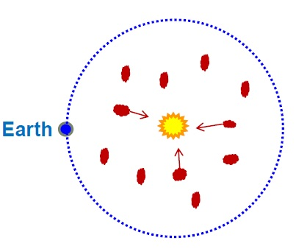
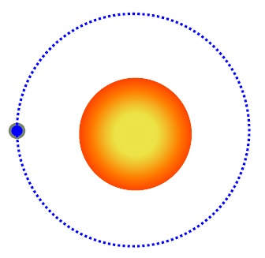
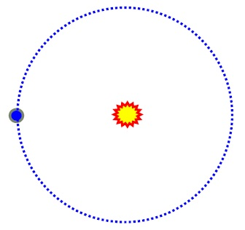
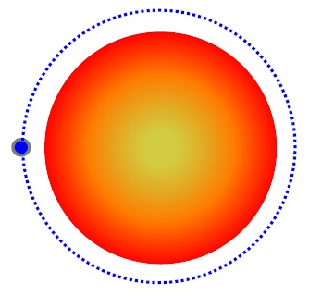
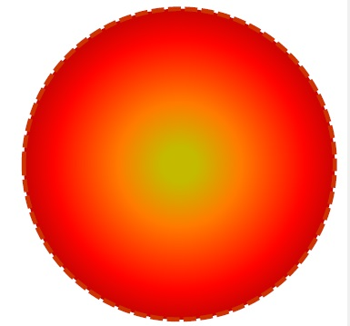

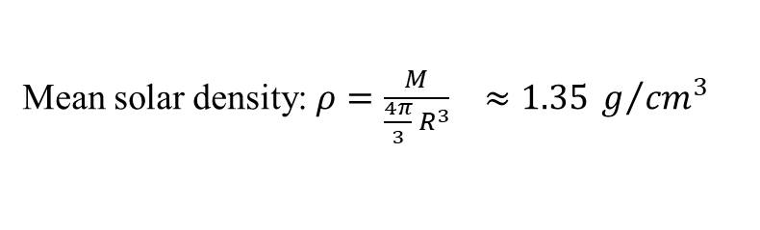

A gaseous, contracting and heating Sun
Mean solar density: $ρ=\frac{M}{\frac{4π}{3} R^{3}} ≈1.35 g/{{cm}^{3}}$
Sun liquid → incompressible
1870s: J. Homer Lane, 1880s: August Ritter : Sun gaseous → compressible
As it shrinks, it releases gravitational energy and it gets hotter
Mayer - Kelvin - Helmholtz
Helmholtz - Ritter
source of solar energy: gravitational contraction
$$energy \sim \frac{G∙M^{2}}{R}$$
characteristic timescale of contraction:
$$T_{contraction}≅\frac{energy}{luminosity} \sim 30 My$$
Kelvin – Helmholtz – Ritter timescale

Slide 4
The chemical composition and physical conditions of stellar surfaces
hot star
cold star

Slide 5
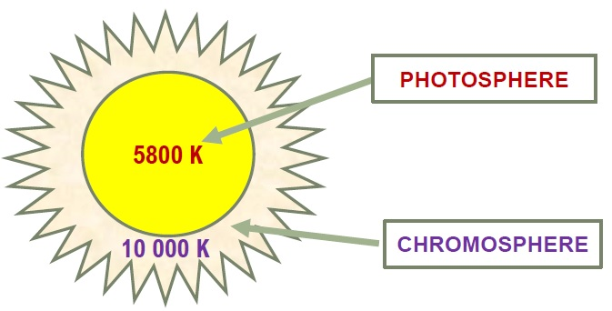
Spectroscopy reveals Helium in the Sun
Pierre Janssen
Sir Norman Lockyer
1868 co-discovery of Helium in the Sun´chromosphere during a solar eclipse
Lockyer´s theory of stellar evolution

Slide 6
Hertzsprung-Russell diagram
red giants
white dwarfs
Lockyer´s theory of stellar evolution:
running opposite to current

Slide 7
Subatomic physics
1896: discovery of radioactivity (Uranium)
by Henri Bequerel
1896-1897: identification of radioactive Po and Ra
by Pierre and Marie Curie
1897: discovery of the electron
by Joseph John Thomson
charge +2
charge -1
1897: identification of alpha and beta rays
by Ernest Rutherford

Slide 8
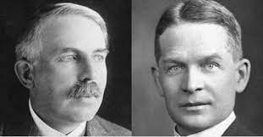
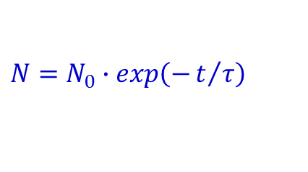
Radioactivity dating of rocks and energy source
1902: Rutherford-Soddy´s law of radioactive decay
$$N=N_{0}∙exp\left(−t/τ\right)$$
1902: Rutherford shows that alpha radiation is Helium nuclei
suggests to use Uranium/Helium for dating
1907: Bertram Boltwood old rocks are 400 My to 2 Gy old, the Earth is even older
1907 Rutherford: Helium in the Sun results from radioactivity and so does solar energy
But what makes substances radioactive and how is the energy put there?

Slide 9

The atomic nucleus and the proton
1909: Geiger-Marsden experiment
strong deflection of some α particles bombarding
a foil of gold
1911 Rutherford: The atom is mostly void,
the volume of the positive charge (nucleus)
is 1000 trillion times smaller than the volume of the atom
nuclear radius ~ 10⁻¹⁵ m
1919 Rutherford produces hydrogen nuclei bombarding nitrogen with α particles
$${}_{}^{14}N+α→{}_{}^{17}O+H$$
1920: Rutherford names the hydrogen nucleus proton (charge +1)
1910s: development of mass spectrograph
by Francis William Aston
identification of isotopes and measurements of their masses
1919: mass (⁴He) = mass (4 protons) * (1-0.007)

Slide 10
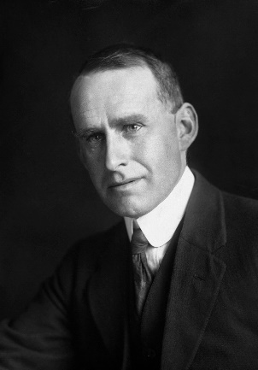
Sun´s energy conversion of H to He: E=Δm·c²
First ideas (rather confused)
1915: William Draper Harkins
1919: Jean Perrin
1920: Sir Arthur Stanley Eddington

Slide 11

The energy of the Sun
Luminosity L = 4·10²⁶ J/s
Time t = 4.5 Gy = 1.35·10¹⁷ s
Energy = Luminosity * Time = 5·10⁴³ Joule
efficiency of transformation of mass to energy through $4p → {}_{}^{4}{He} : ε=0.007$
Sun´s mass m = 2·10³⁰ kg
nuclear energy available $E\left(nuclear\right)=ε∙f∙m∙c^{2}$
Fraction of Sun´s mass (in hydrogen) which participated in nuclear reactions in the past t = 4.5 Gy
$$f\sim \frac{L∙t}{ε∙m∙c^{2}}\sim 0.05$$
How much hydrogen is there in the Sun?

Slide 12
Stellar spectroscopy reveals the chemical composition and physical conditions
hot star
The intensity and width of spectral lines depends not only on the abundances of the elements, but also on the conditions (temperature, pressure and ionization) of the stellar atmosphere
cold star
Quantum mechanical models are required to infer true abundances, through the Saha ionization equation (1925)
Meghnad Saha

Slide 13
Abundances in stellar atmospheres
1925: H and He are the most abundant elements in stellar atmospheres
Cecilia Payne

Slide 14
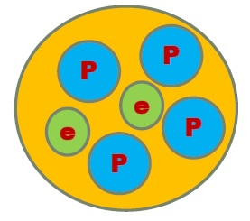
From H to He an impossible reaction?
Problem 1: How to make an α-particle?
(mass = 4·m_{p} charge = 2+)
4 protons + 2 electrons should be brought together
(neutrons unknown then)
Problem 2: How to bring just 2 protons together?
~10¹⁰ K
Enormous temperatures (T > 10¹⁰ K)
are required, so that particles have enough kinetic energy E~kT to overcome their repulsive Coulomb barrier
whereas Eddington´s stellar model suggested T ~ 10⁷ K
We do not argue with the critic who urges that the stars are not hot enough for this process; we tell him to go and find a hotter place
nuclear radius
~10⁻¹⁵ m

Slide 15

George Gamow light at the end of the tunnel
How do emitted α-particle get out of the potential well of radioactive nuclei?
Why their observed energies are smaller than the Coulomb barrier of those nuclei?
energy
V_{Coulomb}
quantum-mechanical tunnel effect (1928):
particles with E < V_{Coulomb} have a finite probability to escape
George Gamow
$$e^{−−\frac{2π∙Z_{1}∙Z_{2}∙e^{2}}{h∙v}}$$
Gamow factor
distance
energy
It also explains quantitatively why nuclei with larger half-lives eject α-particles with smaller energies (R. Gurney & E. Condon 1928-1929)
distance
Edward Condon

Slide 16
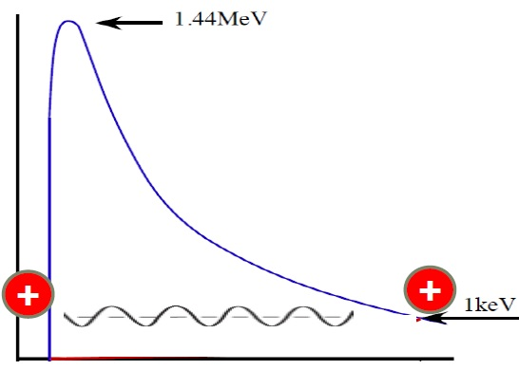
Proton fusion may indeed occur in temperatures at the center of the Sun, thanks to the tunnel effect
But fusion of two protons gives a di-proton, which cannot exist!

Slide 17
Particle discoveries in the 1930s
1930: prediction of the Neutrino
Wolfgang Pauli
1931: prediction of Positron
P.A.M. Dirac
1931: discovery of Deuterium (heavy hydrogen ~ 2·m_{p})
Harold Urey
1932: discovery of Neutron (mass ~ m_{p}, charge = 0
James Cadwick
1932: discovery of Positron (mass ~ m_{e}, charge +1)
Carl Anderson
1934: development of the theory of β-decay
Enrico Fermi

Slide 18
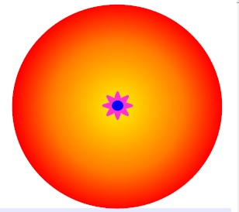
Neutron star
Accretion of inner layers onto a small neutron star found in the stellar core
Niels Bohr & Lev Landau
Hydrostatic equilibrium dictates the density profile of a normal star
An increase of the core density inflates the envelope as in Red Giants, reducing the mean density

Slide 19
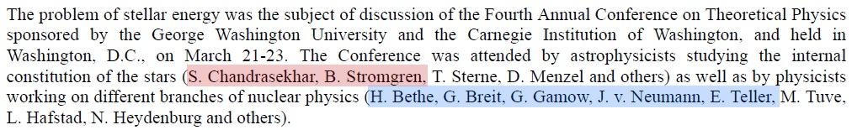
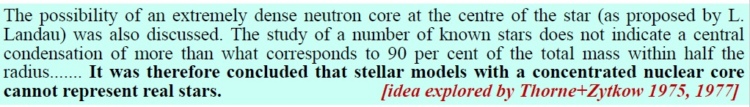
The problem of stellar energy

Slide 20
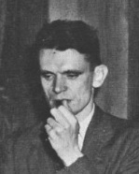
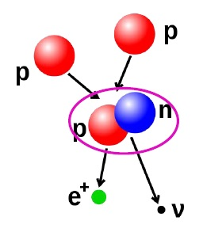
The formation of Deuterons by proton combination
1938
Hans Bethe
Charles Critchfield

Slide 21
Energy production in stars 1939
Hans Bethe

Slide 22
energy
production rate
temperature (MK)
What about elements heavier than He?

Slide 23
Why does the Sun shine?
Because it is hot
and it is hot because it is massive
Why does the Sun shine for so long?
Because its interior is so hot that thermonuclear reactions
ignite and produce huge amounts of energy
released in long timescales

Slide 24
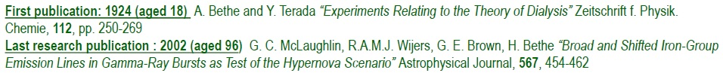
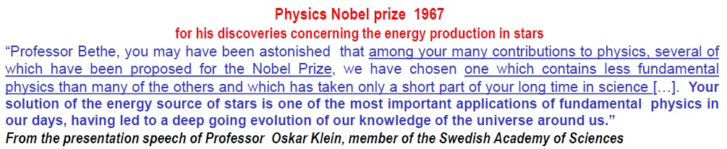
Hans Albrecht Bethe (1906 – 2005)
Atomic physics and spectroscopy
Interactions of fast particles with matter
Solid state physics
Hydrodynamics, especially shock waves
Nuclear physics (from ´pure´ physics to bombs)
Nuclear astrophysics (stellar energy, SN, solar
gravitational wave source
Nuclear weapons, the arm race, national security
Energy policy, including fission power
1947 Henry Draper Medal
1959 Franklin Medal
1961 Eddington Medal
1961 Enrico Fermi Award
1963 Rumford Prize
1975 National Medal of Science
1989 Lomonosov Gold Medal
1993 Oersted Medal
2001 Bruce Medal
2005 Benjamin Franklin Medal

Slide 25
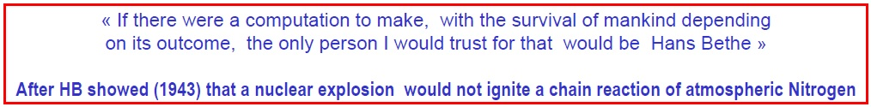
Head of theory division of Manhattan Project 1943-1946
Calculation of critical mass and efficiency of ²³⁵U
Formula for atomic bomb´s explosive yield (with Richard Feynman)
Bethe
Fermi
Teller
Feynman
Bethe vs Teller in Oppenheimer affair (1955)
President´s Science Advisory Committee (1956-59)
Member, US Delegation to discussion
discontinuance and nuclear weapons test, 1958-59
scientists movement against the project of
anti-ballistic missiles (1960s) and star wars (1980s)
Oppenheimer
Teller
Bethe

Slide 26
