Slide 1

Outline: The Sun
Lecturer: Hans-Jürgen Wollersheim
e-mail: h.j.wollersheim@gsi.de
web-page: https://web-docs.gsi.de/~wolle/ and click on
Hertzsprung-Russel diagram
black body radiation
evolution of the sun
heavier stars

Slide 2
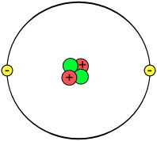
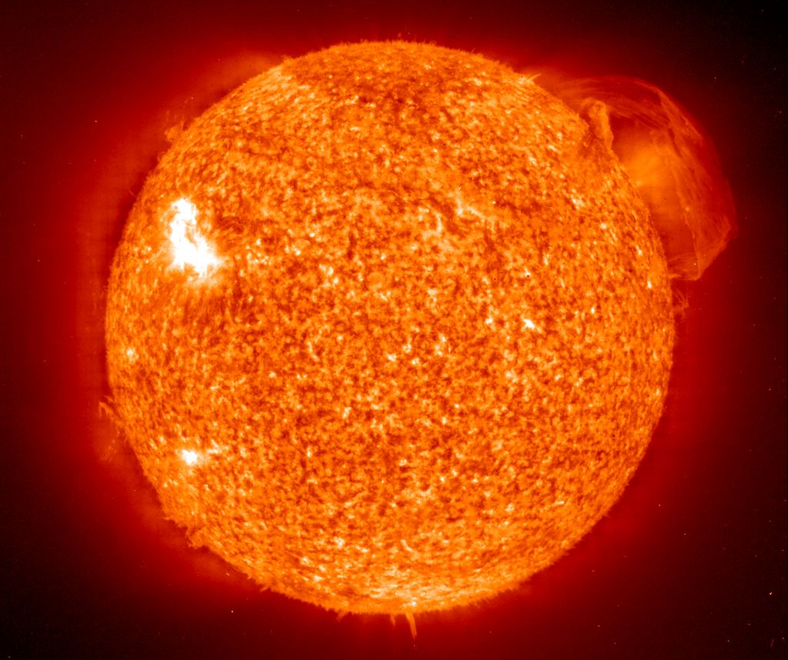
Nuclear Astrophysics
atomic nucleus 1·10⁻¹⁵ m
The every day star ~1·10⁹ m

Slide 3
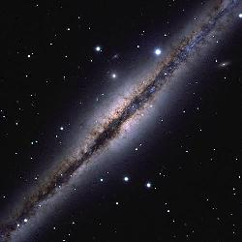
Basic properties of stars
Distance to stars
  parallax method for determining distance
  definition of the “parsec”
Flux, luminosity and stellar magnitude
Hertzsprung-Russell diagram

Slide 4
The distance to the stars
The distance to any astronomical object is the most basic parameter
  quire knowledge of distance in order to calculate just about any other
  property of the object
  distance is often difficult to determine!
Most direct method to measure distances to “nearby” stars uses
trigonometric parallax
  as Earth orbits Sun, we view a star along a slightly different line of
  sight
  this causes the star to appear to move slightly with respect to much
  more distant stars
  we can currently use this technique to measure stellar distances out to
  ~3000 light years from Earth

Slide 5


Determination of distances - parallax

Slide 6
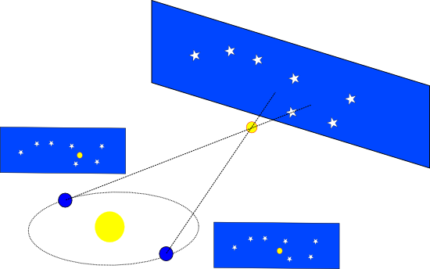
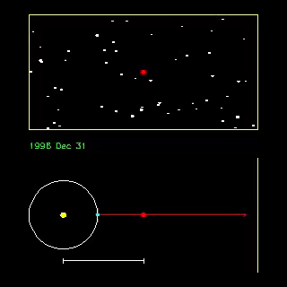
Determination of distances - parallax
Trigonometry:
Limited to stars no more than 100pc distance
1AE
1AU
1parsec (pc) = unit of length, measures the distance of a star with a parallax of 1arc-second
mean Earth – Sun distance = astronomical unit
149 597 870 km

Slide 7
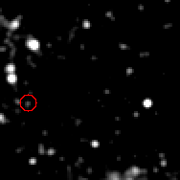
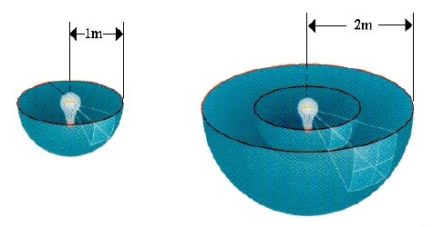
Cepheid – intrinsic stellar pulsation
Cepheids are stars, that undergo pulsations.
(imbalance between ionization and gravitation)
1912: H. Leavitt, H.Shapley:
There is a linear relationship between luminosity and
pulsation period.
This method allows distance measurements up to 50 Mpc.
If one measures the pulsation period of a Cepheid,
one knows its true luminosity.
One compares this with the observed brightness
on Earth and obtains the cosmic distance to the star.

Slide 8
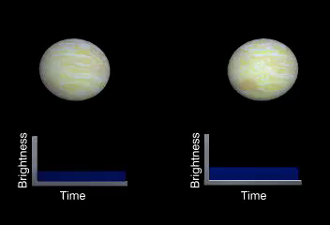
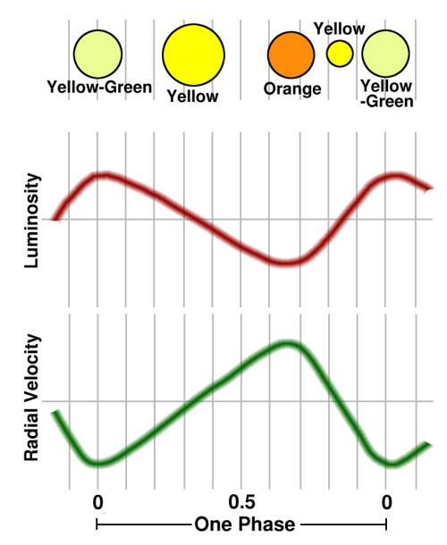

Cepheids – intrinsic stellar pulsation
Luminosity:
small but hot bright
big but cool dim

Slide 9
Cepheids – intrinsic stellar pulsation
50 Mpc – 3 Gpc
L = c · t
time t
Supernovae Ia
1 astronomical unit (AU) =
1.496 · 10¹¹ m
1 AU
1 light year (ly) =
9.461 · 10¹⁵ m
= 63.240 AU = 0.3066 pc
distance L
1 Parsec (pc) =
3.086 · 10¹⁶ m
=2.06 ·105 AU = 3.262 ly

Slide 10
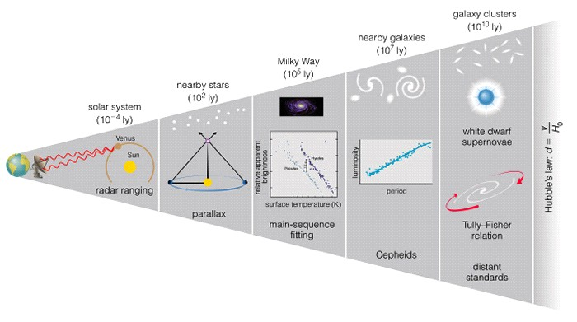
cosmic distance ladder
“standard candle”

Slide 11
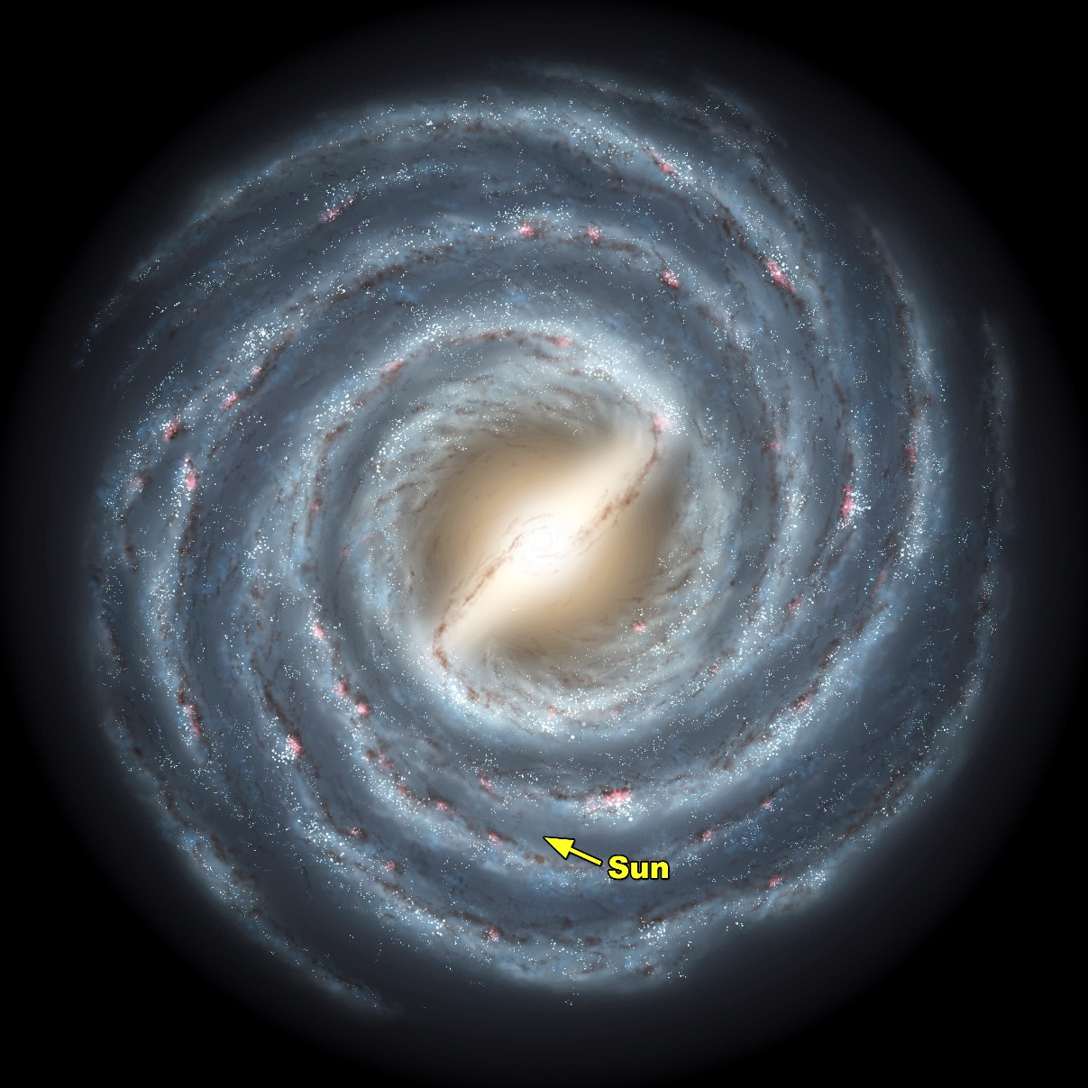
50 000 light years (Milky Way)
We are here
http://www.news.wisc.edu/newsphotos/images/Milky_Way_galaxy_sun05.jpg

Slide 12
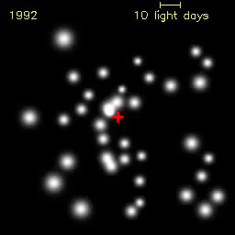
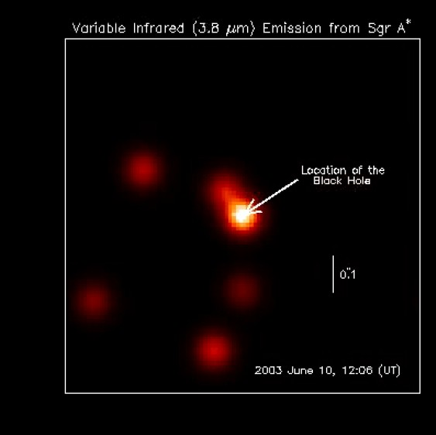
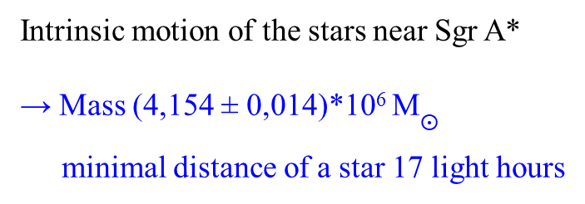
Milky Way Galaxy
The radio source Sagittarius A* (+) is the supermassive black hole at the Galactic Center of the Milky Way
Intrinsic motion of the stars near Sgr A*
→ Mass (4,154 ± 0,014)*10⁶ M$⨀$
minimal distance of a star 17 light hours
Genzel et al. (2003)

Slide 13
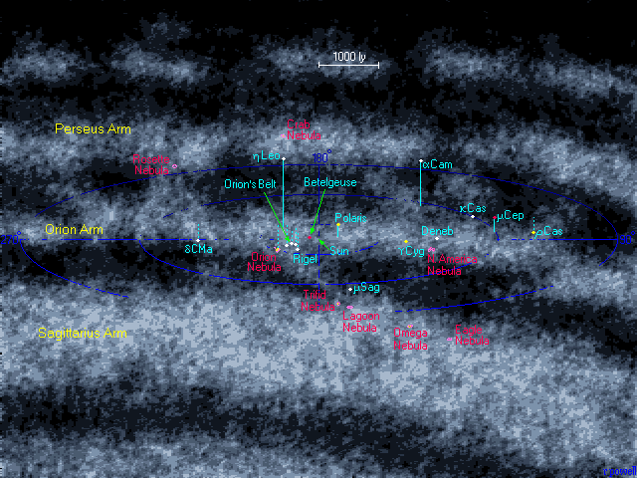
The universe within 5000 Ly – the Orion arm
We are here
http://www.atlasoftheuniverse.com

Slide 14
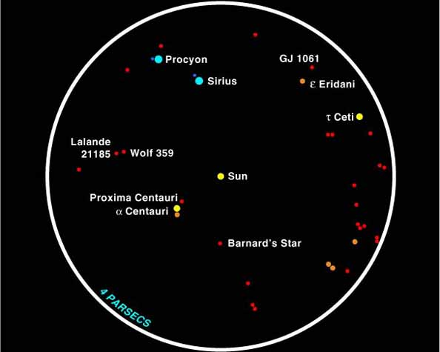
The universe within 5000 Ly – the Orion arm
We are here
All stars within 13 light years (4 parsecs) around the Sun. There are 25 other stars, many are weak shining red dwarves, which can be seen from Earth with the naked eye.
http://stardate.org/

Slide 15

From the Sun we have learned:
stars are far away
stars are bright
stars are hot
stars are massive
How FAR AWAY? (DISTANCE)
How BRIGHT? (LUMINOSITY)
How HOT? (SPECTRAL TYPE)
How MASSIVE? (MASS)

Slide 16

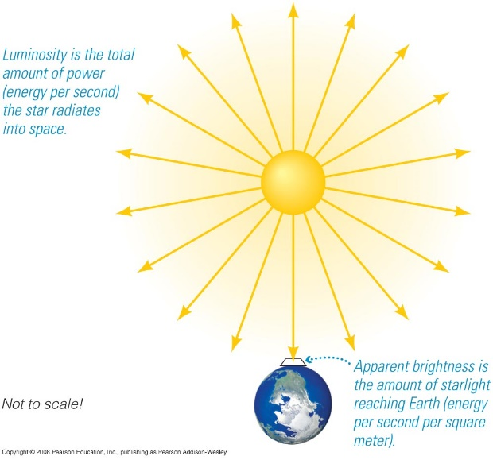
Stellar brightness
The magnitude or brightness of an object depends on both distance and energy output.
Amount of energy output a star radiates is called the Luminosity L: the energy per second
Amount of starlight that reaches Earth is called the apparent magnitude (m)

Slide 17
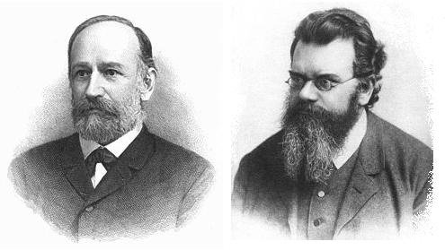
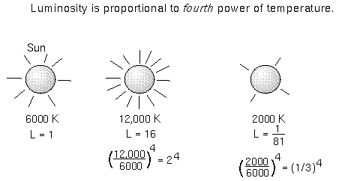



Stars show spectra very close to black-body radiation
d
R*
J. Stefan & L. Boltzmann
flux at the surface:
measured flux:
$$F={\left(\frac{R_{∗}}{d}\right)}^{2}∙σ_{SB}∙T_{∗}^{4}$$
$$F=σ_{SB}∙T_{∗}^{4}$$
with σ_{SB} = 5.67·10⁻⁸ W m⁻² K⁻⁴
luminosity (Stefan-Boltzmann law) is the flux multiplied by entire spherical surface:
$$L=4π∙R_{∗}^{2}∙σ_{SB}∙T_{∗}^{4}$$

Slide 18
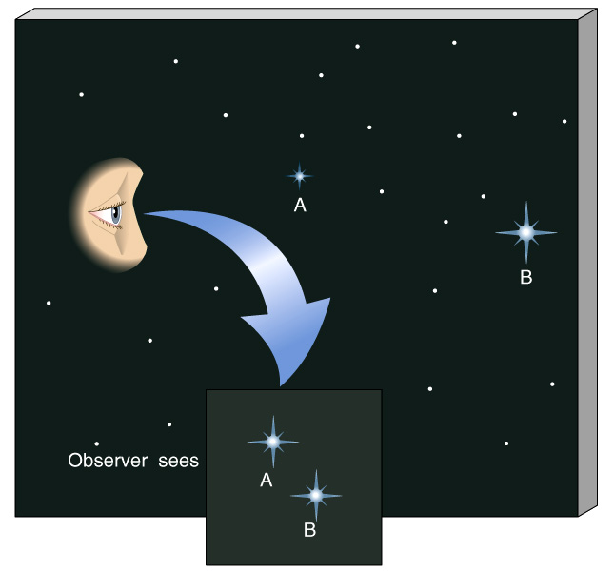
Luminosity and apparent magnitude
Star B is more luminous, but they have the same brightness as seen from Earth.

Slide 19
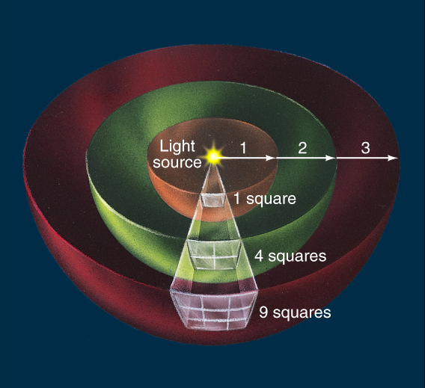
Apparent Brightness and Inverse Square Law
Light appears fainter with increasing distance.
If we increase our distance from the light source by 2, the light energy is spread out over four times the area.
(area of sphere = 4πd²)
Luminosity
4πd²
Flux =
To know a star’s luminosity we must measure its apparent brightness (flux) and know its distance. Then,
Luminosity = Flux *4πd²

Slide 20
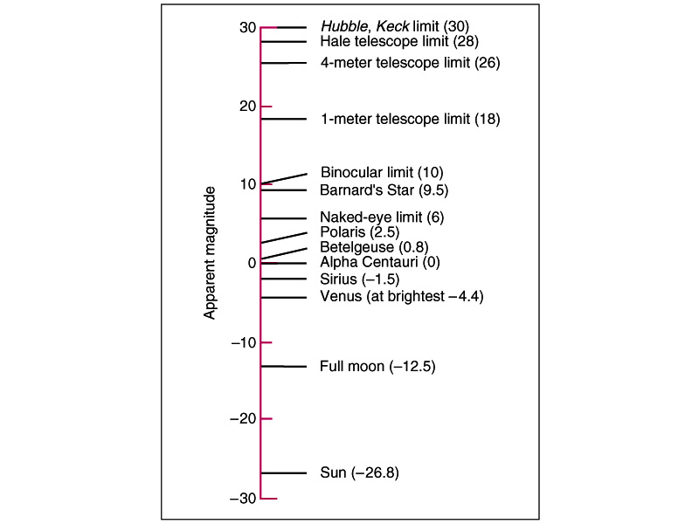
Stellar magnitudes
2nd century BC, Hipparchus ranked all visible stars – brightest = magnitude 1 faintest = magnitude 6.
To our eyes, a change of one magnitude = a factor of 2.5 in flux.
The magnitudes scale is logarithmic.
A change of 5 magnitudes means the flux 100 x greater!
Faintest
Hence
Brightest

Slide 21


Luminosity and apparent magnitude
Modern definition: If two stars have fluxes F₁ and F₂, then their apparent magnitudes m₁ and m₂ are given by
Notes
  The star Vega is defined to have an apparent magnitude of zero! This allows one to talk about the apparent magnitude of a given star rather than just differences in apparent magnitudes

Slide 22
Luminosity and apparent magnitude
  Higher apparent magnitudes, are fainter stars!
  A difference of 5 magnitudes corresponds to a factor of 100 in flux
  Brightest star (Sirius) has m=-1.44
  Faintest stars visible to human eye have m=6.5
  Sun has m=-26.7
  Full Moon has m=-12.6
  Venus at its brightest m=-4.7
  Pluto has m=13.65
  Faintest object visible by Hubble Space Telescope is m=30

Slide 23
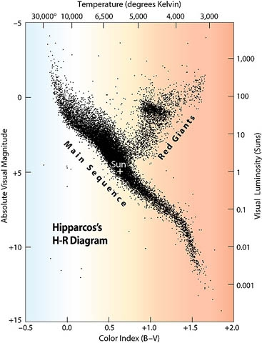
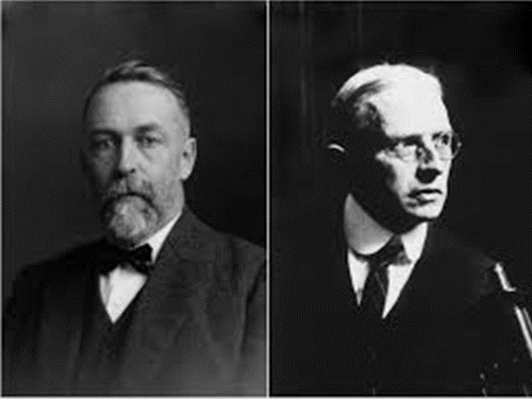

Hertzsprung-Russell (HR) diagram of all stars at a range of 300 light years
Ejnar Hertzsprung, Henry Norris Russell
absolute luminosity
versus
temperature
The stars are stationary on the
´main sequence´,
as long as the fusion of protons to helium persists
This time depends very sensitively on the mass of the individual star
$$L=4π∙R_{∗}^{2}∙σ_{SB}∙T_{∗}^{4}$$

Slide 24
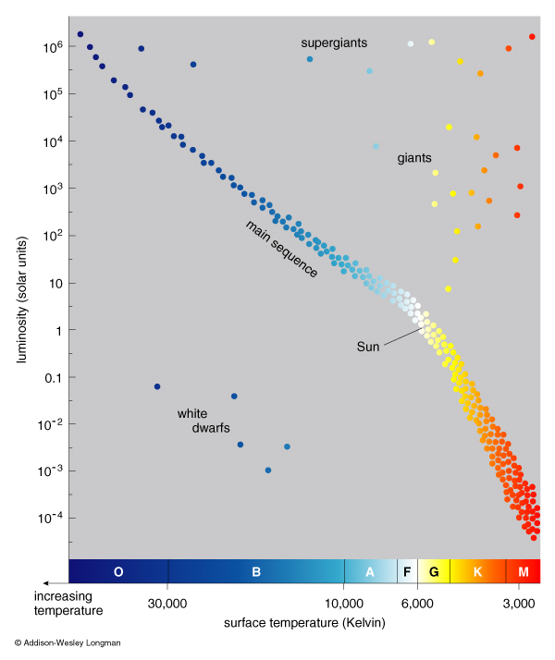
Hertzsprung-Russell (HR) diagram
About 90% of all stars (including the Sun) lie on the Main Sequence.
…where stars reside during their core Hydrogen-burning phase.

Slide 25
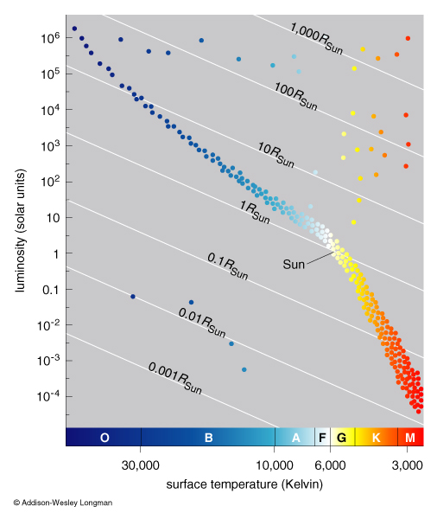
Hertzsprung-Russell (HR) diagram
From Stefan’s law…...
L = 4πR² σT⁴
More luminous stars at the same T must be bigger!
Cooler stars at the same L must be bigger!

Slide 26
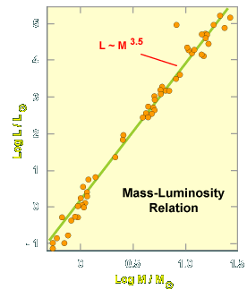
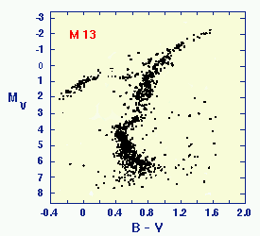





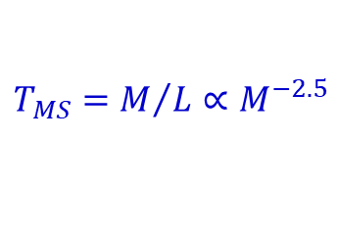






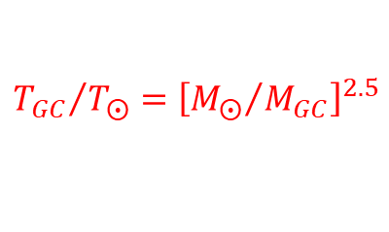



Age of GC from ´kink´ at main sequence
$$5$$
$$4$$
$$3$$
$$\log{L/L_{⨀}}$$
$$2$$
$$1$$
$$0$$
$$−1$$
$$0$$
$$0.5$$
$$1.0$$
$$1.5$$
$$\log{M/M_{⨀}}$$
$$T_{MS}=M/L∝M^{−2.5}$$
mass (M_{sun}) lifetime (years)
1 ~10¹⁰
5 ~10⁸
10 ~10⁷
$${T_{GC}}/{T_{⨀}}={\left[{M_{⨀}}/{M_{GC}}\right]}^{2.5}$$
$$T_{⨀}=9.4 Ga$$

Slide 27

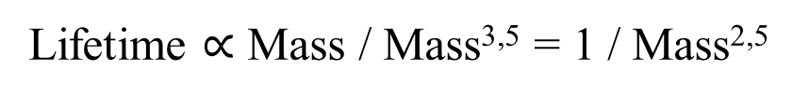
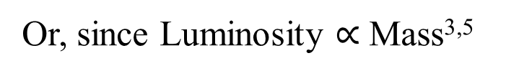
How does mass effect how long a star will live
Lifetime $∝$ Fuel available / How fast fuel is burned
So for a star
Lifetime $∝$ Mass / Luminosity
Or, since Luminosity $∝$ Mass^{3,5}
For main sequence stars
Lifetime $∝$ Mass / Mass^{3,5} = 1 / Mass^{2,5}
Big stars live shorter lives, burn their fuel faster …

Slide 28
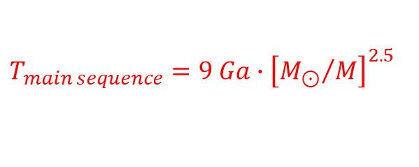
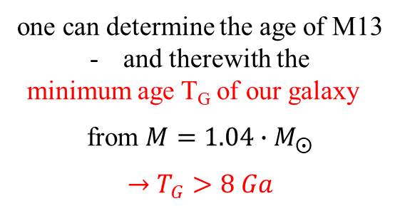

For our Sun this time
is about 9 billion years (Gyr)
for lighter stars longer,
for heavier ones shorter
$$T_{main sequence}=9 Ga∙{\left[{M_{⊙}}/M\right]}^{2.5}$$
when observing at which mass M the stars of M13 are leaving the main sequence
$$\frac{M}{M_{⨀}}=1.04$$
one can determine the age of M13
and therewith the
minimum age T_{G} of our galaxy
from $M=1.04∙M_{⨀}$
$$→T_{G}>8 Ga$$

Slide 29
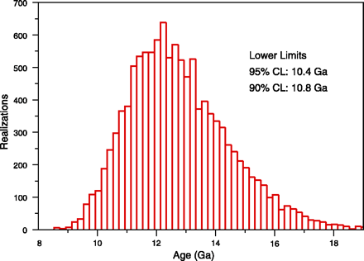
Lower limit of the age of our galaxy ~ 11 Ga
B. Charboyer, L. M. Krauss 2003

Slide 30
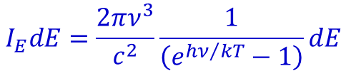

Life cycle of the Sun low-mass stars
The sun can be thought of as simply a source of blackbody radiation
Planck´s law:
$$I_{λ}dλ=\frac{2πhc^{2}}{λ^{5}}\frac{1}{\left(e^{{hc}/{λkT}}−1\right)}dλ$$
$$I_{E}dE=\frac{2πν^{3}}{c^{2}}\frac{1}{\left(e^{{hν}/{kT}}−1\right)}dE$$

Slide 31
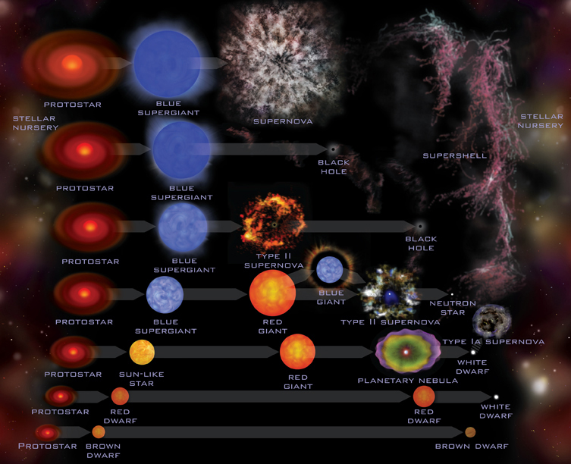
Stellar evolution

Slide 32
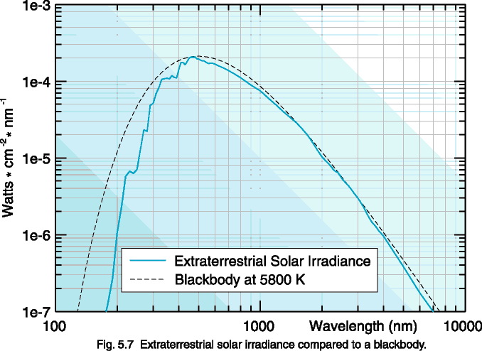
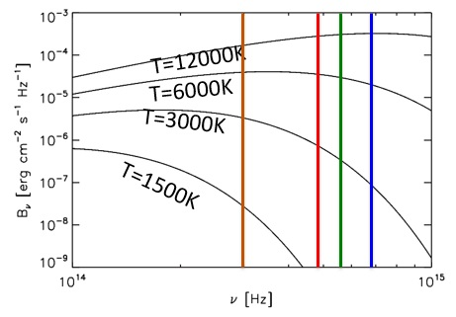



Solar irradiation
spectrum of a black-body:
$$F_{ν}=π∙B_{ν}$$
$$B_{ν}=2∙\frac{ν^{2}}{c^{2}}∙hν∙\frac{1}{exp\left({hν}/{k_{B}T}\right)−1}$$
Hotter blackbodies are brighter and *bluer“

Slide 33
Solar irradiation

Slide 34
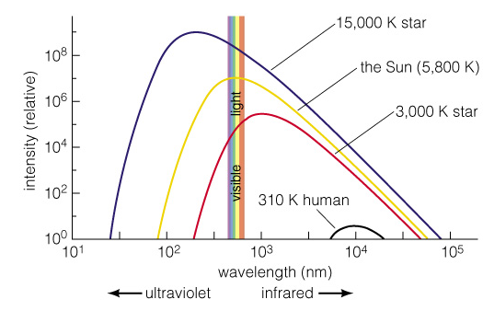

Wien´s displacement law
„Hotter bodies radiate more strongly at shorter wavelengths (i.e. they are bluer)“
$$λ_{max}=\frac{0.29 cm}{T\left(K\right)}$$

Slide 35
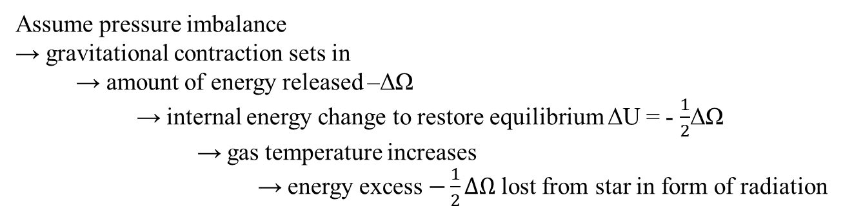

Nature of stellar evolution
Stellar structure and evolution controlled by:
gravity → collapse
internal pressure → expansion
Star composed of many particles (~10⁵⁷ in the sun)
Total energy:
mutual gravitational energy of particles (Ω)
internal (kinetic) energy of particles (including photons) (U)
For an ideal gas in hydrostatic equilibrium: (virial theorem)
$$2U+Ω=0$$
Assume pressure imbalance
→ gravitational contraction sets in
→ amount of energy released –ΔΩ
→ internal energy change to restore equilibrium ΔU = - $\frac{1}{2}$ΔΩ
→ gas temperature increases
→ energy excess $−\frac{1}{2}ΔΩ$lost from star in form of radiation

Slide 36
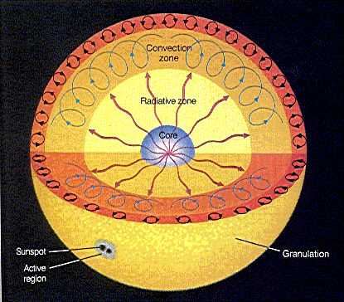
Helioseismology
surface oscillations with periods of 1-20 minutes
max. 0.1 m/s
Stellar convective zone decoupled from core by radiative heat transport

Slide 37
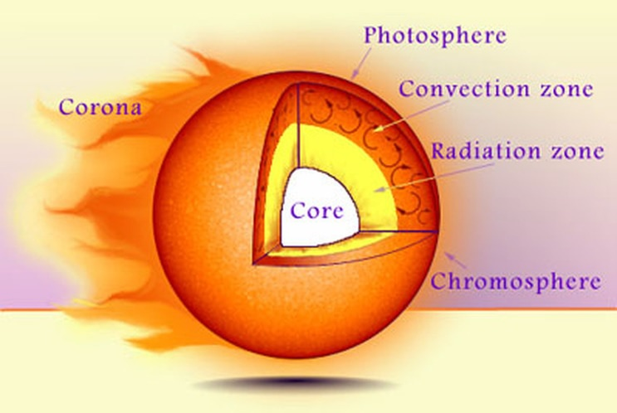
The Sun

Slide 38
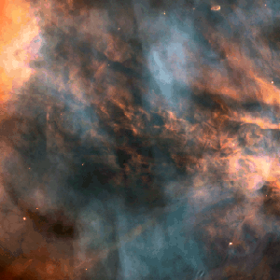
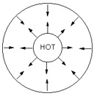

Principle of stellar structure and evolution
gravitational contraction of gas (mainly H) → increase of central temperature T
T high enough → “nuclear burning” takes place
Hydrogen burning (1st equilibrium)
$$4H → {}_{}^{4}{He}+2β^{+}+2ν+26 MeV$$
ash
energy source
of nuclear burning
gravitational collapse is halted → star undergoes phase of hydrostatic equilibrium
main sequence stars
Here: T ~ 10 -15·10⁶ K and ρ ~ 10² g/cm³ are required → M > 0.1 $M_{⊙}$ (Jupiter ${(10}^{−3}M_{⨀}$) = failed star)

Slide 39
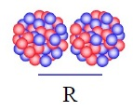





Fusion reaction in a gas
~600 keV
The difficultly arises from the Coulomb repulsion between positively charged nuclei.
$$U=\frac{q_{1}∙q_{2}}{4πε_{0}∙r}$$
We can classically calculate the point of closest approach if the initial velocity of approach is v
$$r_{close}=\frac{2q_{1}q_{2}}{4πε_{o}∙mv^{2}}$$
Naively setting $r \sim {10}^{−15} m$ and $mv^{2}=3kT$ would require $T\sim {10}^{10} K$ to get the nuclei close enough to fuse.
What is wrong?
$$T\sim {15·10}^{6}K$$
kT ~ 8.6 x 10⁻⁸ T[K] keV $⟹ k∙T\sim 1 keV$

Slide 40
with
reduced mass
v = relative velocity
kT ~ 8.6 x 10⁻⁸ T[K] keV
example: Sun T ~ 15x10⁶ K ⇒ k·T ~ 1 keV

Slide 41
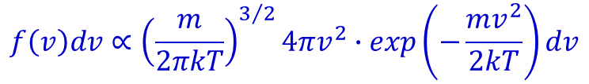
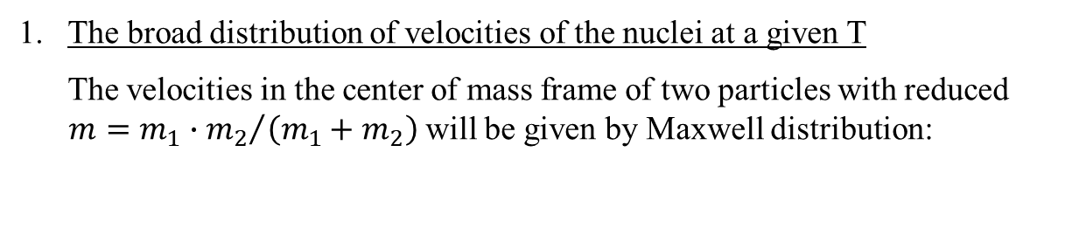
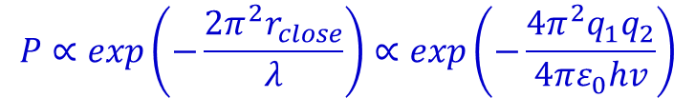
We have forgotten two crucial effects
The broad distribution of velocities of the nuclei at a given T
The velocities in the center of mass frame of two particles with reduced
$m={m_{1}{∙m}_{2}}/{\left(m_{1}+m_{2}\right)}$ will be given by Maxwell distribution:
$$f\left(v\right)dv∝{\left(\frac{m}{2πkT}\right)}^{3/2}4πv^{2}∙exp\left(−\frac{mv^{2}}{2kT}\right)dv$$
Note that, at a given T, the number of particles at high velocity v drops exponentially with v²
2. Quantum tunneling through a potential barrier
The probability of quantum tunneling through a distance r is given in terms of the de
Broglie wavelength λ:
$$P∝exp\left(−\frac{2π^{2}r_{close}}{λ}\right)∝exp\left(−\frac{4π^{2}q_{1}q_{2}}{4πε_{0}hv}\right)$$
Note that the probability of quantum tunneling therefore increases exponentially with v as e^{-1/v}

Slide 42
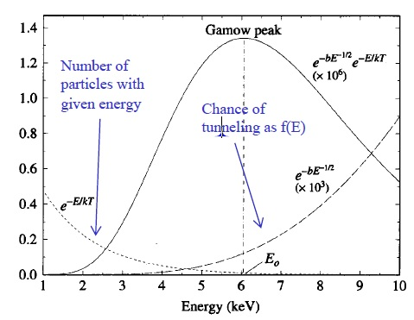




Gamow peak
The probability of a fusion reaction happening to a given pair of particles with a certain v will therefore be proportional to the product of these two competing terms
$$dN∝n_{1}n_{2}∙σ∙v∙exp\left(−\frac{mv^{2}}{2kT}−\frac{πq_{1}q_{2}}{ε_{0}hv}\right)dvdt∝exp\left(−αE−βE^{−1/2}\right)dEdt$$
This is a highly peaked function with a maximum $\left({dN}/{dE}\right)=0$ when the two terms are equal
(plus a factor of 2 from differentiating)
$$v_{max}={\left(\frac{πq_{1}q_{2}kT}{ε_{0}hm}\right)}^{1/3}$$
most of the reactions will occur with kinetic energies close to the Gamow peak
the overall rate reactions strongly increases with temperature
$$E_{0}≅0.12204{\left(Z_{1}^{2}Z_{2}^{2}∙A\right)}^{1/3}T_{9}^{2/3} MeV$$
$$∆E≅0.23682{\left(Z_{1}^{2}Z_{2}^{2}∙A\right)}^{1/6}T_{9}^{5/6} MeV$$

Slide 43
How the sun evolves
Core hydrogen burning ends
Consumed central 10% of sun
No heat source, pressure decreases, gravity wins
Core collapses, releases gravitational energy which heats the core
Core helium burning starts
Core hot-allows fusion of two a’s (Z=2)
Helium fuses to ¹²C, ¹⁶O
Hydrogen burns in shell
He Burning Core
T=10⁸ K
ρ = 10⁴ g/cm³
H burning shell
Non-burning envelop

Slide 44

What‘s next for the sun?
It’s the end of the line
Helium burning ends after 10⁸ years, C and O core
Gravitational collapse, BUT, never reach sufficient T to fuse C + C.
Collapse continues to 10⁷ g/cm³-- electron pressure stops collapse
Shells still burning, unstable, blow off planetary nebula
Star becomes a white dwarf (e.g. Sirius B).
Property Earth Sirius B Sun
Mass (M _{sun}) 3x10⁻⁶ 0.94 1.00
Radius(R _{sun}) 0.009 0.008 1.00
Luminosity(L _{sun}) 0.0 0.0028 1.00
Surface T (K) 287 27,000 5770
Mean ρ (g/cm³) 5.5 2.8x10⁶ 1.41
Central T (K) 4200 2.2x10⁷ 1.6x10⁷
Central ρ (g/cm³) 9.6 3.3x10⁷ 160
Ring nebula in Lyra-NGC 6720—a planetary nebula

Slide 45

Stellar evolution

Slide 46



Hydrogen burning in massive stars
Requires existing CNO abundances as catalyzing isotopes for He production through consecutive four proton capture and two beta-decay processes
energy production rate:
Competition between the pp chain and the CNO cycle
$$M≥1.5 M_{⨀} ⇒ T_{6}>30$$
CNO burning is necessary for massive star evolution to stabilize stellar core against gravitational contraction!
sun

Slide 47

Hydrogen burning in massive stars
mass | last stage | core
< 0.3 M_{o} | H burning | He
0.3-8 M_{o} | He burning | C, O
8-12 M_{o} | C burning | O, Ne, Mg
> 8-12 M_{o} | Si burning | Fe

Slide 48
Heavy-mass stars – the stellar onion
Starts like the sun:
The Result
He Burning Core
T=10⁸ K
ρ= 10⁷ kg/m³
The Stellar Onion
Non-burning H
H
He
C
O
But now, when He is exhausted in the core and the core collapses, it does get hot enough to burn carbon and oxygen.
Silicon
The successive stages in the core are H → He, gravity, He → C,O, gravity, → C,O → Mg, Si, gravity, Si →Fe.
Iron (Fe)
Attention!!!

Slide 49
Fusion of more massive nuclei
Fusion of more massive nuclei will require higher temperatures because of larger Z·e nuclear charges produce higher Coulomb barrier
H to He 1·10⁷ K
He to C,O 1·10⁸ K
C to O, Ne, Na, Mg 5·10⁸ K
Ne to O, Mg 1·10⁸ K
O to Mg – S 2·10⁸ K
Si to around Fe 3·10⁹ K
Also, the flattening of the binding energy curve per nucleon means that less energy is released per reaction at higher nuclear masses as we approach ⁵⁶Fe

Slide 50
Evolutionary stages of a 25 M_{sun} star Weaver et al, 80
Burning Stage | Time Scale | T(K) x 10⁹ | ρ (g/cm³)
H | 7 x 10⁶ y | 0.006 | 5
He | 5 x 10⁵ y | 0.23 | 700
C | 600 y | 0.93 | 2 x 10⁵
Ne | 1 y | 1.7 | 4 x 10⁶
O | 0.5 y | 2.3 | 1 x 10⁷
Si | 1 d | 4.1 | 3 x 10⁷
Core collapse | Seconds | 8.1 | 3 x 10⁹
Core Bounce | Millisec | 34.8 | 3 x 10¹⁴
Explosive | 0-1-10 sec | 1.2-7.0

Slide 51
Supernovae core collapse
Time
Fe (Iron) is special core of our stellar onion is “Fe”, most tightly bound nucleus. Result of fusing two “Fe's” is heavier than two “Fe's”; costs energy to fuse them. No more fusion energy is available.
Core collapses, keeps on collapsing, until reach nuclear density. Then nuclei repel, outer core bounces.
Outgoing shock wave forms
"Fe" core collapse
bounce-form shock wave
shock moves out, Fe → p's , n's in outer part of Fe core

Slide 52

What next?
1-D model (T. Mezzacappa)
We know that
  Shock blows off outer layers of star, a supernova
  10⁵¹ ergs (1foe) visible energy released (total gravitational energy of 10⁵³ ergs mostly emitted as neutrinos).
Theoretically
  Spherical SN don’t explode
  Shock uses its energy dissociating “Fe”, stalls
  Later, ν’s from proto-neutron star deposit energy, restart the shock. Still no explosion.

Slide 53

The question – how do we get from her to an explosion?
SN 1987a in Large Magallanic Cloud

Slide 54


Non-spherical calculations
Two views
Is sphericity the problem?
  Now have 3-D calculations which explode, but have only a part of the detailed microphysics. Their stability against such changes is not known-we return to this later.
  See, e.g. C. Fryer and M. Warren, Astrophysical Journal, 574:L65-L68
  Find 2-D, 3-D similar
Red upwelling
Blue sinking

Slide 55

What is produced in a supernova?
Model
  Evolve the Pre-SN star
  Put in a piston that gives the right energy to the ejecta (Don’t know how explosion really works).
  Calculate what is ejected
  Calculate explosive processes as hot shock passes.
  Example: Wallace and Weaver, Phys. Rep. 227,65(93)
Find
  Elements, mass 20-50, generally reproduced at same ratio to solar.
  Modifications by explosive processes are small

Slide 56


Slide 57
The Sun: a few numbers
mass = 1.99·10³⁰ kg
average density = 1.4 g/cm³
luminosity = 3.84·10²⁶ W
effective temperature = 5777 K
core temperature = 15·10⁶ K
surface gravitational acceleration g = 274 m/s²
age = 4.55·10⁹ years
radius = 6.96·10⁵ km
distance = 1 AU = 1.496 (±0.025)·10⁸ km
1 arc sec =722±12 km on solar surface
rotation period = 27 days at equator

