Slide 1
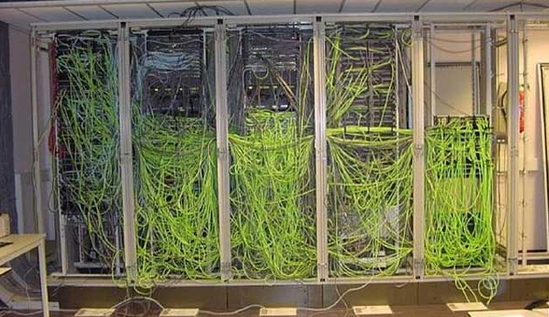
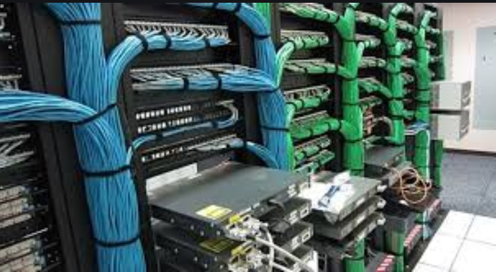
Organization question:
Effort
Let go
Each user thinks for his own little cable
No one cares for overall cleanliness
Everybody is mindful in intervention not to destroy
other people work
Everyone makes a small effort,
Every tentative to move from left to right is dealt with STRONG resistance, long discussions
➔ I spend 20% of my time in the messhute/experiment trying to move left towards right.
I would really appreciate support
Put it differently: we do nuclear physics, you are part of the generation of the mean field around you.
➔ the system is stable if we all contribute to it.

Slide 2
Basic request to value our time:
One Linux PC with screen for major focal plane
table for Linux PC is not “storage area” and PC shall not be disconnected (Specially at S2)
Organize network connection, not “first come first serve” (please contact Christine)
Have a list of what is available where
No dismounting/appropriation of equipment for general application to own project
Screen drivers/basic tools present at each major focal plane for physics
Labeling tools (simply tape, 2 euros tape) present in case of need
Presence of a scope we can use for each focal plane + 1 in the messhute
➔ this will guarantee time saved and free mind power to do our work, not to look for tools or argue if we are allowed to have a screw driver with us when we go to S2 (if tools present at S2 I do not need one)
Respect agreements:
Module data base: I did the full inventory in December… now I have to do again.
If I lock the cabinet, complain, if I let them open, no overview what is where anymore
this was discuss in meetings, concept written, presented, discussed, partially implemented, now thrown to the garbage bin
https://web-docs.gsi.de/~spietri/hwdb/hwdb (was sent by Emma few weeks ago)
Many websites/manuals currently, I put a hub in https://web-docs.gsi.de/~frs-daq/
➔ this (will) contains info on the current system (racks, crates, ip ports, computer per focal plane etc..)
(It is information, please no long discussion on this now, we have beam time to prepare)

Slide 3
IT good practice GSI (not specific to frs/NUSTAR or what ever, things are similar in most labs)
Two types of account: collaboration account, user account
collaboration accounts: profi ➔ for online and standard FRS application
frs-phys ➔ control system related things
frs-daq ➔ to archive IT stuffs
(despec, land etc…)
personal account : for your own analysis, please do not overload collaboration accounts with your own analysis
➔ we should reduce the number of use case to profi/frs-phys to what is needed for experiment
(slow control, data management etc….)
Network domains of interest:
Accelerator domain: just for operators, personal acocunts, csheidenb used as “group account”
➔ DO NOT GIVE PASSWORD TO ANYONE
Campus domain: General purpose Linux (debian with KDE or XFCE)
Lynx domain : DAQ network (only collaboration accounts, profi has old password, ask if you need)
SLURM/virgo : computer center, see below
Collaboration account, password if for collaborators too
Personal AND accelerator domain accounts should never have password shared (IT security rule, not my rule)

Slide 4
IT good practice GSI (not specific to frs/NUSTAR or what ever, things are similar in most labs)
Data: (this is valid for collaboration and general accounts)
/u/$USERACCOUNT ➔ backed up every evening, for code not to store data (I will delete .root files on coll. account)
NOT BACKED UP
/d/frs01 /d/frs02 ➔ old RAID disks, for data, only 3.1 GB, full
/d/land4/sec/ ➔ RAID disk for data storage during experiment (from DAQ, lmd files) (soon we will have our own machine)
/data.local ➔ on your computer, no rule;)
SLURM
/lustre/nustar/profi ➔ for copy of the /d/land4/sec, please do not use
/lustre/nustar/profi-analysis ➔ usually one directory per experiment for root tree generation
/lustre/nustar/$USERACCOUNT ➔ free to use, if huge amount please inform
for profi and frs-phys /lustre is mounted on /u/profi/Lustre (if you see empty, do “>bash ~/.lustremount”)
for Go4/root operation use lxpool or lxgXXX machines.
https://hpc.gsi.de/virgo/access/key_authentication.html and https://hpc.gsi.de/virgo/access/mount_cluster_storage.html )
TAPE ROBOT
move regularly data from/lustre/nustar/profi to tape robot
LYNX DAQ NETWORK:
/lynx/Lynx/frs/usr/profi/mbsrun ➔ NO LMD allowed, (>5 MB)

Slide 5
IT good practice GSI (not specific to frs/NUSTAR or what ever, things are similar in most labs)
To have access to SLURM/virgo : https://hpc.gsi.de/virgo/preface.html
lxpool.gsi.de ➔ computer machines on campus you can log in. It is the firewall from outside
lxgXXX.gsi.de ➔ desk
Simple for us:
For accessing /lustre data storage:
  Make sure you can login with ssh key authentification
  >ssh-keygen –q –f ~/.ssh/id_rsa –t –rsa
  >ssh-copy-id $USER@lxpool.gsi.de
Once done you have access to the cluster: ssh $USER@virgo.hpc.gsi.de
➔ no way to have X session there (used for submitting jobs only)
Now on campus machines (lxgXXX in the messhute/office, or lxpool.gsi.de)
>mnt /u/$USER/mylusterdirectory
>mkdir –p $mnt
>sshfs lustre.hpc.gsi.de:/lustre $mnt
(you can do it in a script: as in /u/profi/.lustremount and /u/profi/.lustreunmount )

