Slide 1
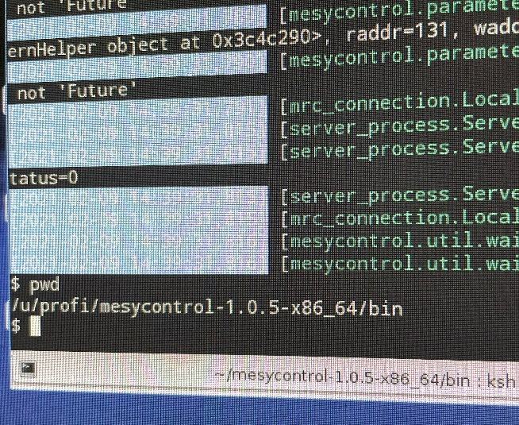
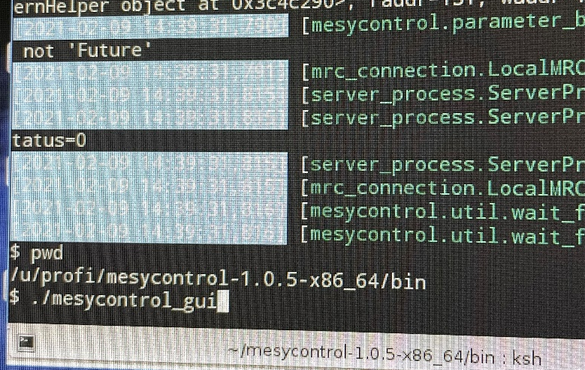
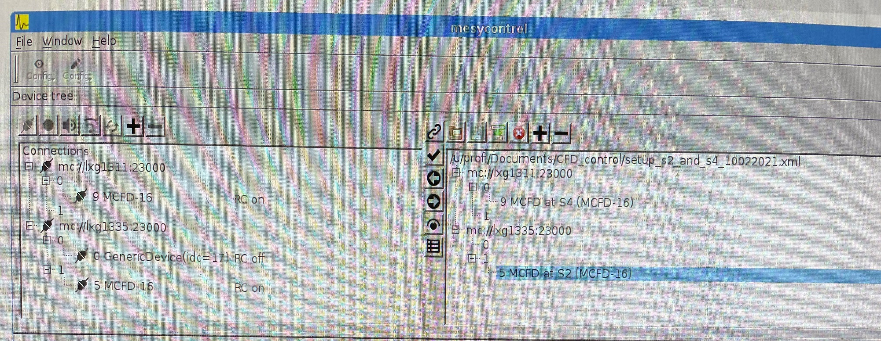
I. under “profi” account go to
$ cd/u/profi/mesycontrol-1.05-x86_64/bin
II. start mesycontrol_gui
$ ./mesycontrol_gui
MRC – the central controlling module
for all remote controllable mesytec devices.
III. Make sure the connection
to MCFD-16 is there
MRC at S2 is connected to lxg1311
MRC at S4 to lxg1335
(you could also see the connections via RS-232 cable as /dev/ttyS0)
The address of the MCFD at S2 is 5 and at S4 is 9

Slide 2
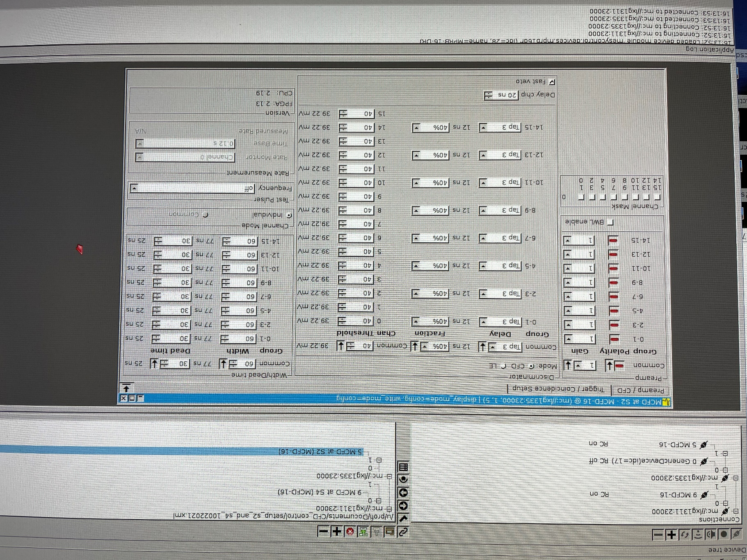
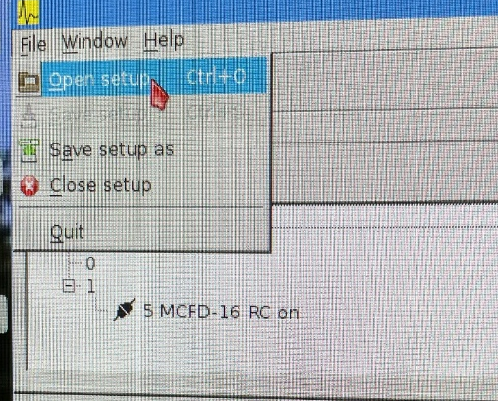
IV. If you see this then the right setup “setup_s2_and_s4_10022021.xml” for S2-S4 is already chosen
if not → File→Open setup
/u/profi/Documents/CFD_control
and load “setup_s2_and_s4_10022021.xml”
(you can also “Save setup as”, just keep s2_and_s4 in the new name)

Slide 3

MCFD at S2
SCI22L/R are connected to the
8th and 9th channel of the MCFD
only for BARB experiment.
SOFIA SCI22 L/R connected to
Philips Scientific CFD.
SCI21L
SCI21R
Polarity: negative
Fraction: 20% or 40%
Threshold: 3 mV-3.5V
Gain: 1 (the-3 dB bandwidth of the built in amplifier is 600 MHz); 3 (500 MHz); 10 (300 MHz)
Pulse width: 6 ns - 660 ns
Dead time: 20 ns - 660 ns
(the time from pulse end to the
next possible pulse)
SCI22L
SCI22R

Slide 4
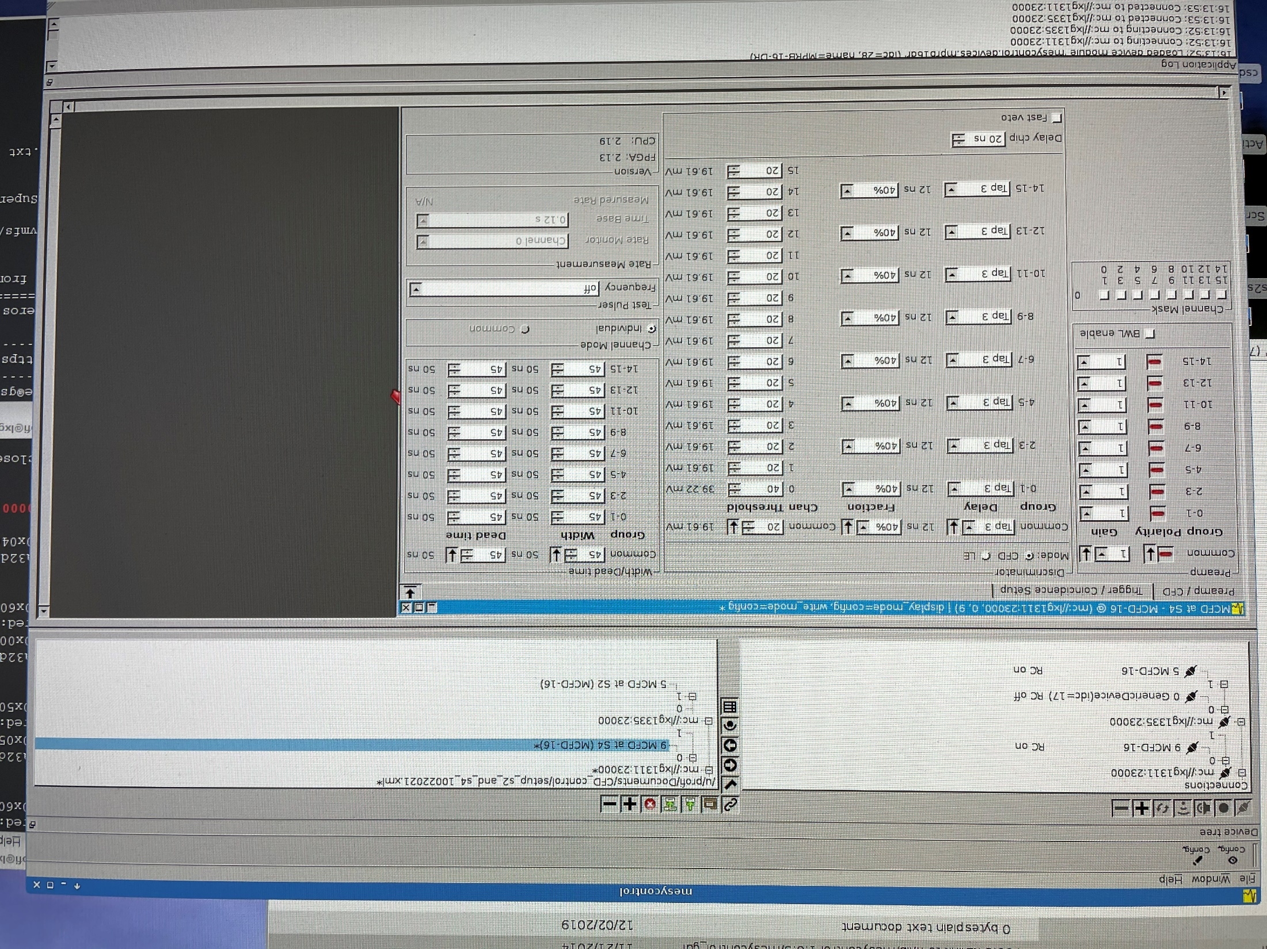
MCFD at S2
SCI41L
SCI41R
SCI42L
SCI42R

Slide 5
MCFD modules at S2, S4 and S8
S4 NIM crate
MCFD-16:
chan.0 SCI41L
chan.1 SCI41R
chan. 2 SCI42L
chan. 3 SCI42R
S2 NIM crate:
MCFD-16:
chan.0 SCI21L
chan.1 SCI21R
….
chan. 8 SCI22L (only for BARB, C - beams)
chan. 9 SCI22R (only for BARB), C -beams
S8 NIM crate
MCFD-16:
chan.0 SCI81L
chan.1 SCI81R

