Slide 1
Coulomb excitation of ¹²⁰Te and ¹²²Te
P.I: Dr Rakesh Kumar
Inter University Accelerator Centre
New Delhi
CO P.I: Prof. Hans Juergen Wollersheim
GSI Germany
AUC meeting 17th Dec 2011

Slide 2
Outline
Introduction
Work done so far…..
Physics background and Scientific Motivation..
Proposed experiment…
Experimental setup
Beam time request…

Slide 3
Introduction
Experimental and theoretical studies-- focused on nuclear shell structure far from the line of stability.
Reduced transition probabilities across closed shell Z = 50 are the area of great interest.
In the Z = 50 Sn nuclei, it is the valence neutrons determines low-energy spectra, but in the Z = 52 Te nuclei both valence protons and neutrons can contribute.
Neutron-deficient Te nuclei provide us with a region where the details of the proton-neutron interaction are enhanced .
Recent gamma spectroscopy studies of neutron deficient
Te [1], I [2] and Xe [3] nuclei have provided evidence of enhanced collectivity when approaching the N=50 shell gap.
1. B. Hadinia et al., Phys. Rev. C 72 (2005) 041303(R).
2. M. Petri et al., Phys. Rev. C 76 (2007) 054301.
3. M. Sandzelius et al., Phys. Rev. Lett. 99 (2007) 022501.

Slide 4
Work done so far…..
Coulomb Excitation of ^{112,114,116}Sn

Slide 5
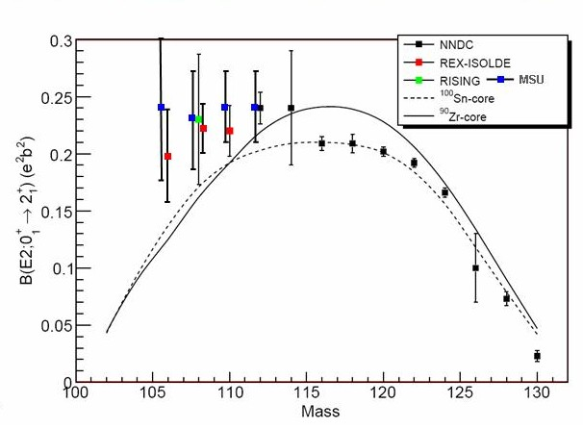
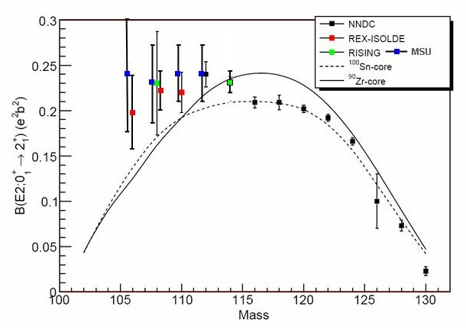
For ¹¹⁴Sn we determined B(E2;0⁺→2⁺)=0.232(8) e²b²
For ¹¹²Sn we determined
B(E2;0⁺→2⁺)=0.242(8) e²b²
Deviations from the seniority scheme when approaching the N=Z=50 shell gap and at the neutron mid shell have been observed.

Slide 6
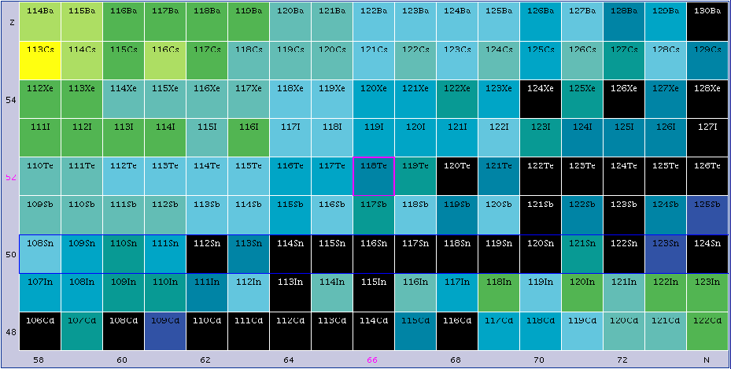
The Te isotopes, a brief background
Physics background and Scientific Motivation
Z=52
Z=50
N

Slide 7
The Te isotopes, a brief background
Physics background and Scientific Motivation
The 2⁺ and 4⁺ states minimise their energies near the neutron mid shell at N =66.
Consequently, transition probabilities increase towards the mid shell.
However, available experimental data suggests reduction of collectivity at the mid shell.

Slide 8
Physics background and Scientific Motivation
Theory and Experiments
Constrained HFB + GCM + 5 dimensional collective quadrupole Hamiltonian with the Gogny D1S interaction.
J.-P. Delaroche et al. Phys. Rev. C 81 014303 (2010)

Slide 9
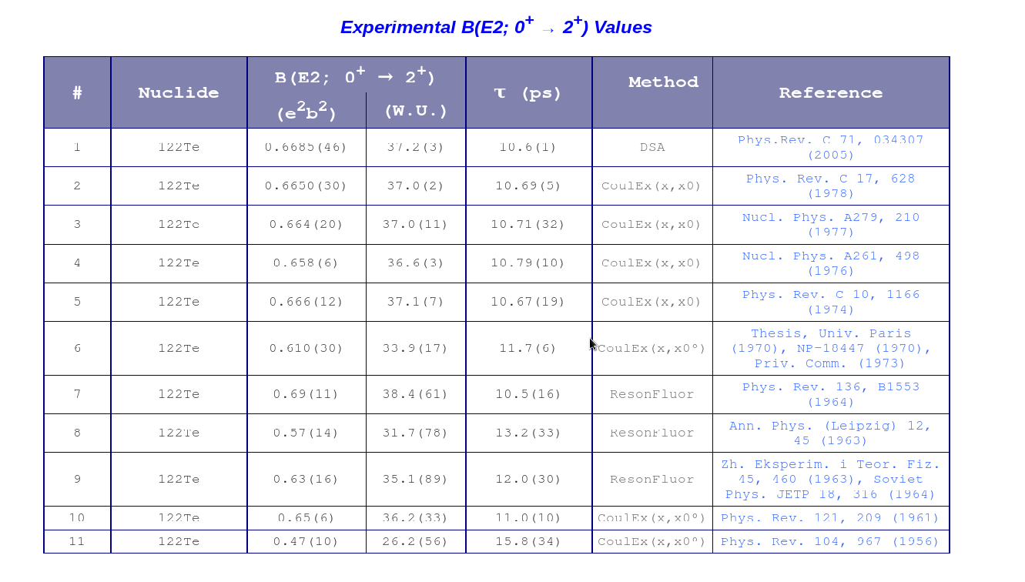
Lower B(E2) values in case of 120Te (two neutrons more than
the mid shell 118Te nucleus) with an error bar of 20%.
It is needed to measure much accurate B(E2↑) values for Te isotopes than that existing in the literature
Literature of ^{120,122}Te (NNDC)

Slide 10
Objectives of the proposed study
To probe collectivity and wave functions around the N =66 neutron mid shell by measuring the B(E2;0⁺→2⁺) value in ¹²⁰Te and ¹²²Te by Coulomb Excitation

Slide 11
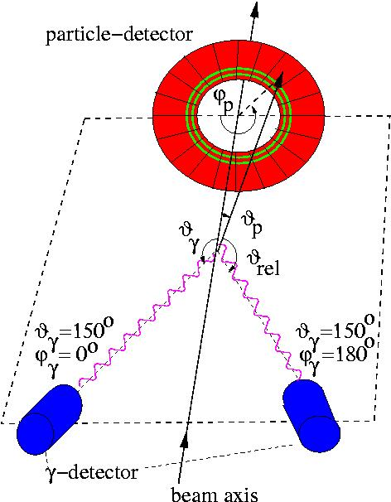
Experimental setup
Scattered projectiles and recoils will be detected in an annular gas-filled parallel-plate avalanche counter (PPAC), subtending the angular range θ_{lab} = 15° - 45°
in the forward direction.
De-excitation γ -rays will be detected in four clover detectors mounted at
ϑγ ∼ 135◦ with respect to the beam direction.
120,122Te target
135⁰
135⁰
58Ni beam

Slide 12
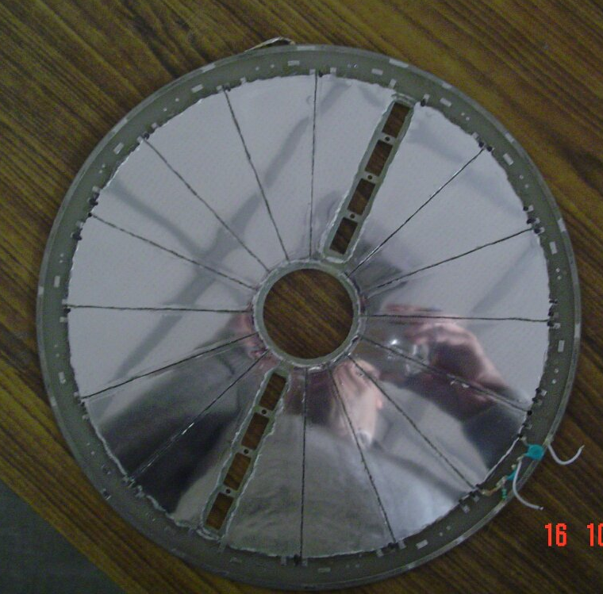
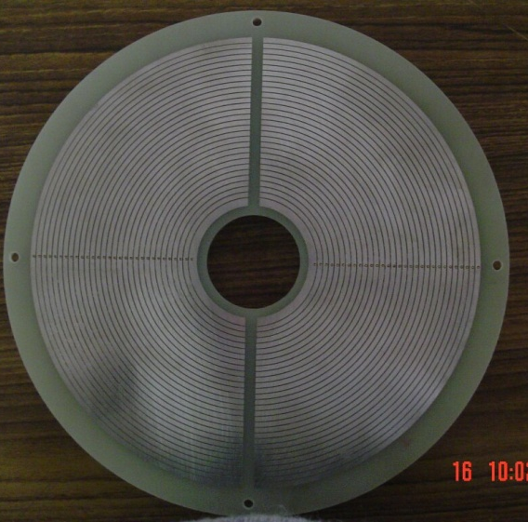
Particle Detector
Front → φ-information
Azimuthal angle φ obtained from anode foil
Divided into 20 radial sections of 18◦ each.
To measure polar angle θ, the cathode is patterned in concentric conductor rings, each 1 mm wide, with an insulating gap of 0.5 mm between them.
Each ring is connected to its neighbor by a delay line of 2 ns.
The cathode signals read out from the innermost and outermost rings, and the θ information will be derived from the time difference between the anode and the cathode signals.
Back→ θ-information

Slide 13
Beam time request
Beam ⁵⁸Ni 0.5 pnA 175 MeV
Targets ^{120,122} Te 500ug/cm² with carbon backing (20-40ug/cm²)
⁽ Max enrichment is 40% in 120Te)
⁽¹²²Te enrichment will be ~99%)
⁵⁸Ni@175 MeV beam energy and a beam current of 0.5 pnA, a cross section of 850 mb is calculated for ¹²⁰Te but we have also to measure 35 mb of ⁵⁸Ni.
The natural abundance of ¹²⁰Te is 0.1%.
The enrichment of Te isotopes is much smaller than that of Sn
isotopes
To achieve 10⁴ counts in projectile and target excitations, Beam time of 7 days (including 1 day for the setup of the electronics and the calibration runs) is required to complete this measurement.

Slide 14
List of collaborators
Mr Akhil Jhingan IUAC akhil_jhingan@yahoo.co.in
Mr. S. Muralithar IUAC smuralithar@gmail.com
Mr. R. P. Singh IUAC rps_inuk@yahoo.com
Ms. Indu Bala IUAC indu_phy@gmail.com
Mr. R. K. Gujjar IUAC pritam.radhakishan@gmail.com
Mr Sunil Ojha IUAC sunil.mumbaikar@gmail.com
Dr Appana Babu IUAC appanababu@gmail.com
Prof. R.K.Bhowmik GGDU ranjanbhowmik@gmail.com
Prof. H.J.Wollersheim GSI h.j.wollersheim@gsi.de
Dr. Pushpendra P. Singh GSI pushpendrapsingh@gmail.com
Dr Pieter Dornenbal RIKEN pieter@ribf.riken.jp
Dr Samit Mandal DU samit01m@googlemail.com
Ms. Mansi Saxena DU mansi.aqua@gmail.com
Prof. B.P. Singh AMU bpsinghamu@gmail.com
Mr. Abhishek Yadav AMU abhishekyadav117@gmail.com
Mr Vijay Raj sharma AMU phy.vijayraj@gmail.com
Prof N.L.Singh MSU Baroda singhnandlal@gmail.com
Dr. Surjeet Mukherjee MSU Baroda smukherjee_msuphy@yahoo.co.in
Dr. Tarkeshwer Trivedi TIFR ttrivedi1@gmail.com
Dr. Ajay Tyagi BHU atyagi44@gmail.com
Mr Somnath Nag IIT kharagpur somnanag@gmail.com

Slide 15
Backup slides

Slide 16
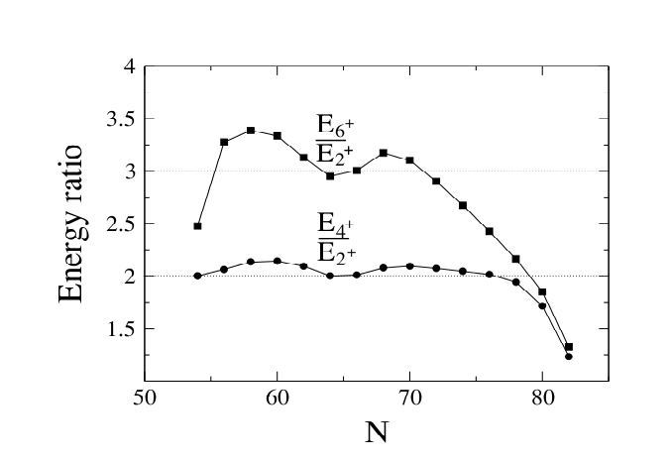

Slide 17
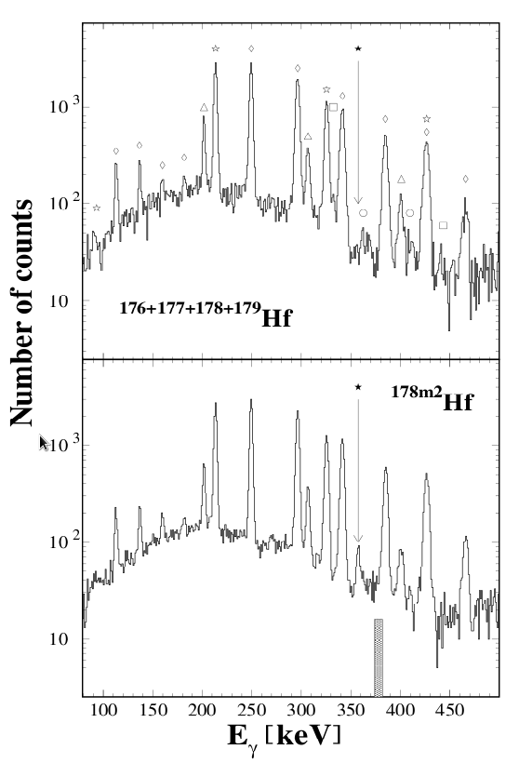

Slide 18
Systematics of the Te isotopes (Z=52)
(Z = 52)
Neutron number 68 70 72 74 76 78 80 82
Val. Neutr. number 14 12 10 8 6 4 2 0

Slide 19
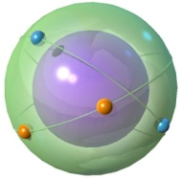
Systematics of the Te isotopes (Z=52)
(Z = 52)
4⁺
1.63
6⁺
1.69
2⁺
1.59
4⁺
1.58
2⁺
1.16
2⁺
1.28
0⁺
4⁺
1.20
1.10
2⁺
0.84
2⁺
0.56
0⁺
0⁺
0⁺
¹²⁰Te
¹³⁰Te
¹³⁴Te
Case of few valence nucleons: lowering of energies, development of multiplets. R_{4/2} → ~2-2.4

Slide 20
Experimental observables in even-even nuclei
1000
4⁺
400
2⁺
0
0⁺
E ( keV)
J^{π}

Slide 21
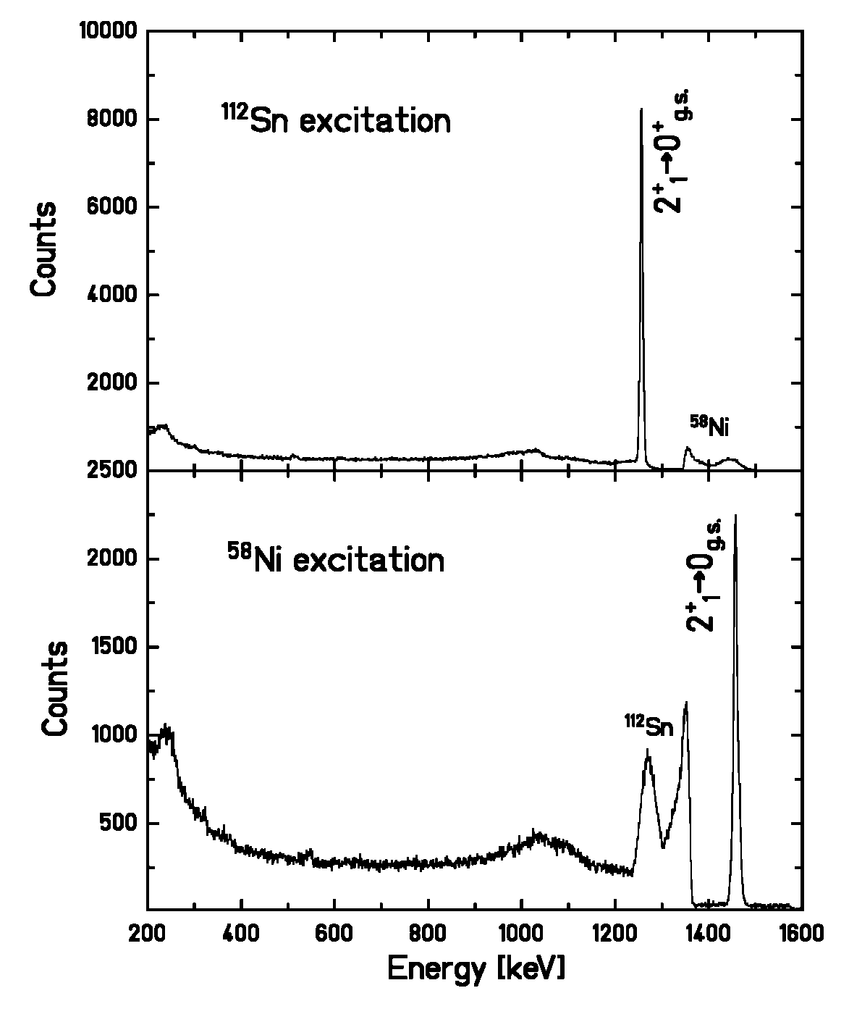
Doppler – shift correction at IUAC
⁵⁸Ni detected in PPAC
¹¹²Sn target excitation
ΔE_{γ}=7.5keV
⁵⁸Ni projectile excitation
ΔE_{γ}=12.4keV

Slide 22
B(E2) Value Determination
Contribution from higher lying states taken into account
Literature value for ¹¹⁶Sn =0.209(6) e²b²
Literature value for ⁵⁸Ni = 0.0493(7) e²b²
Two possibilities to determine B(E2) of ¹¹²Sn:
Relative to ⁵⁸Ni:
Relative to ¹¹⁶Sn:
Small corrections for :
difference in excitation energy ( 1246 & 1294 keV)
difference in c.m. energy
difference in angular distribution
σ(¹¹²Sn)/ σ (¹¹⁶Sn) = 1.304 ± 0.024
[ B(E2) ¹¹²Sn ] / [ B(E2) ¹¹⁶Sn ] = 1.166 ± 0.022
Notes:
In two consecutive experiments the relative excitation strength of the 112 Sn and 116Sn was determined, with the first excited 2+ state in 58 Ni used for Normalisation. This insured that systematic errors were excluded and the projectile excitation was cancelled.
For the 112Sn/116Sn gamma-ray yeild ratio.. The gamma-ray ration is a direct measure of B(E2) of 112Sn relative to 116Sn. Since the adopted BE2 value for 116Sn of 0.209(6) e2b2 is an evaluation of fourteen different experimental results it becomes a reliable and precise reference point.
22

Slide 23
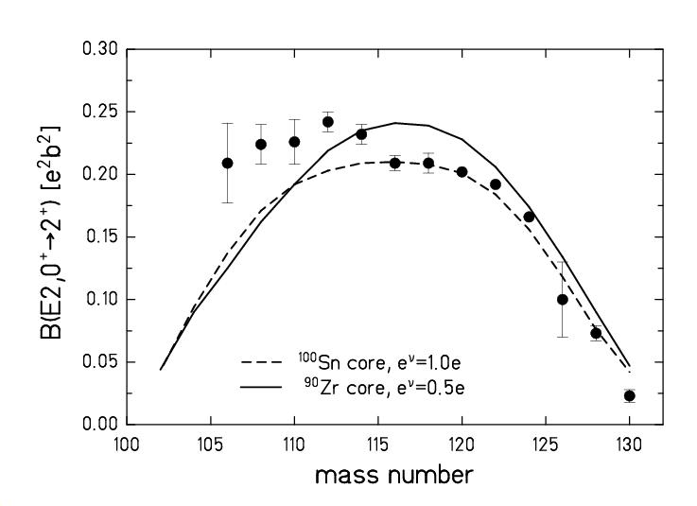
Comparison with Shell Model Calculations
¹⁰⁰Sn core,
M. Hjorth-Jensen etal.:
ν(d_{5/2}g_{7/2}s_{1/2}h_{11/2}), e_{ν} = 1.0e
mid-shell
⁹⁰Zr core,
F. Nowacki et al.:
ν(d_{5/2}g_{7/2}s_{1/2}h_{11/2}), e_{ν} = 0.5e,
π(g_{9/2}g_{7/2}d_{5/2}d_{3/2}s_{1/2}), e_{π} = 1.5e
These values are higher than expected from state of the art LSSM calculations using a ¹⁰⁰Sn or ⁹⁰Zr core
Supports the observed high B(E2) values for ¹⁰⁶⁻¹¹⁰Sn

Slide 24
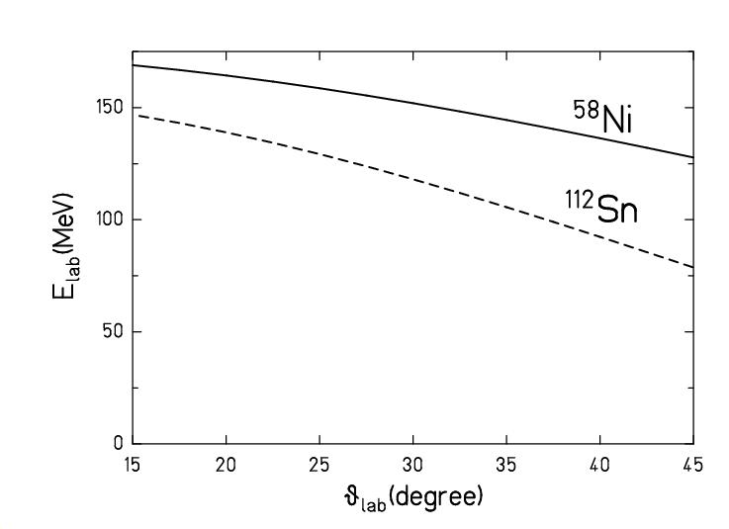
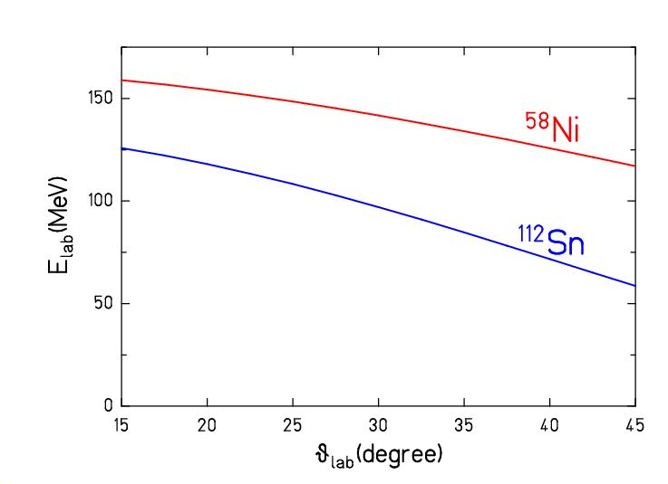
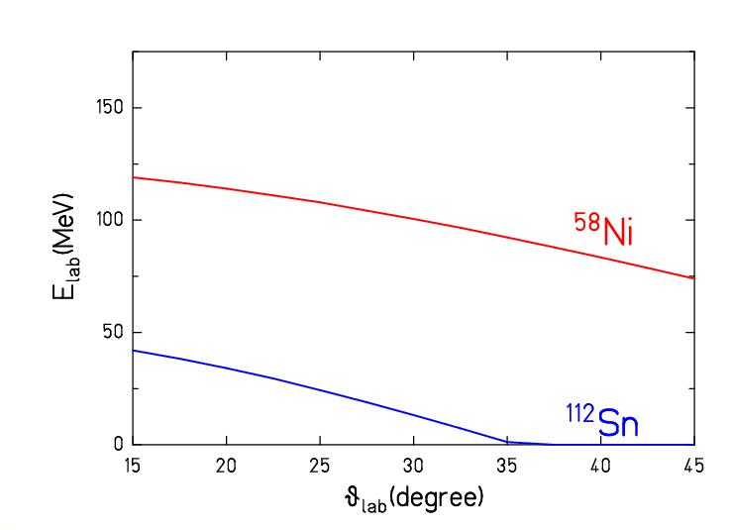
BACK UP SLIDE
⁵⁸Ni ¹¹²Sn →
PPAC
^{112,116}Sn target
Ge-clover
Ge-clover
⁵⁸Ni beam
P. Doornenbal, A.Jhingan, R.Kumar, R.P.Singh et al., Phys.Rev C 78 (2008) rapid comm.

