Slide 1
1930: Energy-conservation in beta-decay violated??
Alpha-Decay
Beta-Decay
view of 1930
Th 234
Pa 234
U 238
Th 234
α (He 4)
β (electron)
energy-
conservation
J
measurement
L
events
events
expectation
energy of α´s
energy of β´s

Slide 2
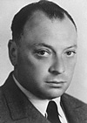
Pauli´s new particle
Beta-Decay
Lepton
charge −1
charge 0
e
ν_{e}
Wolfgang Pauli
Electron
e-Neutrino
μ
ν_{μ}
Myon
μ-Neutrino
*
τ
ν_{τ}
Pa 234
Tauon
τ-Neutrino
β (electron)
Th 234
ν
In addition to the electron a neutral, light particle is created, which carries away the „missing energy“!
„Today I have done something, what one should not do in theoretical physics. I have something, what is not understood, explained by something, what can not be observed!"

Slide 3
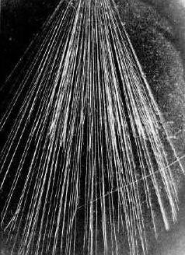
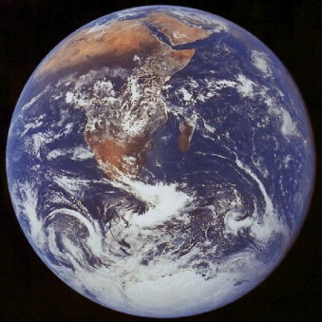
Neutrino detection
Detection of particles:
Interaction of particles with matter (detector)
Interaction with matter depends on the particle:
Charged particles: Ionization of the matter
Photons: Energy transfer to charged particles
Neutrons: Nuclear reactions create charged particles
cloud chamber
Neutrinos interact only weakly:
Only one out of 100 billion neutrinos from a
β-decay is discovered by the Earth.
ν
Calculated 1934: „Hopeless“

Slide 4
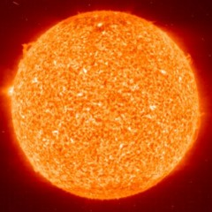
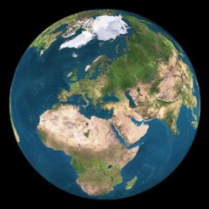
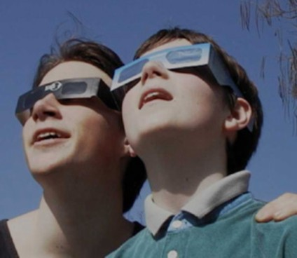
Sunglasses for neutrinos?
8.3 light minutes
A lead layer with a thickness of
several light years is required
Bethe & Peierls 1934
„ … this means that one obviously
is never in the position to observe
a neutrino.”

Slide 5
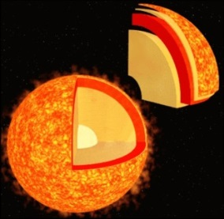
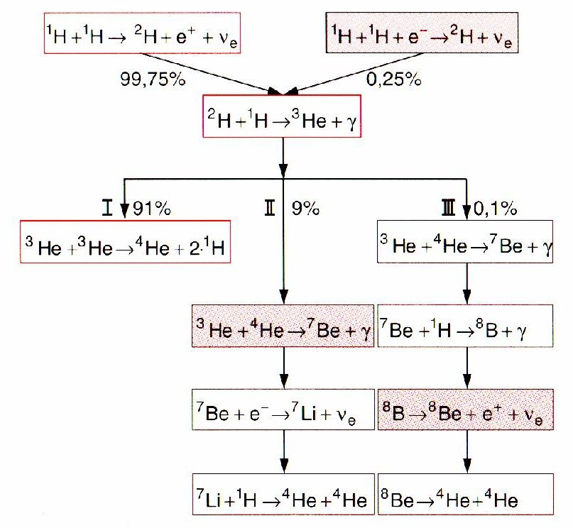
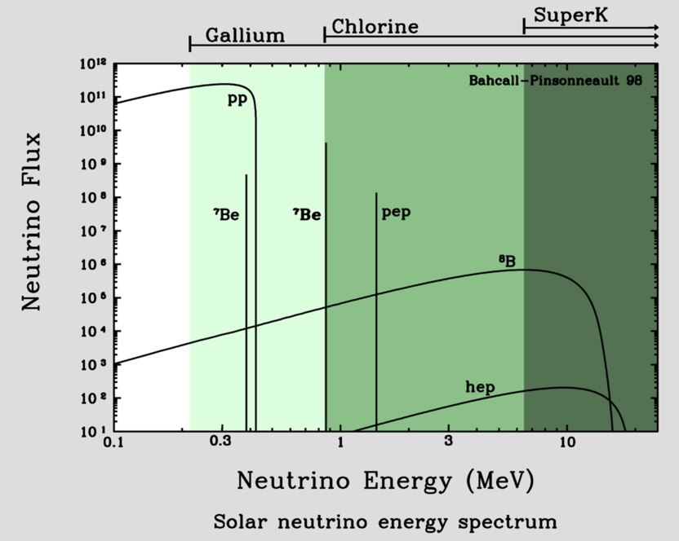
Neutrinos from the Sun
Known: total irradiated energy
Known: Energy per fusion process
Number of neutrinos produced [s⁻¹]!
On Earth: 66 billion ν per (cm² · s¹)
Different fusion pathes

Slide 6
Neutrinos from the Sun
Known: total irradiated energy
Known: Energy per fusion process
Number of neutrinos produced [s⁻¹]!
On Earth: 66 billion ν per (cm² · s¹)
proton-proton-cycle
pp-neutrino
pep-neutrino
p+p => ²H+e⁺+ν_{e} (99%)
p+e⁻+p => ²H+ν_{e} (1%)
2H+p => ³He+γ
hep-neutrino
³He+³He => ⁴He+2p (86%)
³He+p =>⁴He+ν_{e}+e⁺ (<<1%)
³He+⁴He=>⁷Be+γ (14%)
⁷Be-neutrino
⁸B-neutrino
⁷Be + e⁻ =>⁷Li + ν_{e}
⁷Li + p => 2 ⁴He (99%)
⁷Be + p => ⁸B + γ
⁸B => ⁸Be + e⁺+ ν_{e}
⁸Be => 2 ⁴He (1%)

Slide 7
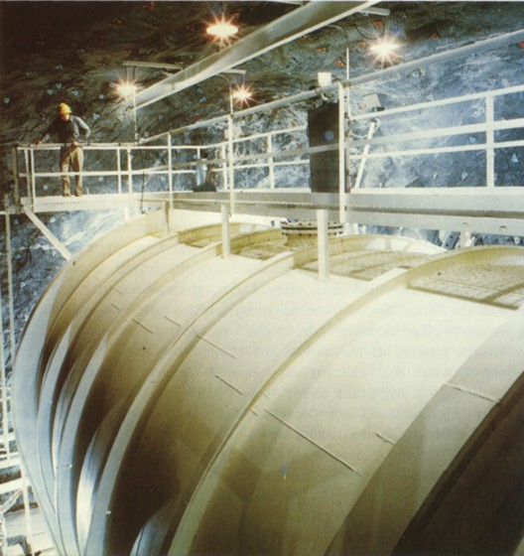
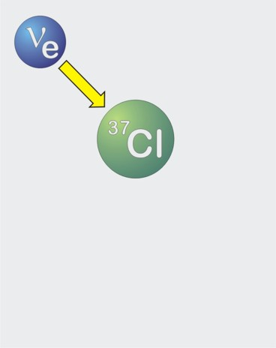
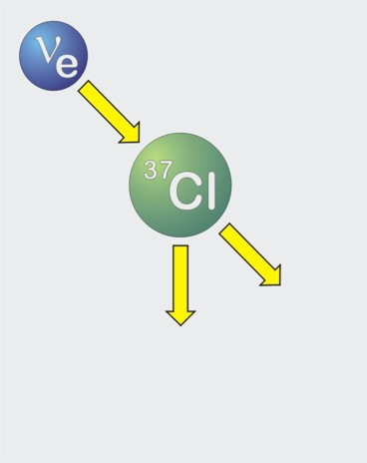
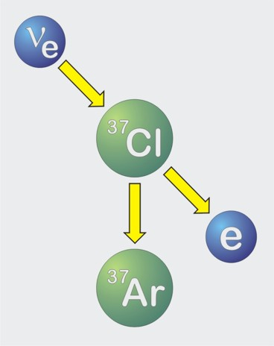
First measurement of the solar neutrinos
Inverse beta-decay
(„neutrino-capture”)
40 days neutrino irradiation …
Expected: 60 atoms ³⁷Ar
600 tons
Carbon tetrachloride
Homestake Sun neutrino-
Observatory (1967−2002)

Slide 8
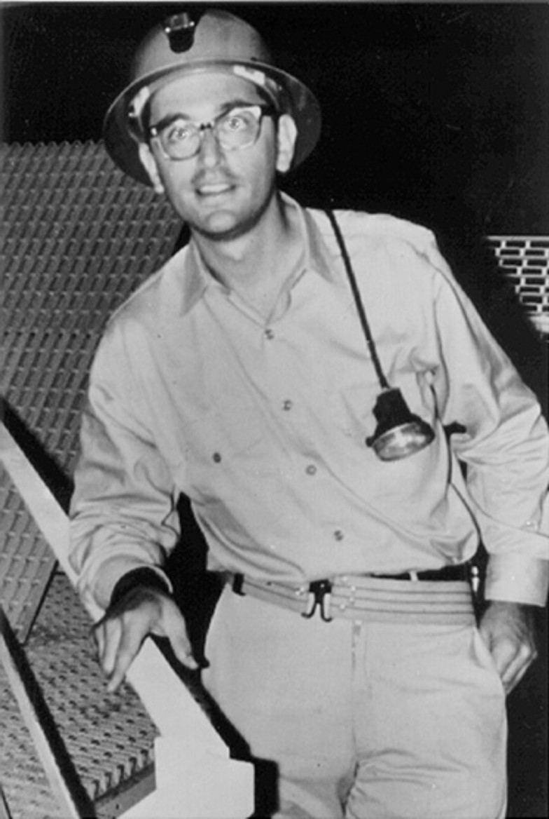
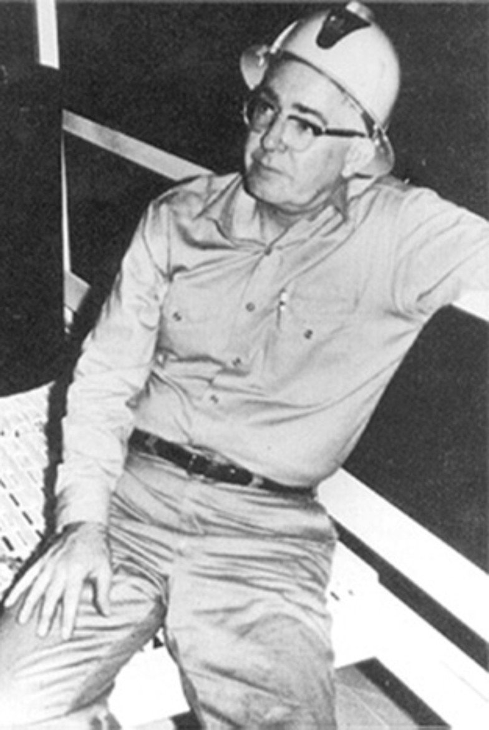
The problem of the missing solar neutrinos
Homestake
Chlorine
⁸B
Calculation of the
solar neutrino flux
from different
source reaktions
CNO
⁷Be
measurements (1970 – 1995)
John Bahcall
1934 − 2005
Raymond Davis Jr.
1914 − 2006

Slide 9
“Neutrino transformation” the solution of the puzzle
detector
Sun
Sun
detector

Slide 10
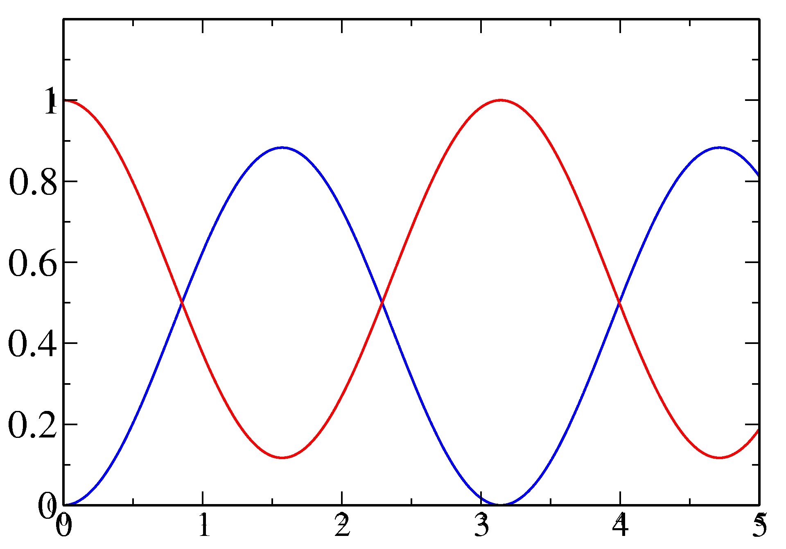
Neutrino oscillations
electron e
myon μ
tau τ
e-neutrino
μ-neutrino
τ-neutrino
Idea: If neutrinos have a mass, then they can convert themselves into one another!
Assumption: Mixture of
Change of a neutrino-beam with the distance to the
neutrino source:
ν_{e}
ν_{μ}
ν_{e} and ν_{μ}
content of the beam
distance to the source
1998: Discovery of the oscillations between myon- and tau-neutrinos using Super-Kamiokande (myon-neutrinos from the atmosphere)

Slide 11
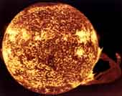
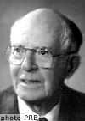
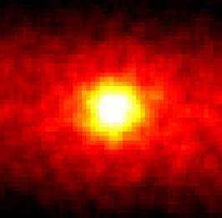
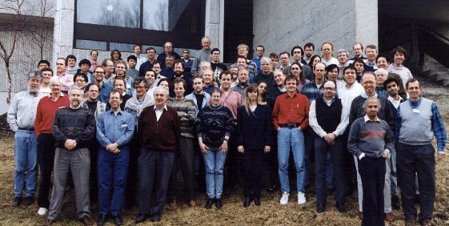
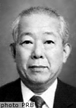
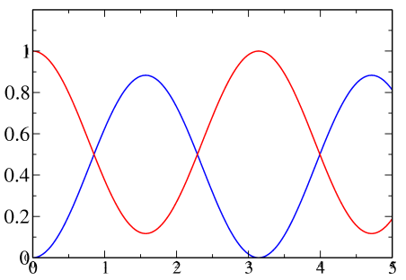
Solar neutrino problem
Sun
Since 4.5 billion years
fusion
66 billion neutrinos/s/cm²
Since 1964: Detection with
Homestake-experiment
Expected: 1,5 reactions/d
Observed: 0.5 reactions/d
solar
neutrino
problem
R. Davis
Prediction
Exp
Since 1986 Kamiokande:
confirmation of Homestake
2002 SNO-experiment:
checks neutrino-oscillation
possible explanation:
neutrino-oscillation
ν₂
solar
neutrino
problem
solved!
Masatoshi Koshiba
All neutrinos
ν₁
Prediction
ν_{e}

Slide 12
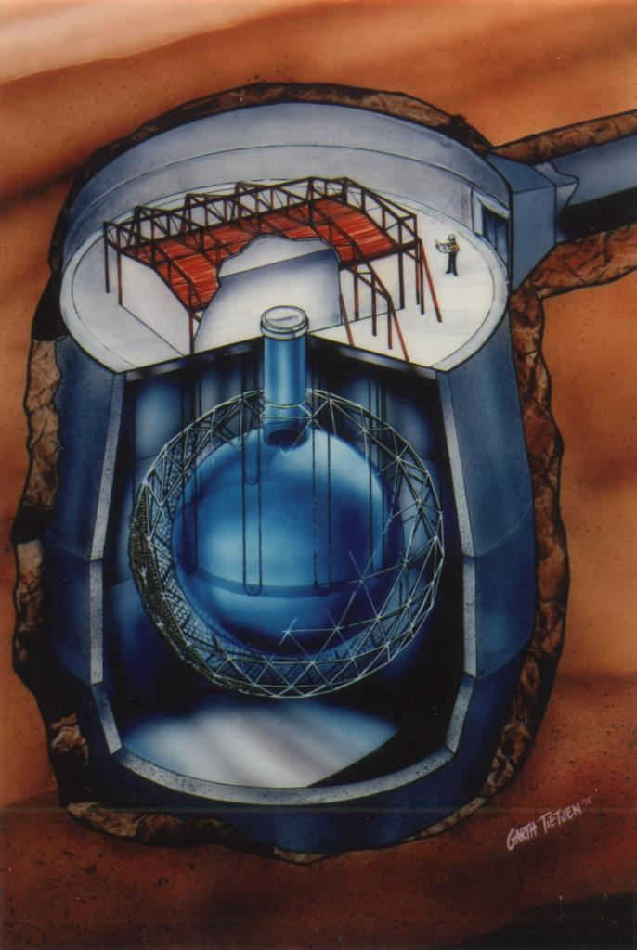
Examination of the oscillation-hypotheses for solar neutrinos
Homestake
So far: Only electron-neutrinos detected
Kamiokande
(
)
unlikely,
undistinguishable
SNO: Detection of different neutrino-types using different reactions on D₂O
SNO 2002
Only electron-neutrino:
detection
p
n
p
p
Sudbury Neutrino Observatory, Kanada
With equal probability for all neutrinos:
detection
1000t heavy water

Slide 13
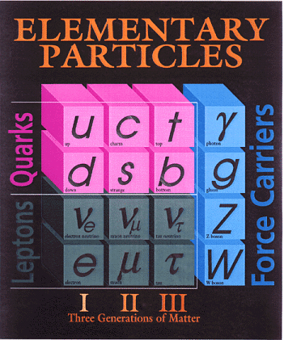
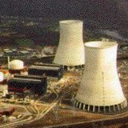
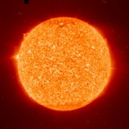
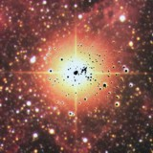
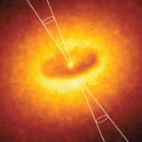
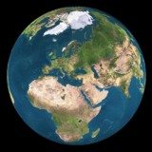
Neutrinos as astrophysical observer
nuclear reactors
✓
Sun
✓
Supernovae
(collapsing stars)
particle accelerator
✓
SN 1987A ✓
Earth atmosphere
(cosmic radiation)
✓
astrophysical
accelerator soon ?
Earth crust
(natural
radioactivity)
Big bang of the universe
(today 330 ν/cm³)
indirect evidence
✓

