Slide 1

Outline: 2-band mixing
Lecturer: Hans-Jürgen Wollersheim
e-mail: h.j.wollersheim@gsi.de
web-page: https://web-docs.gsi.de/~wolle/ and click on
shape coexistence of low-lying 0⁺ states in Kr isotopes
band mixing between the ground and γ-band in ¹⁶⁴Dy
Coulomb excitation of the 8⁻ isomer in ¹⁷⁸Hf

Slide 2
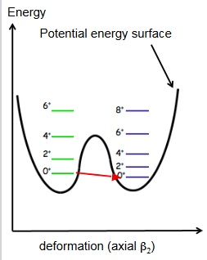
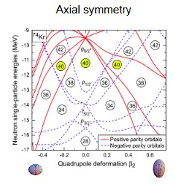
1. Shape coexistence in light Kr isotopes
6⁺
8⁺
4⁺
6⁺
2⁺
4⁺
0⁺
2⁺
potential energy surface
0⁺
⁷⁴Kr
electric monopole (E0) transition
γ
β
M. Girod

Slide 3
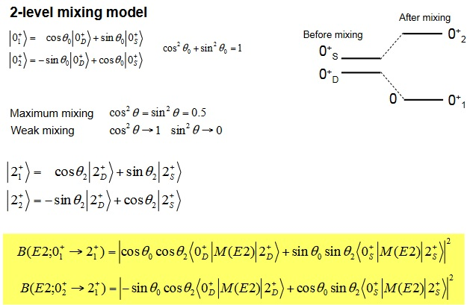
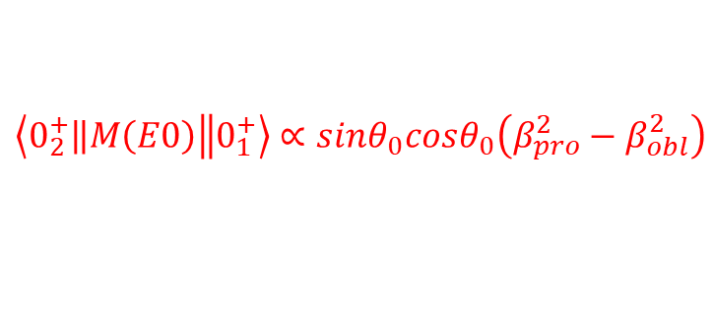
Shape coexistence and low-lying 0⁺ states
$$\left\langle \left.0_{2}^{+}\right\|M\left(E0\right)\left\|0_{1}^{+}\right.\right\rangle ∝sinθ_{0}cosθ_{0}\left(β_{pro}^{2}−β_{obl}^{2}\right)$$

Slide 4
Systematics of the light Kr isotopes
oblate
prolate
6⁺
6⁺
6⁺
6⁺
791
824
858
4⁺
768
4⁺
4⁺
4⁺
0⁺
612
2⁺
558
611
0⁺
664
562
0⁺
2⁺
0⁺
346
2⁺
1017
671
710
2⁺
770
456
52
508
424
455
0⁺
0⁺
0⁺
0⁺
⁷²Kr
⁷⁴Kr
⁷⁶Kr
⁷⁸Kr
ρ²(E0)
72 · 10⁻³ 85 · 10⁻³ 79 · 10⁻³ 47 · 10⁻³
Mixing of the ground state
(two-level mixing extrapolated
from distortion of rotational bands)
E. Bouchez et al., Phys. Rev. Lett. 90, 082502 (2003)

Slide 5
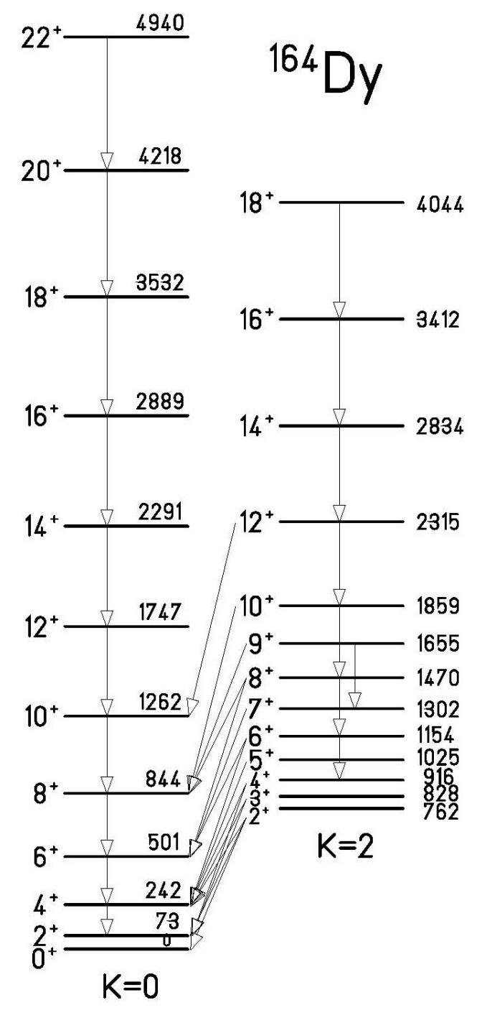

2. Band mixing between the ground and γ-band in ¹⁶⁴Dy

Slide 6

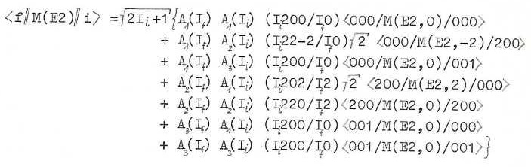
Band mixing between the ground and γ-band in ¹⁶⁴Dy

Slide 7
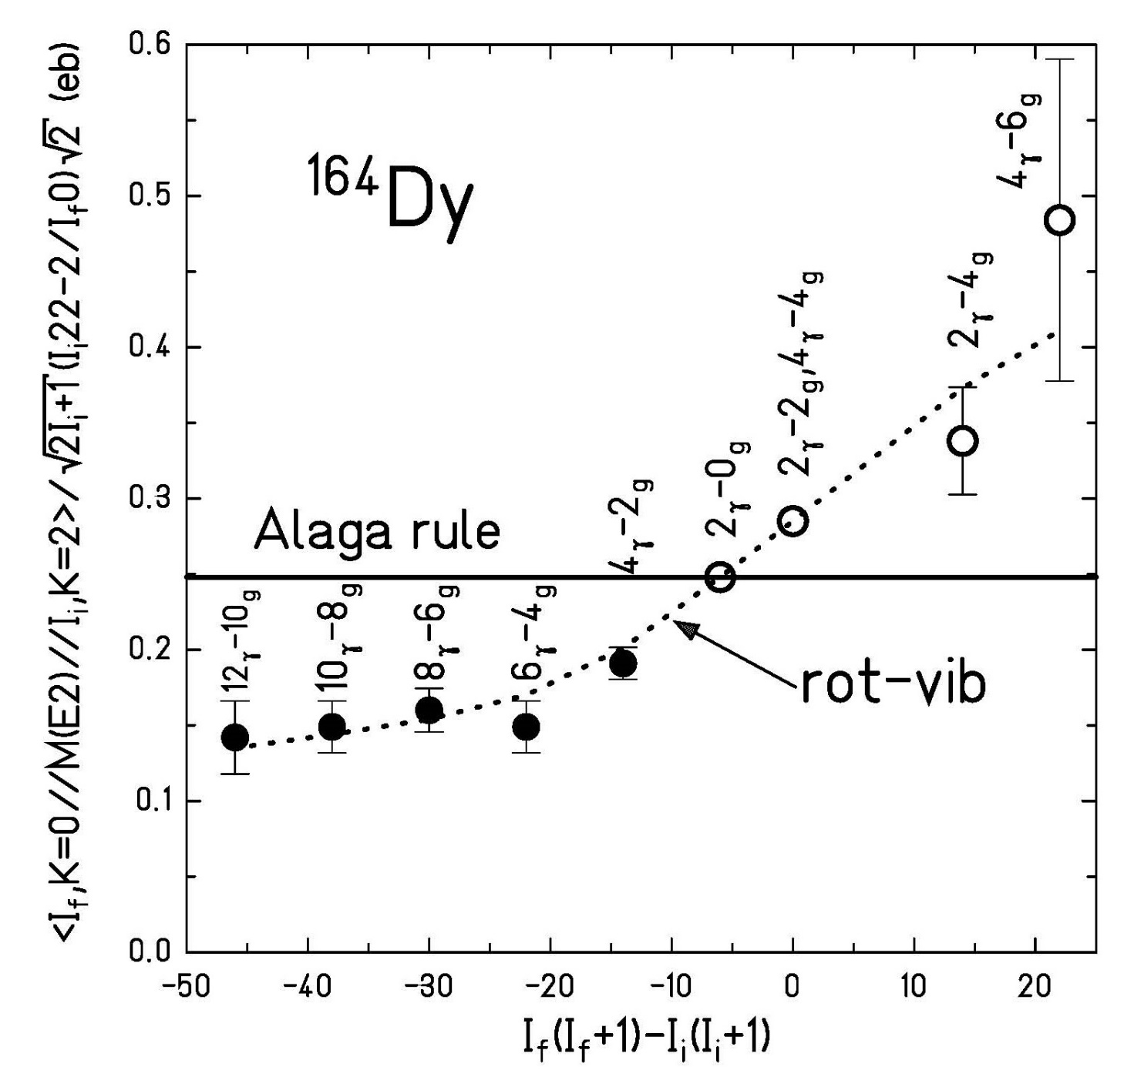
Band mixing between the ground and γ-band in ¹⁶⁴Dy

Slide 8
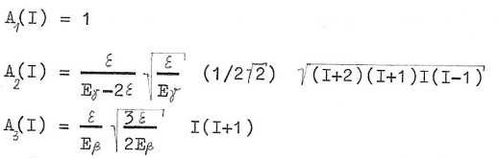


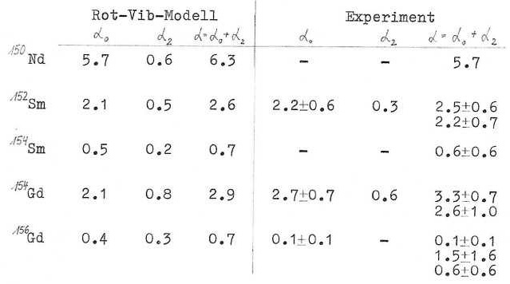
Rotation Vibration Model

Slide 9
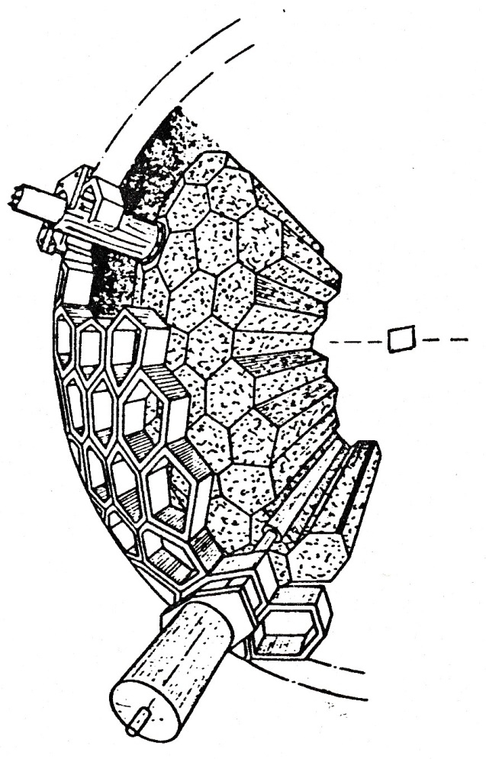
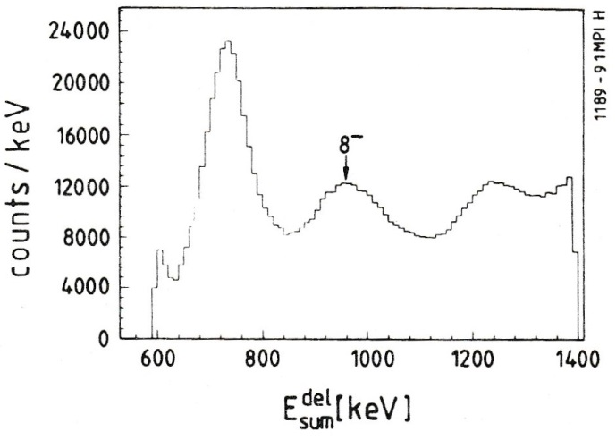
3. Coulomb excitation of the K = 8 isomer in ¹⁷⁸Hf
parameters and resolutions FWHM
E_{i} 5.5% at 1332 keV
t_{i} 2.8 ns
W(θ) 14⁰
E_{total} 18-22% for M_{γ}=20
M_{γ} 25-30% for M_{γ}=20
The two basic observables which can be measured for the resulting γ-ray shower are the total energy emitted as γ-radiation and the number of γ-rays.
¹⁷⁸Hf + ¹³⁰Te at 560, 590, 620 MeV
particle detection at ~180⁰, Pb catcher (0.5 mm thickness) was positioned
1cm downstream to stop the recoiling ¹⁷⁸Hf ions.
8⁻
162 NaI detectors
6 Ge detector
Delayed sum-energy spectrum taken at 590 MeV. (delayed time window 20-65ns with respect to beam pulse) A peak associated to the K^{π}=8⁻ shows up.
The other peaks correspond to isomers of fusion products from target contaminants and β-decay.
H. Xie et al.; Phys. Rev. C48 (1993), 2517

Slide 10
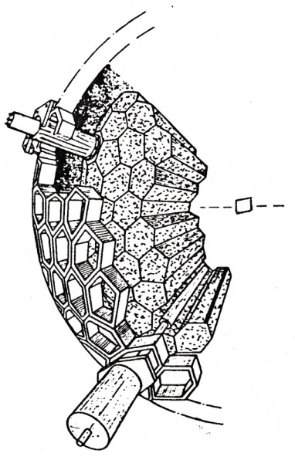
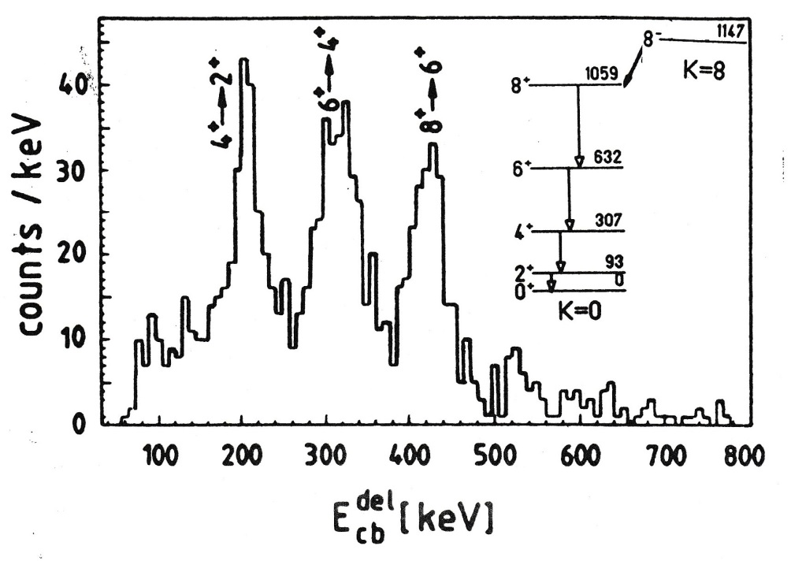
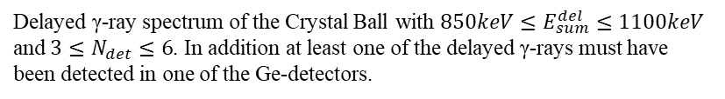

Coulomb excitation of the K = 8 isomer in ¹⁷⁸Hf
¹⁷⁸Hf + ¹³⁰Te at 560, 590, 620 MeV
4 s
$${→M}_{30}\left(E3\right)≤0.01$$
delayed γ-spectrum
Delayed γ-ray spectrum of the Crystal Ball with $850keV≤E_{sum}^{del}≤1100keV$
and $3≤N_{det}≤6$. In addition at least one of the delayed γ-rays must have been detected in one of the Ge-detectors.
H. Xie et al.; Phys. Rev. C48 (1993), 2517

Slide 11
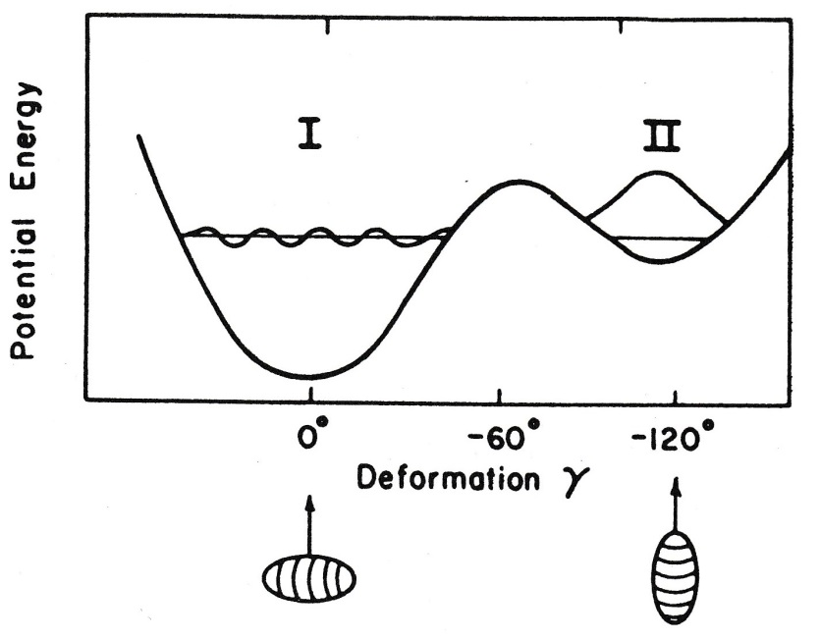
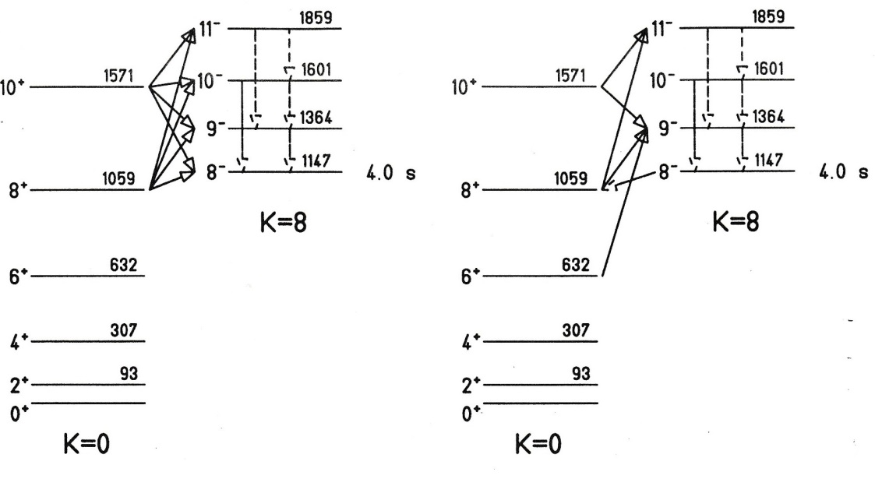
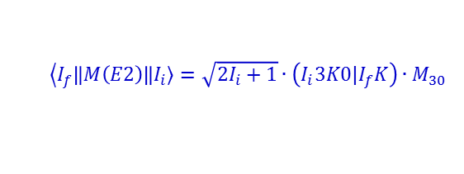
Decay of the isomer by barrier penetration
+ small K=8 admixture
+ small K=0 admixture
rigid rotor model:
$$\left\langle I_{f}\right.\left\|M\left(E2\right)\right\|\left.I_{i}\right\rangle =\sqrt{2I_{i}+1}∙\left(I_{i}3K0|I_{f}K\right)∙M_{30}$$
8⁻ lifetime is independent from excitation

Slide 12
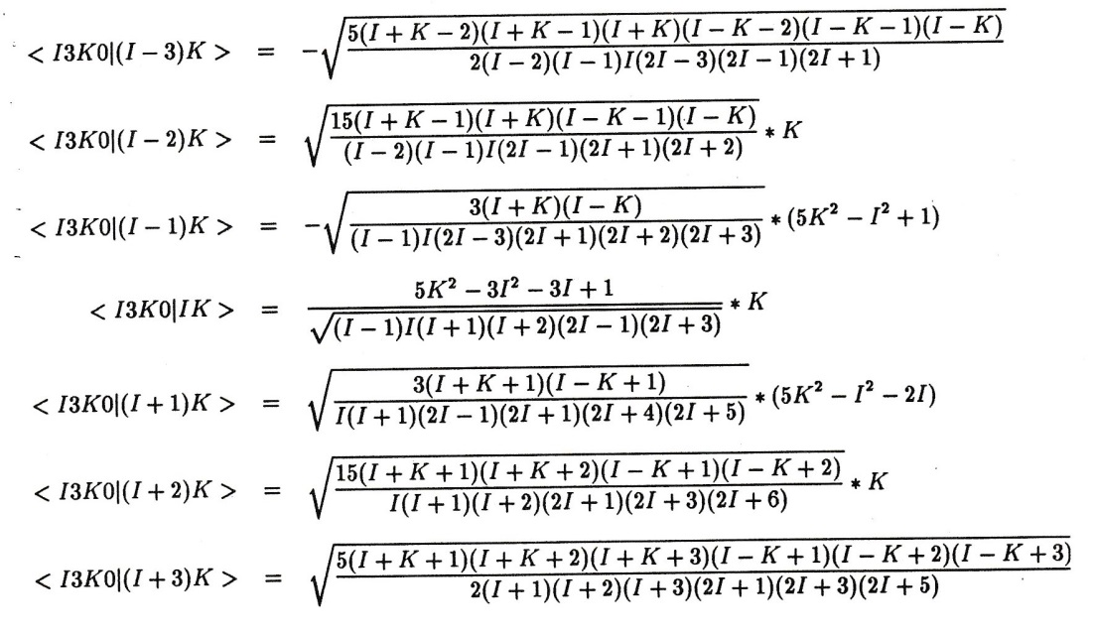

2-band K-mixing model
+ small K=8 admixture
+ small K=0 admixture
8⁻ lifetime is independent from excitation
Clebsch Gordan coefficient:
rigid rotor model:
$$\left\langle I_{f}\right.\left\|M\left(E3\right)\right\|\left.I_{i}\right\rangle =\sqrt{2I_{i}+1}∙\left(I_{i}3K0|I_{f}K\right)∙M_{30}$$

Slide 13
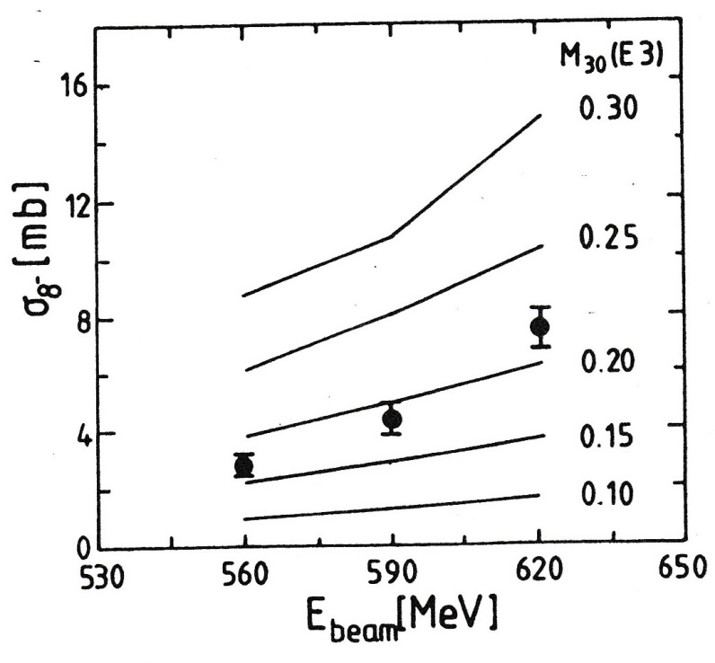
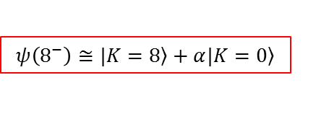

Coulomb excitation of the K = 8 isomer in ¹⁷⁸Hf
¹⁷⁸Hf + ¹³⁰Te at 560, 590, 620 MeV
4 s
$${→M}_{30}\left(E3\right)≤0.01$$
delayed γ-spectrum
$$M_{30}\left(E3\right)$$
coupling between rotational motion and single particle excitation
$$ψ\left(8^{−}\right)≅\left.|K=8\right\rangle +α\left.|K=0\right\rangle$$
H. Xie et al.; Phys. Rev. C48 (1993), 2517

