Slide 1

Outline: Characterization of segmented Ge detectors
Lecturer: Hans-Jürgen Wollersheim
e-mail: h.j.wollersheim@gsi.de
web-page: https://web-docs.gsi.de/~wolle/ and click on
γ-ray camera
moving γ-ray source and Ge detector
scanner at GSI for segmented detectors

Slide 2
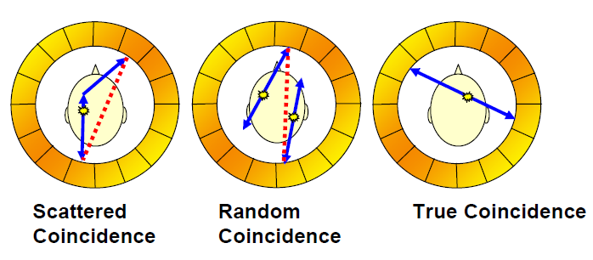
The motivation behind the project
Existing technology relies on BGO scintillator technology
- Limited position resolution
- High patient dose requirement.
- Poor energy resolution only accept photopeak events.
- Will not function in large magnetic field
SPECT applications utilizing Compton Camera techniques.

Slide 3
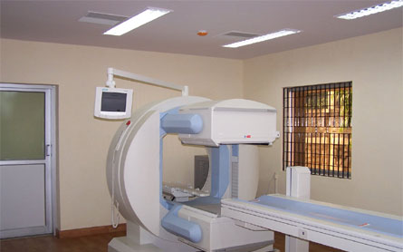
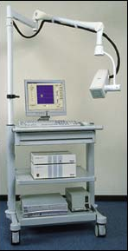
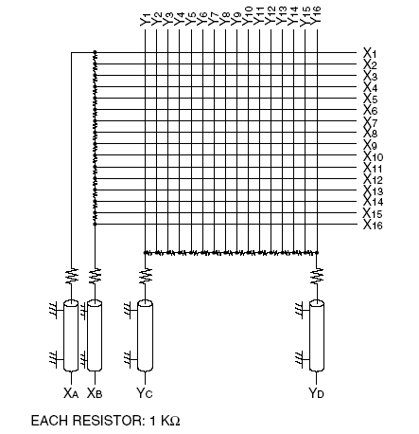
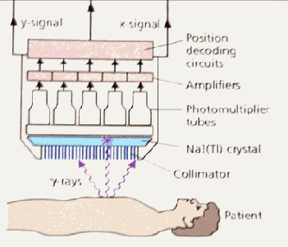
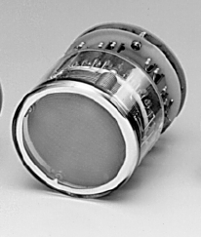
Which γ-ray camera to be used?
Requirements:
Excellent resolution Δx = 2 mm
Large field of view (FOV) = 8x9 cm²
Large FOV of ~20 cm diam.
Low spatial resolution 0.5-1 cm
Small FOV of 3-4 cm diam.
High spatial resolution 2-3 mm
www.siemens.de
Gem-imaging.com

Slide 4
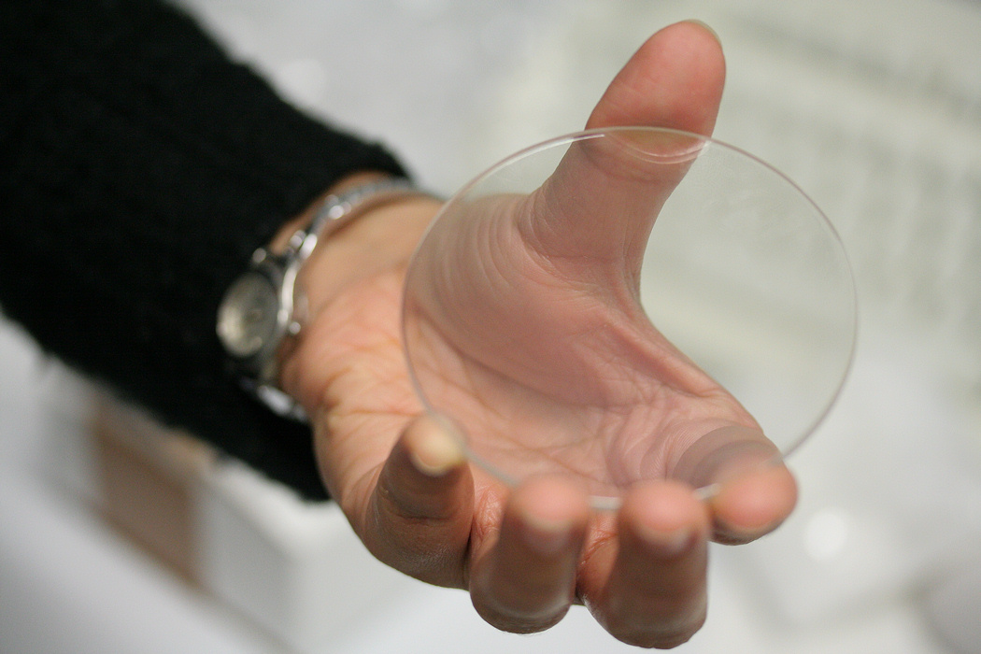
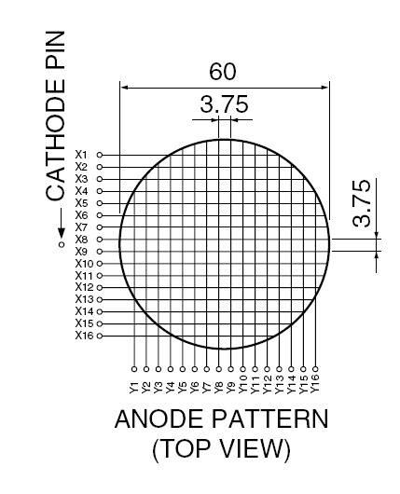
Gamma Camera: Individual multi-anode readout
16 wires in X axis and 16 wires in Y axis
LYSO scintillator
Lu_{2(1-x)}Y_{2x}SiO₅
d = 76 mm t = 3 mm ρ = 7.4 g/cm³
Hamamatsu R2486 PSPMT
Photocathode = 56.25 mm
Lutetium–yttrium oxyorthosilicate
C.Domingo Pardo, N. Goel, et.al., IEEE, Vol.28, Dec. 2009

Slide 5
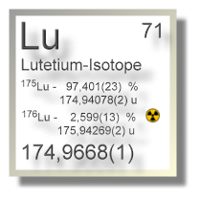
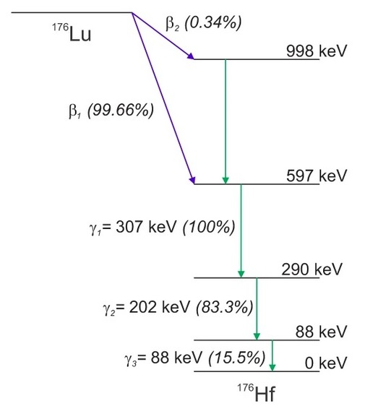
Intrinsic activity of LYSO
LYSO: Lu_{1.8}Y_{0.2}SiO₅:Ce
scintillating properties:
high density (7.1 g/cm³)
fast decay time (40 ns)
very high light output (~ 27600 ph/MeV)

Slide 6
Which γ-ray camera to be used?
Requirements:
Excellent resolution Δx = 2 mm
Large field of view (FOV) = 8x9 cm²
Small FOV of 3-4 cm diam.
High spatial resolution 2-3 mm
Scintillator
Position Sensitive
PMT
Gem-imaging.com

Slide 7

Which γ-ray camera to be used?
Requirements:
Excellent resolution Δx = 2 mm
Large field of view (FOV) = 8x9 cm²
Small FOV of 3-4 cm diam.
High spatial resolution 2-3 mm
γ-ray
Scintillator
Position Sensitive
PMT
Gem-imaging.com

Slide 8
Which γ-ray camera to be used?
Requirements:
Excellent resolution Δx = 2 mm
Large field of view (FOV) = 8x9 cm²
Small FOV of 3-4 cm diam.
High spatial resolution 2-3 mm
g-ray
Scintillator
Position Sensitive
PMT
Gem-imaging.com

Slide 9
Which γ-ray camera to be used?
Requirements:
Excellent resolution Δx = 2 mm
Large field of view (FOV) = 8x9 cm²
Small FOV of 3-4 cm diam.
High spatial resolution 2-3 mm
γ-ray
Scintillator
Position Sensitive
PMT
Gem-imaging.com

Slide 10
Which γ-ray camera to be used?
Requirements:
Excellent resolution Δx = 2 mm
Large field of view (FOV) = 8x9 cm²
Small FOV of 3-4 cm diam.
High spatial resolution 2-3 mm
γ-ray 2
γ-ray
Scintillator
Position Sensitive
PMT
Gem-imaging.com

Slide 11

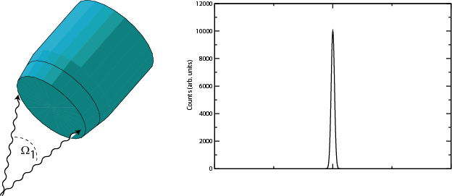
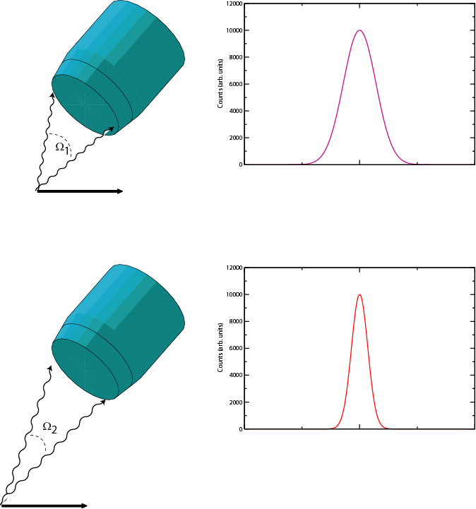
Efficiency versus resolution
With a source at rest, the intrinsic resolution of the detector can be reached;
efficiency decreases with the increasing detector-source distance.
With a moving source also the effective energy resolution depends on the detector-source distance (Doppler effect)
Small d
Large d
Large Ω
Small Ω
High ε
Low ε
Poor FWHM
Good FWHM

Slide 12
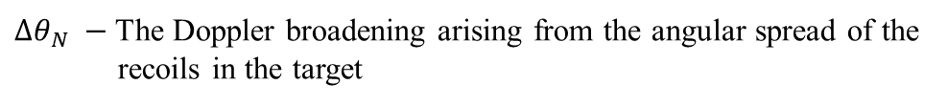
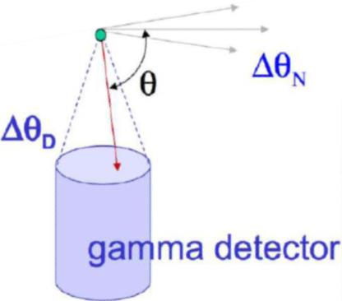

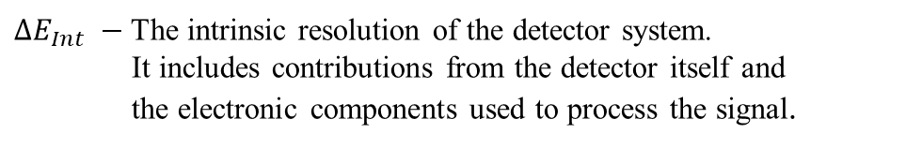

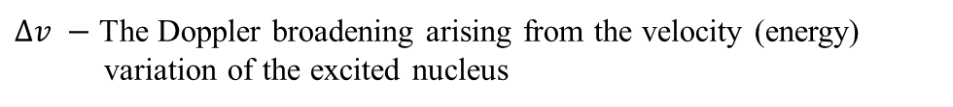

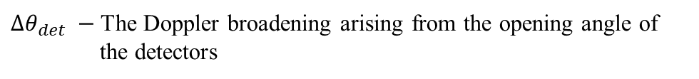

Energy resolution
The major factors affecting the final energy resolution (FWHM) at a particular energy are as follows:
$$ΔE_{γ}^{final}={\left(ΔE_{Int}^{2}+Δθ_{det}^{2}+Δθ_{N}^{2}+Δv^{2}\right)}^{1/2}$$
$$v±∆v$$
$ΔE_{Int} −$The intrinsic resolution of the detector system.
It includes contributions from the detector itself and
the electronic components used to process the signal.
$$Δθ_{N}$$
$$Δθ_{det}$$
$Δθ_{det} −$The Doppler broadening arising from the opening angle of
the detectors
$Δθ_{N} −$The Doppler broadening arising from the angular spread of the
recoils in the target
$Δv −$ The Doppler broadening arising from the velocity (energy)
variation of the excited nucleus

Slide 13
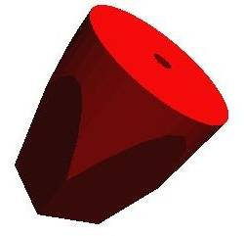
Doppler broadening and position resolution
Position resolution
γ ray
Angular resolution
beam
projectile
Energy resolution

Slide 14
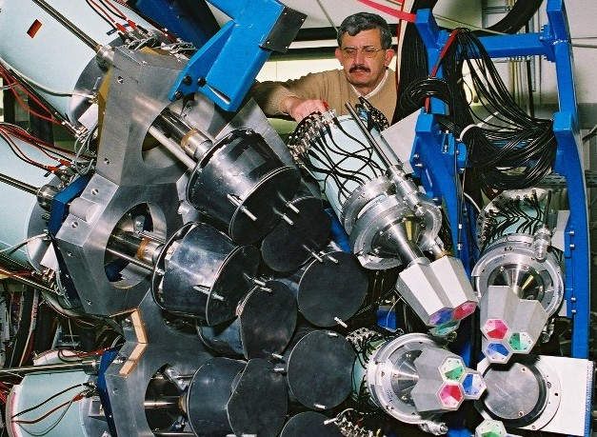

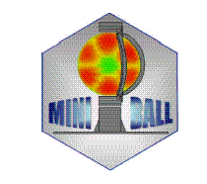
Segmented detectors
70cm
target
beam
20cm

Slide 15
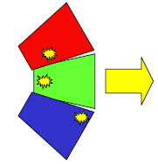
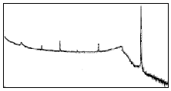
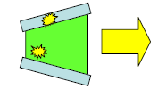
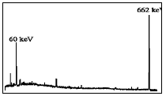
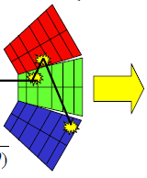
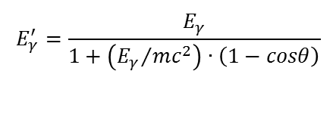
Gamma-ray tracking – the concept
without Compton suppression shield
Compton continuum → small peak to total ratio
Less solid angle coverage → big drop in efficiency
with BGO shielding
with highly segmented detectors
Path of γ-ray reconstructed to form full energy event
→ Compton continuum reduced
→ Excellent efficiency ~50% @ 1 MeV
→ Greatly improved angular resolution (~1%)
to reduce Doppler effect.
$$E_{γ}^{′}=\frac{E_{γ}}{1+\left({E_{γ}}/{mc^{2}}\right)∙\left(1−cosθ\right)}$$

Slide 16
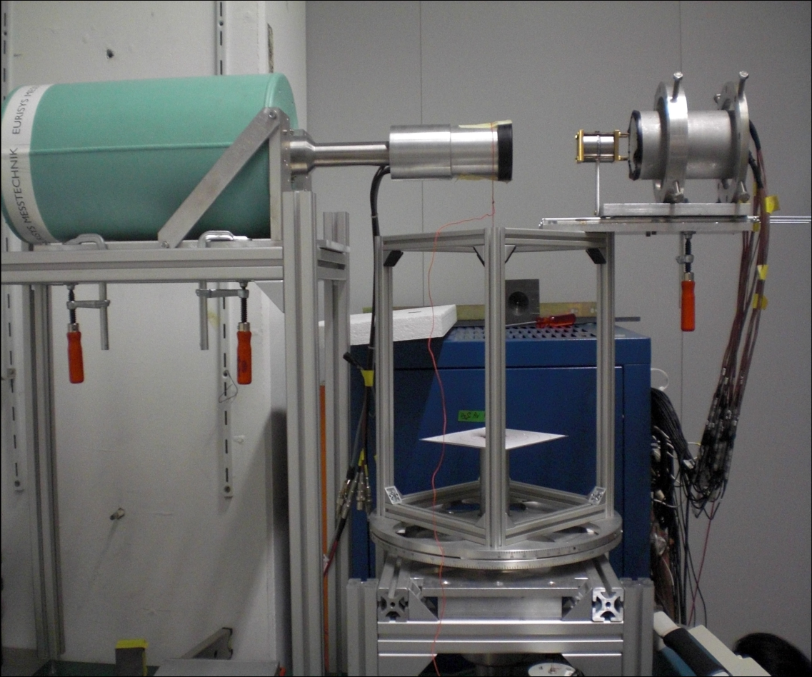
Scanner at GSI
²²Na
Position sensitive detector
Characteristics:
Faster
Precision: 1-2 mm
Imaging capability
Rotating table
Requirements:
1. Position sensitive detector
- Excellent Δx/x
- Large field of view
2. Method to compare the pulses

Slide 17
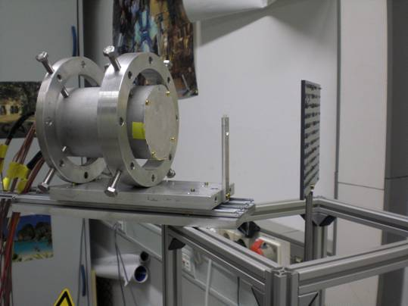
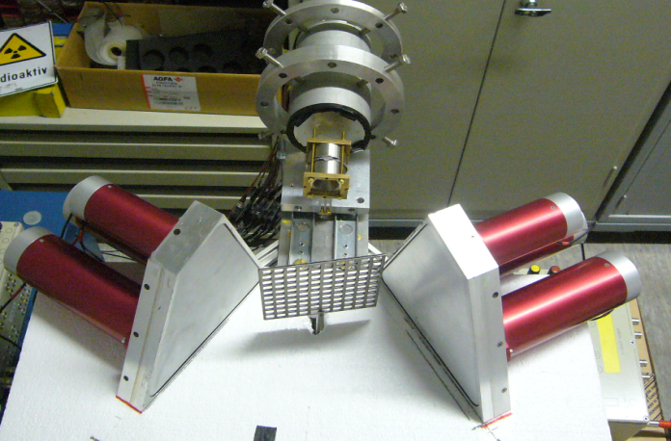
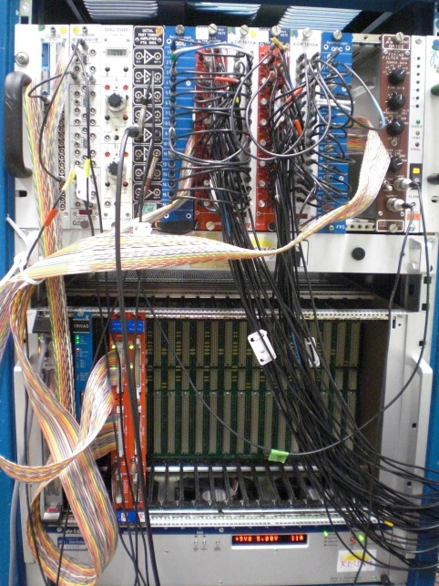
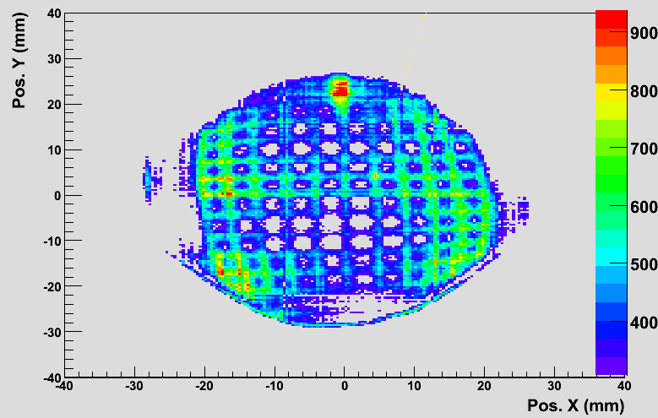
Position calibration
Determine: X_{r}(x_{m},y_{m}), Y_{r}(x_{m},y_{m})
Gamma-ray scattering technique
0⁰ position
Grid raw image when it is parallel to PSD surface (0 deg)

Slide 18
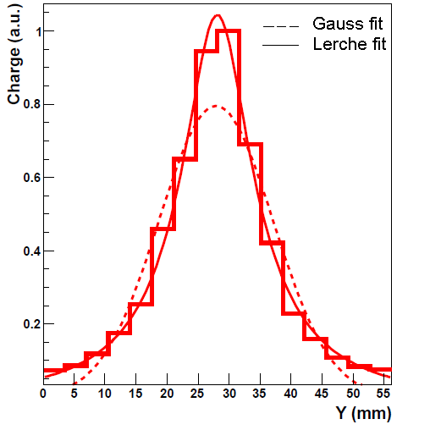
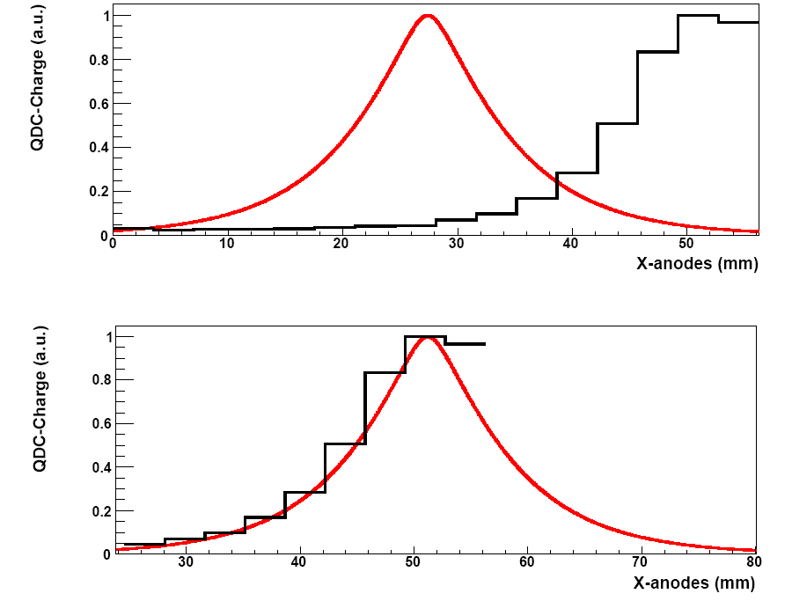
Position reconstruction
Central Interaction
Peripheral Interaction
Photocathode=56.26 mm
LYSO =76 mm
Reference peak fitting
average charge profile at the center
Charge (a.u.)
Y (mm)
Charge (a.u.)
Y (mm)
C. Domingo Pardo, N.Goel, et.al., IEEE, Dec. 2009 Volume: 28 Issue 12
C.W.Lerche, et.al., NIM A, Vol 537, pp. 326-330, Jan. 2005

Slide 19
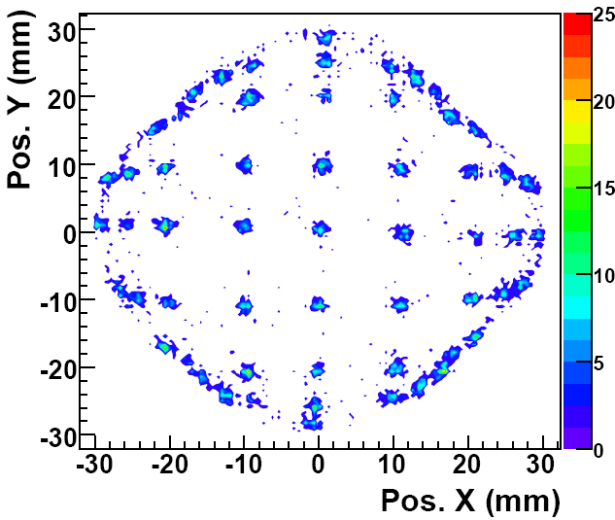
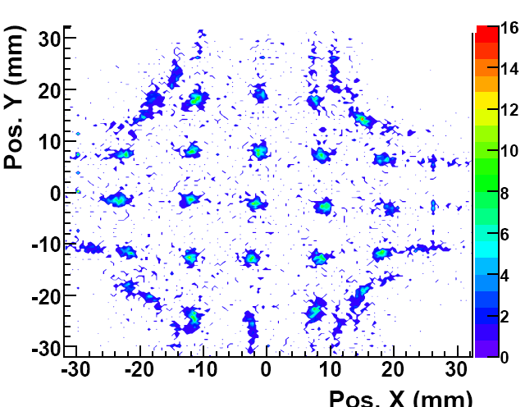
Position reconstruction
Gaussian fitting
Reference peak fitting
Pos. X (mm)
Pos. X (mm)
Gaussian fitting works relatively well in the central region
Linear for 50 mm
Field of view = 28 cm²
Average spatial resolution in X and Y ~ 1mm

Slide 20
Scanner at GSI
²²Na
Position sensitive detector
Characteristics:
Faster
Precision: 1-2 mm
Imaging capability
Rotating table
Requirements:
1. Position sensitive detector
- Excellent Δx/x
- Large field of view
2. Method to compare the pulses

Slide 21
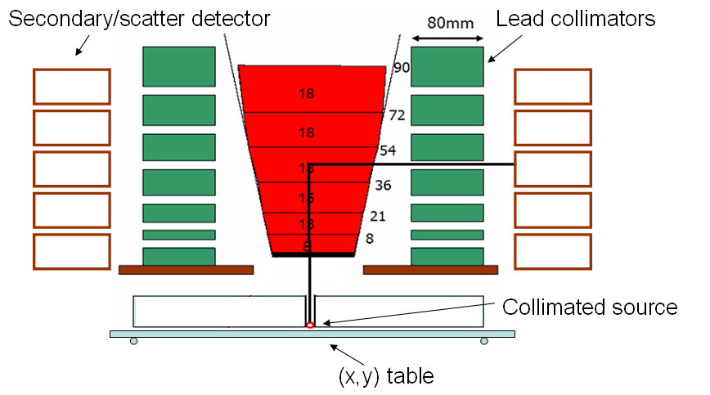
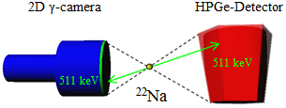
Superiority over conventional scanner
coincidence between the Germanium and BGO detectors for 90 degree Compton scattered events for depth determination
BGO
BGO
¹³⁷Cs
Advantage over conventional scanner: Full detector can be scanned in one measurement 10 times faster than a conventional scanner Accuracy of simulations can be checked for complex regions of electric field

Slide 22
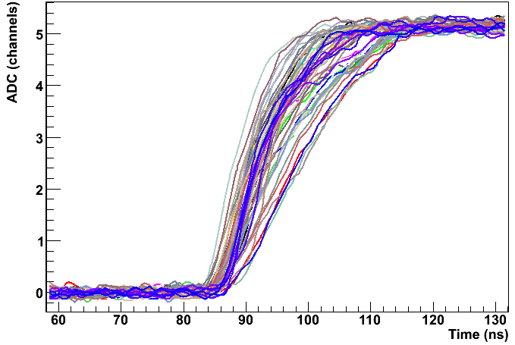
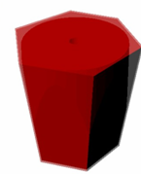
Scanner based on pulse shape comparison scan
a)
a)

Slide 23
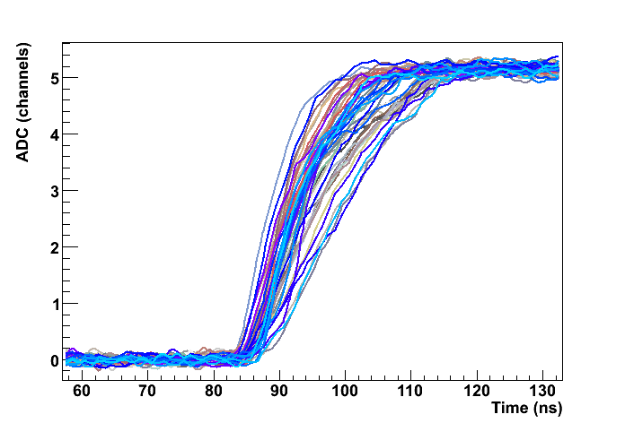
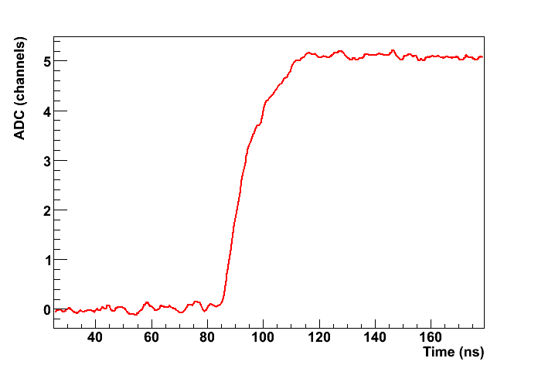
Scanner based on pulse shape comparison scan
b)
a)
a)
Collimated source
Geometric crossing point: x,y,z
Common pulse out of data sets (a) & (b)
b)
F.C.L. Crespi, et al. NIM A 593 (2008), 440

Slide 24
Pulse shape comparison scan method based on a position sensitive detector
Position sensitive
detector
511 keV
²²Na
Recording pulse shapes for positions (a) and (b)
Identical signals at the crossing point.
a)
²²Na
Rotated by 90⁰
b)

Slide 25
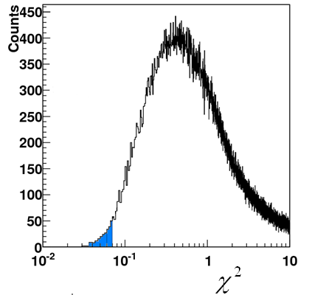
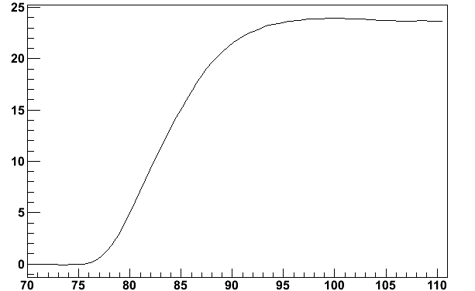
$χ^{2}$ minimization method
0° measurement
90° measurement
amplitude, Φ
amplitude, Φ
t(ns)
t(ns)
distribution
Average pulse
amplitude, Φ
threshold
t(ns)

Slide 26
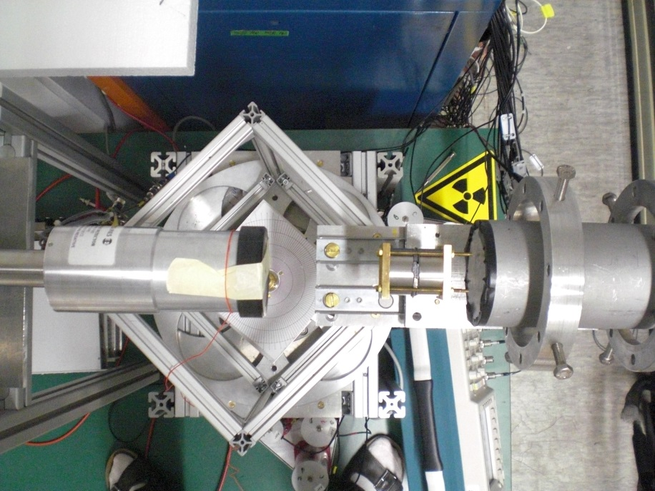
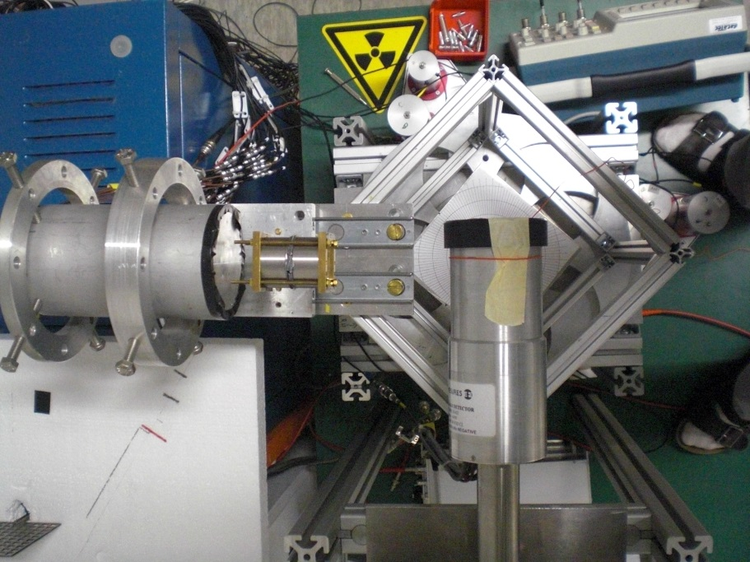
Characterization of planar HPGe detector
Front view
Side view
Planar Ge
d = 4 cm
t = 2 cm
²²Na
Position sensitive detector

Slide 27


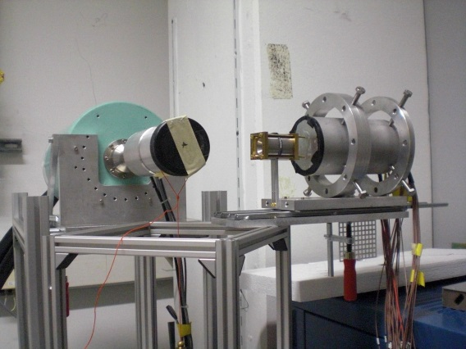
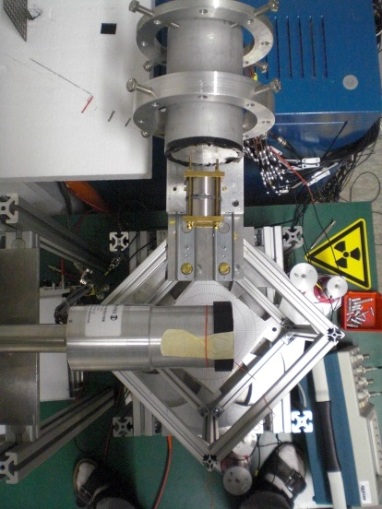
Detector scan
Front view (0 deg):
Side view (90 deg):

Slide 28
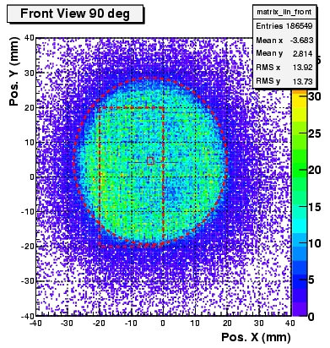
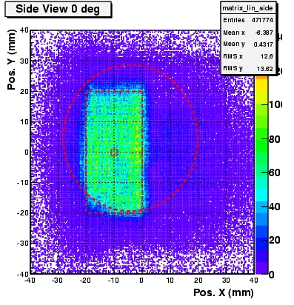
Detector scan
Front view (0 deg):
Side view (90 deg):

Slide 29
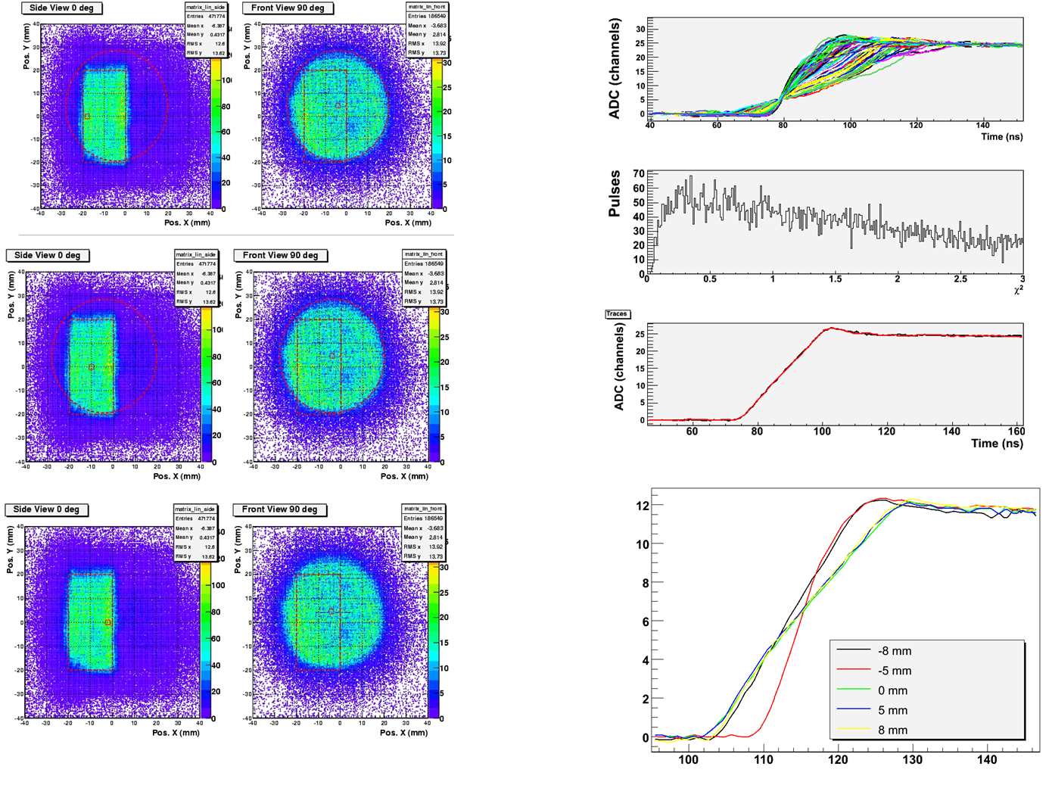
Detector scan data analysis

Slide 30

Experimental validation of the method

Slide 31





Planar HPGe detector scan
Intensity distribution for photopeak events
(a)
t(ns)
amplitude, Φ
(b)
t(ns)

Slide 32


AGATA: Advanced Gamma Tracking Array
4π array of germanium crystals
180 segmented crystals arranged around the reaction target
3D sensitivity
Symmetric AGATA prototype crystal

Slide 33

Signal shapes from all 36 segments
Photopeak event
Most significant transient charge signals are from the direct neighbouring segments

Slide 34




Combined trace for pulse shape comparison
Direct neighbours of segment F3
We have the method, the device and the detector ready, lets do the scan of AGATA!

Slide 35










Gamma detector array
EUROBALL Cluster Detectors
PRESPEC - AGATA
Signals from 36 segments + core
are measured as a function of time
(γ-ray interaction point)
15 EUROBALL det.
photopeak eff. 2.8%

Slide 36


New scanner at GSI
3x3 mm
single-photon avalanche diode
LYSO & SIPM (Silicon Photomultiplier Sensors, series C, 3mm)
Advantages:
High detection probability
Disadvantages:
Dark current (temperature)
www.onsemi.com/products/sensors/photodetectors-sipm-spad/silicon-photomultipliers-sipm/c-series-sipm

Slide 37


Outlook
The GSI system uses conventional NIM and VME electronics, which makes it not easily portable, not easily scalable and rather expensive if one wants to build many of these devices.
However, this drawback could be overcome thanks to the increasing technology of electronics, e.g. a new acquisition system based on ASIC, FPGA, etc. technologies. This would also make the system more suitable for medical applications.
APV25 chip (from CERN CMS experiment)
?
128-channel analogue pipeline chip
M.J. French et al., NIMA 466 (2001) 359

