Slide 1

Outline: 2-proton emitter
Lecturer: Hans-Jürgen Wollersheim
e-mail: h.j.wollersheim@gsi.de
web-page: https://web-docs.gsi.de/~wolle/ and click on
spectroscopy of open systems: proton emitters
proton radioactivity: isomer decay in ⁵⁴Ni
2-proton radioactivity in ⁴⁵Fe
optical time projection chamber
angular correlation

Slide 2
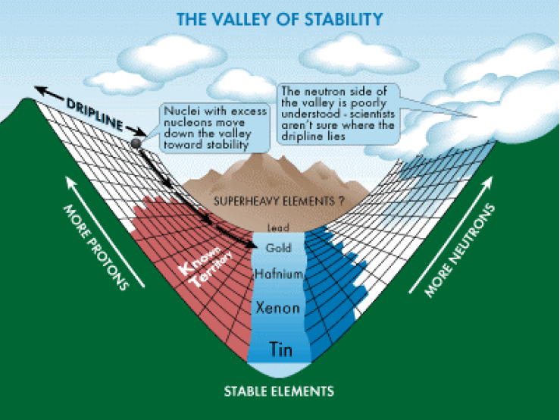
Proton drip line is well established. For all elements occurring naturally on earth and having an odd number of protons, at least one species with proton separation energy less than zero have been experimentally observed.

Slide 3
Spectroscopy of open systems: proton emitters
  Non-adiabatic theory:
  B.Barmore et al., Phys.Rev. C62, 054315 (2000)
  A.T. Kruppa and WN, Phys. Rev. C69, 054311 (2004)

Slide 4

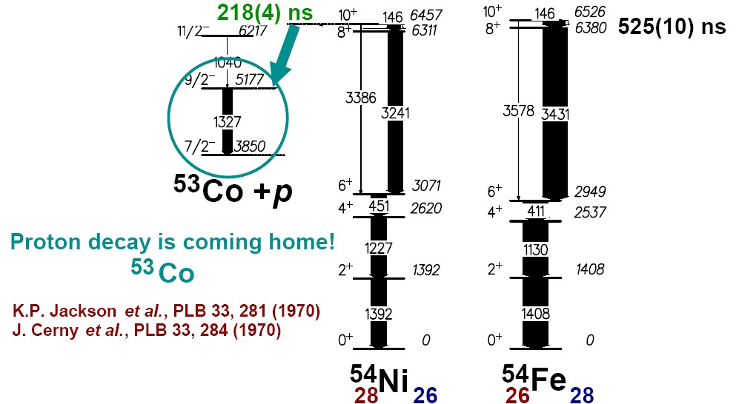
Proton radioactivity – decay of the I^{π}=10⁺ isomer in ⁵⁴Ni
decay of the excited 10⁺-state by proton emission and γ-radiation
D. Rudolph, R. Hoischen et al., Phys.Rev.C78 (2008), 021301

Slide 5
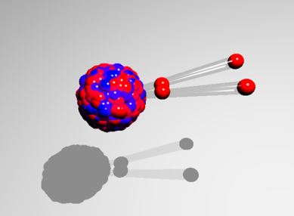
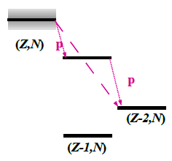
2-proton radioactivity of ⁴⁵Fe
N=Z
1-proton emission:
-120 keV < S_{p} < 70 keV
t_{1/2} > 100s
1-proton emission:
-120 keV < S_{p} < 70 keV
t_{1/2} > 100s
2-proton emission:
-1000 keV < S_{2p} < -1300 keV
t_{1/2}~10⁻⁶s – 1s
sequential
simultanious
proposed by V.I. Goldansky; Nucl. Phys. 19 (1960), 482 Nucl. Phys. 27 (1961), 648 discovered by M.Pfützner et al., EPJA 14 (2002) 279

Slide 6
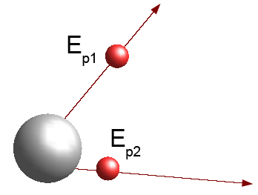
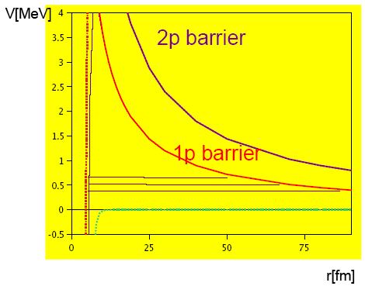
2-proton radioactivity of ⁴⁵Fe
Tunneling through a potential barrier:
S spectroscopic factor for 2-proton creation
ω frequency, with which both protons hit the barrier
P is the penetrability, the probability for a tunneling
process
proposed by V.I. Goldansky; Nucl. Phys. 19 (1960), 482 Nucl. Phys. 27 (1961), 648 discovered by M.Pfützner et al., EPJA 14 (2002) 279

Slide 7
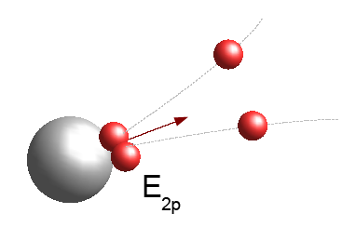
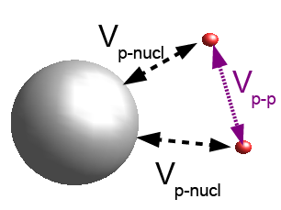
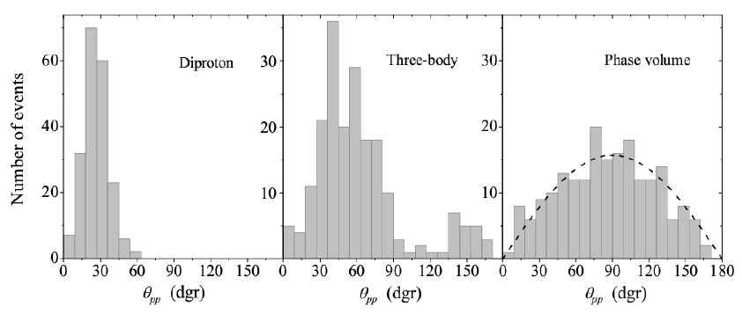
2-proton radioactivity of ⁴⁵Fe
Monte Carlo simulation (200 events) of the opening angles between both protons for the ⁴⁵Fe decay
L. Grigorenko et al. Phys. Rev. Lett. 85 (2000), 22, Nucl.Phys. A714 (2003), 425

Slide 8
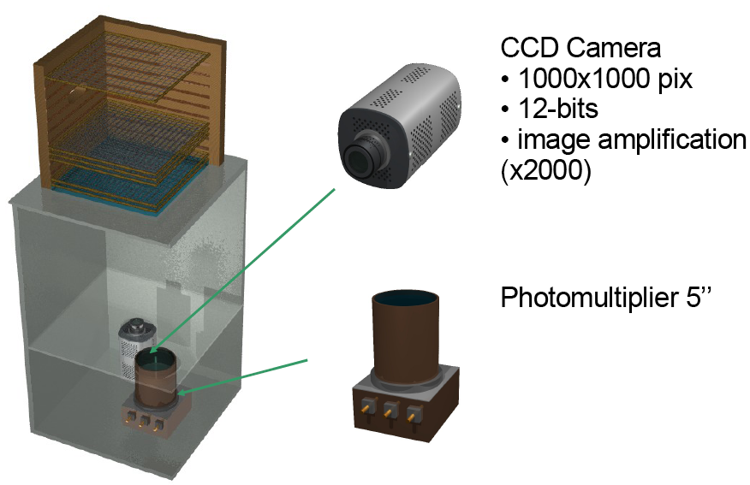
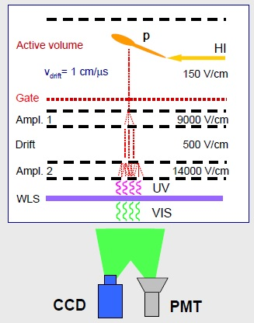
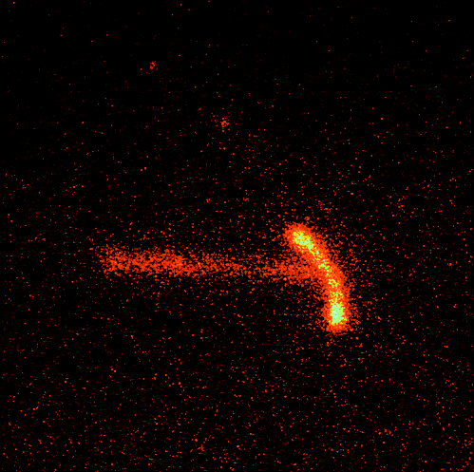
Exotic nuclear decays in digital photography
p
⁴⁵Fe
Gaseous ionization detector (TEA = Triethylamine N(C₂H₅)₃) developed to measure the angular and energy correlations between the protons emitted in 2p decay of ⁴⁵Fe.
p
G. Charpak et al., NIM A269 (1988), 142

Slide 9
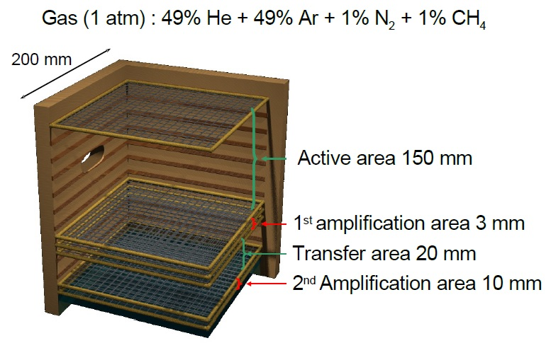
Optical time projection chamber
G. Charpak et al., NIM A269 (1988), 142

Slide 10
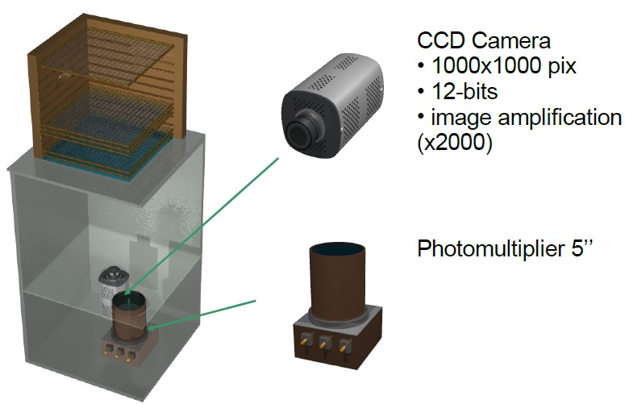
Optical time projection chamber
G. Charpak et al., NIM A269 (1988), 142

Slide 11
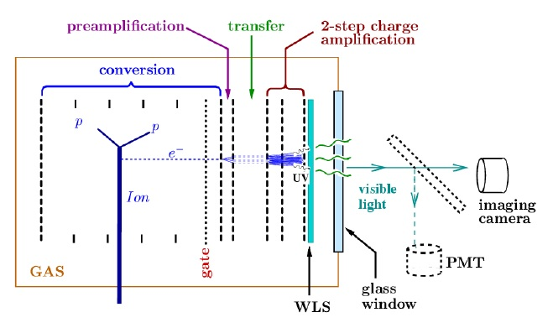
Principle of operational of the optical time projection chamber
WLS ≡ wavelength shifter

Slide 12
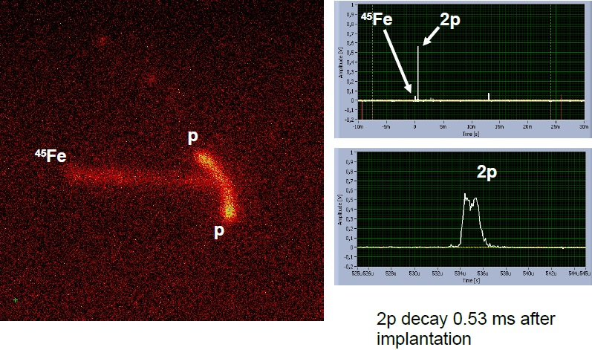
2p decay of ⁴⁵Fe

Slide 13
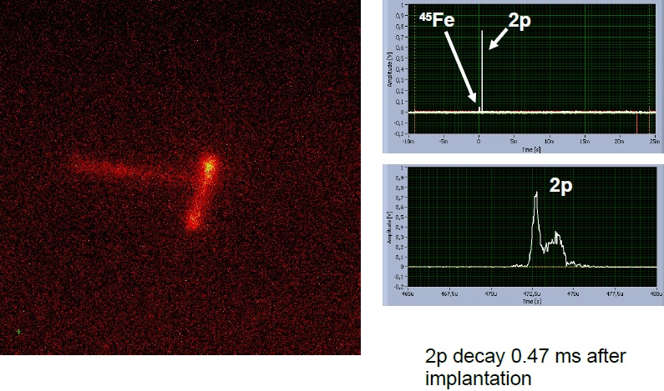
2p decay of ⁴⁵Fe

Slide 14
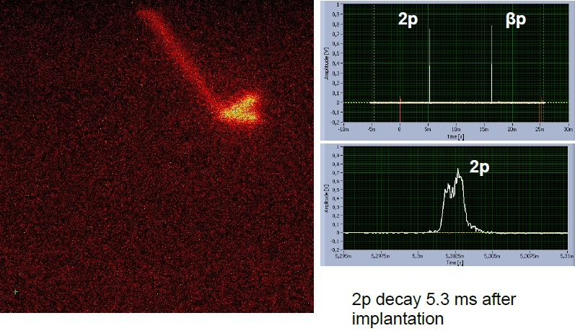
2p decay of ⁴⁵Fe

Slide 15
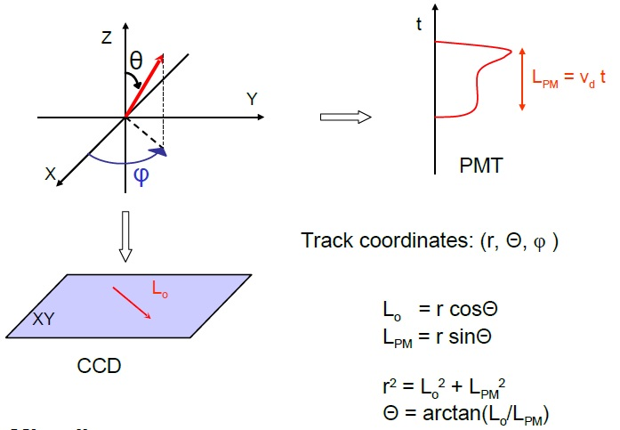
Event reconstruction

Slide 16
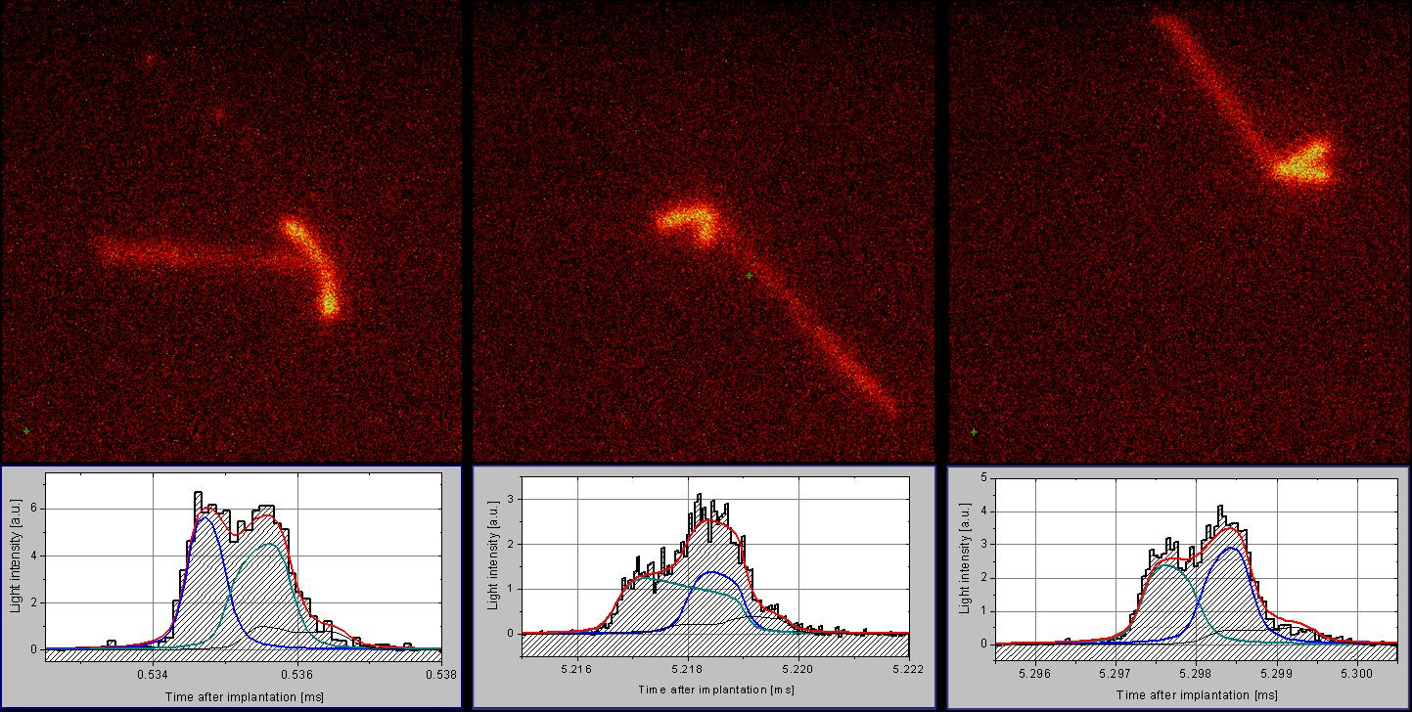
Optical time projection chamber
K. Miernik et al., Phys.Rev.Lett. 99 (2007) 192501

Slide 17
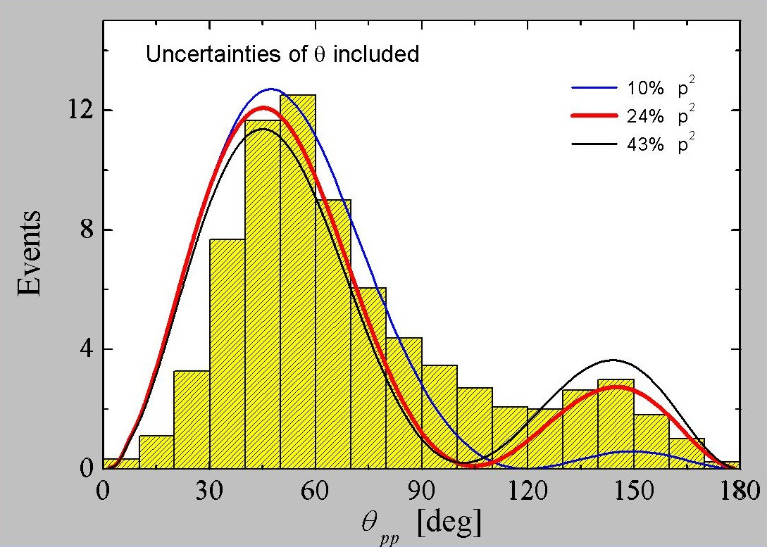
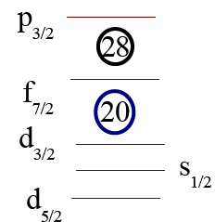
2-proton radioactivity of ⁴⁵Fe
K. Miernik et al., Phys.Rev.Lett. 99 (2007) 192501

Slide 18
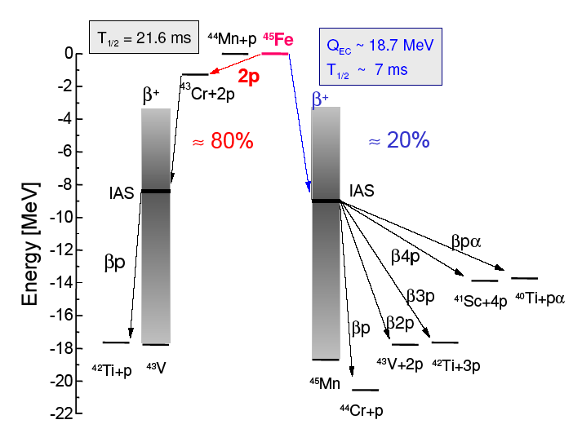
⁴⁵Fe decay channels observed
Q_{2p}=1.15±0.09 MeV und T_{1/2} consistent with 2p-emission [sensitive between 1µs (2p-decay) and 10 ms (β-decay)]
K. Miernik et al., Phys.Rev.Lett. 99 (2007) 192501

Slide 19
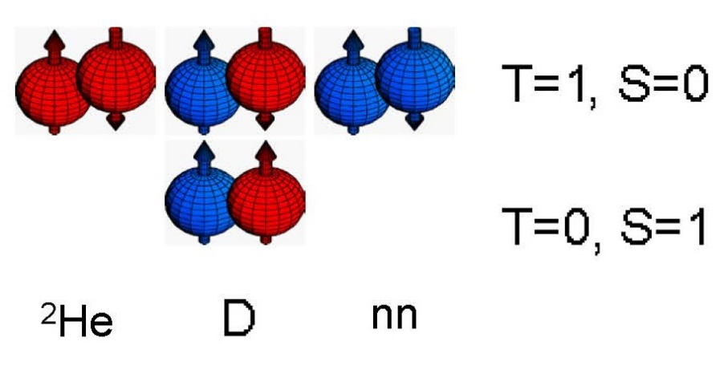
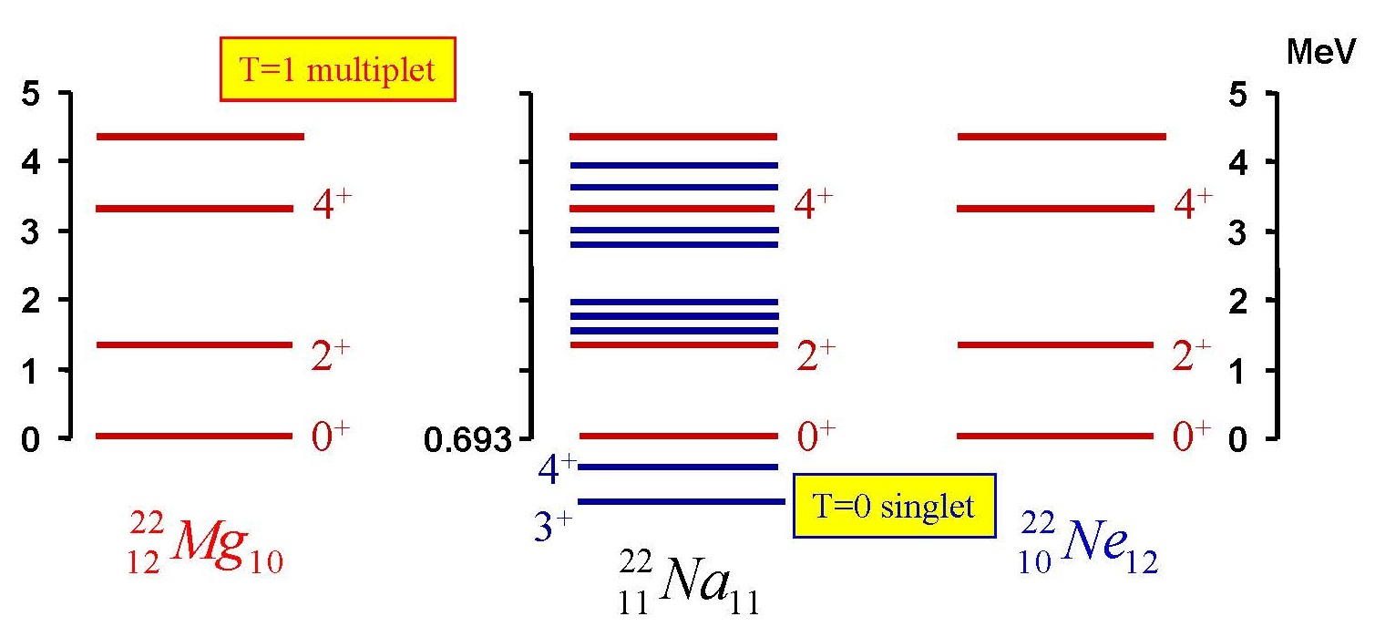
Isobar Analog States IAS
Isobar Analog States IAS
The IAS has the isospin T = T_{Z}+1 = (N-Z)/2 + 1
The isospin of the ground state is T = T_{Z} = (N-Z)/2

