Slide 1

Outline: Transmutation for Nuclear Waste Yacine Kadi
Lecturer: Hans-Jürgen Wollersheim
e-mail: h.j.wollersheim@gsi.de
web-page: https://web-docs.gsi.de/~wolle/ and click on
The problem of nuclear waste
Nuclear reactor
Transmutation and incineration
Accelerator Driven System ADS

Slide 2
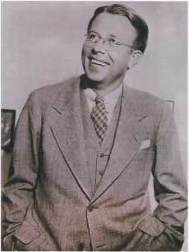
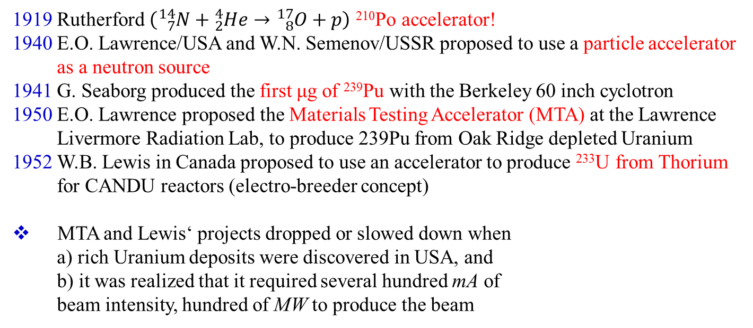
The basic process is nuclear transmutation
1919 Rutherford $\left({}_{7}^{14}N+{}_{2}^{4}{He}→{}_{8}^{17}O+p\right)$ ²¹⁰Po accelerator!
1940 E.O. Lawrence/USA and W.N. Semenov/USSR proposed to use a particle accelerator
as a neutron source
1941 G. Seaborg produced the first μg of ²³⁹Pu with the Berkeley 60 inch cyclotron
1950 E.O. Lawrence proposed the Materials Testing Accelerator (MTA) at the Lawrence
Livermore Radiation Lab, to produce 239Pu from Oak Ridge depleted Uranium
1952 W.B. Lewis in Canada proposed to use an accelerator to produce ²³³U from Thorium
for CANDU reactors (electro-breeder concept)
MTA and Lewis‘ projects dropped or slowed down when
a) rich Uranium deposits were discovered in USA, and
b) it was realized that it required several hundred mA of
beam intensity, hundred of MW to produce the beam

Slide 3
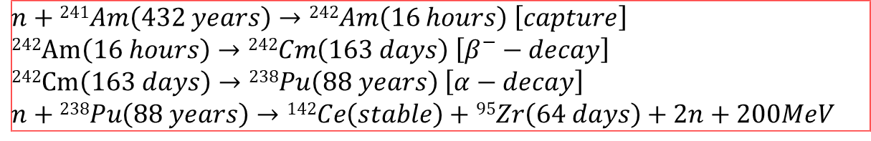
What is the nuclear waste transmutation
To transmute means to convert one element to another and by extension one isotope to another
The main physical process to perform useful transmutation is nuclear fission. One example of transmutation by fission can be:
$$n+239Pu \left(24000 years\right)→134Cs\left(2 years\right)+104Ru\left(stable\right)+2n+200 MeV$$
Sometimes one or several captures and decays must take place before fission can perform the useful transmutation:
n$+240Pu\left(6600 years\right)→241Pu\left(14 years\right)$
n+²⁴¹Pu$\left(14 years\right)→134Xe\left(stable\right)+105Rh\left(35 hours\right)+3n+200 MeV$
$$n+241Am\left(432 years\right)→242Am\left(16 hours\right) \left[capture\right]$$
²⁴²Am$\left(16 hours\right)→242Cm\left(163 days\right) \left[β^{−}−decay\right]$
²⁴²Cm$\left(163 days\right)→238Pu\left(88 years\right) \left[α−decay\right]$
$$n+238Pu\left(88 years\right)→142Ce\left(stable\right)+95Zr\left(64 days\right)+2n+200MeV$$

Slide 4
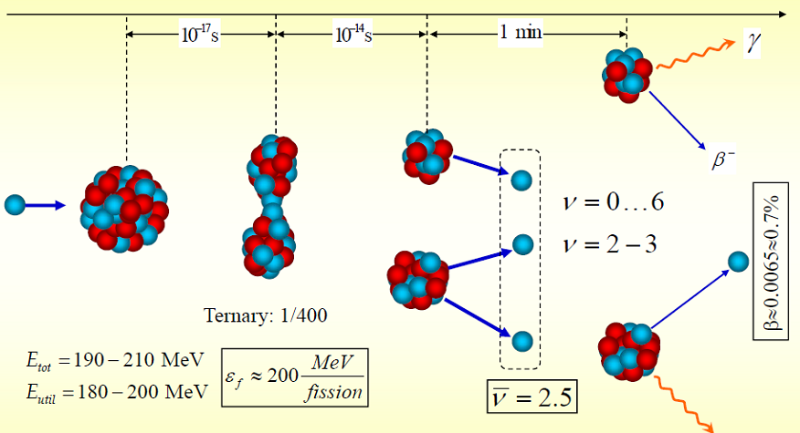
Characteristic properties of nuclear fission

Slide 5
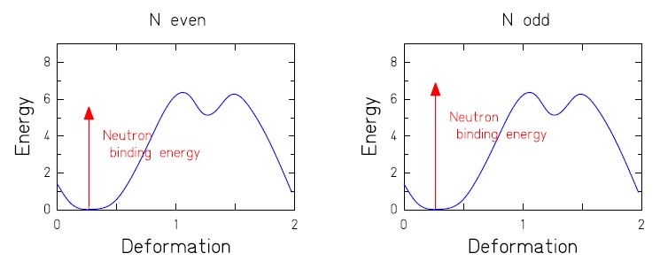
Primordial heavy nuclei
²³²Th: Z=90, N=142
²³⁴U: Z=92, N=142 (0.0055%)
²³⁵U: Z=92, N=143 (0.72%)
²³⁸U: Z=92, N=146 (99.2745%)
excitation by thermal neutrons
Only nuclei with odd neutron number fission after capture of thermal neutrons.
Nuclei with even neutron number are fertile.
(By capture of thermal neutrons, a nucleus with odd neutron number is formed.)
The only natural nuclear fuel for conventional fission reactors is ²³⁵U.

Slide 6
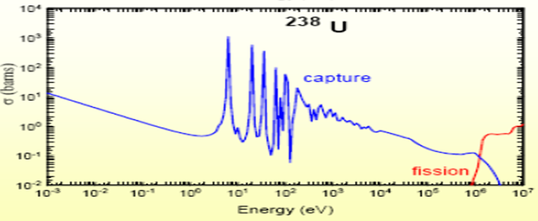
Absorption- and fission cross sections for neutrons
We start with thermalized neutrons,
η is the average number of fission neutrons per thermalized neutron.
0.0253 eV
thermalized
For ²³⁵U: σ_{f} = 584 b and σ_{a} = 97 b, <ν>=2.4
For ²³⁸U: σ_{f} = 0 b and σ_{a} = 2.1 b
Effective value of η = 1.3 for natural Uranium is too small for chain reaction.
→ ²³⁵U has to be enriched to 3% (η=1.8)

Slide 7
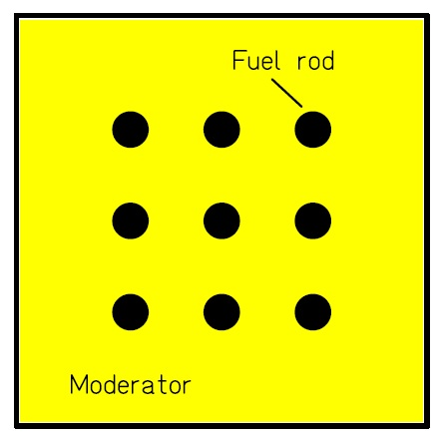
Nuclear reactor
Controlled chain reaction
"Fuel" ²³⁵U enriched from 0,72% to 3,5%.
Fission → 2.2 to 3 neutrons,
exactly one of those induces another fission (criticality = 1)
Control of reactor possible due to delayed neutrons.
Variation of criticality by rods, absorbing neutrons.

Slide 8
Problem of nuclear waste
Which kind of waste?
Fission products
Plutonium —
Dangerous waste or fuel?
Minor actinides
The time scale
Possible solutions
Deposition — safe?, accepted?
Transmutation and incineration by nuclear reactions —
"Cleaning up" in reasonable time?

Slide 9
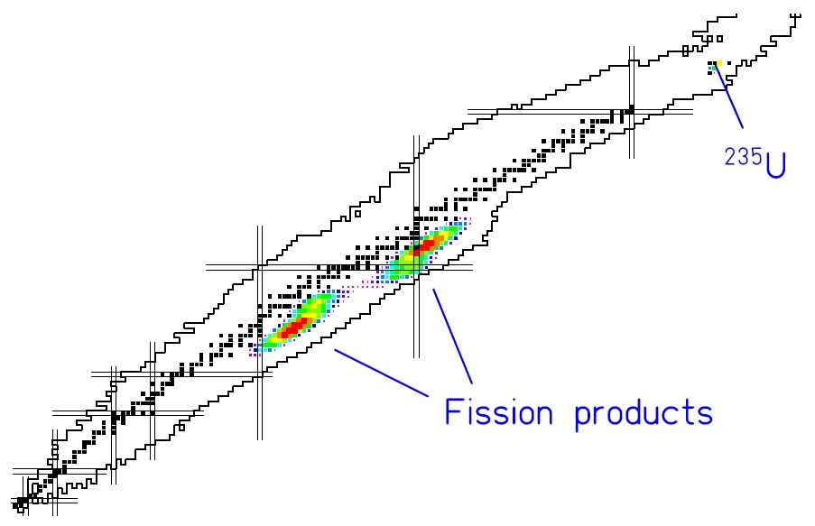
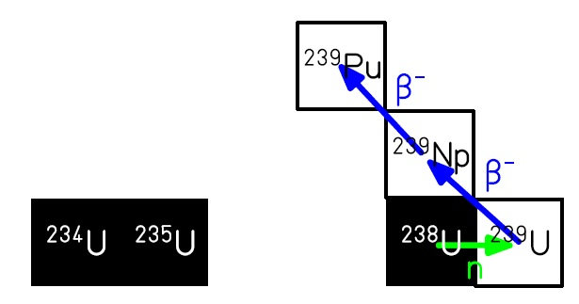
Nuclear reactions in the reactor
Fission:
neutron-breeding:
¹²⁹I (15.7·10⁶ y)
¹⁰⁷Pd (6.5·10⁶ y)
¹³⁵Cs (2·10⁶ y)
⁹³Zr (1.5·10⁶ y) …
Pu, Am, Cm, Np isotopes

Slide 10
List of the reaction products
²³⁵U: Fuel (total reserve for ≈ 200 years)
Fission products:
Isotope | lifetime | 900 MW, 1 year
⁷⁹Se | 70000 years | 0.1 kg
⁹³Zr | 1.5 million years | 15.5 kg
⁹⁹Tc | 210000 years | 17.7 kg
¹⁰⁷Pd | 6.5 million years | 4.4 kg
¹²⁶Sn | 10000 years | 0.44 kg
¹²⁹I | 15.7 million years | 3.9 kg
¹³⁵Cs | 2 million years | 7.7 kg
²³⁹Pu: Fuel or dangerous waste?
Isotope | lifetime | 900 MW, 1 year
²³⁹Pu | 24119 years | 123.1 kg
Other actinides produced by breeding: many not fissile by neutrons
Balance: After a few years, the fuel is consumed.
Problem: Increased neutron capture → poisoning

Slide 11
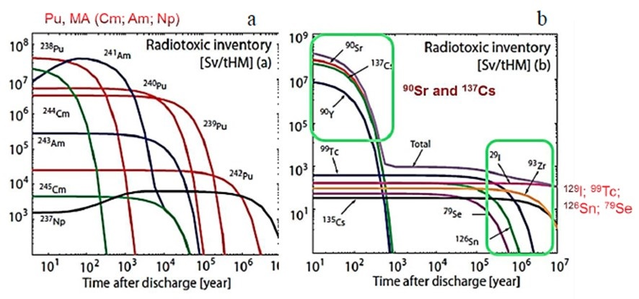
Variation in radiotoxicity over time

Slide 12
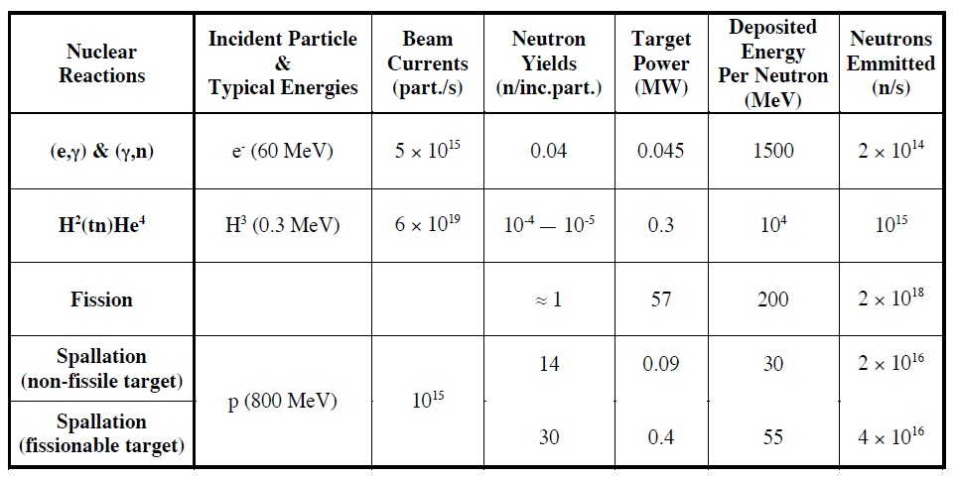
The spallation process
Several nuclear reactions are capable of producing neutrons

Slide 13
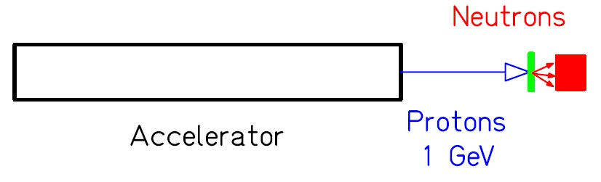
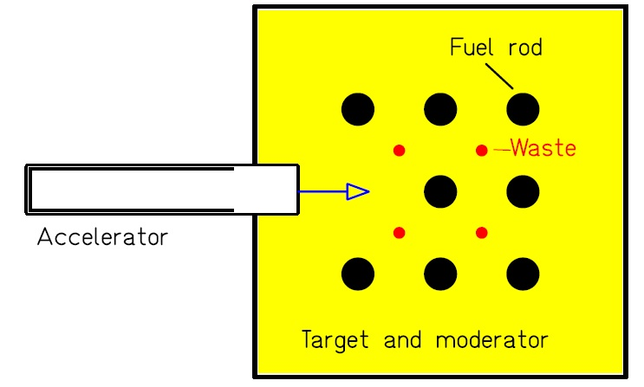
Transmutation of radioactive waste
By spallation neutrons
high energy consumption
By an hybrid reactor (accelerator driven system ADS)?
A subcritical reactor with additional neutrons produced by 1 GeV protons.

Slide 14
Transmutation with an accelerator driven system (ADS)
accelerator
particles | protons
energy | 600 MeV
current | 2.4-4 mA
mode | CW
MTBF | > 250 h
target
main reaction | spallation
output | 2·10¹⁷ n/s
material | LBE (PbBi coolant)
power | 2.4 MW
Accelerator
Spallation Target
Sub-critical Core
reactor
power | ~85 MW_{th}
k_{eff} | 0.95
spectrum | fast (flexible)
fuel | 30-35% Pu MOX
coolant | LBE (PbBi)

Slide 15
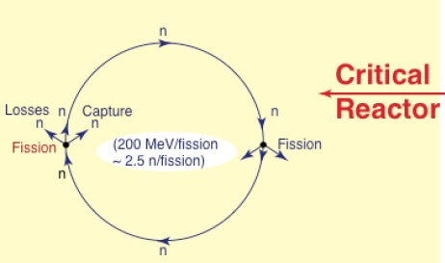
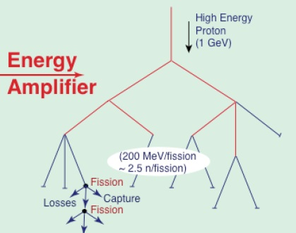



Critical versus Sub-critical Systems
effective neutron multiplication factor
$$k=\frac{production}{absorption+losses}$$
$$energy gain\left(G\right)=\frac{energy produced by EA}{energy provided by beam}=\frac{G_{0}}{\left(1−k\right)}$$
self-sustained process: k=1
(if k<1 the reactor stops)
(if k>1 the reactor is super-critical
externally driven process: k<1 (k=0.98)
G₀=2.7 for Pb
$$E_{tot}=G∙E_{p}$$
EA ≡ energy amplifier

Slide 16
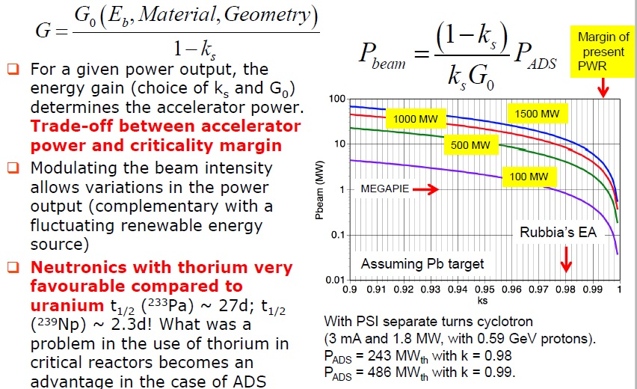
Energy gain in ADS systems

Slide 17
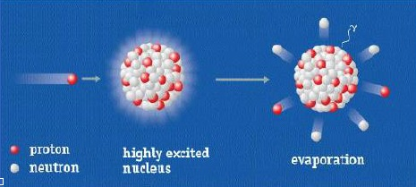
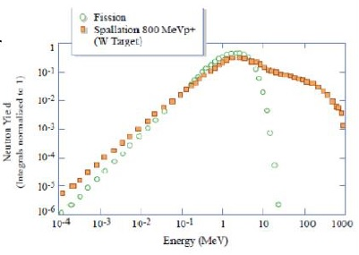
Neutron production
Neutrons are produced through the spallation process on heavy nuclei
at 1 GeV, each proton produce 32 neutrons by spallation
Spallation: A nuclear process in which a high energy proton excites a neutron rich nucleus which decays sending out neutrons (and other particles)
The average energy deposited on the target, about 50 MeV/A, is lower than for deuteron induced nuclear processes.
Neutrons with a broad energy spectrum peaked at 1 MeV

Slide 18
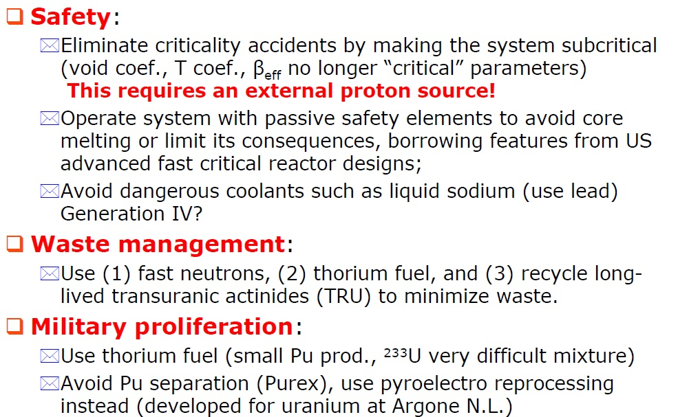
Guidelines for ADS parameters choice

Slide 19
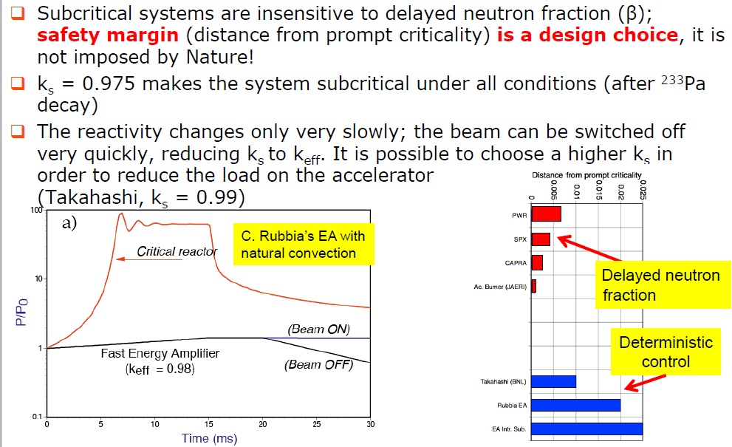
Physics of subcritical systems

Slide 20
Guidelines for ADS parameters choice

Slide 21
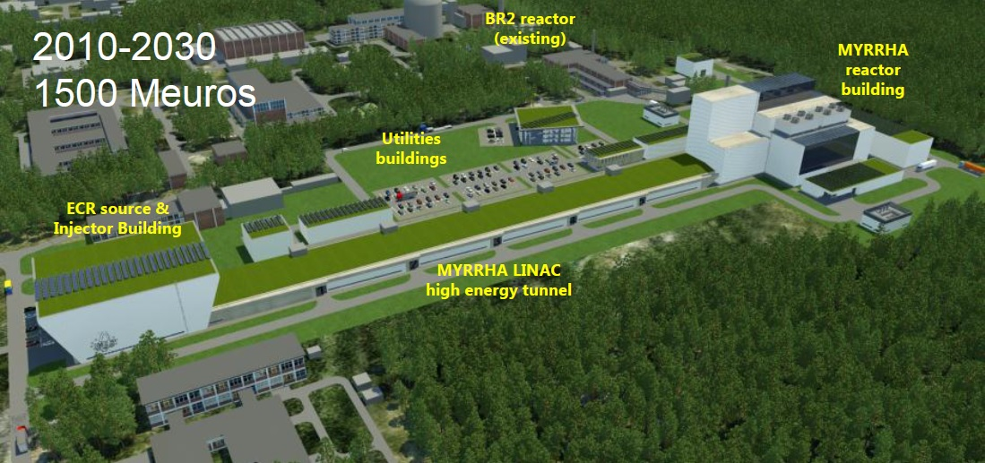
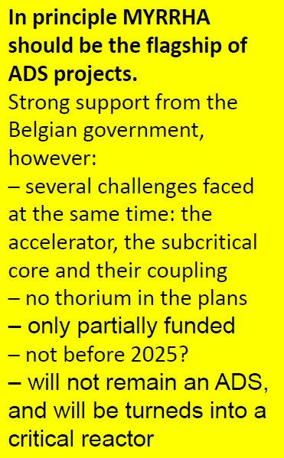
Myrrha project

Slide 22
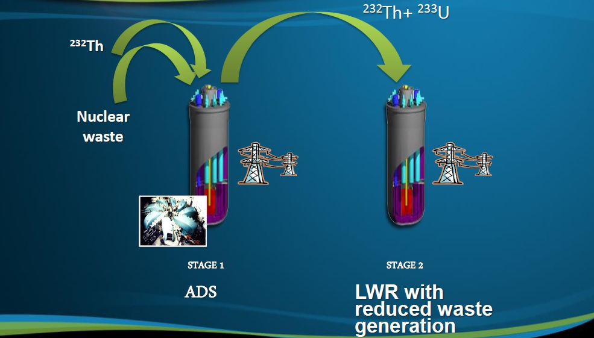
Myrrha project

Slide 23
The Hybrid System (ADS)
Principle:
Slightly under-critical
Controllable by spallation neutrons,
produced by 1 GeV protons
Advantages:
Can be operated with ²³²Th → ²³³U
²³²Th reserves sufficient for 21000 years
Supports some ´poisoning´
Can transmute or incinerate nuclear waste
Is insensitive to some variation of the criticality during long operation
Long operation of fuel rods
Problems:
Nuclear reactions up to 1 GeV must be known
Yield of spallation neutrons
Production of radioactive nuclei by spallation
Material damages due to irradiation

Slide 24
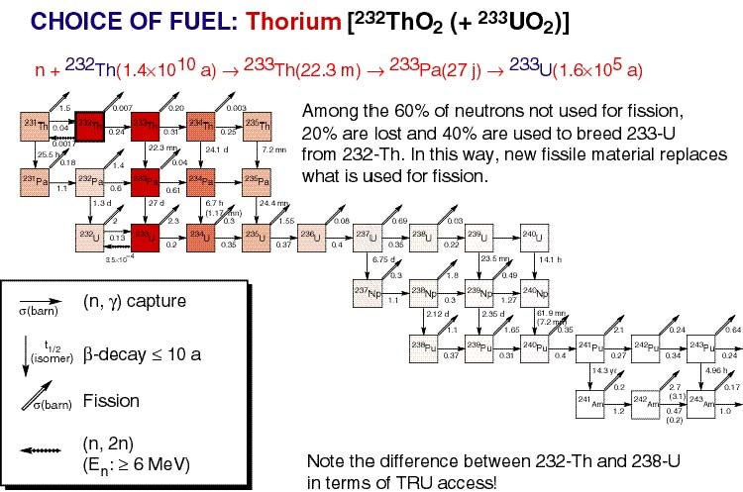
The Hybrid System (ADS)
Thorium is a major asset to minimize waste production
It takes 7 neutron captures to go from ²³²Th to ²³⁹Pu
Pu equilibrium concentration ~ 10⁻⁴ as opposed to 15% in U-Pu system

Slide 25
Research Program at GSI for Transmutation and Incineration of radioactive nuclear waste
Precision Measurements of isotopic yields
¹⁹⁷Au (800 A MeV) + ¹H
²⁰⁸Pb (1 A GeV) + ¹H
²⁰⁸Pb (1 A GeV) + ²H
²⁰⁸Pb (500 A MeV) + ¹H
²³⁸U (1 A GeV) + ¹H
²³⁸U (1 A GeV) + ²H
²³⁸U (1 A GeV) + ²⁰⁸Pb
Development of nuclear-reaction models

Slide 26

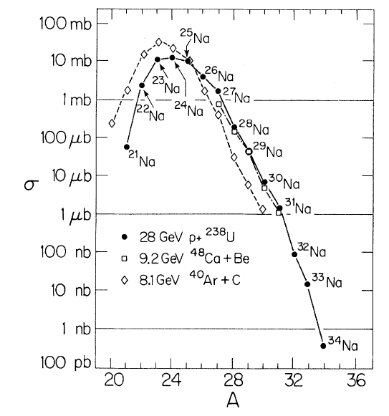
Proton- versus heavy-ion induced reactions
Proton- and heavy-ion induced reactions give very similar isotope distribution:
Na
8 GeV ⁴⁸Ca+Be
Target fragmentation: GeV p + A_{target} → A
Projectile fragmentation: GeV/u A_{proj} + p → A
are equivalent
28 GeV p + ²³⁸U

Slide 27
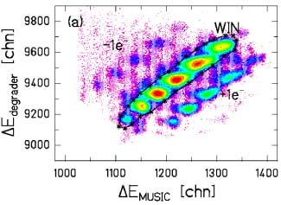
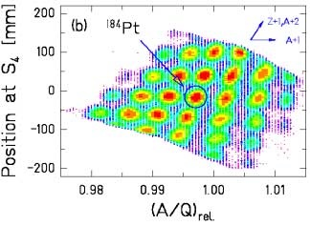
Identification Pattern
²⁰⁸Pb + ¹H, 1GeV/A
T. Enqvist et al., Nucl. Phys. A686 (2001), 481

Slide 28
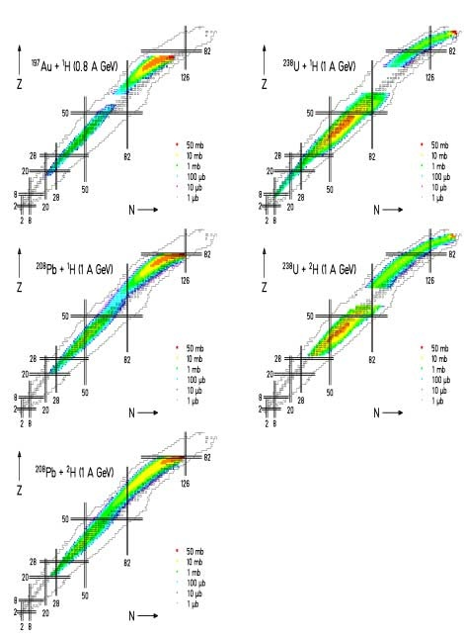
Production cross sections
F. Rejmund et al. NPA 683 (2001) 540
J. Benlliure et al. NPA 683 (2001) 513
T. Enqvist et al. NPA 686 (2001) 481
T. Enqvist et al. NPA 703 (2002) 435
M. Bernas et al. to be published
PhD: B. Mustapha, E. Casarejos, J. Taieb,
M.V. Ricciardi, J. Pereira

