Slide 1

Outline: Experimental Nuclear Astrophysics M. Aliotta
Lecturer: Hans-Jürgen Wollersheim
e-mail: h.j.wollersheim@gsi.de
web-page: https://web-docs.gsi.de/~wolle/ and click on
thermonuclear reactions
nuclear reaction rates
direct & resonant reactions

Slide 2
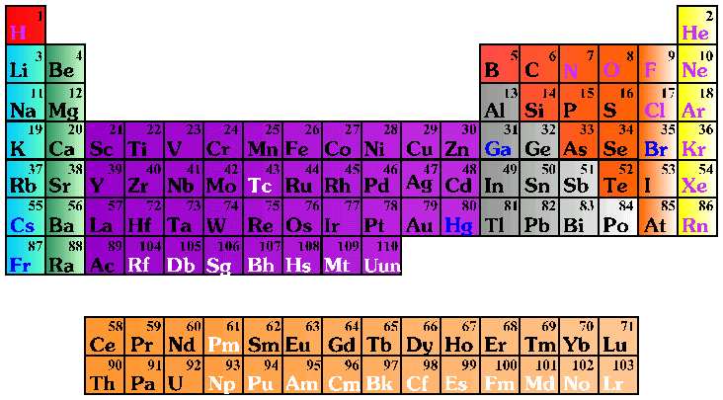
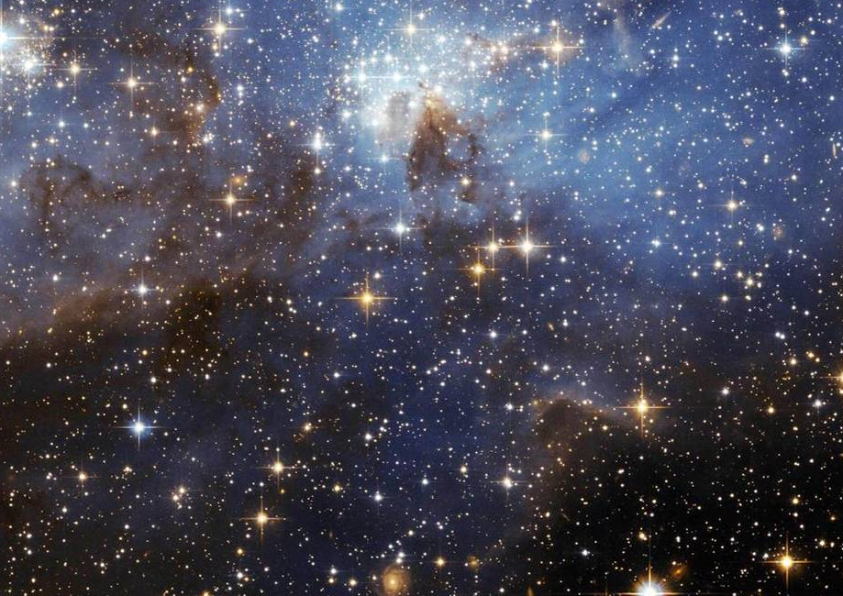
Experimental nuclear astrophysics
study energy generation processes in stars
study nucleosynthesis of the elements
What is the origin of the elements?
How do stars/galaxies form and evolve?
What powers the stars?
How old is the universe?
…
NUCLEAR PHYSICS
KEY for understanding
MACRO-COSMOS intimately related to MICRO-COSMOS

Slide 3
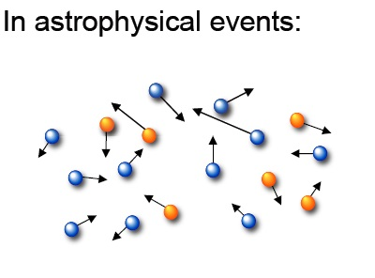
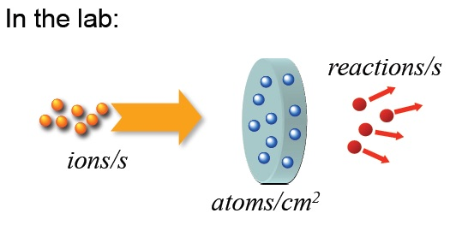

Nuclear reactions in the lab & in space
$$\frac{reactions}{s}=\frac{ions}{s}∙\frac{atoms}{{cm}^{2}}∙σ\left({cm}^{2}\right)$$

Slide 4

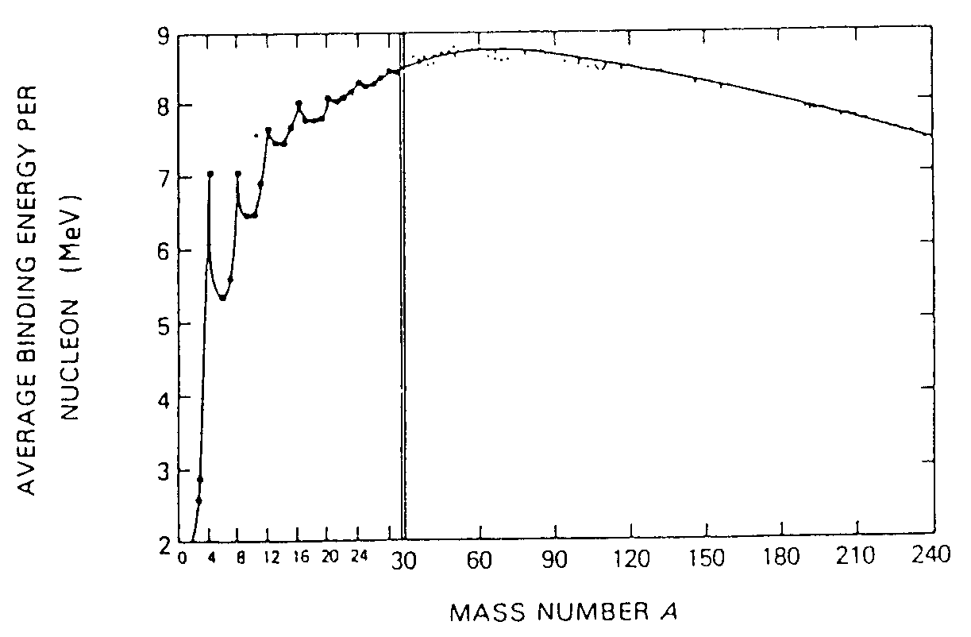
Thermonuclear reactions in stars
Aston:
measurements of atomic masses
M_{nucl} < Σm_{p} + Σm_{n}
ΔE = ΔM_{n}c²
enormous energy stored in nuclei!
Rutherford (1919):
discovery of nuclear reactions
liberate nuclear energy source
complex nuclides formed through reactions
amount of energy liberated in nuclear reaction:
Q =[(m₁+m₂)-(m₃+m₄)]c² > 0
Binding energy curve
spontaneous nuclear processes:
Q > 0
fusion up to Fe region
fission of heavy nuclei
Q > 0
Q < 0
H most abundant element in the Universe
FUSION reactions most effective in stars

Slide 5

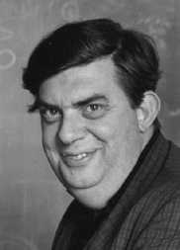
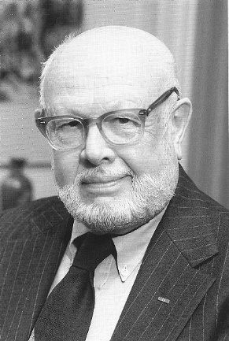
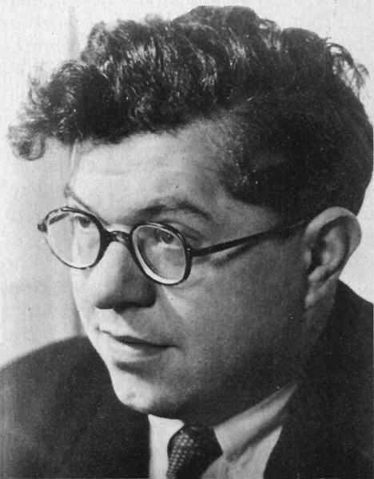

Rev. Mod. Phys. 29 (1957) 547
(B²FH, 1957)
Burbidge
Burbidge
Fowler
Hoyle
1983
Nobel Prize
"for his theoretical and experimental studies of the nuclear reactions
of importance in the formation of the chemical elements in the universe"

Slide 6
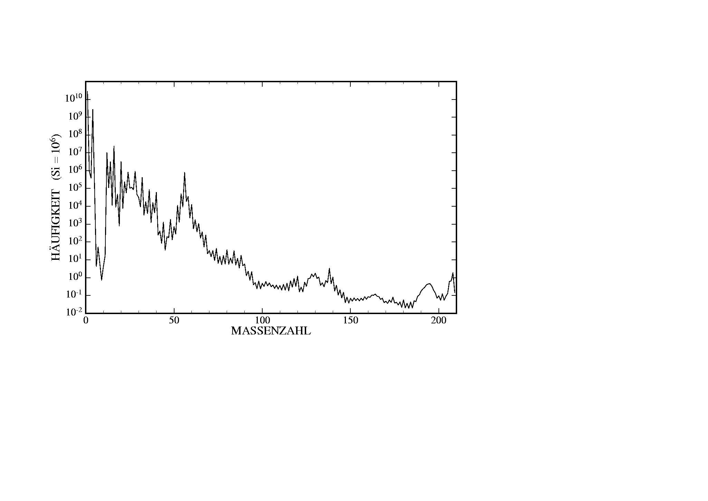
Why does one kilogram of gold costs so much more than one kilogram of iron?
Abundance curve of the elements
Fe
7 orders of
magnitude
less abundant!
Abundance
Au
WHY?
mass number
Question 3
How were the elements from
iron to uranium made?
“The 11 Greatest Unanswered Questions of Physics”
based on National Academy of Science Report, 2002
[Committee for the Physics of the Universe (CPU)]

Slide 7
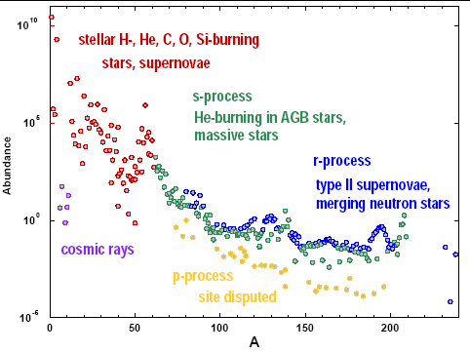
Nucleosynthesis process
The Synthesis of the Elements in Stars
Burbidge, Burbidge, Fowler & Hoyle (B²FH): Rev. Mod. Phys. 29 (1957) 547
M. Wiescher, JINA lectures on Nuclear Astrophysics

Slide 8
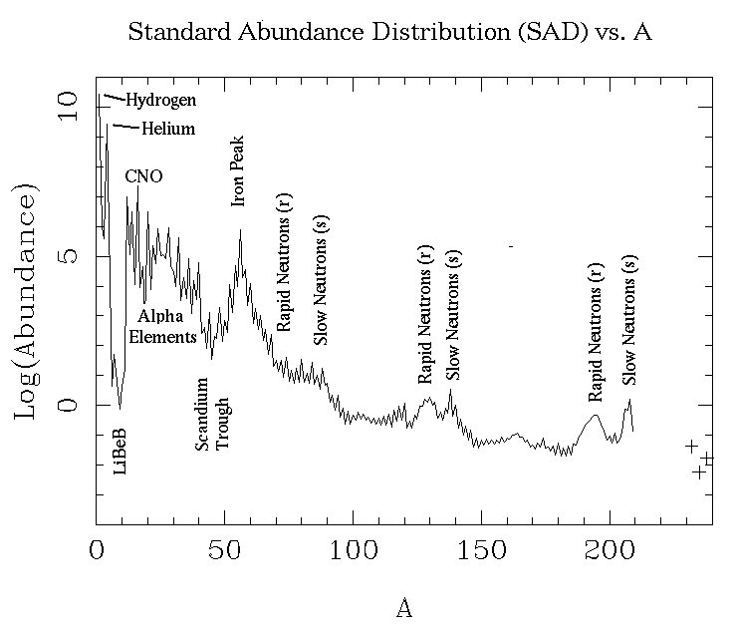
Nuclear processes
charged-particle
induced reaction
mainly neutron
capture reaction
during quiescent stages
of stellar evolution
mainly during explosive
stages of stellar evolution
involve mainly STABLE NUCLEI
involve mainly UNSTABLE NUCLEI

Slide 9
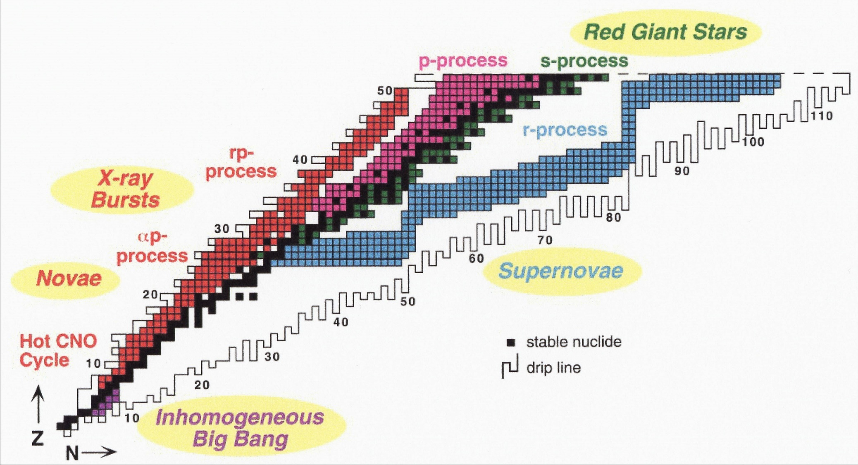
Overview of main astrophysical processes
M.S. Smith and K.E. Rehm,
Ann. Rev. Nucl. Part. Sci, 51 (2001) 91-130
the vast majority of reactions encountered in these processes involve UNSTABLE species hence the need for Radioactive Ion Beams

Slide 10

Nuclear reaction rates
nuclear reactions in stars: a) produce energy
b) synthesise elements
stars = cooking pots of the Universe
for reaction: T(p,e)R
(T = target, p = projectile, e = ejectile, R = recoil)
reaction Q-value: Q=[(m_{p}+m_{T})-(m_{e}+m_{R})]c²
(energy per single reaction)
if Q > 0 ⇒ net production of energy
reaction rate per volume r
(number of reactions per unit time and volume)
N_{i} = number density of interacting species
v = relative velocity
f(v) = velocity distribution in plasma
σ(v) = reaction cross section
KEY QUANTITY
energy production rate ε
ε = r·Q/ρ
typical units: MeV g⁻¹ s⁻¹
Kronecker δ applies for identical particles to avoid double counting

Slide 11
Example of nuclear reaction rates in stars
CNO cycle
O
15
(p,γ)
13
14
15
N
(e⁺ν)
C
12
13
(p,α)
6
7
8
¹²C(p,γ)¹³N(e⁺ν)¹³C(p,γ)¹⁴N(p,γ)¹⁵O(e⁺ν)¹⁵N(p,α)¹²C
cycle limited by β-decay of ¹³N (t ~ 10 min) and ¹⁵O (t ~ 2 min)
CNO isotopes act as catalysts
net result: 4p → ⁴He + 2e⁺ + 2ν + Q_{eff} Q_{eff} = 26.73 MeV
nucleosynthesis
energy production
changes in stellar conditions ⇒ changes in energy production and nucleosynthesis
need to know REACTION RATE at all temperatures to determine ENERGY PRODUCTION

Slide 12
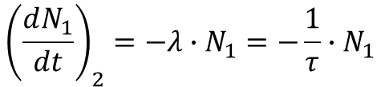
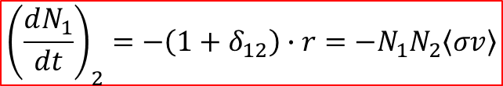



Abundance changes and lifetimes
Consider reaction 1 + 2 → 3
Nuclei of type 1 are destroyed via capture reaction with type 2 nuclei; type 3 nuclei are produced
Average live time of type 1 nuclei in stellar environment is given by the differential equation:
$${\left(\frac{dN_{1}}{dt}\right)}_{2}=−λ∙N_{1}=−\frac{1}{τ}∙N_{1}$$
mean lifetime
decay constant
or
$${\left(\frac{dN_{1}}{dt}\right)}_{2}=−\left(1+δ_{12}\right)∙r=−N_{1}N_{2}\left\langle σv\right\rangle$$
Kronecker symbol disappears often
the following equations are given:
$$=−N_{1}∙ρ∙N_{A}\frac{X_{2}}{A_{2}}\left\langle σv\right\rangle =−N_{1}∙ρ∙N_{A}∙Y_{2}\left\langle σv\right\rangle$$
$$r=\frac{1}{1+δ_{12}}N_{1}∙N_{2}∙\left\langle σv\right\rangle$$
number density N_{i}
matter density ρ
Avogadro‘s number N_{A}
mass fraction X_{i}
atomic mass A_{i}
mol fraction Y_{i}
$$N_{i}=ρ∙N_{A}\frac{X_{i}}{A_{i}}=ρ∙N_{A}∙Y_{i}$$

Slide 13

Abundance changes and lifetimes
reactions are random processes with constant probability (cross section) for given conditions
⇒ abundance change is governed by same laws of radioactive decay
consider reaction 1+2 → 3
where 1 is destroyed through capture of 2 and 3 is produced
example
3 is produced
O
15
13
14
15
N
C
12
13
1 is destroyed
6
7
8
define:
lifetime of 1 against destruction by with 2:
$$τ=\frac{1}{λ}=\frac{1}{Y_{2}∙ρ∙N_{A}\left\langle σv\right\rangle }$$
need to know REACTION RATE at all temperatures to determine NUCLEOSYNTHESIS

Slide 14

Key quantity
stellar reaction rate
need: a) velocity distribution
b) cross section
a) velocity distribution
interacting nuclei in plasma are in thermal equilibrium at temperature T
also assume non-degenerate and non-relativistic plasma
Maxwell-Boltzmann velocity distribution
with
reduced mass
v = relative velocity, E=1/2 μv²
kT ~ 8.6 x 10⁻⁸ T[K] keV
example: Sun T ~ 15x10⁶ K ⇒ kT ~ 1.3 keV

Slide 15
Reaction cross sections
b) cross section
no nuclear theory available to determine reaction cross section a priori
depends sensitively on:
  the properties of the nuclei involved
  the reaction mechanism
and can vary by orders of magnitude, depending on nature of interaction
examples:
Reaction | Force | σ (barn) | E_{proj} (MeV)
¹⁵N(p,α)¹²C | strong | 0.5 | 2.0
³He(α,γ)⁷Be | electromagnetic | 10⁻⁶ | 2.0
p(p,e⁺ν)d | weak | 10⁻²⁰ | 2.0
1 barn = 10⁻²⁴ cm² = 100 fm²
in practice, need experiments AND theory to determine stellar reaction rates

Slide 16

Nuclear properties relevant to reaction rates
recall: nucleons in nuclei arranged in quantised shells of given energy
⇒ nucleus’s configuration as a whole corresponds to discrete energy levels
example
excitation
energy
[MeV]
spin
parity
J^{π}
4.97
2⁻
3rd excited state
4.25
4⁺
2nd excited state
excitation energy
1.63
2⁺
1st excited state
0
0⁺
ground state
0
²⁰Ne
any nucleus in an excited state will eventually decay either by γ, p, n or α-emission with a
characteristic lifetime τ which corresponds to a width Γ in the excitation energy of the state
$$Γ=\frac{ℏ}{τ}$$
Heisenberg’s relationship
the lifetime for each individual exit channel is usually given in terms of partial widths
Γ_{γ}, Γ_{p}, Γ_{n} and Γ_{α}
with

Slide 17
reaction mechanisms:
I. direct reactions
II. resonant reactions

Slide 18
Reaction mechanism
I. direct process
one-step process
direct transition into a bound state
example: radiative capture A(x,γ)B
E_{cm}
γ
Q
A+x
B
H_{γ} = electromagnetic operator describing the transition
reaction cross section proportional to single matrix element
can occur at all projectile energies
smooth energy dependence of cross section
other direct processes: stripping, pickup, charge exchange, Coulomb excitation

Slide 19
Reaction mechanism
II. resonant process
Coulomb
barrier
E, J, ℓ_{tr}, Γ
⇓
E_{coul}
E, J, ℓ_{tr}, Γ
direct measurements
non-resonant
resonance
E, J, ℓ_{tr}, Γ
E, J, ℓ_{tr}, Γ
Astrophysical
region
E_{G}
σ(E)
LOG
SCALE

Slide 20
Reaction mechanism
II. resonant process
two-step process
example: resonant radiative capture A(x,γ)B
1. Compound nucleus formation
(in an unbound state)
2. Compound nucleus decay
(to lower excited states)
E_{cm}
E_{r}
Γ
S_{x}
γ
A+x
Q
B
B
compound decay
probability ∝ Γ_{γ}
compound formation
probability ∝ Γ_{x}
reaction cross section proportional to two matrix elements
only occurs at energies E_{cm} ~ E_{r} - Q
strong energy dependence of cross section
N. B. energy in entrance channel (Q+E_{cm}) has to match excitation energy E_{r} of resonant state,
however all excited states have a width ⇒ there is always some cross section through tails

Slide 21
Reaction mechanism
Consider reaction: T(p,e)R
(T = target, p = projectile, e = ejectile, R = recoil)
(e = particle or photon)
Non-resonant process
One-step process leading to final nucleus Y
σ ∝ |<e+R ǀHǀ p+T>|²
single matrix element
occurs at all interaction energies
cross section has WEAK energy dependence
Resonant process
Two-step process: 1) compound nucleus formation p + T → C*
2) decay of compound nucleus C* → e + R
V
E_{r+1}
σ ∝ |<e+R ǀH’ǀ C*>|² |<C* ǀHǀ p+T>|²
E_{r}
incident nucleus
two matrix elements
E
σ
0
E₂
r₀
r
E₁
occurs at specific energies
cross section has STRONG energy dependence

Slide 22
Reaction mechanism
example: resonant reaction A(x,α)B
1. Compound nucleus formation
(in an unbound state)
2. Compound nucleus decay
(by particle emission)
E_{cm}
Γ
α
S_{x}
A+x
S_{α}
B
B+α
C
C
compound decay
probability ∝ Γ_{α}
compound formation
probability ∝ Γ_{x}
N. B. energy in entrance channel (S_{x}+E_{cm}) has to match excitation energy E_{r} of resonant state,
however all excited states have a width ⇒ there is always some cross section through tails

Slide 23
Cross section
cross section expressions
for direct reactions and resonant reactions
with charged particles
with neutrons

Slide 24
Cross sections for direct reactions
example: direct capture
A + x → B + γ
penetrability/transmission
probability for projectile to
reach target for interaction
depends on projectile’s angular
momentum l and energy E
“geometrical factor”
de Broglie wavelength
of projectile
matrix element
contains nuclear
properties of interaction
σ = (strong energy dependence) · (weak energy dependence)
S(E) = astrophysical factor contains nuclear physics of reaction
+ can be easily: graphed, fitted, extrapolated (if needed)
need expression for P_{l}(E)
factors affecting transmission probability:
    Coulomb barrier (for charged particles only)
    centrifugal barrier (both for neutrons and charged particles)

Slide 25
Reactions with charged particles
charged particles
Coulomb barrier
V
Coulomb potential
energy available: from thermal motion
E_{kin} ~ kT (keV)
E_{coul} ~ Z₁Z₂ (MeV)
kT ~ 8.6 x 10⁻⁸ T[K] keV
tunnel
effect
r₀
r
nuclear well
T ~ 15x10⁶ K (Sun) ⇒ kT ~ 1 keV
T ~ 10¹⁰ K (Big Bang) ⇒ kT ~ 2 MeV
during quiescent burnings: kT << E_{c}
reactions occur through TUNNEL EFFECT
tunneling probability P ∝ exp(-2πη)
2πη = Gamow factor
in numerical units:
2πη = 31.29 Z₁Z₂(μ/E)^{½}
μ in amu and E_{cm} in keV
determines exponential drop in abundance curve!

Slide 26
Coulomb barrier
for projectile and target charges Z₁ and Z₂
V
Coulomb potential
E_{kin} ~ kT (keV)
height of
Coulomb barrier
in numerical units:
tunnel
effect
R
r
nuclear well
example: ¹²C(p,γ) V_{C} = 3 MeV
average kinetic energies in stellar plasmas: kT ~ 1-100 keV!
fusion reactions between charged particles take place well below Coulomb barrier
transmission probability governed by tunnel effect
for E << V_{C} and zero angular momentum, tunnelling probability given by:
with
Gamow factor

Slide 27



Angular momentum barrier
classical treatment:
p
incident
particle
p = projectile linear momentum
d = impact parameter
d
z-axis
target
nucleus
incident particle can have orbital angular momentum
L = p·d
angular momentum is conserved in central potential
⇒ linear momentum p (and hence energy) must increase as distance d decreases
quantum-mechanical treatment:
(discrete values only)
$$L=\sqrt{λ∙\left(λ+1\right)}ℏ$$
= 0 s-wave
= 1 p-wave
= 2 d-wave
…
with parity of wave-function:
$$π={\left(−1\right)}^{λ}$$
angular momentum is conserved in central potential
⇒ non-zero angular momentum implies “angular momentum energy barrier” V_{l}
$$V_{λ}=\frac{λ∙\left(λ+1\right)ℏ^{2}}{2μr^{2}}$$
= reduced mass of projectile-target system
r = radial distance from centre of target nucleus

Slide 28


Charged-particle capture
probability of tunnelling through Coulomb barrier for charged particle reactions
at energies E << V_{coul}
$$η=a∙k_{∞}=\frac{Z_{1}∙Z_{2}∙e^{2}}{ℏ∙v_{∞}}$$
Sommerfeld
parameter
$$b=\sqrt{2μπ}\frac{Z_{1}Z_{2}e^{2}}{ℏ}$$
b² ≡ Gamow energy
assumes:
full ion charges
zero orbital angular momentum
units of S(E): keV barn, MeV barn …
additional angular momentum barrier leads to a roughly constant addition to the S-factor
that strongly decreases with l ⇒ S-factor definition for charged particle reactions is
independent of orbital angular momentum (unlike neutron capture processes!)

Slide 29



Non-resonant reaction
Non-resonant reactions
$$σ∝πλ^{2}∙P_{λ}\left(E\right)∙{\left|\left\langle e+R | H | p+T\right\rangle \right|}^{2}$$
geometrical factor (particle’s
de Broglie wavelength)
interaction
matrix element
penetrability probability
depends on projectile’s
angular momentum  and energy E
$$λ=\frac{h}{p}=\frac{h}{\sqrt{2mE}}$$
$$σ\left(E\right)=\frac{1}{E}∙exp\left(−2πη\right)∙S\left(E\right)$$
(for s-waves only!)
non-nuclear origin
STRONG
energy dependence
nuclear origin
WEAK
energy dependence
Above relation defines ASTROPHYSICAL S(E)-FACTOR
N.B.
$$V_{λ}=\frac{λ\left(λ+1\right)ℏ^{2}}{2μr^{2}}$$
If angular momentum is non zero ⇒ centrifugal barrier must also be taken into account

Slide 30

Astrophysical S-factor
“astro physical S factor” contains detailed information on nuclear structure
$$σ\left(E\right)=\frac{S\left(E\right)}{E}∙e^{−b/{\sqrt{E}}}$$
Relevant energy region for astro physics is very low, typical at the limit and below measured energy for nuclear reaction.
In some cases S€ can be extrapolated
Rolfs & Rodney p. 156

Slide 31
Astrophysical S-factor
Rolfs & Rodney p. 156
Typically data for astrophysical processes are given by S(E)
In some cases S€ varies strongly with energy

Slide 32
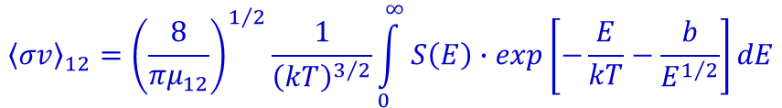
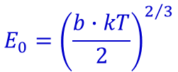



Gamow peak
With above definition of cross section:
$${\left\langle σv\right\rangle }_{12}={\left(\frac{8}{πμ_{12}}\right)}^{1/2}\frac{1}{{\left(kT\right)}^{3/2}}\int_{0}^{∞}{S\left(E\right)∙exp\left[−\frac{E}{kT}−\frac{b}{E^{1/2}}\right]}dE$$
$$b=\sqrt{2μ}\frac{πZ_{1}Z_{2}e^{2}}{η}$$
$$ℏ$$
f(E)
varies smoothly
with energy
governs energy
dependence
MAXIMUM reaction rate:
Maxwell-Boltzmann
distribution
∝ exp(-E/kT)
tunnelling through
Coulomb barrier
∝ exp(- )
$$\frac{df}{dE}=0$$
$$E_{0}={\left(\frac{b∙kT}{2}\right)}^{2/3}$$
ΔE₀ < E₀
relative probability
Gamow peak
only small energy range contributes
to reaction rate
⇓
OK to set S(E) ~ S(E₀) = const.
ΔE₀
ΔE₀
kT
E₀
energy

Slide 33
Gamow peak
and substituting for σ:
maximum reaction rate at E₀:
Gamow peak
Maxwell-Boltzmann
distribution
∝ exp(-E/kT)
tunnelling through
Coulomb barrier
∝ exp(- )
MeV
relative probability
Gamow peak
MeV
ΔE₀
kT
E₀
energy
E₀ = relevant energy for astrophysics >> kT
N.B. Gamow energy depends on reaction and temperature

Slide 34
Gamow peak
Gamow peak:
most effective energy region for thermonuclear reactions
E₀ ± ΔE₀/2
energy window of astrophysical interest
E₀ = f(Z₁, Z₂, T)
varies depending on reaction and/or temperature
Examples: T ~ 15x10⁶ K (T₆ = 15)
reaction | Coulomb barrier (MeV) | E₀ (keV) | exp(-3E₀/kT) ΔE₀
p + p | 0.55 | 5.9 | 7.0x10⁻⁶
α + ¹²C | 3.43 | 56 | 5.9x10⁻⁵⁶
¹⁶O + ¹⁶O | 14.07 | 237 | 2.5x10⁻²³⁷
area of Gamow peak
(height x width) ~ <σv>
STRONG sensitivity
to Coulomb barrier
separate stages: H-burning
He-burning
C/O-burning …

Slide 35

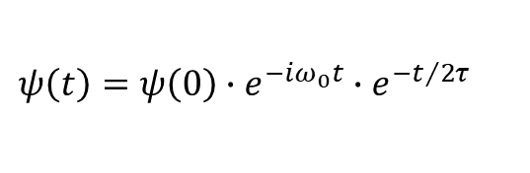
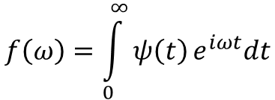


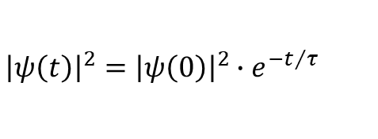
Resonance curve
Wave function for a decaying intermediate state Z* with energy E₀ and live time τ
$$ψ\left(t\right)=ψ\left(0\right)∙e^{−iω_{0}t}∙e^{−t/2τ}$$
$$E=ℏ∙ω ℏ=1$$
$${\left|ψ\left(t\right)\right|}^{2}={\left|ψ\left(0\right)\right|}^{2}∙e^{−t/τ}$$
Exponential decay
τ decay constant
Frequency- or energy dependence is obtained from wave function via Fourier transformation of
$$ψ\left(t\right)$$
$$f\left(ω\right)=\int_{0}^{∞}{ψ\left(t\right)}e^{iωt}dt$$

Slide 36
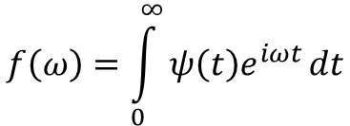
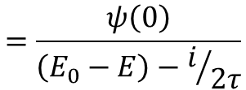
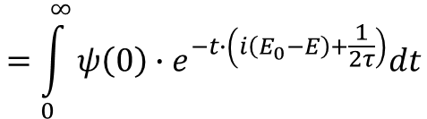
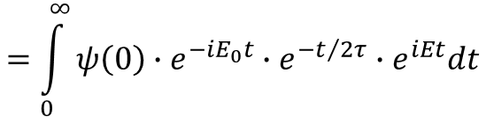
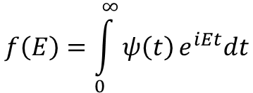
Resonance curve
Fourier transformation:
$$f\left(ω\right)=\int_{0}^{∞}{ψ\left(t\right)e^{iωt}}dt$$
$$f\left(E\right)=\int_{0}^{∞}{ψ\left(t\right)}e^{iEt}dt$$
$$=\int_{0}^{∞}{ψ\left(0\right)}∙e^{−iE_{0}t}∙e^{−t/{2τ}}∙e^{iEt}dt$$
$$=\int_{0}^{∞}{ψ\left(0\right)∙e^{−t∙\left(i\left(E_{0}−E\right)+\frac{1}{2τ}\right)}dt}$$
$$=\frac{ψ\left(0\right)}{\left(E_{0}−E\right)−i/{2τ}}$$

Slide 37

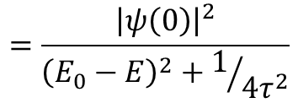
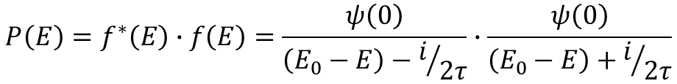
Resonance curve
Probability to find a state with energy E
$$E=f^{∗}∙f$$
$$P\left(E\right)=f^{∗}\left(E\right)∙f\left(E\right)=\frac{ψ\left(0\right)}{\left(E_{0}−E\right)−i/{2τ}}∙\frac{ψ\left(0\right)}{\left(E_{0}−E\right)+i/{2τ}}$$
$$=\frac{{\left|ψ\left(0\right)\right|}^{2}}{{\left(E_{0}−E\right)}^{2}+1/{4τ^{2}}}$$

Slide 38
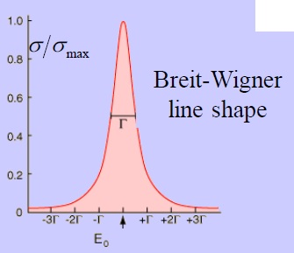


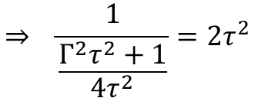
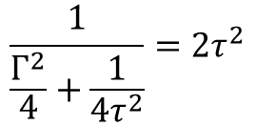
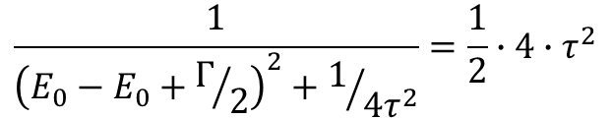

Energy dependence – line shape
probability for Z* to heave energy E
Full Width at Half Maximum FWHM = Γ
$$\frac{1}{{\left(E_{0}−E_{0}+Γ/2\right)}^{2}+1/{4τ^{2}}}=\frac{1}{2}∙4∙τ^{2}$$
$$\frac{1}{\frac{Γ^{2}}{4}+\frac{1}{4τ^{2}}}=2τ^{2}$$
$$⇒ \frac{1}{\frac{Γ^{2}τ^{2}+1}{4τ^{2}}}=2τ^{2}$$
$$⇒ \frac{2}{Γ^{2}τ^{2}+1}=1$$
$$τ∙Γ=1$$
Heisenberg uncertainty principle (ℏ=1)
limited live time ↔ uncertainty in energy

Slide 39


Cross section for resonant reactions
for a single isolated resonance:
resonant cross section given by Breit-Wigner expression
$$E_{r}=E_{0}−i\frac{Γ}{2}$$
$$\left|E_{r}\right|=\sqrt{E_{0}^{2}+\frac{Γ^{2}}{4}}$$
for reaction: 1 + T → C → F + 2
geometrical factor
∝ 1/E
spin factor ω
J = spin of CN’s state
J₁ = spin of projectile
J_{T} = spin of target
strongly energy-dependent term
Γ₁ = partial width for decay via emission of particle 1
= probability of compound formation via entrance channel
Γ₂ = partial width for decay via emission of particle 2
= probability of compound decay via exit channel
= total width of compound’s excited state
= Γ₁ + Γ₂ + Γ_{γ} + …
E_{r} = resonance energy
what about penetrability considerations? ⇒ look for energy dependence in partial widths!
partial widths are NOT constant but energy dependent!

Slide 40
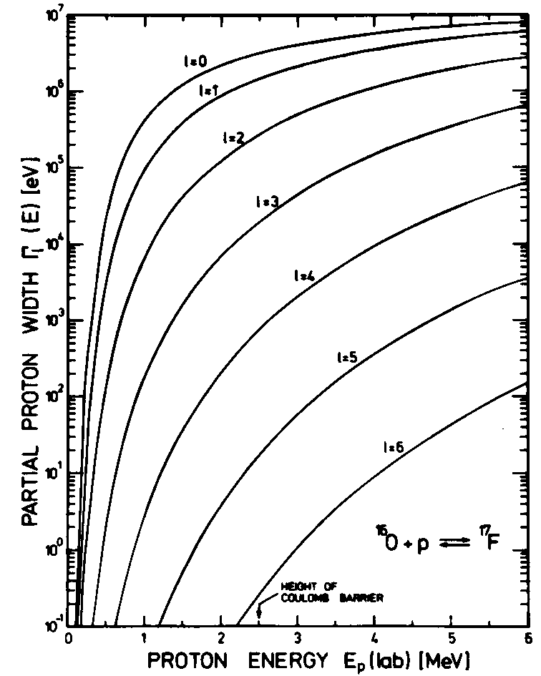
Energy dependence of partial widths
particle widths
θ_{l} = “reduced width” (contains nuclear physics info)
P_{l} gives strong energy dependence
example: ¹⁶O(p,γ)¹⁷F
energy dependence of proton
partial width Γ_{p} as function of l
particle partial widths have approximately
same energy dependence as penetrability
function seen in direct reaction processes

Slide 41
Reaction rates for resonant processes
here Breit-Wigner cross section
integrate over appropriate energy region
E ~ kT for neutron induced reactions
E ~ Gamow window for charged particle reactions
if compound nucleus has an exited state (or its wing) in this energy range
⇒ RESONANT contribution to reaction rate (if allowed by selection rules)
typically:
resonant contribution dominates reaction rate
reaction rate critically depends on resonant state properties
two simplifying cases:
narrow (isolated) resonances
broad resonances

Slide 42
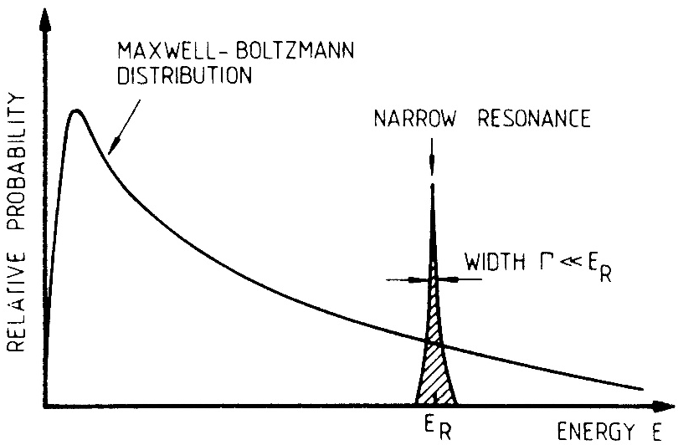


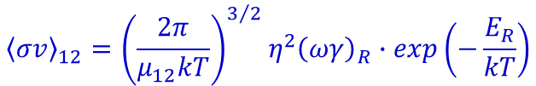
Resonant reactions
Resonant reactions
1. Narrow resonances
Γ << E_{R}
Breit-Wigner formula
σ(E)_{BW} = π²(1+δ₁₂)
$$\frac{2J+1}{\left(2J_{1}+1\right)\left(2J_{2}+1\right)}$$
Γ_{a} Γ_{b}
(E-E_{r})² + (Γ/2)²
insert in expression for reaction rate,
integrate and get:
$${\left\langle σv\right\rangle }_{12}={\left(\frac{2π}{μ_{12}kT}\right)}^{3/2}η^{2}{\left(ωγ\right)}_{R}∙exp\left(−\frac{E_{R}}{kT}\right)$$
(for single resonance)
resonance strength
(integrated cross section over resonant region)
low-energy resonances (E_{R} → kT) dominate reaction rate
Experiment: determine
$${\left(ωγ\right)}_{R}$$
and E_{R}

Slide 43
Some considerations
rate entirely determined by “resonance strength” ωγ and energy of the resonance E_{R}
resonance strength
(= integrated cross section over resonant region)
(Γ_{i} values at resonant energies)
often
reaction rate is determined by the smaller width !
experimental info needed:
    partial widths Γ_{i}
    spin J
    energy E_{R}
note: for many unstable nuclei
most of these parameters are
UNKNOWN!

Slide 44
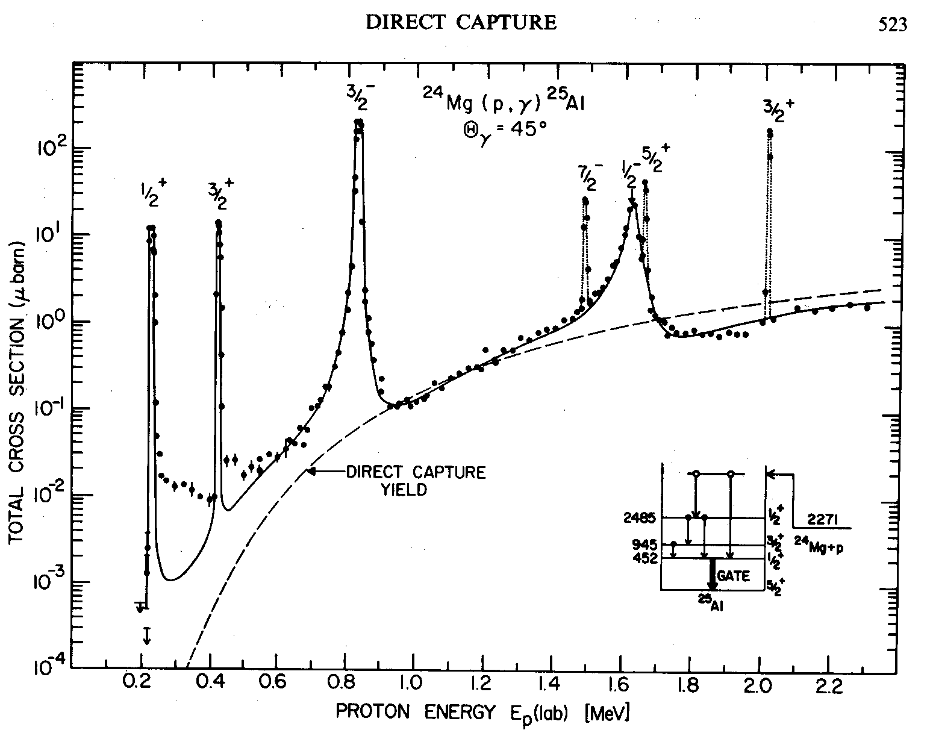
Narrow resonant case
example: ²⁴Mg(p,γ)²⁵Al
the cross section

Slide 45
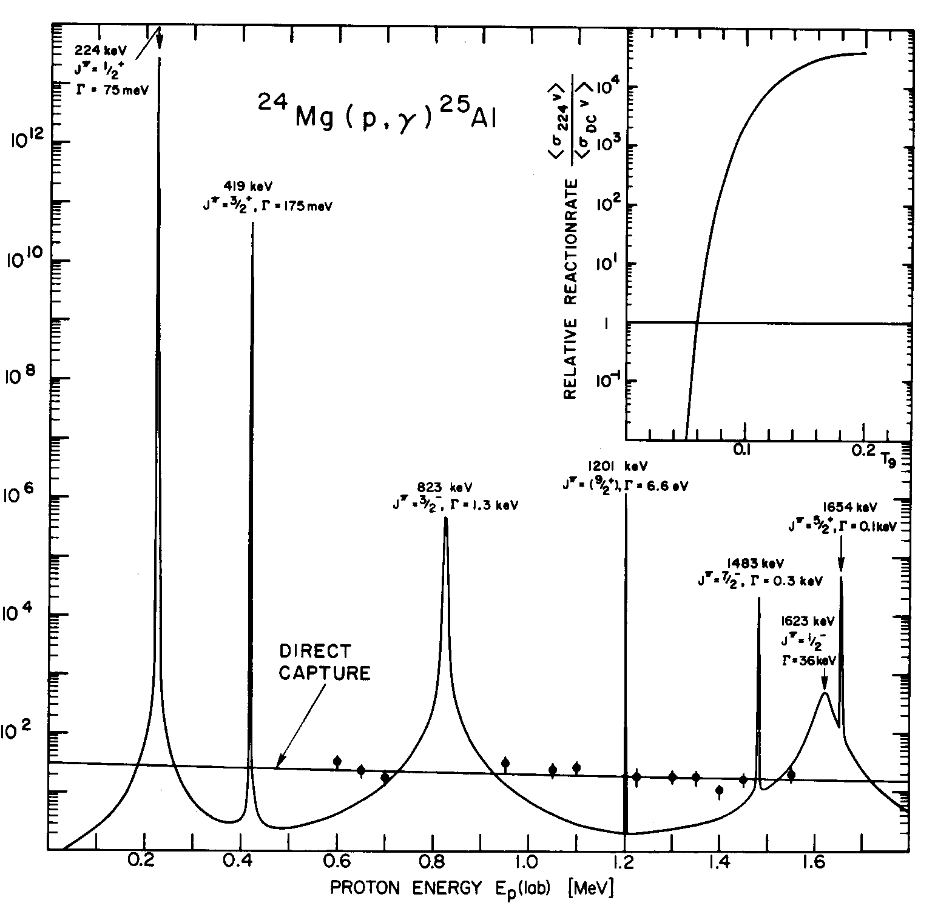
Narrow resonant case
… and the corresponding S-factor
non-constant S-factor
resonant contribution
almost constant S-factor
direct capture contribution
Note varying widths of resonant states !

Slide 46

Remarks
There was only one resonance. There can be several overlapping resonances.
Resonance amplitude
fast change of phase while crossing the resonance energy
$$\sim \frac{1}{i\left(E_{0}−E\right)+Γ/2}$$
Typically there are two processes:
non resonant scattering
e.g. Rutherford scattering
resonant scattering
interferences changes the shape of the resonances, typically asymmetric lines respectively interferences in cross section
example: n scattering with ²⁷Al

Slide 47
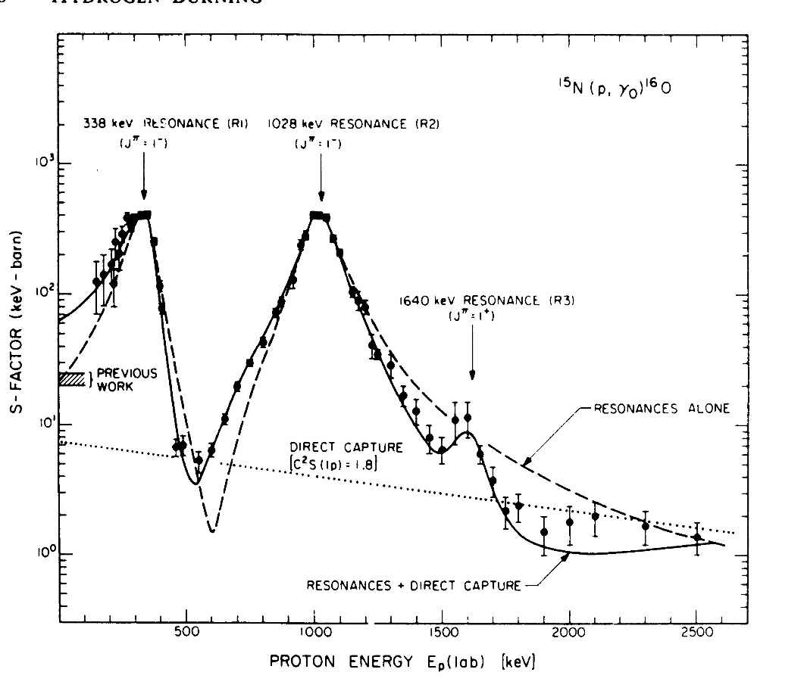
Resonant reactions
2. Broad resonances
Γ ~ E_{R}
Breit-Wigner formula
+
energy dependence of partial Γ_{a}(E), Γ_{b}(E) and total Γ(E) widths
N.B. Overlapping broad resonances of same J^{π} → interference effects

Slide 48
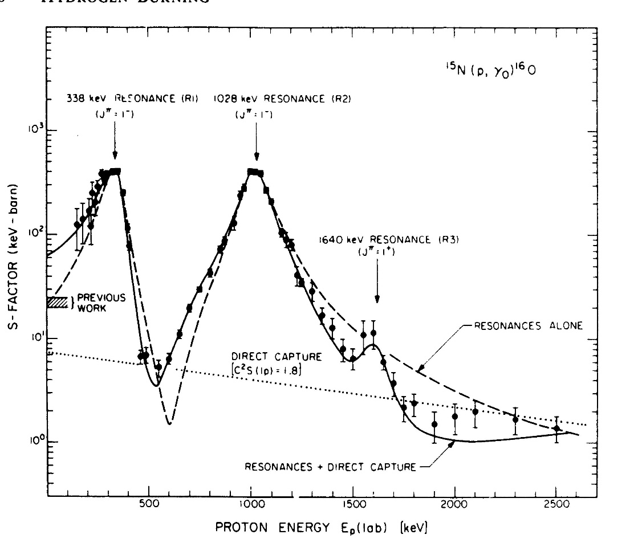
Broad resonance case
Γ ~ E_{R}
broader than the relevant energy
window for the given temperature
resonances outside the energy range
can also contribute through their wings
Breit-Wigner formula
+
energy dependence of partial and total widths
assume:
Γ₂= const, Γ = const and use simplified
same energy dependence
as in direct process
for E << E_{R} very weak
energy dependence
N.B. overlapping broad resonances of same J^{π} → interference effects

Slide 49
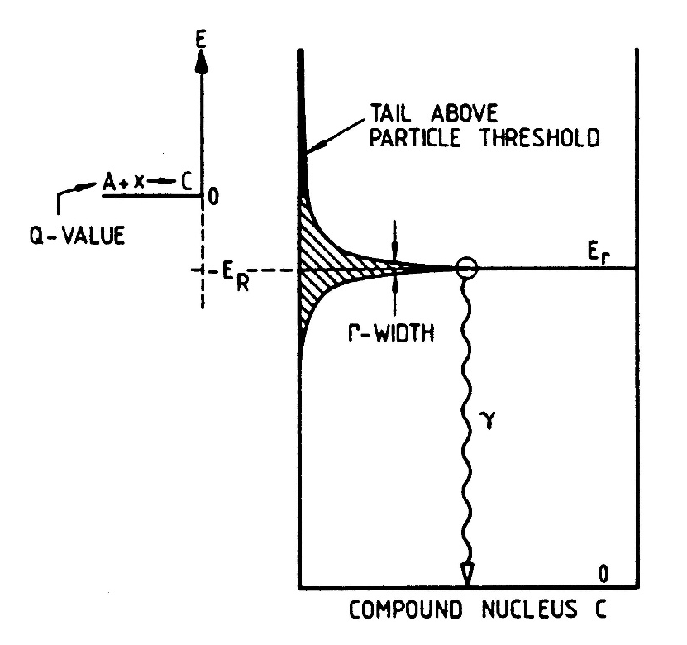
Resonant reactions
3. Sub-threshold resonances
any exited state has a finite width
Γ ~ h/τ
high energy wing can extend
above particle threshold
cross section can be entirely dominated
by contribution of sub-threshold state(s)
Example: ¹²C(α,γ)¹⁶O
TOTAL REACTION RATE
<σv>_{tot} = <σv>_{r} + <σv>_{nr}

Slide 50
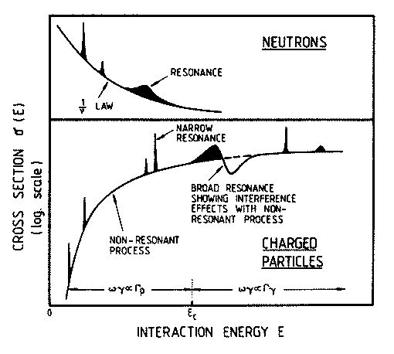
Summary
stellar reaction rate of nuclear reaction determined by the sum of contributions due to
      direct transitions to the various bound states
      all narrow resonances in the relevant energy window
      broad resonances (tails) e.g. from higher lying resonances
      any interference term
total rate
Rolfs & Rodney:
Cauldrons in the Cosmos, 1988
the Gamow window moves to higher energies with increasing temperature
⇒ different resonances play a role at different temperatures

Slide 51
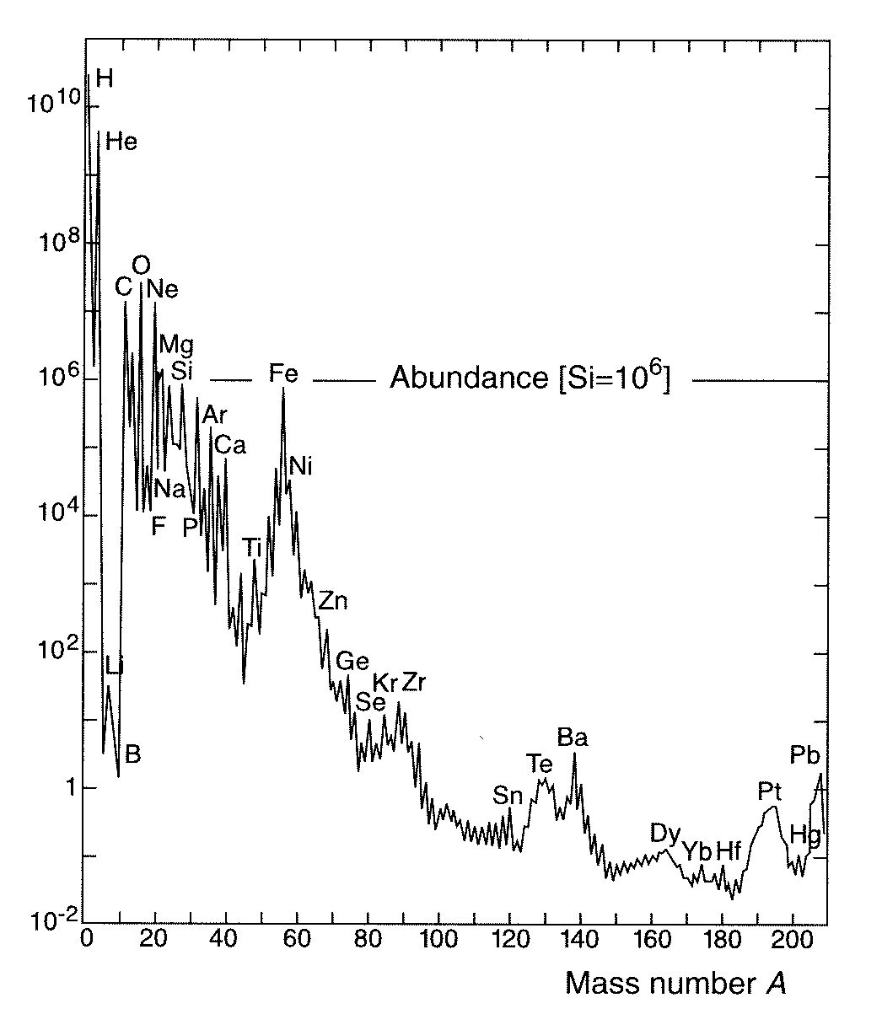
Reactions with neutrons
nucleosynthesis beyond Fe
typically explosive stages

Slide 52
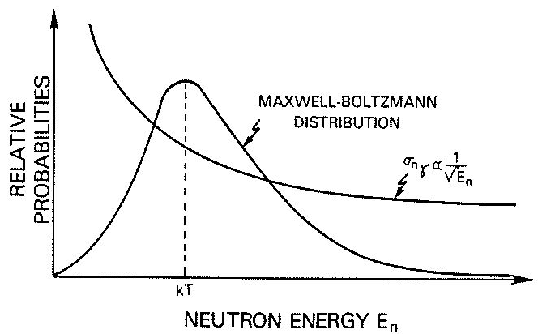

Thermonuclear reactions in stars neutron captures
No Coulomb barrier
neutrons produced in stars are quickly thermalized
E₀ ~ kT = relevant energy (e.g. T ~ 1-6x10⁸ K ⇒ E₀ ~ 30 keV)
accounts for almost flat abundance
distribution beyond iron peak
Typically:
$$σ\sim \frac{1}{v}$$
<σv> ~ const = <σ_{T}v_{T}>
neutron-capture cross sections can be measured DIRECTLY at relevant energies

Slide 53
s-process site(s) and conditions
free neutrons are unstable ⇒ they must be produced in situ
in principle many (α,n) reactions can contribute
in practice, one needs suitable reaction rate & abundant nuclear species
most likely candidates as neutron source are:
²²Ne(α,n)²⁵Mg
²⁵Mg
¹³C(α,n)¹⁶O
(α,n)
¹⁶O
²²Ne
¹³N
(p,γ)
(β⁺)
(α,n)
¹⁸F
(β⁺)
(α,γ)
¹²C
¹³C
(α,γ)
¹⁸O
¹⁴N
astrophysical site:
He-flashes followed by H mixing
into ¹²C enriched zones
low-mass (1.5 - 3 M_{sun}) TP-AGB stars
T₈ ~ 0.9 – 2.7
astrophysical site:
core He burning (and shell C-burning)
in massive stars (e.g. 25 solar masses)
T₈ ~ 2.2 – 3.5
contribution to weak s-process
contribution to main s-process

Slide 54
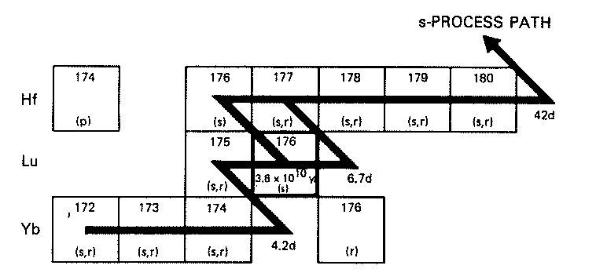
in some cases: τ_{β} ~ τ_{n} ⇒ a branching occurs in nucleosynthesis path
example:
¹⁷⁶Lu^{gs} → ¹⁷⁶Hf τ_{β} ~ 5x10¹⁰ y
¹⁷⁶Lu^{m} → ¹⁷⁶Hf τ_{β} ~ 5.3 h
for N_{n} ~ 10⁸ cm⁻³ ⇒ τ_{n} ~ 1 y
¹⁷⁶Lu^{gs} essentially STABLE
¹⁷⁶Lu^{m} quickly decays into ¹⁷⁶Hf
from abundance determinations:
(note: ¹⁷⁴Hf = p-only nucleus, i.e. not affected by s-process)
⇒ significant amount of s-process branching from ¹⁷⁶Lu^{m} β-decay is required
⇒ need temperatures T₈ > 1 to guarantee that isomeric state is significantly populated
branching points can be used to determine
neutron flux
temperature
density
about 15-20 branchings
relevant to s process
in the star during the s process

Slide 55
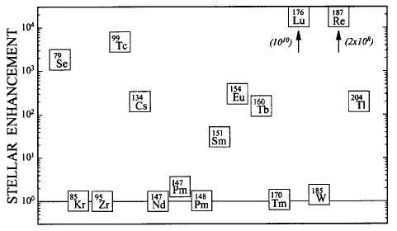
stellar enhancement of decay (stellar decay rate/terrestrial rate)
for some important branching-point nuclei in s-process path @ kT = 30 keV
F. Kaeppeler: Prog. Part. Nucl. Phys. 43 (1999) 419 – 483

Slide 56
Neutron capture
simplest case: s-wave neutrons ⇒ V_{l} = 0 and also V_{C} = 0
discontinuity in potential gives rise to partial reflection of incident wave
incident wave
transmitted wave
reflected wave
V=0
-V₀
attractive nuclear potential
for l = 0 and hence:
transmission probability:
for l ≠ 0 and hence:
consequences:
s-wave neutron capture usually dominates at low energies
(except if hindered by selection rules)
higher l neutron capture only plays role at higher energies
(or if l=0 capture suppressed)

Slide 57
Neutron capture
l dependence of penetrability
through centrifugal barrier
l dependence of neutron capture
cross section
lower l values dominate reaction rate
cross section decreases strongly
with decreasing energy (effect of barrier)
note: arbitrary scale between different l values

Slide 58
Stellar reaction rates for neutron capture
energy range of interest for astrophysics depends on:
temperature and cross section shape
s-wave neutron capture
energy range of interest E ~ kT
stellar reaction rate
σ_{th} = measured cross section for thermal neutrons
most probable velocity,
corresponding to E_{cm} = kT

Slide 59
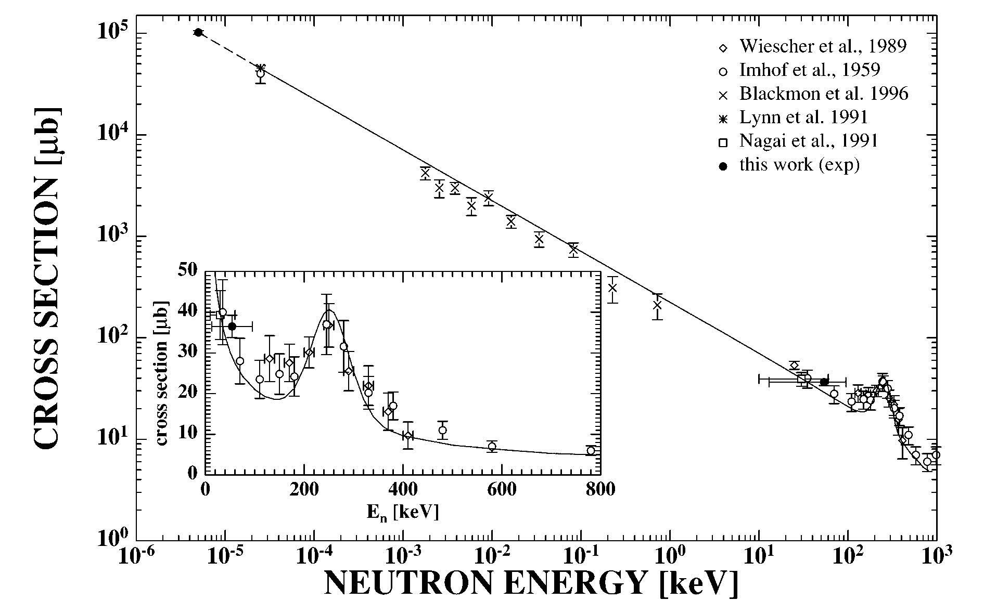
Special case: λ = 0
s-wave neutron capture
thermal
cross section
<σ> = 45.4 mb
example: ⁷Li(n,γ)⁸Li
deviation from 1/v trend due to
resonant contribution (see later)

