Slide 1

Outline: Hydrogen burning
Lecturer: Hans-Jürgen Wollersheim
e-mail: h.j.wollersheim@gsi.de
web-page: https://web-docs.gsi.de/~wolle/ and click on
Sun properties
p-p chains
neutrino emission

Slide 2
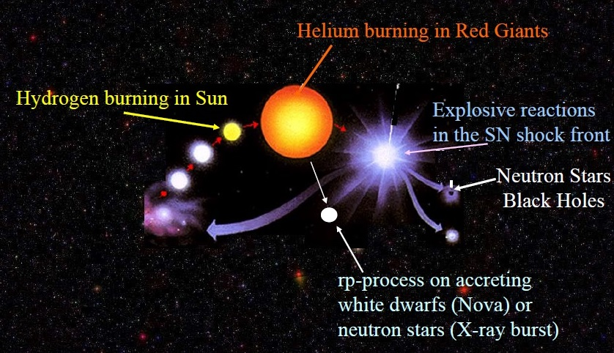

Slide 3
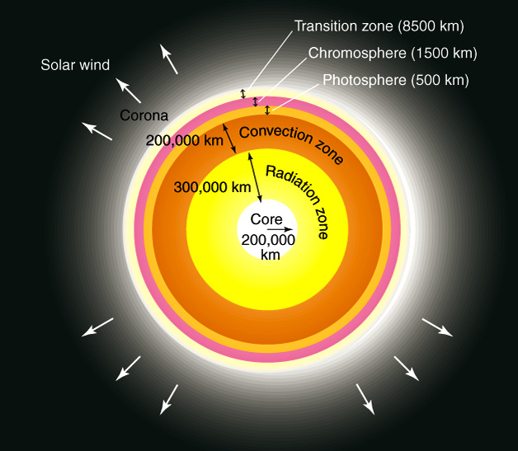
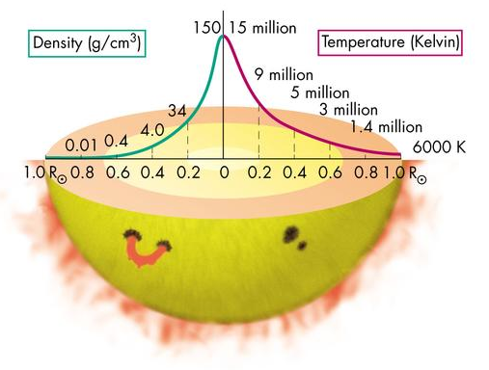
Properties of the Sun
Hydrogen | 73.46%
Helium | 24.85%
Oxygen | 0.77%
Carbon | 0.29%
Iron | 0.16%
Neon | 0.12%
Nitrogen | 0.09%
Radius: 7·10⁸ m
Mass: 2·10³⁹ kg
Density: 1.4 g/cm³
Luminosity: ~ 4·10²⁶ W

Slide 4
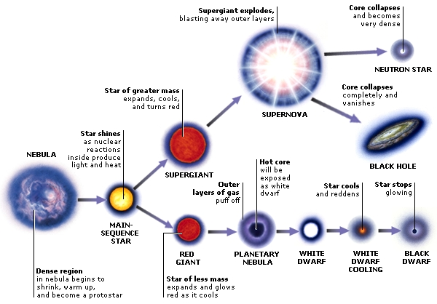

Slide 5
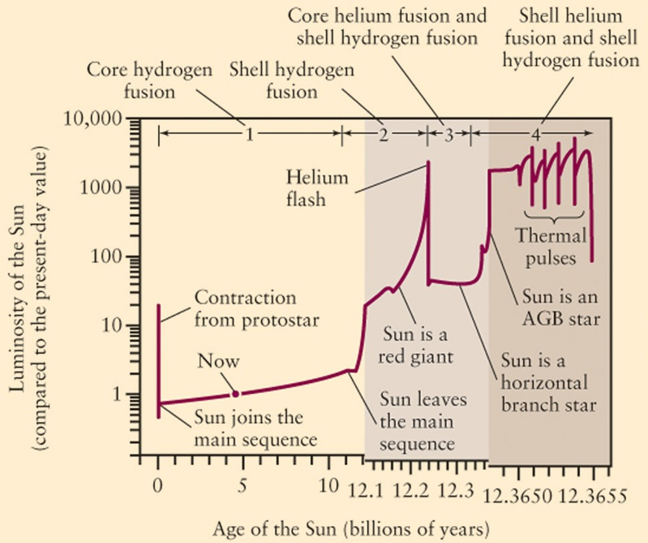

Slide 6
Why does the star expand and become a red giant?
Because of higher Coulomb barrier He burning requires much higher temperatures
drastic change in central temperature
star has to readjust to a new configuration
Qualitative argument:
  need about the same Luminosity – similar temperature gradient dT/dr
  now much higher T_{c} – need larger star for same dT/dr
Lower mass stars become red giants during shell H-burning
If the sun becomes a red giant in about 5 Bio years, it will almost fill the orbit of Mars

Slide 7
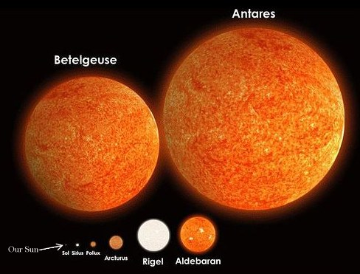
Red Giants

Slide 8
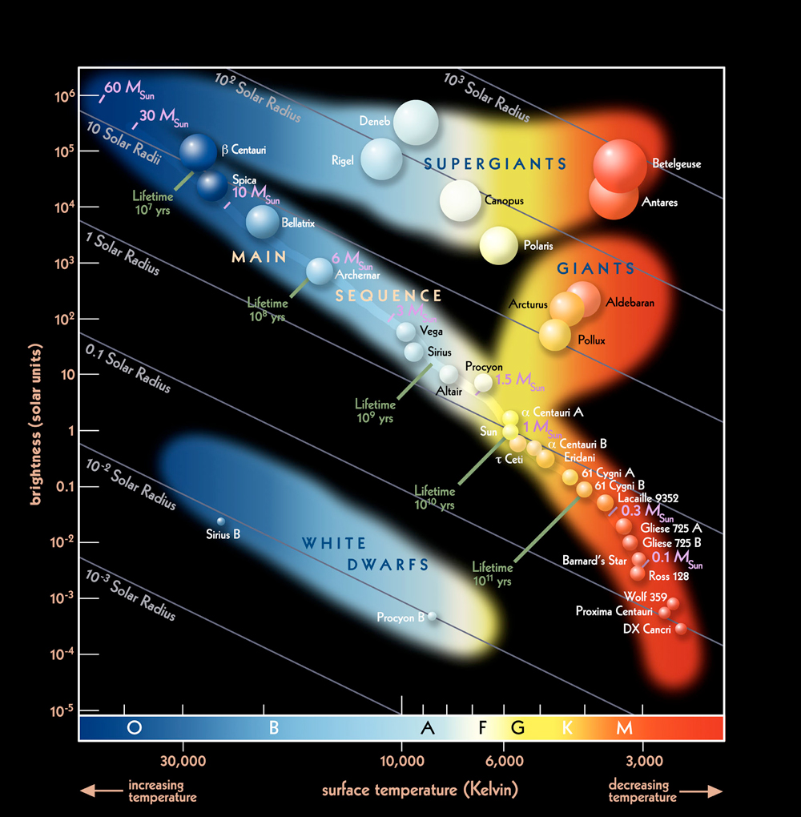
Hertzsprung Russell Diagram
Main Sequence Stars are identified as stars in their hydrogen burning stage. As more massive the star is as larger its size, its energy production (temperature) and its luminosity
Sun

Slide 9
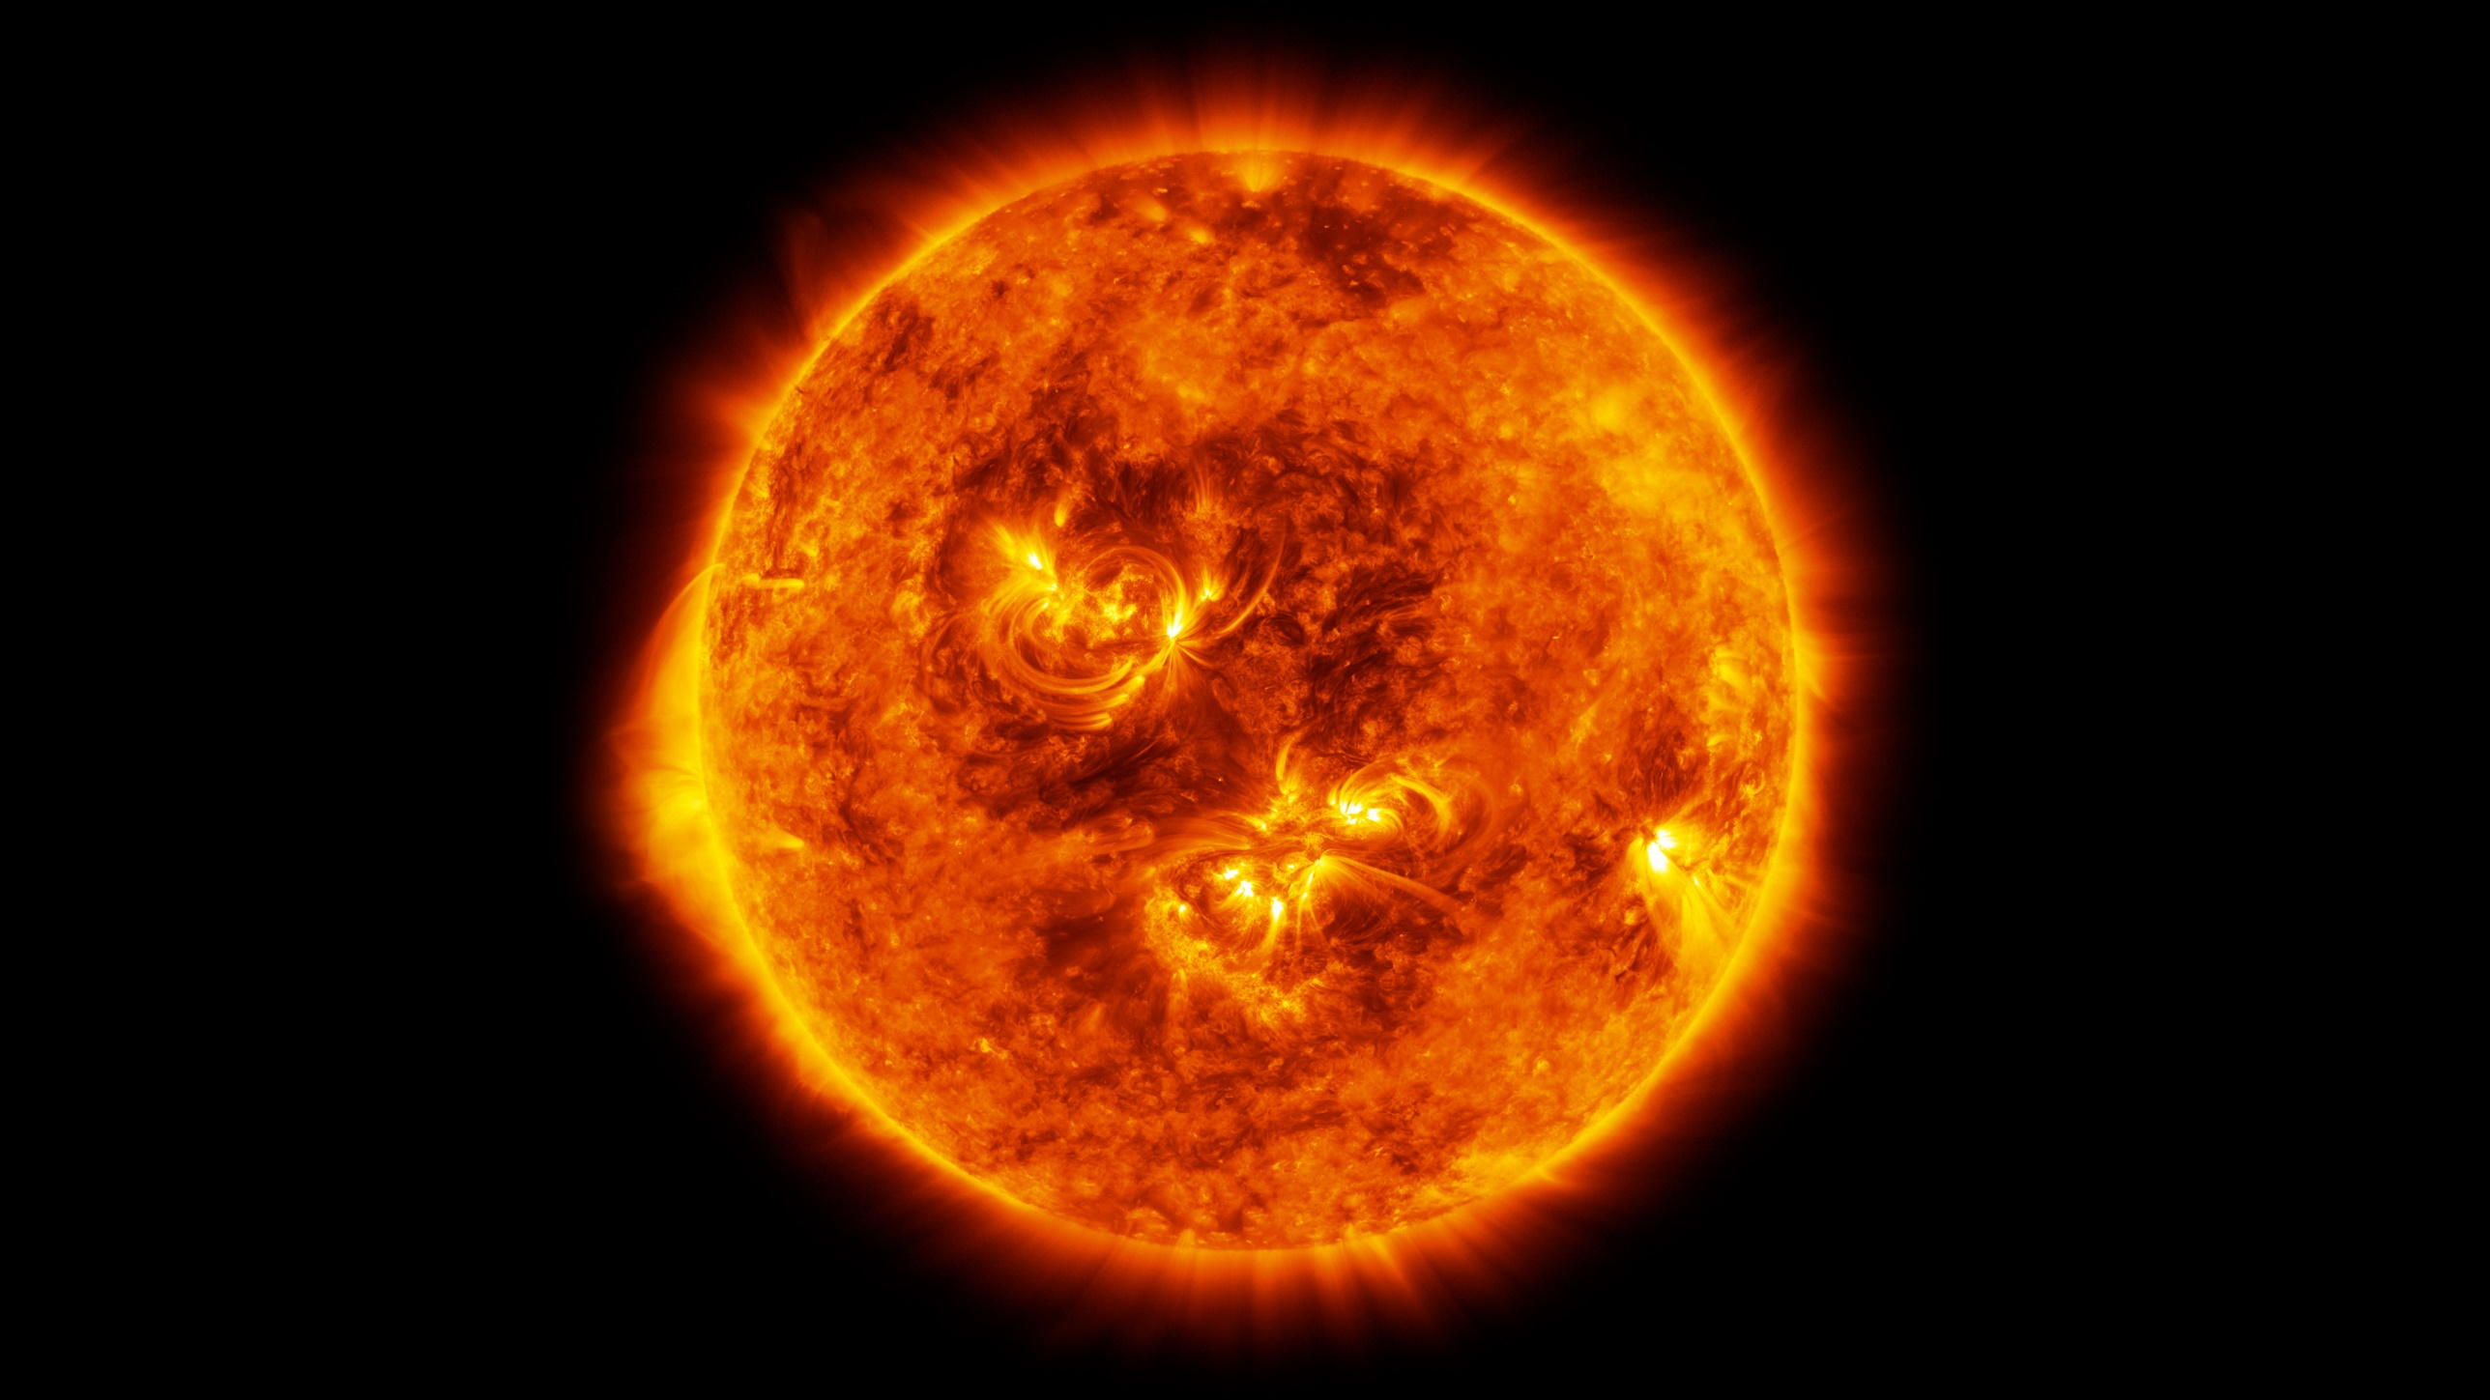
Hydrogen burning in stars
Hydrogen in induced reaction have lowest Coulomb barrier highest reaction rate
Hydrogen burning provides energy production in “Main Sequence Stars” in the HR diagram (sun) until hydrogen fuel is depleted → the life time of main sequence star depends on the reaction rates
The stellar evolution, of subsequent evolutionary stages depend on the subsequent nucleosynthesis mechanism or their nuclear fuel processing!

Slide 10
The p-p chains
As a star forms density and temperature (heat source?) increase in its center
Fusion of hydrogen (¹H) is the first long term nuclear energy source that can ignite.
Why?
With only hydrogen available (for example in a first generation star right after it´s formation) the p-p chain is the only possible sequence of reactions.
(all other reaction sequences require the presence of catalyst nuclei)
3- or 4-body reactions are too unlikely – chain has to proceed by steps of 2-body reactions or decays.
Final product is ⁴He

Slide 11





pp-chains
pp-chains: ¹H → ⁴He
step 1:
available: ¹H, some ⁴He
no atoms exist in nature with an A = 5 or 8
$$p+p→d+e^{+}+ν_{e}$$
⁴He$+4He$
$$p+4He$$
$$p+p$$
$$p+p→d+e^{+}+ν_{e}$$

Slide 12




pp-chains
pp-chains: ¹H → ⁴He
step 1:
available: ¹H, some ⁴He
$$p+p→d+e^{+}+ν_{e}$$
step 2:
available: ¹H, some d, ⁴He
d$+ p→3He$
d$+4He ?$
d$+p ?$
$$d+d ?$$

Slide 13






pp-chains
pp-chains: ¹H → ⁴He
step 1:
available: ¹H, some ⁴He
$$p+p→d+e^{+}+ν_{e}$$
step 2:
available: ¹H, some d, ⁴He
³He$+3He$
³He$+4He$
d$+ p→3He$
step 3:
available: ¹H, some ³He, ⁴He
little d (rapid destruction)
³He$+p$
³He$+d$
$$86\% 3He+3He→2p+4He$$
$$14\% 3He+4He→7Be$$

Slide 14


pp-chains
pp-chains: ¹H → ⁴He
step 1:
available: ¹H, some ⁴He
$$p+p→d+e^{+}+ν_{e}$$
0.02%
step 2:
available: ¹H, some d, ⁴He
d$+ p→3He$
14%
step 3:
available: ¹H, some ³He, ⁴He
little d (rapid destruction)
14%
$$86\% 3He+3He→2p+4He$$
$$14\% 3He+4He→7Be$$
86%
step 4:
$$14\% 7Be+e^{−}→7Li+ν_{e}$$
$$0.02\% 7Be+p→8B$$

Slide 15



pp-chains
pp-chains: ¹H → ⁴He
step 1:
available: ¹H, some ⁴He
$$p+p→d+e^{+}+ν_{e}$$
0.02%
step 2:
available: ¹H, some d, ⁴He
d$+ p→3He$
14%
step 3:
available: ¹H, some ³He, ⁴He
little d (rapid destruction)
14%
$$86\% 3He+3He→2p+4He$$
$$14\% 3He+4He→7Be$$
86%
step 4:
$$14\% 7Be+e^{−}→7Li+ν_{e}$$
$$0.02\% 7Be+p→8B$$
step 5:
$$7Li+p→8Be$$
$$2∗4He$$
$$8B→e^{+}+ν_{e}+8Be$$

Slide 16
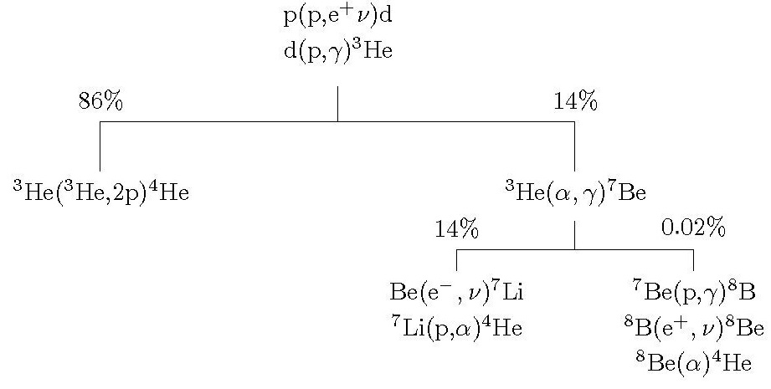
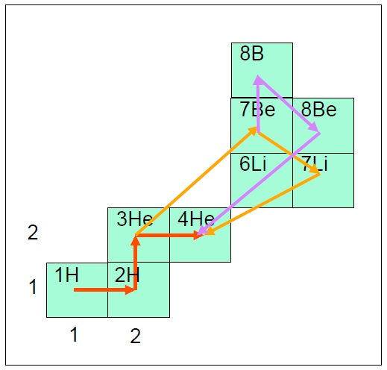
Summary pp-chain
pp-I
Q_{eff} = 26,20 MeV
pp-II
pp-III
pp-I
pp-II
pp-III
Why do additional pp-chains matter?
p+p dominates timescale BUT
pp-I produces 50% ⁴He per p+p reaction
pp-II or III produces 1 ⁴He per p+p reaction
→ increase burning rate

Slide 17
Summary pp-chain
p + p → d + e⁺ + ν
p + d → ³He + γ
86%
14%
pp-I
Q_{eff}= 26.20 MeV
³He + ³He → ⁴He + 2p
³He + ⁴He → ⁷Be + γ
pp-II
Q_{eff}= 25.66 MeV
99.7%
0.3%
pp-III
Q_{eff}= 19.17 MeV
⁷Be + e⁻ → ⁷Li + ν
⁷Be + p → ⁸B + γ
pp-I
⁷Li + p → 2 ⁴He
⁸B → ⁸Be + e⁺ + ν
pp-II
pp-III
2 ⁴He
net result: 4p → ⁴He + 2e⁺ + 2ν_{e} + Q_{eff}
Why do additional pp-chains matter?
p+p dominates timescale BUT
pp-I produces 50% ⁴He per p+p reaction
pp-II or III produces 1 ⁴He per p+p reaction
→ increase burning rate

Slide 18
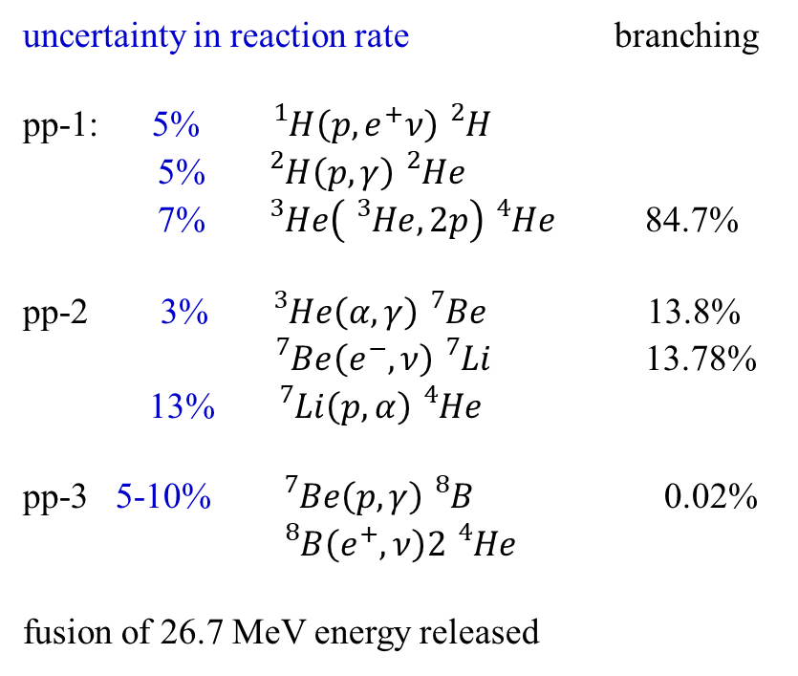
Solar fusion: the pp-chain
uncertainty in reaction rate branching
pp-1: 5% ${}_{}^{1}H\left(p,e^{+}ν\right){}_{}^{2}H$
5% ${}_{}^{2}H\left(p,γ\right){}_{}^{2}{He}$
7% ${}_{}^{3}{He}\left({}_{}^{3}{He},2p\right){}_{}^{4}{He}$ 84.7%
pp-2 3% ${}_{}^{3}{He}\left(α,γ\right){}_{}^{7}{Be}$ 13.8%
${}_{}^{7}{Be}\left(e^{−},ν\right){}_{}^{7}{Li}$ 13.78%
13% ${}_{}^{7}{Li}\left(p,α\right){}_{}^{4}{He}$
pp-3 5-10% ${}_{}^{7}{Be}\left(p,γ\right){}_{}^{8}B$ 0.02%
${}_{}^{8}B\left(e^{+},ν\right)2{}_{}^{4}{He}$
fusion of 26.7 MeV energy released
only ν most experiments measure

Slide 19
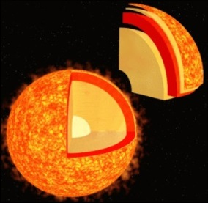
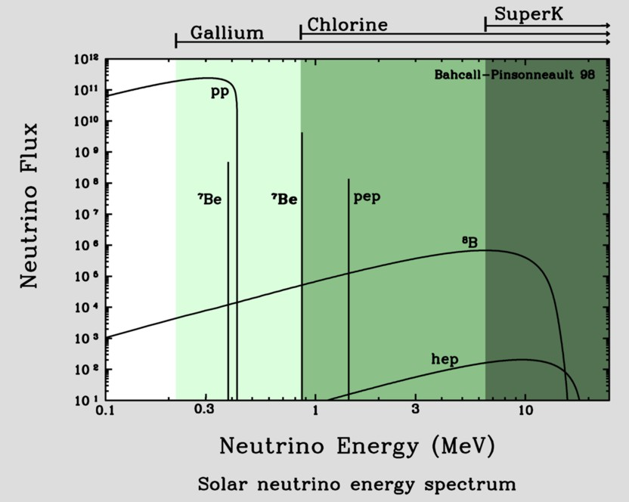
Neutrinos from the sun
Known: total emitted energy
Known: energy per fusion process
number of created neutrinos per sec!
on earth: 66 billions ν per (cm² · s¹)
proton-proton-cycle
pp-neutrino
pep-neutrino
p+p => ²H+e⁺+ν_{e} (99%)
p+e⁻+p => ²H+ν_{e} (1%)
2H+p => ³He+γ
hep-neutrino
³He+³He => ⁴He+2p (86%)
³He+p => ⁴He+ν_{e}+e⁺ (<<1%)
³He+⁴He => ⁷Be+γ (14%)
⁷Be-neutrino
⁸B-neutrino
⁷Be + e⁻ =>⁷Li + ν_{e}
⁷Li + p => 2 ⁴He (99%)
⁷Be + p => ⁸B + γ
⁸B => ⁸Be + e⁺+ ν_{e}
⁸Be => 2 ⁴He (1%)

Slide 20



Neutrino emission
$$\left\langle E\right\rangle =0.27 MeV$$
$$E=0,39, 0.86 MeV$$
$$\left\langle E\right\rangle =6.74 MeV$$
pp-I loss: ~2%
pp-II loss: 4%
pp-III loss: 28%
note: <E>/Q = 0,27/26.73 = 1%
total loss: 2.3%

Slide 21



Neutrino emission
2 neutrino energies from ⁷Be electron capture?
$$7Be+e^{−}→7Li+ν_{e}$$
$$E_{ν}$$
$$E_{ν}$$

Slide 22
Solar Neutrino Production
Neutrinos as signature for probing the solar core

