Slide 1

Outline:
Lecturer: Hans-Jürgen Wollersheim
e-mail: h.j.wollersheim@gsi.de
web-page: https://web-docs.gsi.de/~wolle/ and click on
hydrostatic equilibrium
ideal gas assumption
virial theorem
timescales

Slide 2
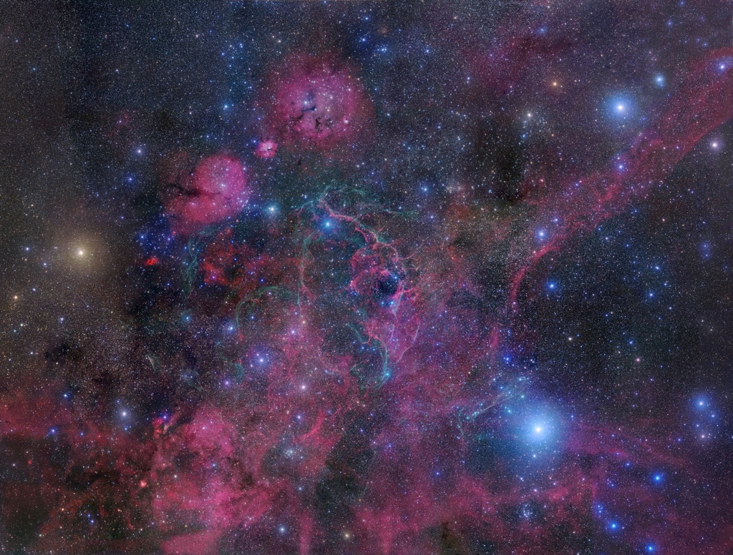
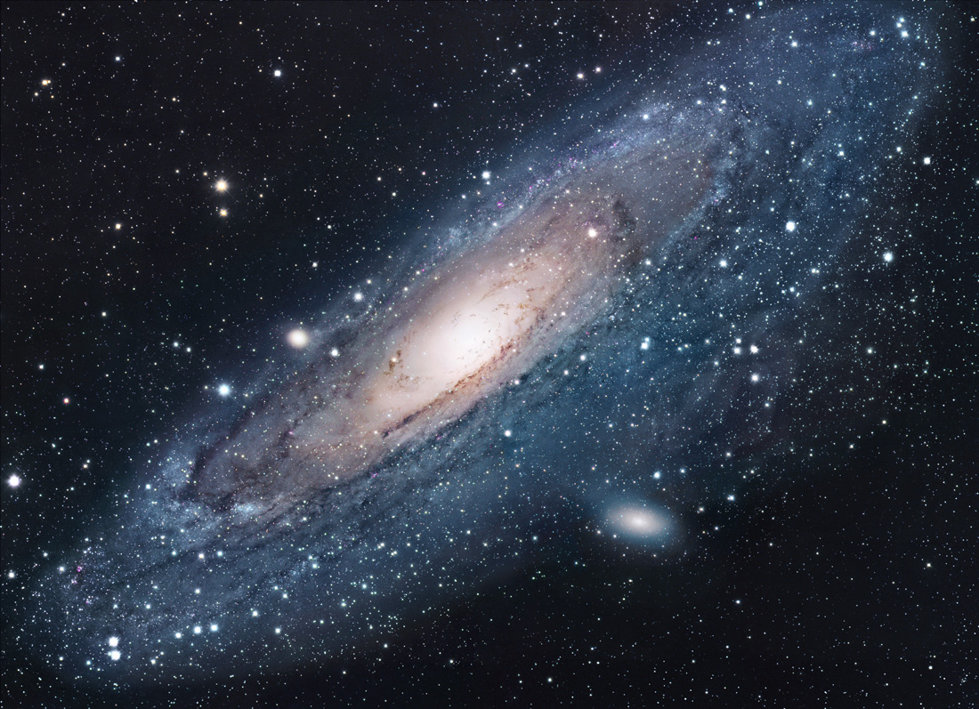
Outline:
Stars are the building blocks of our Universe

Slide 3
Hydrostatic Equilibrium: Stars as self-regulating system
Energy is generated in the star’s hot core, then carried outward to the cooler surface.
Inside a star, the inward force of gravity is balanced by the outward force of pressure.
The star is stabilized (i.e. nuclear reactions are kept under control) by a pressure-temperature thermostat.

Slide 4
Hydrostatic Equilibrium: Stars as self-regulating system
Self-Regulation in Stars
Suppose the fusion rate increases slightly. Then,
(1) Temperature increases.
(2) Pressure increases.
(3) Core expands.
(4) Density and temperature decrease.
(5) Fusion rate decreases.
So there's a feedback mechanism which prevents the
fusion rate from skyrocketing upward. We can reverse this argument as well …
Now suppose that there was no source of energy in stars
(e.g., no nuclear reactions)
Core Collapse in a Self-Gravitating System
Suppose that there was no energy generation in the core. The pressure would still be high, so the core would be hotter than the envelope.
Energy would escape (via radiation, convection…) and so the core would shrink a bit under the gravity
That would make it even hotter, and then even more energy would escape; and so on, in a feedback loop
Core collapse! Unless an energy source is
present to compensate for the escaping
energy.
In stars, nuclear reactions play this role. In star clusters, hard binaries do.

Slide 5
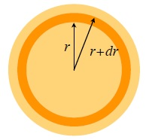



Conservation of mass
If m is the mass interior to radius r, then m, r and ρ are not independent, because m(r) is determined by ρ(r).
Consider a thin shell inside the star, radius r and thickness dr
Volume is $dV=4πr^{2}dr$, so mass of shell is
$$dm=4πr^{2}dr∙ρ\left(r\right)$$
or
$$\frac{dm}{dr}=4πr^{2}∙ρ\left(r\right)$$
the equation of mass conservation

Slide 6
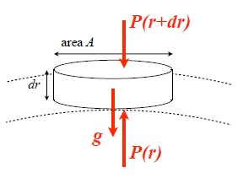





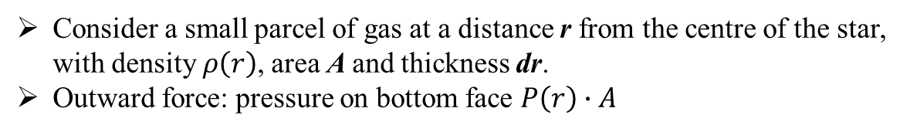

Hydrostatic equilibrium
Consider a small parcel of gas at a distance r from the centre of the star, with density $ρ\left(r\right)$, area A and thickness dr.
Outward force: pressure on bottom face $P\left(r\right)∙A$
Inward force: pressure on top face, plus gravity due to material interior to r:
$$P\left(r\right)∙A=P\left(r+dr\right)∙A+\frac{G∙m\left(r\right)∙dm}{r^{2}}$$
$$=P\left(r+dr\right)∙A+\frac{G∙m\left(r\right)∙ρ∙A∙dr}{r^{2}}$$
$$\frac{P\left(r+dr\right)−P\left(r\right)}{dr}∙A∙dr=−\frac{G∙m\left(r\right)}{r^{2}}∙ρ\left(r\right)∙A∙dr$$
$$\frac{dP}{dr}=−\frac{G∙m}{r^{2}}∙ρ$$
the equation of $hydrostatic equilibrium$
alternate form:
$$\frac{dP}{dm}=\frac{dP}{dr}∙\frac{dr}{dm}=−\frac{G∙m}{r^{2}}∙ρ∙\frac{1}{4π∙r^{2}ρ}=−\frac{G∙m}{4πr^{4}}$$

Slide 7


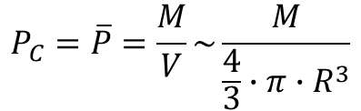
Estimate for central pressure
We can use hydrostatic equilibrium to estimate P_{C}: we approximate the pressure gradient as a constant
$$\frac{dP}{dr}\sim −\frac{∆P}{∆R}=\frac{P_{c}}{R}=\frac{G∙M}{R^{2}}∙ρ$$
Now assume the star has constant density, so
$$P_{C}=\overline{P}=\frac{M}{V}\sim \frac{M}{\frac{4}{3}∙π∙R^{3}}$$
then so
$$P_{C}\sim \frac{3∙G∙M^{2}}{4∙π∙R^{4}}$$
For the Sun, we estimate $P_{C}\sim 3∙{10}^{14} Nm^{−2}=3∙{10}^{9} atm$
(R = 7·10⁸ m, M = 2·10³⁰ kg, G = 6,67·10⁻¹¹ N m² kg⁻²)

Slide 8
Equation of state in stars
Interior of a star contains a mixture of ions, electrons, and radiation (photons). For most stars (exception very low mass stars and stellar remnants) the ions and electrons can be treated as an ideal gas and quantum effects can be neglected.
Total pressure:
P = P_{I} + P_{e} + P_{r}
= P_{gas} + P_{r}
• P_{I} is the pressure of the ions
• P_{e} is the electron pressure
• P_{r} is the radiation pressure

Slide 9
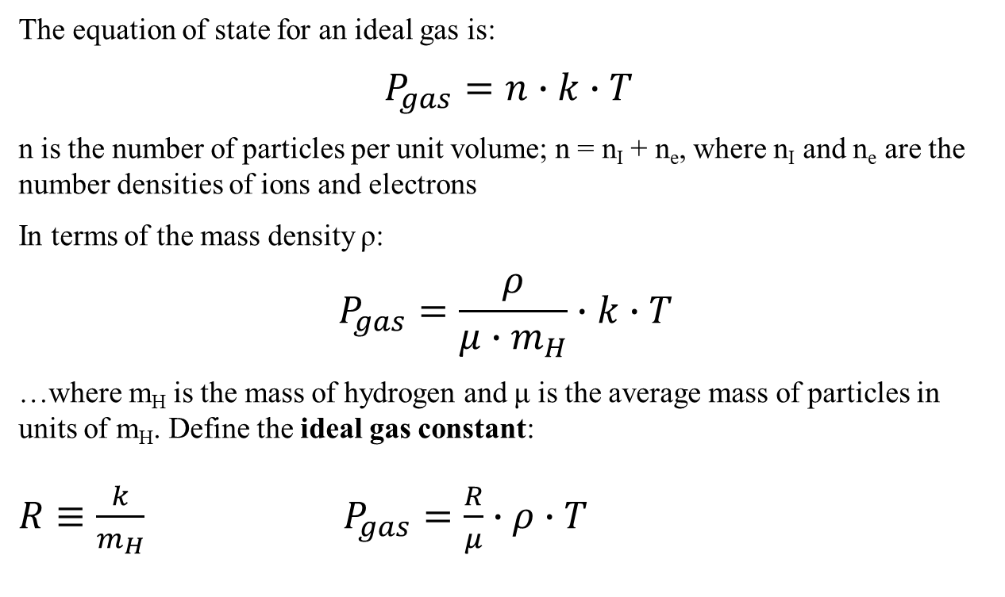
Gas pressure
The equation of state for an ideal gas is:
$P_{gas}=n∙k∙T$
n is the number of particles per unit volume; n = n_{I} + n_{e}, where n_{I} and n_{e} are the number densities of ions and electrons
In terms of the mass density ρ:
$$P_{gas}=\frac{ρ}{μ∙m_{H}}∙k∙T$$
…where m_{H} is the mass of hydrogen and μ is the average mass of particles in units of m_{H}. Define the ideal gas constant:
$R≡\frac{k}{m_{H}}$ $P_{gas}=\frac{R}{μ}∙ρ∙T$

Slide 10
Determining mean molecular weight μ
μ will depend upon the composition of the gas and the state of ionization. For example:
• Neutral hydrogen: μ = 1
• Fully ionized hydrogen: μ = 0.5
In the central regions of stars, OK to assume that all the elements are fully ionized.
Denote abundances of different elements per unit mass by:
• X hydrogen - mass m_{H}, one electron
• Y helium - mass 4m_{H}, two electrons
• Z the rest, `metals’, average mass A·m_{H}, approximately
(A / 2) electrons per nucleus

Slide 11
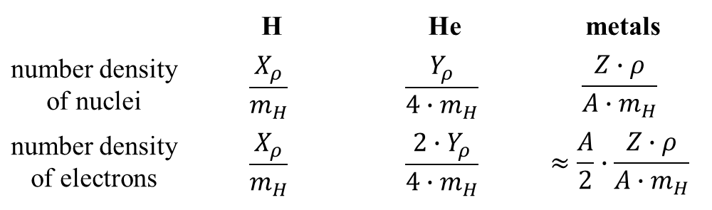
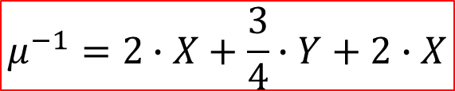

Determining mean molecular weight μ
If the density of the plasma is ρ, then add up number densities of hydrogen, helium, and metal nuclei, plus electrons from each species:
 | H | He | metals
number density of nuclei | $$\frac{X_{ρ}}{m_{H}}$$ | $$\frac{Y_{ρ}}{{4∙m}_{H}}$$ | $$\frac{Z∙ρ}{A∙m_{H}}$$
number density of electrons | $$\frac{X_{ρ}}{m_{H}}$$ | $$\frac{2∙Y_{ρ}}{{4∙m}_{H}}$$ | $$≈\frac{A}{2}∙\frac{Z∙ρ}{A∙m_{H}}$$
$$n=\frac{ρ}{m_{H}}\left[2∙X+\frac{3}{4}∙Y+\frac{1}{2}Z\right]=\frac{ρ}{μ∙m_{H}}$$
… assuming that A >> 1
$$μ^{−1}=2∙X+\frac{3}{4}∙Y+2∙X$$

Slide 12

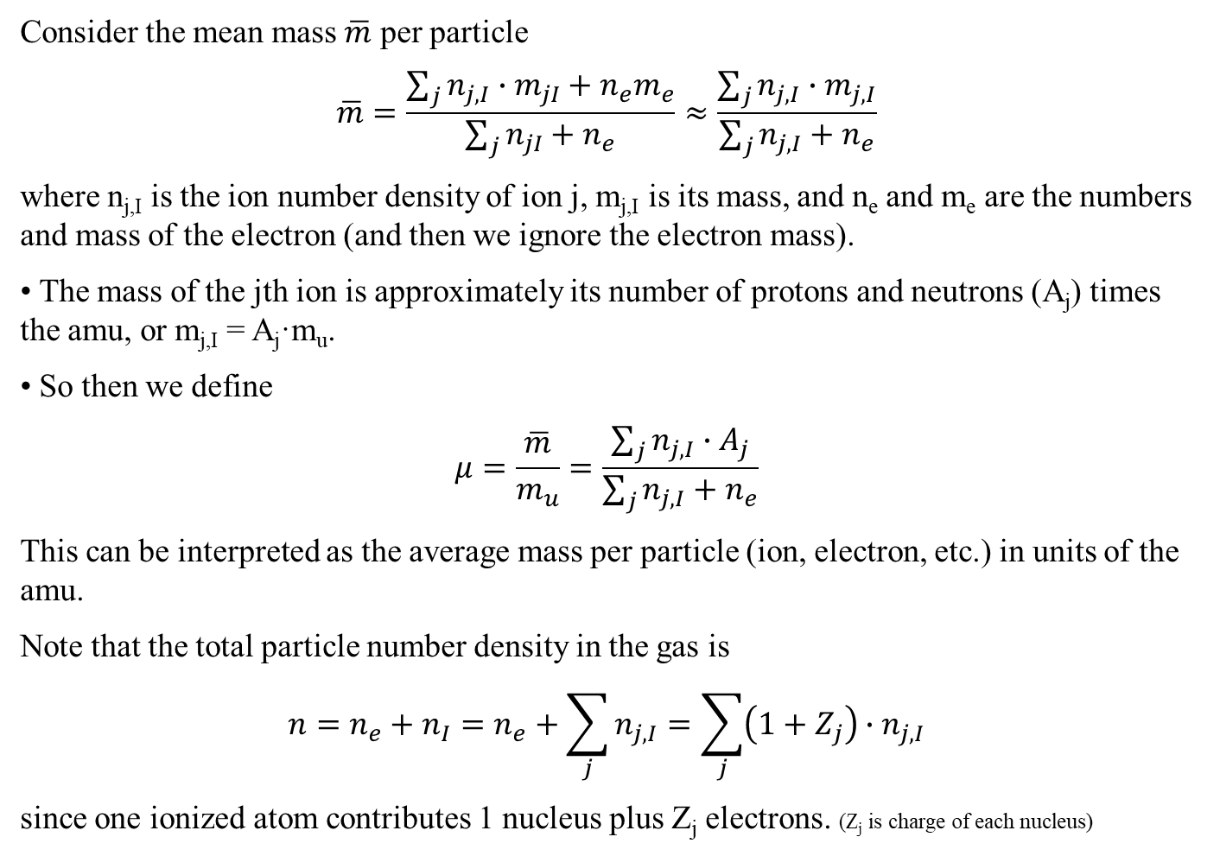
Mean molecular weight μ
Consider the mean mass $\overline{m}$ per particle
$$\overline{m}=\frac{\sum_{j}{n_{j,I}∙m_{jI}+n_{e}m_{e}}}{\sum_{j}{n_{jI}+n_{e}}}≈\frac{\sum_{j}{n_{j,I}∙m_{j,I}}}{\sum_{j}{n_{j,I}+n_{e}}}$$
where n_{j,I} is the ion number density of ion j, m_{j,I} is its mass, and n_{e} and m_{e} are the numbers and mass of the electron (and then we ignore the electron mass).
• The mass of the jth ion is approximately its number of protons and neutrons (A_{j}) times the amu, or m_{j,I} = A_{j}·m_{u}.
• So then we define
$$μ=\frac{\overline{m}}{m_{u}}=\frac{\sum_{j}{n_{j,I}∙A_{j}}}{\sum_{j}{n_{j,I}+n_{e}}}$$
This can be interpreted as the average mass per particle (ion, electron, etc.) in units of the amu.
Note that the total particle number density in the gas is
$$n=n_{e}+n_{I}=n_{e}+\sum_{j}{n_{j,I}}=\sum_{j}{\left(1+Z_{j}\right)∙n_{j,I}}$$
since one ionized atom contributes 1 nucleus plus Z_{j} electrons. (Z_{j} is charge of each nucleus)

Slide 13
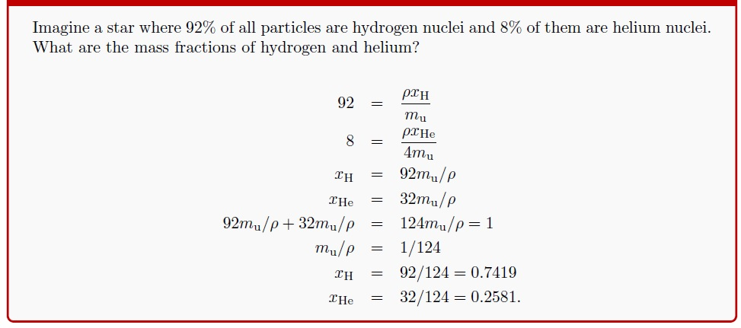
Mean molecular weight μ

Slide 14
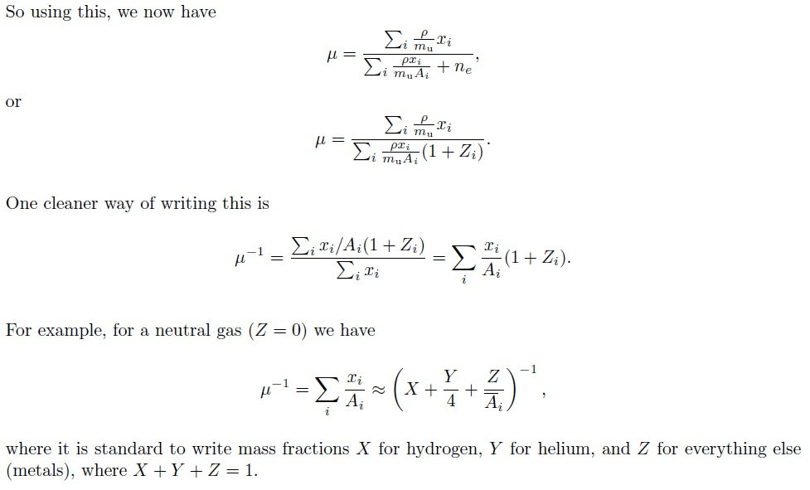
Mean molecular weight μ

Slide 15
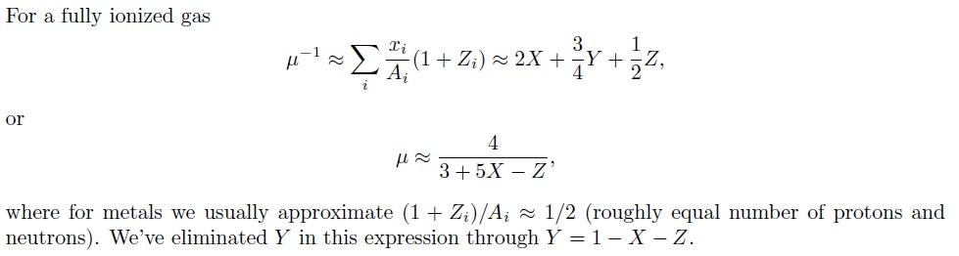
Mean molecular weight μ

Slide 16
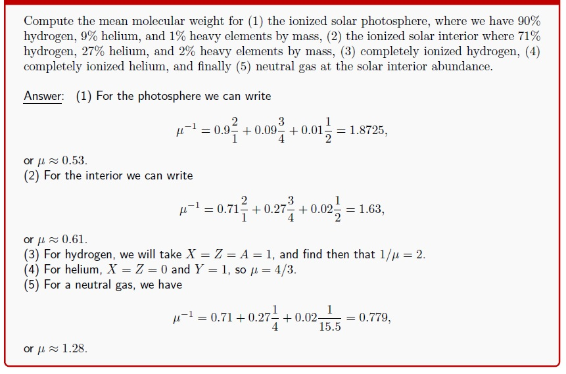
Mean molecular weight μ

Slide 17
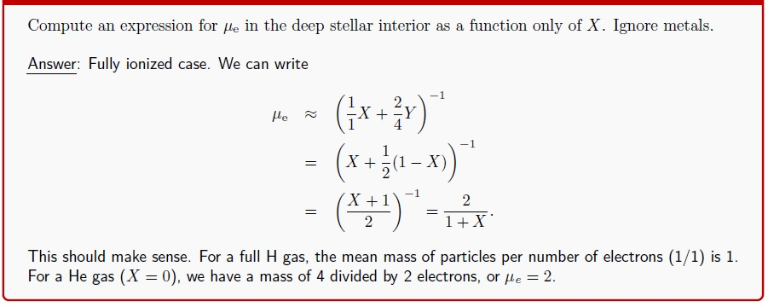
Mean molecular weight μ

Slide 18
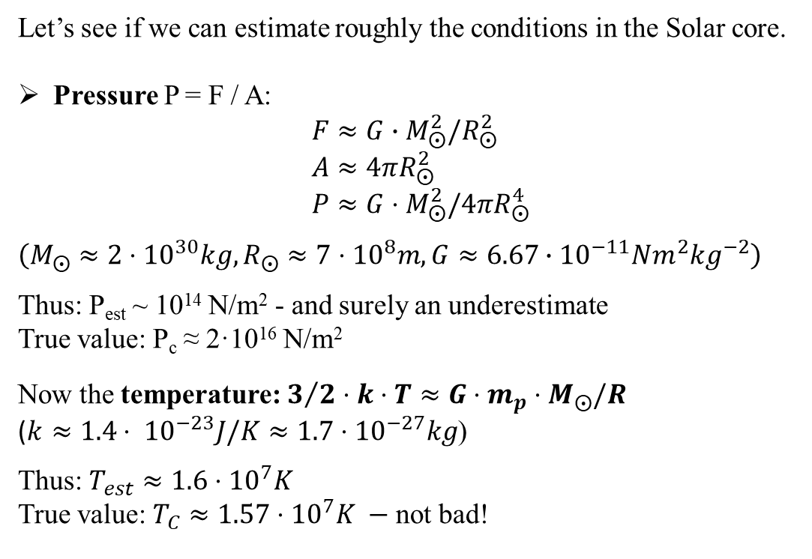
Some Order-of-Magnitude
Let’s see if we can estimate roughly the conditions in the Solar core.
Pressure P = F / A:
$$F≈G∙M_{⨀}^{2}/R_{⨀}^{2}$$
$$A≈4πR_{⨀}^{2}$$
$$P≈G⋅M_{⨀}^{2}/4πR_{⨀}^{4}$$
$$\left(M_{⨀}≈2⋅{10}^{30}kg, R_{⨀}≈7⋅{10}^{8}m, G≈6.67∙{10}^{−11}Nm^{2}{kg}^{−2}\right)$$
Thus: P_{est} ~ 10¹⁴ N/m² - and surely an underestimate
True value: P_{c} ≈ 2·10¹⁶ N/m²
Now the temperature: $3/2⋅k⋅T≈G⋅m_{p}⋅M_{⨀}/R$
($k≈1.4⋅ {10}^{−23}J/K≈1.7⋅{10}^{−27}kg$)
Thus: $T_{est}≈1.6⋅{10}^{7}K$
True value: $T_{C}≈1.57⋅{10}^{7}K −$not bad!
(R = 7·10⁸ m, M = 2·10³⁰ kg, m_{H} = 1.67·10⁻²⁷ kg, G = 6,67·10⁻¹¹ Nm²kg⁻²)

Slide 21
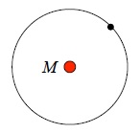
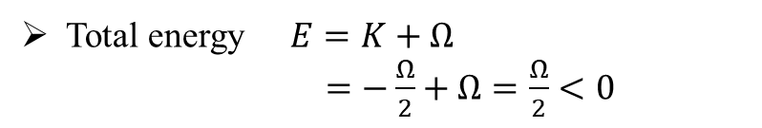
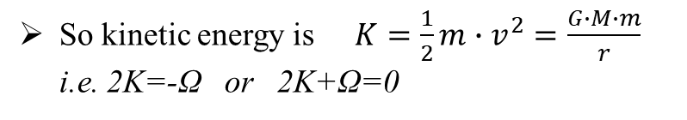

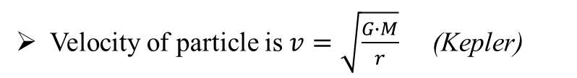
Interlude: The virial theorem
Gravity has a very important property which relates the gravitational energy of a star to its thermal energy.
Consider a particle in a circular orbit of radius r around a mass M
Potential energy of particle is
$$Ω=−\frac{G∙M∙m}{r}$$
Velocity of particle is $v=\sqrt{\frac{G∙M}{r}}$ (Kepler)
So kinetic energy is $K=\frac{1}{2}m∙v^{2}=\frac{G∙M∙m}{r}$
i.e. 2K=-Ω or 2K+Ω=0
Total energy $E=K+Ω$
$=−\frac{Ω}{2}+Ω=\frac{Ω}{2}<0$
Consequence: when something loses energy in gravity it speeds up!

Slide 22
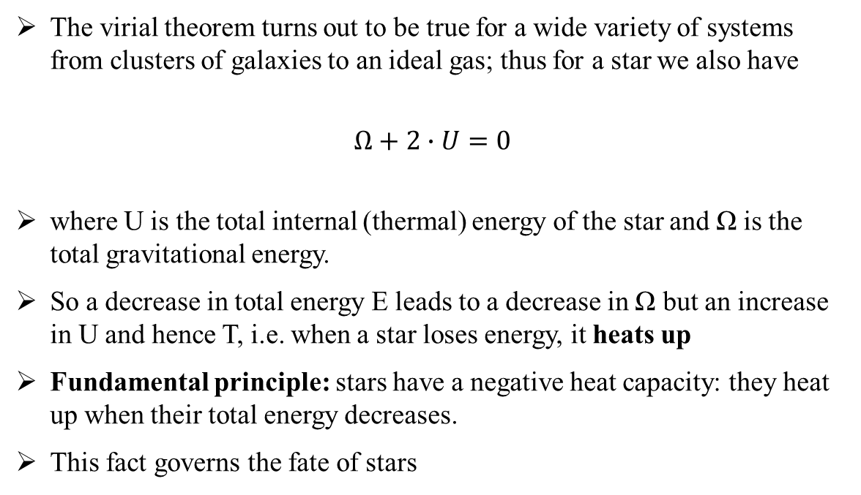
The virial theorem
The virial theorem turns out to be true for a wide variety of systems from clusters of galaxies to an ideal gas; thus for a star we also have
$$Ω+2∙U=0$$
where U is the total internal (thermal) energy of the star and Ω is the total gravitational energy.
So a decrease in total energy E leads to a decrease in Ω but an increase in U and hence T, i.e. when a star loses energy, it heats up
Fundamental principle: stars have a negative heat capacity: they heat up when their total energy decreases.
This fact governs the fate of stars

Slide 23
Timescales
There are three important timescales in the life of stars:
dynamical timescale – the time scale on which a star would expand or contract if the balance between pressure gradients and gravity was suddenly disrupted
thermal timescale – how long a star would take to radiate away its thermal energy if reactions stopped
nuclear timescale – how long a star would take to exhaust its nuclear fuel at current rate

Slide 24

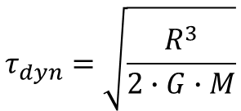
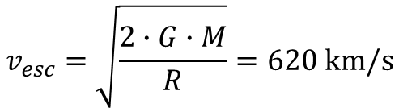
Timescales
Dynamical timescale:
the timescale on which a star would expand or contract if it were not in
equilibrium, also called the free-fall timescale
$$τ_{dyn}≡\frac{characteristic radius}{characteristic velocity}=\frac{R}{v_{esc}}$$
Escape velocity from the surface of the star:
$$v_{esc}=\sqrt{\frac{2∙G∙M}{R}}=620 km/s$$
$$τ_{dyn}=\sqrt{\frac{R^{3}}{2∙G∙M}}$$
For the Sun (R = 7·10⁸ m, M = 2·10³⁰ kg, G = 6,67·10⁻¹¹ m³s⁻²), $τ_{dyn}≅1100 s$

Slide 25
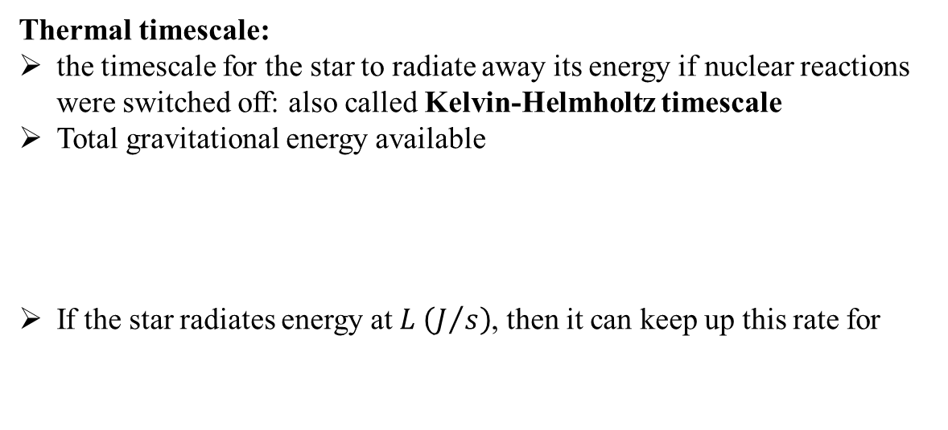



Timescales
Thermal timescale:
the timescale for the star to radiate away its energy if nuclear reactions were switched off: also called Kelvin-Helmholtz timescale
Total gravitational energy available
If the star radiates energy at $L \left(J/s\right)$, then it can keep up this rate for
$$E_{grav}\sim \frac{G∙M^{2}}{R}$$
$$τ_{th}\sim \frac{E_{grav}}{L}\sim \frac{G∙M^{2}}{R∙L}$$
For the Sun, $τ_{th}≅3∙{10}^{7} y ≪age of Earth$

Slide 26


Timescales
Nuclear timescale: times to exhaust nuclear fuel at current rate.
$$τ_{nuc}\sim \frac{η∙M_{C}∙c^{2}}{L}$$
where η is an efficiency factor for nuclear fusion: η ~ 0.7% and M_{C} is the mass of the core.
For the Sun, $τ_{th}{\sim 10}^{10} y$

Slide 27
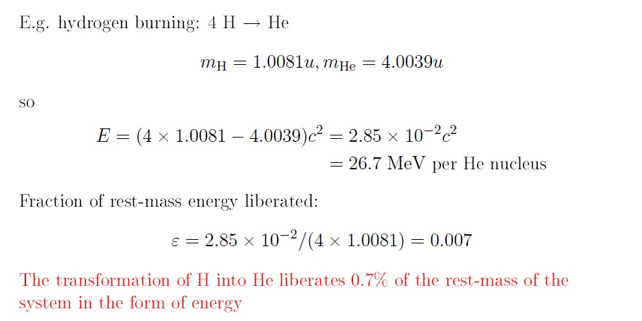
Binding energy

Slide 28
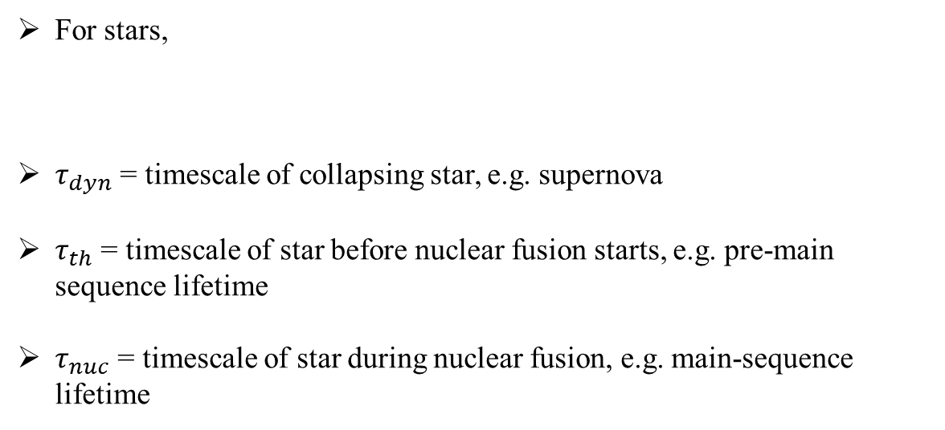

Timescales
For stars,
$τ_{dyn}$ = timescale of collapsing star, e.g. supernova
$τ_{th}$ = timescale of star before nuclear fusion starts, e.g. pre-main sequence lifetime
$τ_{nuc}$ = timescale of star during nuclear fusion, e.g. main-sequence lifetime
$$τ_{dyn}≪τ_{th}≪τ_{nuc}$$

Slide 29
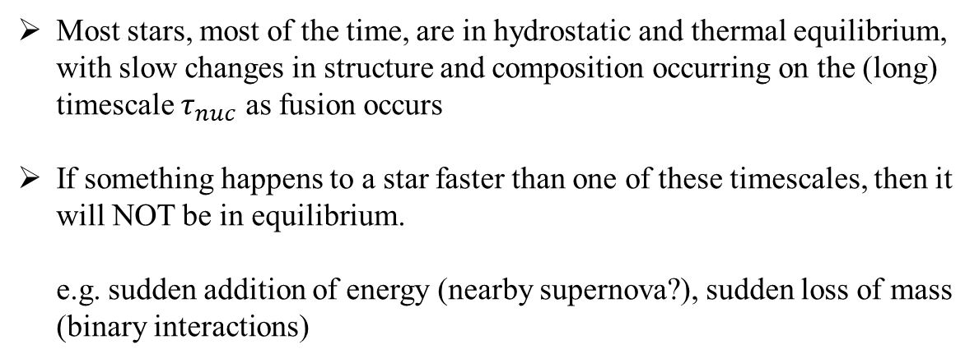
Timescales
Most stars, most of the time, are in hydrostatic and thermal equilibrium, with slow changes in structure and composition occurring on the (long) timescale $τ_{nuc}$ as fusion occurs
If something happens to a star faster than one of these timescales, then it will NOT be in equilibrium.
e.g. sudden addition of energy (nearby supernova?), sudden loss of mass
(binary interactions)

Slide 30
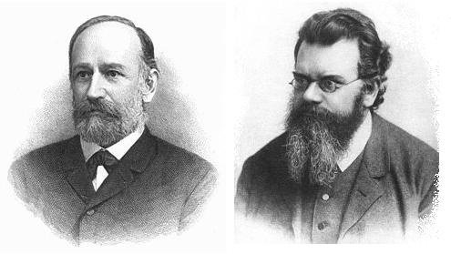
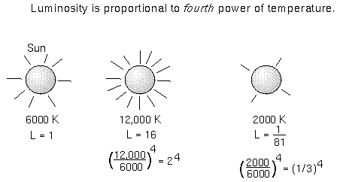
Stars show spectra very close to black-body radiation
d
R*
J. Stefan & L. Boltzmann
flux at the surface:
measured flux:
$$F={\left(\frac{R_{∗}}{d}\right)}^{2}∙σ_{SB}∙T_{∗}^{4}$$
$$F=σ_{SB}∙T_{∗}^{4}$$
with σ_{SB} = 5.67·10⁻⁸ W m⁻² K⁻⁴
luminosity (Stefan-Boltzmann law) is the flux multiplied by entire spherical surface:
$$L=4π∙R_{∗}^{2}∙σ_{SB}∙T_{∗}^{4}$$

Slide 31
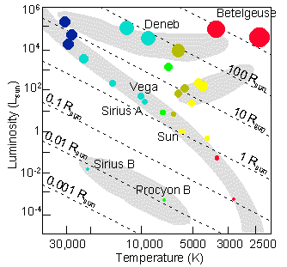
Hertzsprung-Russell diagram
M, R, L and T_{e} do not vary independently.
Two major relationships – L with T
– L with M
The first is known as the Hertzsprung-Russell (HR) diagram or the colour-magnitude diagram.
Colour Index (B-V) –0.6 0 +0.6 +2.0
Spectral type O B A F G K M

