Slide 1
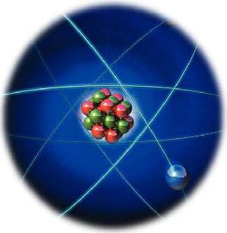
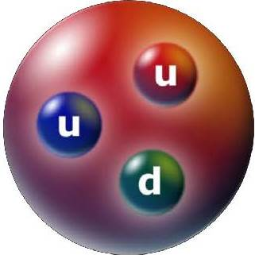
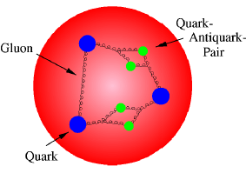
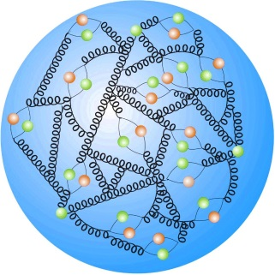
Particle Physics
The proton does not only consist of three quarks (blue) being held together by gluons (springs), but is a sizzling place of gluons and pairs of quarks and antiquarks (green) interacting with each other.
Particle physics is a branch of physics that studies the elementary constituents of matter and radiation, and the interactions between them. It is also called "high energy physics", because many elementary particles do not occur under normal circumstances in nature, but can be created and detected during energetic collisions of other particles, as is done in particle accelerators

Slide 2
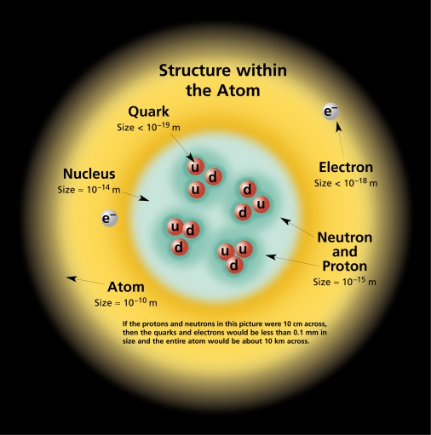
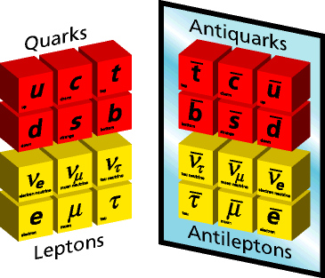
Tentative outline of Particle Physics
Introduction
100 years of particle physics
Basic Concepts
Forces of nature
Standard model chart
Lepton and Baryon numbers
Units and dimensions
Cross section and decay rates
Feynman Diagrams
exchange of photons
exchange of massive bosons
Yukawa potential
Weak, electromagnetic, strong interaction
Leptons
Weak interaction (beta decay)
Electron, muon, tau
Tau decay
Lepton conservation
Quarks
Example of baryons and meson
Quark number conservation
Isospin
Color a new quantum number
Summary & Open Questions
Beyond the Standard Model

Slide 3
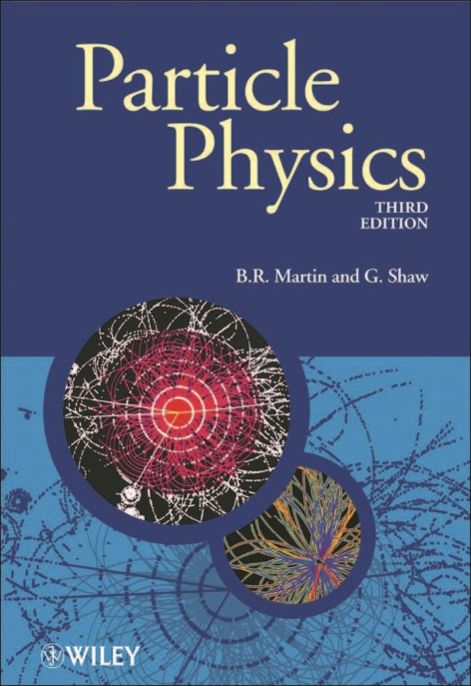
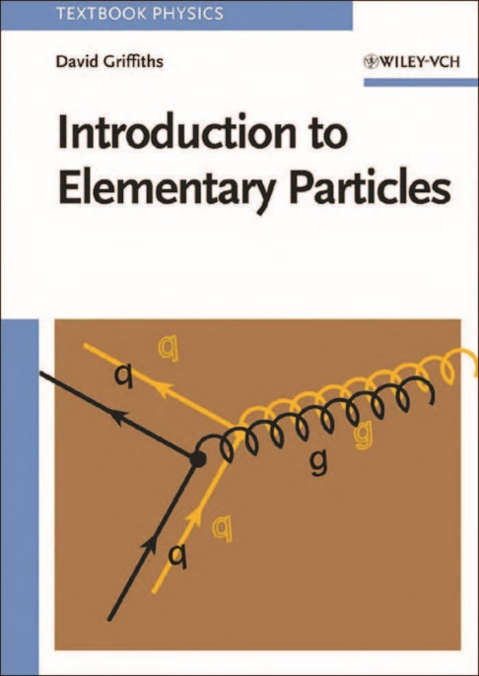
Literature
Recommended Textbook

Slide 4
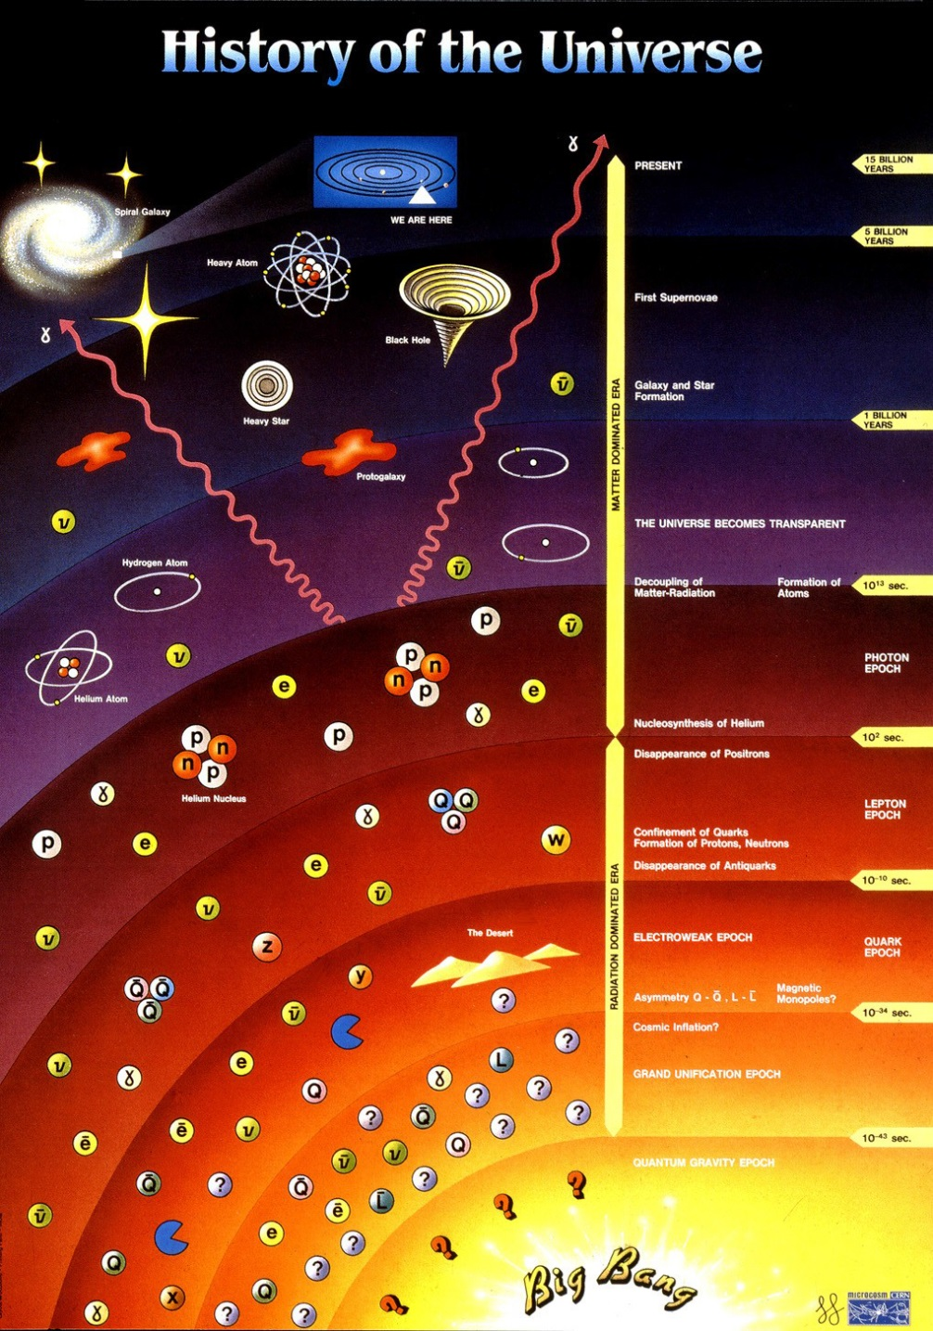

Particle Physics
era of gravitation
${10}^{13} s$
≈ 300 000 years
era of particle physics

Slide 5
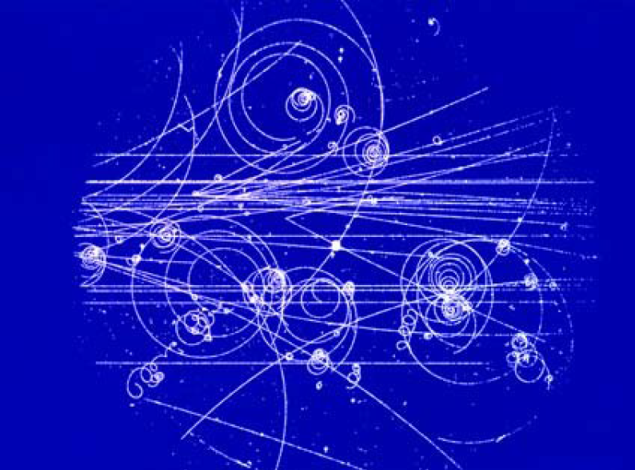
100 years of particle physics

Slide 6
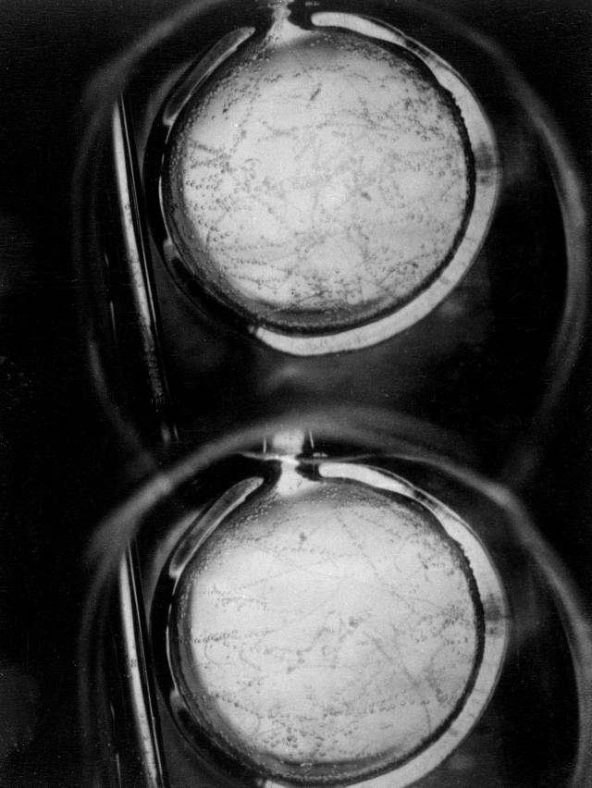
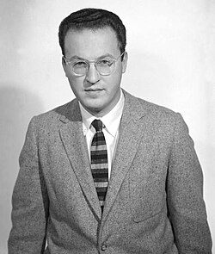
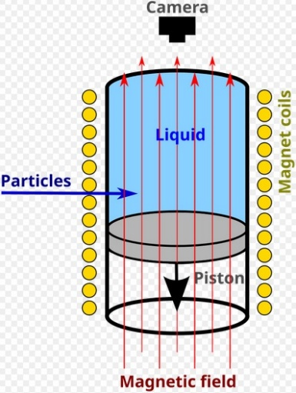
Bubble chamber
How does a bubble chamber work:
It is filled with a liquid under pressure (hydrogen)
Particles ionize the liquid along their passage
When pressure drops, liquid boils preferentially along the ionization trails
Donald Glaser

Slide 7
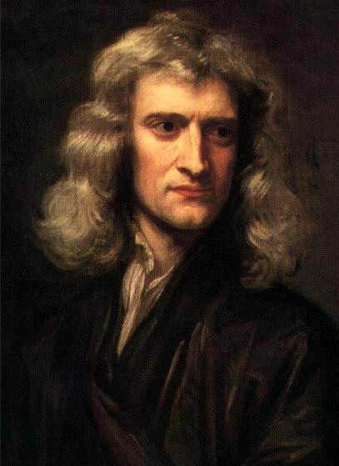
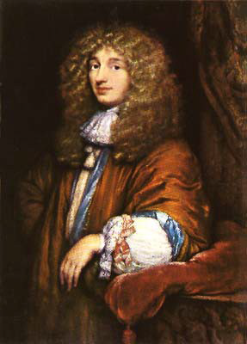
Corpuscular Theory of Light
Light consist out of particles (Newton)
Light is a wave (Huygens)
Mainly because of Newton’s prestige, the corpuscle theory was widely accepted (more than 100 years)
Failing to describe interference, diffraction, and polarization (e.g. Fresnel) corpuscle theory was abandoned for Huygens wave theory
Wave theory strongly supported by Maxwell equations and by H. Hertz experiments
Until in the early 20th century …
Isaac Newton
1643-1727
Christiaan Huygens
1629-1695

Slide 8
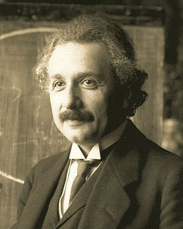
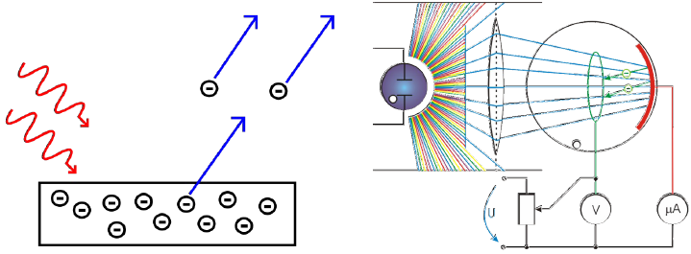
Photoelectric Effect
Observation: 1836 Becquerel
Metal absorbs light and emits electrons →
Maximum energy of electrons independent on intensity
(number of photons)
Interpretation: 1905 Einstein (Nobel prize 1921)
Light consists of particles (photons) with quantized energy
Albert Einstein
1879-1955

Slide 9
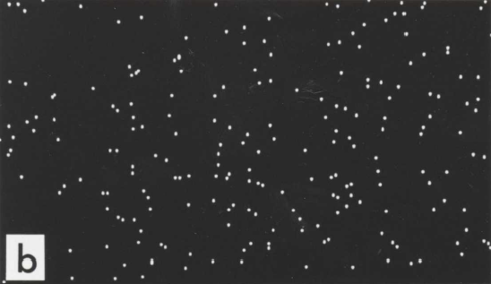
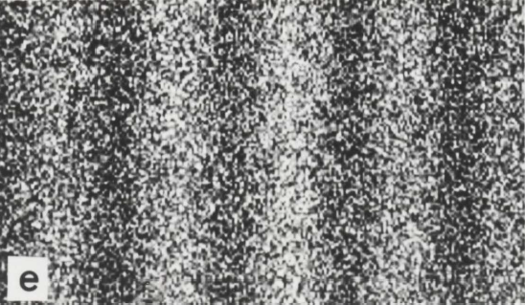
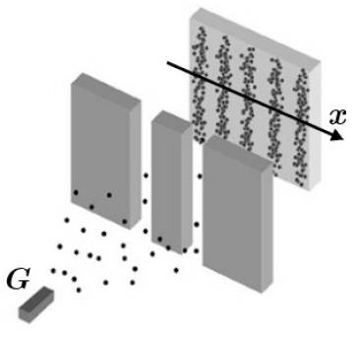

Double Slit with Electrons
Electron (particles) have wavelength
De Broglie wavelength:
$$λ=\frac{h}{p}=\frac{Planck constant}{momentum (=mass ∙velocity)}$$

Slide 10
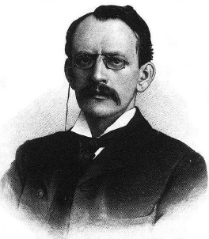
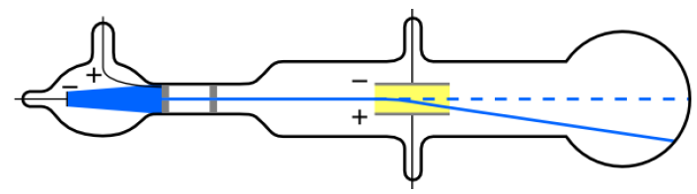
The Electron
Observation: 1897 (Nobel Prize 1906)
  Constituents of cathode rays deflected by electric field
  Constituents of cathode rays deflected by magnetic field + heating of thermal junction → first mass/charge ratio
  Higher precision of mass/charge from comparing deflection by electric and magnetic fields
Joseph J. Thomson
1856-1940

Slide 11
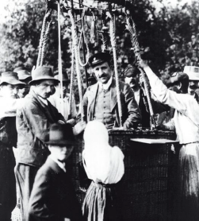
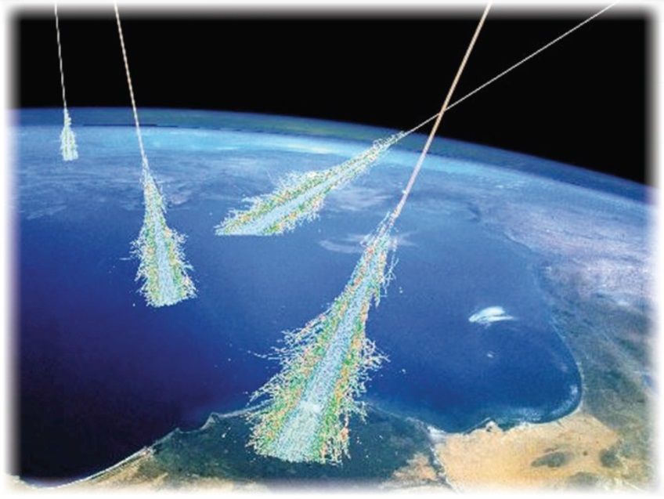
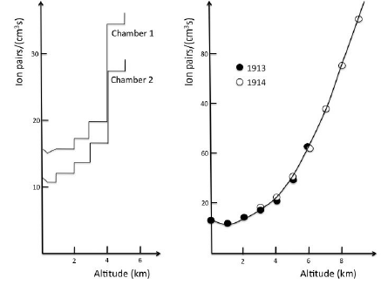
Ionization Measurements
Victor Hess (1912)
discovery of cosmic showers
Nobel Prize 1936

Slide 12
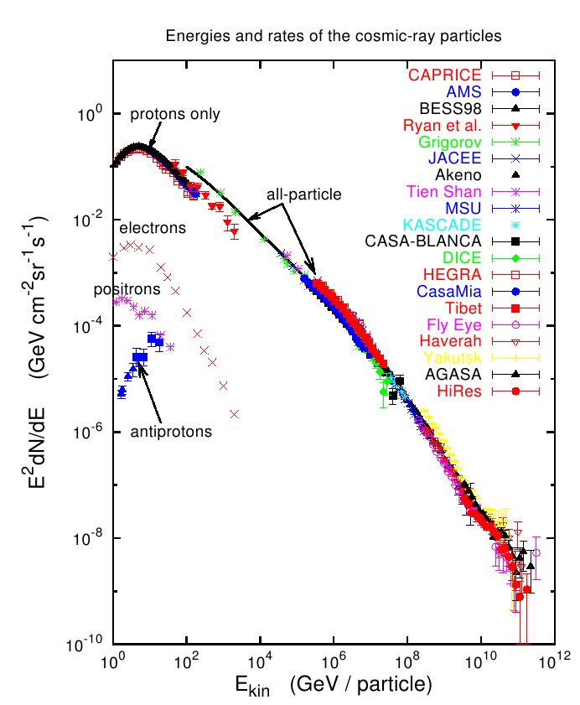
The Cosmic Accelerator

Slide 13
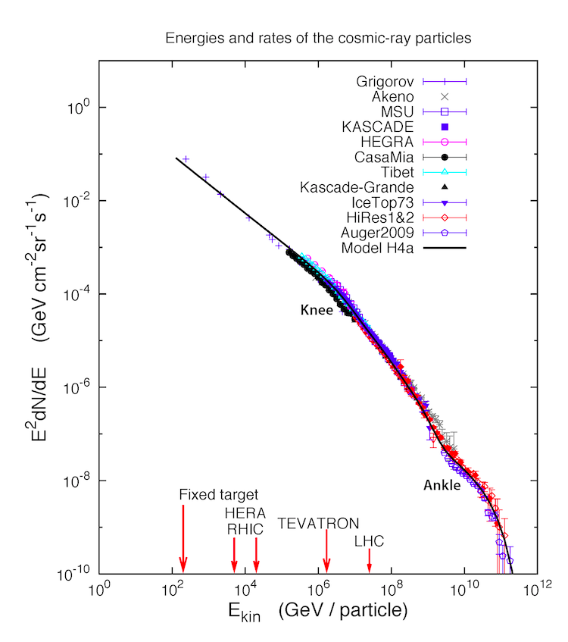
The Cosmic Accelerator flux density of cosmic rays

Slide 14
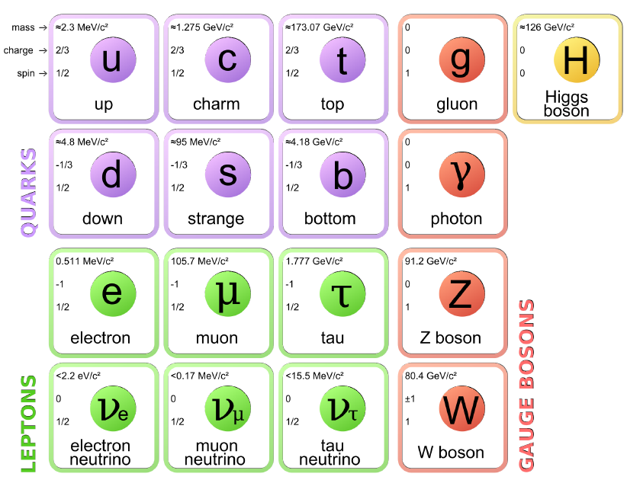
1912 ^{~100 years} 2017
electron
photons
nuclei (protons)

Slide 15
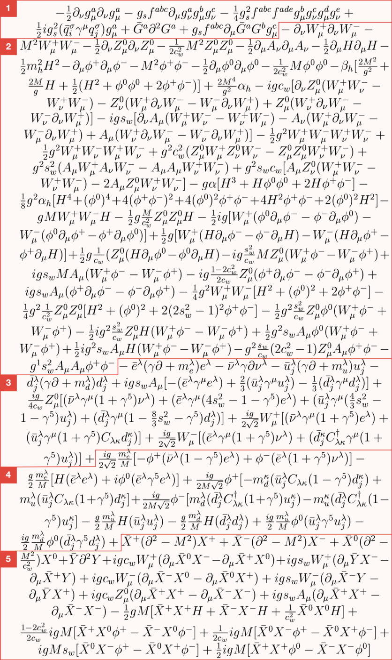
1912 ^{~100 years} 2017
electron
photons
nuclei (protons)
Standard Model
Lagrangian
1 is ultra specific to the gluon, the boson that carries the strong force
2 is dedicated to explain interactions between bosons, particularly W and Z
3 describes how elementary matter particles interact with the weak force
4 describes how matter particles interact with Higgs ghosts, virtual artifacts
In quantum mechanics, there is no single path a particle can take

Slide 16
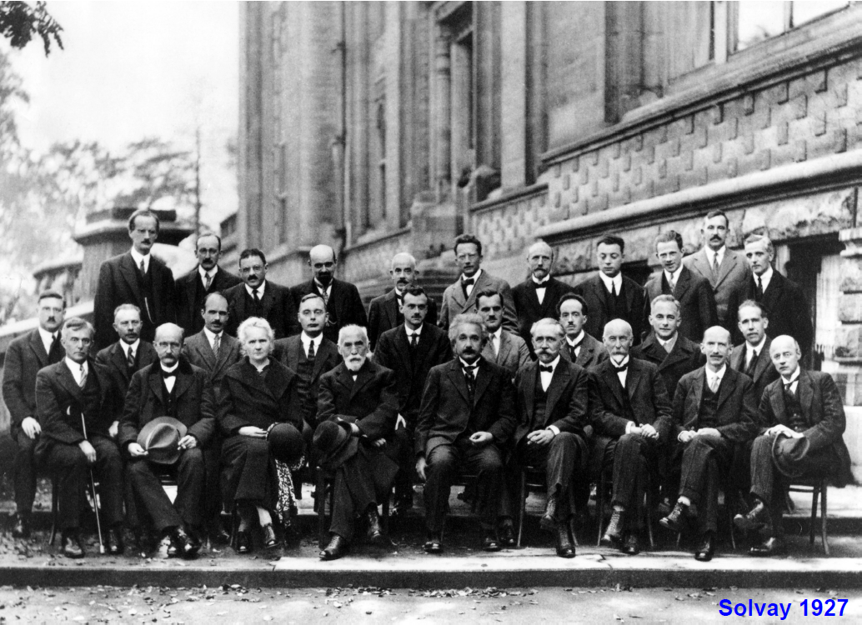
Quantum Mechanics
A. Piccard, E. Henriot, P. Ehrenfest, E. Herzen, Th. de Donder, E. Schrödinger, J.E. Verschaffelt, W. Pauli, W. Heisenberg, R.H. Fowler, L. Brillouin
P. Debye, M. Knudsen, W.L. Bragg, H.A. Kramers, P.A.M. Dirac, A.H. Compton, L. de Broglie, M. Born, N. Bohr,
I. Langmuir, M. Planck, M. Curie, H.A. Lorentz, A. Einstein, P. Langevin, Ch.-E. Guye, C.T.R. Wilson, O.W. Richardson

Slide 17
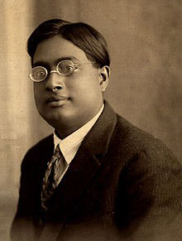
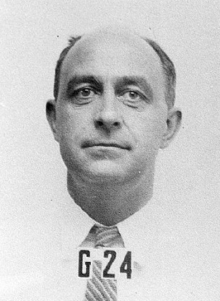
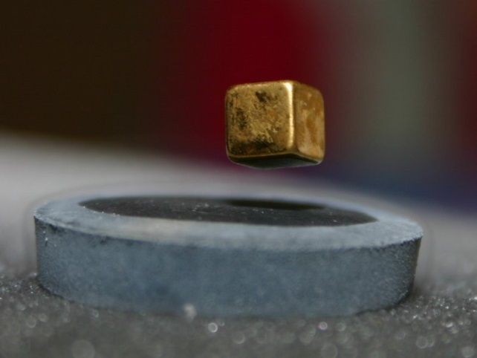
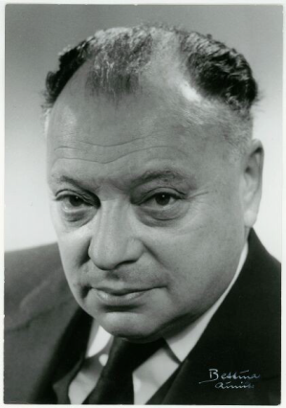
Fermions and Bosons
Fundamental characteristics of particles: Spin (“self angular momentum”)
Integer values (0, ±1, …) → Bosons
Half integer values (±1/2, ±3/2, …) → Fermions
Bosons (Cooper pairs …) can be described by common wave function
→ funny effects (super conductivity, super fluidity, …)
Satyendranath Bose
Enrico Fermi
Fermions (electrons or protons …) must be in different states
→ Pauli’s exclusion principle (basis of all chemistry…)
Wolfgang Pauli

Slide 18
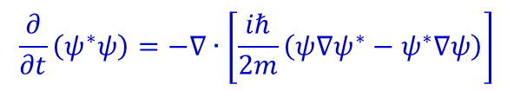
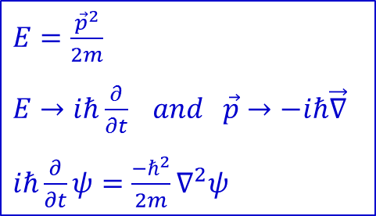



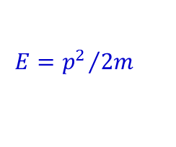
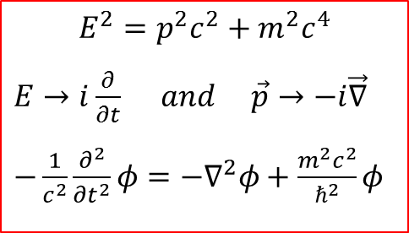
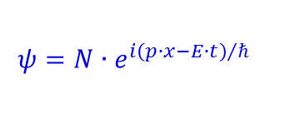
Matter Waves for Particles without Spin
Non relativistic:
Relativistic:
$E=\frac{{\vec{p}}^{2}}{2m}$
$E→iℏ\frac{∂}{∂t} and \vec{p}→−iℏ\vec{∇}$
$iℏ\frac{∂}{∂t}ψ=\frac{−ℏ^{2}}{2m}∇^{2}ψ$
$$E^{2}=p^{2}c^{2}+m^{2}c^{4}$$
$E→i\frac{∂}{∂t} and \vec{p}→−i\vec{∇}$
$−\frac{1}{c^{2}}\frac{∂^{2}}{{∂t}^{2}}φ=−∇^{2}φ+\frac{m^{2}c^{2}}{ℏ^{2}}φ$
Kinematics:
Quantum Mechanics:
Wave Equation:
density:
$$ρ\left(x,t\right)={\left|ψ\left(x,t\right)\right|}^{2}$$
continuity equation:
$$\frac{∂ρ}{∂t}+∇∙j=0$$
Schrödinger equation:
$$\frac{∂}{∂t}ψ=\frac{iℏ}{2m}∇^{2}ψ$$
$$\frac{∂}{∂t}\left(ψ^{∗}ψ\right)=−∇∙\left[\frac{iℏ}{2m}\left(ψ∇ψ^{∗}−ψ^{∗}∇ψ\right)\right]$$
continuity equation:
plane waves:
are solutions to the free
Schrödinger equation
$$ψ=N∙e^{i{\left(p∙x−E∙t\right)}/ℏ}$$
$$E={p^{2}}/{2m}$$
p → -p gives to same result
Notes:
$ψ^{∗}\frac{∂ψ}{∂t}=ψ^{∗}\left(\frac{iℏ}{2m}\right)∇^{2}ψ$ + $ψ\frac{∂ψ^{∗}}{∂t}=ψ\left(\frac{−iℏ}{2m}\right)∇^{2}ψ^{∗}$ = $\frac{∂}{∂t}ρ=−∇j$

Slide 19



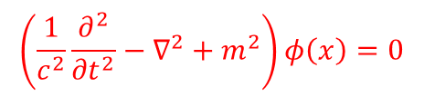
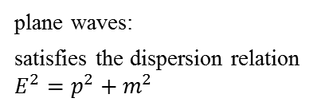

Matter Waves for Particles without Spin
Non relativistic:
Relativistic:
$E=\frac{{\vec{p}}^{2}}{2m}$
$E→iℏ\frac{∂}{∂t} and \vec{p}→−iℏ\vec{∇}$
$iℏ\frac{∂}{∂t}ψ=\frac{−ℏ^{2}}{2m}∇^{2}ψ$
$$E^{2}=p^{2}c^{2}+m^{2}c^{4}$$
$E→i\frac{∂}{∂t} and \vec{p}→−i\vec{∇}$
$−\frac{1}{c^{2}}\frac{∂^{2}}{{∂t}^{2}}φ=−∇^{2}φ+\frac{m^{2}c^{2}}{ℏ^{2}}φ$
Kinematics:
Quantum Mechanics:
Wave Equation:
Klein-Gordon equation
Unlike the Schrödinger equation, the Klein-Gordan equation does not contain factor i. Consequently, it can have both real and complex solutions.
$$\left(\frac{1}{c^{2}}\frac{∂^{2}}{{∂t}^{2}}−∇^{2}+m^{2}\right)φ\left(x\right)=0$$
plane waves:
satisfies the dispersion relation $E^{2}=p^{2}+m^{2}$
$$φ\left(x\right)=Ne^{i\left(p∙x−E∙t\right)}=e^{−ip_{μ}∙x^{μ}}$$
continuity equation:
The factor i is introduced to make the density real
$$\frac{∂}{∂t}i\left(φ^{∗}\frac{∂φ}{∂t}−φ\frac{∂φ^{∗}}{∂t}\right)=∇∙\left[i\left(φ^{∗}∇φ−φ∇φ^{∗}\right)\right]$$
$$ρ=2{\left|N\right|}^{2}E$$
$$j=2{\left|N\right|}^{2}p$$

Slide 20
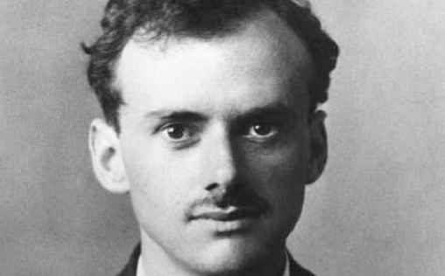

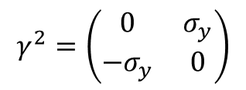
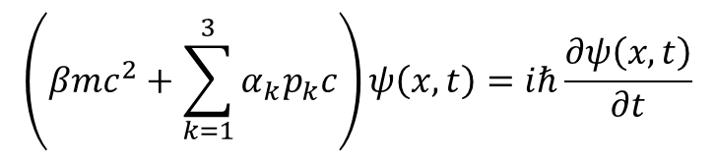



Matter Waves for Particles with Spin
$$\left(βmc^{2}+\sum_{k=1}^{3}{α_{k}p_{k}c}\right)ψ\left(x,t\right)=iℏ\frac{∂ψ\left(x,t\right)}{∂t}$$
Dirac equation
The problem with the Klein-Gordon equation: it is second order in derivatives. In 1928, Dirac found the first-order form having the same solutions. α_{k} and β are 4x4 matrices and Ψ are four-component wave functions: spinors (for particles with spin ½).
Paul Dirac 1902-1984
$$iℏγ^{μ}∂_{μ}ψ−mcψ=0$$
$$γ^{0}=\left(\begin{matrix}I_{2} & 0 \\ 0 & I_{2}\end{matrix}\right)$$
$$γ^{1}=\left(\begin{matrix}0 & σ_{x} \\ {−σ}_{x} & 0\end{matrix}\right)$$
$$γ^{2}=\left(\begin{matrix}0 & σ_{y} \\ −σ_{y} & 0\end{matrix}\right)$$
$$γ^{3}=\left(\begin{matrix}0 & σ_{z} \\ −σ_{z} & 0\end{matrix}\right)$$

Slide 21
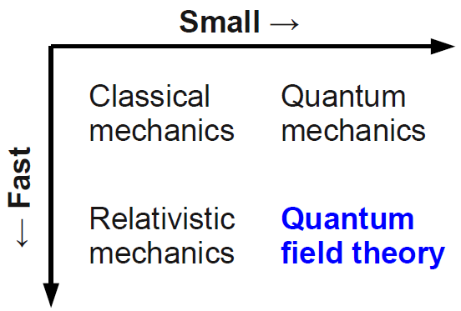
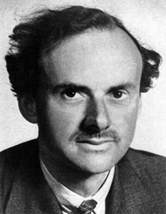
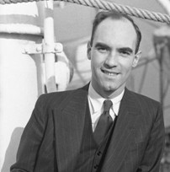


Quantum Field Theory
First major achievement: Dirac’s equation for free electrons (and positrons)
$$E^{2}={\left(mc^{2}\right)}^{2}+{\left(pc\right)}^{2}$$
$$E=±\sqrt{p^{2}c^{2}+m^{2}c^{4}}$$
Interpretation of negative energies: sea of electrons → holes in sea act as positively charged electrons → confirmed by Anderson 1932
Paul Dirac
1902-1984
Nobel Prize 1933
Carl Anderson
1905-1991
Nobel Prize 1936

Slide 22
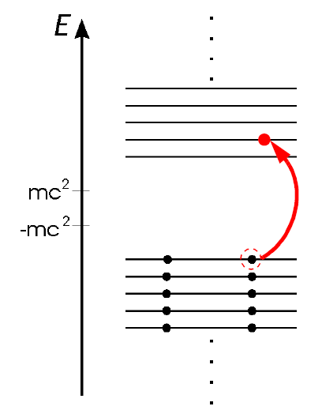
Dirac’s Picture of Vacuum
Fermions in Dirac’s representation
The “hole” created by the appearance of the electron with a positive energy is interpreted as the presence of electron’s antiparticle with the opposite charge.
Later, Feynman – Stückelberg interpretation: antiparticles are particles travelling in revers time direction
Every charged particle has the antiparticle of the same mass and opposite charge.
“negative” energy → antiparticles

Slide 23
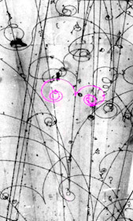
Antimatter
Antiparticles look and behave just like their corresponding matter particles, except they have opposite charges.
evidence for antimatter in this early bubble chamber photo.
The magnetic field in this chamber makes negative particles curl left and positive particles curl right.
The antielectron is called positron and is designated e⁺.

Slide 24
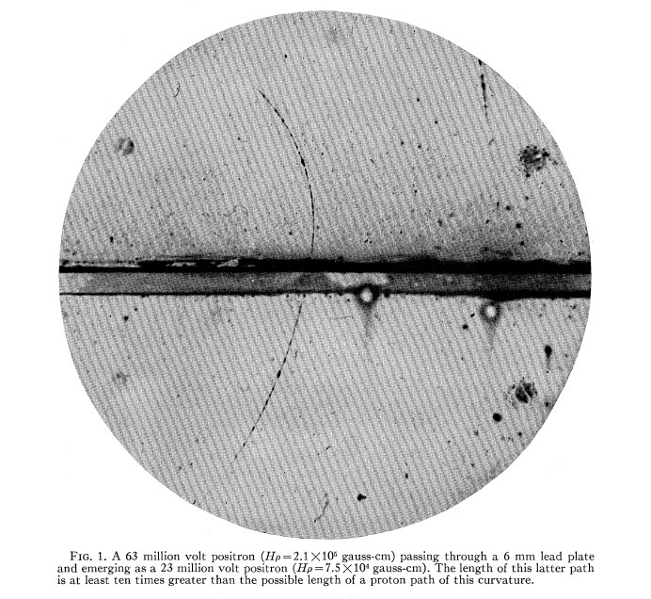
Discovery of the Positron
First observed by D. Skobeltsyn in cosmic rays, using a Wilson cloud chamber (1929)
C. D. Anderson: study of cosmic rays in a cloud chamber (1932)
positrons are bent due to Lorentz force in magnetic field
proof of existence of antiparticles
lead plate
positron track
Carl D. Anderson; Nobel Prize 1936

Slide 25

Muon Discovery (1936)
Muon-Lepton discovery in cosmic rays by
Carl D. Anderson
+
Seth Nedermeyer
mass: m_{μ} ~ 100 MeV
The muon is the first “exotic” particle
It was believed to be the meson predicted by Yukawa
Carl D. Anderson; Nobel Prize 1936

Slide 26







Prediction of the Pion
H. Yukawa predicted 1935 mesons as carriers of the strong force
$$meson mass \sim {ℏc }/{\left(range of force\right)}$$
$$range \sim 1 fm → m_{meson}=200 MeV$$
$$ℏc=197.326 MeV fm$$
note 1: mesons are quark-antiquark $q\overline{q}$ states and not elementary
note 2: meson = “mean, intermediate state”
Hideki Yukawa
1907-1981
The range of forces is related to the mass of exchange particle $M$. An amount of energy $∆E=Mc^{2}$ borrowed for a time $∆t$ is governed by the Uncertainty Principle:
$$∆E∙∆t\sim ℏ$$
The maximum distance the particle can travel is $∆x=c∙∆t$, where $c$ is the velocity of light.
$$∆x={ℏc}/{∆E}$$
$$∆x={ℏc}/{Mc^{2}}$$
The photon has M = 0 → infinite range of EM force.
W boson has a mass of 80 GeV/c² → range of weak force $∆x=2∙{10}^{−3} fm$
Nobel Prize 1949

Slide 27

Discovery of Pions
Discovered pions were fitting very well into Yukawa’s theory – they were supposed to be responsible for the nuclear force:
Yukawa model of direct (a) and exchange (b, c) nuclear force
The resulting potential for this kind of exchange is of Yukawa type and at the longest range reproduces observed nuclear forces very well, including even spin effects.
However, at the ranges comparable with the size of nucleons, this description fails, and the internal structure of hadrons must be taken into account.

Slide 28

Discovery of the Pion
1947 discovered by Perkins, Ochialini and Powell
μ
e
π
First observed pions: a π⁺ stops in the emulsion and decays to a μ⁺ and ν_{μ}, followed by the decay of μ⁺.
Powell; Nobel Prize 1950

Slide 29



Discovery of the Pion
Some reactions induced by cosmic rays primaries:
$$p+p→p+n+π^{+}$$
$$→p+p+π^{0}$$
$$→p+p+π^{+}+π^{−}$$
Same reactions can be reproduced in accelerators, with higher rates, although cosmic rays may provide higher energies.

Slide 30



Discovery of the Pion
In emulsions, pions were identified by much more dense ionization along the track, as compared to electrons.
The figure shows examples of the reaction
where pion comes to the rest, producing muons having equal energies, which in turn decay by the reaction $μ^{+}→e^{+}ν_{e}\overline{ν_{μ}}$
$$π^{+}→μ^{+}+ν_{μ}$$
Charged pions decay mainly to the muon-neutrino pair (branching ratio about 99.99%), having lifetimes of 2.6·10⁻⁸ s. In quark terms:
$$\left(u\overline{d}\right)→μ^{+}+ν_{μ}$$
Neutral pions decay mostly by the electromagnetic interaction, having shorter lifetimes of 0.8·10⁻¹⁶ s:
$$π^{0}→γ+γ$$

Slide 31



Beta Decay
$$beta decay: n →p+ e^{−}+ \overline{ν}$$
$$e^{−}$$
m_{e} = 0.511 MeV/c²
n
p
m_{n} = 939.565 MeV
m_{p} = 938.272 MeV
$$\overline{ν}$$
missing energy?
W. Pauli predicted in a letter to E. Fermi
the existence of neutrinos (1930)

Slide 32

Discovery of the Electron-Neutrino
Discovery of the electron neutrino (Cowan, Reines, 1957)
Anti-Electron Neutrino
Nobel Prize 1995

Slide 33




Existence of Muon-Neutrinos
proton
accelerator
dipole
magnets
iron
absorber
big spark
chamber
pion decay
channel 21 m
beryllium plate
$$decay: π→μ{ ν}_{μ}$$
$$ν_{μ}+n→p+μ^{−}$$
Discovery of the muon neutrino (Ledermann, Schwartz, Steinberger 1962)
Nobel Prize 1988

Slide 34



Discovery of Strangeness Surprise!
“V-particles”
Production of Kaons and
K⁺$\left(u\overline{s}\right)$, K⁰ $\left({d\overline{s}}/{s\overline{d}}\right)$, K⁻$\left(s\overline{u}\right)$
Lambda-Baryons $\left(uds\right)$ in pp-collisions
Long lifetime!!!
neither electromagnetic nor strong force
(1950ties)
A bubble chamber picture of the above reaction
How does a bubble chamber work:
It is filled with a liquid under pressure (hydrogen)
Particles ionize the liquid along their passage
When pressure drops, liquid boils preferentially along the ionization trails

Slide 35



Discovery of Strangeness
Strange mesons and baryons
were called so because, being produced in strong interactions, had quite long lifetimes and decayed weakly rather than strongly.
The most light particles containing s-quark are:
mesons K⁺. K⁻ and K⁰, $\overline{K^{0}}$: “Kaons”, lifetime of K⁺ is 1.2·10⁻⁸ s
baryon Λ, lifetime of 2.6·10⁻¹⁰ s
Principle decay modes of strange hadrons:
$K^{+}→μ^{+}+ν_{μ}$ (B=0.64)
$K^{+}→π^{+}+π^{0}$ (B=0.21)
$Λ→π^{−}+p$ (B=0.64)
$Λ→π^{0}+n$ (B=0.36)
While the first decay in the list is clearly a weak one, decays of Λ can be very well described as strong ones, if not the long lifetime: $\left(udd\right)→\left(d\overline{u}\right)+\left(uud\right)$ must have a lifetime of order 10-23 s, thus Λ can not be another sort of neutron…
B ≡ branching

Slide 36
Discovery of Strangeness
Solution: to invent a new “strange” quark, bearing a new quark number – “strangeness”, which does not have to be conserved in weak interactions
S = 1 | S = -1
 | Λ (1116) = $uds$
K⁺ (494) = $u\overline{s}$ | K⁻ (494) = $s\overline{u}$
K⁰ (498) = $d\overline{s}$ | $\overline{K^{0}}$ (498) = $s\overline{d}$
In strong interactions, strange particles have to be produced in pairs in order to conserve total strangeness (“associated production”):
$$π^{−}+p→K^{0}+Λ$$
In 1952, bubble chambers were invented as particle detectors, and also worked as targets, providing, for instance, the proton target for the above reaction.

Slide 37


Status in 1962 – (50 years after Hess ’balloon trip)
known fermions
M. Gell-Mann and G. Zweig
hypnotized existence of quarks:
up-quark
down-quark
strange-quark
in the year 1964
Murray Gell-Mann
1929-
George Zweig
1937-
Nobel Prize 1969

Slide 38




Prediction of the Charm-Quark
How explain non-observation of Flavor Changing Neutral Currents?
$$K ↛ π γ$$
$$γ$$
K
$$u\overline{s}$$
?
$$u\overline{d}$$
π
Such a flavor changing decay is forbidden if a fourth quark exists
(Glashow, Iliopoulos, Maiani)
prediction
Note: Kaon and Pion have similar quantum numbers!

Slide 39





Observation of Neutral Currents
$$\overline{ν_{e}} e → \overline{ν_{e}} e$$
$$\overline{ν_{e}}$$
$$\overline{ν_{e}}$$
Z
e
e
We find interactions without visible incoming or outgoing particle.
Bubble Chamber Gargamelle (1974)

Slide 40





Observation of the Charm-Quark
$$c\overline{c}$$
resonance
p Be → X J/Psi → X e⁺e⁻
BNL: S. Ting et al. (1974)
e⁺e⁻ → J/Psi → e⁺e⁻ (μ⁺μ⁻), (π⁺π⁻)
SLAC: B. Richter et al. (1974)
Nobel Prize 1976

Slide 41
Discovery of Charm-Quark
Bubble chambers were great tools of particle discovery, providing physicists with numerous hadrons, all of them fitting u-d-s quark scheme until 1974.
In 1974, a new particle was discovered, which demanded a new flavour to be introduced. Since it was detected simultaneously by two rival groups in Brookhaven (BNL) and Stanford (SLAC), it received a double name:
$$J/Ψ\left(3097\right)=c\overline{c}$$
The new quark was called “charmed”, and the corresponding quark number is charm, C. Since $J/Ψ$ itself has C = 0, it is said to contain “hidden charm”.
Shortly after that particles with “naked charm” were discovered as well:
$$D^{+}\left(1869\right)=c\overline{d}, D^{0}\left(1865\right)=c\overline{u}$$
$$D^{−}\left(1869\right)=d\overline{c}, D^{0}\left(1865\right)=cu$$
$$Λ_{c}^{+}\left(2285\right)=udc$$

Slide 42

Status in 1975
known fermions
no anti-matter in universe!
Charge and Parity Conservation must be broken!
(2nd A. Sakharovs condition)
→ third quark family could explain matter – anti-matter asymmetry
Nambu, Kobayashi, Maskawa
Note: particle physics and evolution of universe are closely related!
Nobel Prize 2008

Slide 43

Discovery of Charm- and Bottom-Quark
Even heavier charmed mesons were found – those which contained strange quark as well:
$$D_{S}^{+}\left(1969\right)=c\overline{s} D_{S}^{−}\left(1969\right)=s\overline{c}$$
Lifetimes of the lightest charmed particles are of order 10⁻¹³ s, well in the expected range of weak decays.
Discovery of “charmed” particles was a triumph for the electroweak theory, which demanded number of quarks and leptons to be equal.
In 1977, “beautiful” mesons were discovered:
$$Y\left(9460\right)=b\overline{b}$$
$$B^{+}\left(5279\right)=u\overline{b} B^{0}\left(5279\right)=d\overline{b}$$
$$B^{−}\left(5279\right)=b\overline{u} B^{0}\left(5279\right)=b\overline{d}$$
and the lightest b-baryon: $Λ_{b}^{0}\left(5461\right)=udb$
And this is the limit: top-quark is too unstable to form observable hadrons

Slide 44





Discovery of the Third Family
Tau Lepton discovered by MARK1 at SPEAR (1974-1976)
$$e^{+}e^{−}→τ^{+}τ^{−}$$
$$τ→e νν$$
$$τ→μ νν$$
$$m_{τ}=1.777 GeV$$
discovery of tau-lepton
(Reines et al., M. Perl Nobel Prize 1995)
Discovery of the Bottom-Quark (1977) by M. Ledermann et al. Nobel Prize 1988

Slide 45


Top-Quark Discovery at Tevatron
Fermilab
Tevatron
$$p\overline{p} collider s^{1/2}=2 TeV$$

Slide 46




Top-Quark Discovery in 1995
CDF Collaboration
C0 Collaboration
Top-Quark mass ~ 175 GeV
Top production:
Top decay:
$$p\overline{p}→t\overline{t} X$$
$$t→W b and W→q\overline{q}$$

Slide 47

Top-Quark Discovery in 1995
Top-Quark mass ~ 175 GeV
Top production:
Top decay:
$$p\overline{p}→t\overline{t} X$$
$$t→W b and W→q\overline{q}$$

Slide 48
Status in 2000 (~90 years after Hess balloon trip)
all fermions discovered
tau-neutrino discovered
in 2000 by Donut experiment

Slide 49



Status in 2002 (~90 years after Hess balloon trip)
Nobel Prize 2015
Takaaki Kajita + Arthur B. McDonald
neutrinos have mass!
Super-Kamiokande (1998)
SNO experiment (2001/2)

Slide 50


Discovery of Vector-Bosons
Photons:
X-rays (Röntgen 1895) → Nobel Prize 1901
photo-electric effect (Einstein 1905) → Nobel Prize 1921
Gluons:
8 carriers of strong force
predicted by Gell-Mann et al.
experimental discovery as jets of hadrons
(e.g. PETRA)
W± bosons:
carriers of weak interactions
responsible for weak decays
building blocks of “Standard Model”
Glashow, Salam, Weinberg → Nobel Prize 1979
W-boson discovered at CERN $Sp\overline{p}S$ in 1983
C. Rubbia and S. van der Meer → Nobel Prize 1984
Abdus Salam, Steven Weinberg, Sheldon L. Glashow

Slide 51




Discovery of Vector Bosons
Z-boson:
indirectly observed at Gargamelle
discovered at CERN $Sp\overline{p}S$ in 1983
C. Rubbia and S. van der Meer → Noble Prize 1984
precision studies at LEP accelerator
Large Electron Positron (LEP) collider
Carlos Rubbia Simon van der Meer

Slide 52



Large Electron-Positron Collider at CERN
1989-2000: S^{1/2} = 90-200 GeV
26.7 km circumference
Four experiments:
ALEPH
DELPHI
L3
OPAL

Slide 53

Large Electron-Positron Collider at CERN

Slide 54


Large Hadron Collider at CERN
LHC (p → ← p)
s^{1/2} ≤ 14 TeV
26.7 km circumference
40000 tons of cold mass spread over 27 km
10000 tons of Liquid Nitrogen (at T = 80 K)
60 tons of Liquid Helium (cools ring to final 1.9 K)

Slide 55



The Higgs-Boson
ATLAS
CMS
M_{H} = 125 GeV
Nobel Prize 2013
F. Englert
P. Higgs

Slide 56

CMS - Collaboration
Notes:
Compact Muon Solenoid

