Slide 1
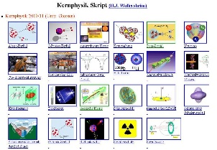
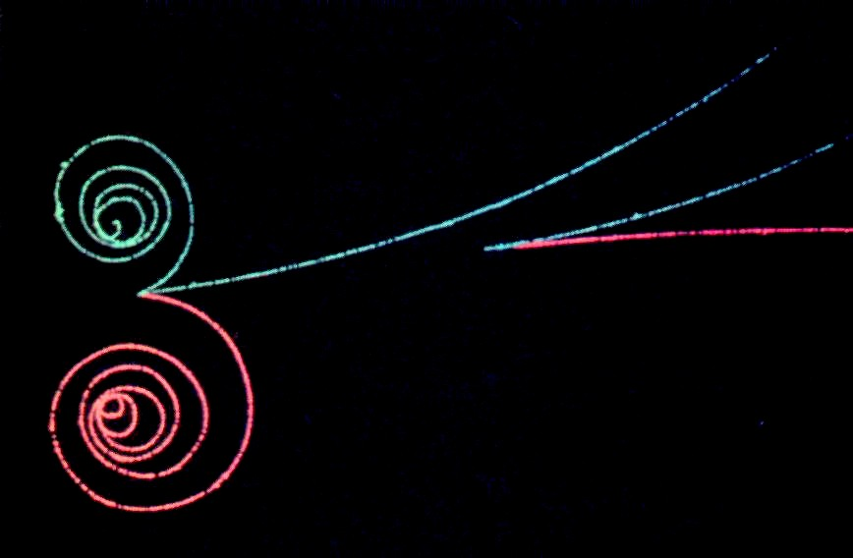

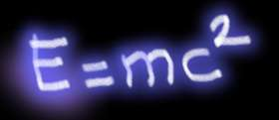
Outline: Antimatter
Lecturer: Hans-Jürgen Wollersheim
e-mail: h.j.wollersheim@gsi.de
web-page: https://web-docs.gsi.de/~wolle/ and click on
particle
Energy*
* gamma rays
antiparticle
History of Antimatter
Cosmology (Standard Model)
Matter-Antimatter asymmetry in particle physics
Neutrinoless double-beta decay

Slide 2
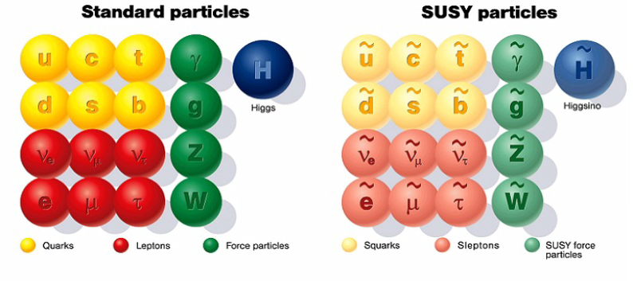
Outline: Antimatter
Lecturer: Hans-Jürgen Wollersheim
e-mail: h.j.wollersheim@gsi.de
web-page: https://web-docs.gsi.de/~wolle/ and click on
History of Antimatter
Cosmology
Matter-Antimatter Asymmetry
experiments

Slide 3
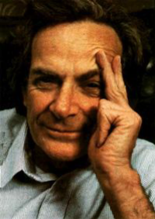
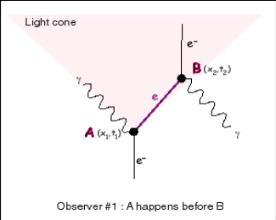
Special Relativity + Quantum Mechanics = Antimatter
“Second quantization” – the electron (field) is no longer described by a wave function but an operator that creates and destroys particles. All energies are positive.
Richard Feynman
An electron can emit a photon at A, propagate a certain distance, and then absorb another photon at B.

Slide 4

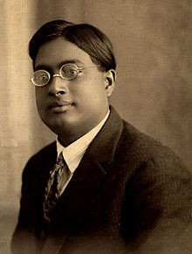
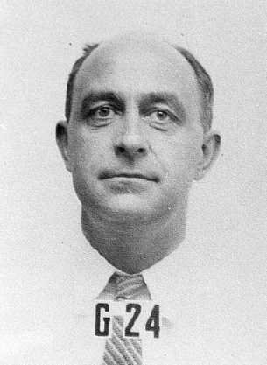
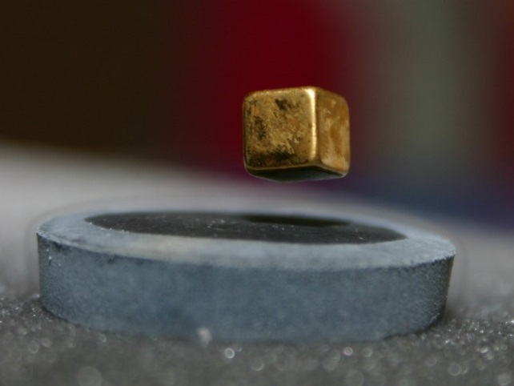
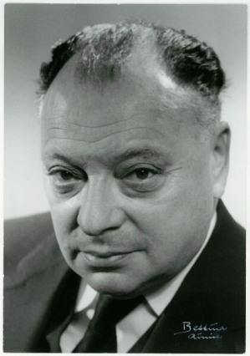
Fermions and Bosons
Fundamental characteristics of particles: Spin (“self angular momentum”)
Integer values (0, ±1, …) → Bosons
Half integer values (±1/2, ±3/2, …) → Fermions
Bosons (Cooper pairs …) can be described by common wave function
→ funny effects (super conductivity, super fluidity, …)
Satyendranath Bose
Enrico Fermi
Fermions (electrons or protons …) must be in different states
→ Pauli’s exclusion principle (basis of all chemistry…)
Wolfgang Pauli

Slide 5
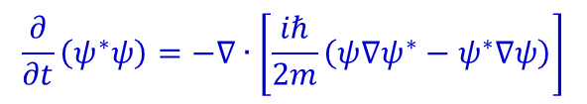
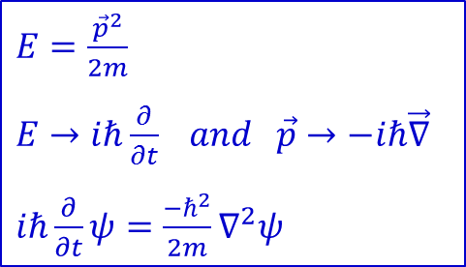



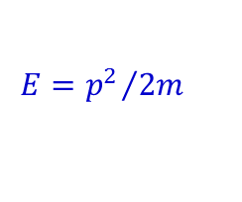
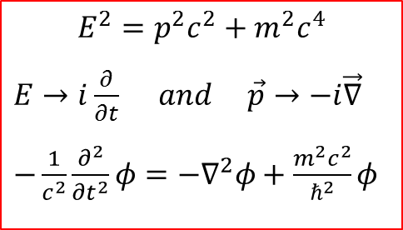
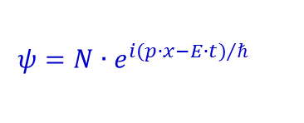
Matter Waves for Particles without Spin
Non relativistic:
Relativistic:
$E=\frac{{\vec{p}}^{2}}{2m}$
$E→iℏ\frac{∂}{∂t} and \vec{p}→−iℏ\vec{∇}$
$iℏ\frac{∂}{∂t}ψ=\frac{−ℏ^{2}}{2m}∇^{2}ψ$
$$E^{2}=p^{2}c^{2}+m^{2}c^{4}$$
$E→i\frac{∂}{∂t} and \vec{p}→−i\vec{∇}$
$−\frac{1}{c^{2}}\frac{∂^{2}}{{∂t}^{2}}φ=−∇^{2}φ+\frac{m^{2}c^{2}}{ℏ^{2}}φ$
Kinematics:
Quantum Mechanics:
Wave Equation:
density:
$$ρ\left(x,t\right)={\left|ψ\left(x,t\right)\right|}^{2}$$
continuity equation:
$$\frac{∂ρ}{∂t}+∇∙j=0$$
Schrödinger equation:
$$\frac{∂}{∂t}ψ=\frac{iℏ}{2m}∇^{2}ψ$$
$$\frac{∂}{∂t}\left(ψ^{∗}ψ\right)=−∇∙\left[\frac{iℏ}{2m}\left(ψ∇ψ^{∗}−ψ^{∗}∇ψ\right)\right]$$
continuity equation:
plane waves:
are solutions to the free
Schrödinger equation
$$ψ=N∙e^{i{\left(p∙x−E∙t\right)}/ℏ}$$
$$E={p^{2}}/{2m}$$
p → -p gives to same result
Notes:
$ψ^{∗}\frac{∂ψ}{∂t}=ψ^{∗}\left(\frac{iℏ}{2m}\right)∇^{2}ψ$ + $ψ\frac{∂ψ^{∗}}{∂t}=ψ\left(\frac{−iℏ}{2m}\right)∇^{2}ψ^{∗}$ = $\frac{∂}{∂t}ρ=−∇j$

Slide 6



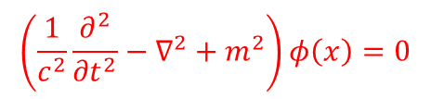
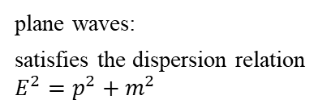

Matter Waves for Particles without Spin
Non relativistic:
Relativistic:
$E=\frac{{\vec{p}}^{2}}{2m}$
$E→iℏ\frac{∂}{∂t} and \vec{p}→−iℏ\vec{∇}$
$iℏ\frac{∂}{∂t}ψ=\frac{−ℏ^{2}}{2m}∇^{2}ψ$
$$E^{2}=p^{2}c^{2}+m^{2}c^{4}$$
$E→i\frac{∂}{∂t} and \vec{p}→−i\vec{∇}$
$−\frac{1}{c^{2}}\frac{∂^{2}}{{∂t}^{2}}φ=−∇^{2}φ+\frac{m^{2}c^{2}}{ℏ^{2}}φ$
Kinematics:
Quantum Mechanics:
Wave Equation:
Klein-Gordon equation
Unlike the Schrödinger equation, the Klein-Gordan equation does not contain factor i. Consequently, it can have both real and complex solutions.
$$\left(\frac{1}{c^{2}}\frac{∂^{2}}{{∂t}^{2}}−∇^{2}+m^{2}\right)φ\left(x\right)=0$$
plane waves:
satisfies the dispersion relation $E^{2}=p^{2}+m^{2}$
$$φ\left(x\right)=Ne^{i\left(p∙x−E∙t\right)}=e^{−ip_{μ}∙x^{μ}}$$
continuity equation:
The factor i is introduced to make the density real
$$\frac{∂}{∂t}i\left(φ^{∗}\frac{∂φ}{∂t}−φ\frac{∂φ^{∗}}{∂t}\right)=∇∙\left[i\left(φ^{∗}∇φ−φ∇φ^{∗}\right)\right]$$
$$ρ=2{\left|N\right|}^{2}E$$
$$j=2{\left|N\right|}^{2}p$$

Slide 7
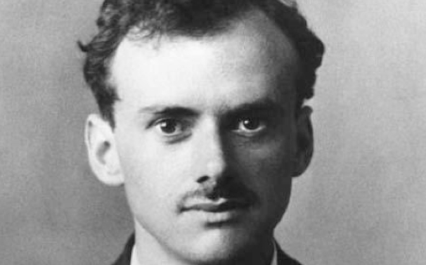

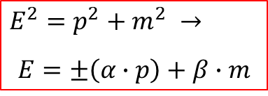
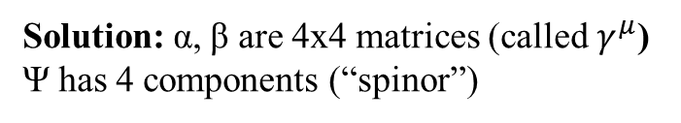
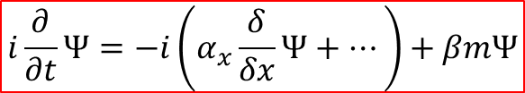
Matter Waves for Particles with Spin relativistic electron
Which equation describes a relativistic electron (c=1)?
Dirac: Take the ‘square root’ – and deal with negative solution
$$E^{2}=p^{2}+m^{2} →$$
$$E=±\left(α∙p\right)+β∙m$$
Paul Dirac 1902-1984
Linear equation, based on relativistic energy-momentum conservation
$$i\frac{∂}{∂t}Ψ=−i\left(α_{x}\frac{δ}{δx}Ψ+⋯\right)+βmΨ$$
Solution: α, β are 4x4 matrices (called $γ^{μ}$) Ψ has 4 components (“spinor”)
What does Ψ stand for?
P. A. M. Dirac, Phys. Roy. Soc. A118 (1928) 351

Slide 8
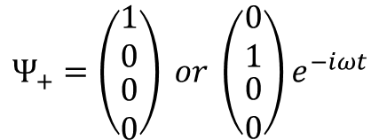
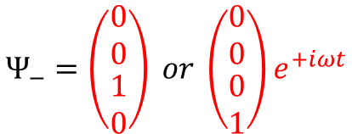
Dirac equation – Four components?
Electron has spin ½ (two ways of alignment in a magnetic field).
Description by a two-component Pauli ‘spinor’ (spin-up and spin-down).
But: Ψ had two spin ½ particles!
$$Ψ_{+}=\left(\begin{matrix}\begin{matrix}1 \\ 0\end{matrix} \\ \begin{matrix}0 \\ 0\end{matrix}\end{matrix}\right) or \left(\begin{matrix}\begin{matrix}0 \\ 1\end{matrix} \\ \begin{matrix}0 \\ 0\end{matrix}\end{matrix}\right)e^{−iωt}$$
$$Ψ_{−}=\left(\begin{matrix}\begin{matrix}0 \\ 0\end{matrix} \\ \begin{matrix}1 \\ 0\end{matrix}\end{matrix}\right) or \left(\begin{matrix}\begin{matrix}0 \\ 0\end{matrix} \\ \begin{matrix}0 \\ 1\end{matrix}\end{matrix}\right)e^{+iωt}$$
These are the two spin states of an electron with positive energy
These are the two spin states of something (similar) with ‘negative’ energy
For moving electrons, the upper and lower components mix.
The ‘one-particle’ wave function describes now a multi-particle wave function
Dirac 1929: ‘negative’ energy states with positive charge = proton ???

Slide 9
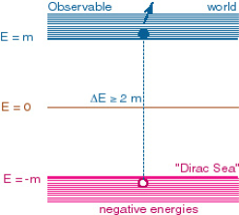
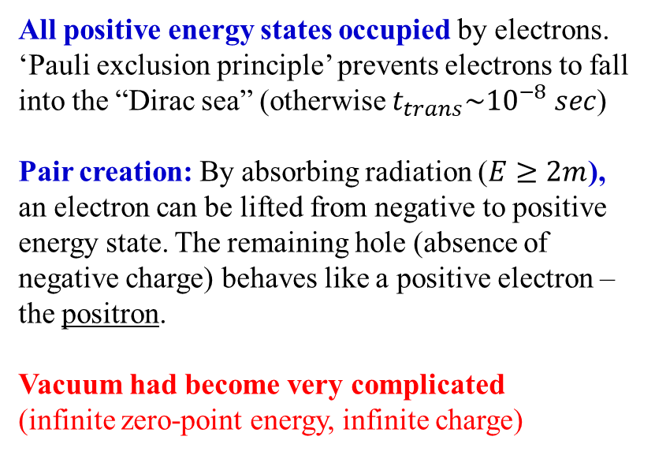
Dirac’s interpretation: Holes in the vacuum
Dirac 1931: “Subsequent investigations, however, have shown that this particle necessarily has the same mass of an electron and also that, if it collides with an electron, the two will have a chance of annihilating one another …”
All positive energy states occupied by electrons. ‘Pauli exclusion principle’ prevents electrons to fall into the “Dirac sea” (otherwise $t_{trans}\sim {10}^{−8} sec$)
Pair creation: By absorbing radiation ($E≥2m$), an electron can be lifted from negative to positive energy state. The remaining hole (absence of negative charge) behaves like a positive electron – the positron.
Vacuum had become very complicated
(infinite zero-point energy, infinite charge)

Slide 10
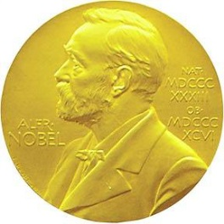
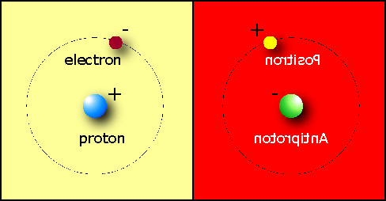
Is the Universe symmetric?
1933 Dirac (from his Nobel lecture)
“If we accept the view of complete symmetry between positive and negative electric charge so far as concerns the fundamental laws of Nature, we must regard it rather as an accident that the Earth (and presumably the whole solar system), contains a preponderance of negative electrons and positive protons.
positronium lifetime: τ = 0.125 ns

Slide 11
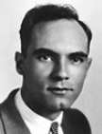
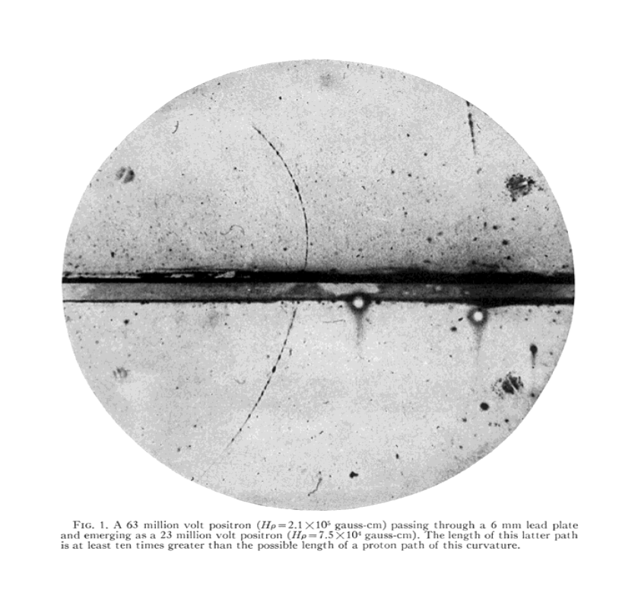
Positron discovery (1932)
Anderson used cloud chamber in a 15 kG magnetic field
CC had two parts, separated by a 6 mm lead plate
Greater curvatures of lower track indicates that particles entered the chamber from below. This determines the positive charge of the particle.
From the track curvature and track length(= energy loss per cm) Anderson concluded that the positive charge of the particles is less than twice that of proton and the mass is less than twenty times the proton mass.
Carl Anderson
23 MeV positive track,
>10x to long for a proton
6 mm Pb plate
63 MeV positive track
C. D. Anderson, “The positive electron”, Phys. Rev. 43 (1933) 491

Slide 12
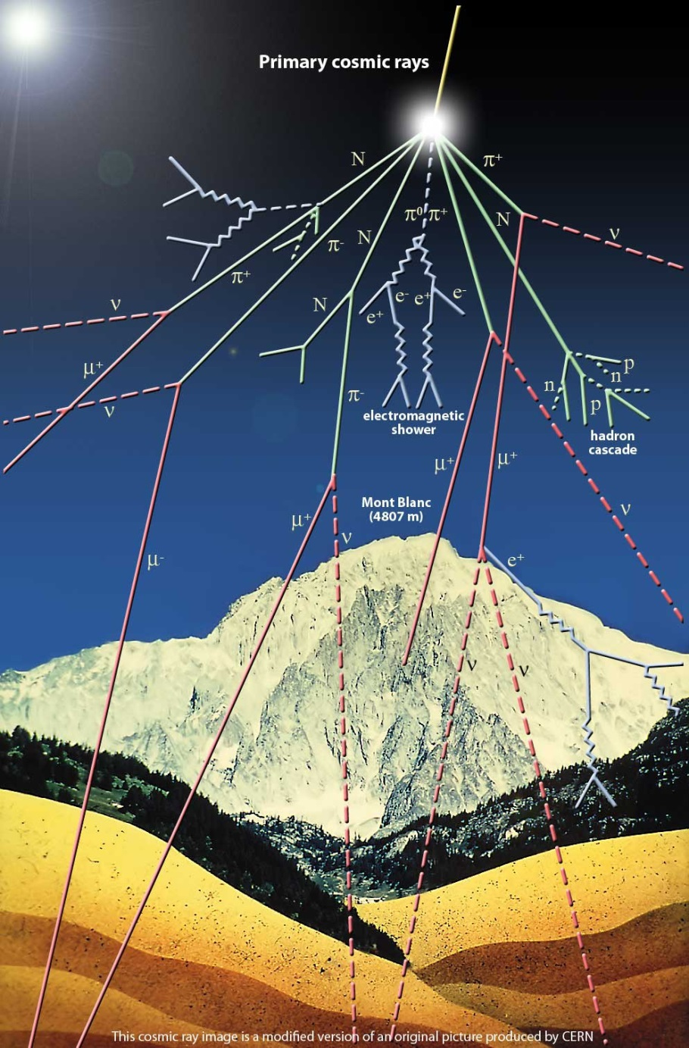
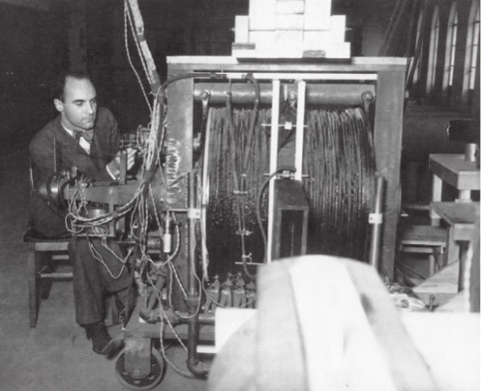
Positron discovery (1932)
The 800 turns of 1 cm Cu tubing carried both an electrical current of up to 1600 A and cooling water, 150 liters per minute. A dc generator in the basement of the Aeronautics building at Caltech delivered up to 600 kW giving a strong magnetic field of up to 2.4 T.
C. D. Anderson, “The positive electron”, Phys. Rev. 43 (1933) 491

Slide 13
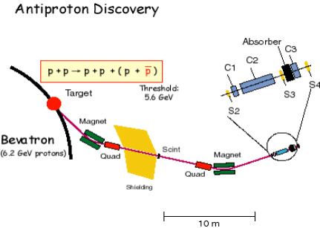
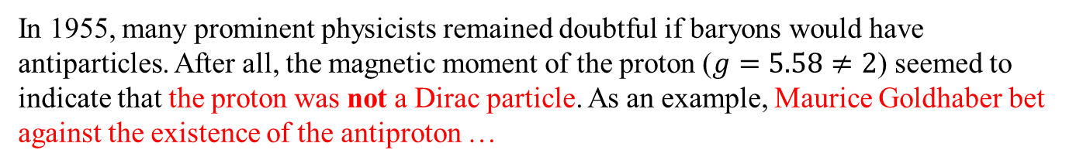
Discovery of antiproton (1955)
In 1955, many prominent physicists remained doubtful if baryons would have antiparticles. After all, the magnetic moment of the proton ($g=5.58≠2$) seemed to indicate that the proton was not a Dirac particle. As an example, Maurice Goldhaber bet against the existence of the antiproton …
… and lost
(he gave Snyder 500 $
in November 1955)
The energy of the Bevatron at Berkeley had been designed for the production of the antiproton and as built by Ernest Lawrence and his team.

Slide 14
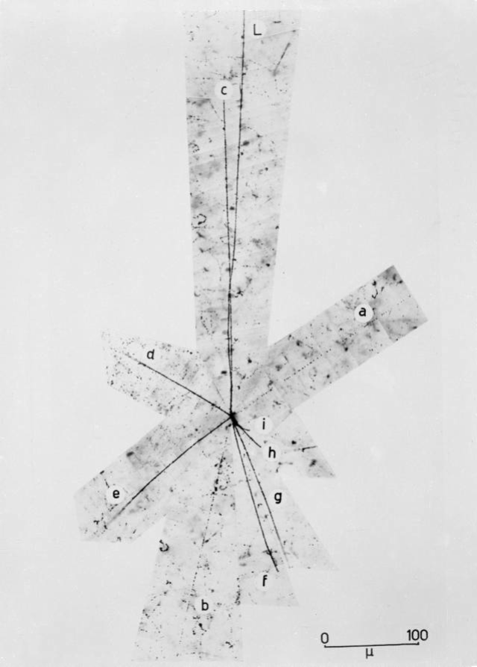
Discovery of antiproton (1955)
Antiproton annihilation
First symmetry test – mass, charge agreed to ~10%

Slide 15
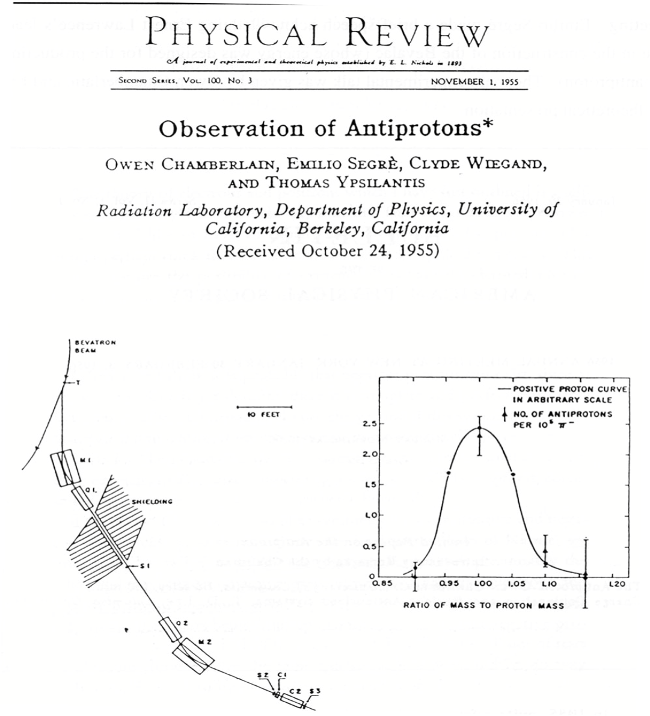
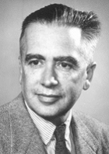
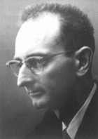
Discovery of antiproton (1955)
Segrè
Nobel prize (1959)
for 50% of the collaboration
Chamberlain
Tedious analysis …

Slide 16
Antineutron, Anti-Nuclei
Berkeley 1956: Discovery of antineutron
(Cork, Lambertson, Piccioni, Wenzel)
using the ‘antiproton beam’ and charge-exchange reaction
antiproton + proton → antineutron + neutron
The produced antineutron was recognizable by its annihilation properties, forming a star in the cloud chamber that is very similar to an antiproton star.
CERN 1965: Discovery of the anti-deuteron
(Massam, Muller, Righini, Schneegans, Zichichi)
The results reported imply the conclusion that a negative particle exists with mass equal to 1867±80 MeV. The most simple interpretation of these data is to identify this particle with the anti-deuteron.

Slide 17
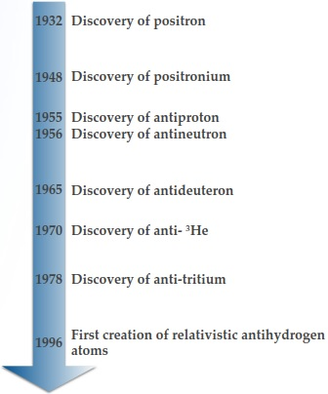
More Antimatter …
τ = 0.125 ns

Slide 18
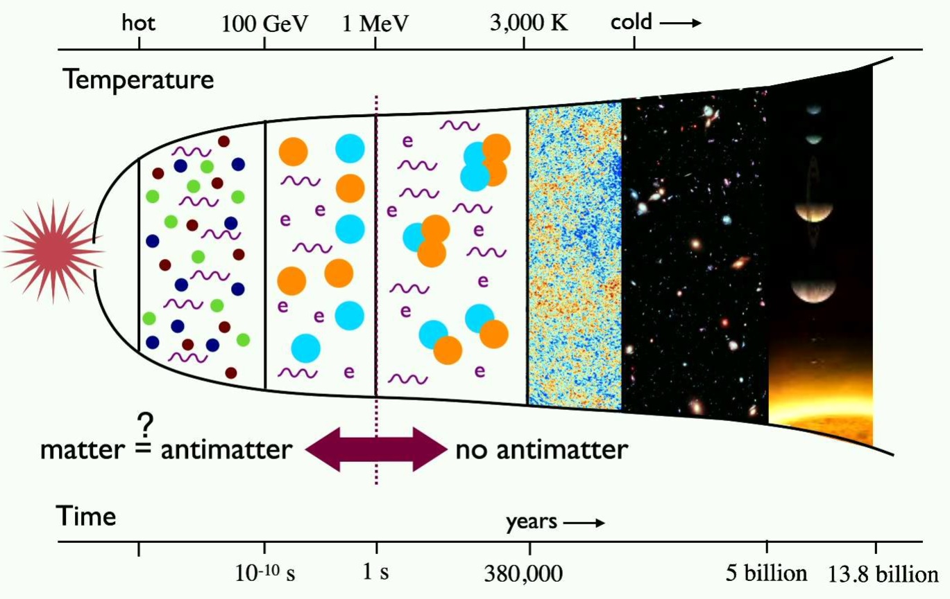
Matter-Antimatter Asymmetry in the Universe

Slide 19
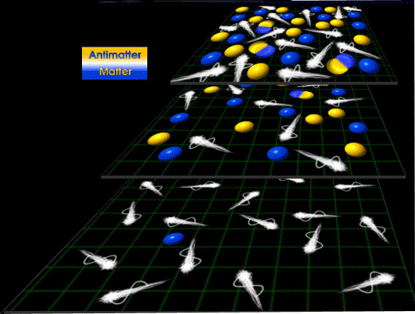
Matter-Antimatter Asymmetry in the Universe
Without asymmetry – we would not be here!

Slide 20
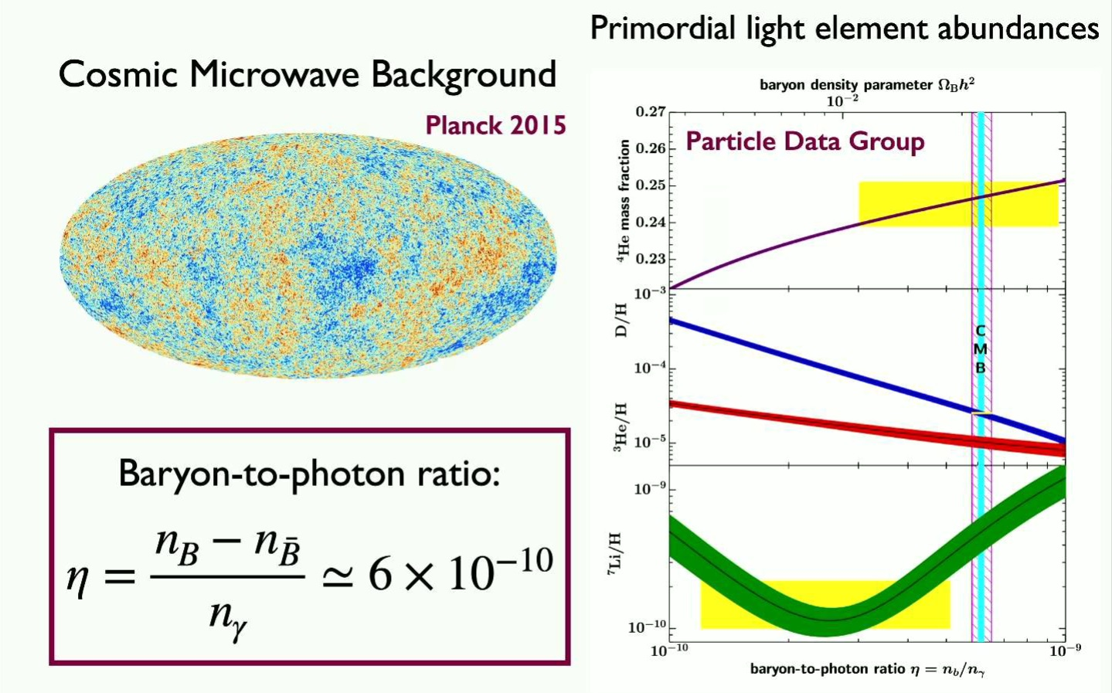
Matter-Antimatter Asymmetry in the Universe

Slide 21
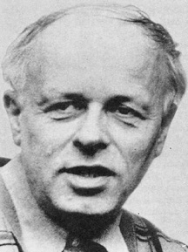
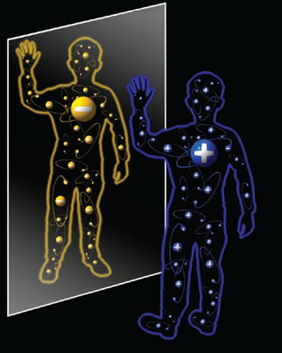
Sakharov’s Idea
Particles decay (a little) faster than antiparticles*
Small imbalance (1,000,000,001:1,000,000,000)
occurs during cool-down of Universe
Most particle-antiparticle pairs annihilate to radiation
Galaxies, stars, planets, us = ‘left-over’
Andrei D. Sacharow
Baryon number cannot be a conserved quantity
Charge and Charge-Parity (CP) symmetries must be violated
Out-of-equilibrium processes
*For experts: this is called ‘CP violation’
Consequence: Proton is not stable!
When we look at our image in a standard mirror, we are looking at the parity transformation of ourselves
CPT theorem: particles and antiparticles have the same mass, the same lifetime, but opposite charges (electric, baryonic, leptonic, etc.
Notes:
CP violation is not sufficient. violation of Baryon number needed

Slide 22
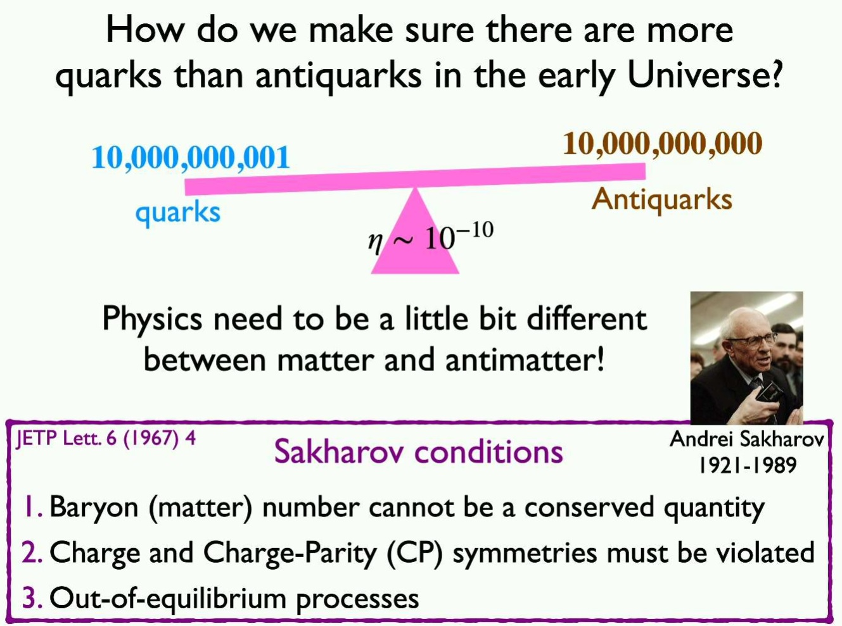
Matter-Antimatter Asymmetry

Slide 23
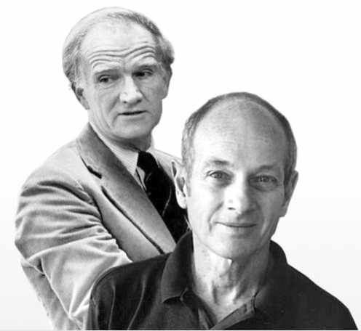
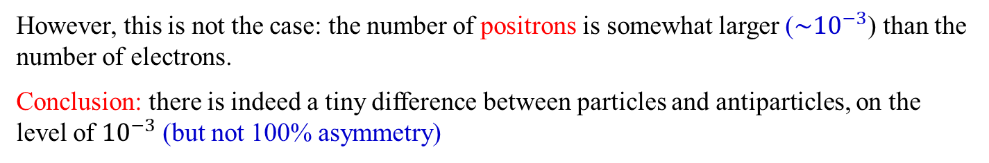


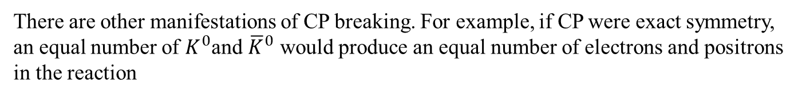
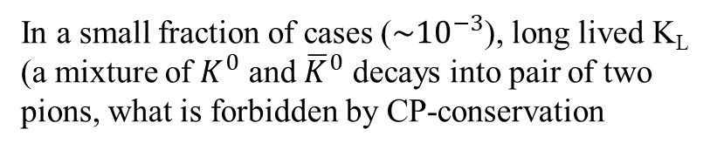
Matter-Antimatter Asymmetry in particle physics
1964 (Cronin, Fitch, Christenson, Turlay)
In a small fraction of cases ($\sim {10}^{−3}$), long lived K_{L} (a mixture of $K^{0}$ and ${\overline{K}}^{0}$ decays into pair of two pions, what is forbidden by CP-conservation
There are other manifestations of CP breaking. For example, if CP were exact symmetry, an equal number of $K^{0}$and ${\overline{K}}^{0}$ would produce an equal number of electrons and positrons in the reaction
$$K^{0}→π^{−}e^{+}ν_{e}$$
$${\overline{K}}^{0}→π^{+}e^{−}{\overline{ν}}_{e}$$
However, this is not the case: the number of positrons is somewhat larger ($\sim {10}^{−3}$) than the number of electrons.
Conclusion: there is indeed a tiny difference between particles and antiparticles, on the level of ${10}^{−3}$ (but not 100% asymmetry)

Slide 24
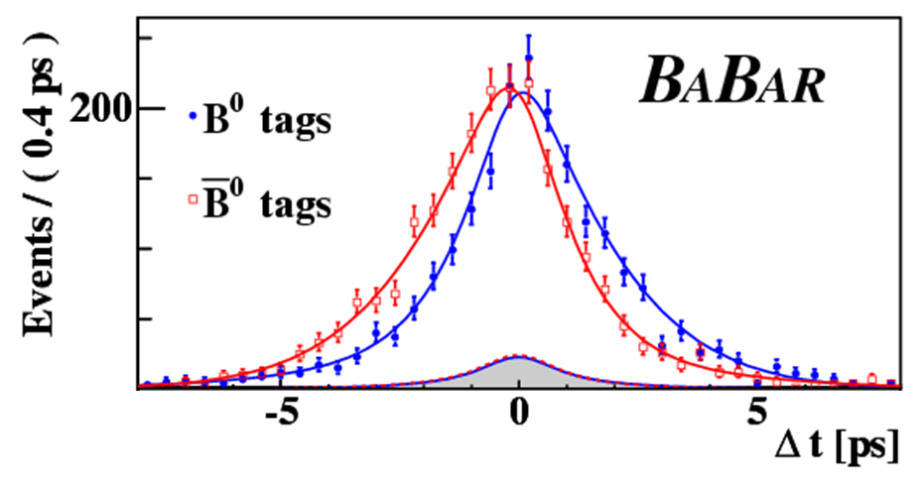
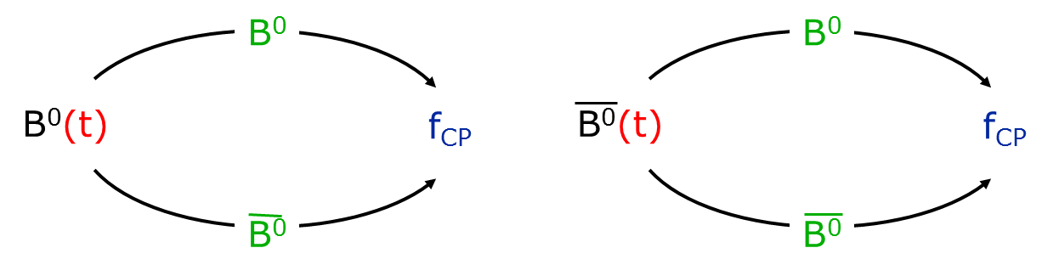


Measuring CP Violation with B⁰s
$$B^{0}=\overline{b}d$$
$$\overline{B^{0}}=b\overline{d}$$
Not equal –
CP Violation!
Stanford Linear Accelerator Center
B-meson

Slide 25



Why are neutrinos so interesting?
mass | < 0.120 eV/c²
charge | 0 e
spin | ½ ℏ
chirality | left
interaction | weak and gravitation
Particle/Nuclear Physics
  Fundamental questions about standard model
  Fundamental issues regarding interactions
Cosmology
  Density 336 neutrinos per cubic centimeter
  Leptogenesis and matter-antimatter asymmetry
Astrophysics
  Supernova explosions
  Solar burning

Slide 26



Two neutrino double beta decay
In some cases, the single beta decay is energetically forbidden.
Then the double beta decay becomes relevant
Carl von Weizäcker

Slide 27






Neutrinoless double-beta decay “forbidden” in SM
Paul Dirac
Ettore Majorana
Fermions
particle-antiparticle pair
Neutral Particles
they are their own antiparticles
works for massless neutrinos
$$ν=\overline{ν}$$

Slide 28


Which nuclei can decay via 0νββ ?
Even-even nuclei
Natural abundance is low (except ¹³⁰Te)
Must use enriched material
Best lower limits on T_{1/2}:
$1.07∙{10}^{26} yr$ for ¹³⁶Xe
$0.9 ∙{10}^{26}yr$ for ⁷⁶Ge
$2.7∙{ 10}^{24}yr$ for ¹³⁰Te

Slide 29



Dirac versus Majorana
Paul Dirac:
„The neutrino is not identical to the known antineutrino”
Ettore Majorana:
„The neutrino is identical to the known antineutrino”

Slide 30


Dirac versus Majorana
helicity:
projection of spin onto momentum
Paul Dirac:
„Even if the neutrino flips its helicity it is still a fundamentally different particle. The reaction is not possible”
Ettore Majorana:
„Neutrino only has the wrong helicity, if it can flip the helicity this reaction should be possible”

Slide 31

Gedankenexperiment

Slide 32

Dirac versus Majorana
helicity:
projection of spin onto momentum

Slide 33



Neutrinoless ββ-decay
Golden plated channel:
2 electrons
E_{β1}+ E_{β2}=Q_{ββ}
~<m>²/E²
(A,Z)→(Z+2,A)+2e⁻

Slide 34




Neutrinoless double-beta decay GERDA experiment
$$Q_{ββ}=2039 keV$$
Located in Hall A at Laboratori Nazionali del Gran Sasso of INFN
Array of bare Ge detectors 86% enriched in ⁷⁶Ge (~36 kg) directly inserted in liquid argon (LAr)
LEGEND 200 (kg)

Slide 35


Neutrinoless double-beta decay GERDA experiment

Slide 36

KATRIN = Karlsruhe Tritium Neutrino Experiment
Goal: measure neutrino mass with sensitivity of 0.2 eV

Slide 37




KATRIN = Karlsruhe Tritium Neutrino Experiment
neutrino mass (2025) < 0,45 eV/c²

Slide 38

Appendix
How many 0νββ decays occur …
for 1 t of Ge enriched to 86% ⁷⁶Ge
in 1 year
and if the half-life for 0νββ of ⁷⁶Ge was 10²⁷ years

Slide 39

Appendix
How many 0νββ decays occur …

Slide 40


Appendix
How many 0νββ decays occur …

