Slide 1
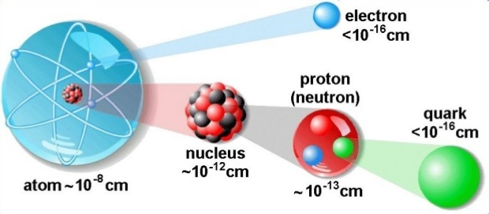
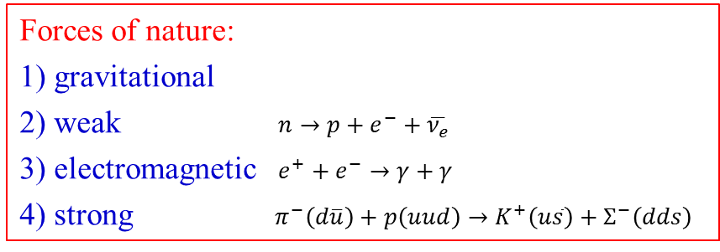
Basic Concepts
Particle physics studies the elementary “building blocks” of matter and interaction between them.
Matter consists of particles and fields.
Particles interact via forces caused by fields.
Forces are being carried by special particles, called gauge bosons.
Forces of nature:
1) gravitational
2) weak $n→p+e^{−}+\overline{ν_{e}}$
3) electromagnetic $e^{+}+e^{−}→γ+γ$
4) strong $π^{−}\left(d\overline{u}\right)+p\left(uud\right)→K^{+}\left(u\overline{s}\right)+Σ^{−}\left(dds\right)$

Slide 2
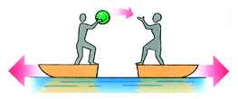
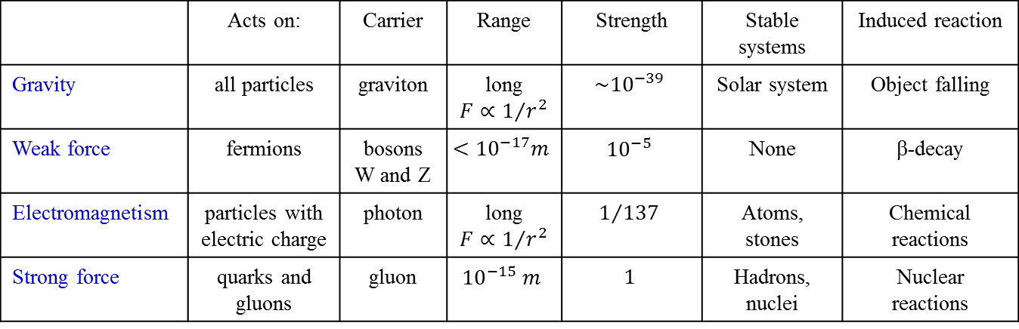
Forces of Nature
 | Acts on: | Carrier | Range | Strength | Stable systems | Induced reaction
Gravity | all particles | graviton | long $F∝1/{r^{2}}$ | $$\sim {10}^{−39}$$ | Solar system | Object falling
Weak force | fermions | bosons W and Z | $$<{10}^{−17}m$$ | $${10}^{−5}$$ | None | β-decay
Electromagnetism | particles with electric charge | photon | long $F∝1/{r^{2}}$ | $$1/{137}$$ | Atoms, stones | Chemical reactions
Strong force | quarks and gluons | gluon | $${10}^{−15} m$$ | $$1$$ | Hadrons, nuclei | Nuclear reactions
Two people are standing in boats. One person
moves their arm and is pushed backwards; a moment later the other person grabs at an invisible object and is driven backwards. Even though you cannot see a basketball, you can assume that one person threw a basketball to the other person because you see its effect on the people.
It turns out that all interactions which affect matter
particles are due to an exchange of force carrier particles, a different type of particle altogether. These particles are like basketballs tossed between matter particles (which are like the basketball players). What we normally think of as "forces" are actually the effects of force carrier particles on matter particles.

Slide 3
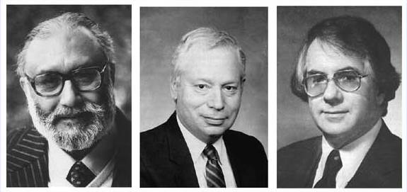
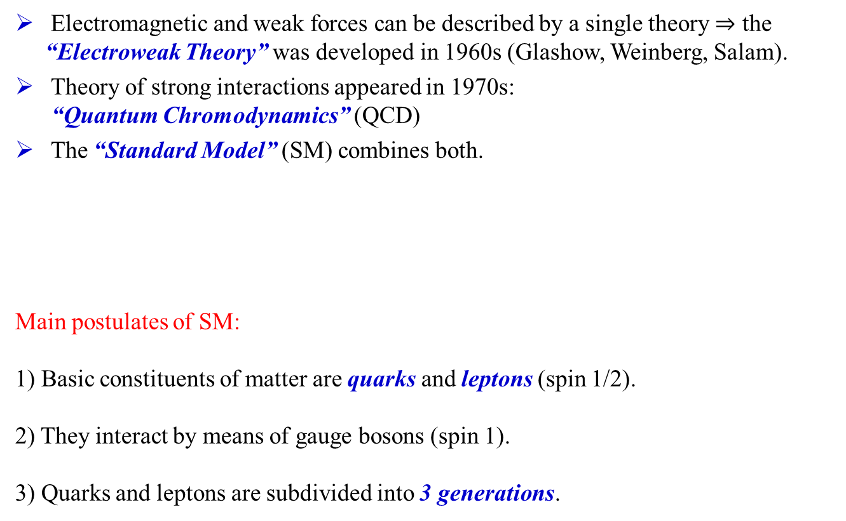
The Standard Model
Electromagnetic and weak forces can be described by a single theory $⇒$ the “Electroweak Theory” was developed in 1960s (Glashow, Weinberg, Salam).
Theory of strong interactions appeared in 1970s:
“Quantum Chromodynamics” (QCD)
The “Standard Model” (SM) combines both.
Main postulates of SM:
1) Basic constituents of matter are quarks and leptons (spin 1/2).
2) They interact by means of gauge bosons (spin 1).
3) Quarks and leptons are subdivided into 3 generations.
Abdus Salam, Steven Weinberg, Sheldon L. Glashow

Slide 4
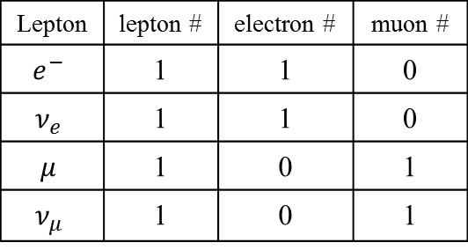

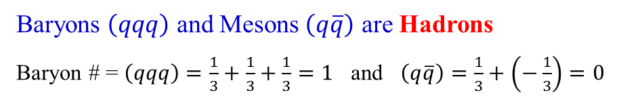




The Standard Model
Fermions
Bosons
Leptons and
Quarks
Spin = $\frac{1}{2}$
Force Carrier
Particles
Spin = 1*
Baryons $\left(qqq\right)$
Spin = $\frac{1}{2}, \frac{3}{2}, \frac{5}{2}, ⋯$
Spin = $0, 1, 2, ⋯$
Meson $\left(q\overline{q}\right)$
Baryons $\left(qqq\right)$ and Mesons $\left(q\overline{q}\right)$ are Hadrons
Baryon # = $\left(qqq\right)=\frac{1}{3}+\frac{1}{3}+\frac{1}{3}=1$ and $\left(q\overline{q}\right)=\frac{1}{3}+\left(−\frac{1}{3}\right)=0$
Lepton | lepton # | electron # | muon #
$$e^{−}$$ | 1 | 1 | 0
$$ν_{e}$$ | 1 | 1 | 0
$$μ$$ | 1 | 0 | 1
$$ν_{μ}$$ | 1 | 0 | 1
Lepton numbers are conserved in any reaction
(for anti-leptons L = -1)

Slide 5
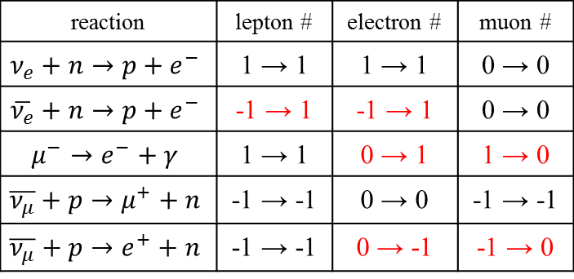
Consequence of Lepton-Number Conservation
reaction | lepton # | electron # | muon #
$$ν_{e}+n→p+e^{−}$$ | 1 → 1 | 1 → 1 | 0 → 0
$$\overline{ν_{e}}+n→p+e^{−}$$ | -1 → 1 | -1 → 1 | 0 → 0
$$μ^{−}→e^{−}+γ$$ | 1 → 1 | 0 → 1 | 1 → 0
$$\overline{ν_{μ}}+p→μ^{+}+n$$ | -1 → -1 | 0 → 0 | -1 → -1
$$\overline{ν_{μ}}+p→e^{+}+n$$ | -1 → -1 | 0 → -1 | -1 → 0

Slide 6
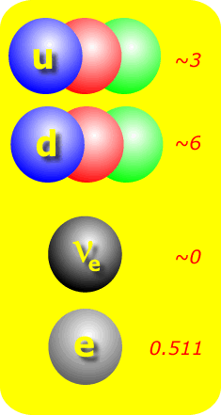
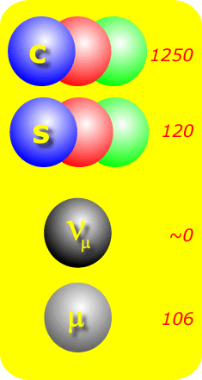
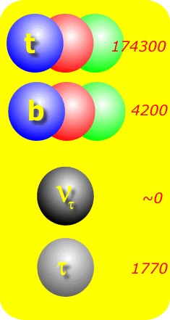
Fermions: The Elementary Players
1st generation
2nd generation
3rd generation
charge [e]
2/3
Quarks
-1/3
0
Leptons
-1

Slide 7


Color charge of quarks
So one had to explain why one saw only those combinations of quarks and antiquarks that had integer charge, and why no one ever saw a q, qq, qqqbar, or countless other combinations.
Gell-Mann and others proposed that quarks can have three color charges. This type of charge was called "color" because certain combinations of quark colors would be "neutral" in the sense that three ordinary colors can yield white, a neutral color.
This also resolve a problem with Pauli principle

Slide 8
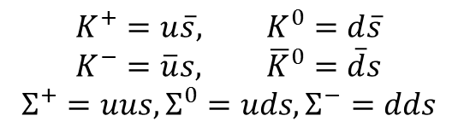
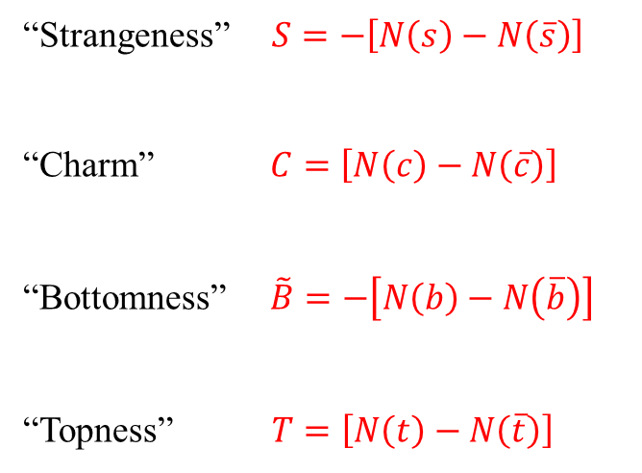
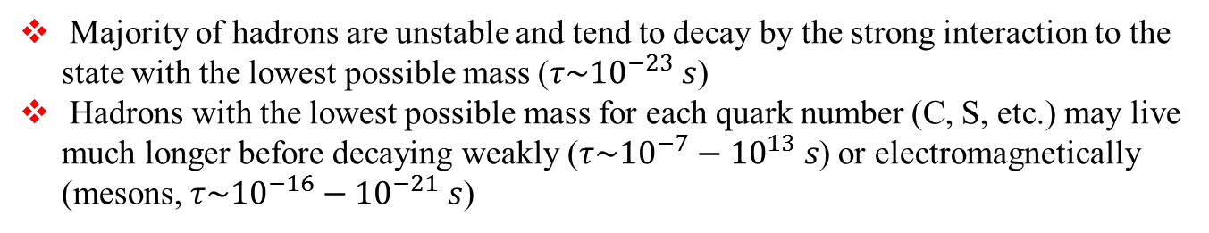
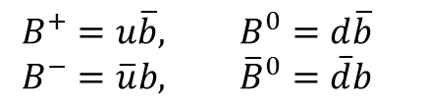
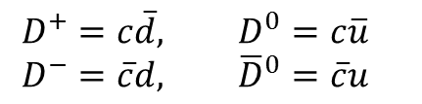
Quantum Numbers and Flavours
$$K^{+}=u\overline{s}, K^{0}=d\overline{s}$$
$$K^{−}=\overline{u}s, {\overline{K}}^{0}=\overline{d}s$$
$$Σ^{+}=uus, Σ^{0}=uds, Σ^{−}=dds$$
“Strangeness” $S=−\left[N\left(s\right)−N\left(\overline{s}\right)\right]$
“Charm” $C=\left[N\left(c\right)−N\left(\overline{c}\right)\right]$
“Bottomness” $\tilde{B}=−\left[N\left(b\right)−N\left(\overline{b}\right)\right]$
“Topness” $T=\left[N\left(t\right)−N\left(\overline{t}\right)\right]$
$$D^{+}=c\overline{d}, D^{0}=c\overline{u}$$
$$D^{−}=\overline{c}d, {\overline{D}}^{0}=\overline{c}u$$
$$B^{+}=u\overline{b}, B^{0}=d\overline{b}$$
$$B^{−}=\overline{u}b, {\overline{B}}^{0}=\overline{d}b$$
No composite hadrons are formed that contain the top (anti) quark
Majority of hadrons are unstable and tend to decay by the strong interaction to the state with the lowest possible mass ($τ\sim {10}^{−23} s$)
Hadrons with the lowest possible mass for each quark number (C, S, etc.) may live much longer before decaying weakly ($τ\sim {10}^{−7}−{10}^{13} s$) or electromagnetically (mesons, $τ\sim {10}^{−16}−{10}^{−21} s$)

Slide 9
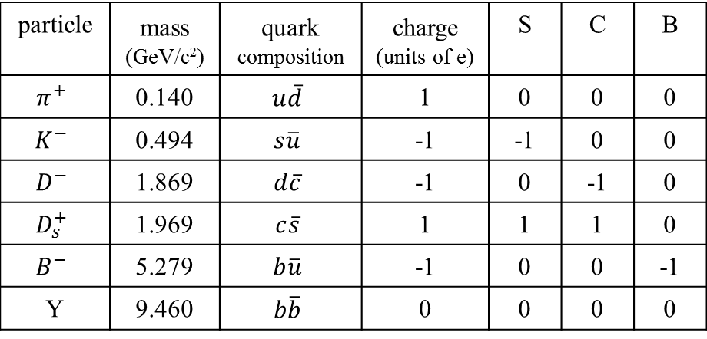
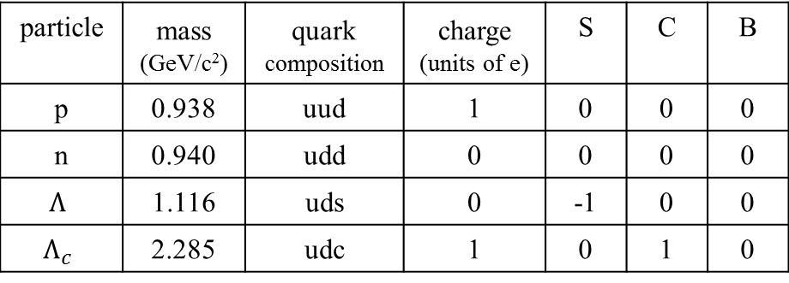
Quantum Numbers and Flavours
Some examples of baryons:
particle | mass (GeV/c²) | quark composition | charge (units of e) | S | C | B
p | 0.938 | uud | 1 | 0 | 0 | 0
n | 0.940 | udd | 0 | 0 | 0 | 0
$$Λ$$ | 1.116 | uds | 0 | -1 | 0 | 0
$$Λ_{c}$$ | 2.285 | udc | 1 | 0 | 1 | 0
Some examples of mesons:
particle | mass (GeV/c²) | quark composition | charge (units of e) | S | C | B
$$π^{+}$$ | 0.140 | $$u\overline{d}$$ | 1 | 0 | 0 | 0
$$K^{−}$$ | 0.494 | $$s\overline{u}$$ | -1 | -1 | 0 | 0
$$D^{−}$$ | 1.869 | $$d\overline{c}$$ | -1 | 0 | -1 | 0
$$D_{s}^{+}$$ | 1.969 | $$c\overline{s}$$ | 1 | 1 | 1 | 0
$$B^{−}$$ | 5.279 | $$b\overline{u}$$ | -1 | 0 | 0 | -1
Y | 9.460 | $$b\overline{b}$$ | 0 | 0 | 0 | 0

Slide 10
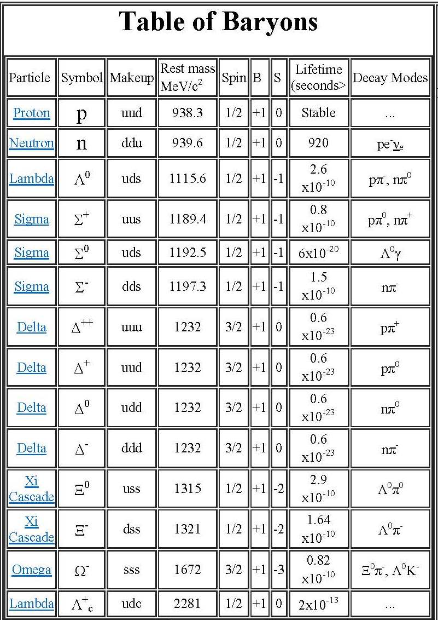
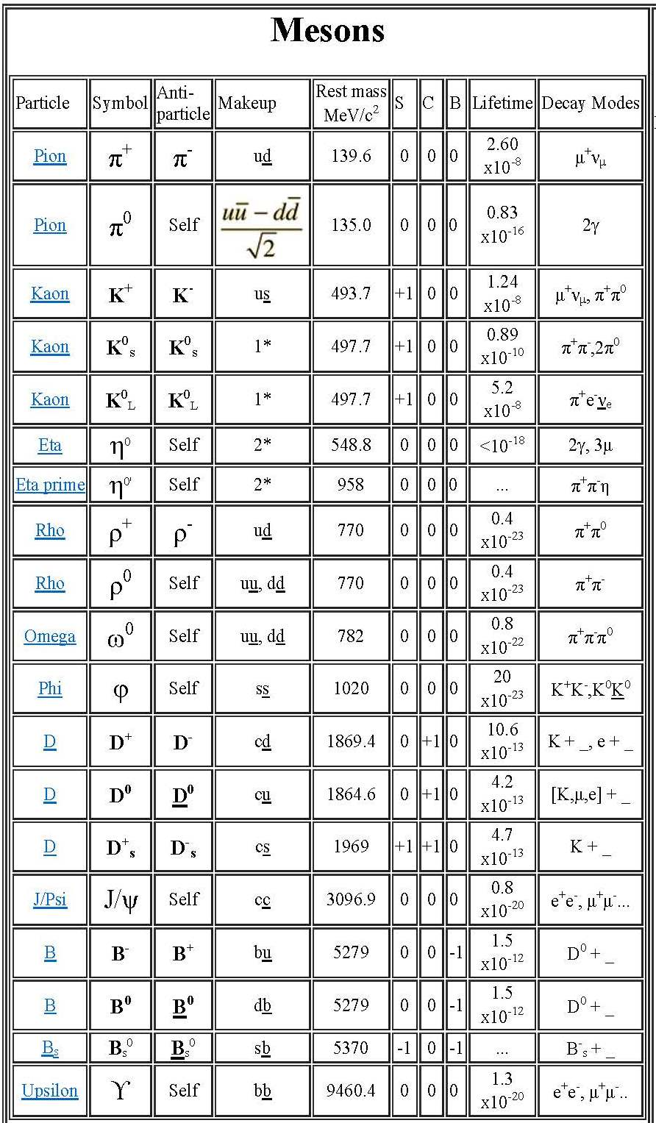
Table of Baryons and Mesons

Slide 11
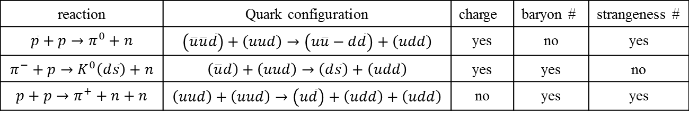
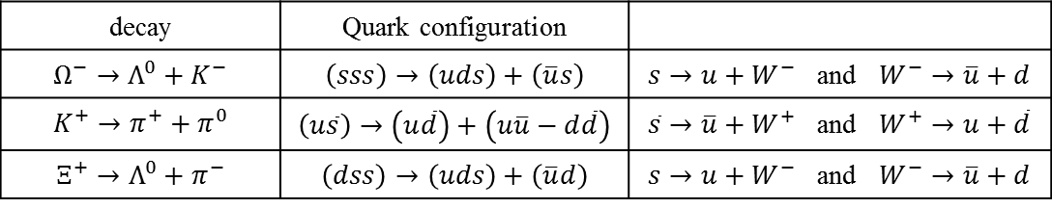
Consequence of Quark-Number Conservation
reaction | Quark configuration | charge | baryon # | strangeness #
$$\overline{p}+p→π^{0}+n$$ | $$\left(\overline{u}\overline{u}\overline{d}\right)+\left(uud\right)→\left(u\overline{u}−d\overline{d}\right)+\left(udd\right)$$ | yes | no | yes
$$π^{−}+p→K^{0}\left(d\overline{s}\right)+n$$ | $$\left(\overline{u}d\right)+\left(uud\right)→\left(d\overline{s}\right)+\left(udd\right)$$ | yes | yes | no
$$p+p→π^{+}+n+n$$ | $$\left(uud\right)+\left(uud\right)→\left(u\overline{d}\right)+\left(udd\right)+\left(udd\right)$$ | no | yes | yes
decay | Quark configuration
$$Ω^{−}→Λ^{0}+K^{−}$$ | $$\left(sss\right)→\left(uds\right)+\left(\overline{u}s\right)$$ | $s→u+W^{−}$ and $W^{−}→\overline{u}+d$
$$K^{+}→π^{+}+π^{0}$$ | $$\left(u\overline{s}\right)→\left(u\overline{d}\right)+\left(u\overline{u}−d\overline{d}\right)$$ | $\overline{s}→\overline{u}+W^{+}$ and $W^{+}→u+\overline{d}$
$$Ξ^{+}→Λ^{0}+π^{−}$$ | $$\left(dss\right)→\left(uds\right)+\left(\overline{u}d\right)$$ | $s→u+W^{−}$ and $W^{−}→\overline{u}+d$

Slide 12
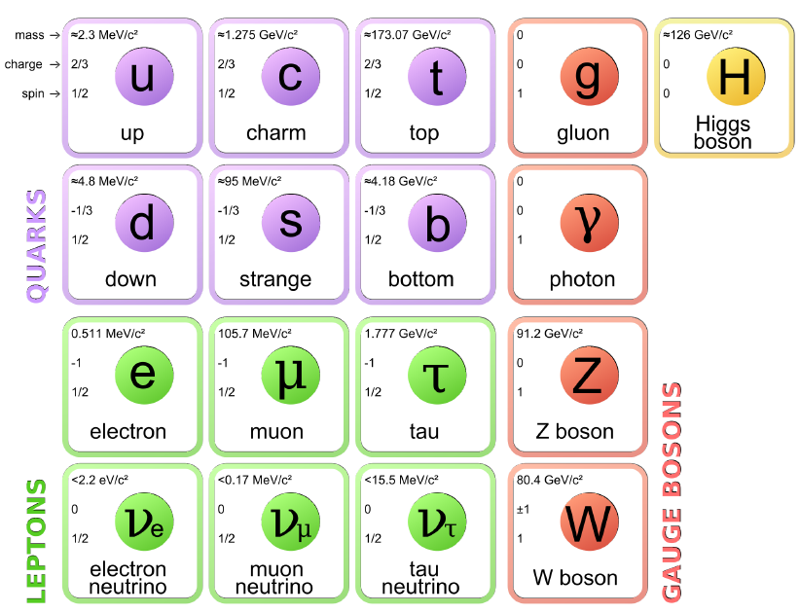
The Standard Model Chart
Three Generations of Matter (Fermions)
I II III
Force Carriers
(Gauge Bosons)
Strong Interactions
Electromagnetism
Weak Interactions
Standard Model does not explain neither appearance of the mass nor the reason for existence of 3 generations.

Slide 13

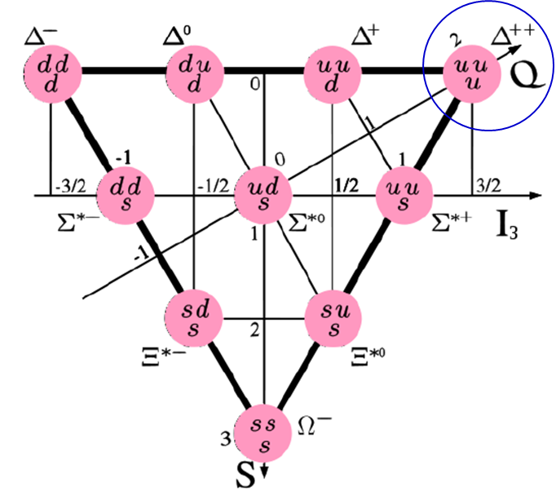
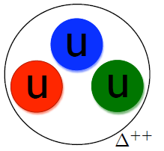
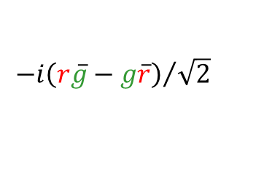
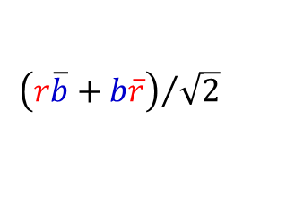
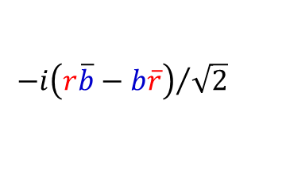
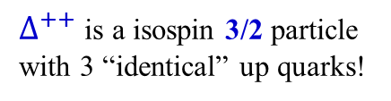
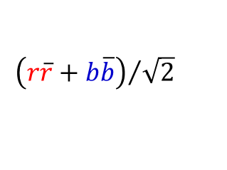
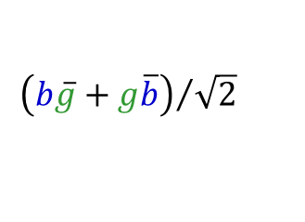
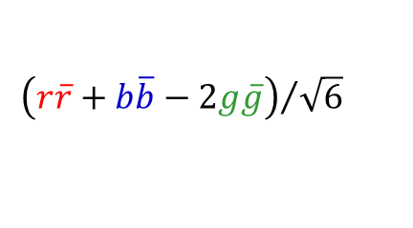
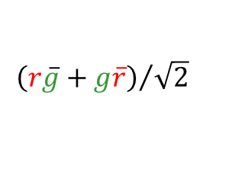
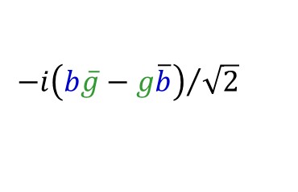
Why colored Quarks?
Three Generations
I II III
Force
Carriers
$∆^{++}$ is a isospin 3/2 particle with 3 “identical” up quarks!
Strong Interactions
Electromagnetism
Weak Interactions
Eight gluon colors
Pauli principle
$${\left(r\overline{b}+b\overline{r}\right)}/{\sqrt{2}}$$
$${−i\left(r\overline{b}−b\overline{r}\right)}/{\sqrt{2}}$$
$${\left(r\overline{g}+g\overline{r}\right)}/{\sqrt{2}}$$
$${−i\left(r\overline{g}−g\overline{r}\right)}/{\sqrt{2}}$$
$${\left(b\overline{g}+g\overline{b}\right)}/{\sqrt{2}}$$
$${−i\left(b\overline{g}−g\overline{b}\right)}/{\sqrt{2}}$$
$${\left(r\overline{r}+b\overline{b}\right)}/{\sqrt{2}}$$
$${\left(r\overline{r}+b\overline{b}−2g\overline{g}\right)}/{\sqrt{6}}$$

Slide 14
Particles and Interactions
_{Force} ^{Particles} | Quarks | Charged Leptons | Neutrinos
Strong | yes | no | no
Electromagnetic | yes | yes | no
Weak | yes | yes | yes
Quarks (hence hadrons) have all types of interactions!

Slide 15
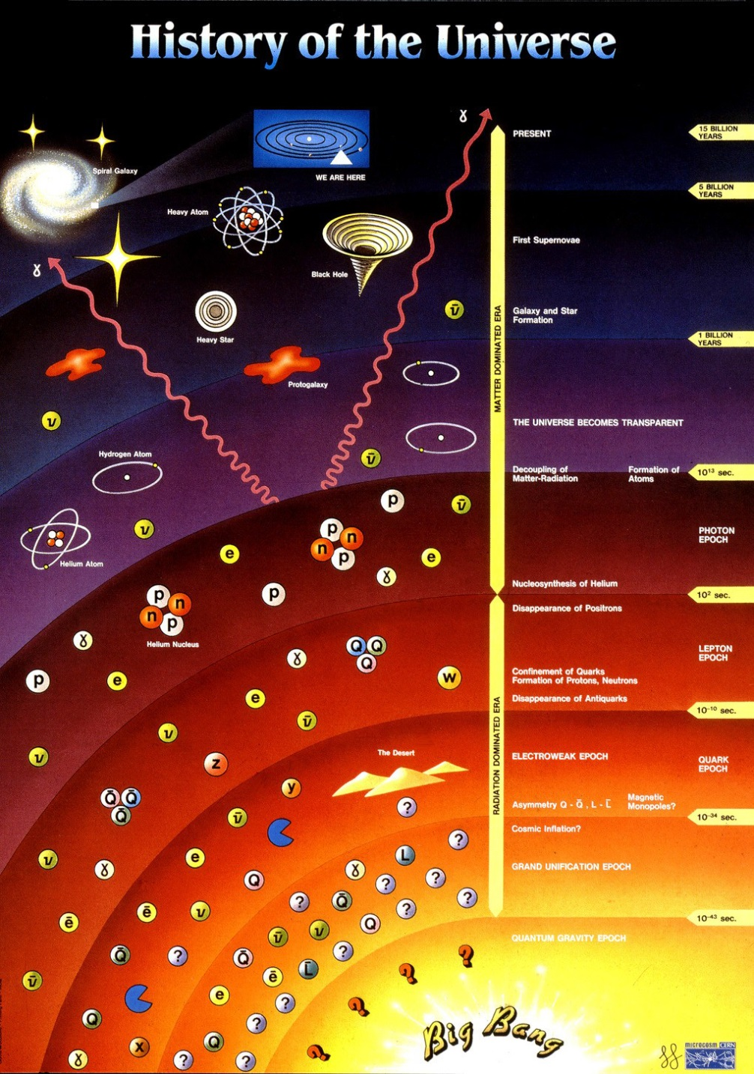

History of the Universe
era of gravitation
$${10}^{13} s$$
era of particle physics

Slide 16
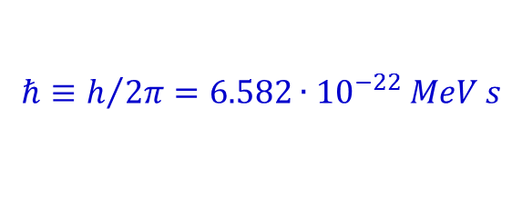

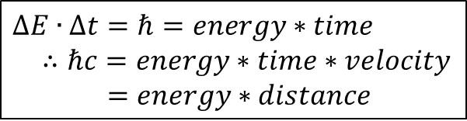

Units and Dimensions
The energy is measured in electron-Volts:
$$1 eV=1.602∙{10}^{−19} J$$
1 keV = 10³ eV; 1 MeV = 10⁶ eV; 1GeV = 10⁹ eV; 1 TeV = 10¹² eV
The Planck constant (reduced) is:
$$ℏ≡h/{2π}=6.582∙{10}^{−22} MeV s$$
and the “conversion constant” is:
$$ℏc=197.327∙{10}^{−15} MeV m$$
$∆E∙∆t=ℏ=energy∗time$
$∴ℏc=energy∗time∗velocity$
$=energy∗distance$
Charges measured in terms of electronic charges $e=1.6∙{10}^{−19}C$
Cross sections measured in terms of barns. $1 barn={10}^{−28} m^{2}$

Slide 17
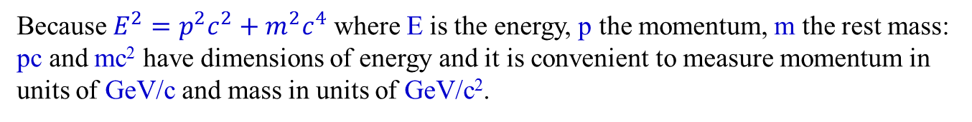
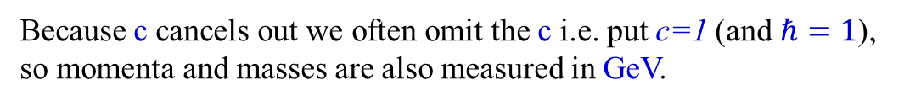
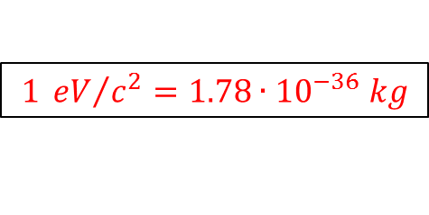
Units and Dimensions
Because $E^{2}=p^{2}c^{2}+m^{2}c^{4}$ where E is the energy, p the momentum, m the rest mass: pc and mc² have dimensions of energy and it is convenient to measure momentum in units of GeV/c and mass in units of GeV/c².
$${\left[E\left(GeV\right)\right]}^{2}={\left[p\left(GeV/c\right)\right]}^{2}c^{2}+{\left[m\left(GeV/c^{2}\right)\right]}^{2}c^{4}$$
$$1 {eV}/{c^{2}}=1.78∙{10}^{−36} kg$$
Because c cancels out we often omit the c i.e. put c=1 (and $ℏ=1$), so momenta and masses are also measured in GeV.

Slide 18

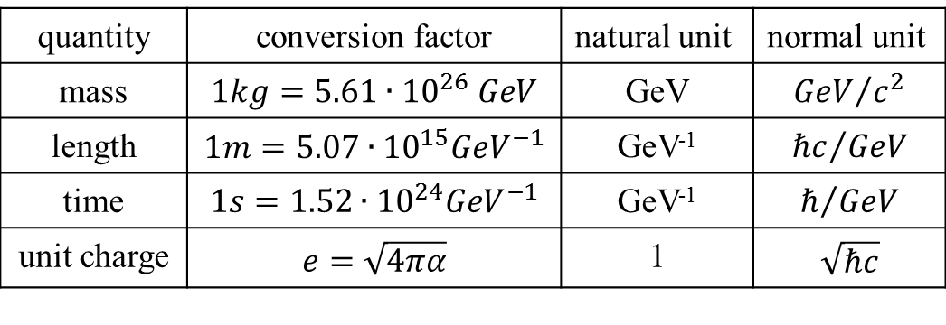
Units and Dimensions
This implies, however, that the results of calculations must be translated back to measureable quantities in the end. Conversion factors are the following:
quantity | conversion factor | natural unit | normal unit
mass | $$1kg=5.61∙{10}^{26} GeV$$ | GeV | $${GeV}/{c^{2}}$$
length | $$1m=5.07∙{10}^{15}{GeV}^{−1}$$ | GeV⁻¹ | $${ℏc}/{GeV}$$
time | $$1s=1.52∙{10}^{24}{GeV}^{−1}$$ | GeV⁻¹ | $$ℏ/{GeV}$$
unit charge | $$e=\sqrt{4πα}$$ | 1 | $$\sqrt{ℏc}$$
Excercise-1:
Derive the conversion factors for mass, length and time in the table above.
$$Joule=6.25∙{10}^{18} eV$$
$$E=m∙c^{2}=1kg∙8.99∙{10}^{16}\left[Joule\right]=8.99∙{10}^{16}∙6.25∙{10}^{18}\left[eV\right]=5.61∙{10}^{26}\left[GeV\right]$$

Slide 19
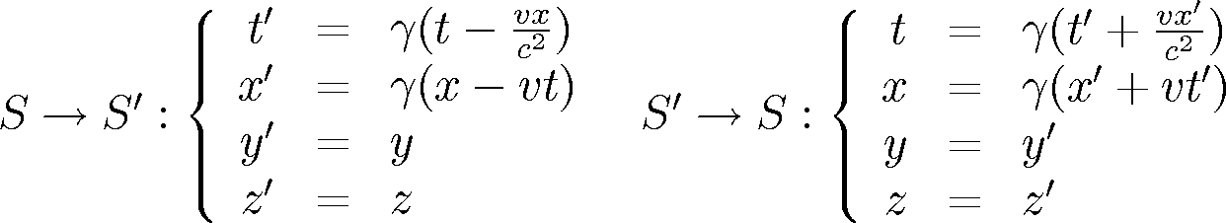
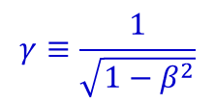

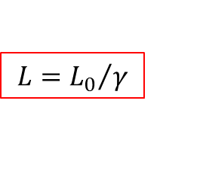

Lorentz Transformation
Co-moving coordinate systems
S
S’
v
x’’
x
$$γ≡\frac{1}{\sqrt{1−β^{2}}}$$
$$β=\frac{v}{c}$$
Lorentz contraction:
$$L={L_{0}}/γ$$
Time dilatation:
$$t=t_{0}∙γ$$

Slide 20
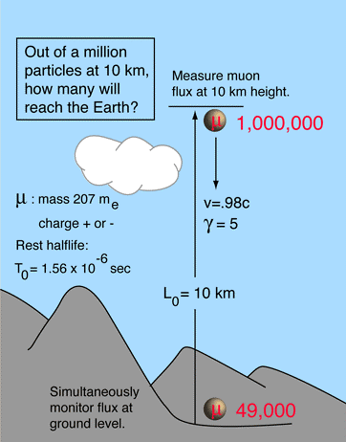
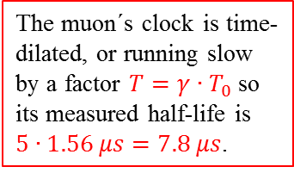
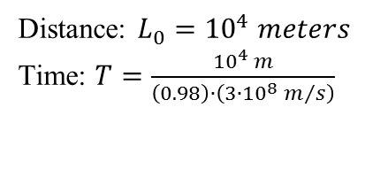


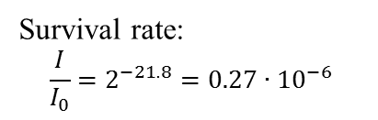

Time Dilatation
non-relativistic
Earth-frame observer
Distance: $L_{0}={10}^{4} meters$
Time: $T=\frac{{10}^{4} m}{\left(0.98\right)∙\left(3∙{10}^{8} m/s\right)}$
$$T=34∙{10}^{−6} s=21.8 halflives$$
$$=4.36 halflives$$
Survival rate:
$$\frac{I}{I_{0}}=2^{−21.8}=0.27∙{10}^{−6}$$
$$\frac{I}{I_{0}}=2^{−4.36}=0.049$$
Or only about 0.3 out of a million
Or only about 49000 out of a million
The muon´s clock is time-dilated, or running slow by a factor $T=γ∙T_{0}$ so its measured half-life is $5∙1.56 μs=7.8 μs$.

Slide 21
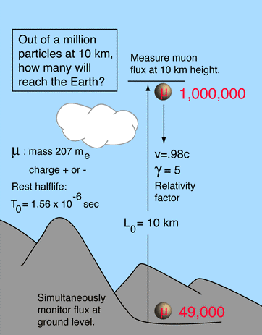



Lorentz Contraction
non-relativistic
Muon-frame observer
Distance: $L_{0}={10}^{4} meters$
Time: $T=\frac{{10}^{4} m}{\left(0.98\right)∙\left(3∙{10}^{8} m/s\right)}$
$$=\frac{2000 m}{\left(0.98\right)∙\left(3∙{10}^{8} m/s\right)}$$
$$T=34∙{10}^{−6} s=21.8 halflives$$
$$=6.8∙{10}^{6} s$$
$$=4.36 halflives$$
Survival rate:
$$\frac{I}{I_{0}}=2^{−21.8}=0.27∙{10}^{−6}$$
$$\frac{I}{I_{0}}=2^{−4.36}=0.049$$
Or only about 0.3 out of a million
Or only about 49000 out of a million
The muon sees distance as length-contracted , so that $L={L_{0}}/{γ=0.2∙L_{0}}$ $=2 km$.

Slide 22










Relativistic Kinematics
The relativistic relationship between the total energy E, momentum p and rest mass m is
$$E^{2}=p^{2}c^{2}+m^{2}c^{4}$$
$$Non relativistic \left(p≪m\right):$$
$$E={\left(p^{2}c^{2}+m^{2}c^{4}\right)}^{1/2}$$
$=mc^{2}∙{\left(1+{p^{2}c^{2}}/{m^{2}c^{4}}\right)}^{1/2}$
$=mc^{2}∙\left(1+{p^{2}}/{2m^{2}c^{2}}+⋯\right)$
$≅mc^{2}+{p^{2}}/{2m} \left(p=mv\right)$
$≅mc^{2}+\frac{1}{2}mv^{2}$
or
$$E^{2}=p_{x}^{2}c^{2}+p_{y}^{2}c^{2}+{}_{z}^{2}pc^{2}+m^{2}c^{4}$$
The particle velocity $v=βc$ or $β=v/c$ and the Lorentz factor
$$γ=\frac{1}{\sqrt{1−{v^{2}}/{c^{2}}}}=\frac{1}{\sqrt{1−β^{2}}}$$
So that $γ^{2}\left(1−β^{2}\right)=1$ or $γ^{2}=γ^{2}β^{2}+1$
- multiplied by $m^{2}c^{4}$
$$γ^{2}m^{2}c^{4}=γ^{2}β^{2}m^{2}c^{4}+m^{2}c^{4}$$
Compare with
$$E^{2}=p^{2}c^{2}+m^{2}c^{4}$$
$E=γmc^{2}$ and $p=γβmc$ or $γ=E/{mc^{2}}$ and $β=p/{γmc}={pc}/E$

Slide 23





$$Invariant Mass$$
$$M^{2}={\left(\sum_{i}{E_{i}}\right)}^{2}−{\left(\sum_{i}{\vec{p_{i}}}\right)}^{2}$$
$π^{0}→γγ$ decay:
(two massless particles)
$$M^{2}={\left[\left(p_{1},0,0,p_{1}\right)+\left(p_{2},0,p_{2}sinθ,p_{2}cosθ\right)\right]}^{2}={\left(p_{1}+p_{2}\right)}^{2}−p_{2}^{2}\sin^{2}θ−{\left(p_{1}+p_{2}cosθ\right)}^{2}$$
$$=2p_{1}p_{2}\left(1−cosθ\right)$$
$$\left(E,p_{x},p_{y},p_{z}\right)$$

Slide 24





Example: Data from Two Arm Photon Spectrometer TAPS
γγ invariant mass
signal
$$π^{0}→γγ$$
Compute invariant mass $m_{γγ}$ for all possible photon pairs
combinatorial background
$$m_{γγ}=\sqrt{2E_{γ1}E_{γ2}\left(1−cosθ_{γγ}\right)}$$

Slide 25


Compressed nuclear matter

Slide 26

Compressed nuclear matter

Slide 27


Slide 28


Slide 29


Slide 30



Slide 31


Slide 32
Probing the interior of the dense interaction zone
e.g. Au+Au @ 1 GeV/u
ρ = 2-3ρ₀
T < 100 MeV
n
π
p
p
Λ
π
ρ
e⁺
Δ⁺⁺
K
e⁻

Slide 33

The HADES experiment @ GSI
Probing the interior of the dense interaction zone

Slide 34
Observables
Scattering Cross section (σ)
Decays Decay rate (Γ)
Both σ and Γ are related to the probability for the considered process to occur

Slide 35



Cross Section
Consider a beam of projectiles of intensity Φ_{a} particles/sec which hits a thin foil of target nuclei with the result that the beam is attenuated by reactions in the foil such that the transmitted intensity is Φ particles/sec.
The fraction of the incident particles disappear from the beam, i.e. react, in passing through the foil is given by
The number of reactions that are occurring is the difference between the initial and transmitted flux
d
A
v_{a}
$$dΦ=−Φ∙n_{b}∙σ∙dx$$
$$Φ_{initial}−Φ_{trans}=Φ_{initial}\left(1−exp\left[−n_{b}∙d∙σ\right]\right)$$
$$≈Φ_{initial}∙N_{b}∙σ$$
(for thin target)
Example:
Φ_{a} = n_{a}·v_{a}
N_{b} = n_{b}·A·d
A particle current of 1 pnA consists of 6·10⁹ projectiles/s.
A ¹³²Sn target (1 mg/cm²) consists of 5·10¹⁸ nuclei/cm²
$$\frac{6∙{10}^{23}∙{10}^{−3} g/{{cm}^{2}}}{132g}=4.5∙{10}^{18} \left[\frac{target nuclei}{{cm}^{2}}\right]$$
Luminosity = projectiles [s⁻¹] · target nuclei [cm⁻²]
Luminosity (projectile → ¹³²Sn) = 3·10²⁸ [s⁻¹cm⁻²]
Reaction rate [s⁻¹] = luminosity · cross section [cm²]
= projectiles [s⁻¹] · target nuclei [cm⁻²] · cross section [cm²]

Slide 36


Decay Time and Lifetime
$$τ=proper time \left(measured in the particle rest frame\right)$$
In laboratory frame: $λ_{decay}=γβc∙τ$

Slide 37




Decay Width
cross section σ
$$Γ≡\frac{ℏ}{τ}$$
FWHM
Uncertainty principle
E₀ E
If a particle has a finite lifetime τ, it decays with probability $e^{−t/τ}$ and a decay width Γ can be defined. One can interpret $Γ∙τ=ℏ$ as a relationship between uncertainty in energy (mass) and lifetime i.e. $∆E∙∆t=ℏ$.
Strongly decaying particles have very short lifetimes and hence large width. The $ρ\left(770\right)$ has $Γ=151 MeV$ and $τ=4.4∙{10}^{−24} s$.
Weakly decaying particles have longer lifetimes and hence much smaller widths. The $K^{0}$ meson has $Γ=7.3∙{10}^{−12} MeV$ and $τ=0.9∙{10}^{−10} s$.

