Slide 1
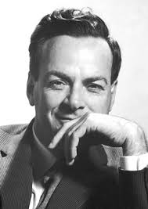
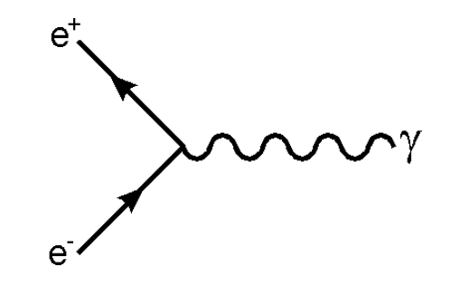








Feynman diagrams
In 1940s, R. Feynman developed a diagram technique to describe particle interactions in space-time.
Feynman diagram example
Richard Feynman
time
Particles are represented by lines
Fermion $f$
Particles go forward in time
Antifermion $\overline{f}$
Antiparticles go backwards in time
$$γ, Z, W$$
Gluon
Boson

Slide 2
Feynman diagrams
In 1940s, R. Feynman developed a diagram technique to describe particle interactions in space-time.
Feynman diagram example
Richard Feynman
time
Main assumptions and requirements:
Time runs from left to right (convention)
Particles are usually denoted with solid lines, and gauge bosons - with helices or dashed lines
Arrow directed towards the right indicates a particle, otherwise – antiparticle
Points at which 3 or more particles meet are called vertices
At any vertex, momentum, angular momentum and charge are conserved (but not energy)

Slide 3



Feynman diagrams
Feynman diagrams are like circuit diagrams – they show what is connected to, but length and angle of momentum vectors are not relevant.
space
A particle moving (instantaneously) from one point to another
Richard Feynman
A particle moving forward in time and space
A particle at rest
time
Fermion $f$
Antifermion $\overline{f}$
$$γ, Z, W$$
Gluon
Boson

Slide 4
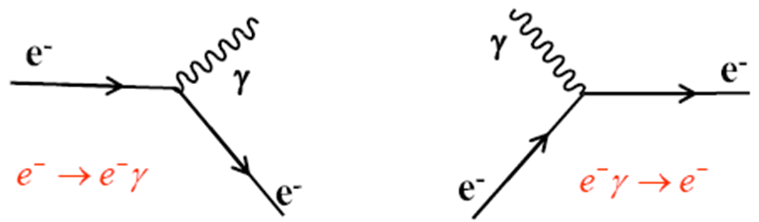
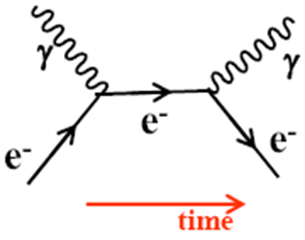
Vertices
Lines connect into vertices, which are the building blocks of Feynman diagrams
Charge, lepton number and baryon number as well as momentum are always conserved at a vertex.
Compton scattering
A photon scatters from an electron producing a photon and an electron in the final state
Lowest order diagram has two vertices

Slide 5
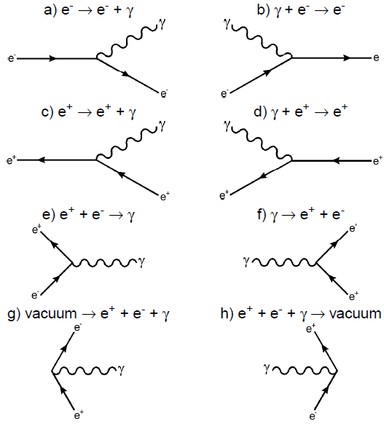
Virtual processes
Feynman diagrams for basic processes involving electron, positron and photon

Slide 6
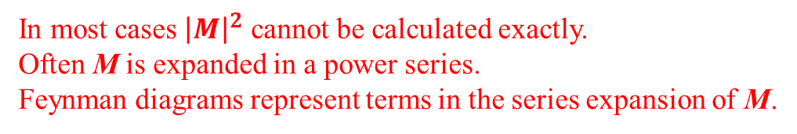


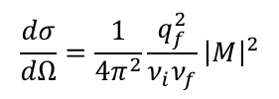
Feynman Diagrams
Each Feynman diagram represents an Amplitude (M)
$$transition rate=\frac{2π}{ℏ}{\left|M\right|}^{2}×\left(phase space\right)$$
In lowest order perturbation theory M is the Fourier transformation of the potential. “Born Approximation”
Fermi’s Golden Rule:
Differential cross section for two body scattering (e.g. $pp→pp$) in the CM system:
$$\frac{dσ}{dΩ}=\frac{1}{4π^{2}}\frac{q_{f}^{2}}{ν_{i}ν_{f}}{\left|M\right|}^{2}$$
q_{f} = final state momentum
v_{f} = speed of final state particle
v_{i} = speed of initial state particle
The decay rate (Γ) for a two body decay (e.g. $K^{0}→π^{+}π^{−}$) in the CM system:
$$Γ=\frac{S∙\left|\vec{p}\right|}{8πℏm^{2}c}{\left|M\right|}^{2}$$
m = mass of parent
p = momentum of decay particle
S = statistical factor (fermions/bosons)
In most cases ${\left|M\right|}^{2}$ cannot be calculated exactly.
Often M is expanded in a power series.
Feynman diagrams represent terms in the series expansion of M.

Slide 7
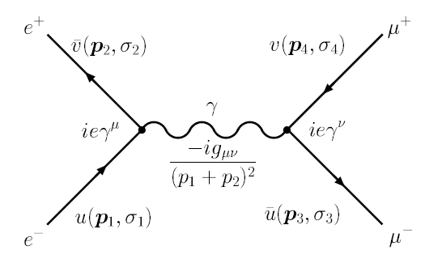
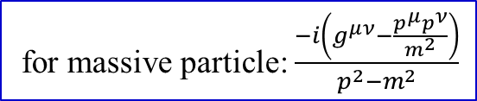
Feynman Diagrams
$$−iM=\left[\overline{u}\left(p_{3},σ_{3}\right)\left(ieγ^{ν}\right)v\left(p_{4},σ_{4}\right)\right]\frac{−ig_{μν}}{{\left(p_{1}+p_{2}\right)}^{2}}\left[\overline{v}\left(p_{2},σ_{2}\right)\left(ieγ^{μ}\right)u\left(p_{1},σ_{1}\right)\right]$$
for massive particle: $\frac{−i\left(g^{μν}−\frac{p^{μ}p^{ν}}{m^{2}}\right)}{p^{2}−m^{2}}$

Slide 8
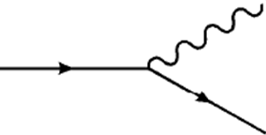
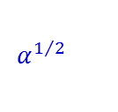

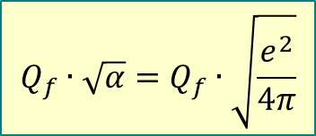
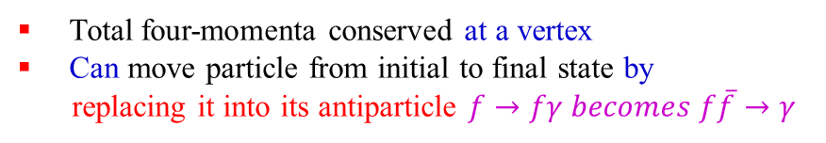

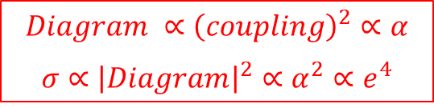

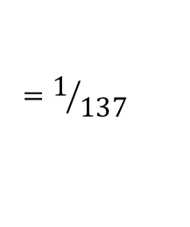



Feynman Diagrams
A coupling constant (multiplication factor) is associated with each vertex.
Value of coupling constant depends on type of interaction
$$Q_{f}=fermion charge$$
$$f$$
$$γ$$
(in units of electron charge)
$$Q_{f}∙\sqrt{α}=Q_{f}∙\sqrt{\frac{e^{2}}{4π}}$$
$$f$$
Electromagnetic $f→fγ$
Example: Compton scattering of an electron
$$Diagram ∝{\left(coupling\right)}^{2}∝α$$
$$σ∝{\left|Diagram\right|}^{2}∝α^{2}∝e^{4}$$
$$=1/{137}$$
$$α^{1/2}$$
$$α^{1/2}$$
Total four-momenta conserved at a vertex
Can move particle from initial to final state by
replacing it into its antiparticle $f→fγ becomes f\overline{f}→γ$

Slide 9
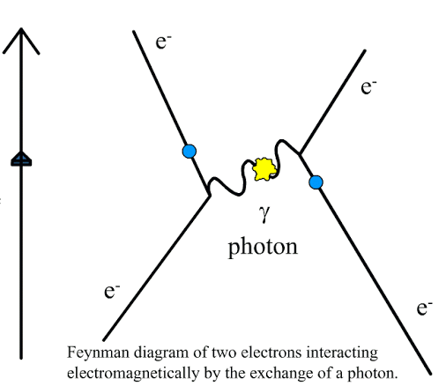

Slide 10
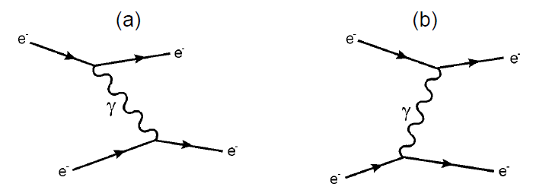
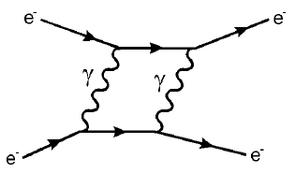
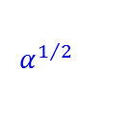

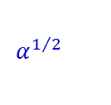
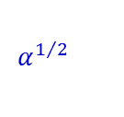
Real processes
For a real process there must be energy conversation $→$ it has to be a combination of virtual processes
$$α^{1/2}$$
$$α^{1/2}$$
$$α^{1/2}$$
$$α^{1/2}$$
Electron-electron scattering, single photon exchange
Any real process receives contributions from all possible virtual processes
$$α^{1/2}$$
$$α^{1/2}$$
$$α^{1/2}$$
$$α^{1/2}$$
Two-photon exchange contribution

Slide 11
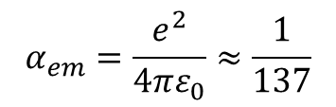
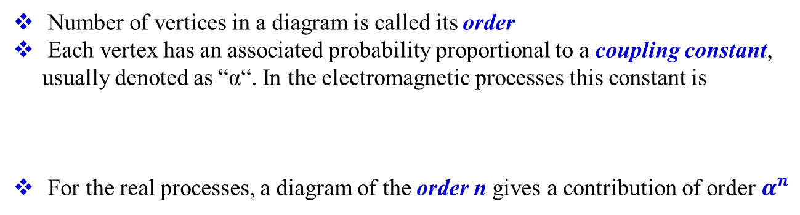
Real processes
$$α^{1/2}$$
$$α^{1/2}$$
$$α^{1/2}$$
$$α^{1/2}$$
Two-photon exchange contribution
Number of vertices in a diagram is called its order
Each vertex has an associated probability proportional to a coupling constant, usually denoted as “α“. In the electromagnetic processes this constant is
For the real processes, a diagram of the order n gives a contribution of order $α^{n}$
$$α_{em}=\frac{e^{2}}{4πε_{0}}≈\frac{1}{137}$$
Provided that α is small enough, higher order contributions to many real processes can be neglected.

Slide 12
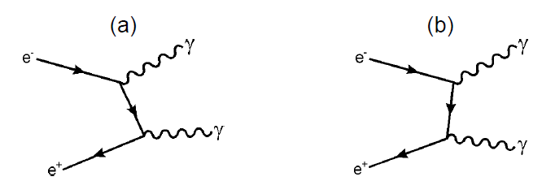
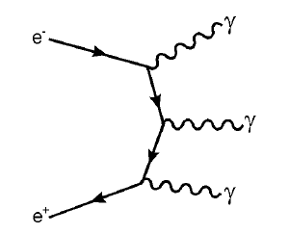


Real processes
Diagrams which differ only by time-ordering are usually implied by drawing only one of them
Lowest order contributions to $e^{+}e^{−}→γγ$
This kind of process implies 3! = 6 different time orderings
Lowest order contributions to $e^{+}e^{−}→γγγ$

Slide 13
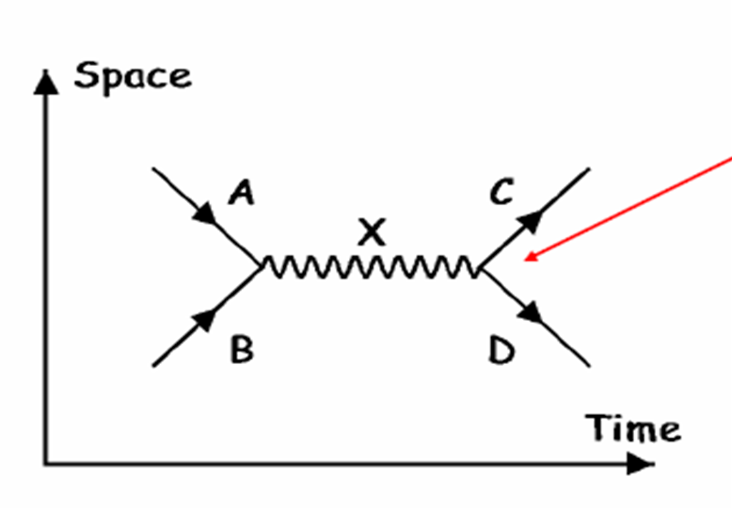
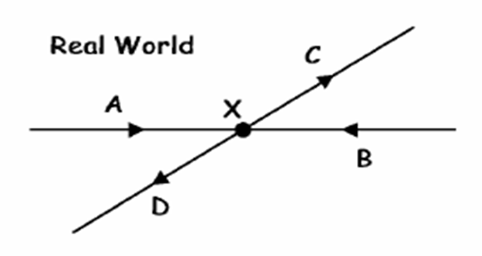
Annihilation diagram
Annihilation / Formation Diagram: Particle A and B collide to form particle X which later decays to C and D
At each vertex, electric charge must be conserved and, except in Weak Interactions, quark or lepton flavours.

Slide 14
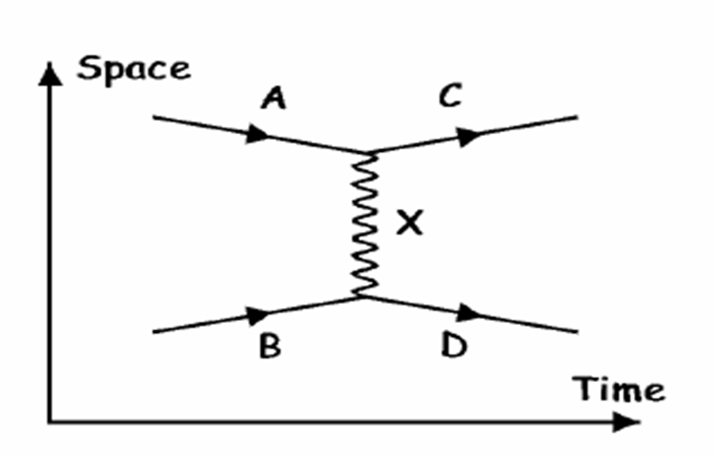
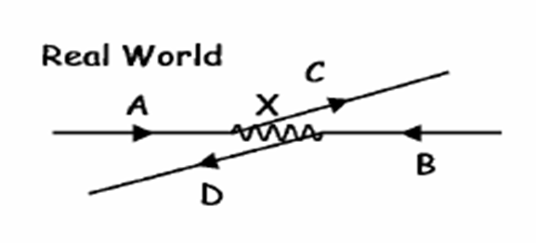
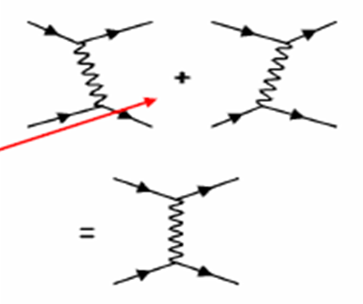
Exchange diagrams
Exchange Diagram: Particles A scatters off particle B by exchanging particle X. Particle A becomes particle C and B becomes D.
We don’t know if A emitted X and B absorbed it or vice versa.

Slide 15
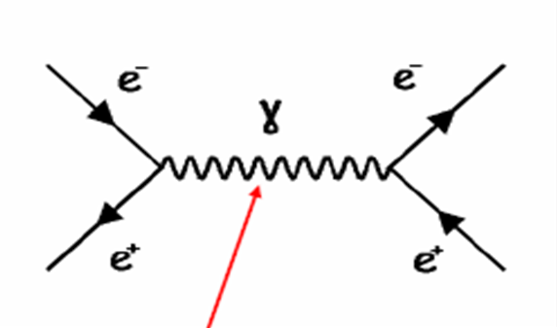
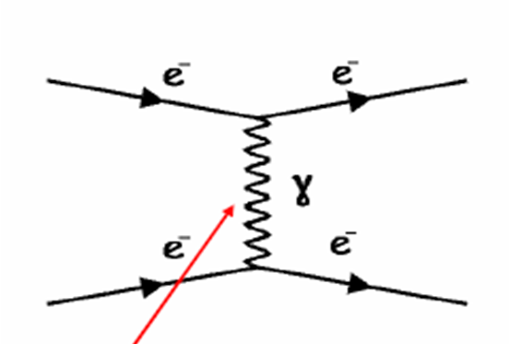

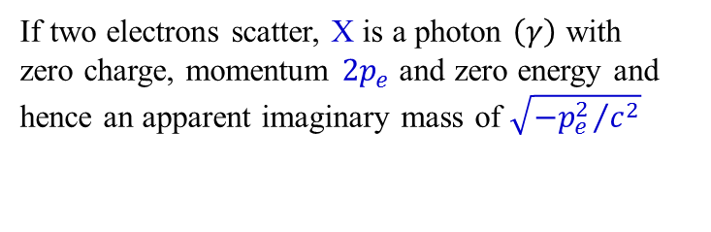
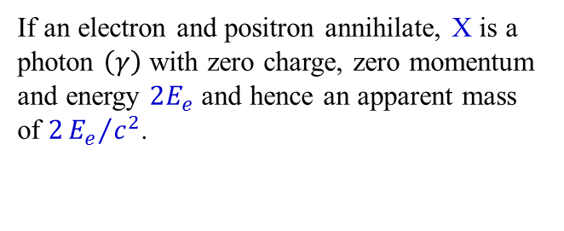
Virtual particles
In both previous cases particle X is ´virtual´ and the time it exists is governed by the uncertainty principle $∆E∙∆t\sim ℏ$. The mass of particle X is usually not its rest mass.
If an electron and positron annihilate, X is a photon $\left(γ\right)$ with zero charge, zero momentum and energy $2E_{e}$ and hence an apparent mass of $2{E_{e}}/{c^{2}}$.
If two electrons scatter, X is a photon $\left(γ\right)$ with zero charge, momentum $2p_{e}$ and zero energy and hence an apparent imaginary mass of $\sqrt{{{−p}_{e}^{2}}/{c^{2}}}$
$$E^{2}=p^{2}c^{2}+m^{2}c^{4}$$

Slide 16
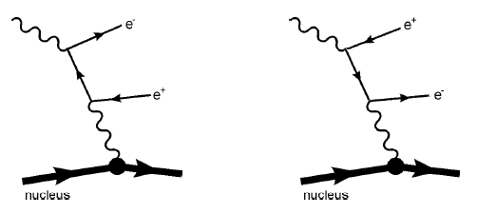
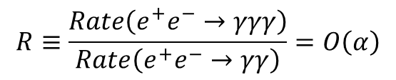
Real processes
From the order of diagrams one can estimate the ratio of appearance rates of processes:
$$R≡\frac{Rate\left(e^{+}e^{−}→γγγ\right)}{Rate\left(e^{+}e^{−}→γγ\right)}=O\left(α\right)$$
This ratio can be measured experimentally; it appears to be R = 0.9·10⁻³, which is smaller than α_{em} = 7·10⁻³, but the equation above is only a first order prediction.
Diagrams are not related by time ordering
For nucleus, the coupling is proportional to Z²α, hence the rate of this process is of the order of Z²α³.

Slide 17
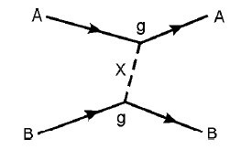


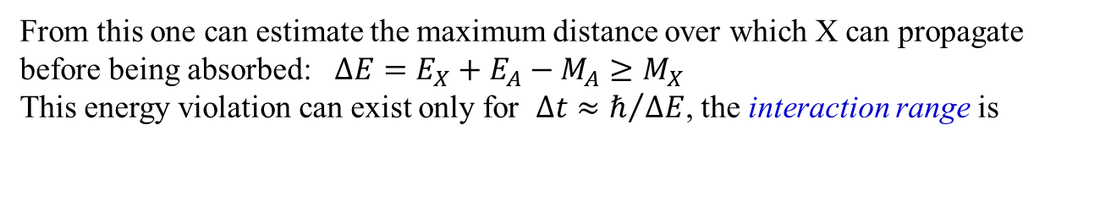
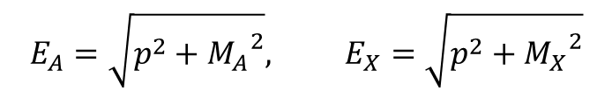

Exchange of a massive boson
Exchange of a massive particle X
In the rest frame of particle A:
$$A\left(E_{0},\vec{p_{0}}\right)→A\left(E_{A},\vec{p}\right)+X\left(E_{X},−\vec{p}\right)$$
where $E_{0}=M_{A}, \vec{p_{0}}=\left(0,0,0\right)$
$$E_{A}=\sqrt{p^{2}+{M_{A}}^{2}}, E_{X}=\sqrt{p^{2}+{M_{X}}^{2}}$$
From this one can estimate the maximum distance over which X can propagate before being absorbed: $∆E=E_{X}+E_{A}−M_{A}≥M_{X}$
This energy violation can exist only for $∆t≈ℏ/{∆E}$, the interaction range is
$$r≈R≡ℏc/M_{X}$$

Slide 18
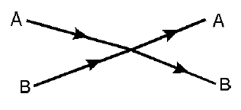
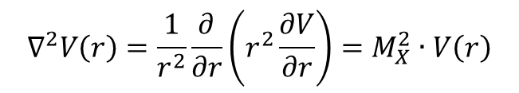
Exchange of a massive boson
For a massless exchanged particle, the interaction has an infinite range (e.g. electromagnetic)
In case of a very heavy exchanged particle (e.g. a W boson in weak interaction), the interaction can be approximated by a zero-range, or point interaction
Point interaction as a result of M_{X} → ∞
$$R_{W}={ℏc}/{M_{W}}={ℏc}/{80.4 {GeV}/{c^{2}}=\frac{197.3∙{10}^{−18}}{80.4}}≈2∙{10}^{−18}m$$
Considering particle X as an electrostatic potential V(r), the Klein-Gordon equation for it will look like
$$∇^{2}V\left(r\right)=\frac{1}{r^{2}}\frac{∂}{∂r}\left(r^{2}\frac{∂V}{∂r}\right)=M_{X}^{2}∙V\left(r\right)$$

Slide 19
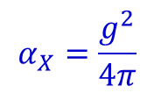
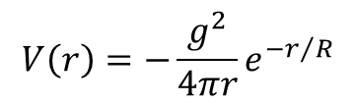
Yukawa potential (1935)
Integration of the previous equation gives the solution of
$$V\left(r\right)=−\frac{g^{2}}{4πr}e^{−r/R}$$
Here g is an integration constant, and it is interpreted as the coupling strength for particle X to the particle A and B (strong nuclear charge).
In Yukawa theory, g is analogous to the electric charge in QED, and the analogue of α_{em} is
$$α_{X}=\frac{g^{2}}{4π}$$
α_{X} characterizes the strength of the interaction at distances r ≤ R
Consider a particle being scattered by the potential (given above), thus receiving a momentum transfer $\vec{q}$
the above potential has the corresponding amplitude, which is its Fourier-transform (like in optics):

Slide 20
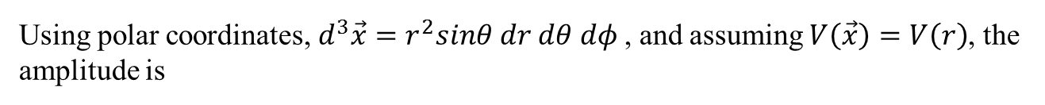
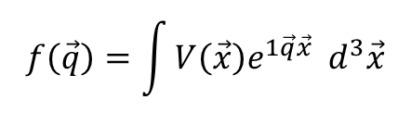
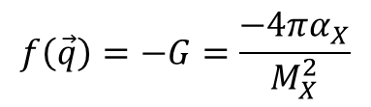
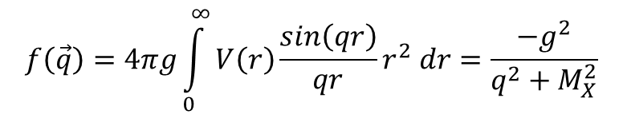
Yukawa potential (1935)
A particle is scattered by this potential, thus receiving a momentum transfer $\vec{q}$
Fourier-transform:
$$f\left(\vec{q}\right)=\int{V\left(\vec{x}\right)e^{1\vec{q}\vec{x}}{ d}^{3}\vec{x}}$$
Using polar coordinates, $d^{3}\vec{x}=r^{2}sinθ dr dθ dφ$, and assuming $V\left(\vec{x}\right)=V\left(r\right)$, the amplitude is
$$f\left(\vec{q}\right)=4πg\int_{0}^{∞}{V\left(r\right)\frac{sin\left(qr\right)}{qr}r^{2} dr}=\frac{−g^{2}}{q^{2}+M_{X}^{2}}$$
For the point interaction, $M_{X}^{2}≫q^{2}$, hence $f\left(\vec{q}\right)$ becomes a constant:
$$f\left(\vec{q}\right)=−G=\frac{−4πα_{X}}{M_{X}^{2}}$$
That means that the point interaction is characterized not only by α_{X}, but by M_{X} as well.

Slide 21
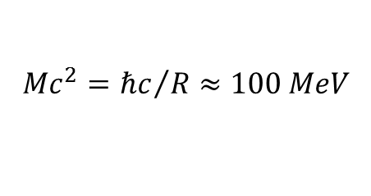
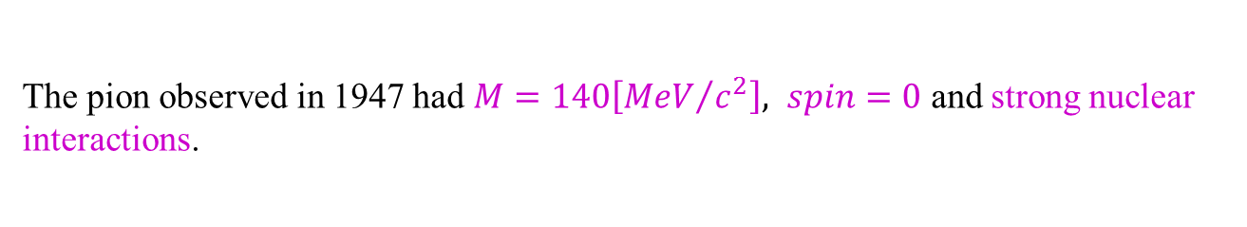
Yukawa potential (1935)
For nuclear forces with a range $R\sim {10}^{−15}m$, Yukawa hypothesis predicted a spinless quantum of mass:
$$Mc^{2}={ℏc}/R≈100 MeV$$
The pion observed in 1947 had $M=140\left[{MeV}/{c^{2}}\right], spin=0$ and strong nuclear interactions.
Nowadays: pion exchange still accounted for the longer-range part of nuclear potential.
However, full details of interaction are more complicated.

Slide 22
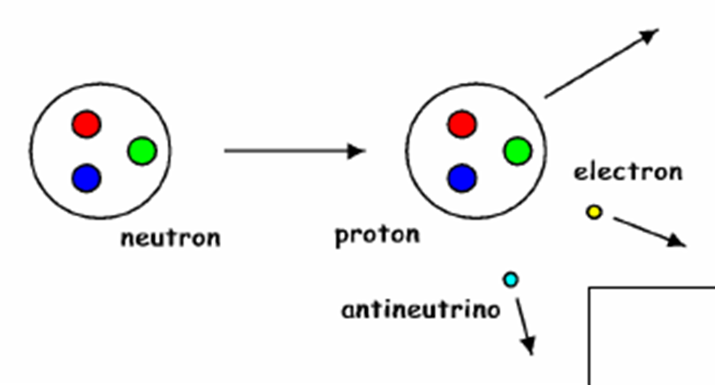


Electroweak Interactions – β⁻-Decay
Beta decay: $n→p+e^{−}+\overline{ν_{e}}$
Mediated by charged W exchange:
The charge that goes into the vertex must equal the charge that comes out of it.

Slide 23


Slide 24



Electromagnetism
At particle physics level the interaction is with the quarks
Photons mediate the force between protons and electrons

Slide 25


Strong Interaction
Gluons hold protons and neutron together and are responsible for the Strong force between them

Slide 26


Slide 27



Use of Feynman Diagrams
Although they are used pictorially to show what is going on, Feynman Diagrams are used more seriously to calculate cross sections or decay rates.
Draw all possible Feynman Diagrams for the process:
Assign values to each part of the diagram:
Calculate the amplitude by multiplying together.
Add the amplitudes for each diagram (including interference).
Square the amplitude to get the intensity/probability (cross section or decay rate).
Propagator $\sim \frac{1}{p^{2}+m^{2}}$
free particle
Vertex
~ charge

