Slide 1

Outline: Transfer Reactions
Lecturer: Hans-Jürgen Wollersheim
e-mail: h.j.wollersheim@gsi.de
web-page: https://web-docs.gsi.de/~wolle/ and click on
direct reactions
Q-values
theories: DWBA, Fresco, Faddeev
radioactive beams
Knock-out reactions (¹¹Li)

Slide 2
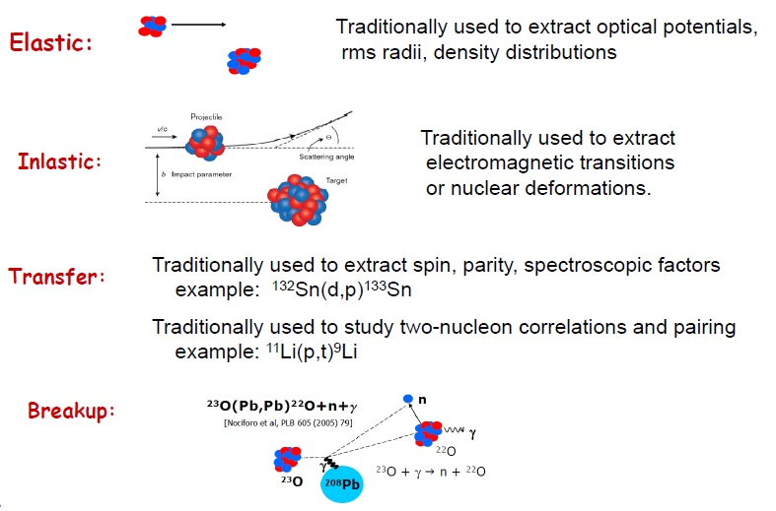
Why reactions?

Slide 3
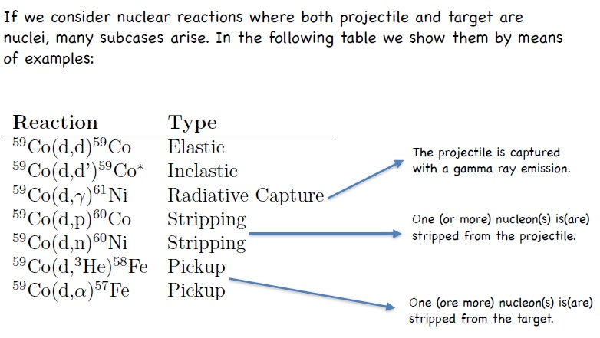
Reactions types

Slide 4
Reactions: tool to excite and probe nuclear states
B. Jonson, Phys. Report 389 (2004)

Slide 5
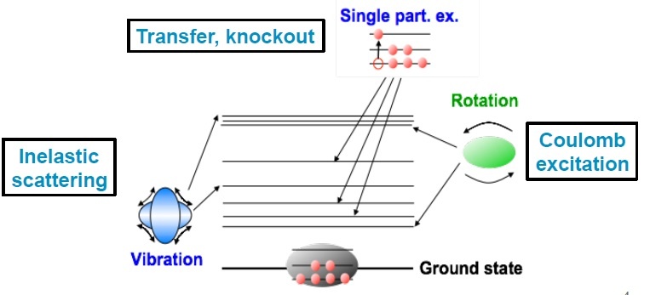
Selectivity of direct reactions
direct reactions with nuclei
Elastic & inelastic scattering
Few-particle transfer (stripping, pick-up)
Charge exchange
Knockout

Slide 6
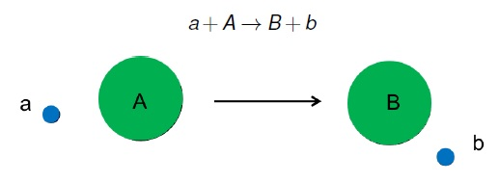
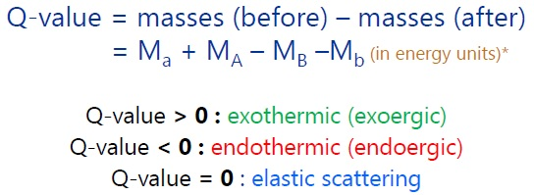
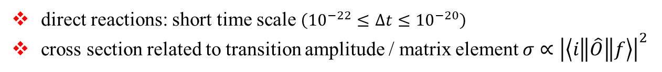
Transfer reactions
Transfer reactions are direct reactions which link entrance channel a, A and exit channel b, B
target nucleus → A(a,b)B ← residual nucleus
projectile
ejectile
direct reactions: short time scale $\left({10}^{−22}≤∆t≤{10}^{−20}\right)$
cross section related to transition amplitude / matrix element $σ∝{\left|\left\langle i\left\|\hat{O}\right\|f\right\rangle \right|}^{2}$

Slide 7
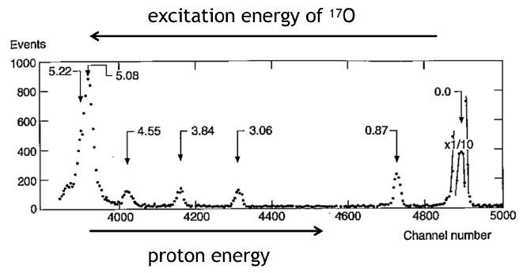
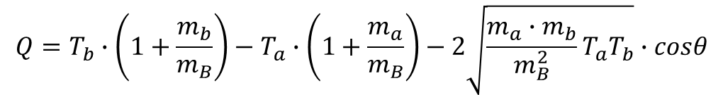
Transfer reactions
determine Q-value by measuring the beam energy T_{a}, the kinetic energy of the light particle T_{b}, and the scattering angle θ
$$Q=T_{b}∙\left(1+\frac{m_{b}}{m_{B}}\right)−T_{a}∙\left(1+\frac{m_{a}}{m_{B}}\right)−2\sqrt{\frac{m_{a}∙m_{b}}{m_{B}^{2}}T_{a}T_{b}}∙cosθ$$
and from this the excitation energy of the ejectile, missing mass technique
traditionally done at 10-20 MeV
measurement of θ and T_{b} with magnetic spectrometer
example ¹⁶O(d,p)¹⁷O
done extensively in the past with deuteron beams from tandem accelerators
tritium beams for two-neutron transfer reactions

Slide 8
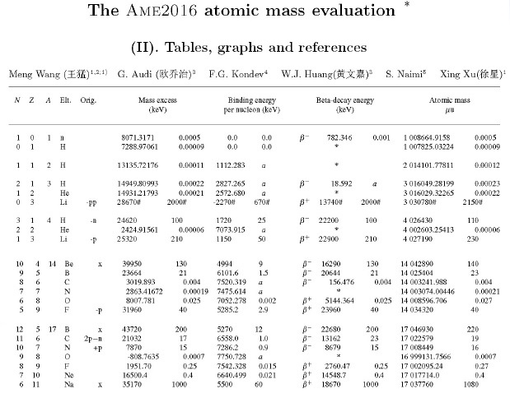
Q-value
p + ¹⁷O → ¹⁴N + α
Q-value = 1191.83 keV

Slide 9
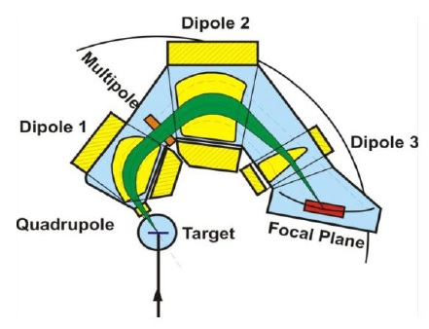
Measuring transfer reactions – good kinematics
Transfer reactions in normal/forward kinematics (light beam on heavy target) is using a magnetic spectrometer
Momentum-analyze the reaction products
Measure the position at which the particles hit the focal plane → tell us how easily bent in the magnetic field gives the rigidity
(momentum/charge)
Reconstruct excitation energy with two-body kinematics
Can also do this with solid-state detectors e.g. silicon arrays
Q₃D spectrometer (formerly) at Munich. The edges of the pole pieces and the multiple correct the kinematic aberrations

Slide 10
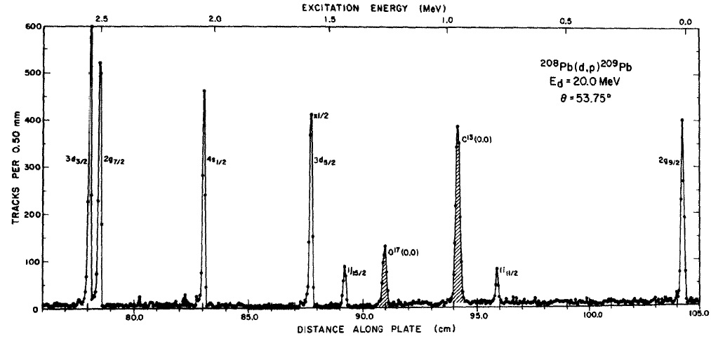
²⁰⁸Pb (d,p) ²⁰⁹Pb
²⁰⁸Pb (d,p) ²⁰⁹Pb stripping reaction
population of neutron states
excitation energy (MeV)
3d_{3/2}
2g_{7/2}
4s_{1/2}
3d_{5/2}
2g_{9/2}
1j_{15/2}
1i_{11/2}

Slide 11
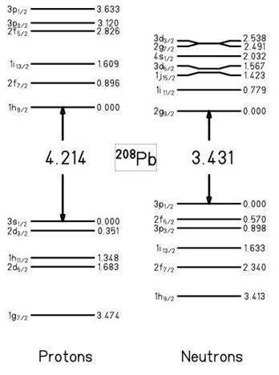
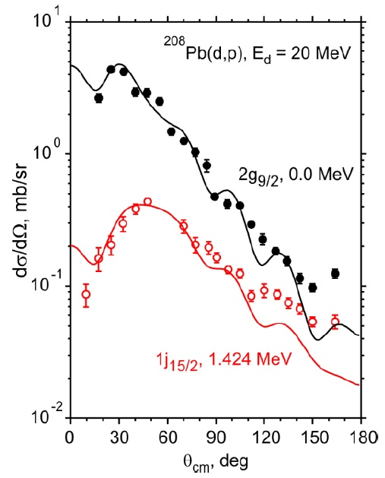
²⁰⁸Pb (d,p) ²⁰⁹Pb
²⁰⁸Pb (d,p) ²⁰⁹Pb stripping reaction
population of neutron states
²⁰⁸Pb
Angular distributions of different reaction channels look different

Slide 12
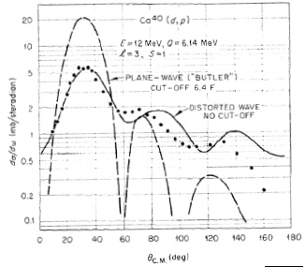
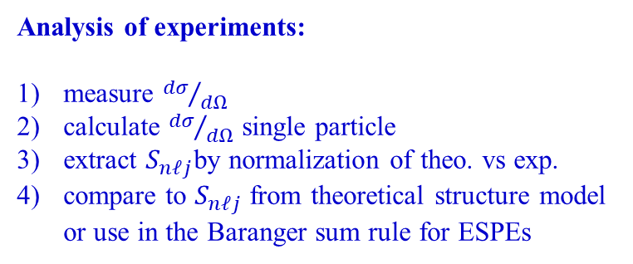
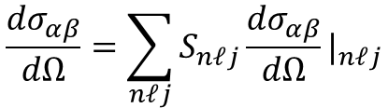
Transfer reactions: DWBA distorted wave Born approximation
Transfer cross section in DWBA
$$\frac{{dσ}_{αβ}}{dΩ}=\sum_{nℓj}{S_{nℓj}\frac{{dσ}_{αβ}}{dΩ}|_{nℓj}}$$
Analysis of experiments:
measure ${dσ}/{dΩ}$
calculate ${dσ}/{dΩ}$ single particle
extract $S_{nℓj}$by normalization of theo. vs exp.
compare to $S_{nℓj}$ from theoretical structure model or use in the Baranger sum rule for ESPEs

Slide 13
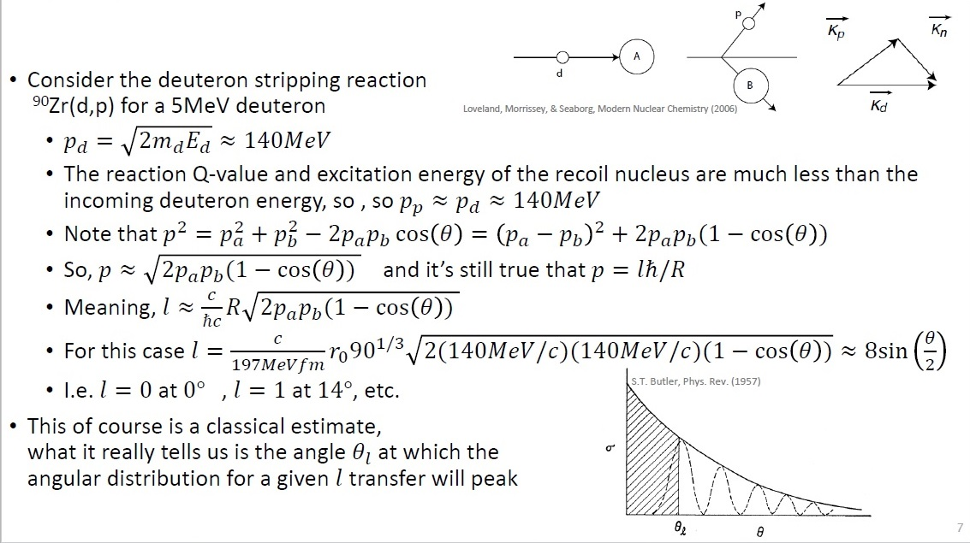
Angular distribution examples

Slide 14
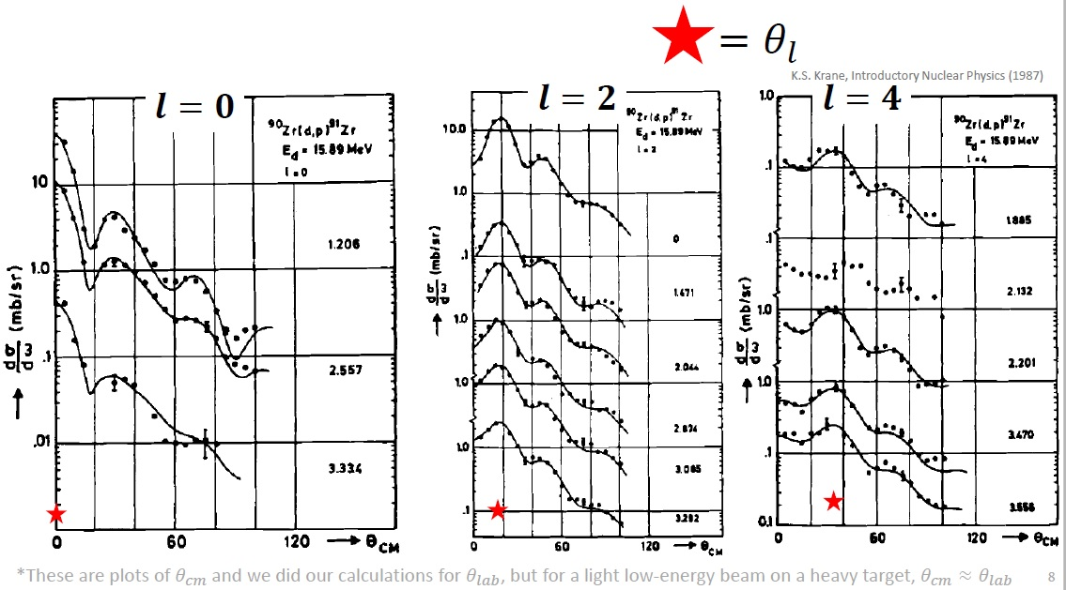
Angular distribution examples

Slide 15
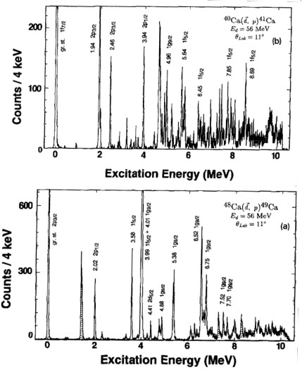
Probing occupation of levels
measure energy of levels and determine their occupation
(d,p) transfer reaction to add a neutron
Y. Uozumi et al., Nucl. Phys. A576 (1994) 123

Slide 16
Probing occupation of levels
measure energy of levels and determine their occupation
(d,p) transfer reaction to add a neutron
map valence space above a magic number
Y. Uozumi et al., Nucl. Phys. A576 (1994) 123

Slide 17
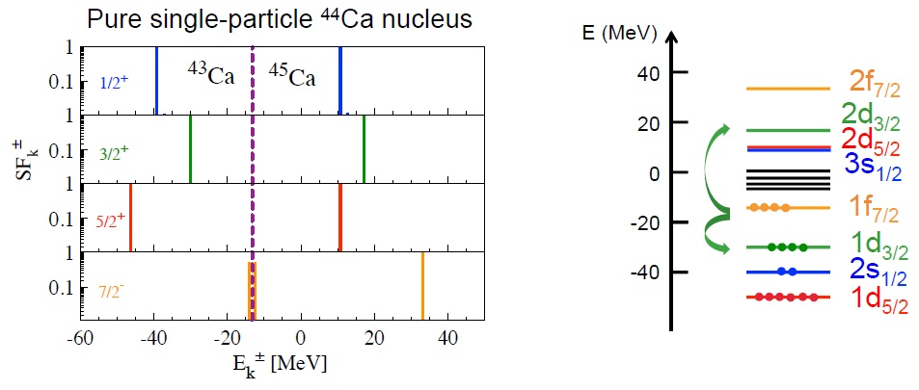


Intuitive view of spectroscopic factors
Spectroscopic factor: the square overlap of a final state with a single particle state
$$S_{k}^{nℓj +}={\left\langle Ψ_{k}^{A+1} | a_{nℓj}^{+} | Ψ_{0}^{A}\right\rangle }^{2}$$
$$S_{k}^{nℓj −}={\left\langle Ψ_{k}^{A+1} | a_{nℓj} | Ψ_{0}^{A}\right\rangle }^{2}$$
Pick-up, exp: ⁴⁴Ca(d,p)⁴⁵Ca
Stripping, exp: ⁴⁴Ca(p,d)⁴³Ca

Slide 18
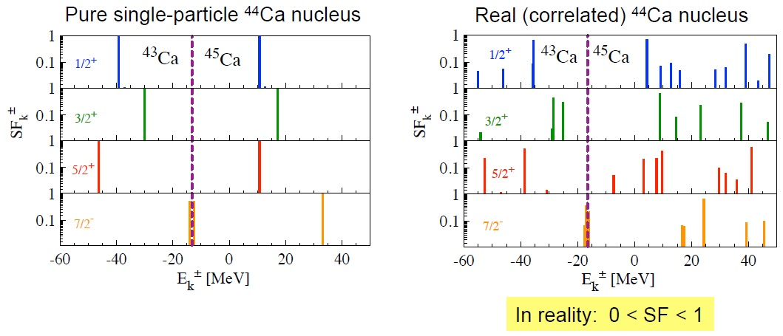
Intuitive view of spectroscopic factors
Spectroscopic factor: the square overlap of a final state with a single particle state
$$S_{k}^{nℓj +}={\left\langle Ψ_{k}^{A+1} | a_{nℓj}^{+} | Ψ_{0}^{A}\right\rangle }^{2}$$
$$S_{k}^{nℓj −}={\left\langle Ψ_{k}^{A+1} | a_{nℓj} | Ψ_{0}^{A}\right\rangle }^{2}$$
Pick-up, exp: ⁴⁴Ca(d,p)⁴⁵Ca
Stripping, exp: ⁴⁴Ca(p,d)⁴³Ca

Slide 19
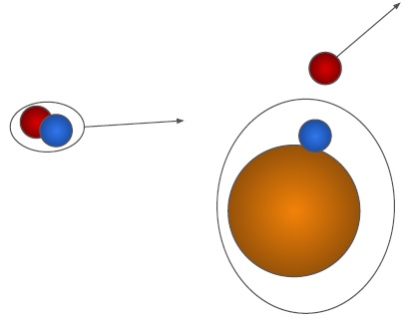
Theory of transfer reactions
Assume the following:
Entrance and exit channels dominated by elastic scattering
Transfer is weak - treat as first-order perturbation
Transfer proceeds directly between two channels
Direct transfer into the final state with no other rearrangement of the core

Slide 20
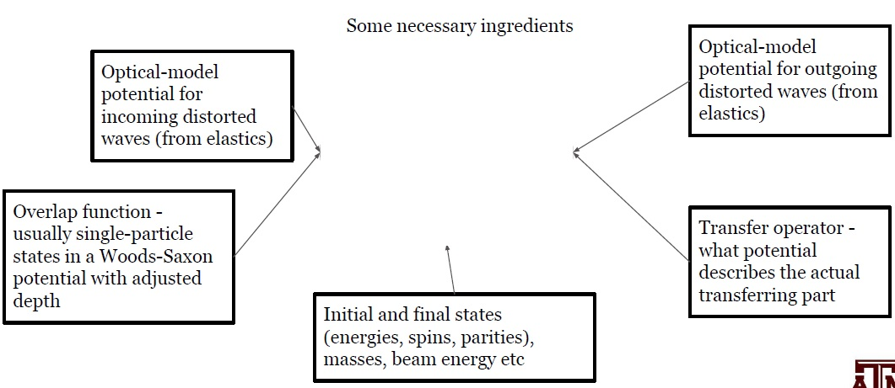
Theory of transfer reactions

Slide 21
Calculations
This book
has all the gory details and, tells you how to use the code FRESCO, which is mainly for coupled-channels, but can do DWBA as well

Slide 22
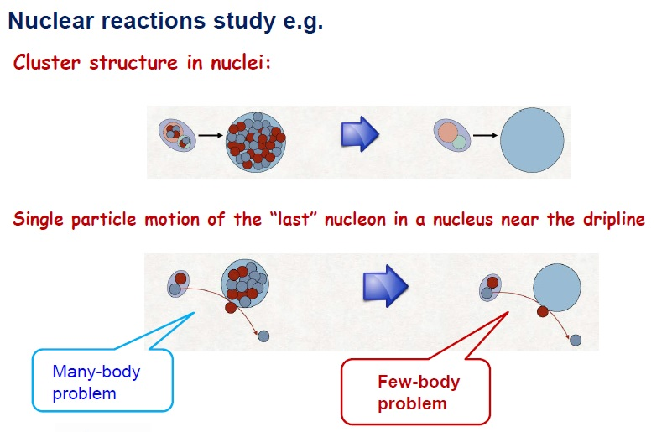
Faddeev Ansatz in Nuclear Reactions

Slide 23
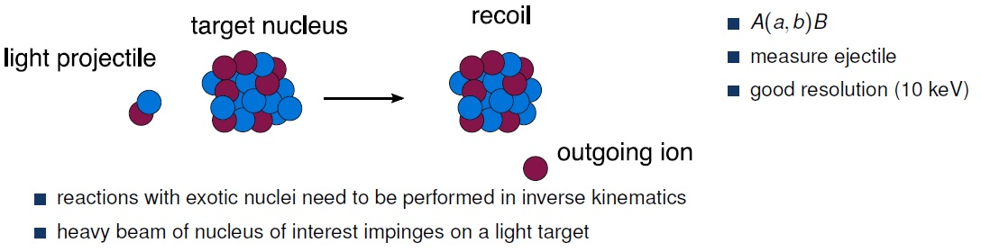
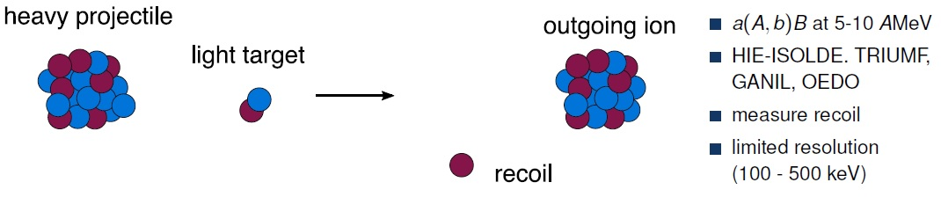
Radioactive beams
K. Wimmer, Jour. Phys. G45 (2018) 033002

Slide 24
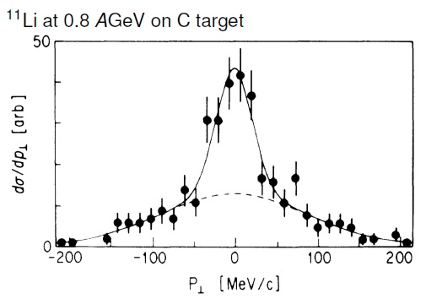


Knockout reactions ¹¹Li – neutron halo nucleus
fast projectile mass A collides with light target
mass (A – 1) residues are detected
light fragments are unobserved, final state tagging by γ-ray if needed
sudden approximation:
momentum of the stuck nucleon k₃ is related to the residues k_{A-1}
$${\vec{k}}_{3}=\frac{A−1}{A}∙{\vec{k}}_{A}−{\vec{k}}_{A−1}$$
two components in the transverse momentum distribution of ⁹Li residues
broad like for stable nuclei
very narrow component
→ removal of weakly bound neutrons
uncertainty relation
$$∆p∙∆x ≥ ℏ$$
small → large

Slide 25
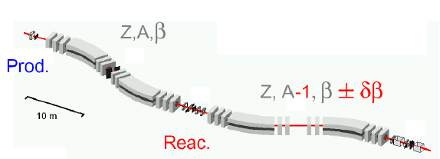
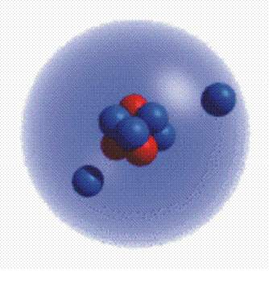

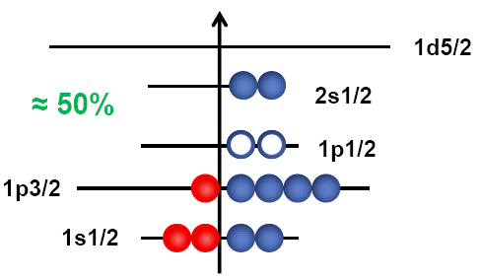
Measurement of the reaction cross section
800 MeV/u ¹¹B primary beam
Fragmentation
FRagment Separator FRS
test of the extended wave function
momentum distribution:
wider momentum distribution for strongly bound particles
narrow momentum distribution for weakly bound particles
interpretation:
One can simplify ¹¹Li by describing it as a ⁹Li core plus a di-neutron
One can use the arguments of an extended wave function with an exponential decline:
S_{2n}=250(80) keV
N=8
N=2
$$κ^{2}=\frac{2∙μ_{2n}∙S_{2n}}{ℏ^{2}}$$

Slide 26

Discovery of halo nuclei
Momentum distribution of ¹¹Li
⁶He distribution from ⁸He
similar to Goldhaber model
⁹Li distribution from ¹¹Li (very narrow!)
uncertainty principle
$$∆p∙∆x ≥ ℏ$$
small → large
wider distribution is similar to Goldhaber model

Slide 27
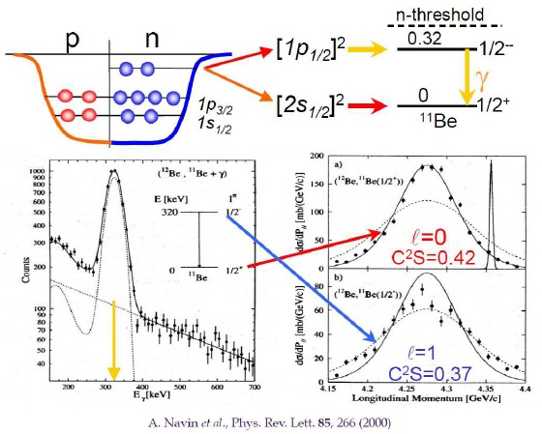
Knockout typical result: ¹²Be

Slide 28
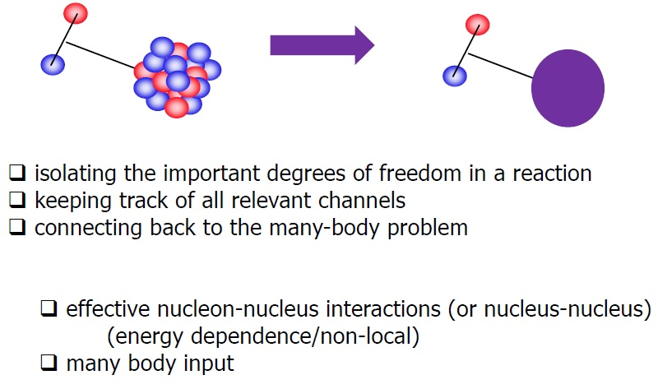

Reducing the many body to a few body problems
does not converge for $Z≥20$

Slide 29
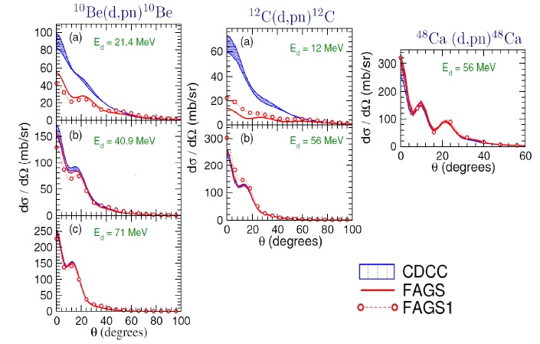
Reaction methods; comparing CDCC with Faddeev
CDCC continuum discretized coupled channels

Slide 30
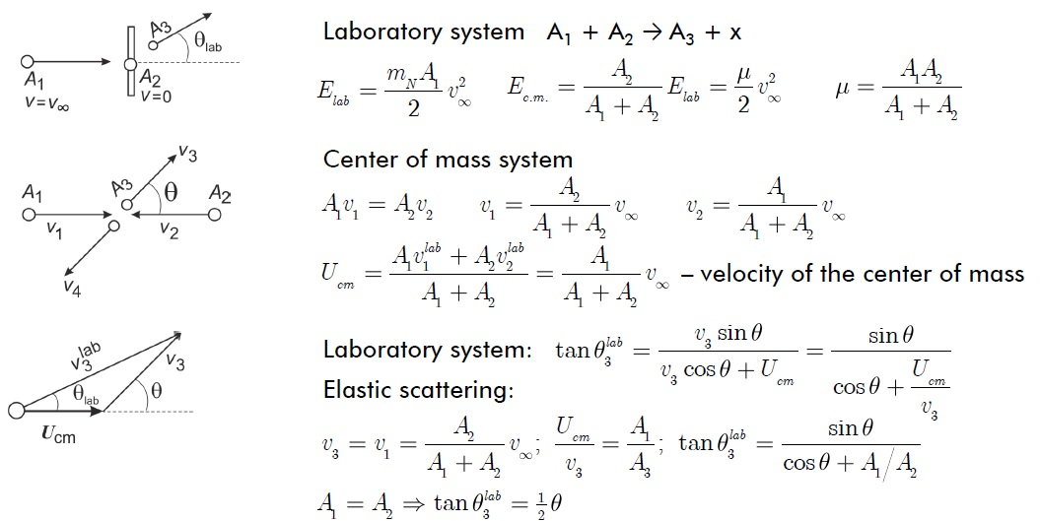
Appendix: nuclear kinematics
CDCC continuum discretized coupled channels

