Slide 1
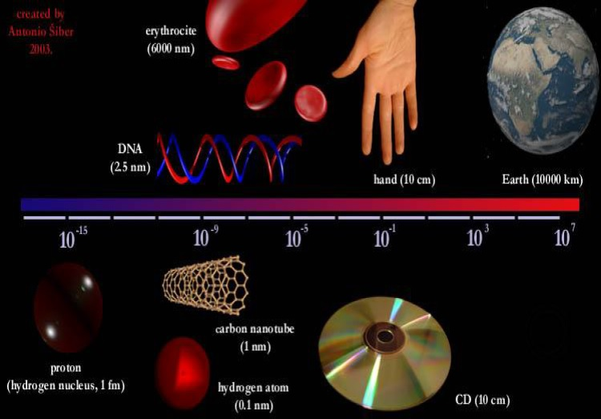
Basics of Nanotechnology

Slide 2
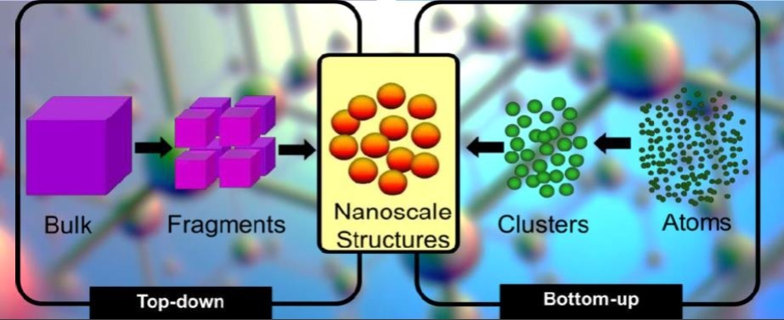
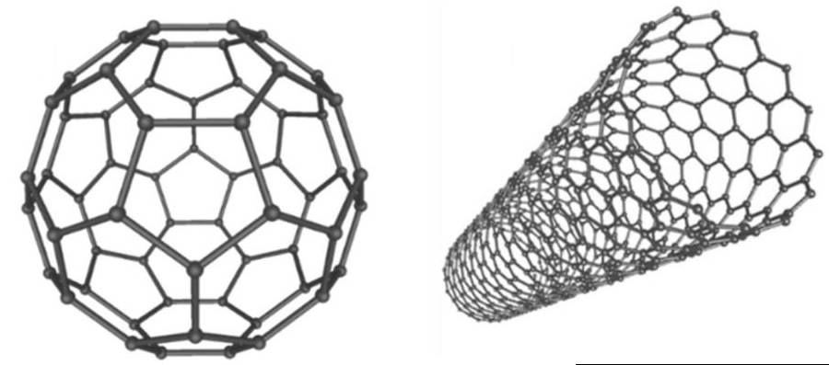
Basics of Nanotechnology

Slide 3
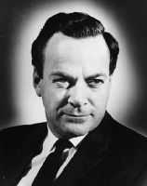
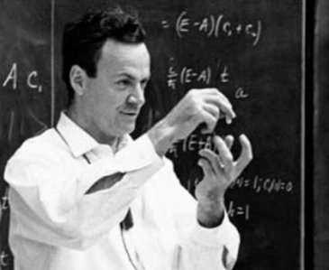
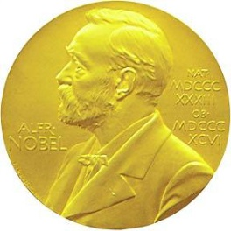
Richard Feynman: Father of Nanotechnology
In 1959, the late Nobel Prize – winning physicist Richard P. Feynman presented a talk entitled
“There’s Plenty of Room at the Bottom” at the annual meeting of the American Physical Society.
Feynman proposed using machine tools to make smaller machine tools, which, in turn, would be used to make still smaller machine tools, and so on all the way down to the molecular level.
Richard P. Feynman (Nobel prize in QED 1965)

Slide 4

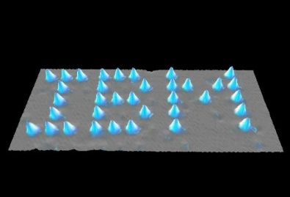
History of Nanotechnology
1959 – “There is plenty of room at the bottom” by R. Feynman
1974 – “Nanotechnology” Nori Taniguchi uses the term nanotechnology for the first time
1981 – IBM develops Scanning Tunneling Microscope (Rohrer & Binning)
1986 “Engines of Creation: The coming era of Nanotechnology” first book on nanotechnology by K. Eric Drexler
1989 – IBM logo made with individual atoms
1991 – Carbon nanotube discovered by Sumio Iijima
1999 – “Nanomedicine” – 1st nanomedicine book by R. Freitas
2016 – “Turning molecules into machines” Nobel prize for J.-P. Sauvage, F.Stoddart & B. Feringa

Slide 5
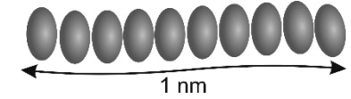
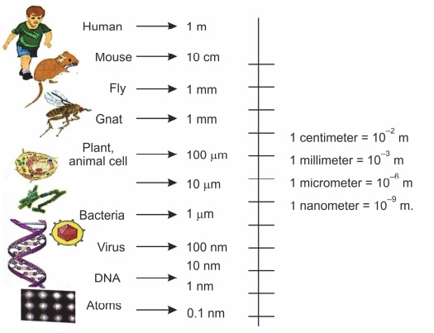
Definition of Nano
Nano comes from the Greek word “nanos”, meaning “dwarf”, but nano is infinitely smaller than a dwarf. Nano means 10⁻⁹.
10 hydrogen atoms

Slide 6
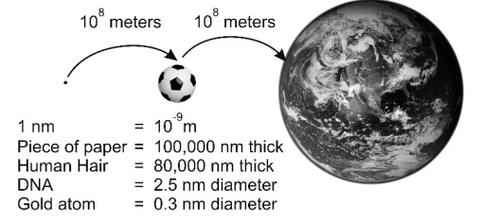
How small is Nano?

Slide 7
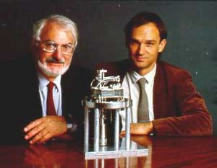
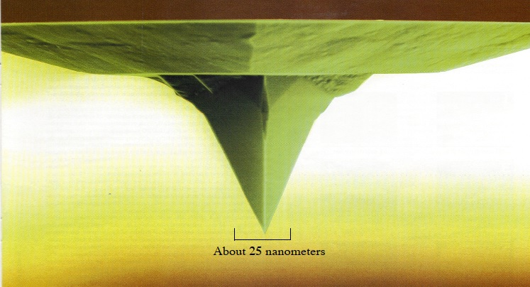
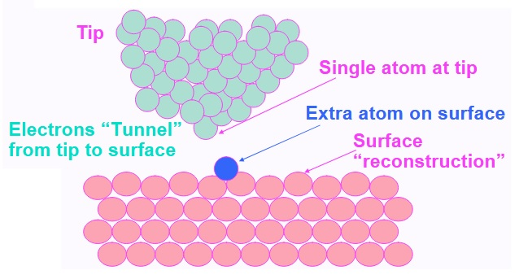
Scanning Tunneling Microscope
Heinrich Rohrer & Gerd Binning
Touching the surface

Slide 8
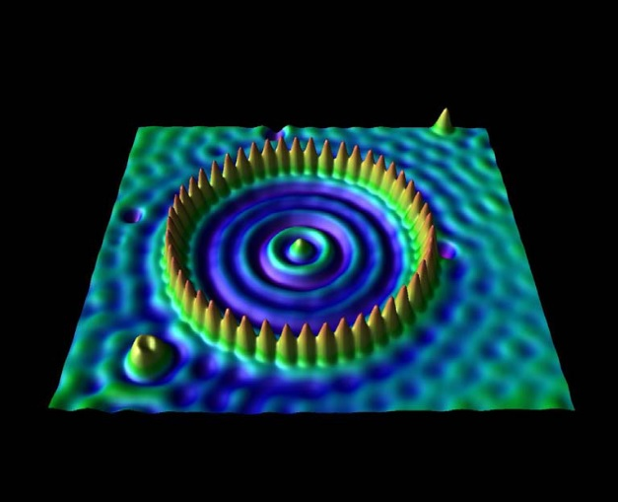
Scanning Tunneling Microscope
Quantum-corral of 48 Fe-atoms placed one at the time by maneuvering atoms with STM (D. Eigler 1993)
Atomic Force Microscope AFM, 2006

Slide 9
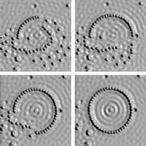
Nano-objects
A series of STM images showing formation of a “quantum corral” from 48 Fe atoms absorbed on the surface of Cu (111).

Slide 10
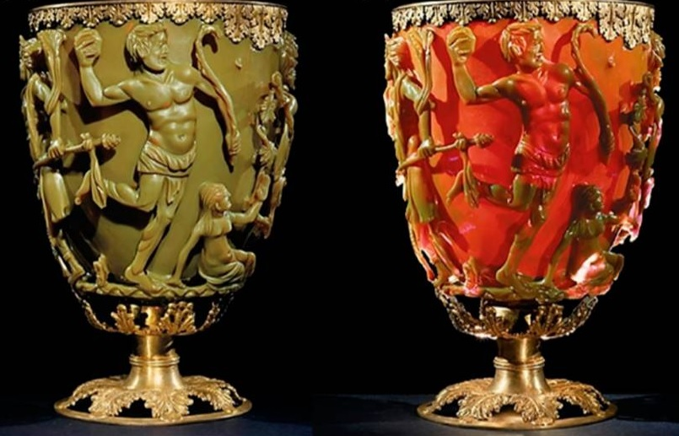
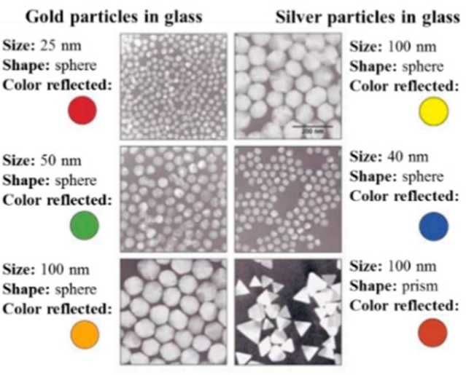
History of Nanotechnology
Lycurgus cup (4th century A.D.)
Is nanoscience just seeing and moving really small things?
Properties of materials change at nanoscale!

Slide 11
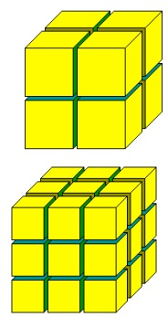
Is Gold always “Gold”?
Cutting down a cube of gold
  If you have a cube of pure gold and
  cut it, what color would the pieces be?
  Now you cut those pieces.
  What color will each of the pieces be?
  If you keep doing this –
  cutting each block in half –
  will the pieces of gold always look “gold”?

Slide 12
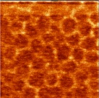
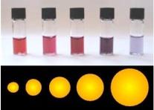
Is Gold always “Gold”?
Strange things happen at the small scale
  If you keep cutting until the gold pieces are in nanoscale range, they don’t look gold anymore…
  They look RED!
  In fact, depending on size, they can turn red, blue, yellow, and other colors
Why?
  Different thicknesses of materials reflect and absorb light differently
12 nm gold particles
look red
Other sizes are other
colors

Slide 13
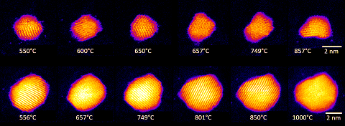
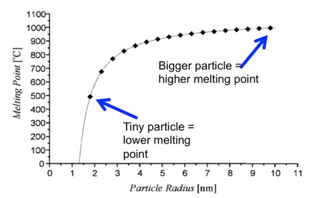
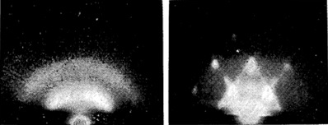
Particle size and melting point of Gold size matters
1064⁰ C
diffraction pattern
fluid
solid
Gibbs-Thomson equation

Slide 14
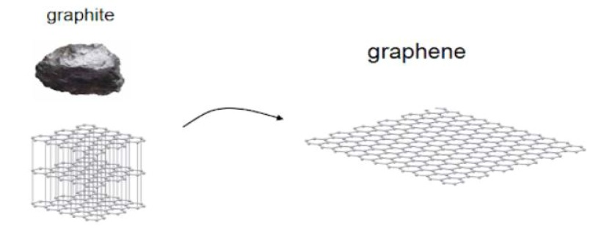
Graphite: a layered structure
Graphene is one carbon sheet, singular flat carbon bonds are very strong which makes Graphene the super-material that it is; atoms behave different at the nanoscale producing different physical properties.
200 times stronger than steel
6 times lighter
Superconductive
Can stretch up to 20% its length
Endlessly bend without breaking

Slide 15
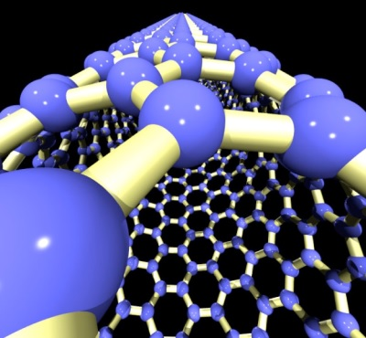
Carbon Nanotubes
Using new techniques, we’ve created amazing structures like carbon nanotubes
  100 times stronger than steel and very flexible
  If added to materials like car bumpers, increases strength and flexibility
model of a carbon nanotube

Slide 16
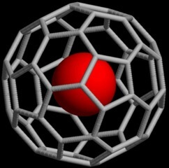
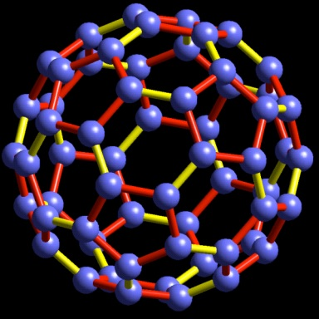
Carbon Buckyballs (C60)
Incredible strength due to their bond structure and “soccer ball” shape
Could be useful “shells” for drug delivery
  Can penetrate cell walls
  Are nonreactive (move safely through blood stream)
model of a carbon buckminsterfullerene

Slide 17
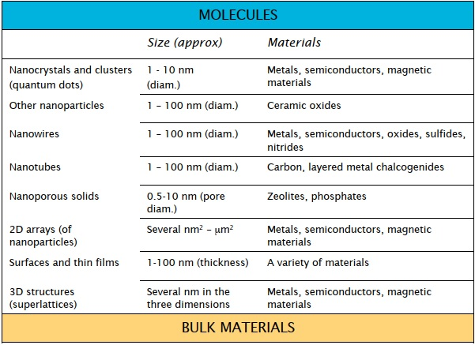
Nanomaterials

Slide 18
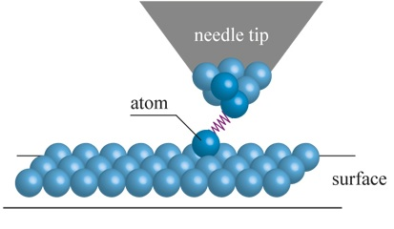

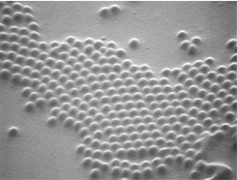
Fabrication methods
Atom-by-atom assembly
  Like bricklaying, move atoms into place one at a time using tools like the AFM and STM
Chisel away atoms
  Like a sculptor, chisel out material from a surface until the desired structure emerges (laser pressure)
Self assembly
  Set up an environment so atoms assembly automatically. Nature uses self assembly (e.g. cell membranes)
IBM logo assembled from individual xenon atoms
Polystyrene spheres self assembling

Slide 19
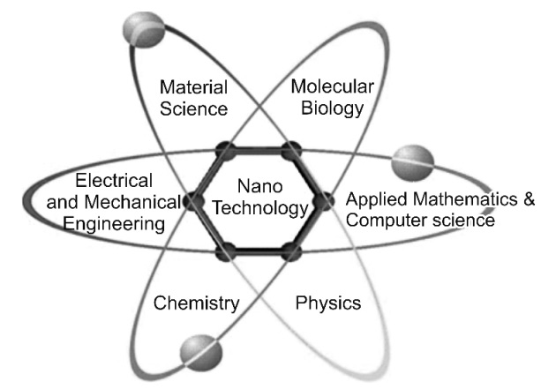
Nanoscience multidisciplinary subject

Slide 20
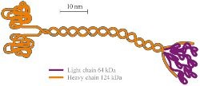
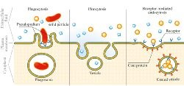
Molecular machines
Kinesin
  they mainly carry out transport from the centre of the cell in the direction of the cytoplasmic membrane
Endocytosis
  is the central process in the delivery of nanodrugs and therapeutic genes to a cell
Macromolecule
  examples of linear macromolecules of natural rubber, cellulose, some proteins etc
eng.thesaurus.Rusnano.com/wikw/article2193

Slide 21
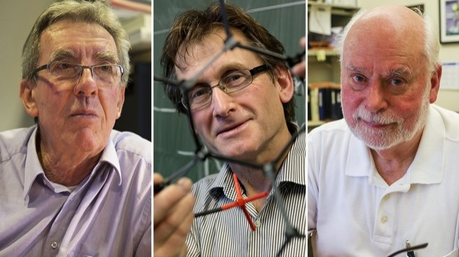

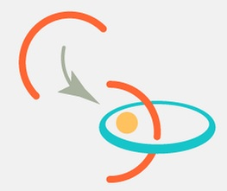
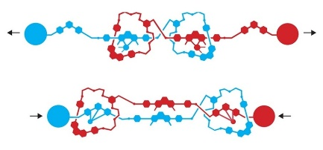
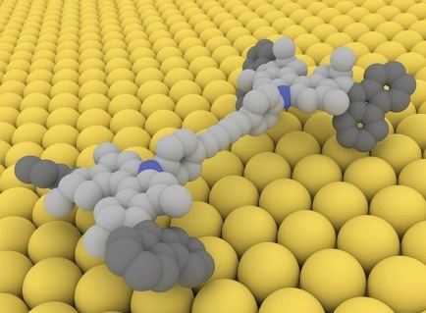
Biological motors
Jean-Pierre Sauvage
  creation of molecule chains with mechanical connections
Fraser Stoddart
  invented axis, wheel and elevator
Bernard Feringa
  created an engine and a molecular car
eng.thesaurus.Rusnano.com/wikw/article2193

Slide 22
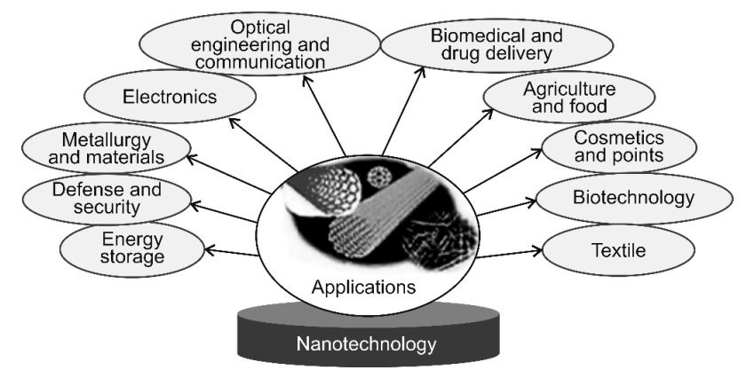
Applications of Nanomaterials

Slide 23
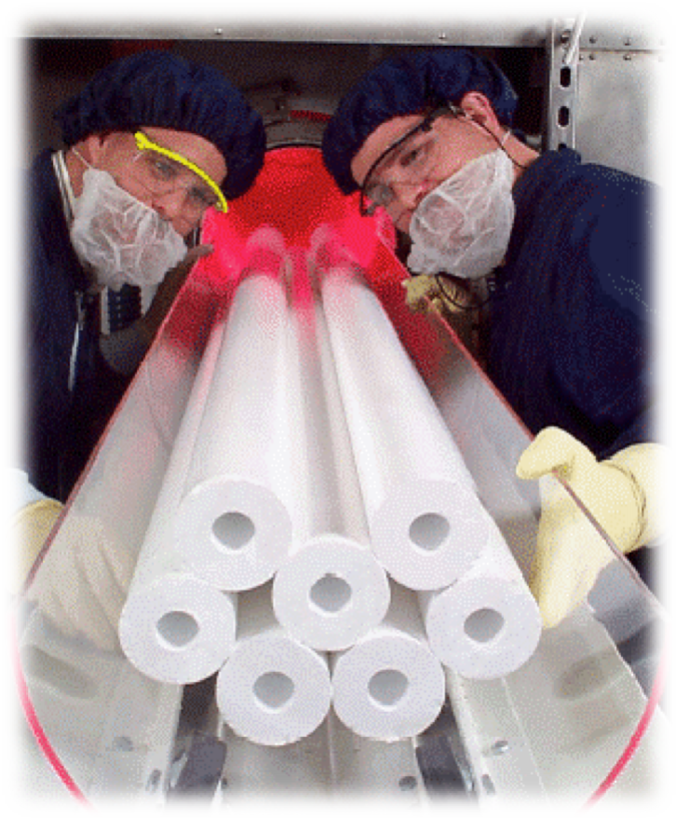
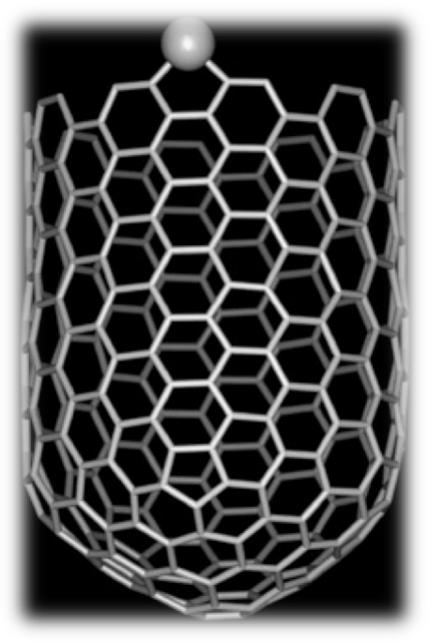
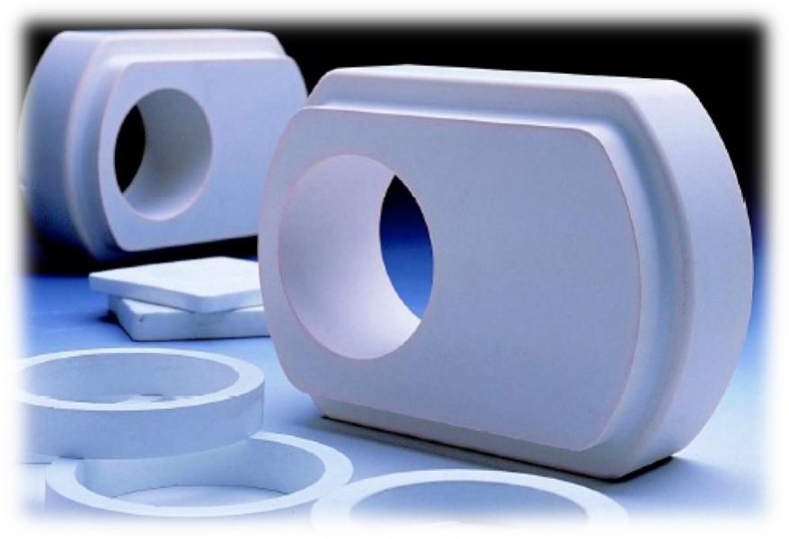
Nanomaterials manufacturing
Carbon Nanotubes
Nanostructure Polymers
Optical fiber performs through sol-gel processing of nanoparticles
Nanoparticles in imaging systems
Nanostructure coatings
Ceramic Nanoparticles for netshapes

Slide 24
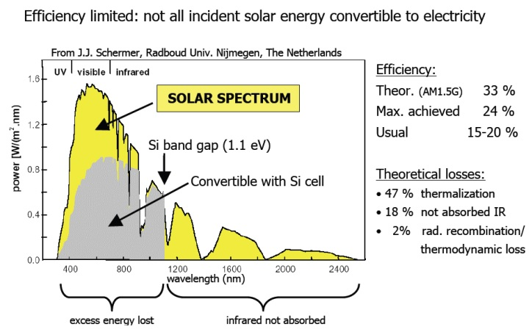
Solar Cells - Silicon

Slide 25
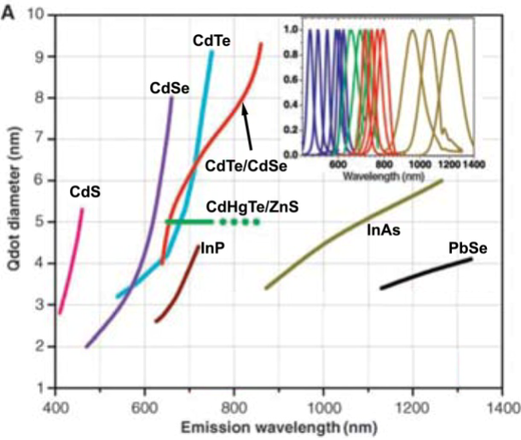
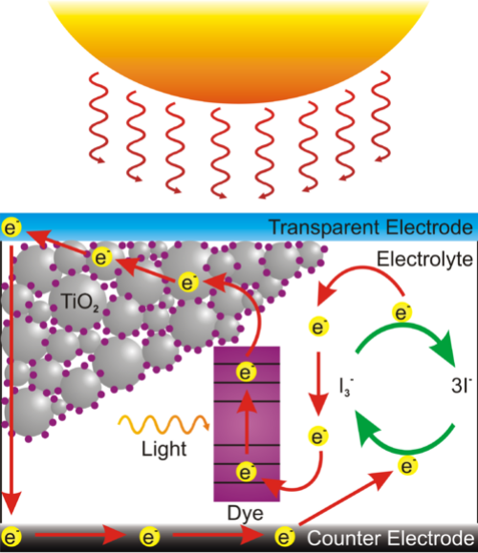
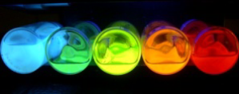
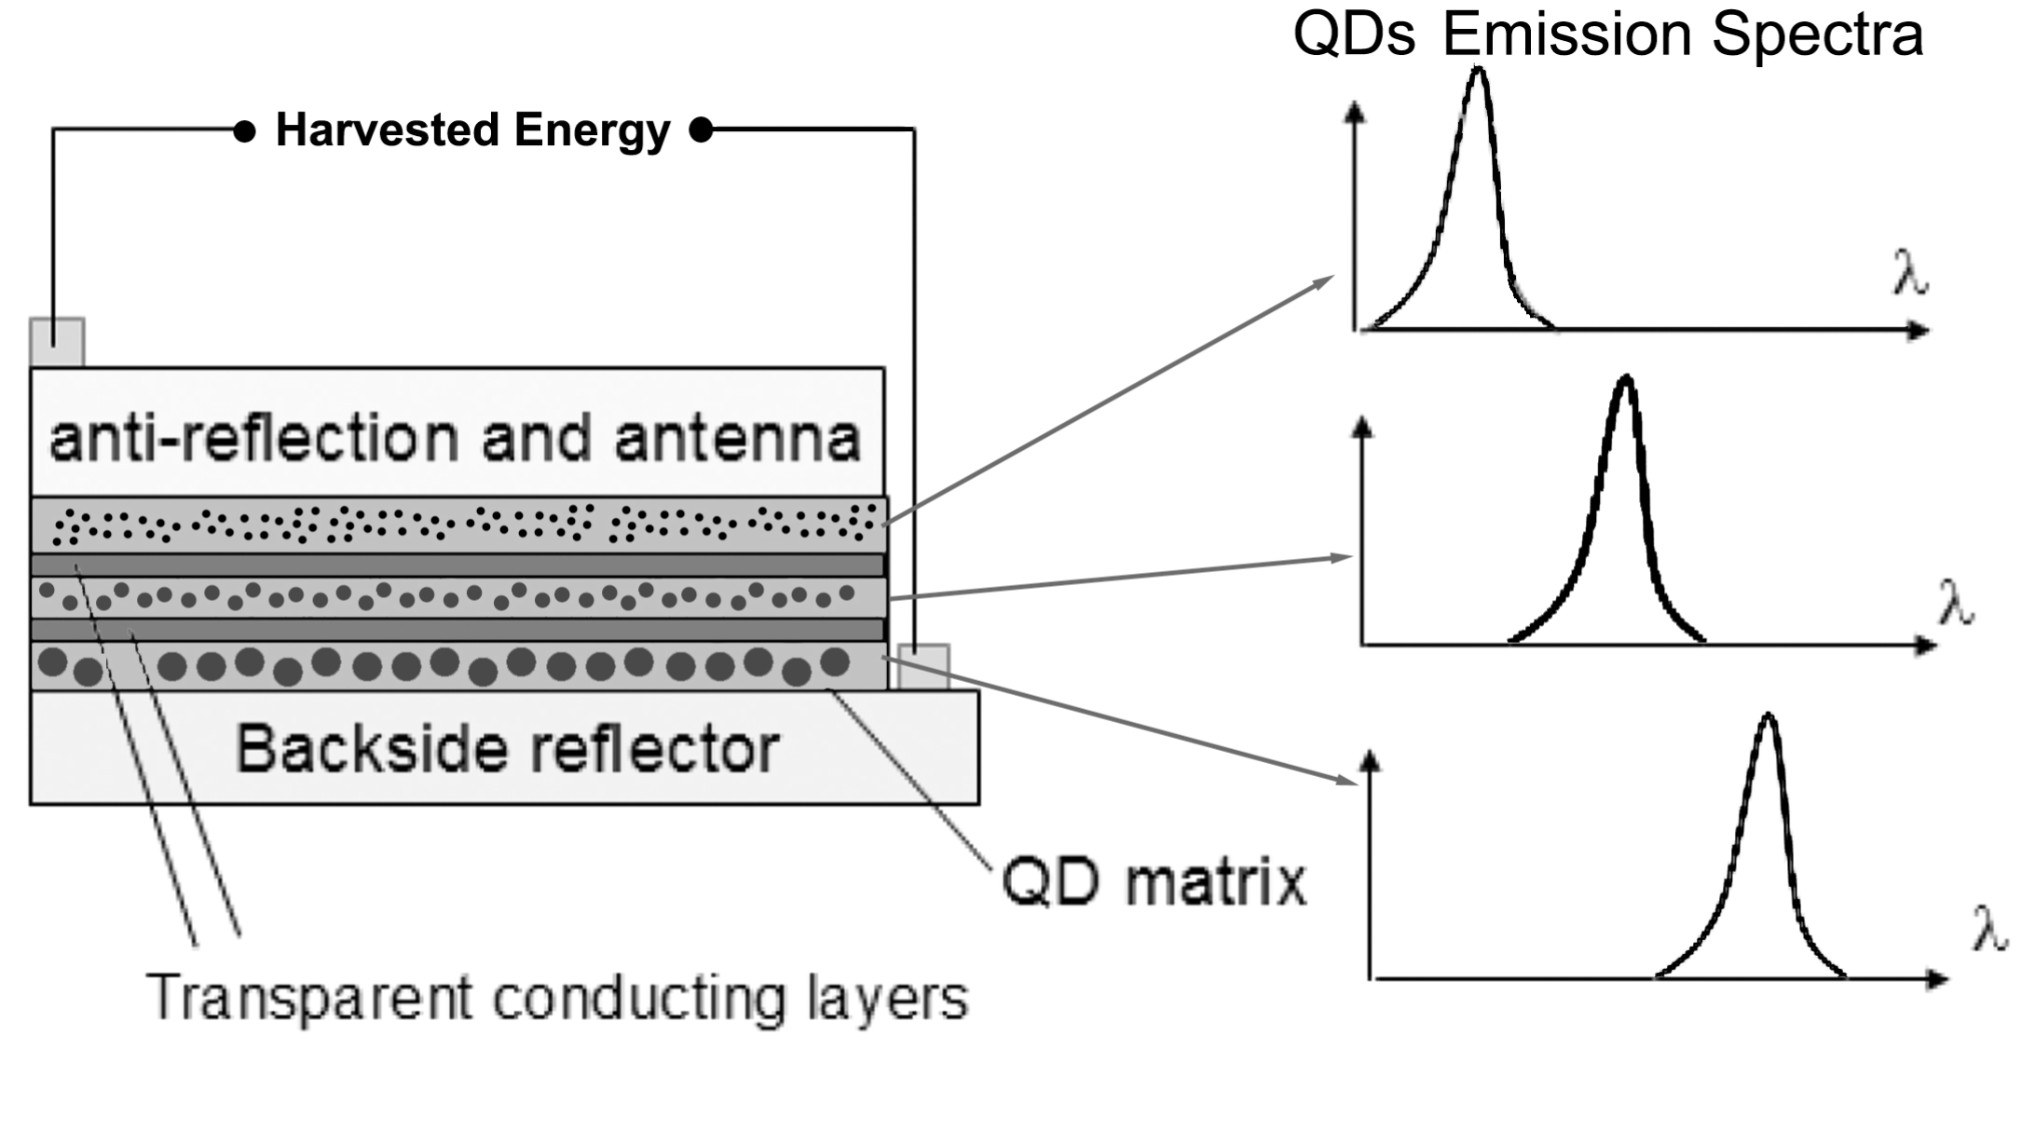
Solar Cells – Harvesting of Light
Dye-sensitized Solar Cells w/ TiO₂

Slide 26
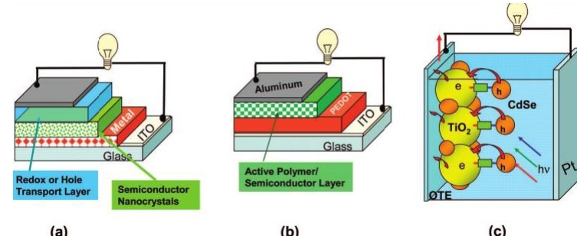
Quantum Dot Solar Cells – Semiconductor Nanocrystals as Light Harvesters
The strategies to develop QD based on solar cells: (a) metal-semiconductor junction
(b) polymer-semiconductor, and (c) semiconductor-semiconductor system

Slide 27
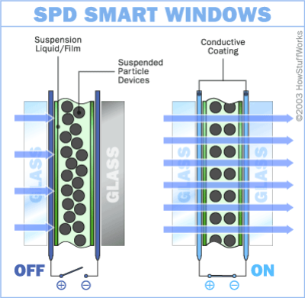
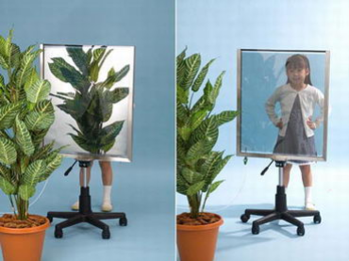
Optical Applications – Smart Window
Needle shaped nano-particles of polyiodides
Suspended Particle Device SPD
The electric field causes the particle material to polarize /induced electric dipoles)
The induced electric dipoles interact and the particles align in chains with maximizes their attraction

Slide 28


Nanotechnology in Transportation
More efficient catalytic converters
Thermal barrier and wear resistant coatings
Battery, fuel cell technology
Improved displays
wear-resistant tires
High temperature sensors for ‘under the hood’ novel sensors for “all electric” vehicles
High strength, light weight composites for increasing fuel efficiency

Slide 29
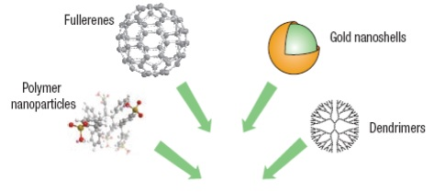

Nanomedicine
Fast and more efficient biosensors
Magnetic resonance imaging enhancement
Targeted drug delivery to specific cells
Single cell study and bio-manipulation
Novel cancer therapy and hyperthermia treatments
Novel diagnostic tools for early stage detection of diseases

Slide 30



Nanomaterials in biology and medicine
Pill is designed to deliver medicine
Targeted drug delivery
using a multicomponent nanoparticle containing therapeutic as well as biological surface modifying agent

Slide 31



Nanoparticle-based systems
Drug Delivery
Magnetic-field guided drug delivery with magnetic aerosols
Nature Nanotechnology 2 (2007), 467
Detection
Pregnancy test based on Au colloids surface plasmon absorption of Au Nps

Slide 32



Nano-Therapeutics: Hyperthermia
injectable magnetic implants
interaction of an electromagnetic radiation with metal nanostructures
plasmonics

Slide 33

Micromachines
Electron microscope image of a complex mechanical clutch, part of one of today’s advanced micromechanical systems. The gears shown are just 50 microns in diameter. Source: Sandia National Laboratories.

